Slide 1
Boardgames rating analysis
Python EDA Project

Slide 2

Question of interest
A boardgame’s user ratings on any online platform can be analogous to its overall popularity.
This project researches whether certain metrics on online boardgame databases contribute to board game rating/popularity.
This project compares BGG Geek Rating to different metrics to see if they affect the game’s rating in any way.

Slide 3
STAKEHOLDERS
Game Developers trying to increase their game's rating/popularity and eventually increase sales.
Game Developers developing a new game and looking to research best metrics to incorporate in order to maximize game ratings.

Slide 4
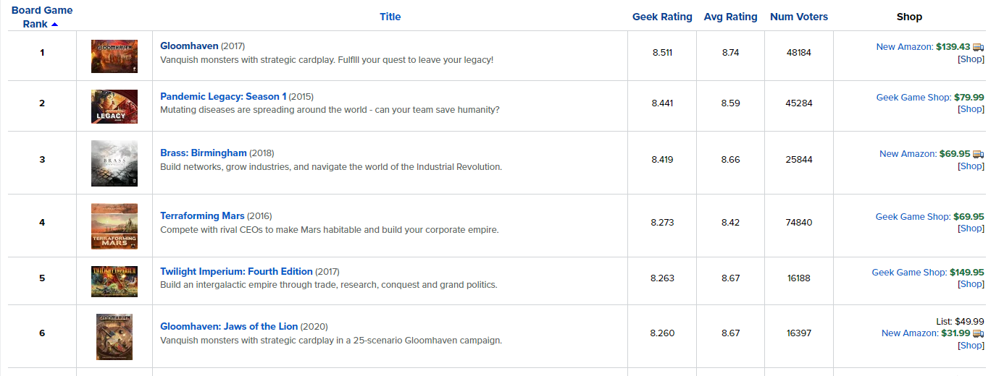
Dataset introduction
Online platform (BGG) - www.boardgamegeeks.com

Slide 5
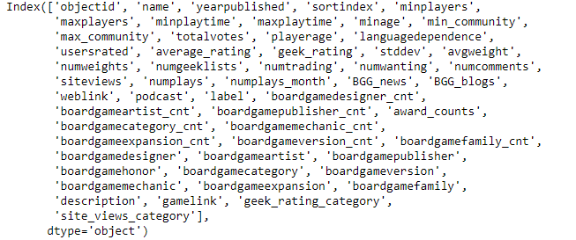
Dataset introduction (cont..)
Kaggle dataset –
20,000 Boardgames Dataset:
Dataset created from data scraped off BGG site for all ranked games.
For the 20,000 games, the dataset includes info ranging from ratings, player age, playing time to game designer names, genres and honor counts.
https://www.kaggle.com/extralime/20000-boardgames-dataset

Slide 6
Features of interest
Site views for games on BGG site
Mentions of the game in different media types such as news/online review articles, blog posts, and podcasts.
Total number of awards won by the game.
Different categories/genres of the game.
Minimum and maximum playing time for the game.

Slide 7
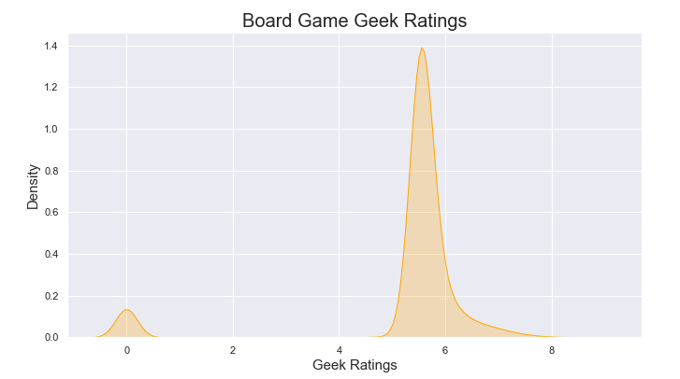
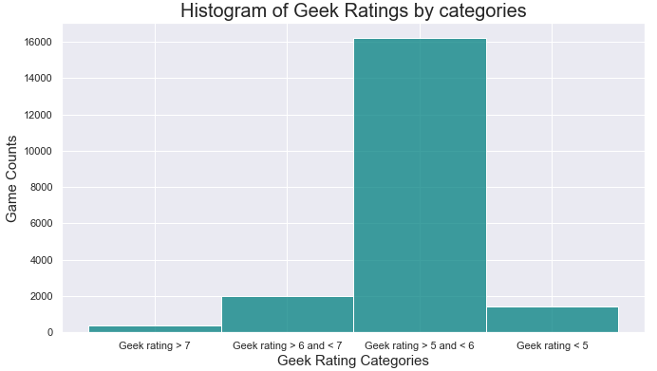
Evaluating geek ratings
Rating density plot for all games:
Rating categories focusing on ratings higher than 4.

Slide 8
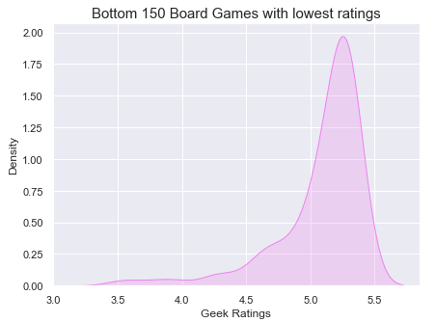
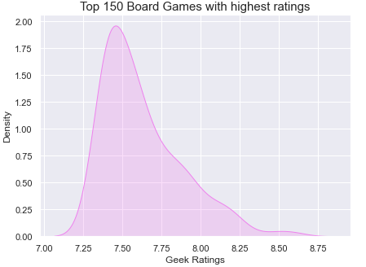
Evaluating geek ratings
Rating density evaluated for top 150 games (sorted by geek rating)
Rating density evaluated for bottom 150 games (sorted by geek rating)

Slide 9
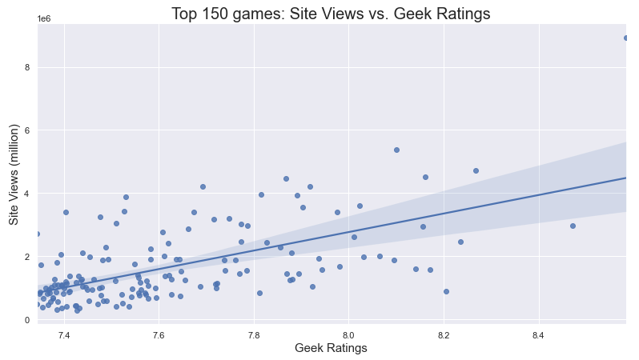
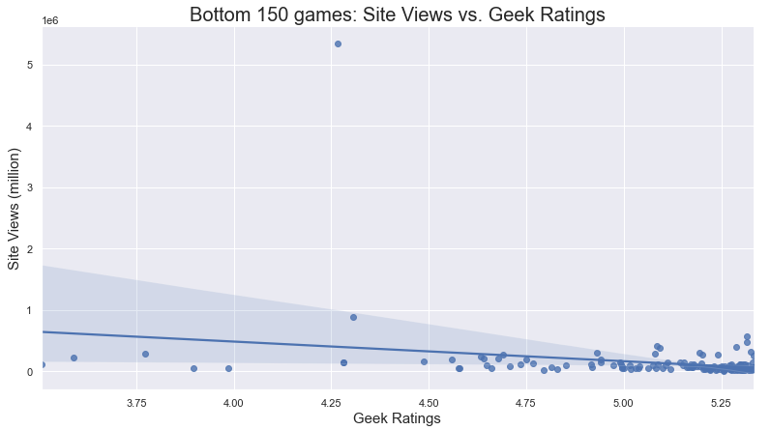
Site views evaluation
Notes:
Add a line.

Slide 10
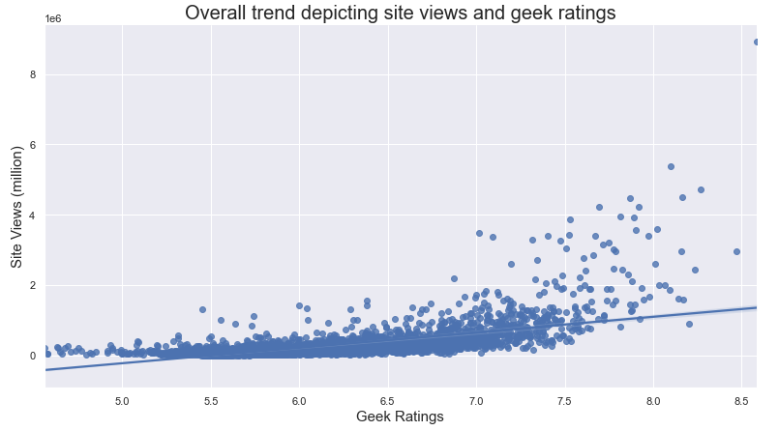
Site views evaluation (cont..)
Site views pick up as the game rating increases from 6.5 onwards.

Slide 11
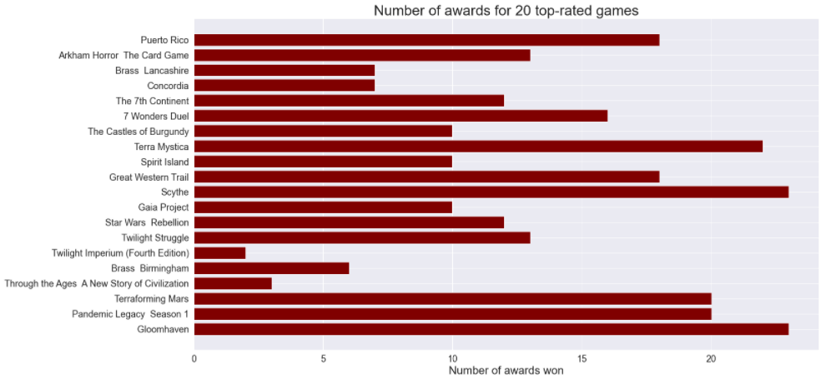
Game Awards evaluation
aaaaaaaaaaaaaaaaaaaaaaaaaaaaaaaaa

Slide 12
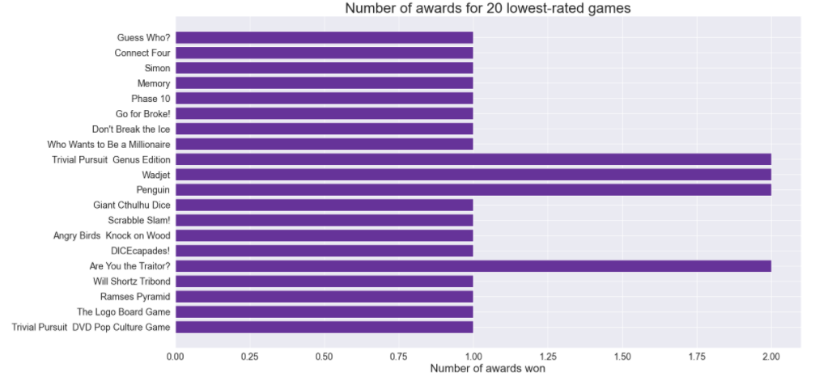
Game Awards evaluation (cont..)
aaaaaaaaaaaaaaaaaaaaaaaaaaaa

Slide 13
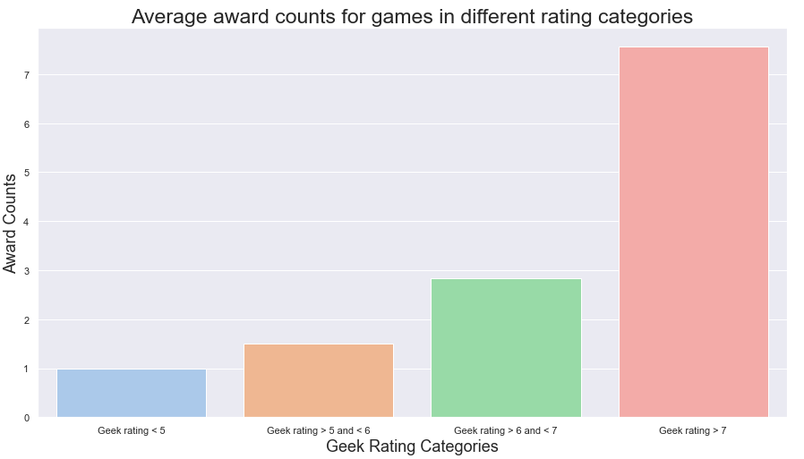
Game Awards evaluation(cont..)

Slide 14
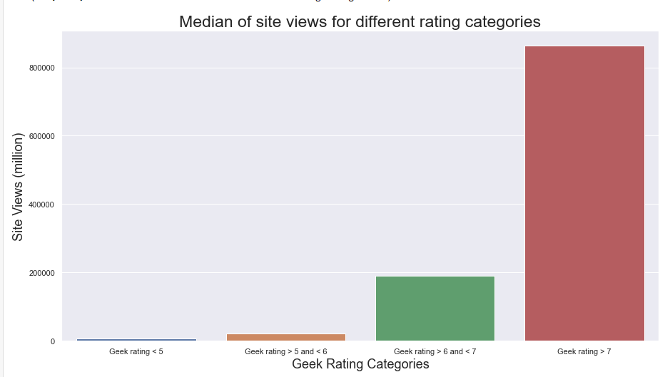
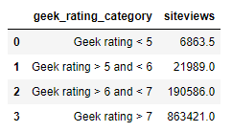
Media type evaluation
For the next evaluation, the feature will be compared with site views as higher site views can translate to higher ratings:
Higher rating categories have high median site view count.

Slide 15
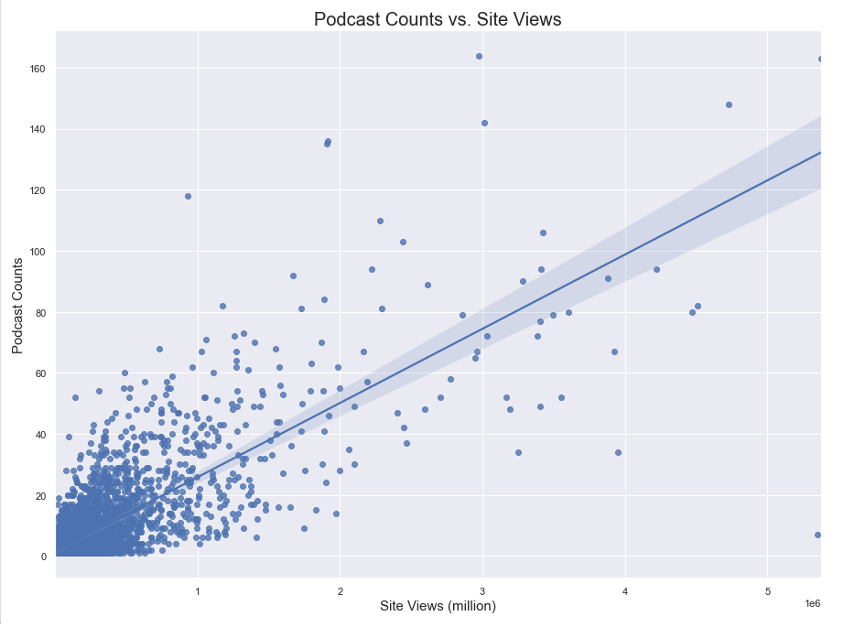
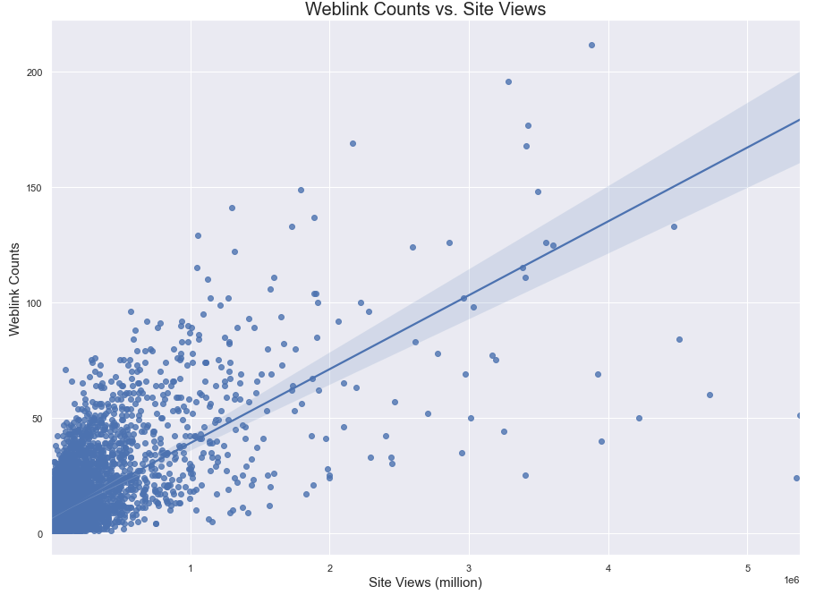
Media type evaluation (cont..)
Trend of number podcast links for a game versus site views for the game
Trend of number web article links for a game versus site views for the game
Games evaluated have at least one podcast and weblink listed

