Slide 1
Boardgames rating analysis
Python EDA Project

Slide 2

Question of interest
A boardgame’s user ratings on any online platform can be analogous to its overall popularity.
This project researches whether certain metrics on online boardgame databases contribute to board game rating/popularity.
This project compares BGG Geek Rating to different metrics to see if they affect the game’s rating in any way.

Slide 3
STAKEHOLDERS
Game Developers trying to increase their game's rating/popularity and eventually increase sales.
Game Developers developing a new game and looking to research best metrics to incorporate in order to maximize game ratings.

Slide 4
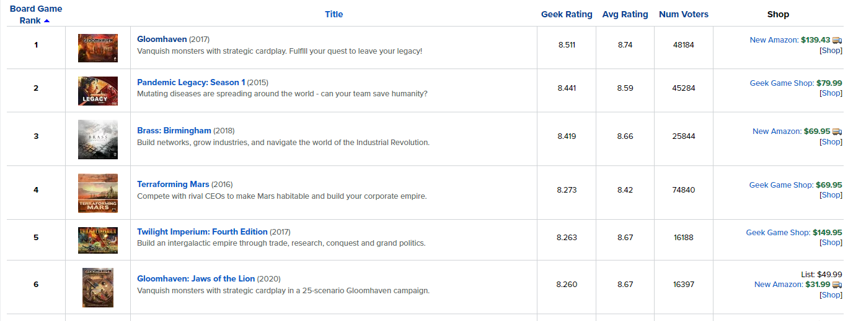
Dataset introduction
Online platform (BGG) - www.boardgamegeeks.com

Slide 5
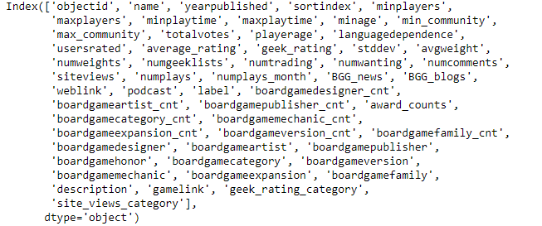
Dataset introduction (continued)
Kaggle dataset –
20,000 Boardgames Dataset:
Dataset created from data scraped off BGG site for all ranked games.
For the 20,000 games, the dataset includes info ranging from ratings, player age, playing time to game designer names, genres and honor counts.
https://www.kaggle.com/extralime/20000-boardgames-dataset

