Slide 1
R
Bina Ramamurthy

Slide 2
R Language
R is a software package for statistical computing.
R is an interpreted language
It is open source with high level of contribution from the community
“R is very good at plotting graphics, analyzing data, and fitting statistical models using data that fits in the computer’s memory.”
“It’s not as good at storing data in complicated structures, efficiently querying data, or working with data that doesn’t fit in the computer’s memory.”

Slide 3
Why R?
There are many packages available for statistical analysis such as SAS and SPSS but there are expensive (user license based) and are proprietary.
R is open source and it can pretty much do what SAS can do but free.
R is considered one of the best statistical tools in the world.
For R people can submit their own packages/libraries, using the latest cutting edge techniques.
To date R has got almost 15,000 packages in the CRAN (Comprehensive R Archive Network – The site which maintains the R project) repository.
R is great for exploratory data analysis (EDA): for understanding the nature of your data before you launch serious analytics.
Many tutorial vignettes are available for you to learn.

Slide 4
R Packages
An R package is a set of related functions
To use a package you need to load into R
R offers a large number of packages for various vertical and horizontal domains:
Horizontal: display graphics, statistical packages, machine learning
Verticals: wide variety of industries: analyzing microarray data, modeling credit risks, social sciences, automobile data (none so far on sensor data from automobiles!)

Slide 5
Library
Library→ Package→ Class→
R considers every item as a class/object
Thousands of Online libraries
150000 packages
CRAN: Comprehensive R Archive Network
Look at all the packages available in CRAN
http://cran.r-project.org/
R-Forge is another source for people to collaborate on R projects

Slide 6
Approach to learning R
R Basics, fundamentals
The R language
Working with data
Statistics with R language

Slide 7
R Basics
Obtaining the R package
Installing it
Install and use packages
Quick overview and tutorial

Slide 8
A quick demo of R’s capabilities
See p.98 onwards till p.102 of
simpleR: Using R for introductory statistics
By J. Verzani
http://cran.r-project.org/doc/contrib/Verzani-SimpleR.pdf
R in a nutshell, by Joseph Adler, O’reilly, 2010
Chapter 3 Basics, Ch.4 packages,
(search for this online)
Look for these resources online…and try these.
See Rhandout.pdf linked to today’s lecture

Slide 9
Packages
A package is a collection of functions and data files bundled together.
In order to use the components of a package it needs to be installed in the local library of the R environment.
Loading packages
Custom packages
Building packages

Slide 10
More R
R syntax
R Control structures
R Objects
R formulas

Slide 11
R Syntax
R language is composed of series of expression resulting in a value
Examples of expression include assignment statements, conditional statements, and arithmetic expressions
> a<- 42
> b <- a% 5
> if (b == 0) " a divisible evenly by 5" else " not evenly divisible by 5"
[1] " not evenly divisible by 5"
Variables in R are called symbols

Slide 12
R Objects
All items vectors, lists, even functions are considered as objects in R
Example : a vector of integers , and then floats
p<- c(6, 8,4,5,78)
p
q<- c(5.6, 4.5, 7.8, 9.3)
Q
A list can be made of items of any type
> r<- list(p, q, "this demo")
> r
[[1]]
[1] 6 8 4 5 78
[[2]]
[1] 5.6 4.5 7.8 9.3
[[3]]
[1] "this demo“

Slide 13
Special Values
> v <- c(1,2,3)
> v
[1] 1 2 3
> length(v) <- 4
> v
[1] 1 2 3 NA
NA : not defined or not available
Very Large and very small numbers:
> 2 ^ 1024
[1] Inf
> - 2 ^ 1024
[1] -Inf

Slide 14
Curly braces
Curly braces are used to group a set of operations in the body of a function:
> f <- function() {x <- 1; y <- 2; x + y}
> f()
[1] 3

Slide 15
Control Structures
> i <-4
> repeat {if (i > 25) break else {print(i); i <- i + 5;}}
[1] 4
[1] 9
[1] 14
[1] 19
[1] 24

Slide 16
One last example
survey.results <- factor( c("Disagree", "Neutral", "Strongly Disagree", "Neutral", "Agree", "Strongly Agree","Disagree", "Strongly Agree", "Neutral","Strongly Disagree", "Neutral", "Agree"),levels=c("Strongly Disagree", "Disagree", "Neutral", "Agree", "Strongly Agree"),ordered=TRUE)
survey.results
R will automatically compute the numbers in each category!
There are many more functions and operations available in R that are related to data.

Slide 17
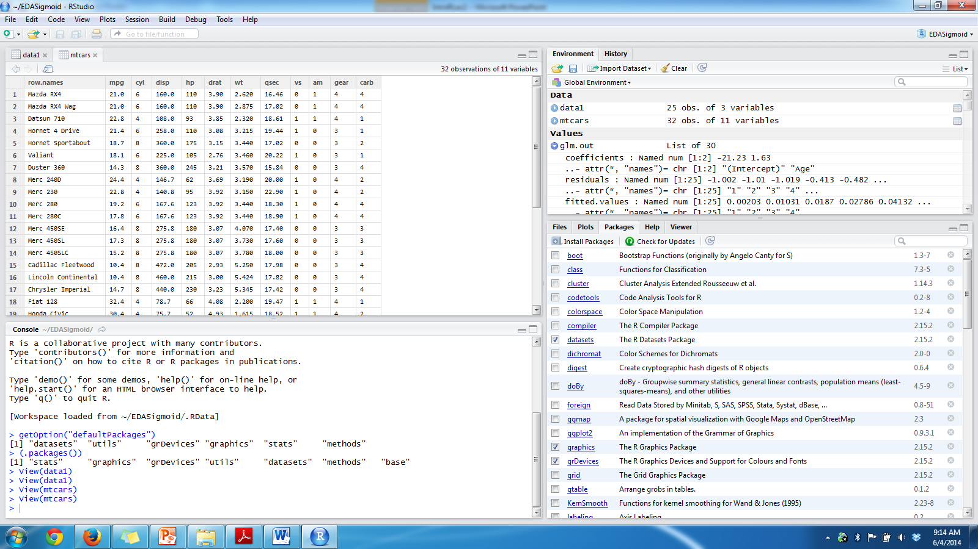
Lets explore RStudio

Slide 18
Let do a EDA of cars data
Look at the tutorial in handout#1
R is good for Exploratory Data Analytics
It is really good for most statistical computing you will you in your domain.
You can repeat the same on Jupyter.

