Slide 1
INVESTMENT ASSIGNMENT SUBMISSION
Name: Suhitha Mithinti

Slide 2
Introduction
Project Brief:
The CEO of Spark Funds wants to understand the global trends in investments so that she can take the decision on investments in few companies effectively.
Constraints:
Investment should be between 5 to 15 million USD per each round of investment.
Wants to invest only in English-speaking countries because of the ease of communication.
Strategy:
To invest where invest where most other investors are investing.
Business Objective:
To Identify the best sectors, countries, and a suitable investment type for making investments.
Data Analysis Goals:
Investment type analysis : Best investment type based on investment amount constraint.
Country analysis : The countries which have been the most heavily invested in the past
Sector analysis : Understanding the distribution of investments across the eight main sectors
Data understanding:
Companies : Table with basic data of companies like unique_id for the company, name, category etc,.
Rounds2 : Table with details of the funding types, rounds, funding amount etc,.
Mapping : This file maps the numerous category names in the companies table to eight broad sector names.

Slide 3
Problem solving methodology
Business Objective Understanding
Input Data Understanding
Data Cleaning
START
Business Strategies
Business Constraints
Business Goals
Identifying Primary, join keys between datasets.
Exploring dataset shape.
Understanding the business meaning of columns
Identifying and decoding the encoded data.
Fixing rows and columns
Handling missing values
Standardizing case
Fill NAs
Plot the graphs
Input files
Companies
Funding round
Sector mapping
Funding Type Analysis
Sector Analysis
companies
rounds2
Extract statistics
Wide format Mapping
Master Frame
Country Analysis
Merge
Melt
D2
Mapping
ENGLISH SPEAKING == TRUE
ENGLISH SPEAKING COUNTRIES
Funding round type == FT
Master Frame
GROUP BY funding round type
D1
D3
Extract Primary sector
Top 9
Y
Country = C2
Merge
Median >= 5M & <=15M
Country = C1
Country = C3
Sub
Master Frame
Y
Median of raised amt for each group
Funding round type == FT & raised amt >= 5M & <=15M
Master sector Frame
Top 3
English speaking
highly invested countries
C1,C2,C3
Sort desc
Sum of raised amt for each group
GROUP BY country code
Funding Type => FT

Slide 4
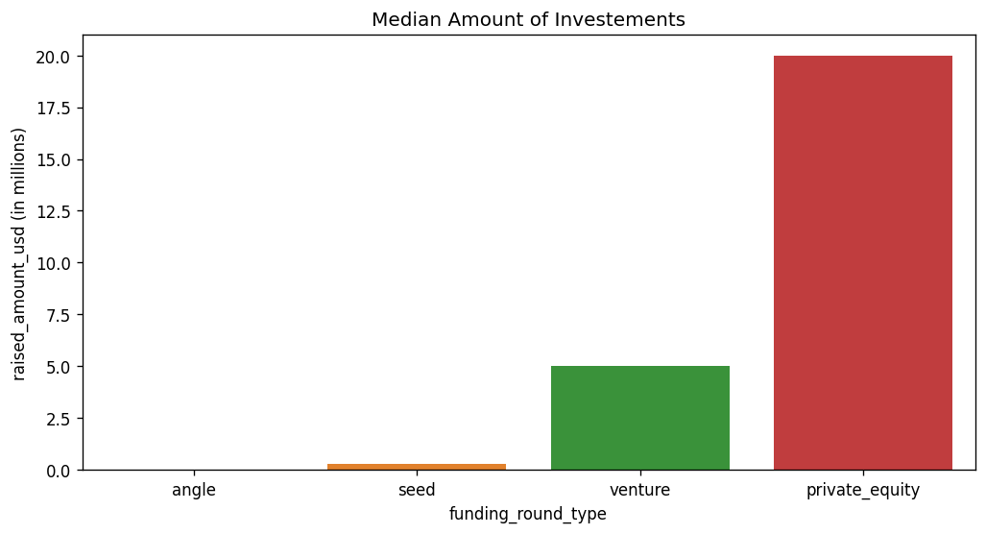
Funding Type Analysis
Spark funds wants to invest between 5 to 50 million USD per investment round.
The table below shows the representative value(median) of each funding round type which is been graphically shown by the bar graph.
From both the table and the bar graph it is clear that “VENTURE” funding type is the best suitable funding type according to constraints given by Spark funds
Funding Round Type | Raised Amount (USD)
seed | 275000.00
angel | 400000.00
venture | 5000000.00
private_equity | 20000000.00

Slide 5
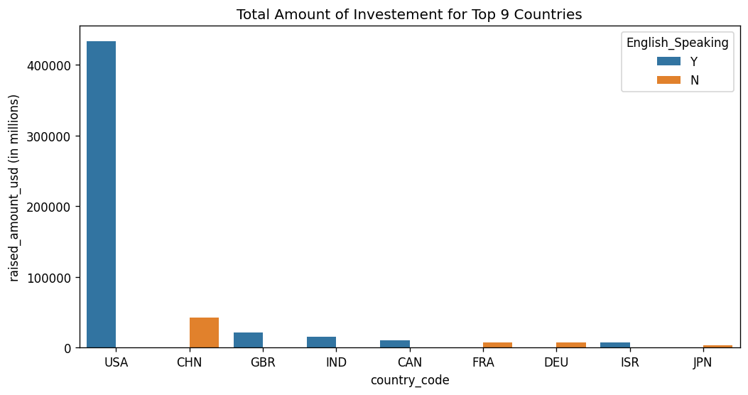
Country Analysis
Spark funds’ strategy is to invest in the country where huge invests are made by other investors.
For the ease of communication it also wants to invest in only English speaking countries.
The table has the top 9 highly invested countries.
The bivariate bar plot graph represents the table with Top 9 Countries with hue as English Speaking Flag.
From the bar plot it is clear that USA, GBR, IND are top 3 highly invested English speaking countries.
Country Code | Sum of Raised Amount (USD)
USA | 433675842796.00
CHN | 42450418773.00
GBR | 21485627416.00
IND | 15231858718.00
CAN | 10033332317.00
FRA | 7599536732.00
DEU | 7486959822.00
ISR | 7477514579.00
JPN | 3583676611.0

Slide 6
Sector Analysis
Spark Funds wants to get the most invested sector of all the 8 main sectors.
The tables below represent the total no. of investments made for each main sectors for the Top 3 highly invested English speaking countries with venture funding type and the funding amount falling in between 5 to 50 million USD per investment round.
USA
GBR
IND
Main Sector | No. of Investments
Others | 3373
Cleantech / Semiconductors | 2561
Social, Finance, Analytics, Advertising | 2309
News, Search and Messaging | 1824
Health | 1048
Manufacturing | 989
Entertainment | 712
Automotive & Sports | 228
Main Sector | No. of Investments
Others | 207
Cleantech / Semiconductors | 150
Social, Finance, Analytics, Advertising | 139
News, Search and Messaging | 97
Entertainment | 78
Manufacturing | 52
Health | 32
Automotive & Sports | 26
Main Sector | No. of Investments
Others | 157
News, Search and Messaging | 76
Social, Finance, Analytics, Advertising | 59
Entertainment | 46
Health | 33
Manufacturing | 30
Cleantech / Semiconductors | 29
Automotive & Sports | 14

Slide 7
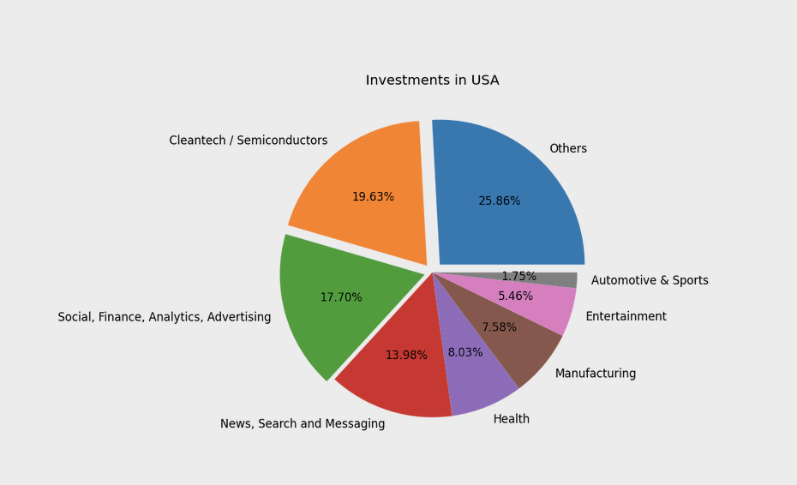
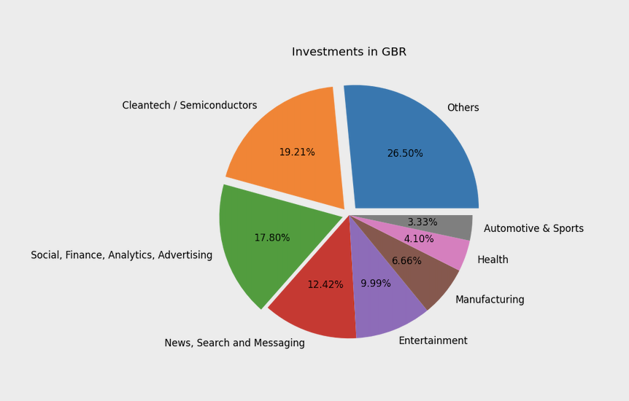
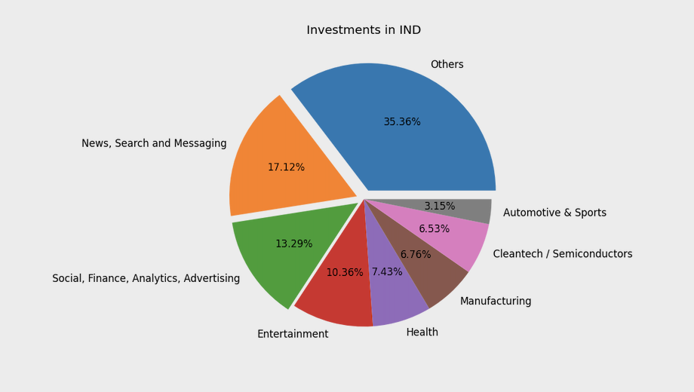
Sector Analysis
USA
GBR
IND

Slide 8
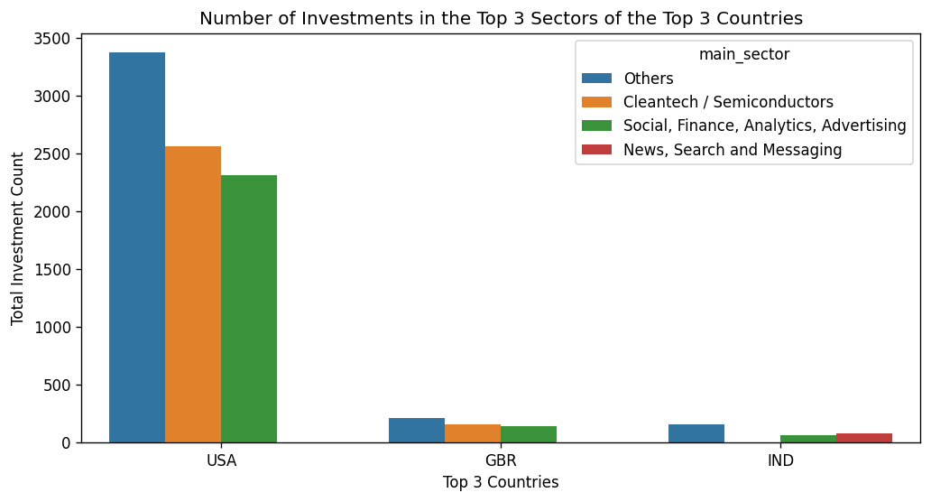
Sector Analysis
The graph below shows the number of investments made for Top 3 sectors of the Top 3 countries.
From the graph we can observe that USA has relative very huge number of investments compared to next two countries mainly for the “Others” sector.

Slide 9
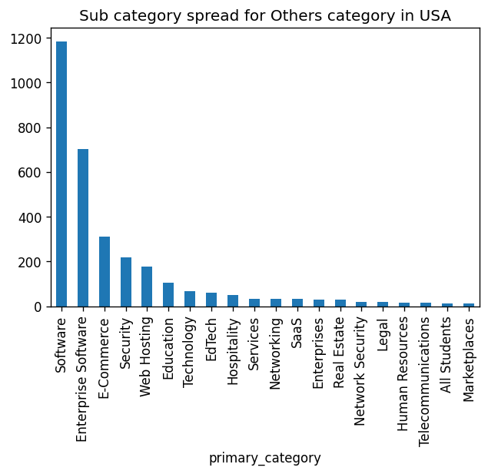
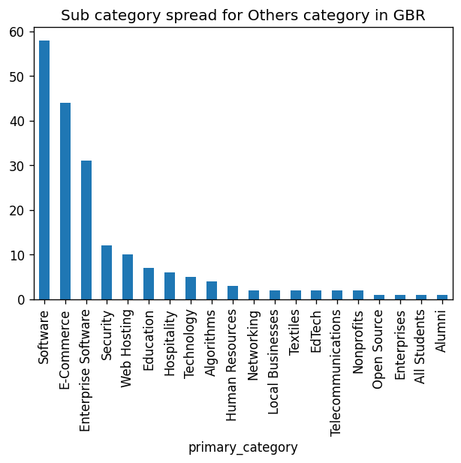
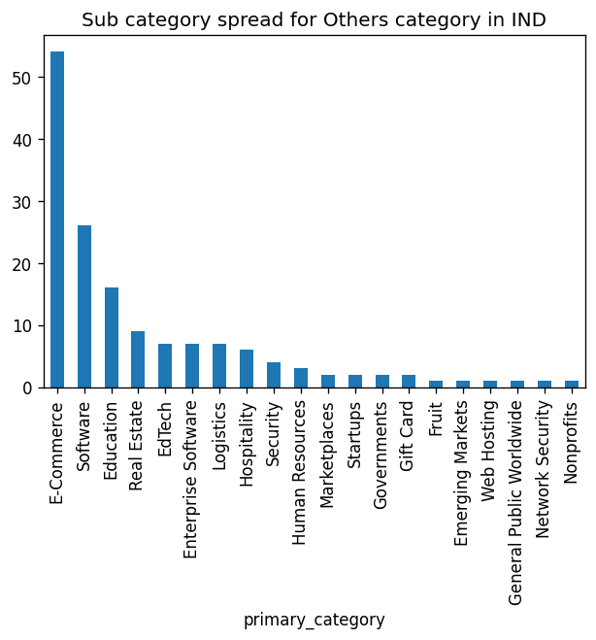
Sub - Category Analysis
From the bar plot in the previous slide it is evident that “Others” is the segment which is in the first place in number of investments.
Others category is very vague to invest so we can analyse in depth to see what sector/category in others is driving for these results.
We can see that software category almost ruled out all other categories except in IND where it is in second place. All the top categories like Enterprise software, E-commerce, security, web hosting can be termed as Applications related to software.
So we can say that Software and other application of it are the most and heavily invested sectors in almost any country (Top 3 specifically).

Slide 10
Conclusion
Below are the insights for Spark Funds for their investment decision based on their business strategy and constraints.
Venture funding type is the best fit for the investment range decided by Spark Funds (5 to 50 million USD per investment round).
Of all the countries United States of America (USA), Great Britain (GBR), India (IND) are the best to invest as they are having huge amount of investments made by other investors and are English speaking, which is inline with the strategy of Spark Funds.
The main category “Others” is having huge number of investments. It almost ruled out next highest main category for the top 2 countries.
In all the three countries Software and its applications are the sub-categories which are having very huge number of investment and are ideal field for Spark Funds to make their investment.
So the first priority of Spark Funds can be to invest in Software and its applications companies in USA.
If it wants to invest in different countries to reduce the risk of country specific economy fluctuations it can it of investing in GBR or IND in the same sub category (Software and its applications).

