Slide 1

UNIVERSITY OF COMPUTER STUDIES, (MANDALAY )
Internship Training and Project Presentation on
“Accomplished in D.I.S Technology Co,. Ltd ”
Date:15.8.2025
Supervised by
Daw Ohnmar Aung
Presented by
Su Su Hlaing KPTM-10896
Cho Yee Mon Hlwar KPTM-10897
Su Hnin Wut Yee KPTM-10900
1

Slide 2
OUTLINE OF PRESENTATION
INTRODUCTION
BRIEF HISTORY OF D.I.S TECHNOLOGY Co., Ltd
TRAINING PROGRAM
SWOT ANALYSIS
PRODUCT LINE
CONCLUSION
2

Slide 3
The system stores all internship-related data securely and provides easy access to authorized users.
The system is built using ASP.NET Core MVC with a responsive design for desktop and mobile use.
To simplify and automate the internship project management process.
To provide a centralized platform for students, companies, and supervisors to collaborate effectively.
Reduces paperwork and manual tracking errors.
Enhances communication and transparency among all parties involved.
Saves time and improves the overall internship experience for students.
INTRODUCTION
3

Slide 4
BRIEF HISTORY D.I.S TECHNOLOGY Co., Ltd
D.I.S Technology Co., Ltd. was founded in 2009 as part of the PAG Group, driven by a vision to lead Myanmar’s digital transformation.
The company began with a small team and grew into one of the country’s top IT solution providers, serving both government and private sectors.
By earning multiple government recognitions, D.I.S became known for major projects like e-Driving License Systems, IRD Documentation Systems, and Banking Applications.
Today, the company has a strong workforce of 100+ talented professionals across software development, project management, and technical support.
You can contact D.I.S Technology at No.131, Kanar Road, Thanlyin Township, Yangon,
Tel: [09796727093], Email: [discompany@pag98.com].
4

Slide 5
TRAINING PROGRAM
Learned how to design and develop a database to store internship and project details securely.
Gained practical skills in using ASP.NET Core MVC for building web-based management systems.
Collected ideas by reviewing multiple existing internship and project management platforms.
Improved teamwork and communication skills by collaborating with peers and industry partners during the project.
5

Slide 6
STRENGTHS
Use of latest technologies like C#, .NET Core MVC, React.js, and MSSQL.
Friendly and supportive work environment.
Strong teamwork and open communication culture.
Opportunities to work on real projects and apply knowledge practically.
Good mentorship from senior developers.
6

Slide 7
WEAKNESS
Limited involvement of interns in some projects.
Some processes and tools still developing and need improvement.
Limited opportunities for interns to participate in client-facing meetings.
7

Slide 8
OPPORTUNITIES
Chance to adopt and explore emerging tech like cloud computing or AI.
Potential to expand into mobile app development.
Receive mentorship from experienced developers.
Improving internship programs to attract more talent.
8

Slide 9
THREATS
Economic instability might reduce project budgets.
Strong competition from bigger IT companies and outsourcing firms.
Infrastructure limitations sometimes cause delays in project delivery timelines.
9

Slide 10
PRODUCT LINE
The system manages internship projects, student profiles, and company details in one platform.
It supports role-based access for students and supervisors.
Includes features for project submission and approval.
Offers notification tools to remind users of important deadlines and tasks.
10

Slide 11
ABSTRACT OF THE PROJECT
This presentation covers the four main workflows of the Internship Project Information System.
It highlights the process flow for project management, public user access, final year student participation, and teacher administration.
A web-based platform designed to manage internship and final year project processes.
Supports multiple user roles with tailored access for Students ,Teachers and Public Visitors
11

Slide 12
TOOLS AND TECHNOLOGY
ASP.NET Core MVC
Microsoft SQL Server
HTML5
CSS3
Bootstrap
Entity Framework Core
JavaScript
jQuery
12

Slide 13
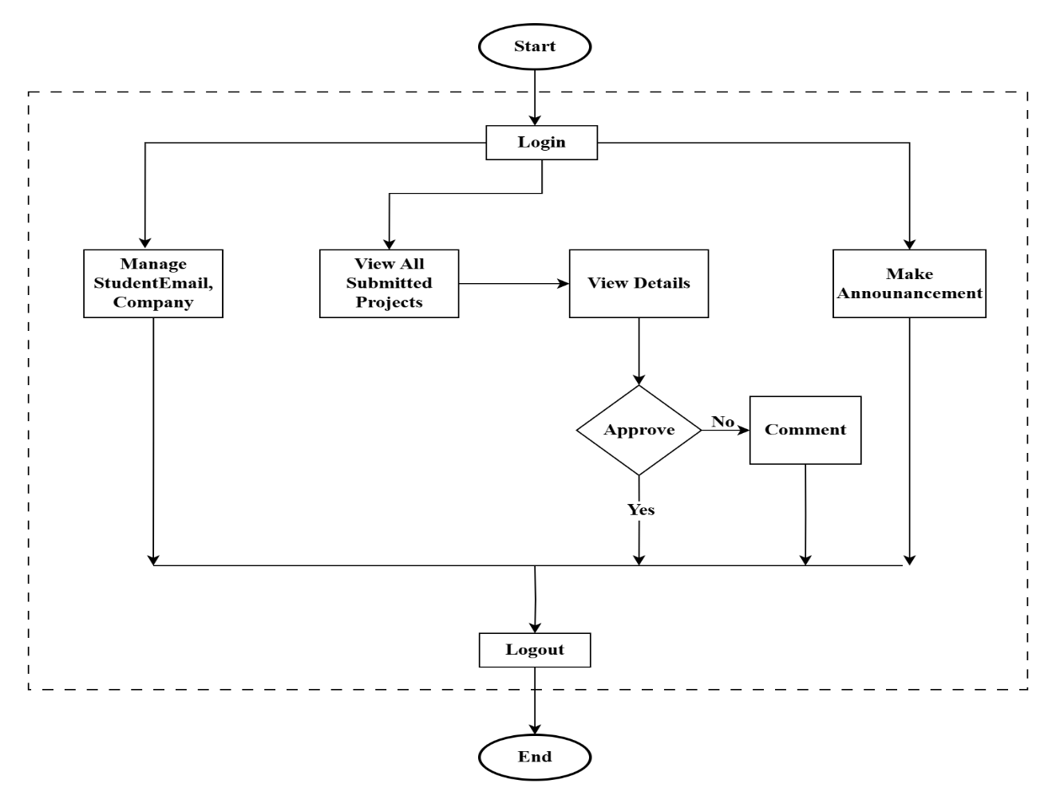
SYSTEM FLOW CHART FOR TEACHER(ADMIN)
13

Slide 14
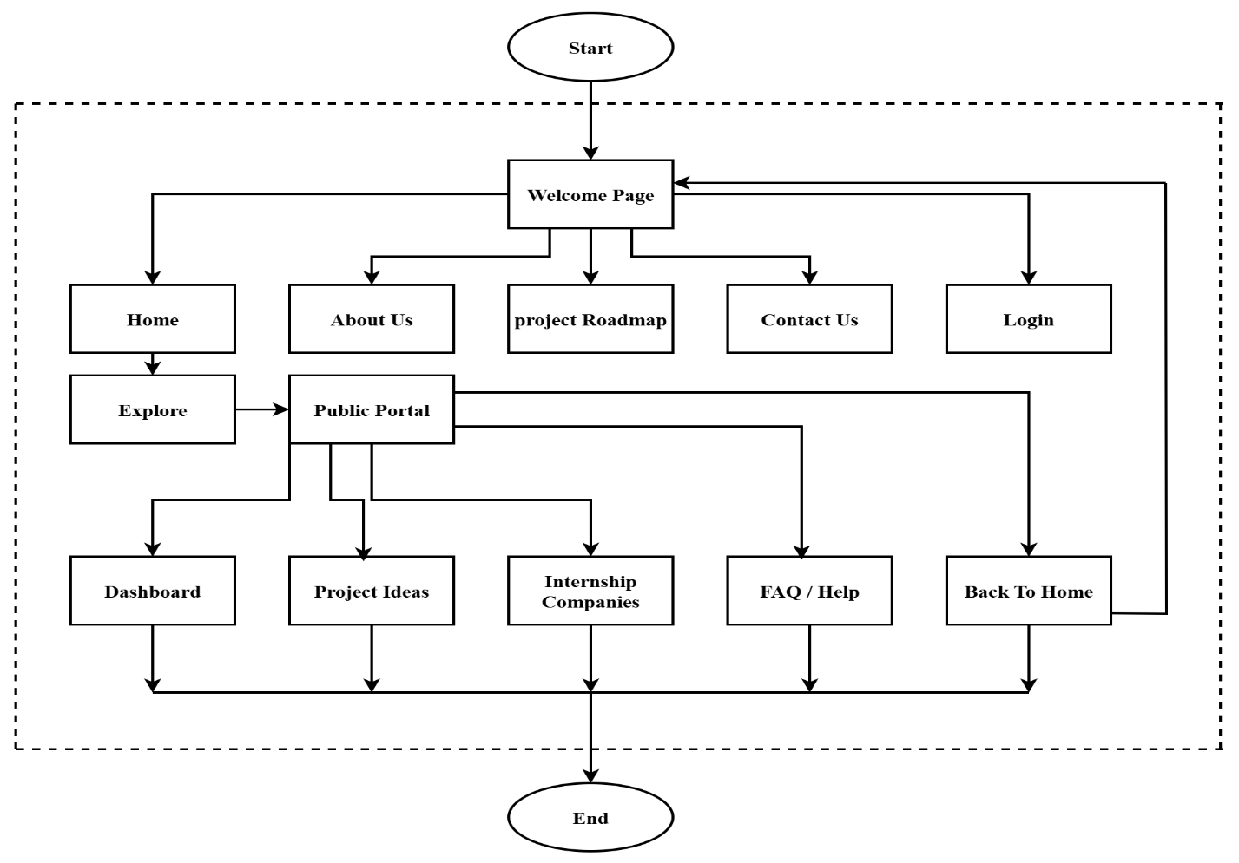
SYSTEM FLOW CHART FOR PUBLIC
14

Slide 15
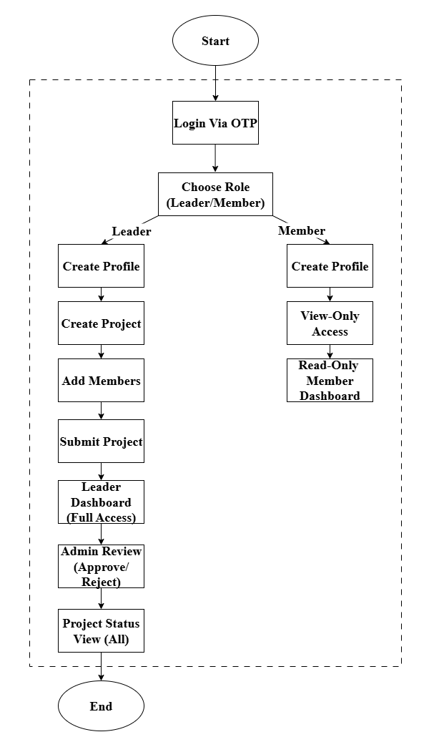
SYSTEM FLOW CHART FOR STUDENT
15

Slide 16
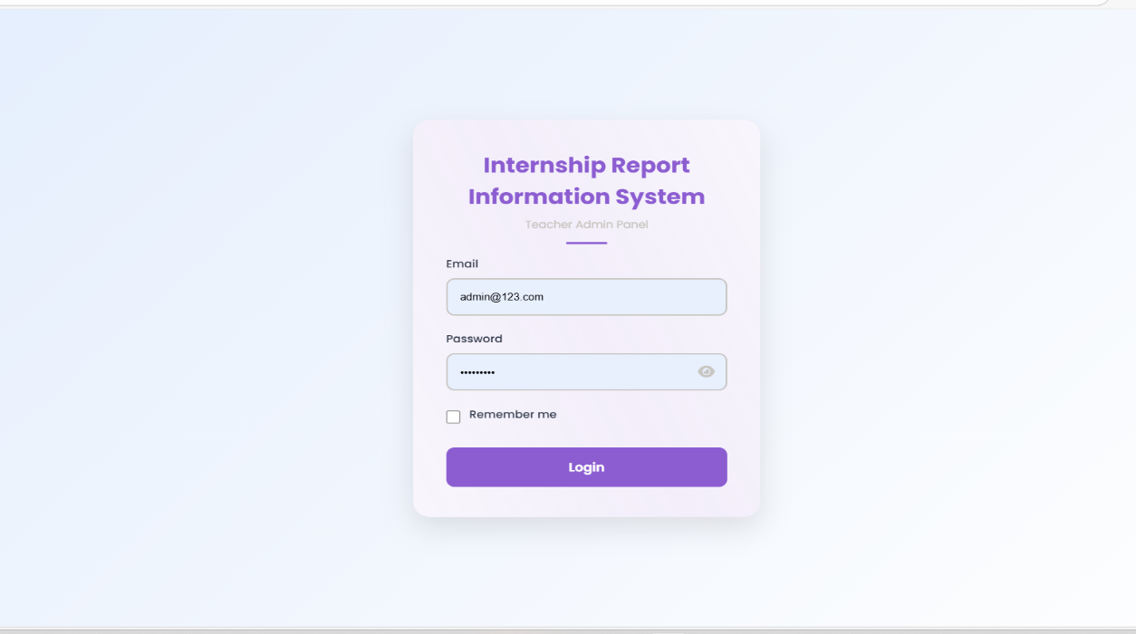
01
TEACHER PORTAL WORKFLOW(ADMIN)
Figure : Admin Login
16

Slide 17
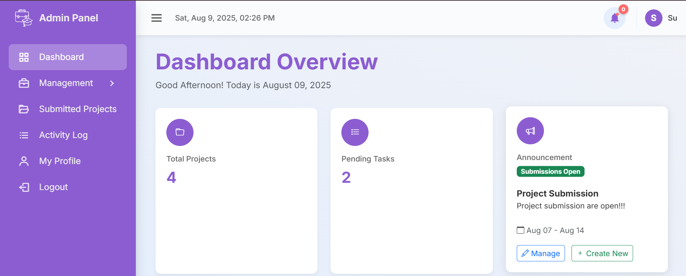
1.1 TEACHER DASHBOARD
Figure : Dashboard Page
17

Slide 18
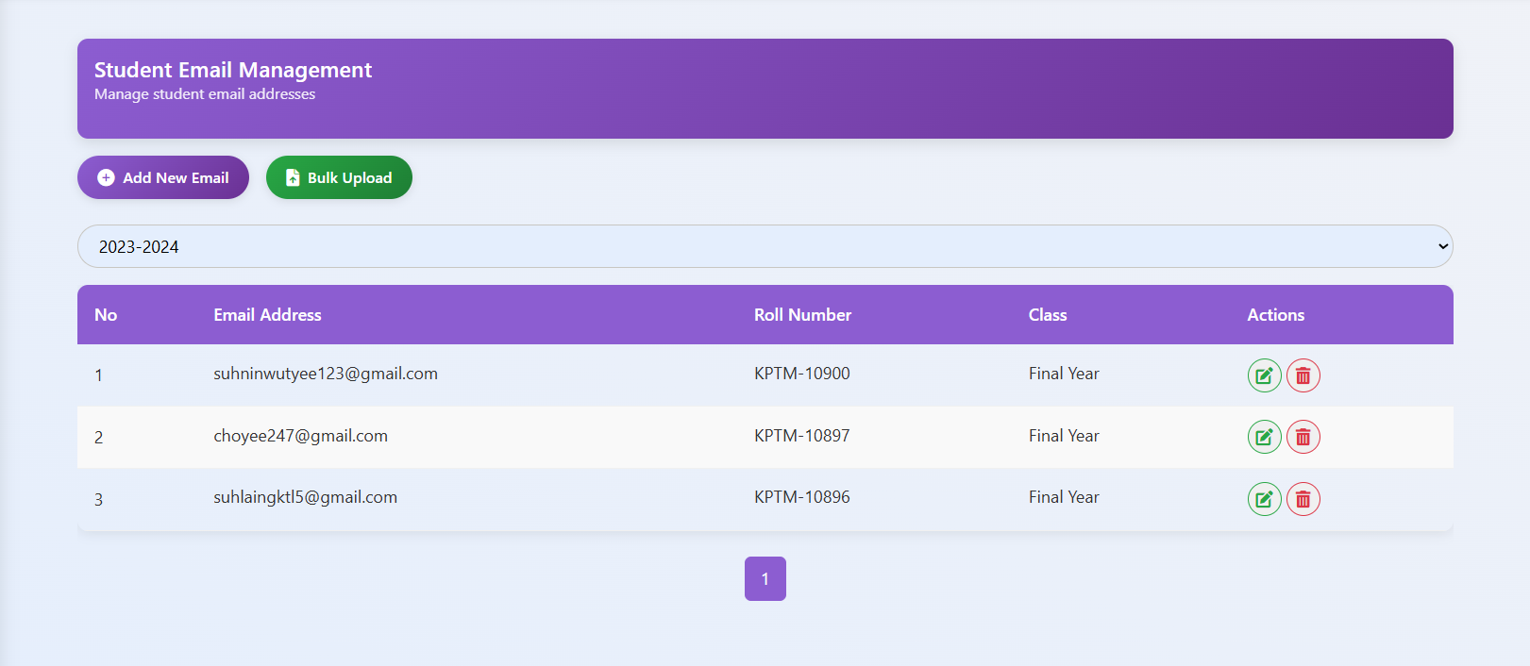
1.2 EMAIL MANAGEMENT
Figure : Email Management Page
18

Slide 19
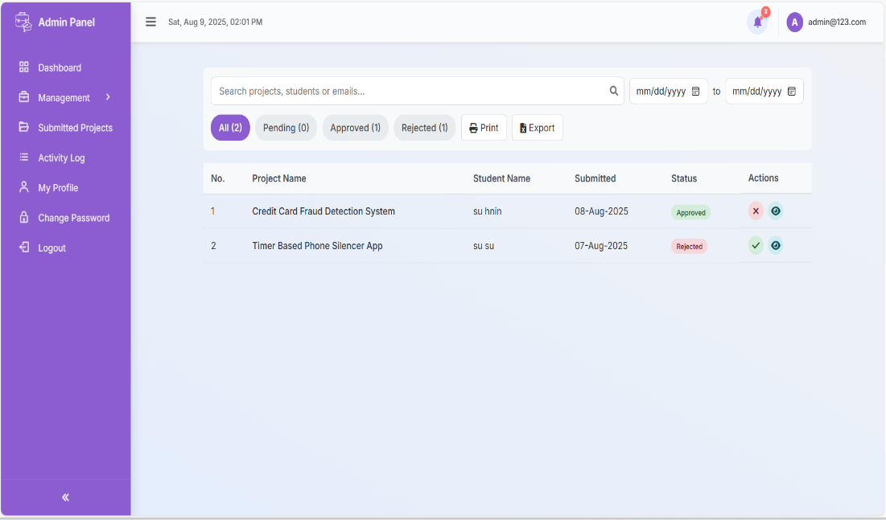
1.3 PROJECT APPROVAL MANAGEMENT
Figure : Project Approval Management Page
19

Slide 20
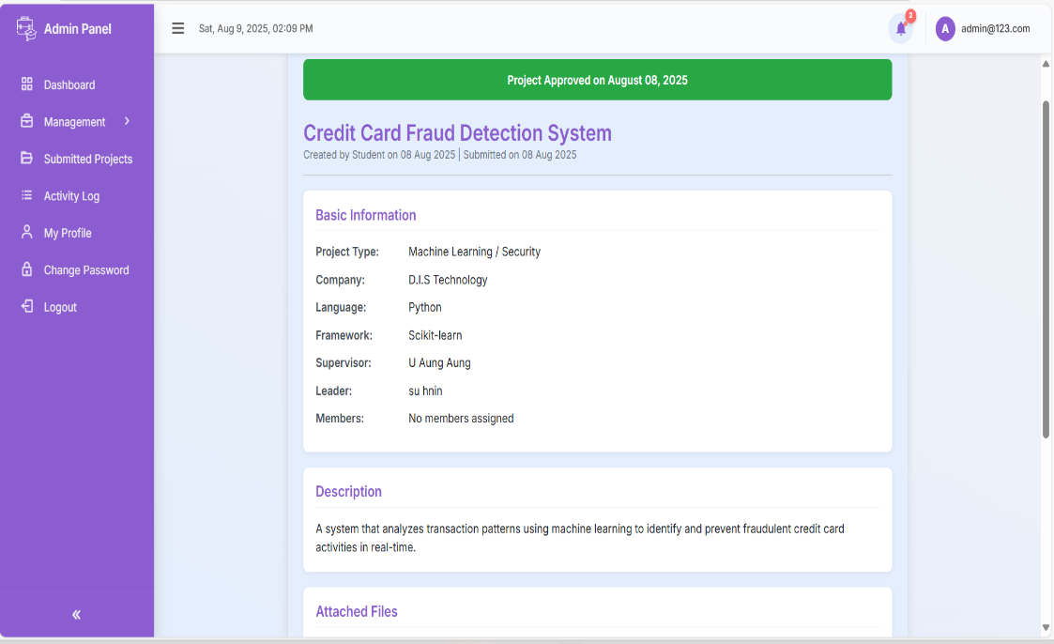
1.4 PROJECT APPROVAL
Figure : Project Approval Page
20

Slide 21
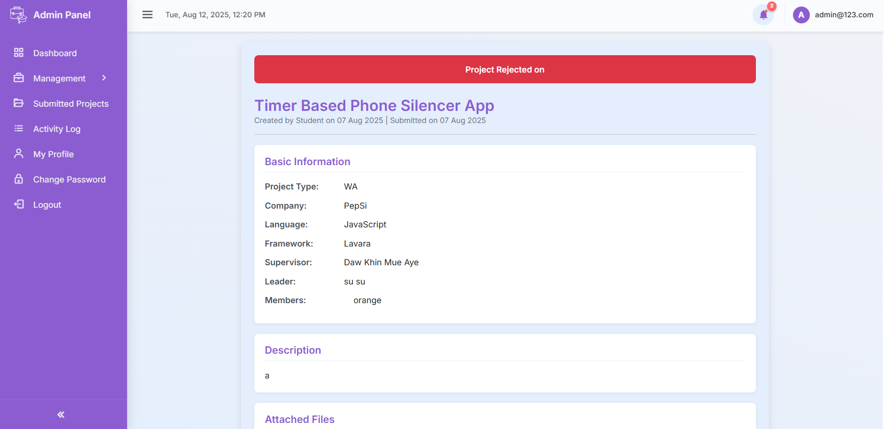
1.5 PROJECT REJECTION
Figure : Project Rejection Page
21

Slide 22
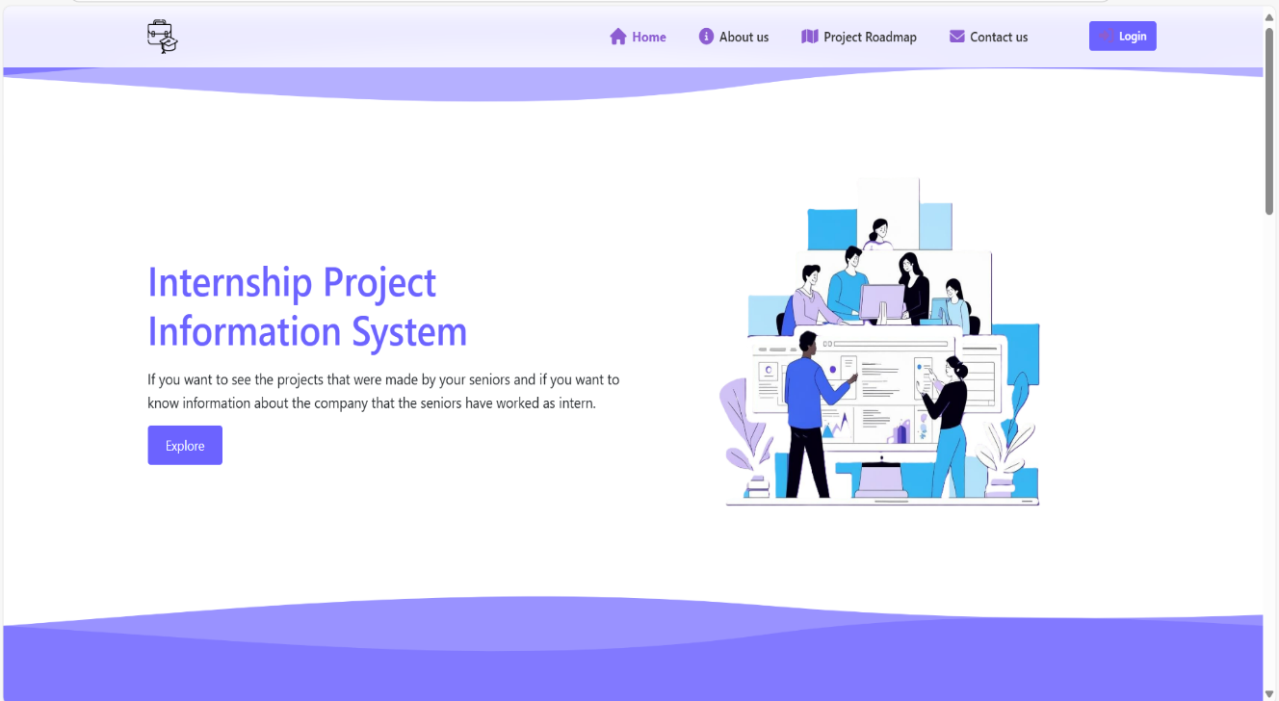
PUBLIC PORTAL (BEFORE LOGIN)
02
Figure : Home Page For Public Users
22

Slide 23
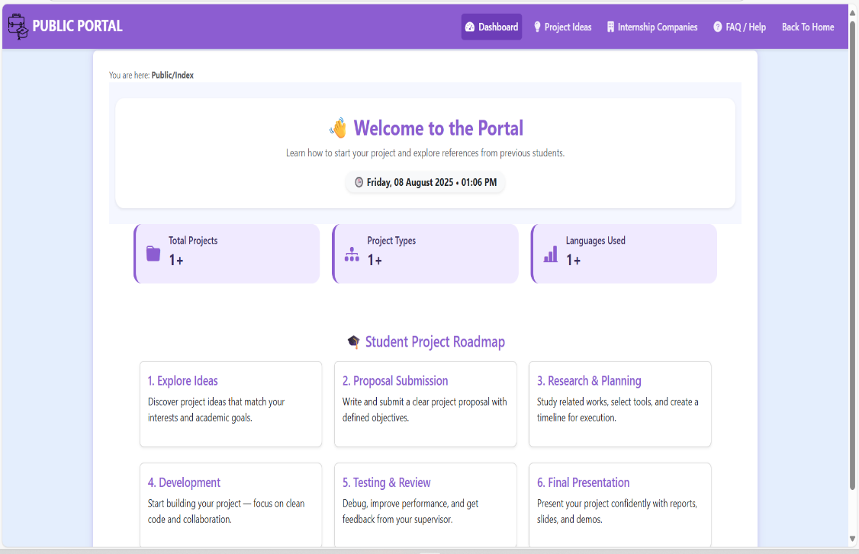
2.1 PUBLIC DASHBOARD
Figure : Public Dashboard
23

Slide 24
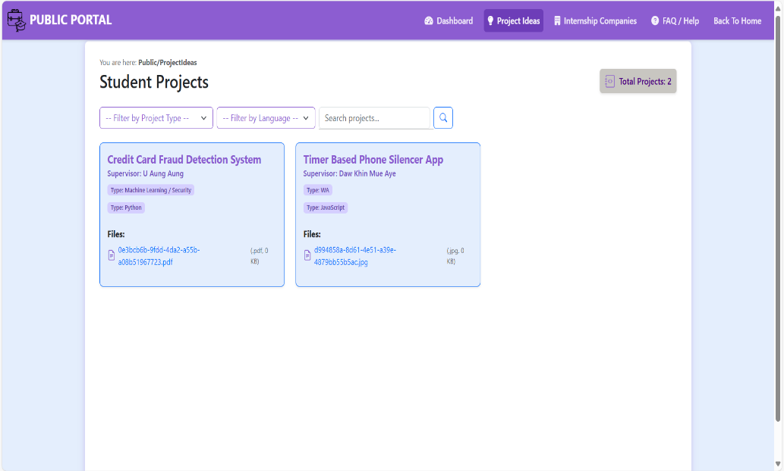
2.2 PROJECT IDEA
Figure : Project Idea Page
24

Slide 25
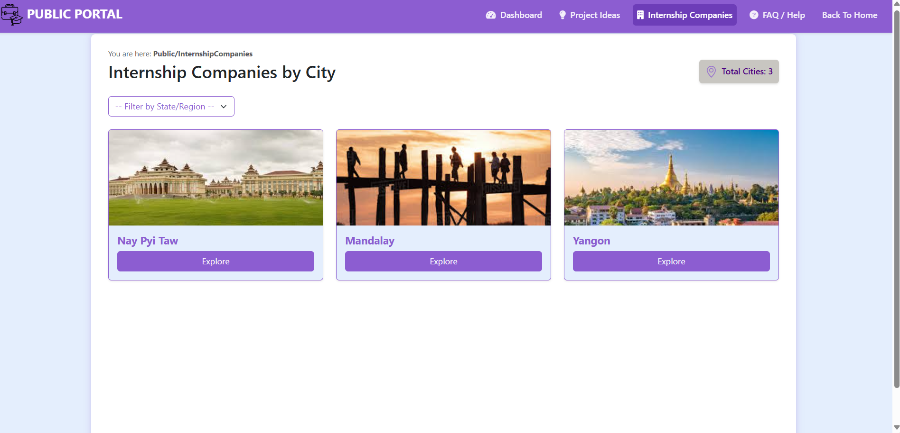
2.3 INTERNSHIP COMPANIES
Figure :Internship Companies Page
25

Slide 26
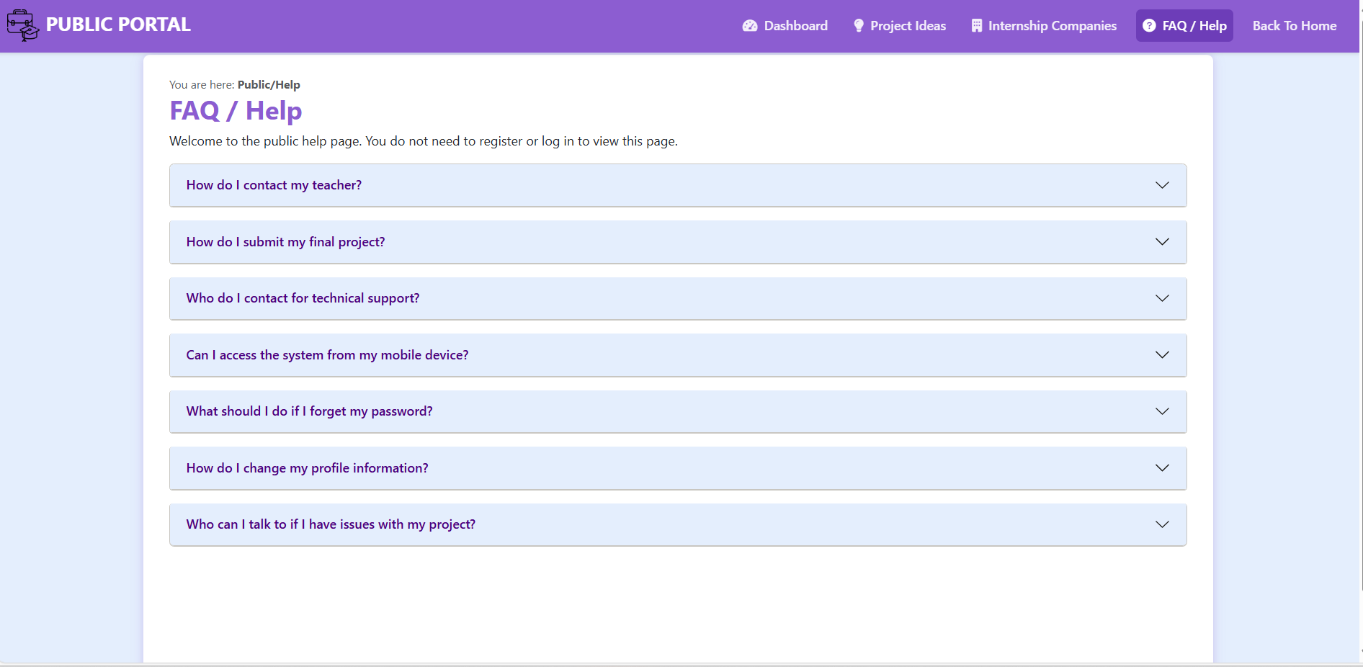
2.4 FAQ/HELP
Figure :FAQ/Help Page
26

Slide 27
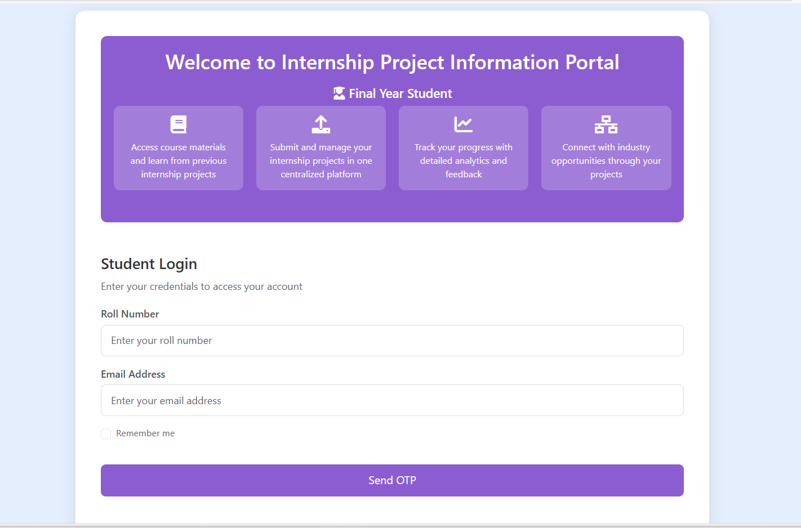
03
FINAL YEAR STUDENT PORTAL WORKFLOW
3.1 LOGIN PAGE
Figure: Student Login Page
27

Slide 28
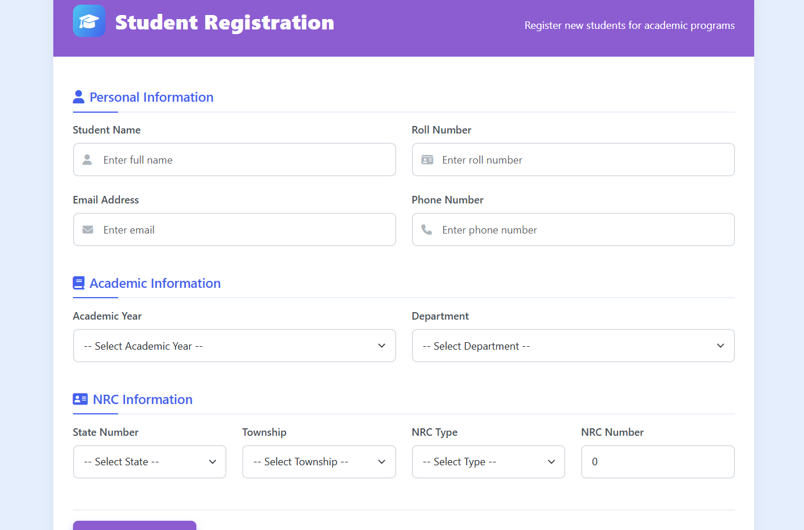
3.2 CREATE PROFILE
Figure: Create Profile Page
28

Slide 29
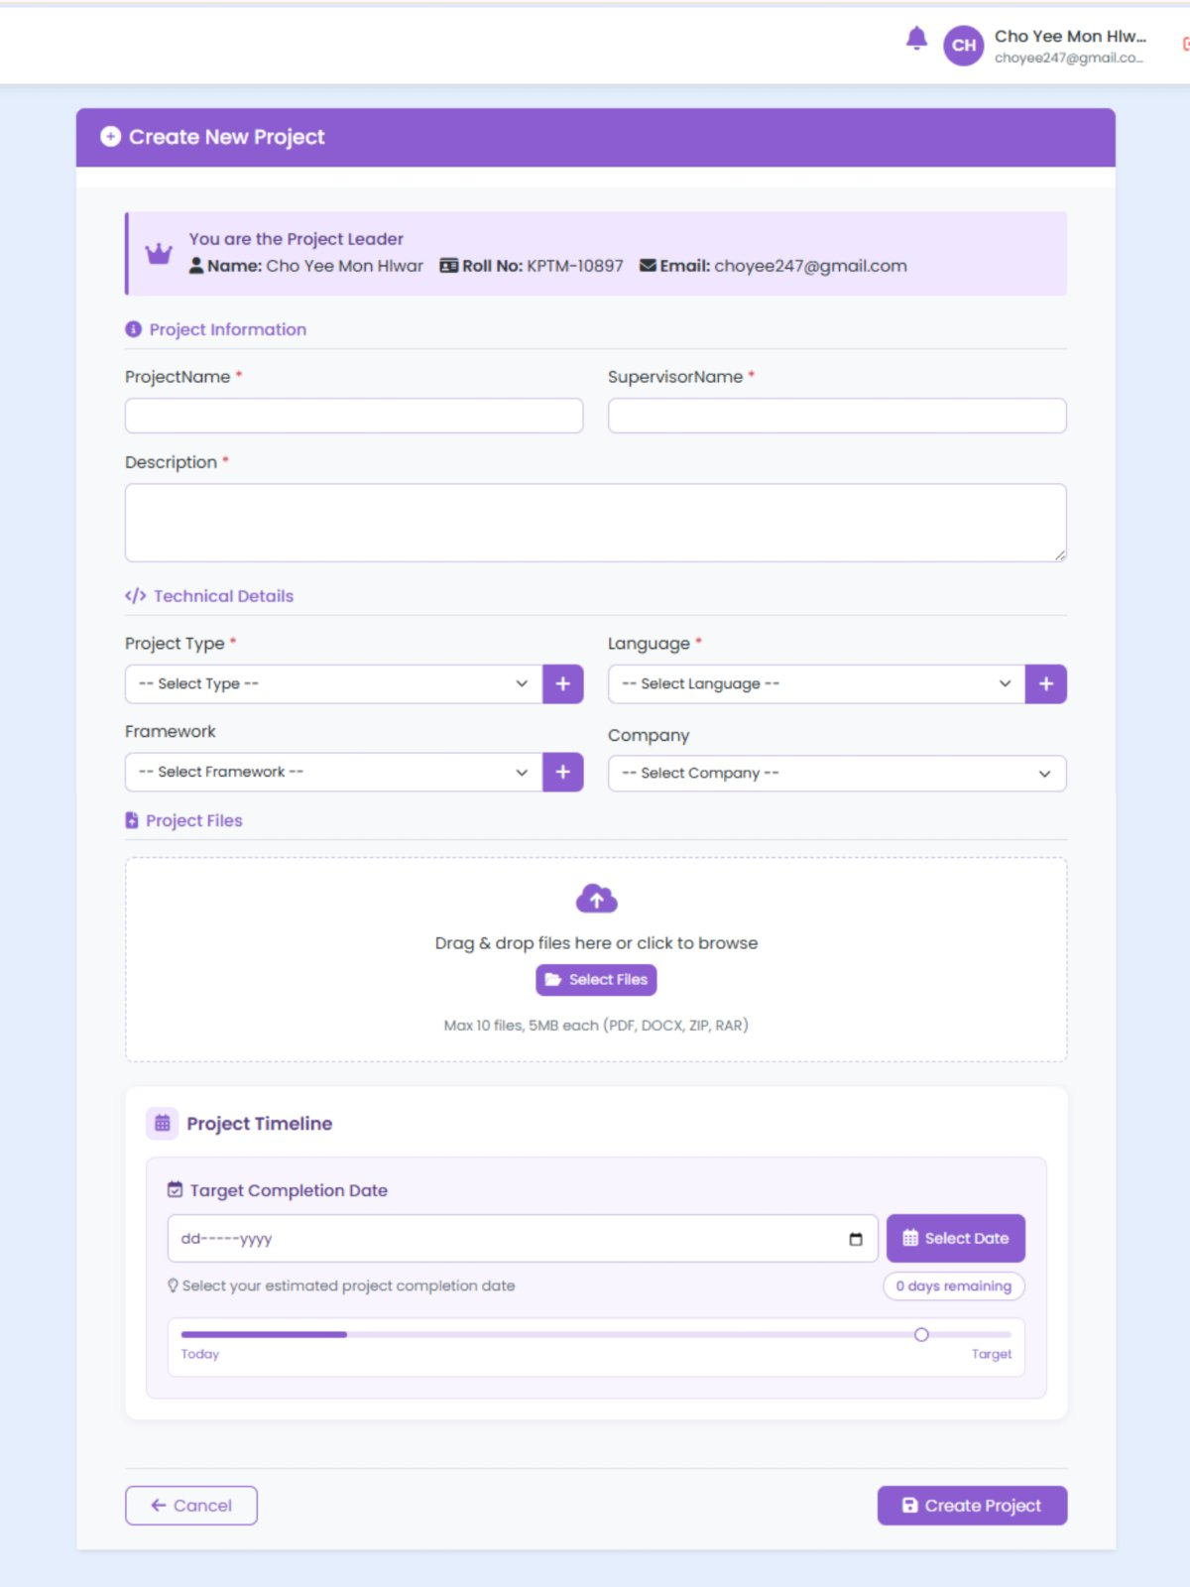
3.3 CREATE PROJECT
Figure: Create Project Page
29

Slide 30
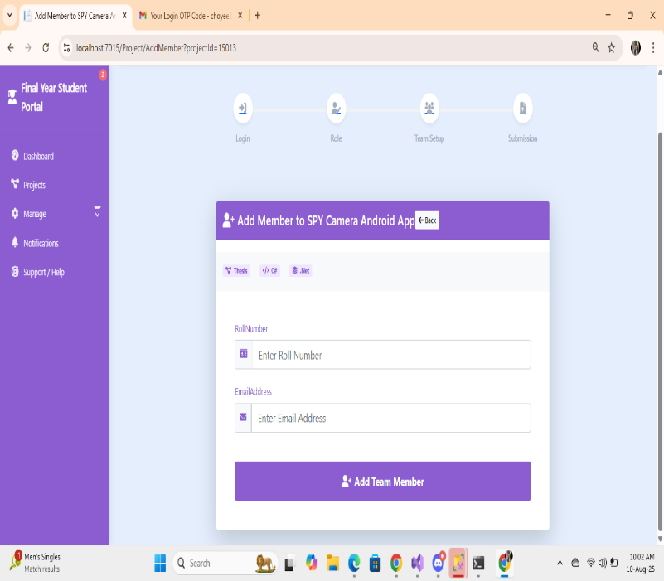
3.4 ADD MEMBER
Figure: Add Member Page
30

Slide 31
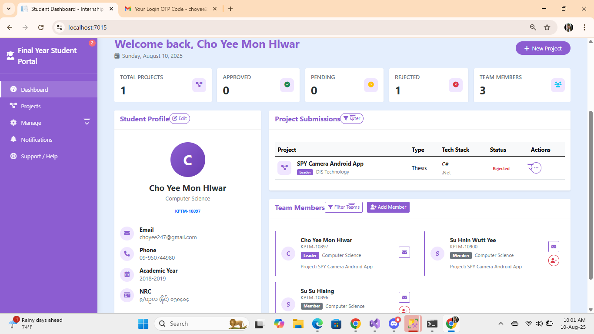
3.5 DASHBOARD
Figure: Dashboard Page
31

Slide 32
CONCLUSION
My internship was a very useful and meaningful experience.
I improved my skills, such as problem-solving, teamwork, and time management, and I also learned how to work in a professional environment.
The guidance from my seniors helped me grow and understand the industry better.
This internship has given me more confidence and has prepared me well for my future career.
32

Slide 33
THANK YOU FOR YOUR ATTENTION!
If you have any question , feel free to ask.
33

