Slide 1

UNIVERSITY OF COMPUTER STUDIES, (MANDALAY )
Internship Training and Project Presentation on
“Accomplished in D.I.S Technology Co,. Ltd ”
Date:12.8.2025
Supervised by
Daw Ohnmar Aung
Presented by
Su Su Hlaing KPTM-10896
Cho Yee Mon Hlwar KPTM-10897
Su Hnin Wut Yee KPTM-10900

Slide 2
OUTLINE OF PRESENTATION
INTRODUCTION
TRANING PROGRAM
BRIEF HISTORY OF D.I.S TECHNOLOGY Ct., Ltd
SWOT ANALYSIS
PRODUCT LINE
CONCLUSION

Slide 3
INTRODUCTION
This presentation covers the four main workflows of the Internship Project Information System.
It highlights the process flow for project management, public user access, final year student participation, and teacher administration.
Each workflow is explained clearly with key points for seamless understanding and implementation.
A web-based platform designed to manage internship and final year project processes.
Facilitates collaboration between students, teachers, and internship companies.
Centralizes project proposals, approvals, submissions, and internship placements.
Supports multiple user roles with tailored access for Students ,Teachers and Public Visitors

Slide 4
TRAINING PROGRAM
Learned how to design and develop a database to store internship and project details securely.
Gained practical skills in using ASP.NET Core MVC for building web-based management systems.
Collected ideas by reviewing multiple existing internship and project management platforms.
Improved teamwork and communication skills by collaborating with peers and industry partners during the project.

Slide 5
BRIEF HISTORY D.I.S TECHNOLOGY Ct., Ltd
D.I.S Technology Co., Ltd. was founded in 2009 as part of the PAG Group, driven by a vision to lead Myanmar’s digital transformation.
The company began with a small team and grew into one of the country’s top IT solution providers, serving both government and private sectors.
By earning multiple government recognitions, D.I.S became known for major projects like e-Driving License Systems, IRD Documentation Systems, and Banking Applications.
Today, the company has a strong workforce of 100+ talented professionals across software development, project management, and technical support.
You can contact D.I.S Technology at No.131, Strand Road, Thanlyin Township, Yangon, Tel: [Insert Number], Email: [Insert Email].

Slide 6
STRENGTH
D.I.S Technology Co., Ltd. was founded in 2009 as part of the PAG Group, driven by a vision to lead Myanmar’s digital transformation.
Use of latest technologies like C#, .NET Core MVC, React.js, and MSSQL.
Friendly and supportive work environment.
Strong teamwork and open communication culture.
Opportunities to work on real projects and apply knowledge practically.
Good mentorship from senior developers.

Slide 7
WEAKNESS
Workload varies, causing some downtime.
Limited involvement of interns in some projects.
Some processes and tools still developing and need improvement.
Limited opportunities for interns to participate in client-facing meetings.

Slide 8
OPPORTUNITIES
Chance to adopt and explore emerging tech like cloud computing or AI.
Potential to expand into mobile app development.
Growing local and international demand for custom software solutions.
Receive mentorship from experienced developers.
Improving internship programs to attract more talent.

Slide 9
THREATS
Economic instability might reduce project budgets
Strong competition from bigger IT companies and outsourcing firms
Infrastructure limitations sometimes cause delays in project delivery timelines.

Slide 10
PRODUCT LINE
The system manages internship projects, student profiles, and company details in one platform.
It supports role-based access for students and supervisors.
Includes features for project submission, progress tracking, and report generation.
Offers notification tools to remind users of important deadlines and tasks.

Slide 11
ABSTRACTS OF THE PROJECT
This project develops a web-based Internship Project Information System to manage internship workflows efficiently.
The system stores all internship-related data securely and provides easy access to authorized users.
It features dashboards, submission portals, progress monitoring, and report generation tools.
The system is built using ASP.NET Core MVC with a responsive design for desktop and mobile use.
By automating routine tasks, the system aims to improve administrative efficiency and user satisfaction.

Slide 12
AIM AND BENEFITS
Aim: To simplify and automate the internship project management process.
Aim: To provide a centralized platform for students, companies, and supervisors to collaborate effectively.
Benefit: Reduces paperwork and manual tracking errors.
Benefit: Enhances communication and transparency among all parties involved.
Benefit: Saves time and improves the overall internship experience for students and staff.

Slide 13
TOOLS AND TECHNOLOGY
ASP.NET Core MVC
Microsoft SQL Server
HTML5
CSS3
Bootstrap
Entity Framework Core
JavaScript
jQuery

Slide 14
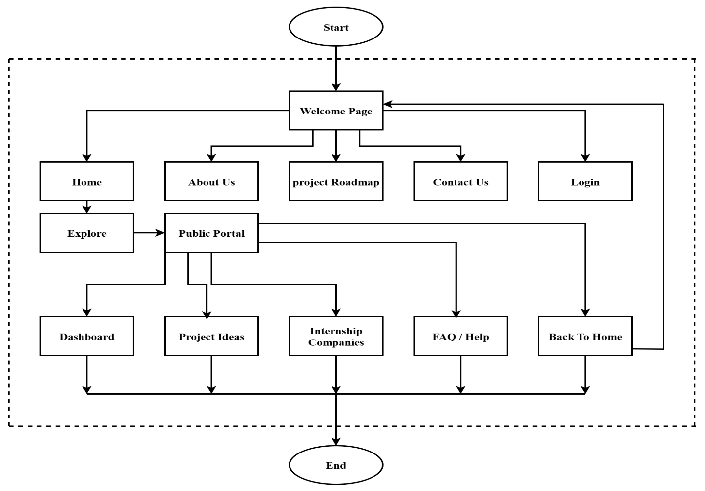
SYSTEM FLOW CHART FOR PUBLIC

Slide 15
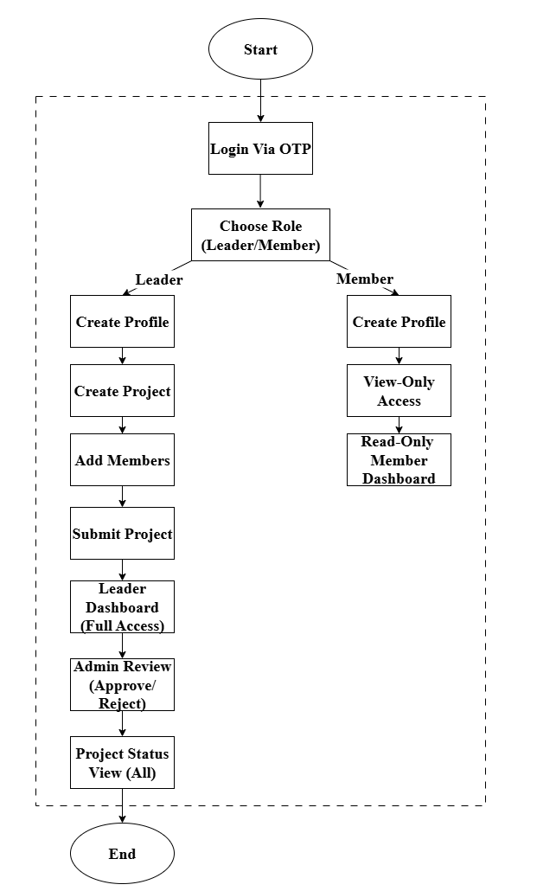
SYSTEM FLOW CHART FOR STUDENT

Slide 16
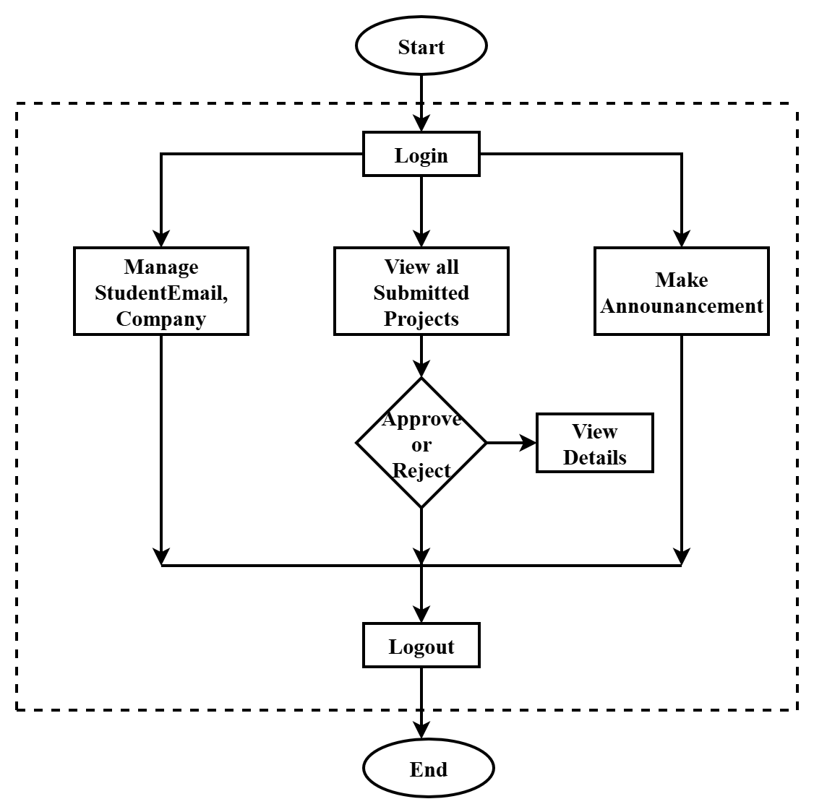
SYSTEM FLOW CHART FOR TEACHER

Slide 17
01
PROJECT WORKFLOW
The Internship Project Information System manages the complete lifecycle of student internship projects, connecting students, teachers, and companies through a centralized platform.
The workflow begins with students logging in via OTP authentication, where leaders create project profiles, add team members, and submit project details for approval.

Slide 18
1.1 PROJECT WORKFLOW
Teachers manage submissions, approvals or rejections for the project submitted by students.
Throughout the process, the system tracks project statuses and provides dashboards tailored to each user role, ensuring transparency and efficient communication.
Public users can browse approved projects and internship opportunities without needing to log in, making the system accessible and informative for all stakeholders.

Slide 19
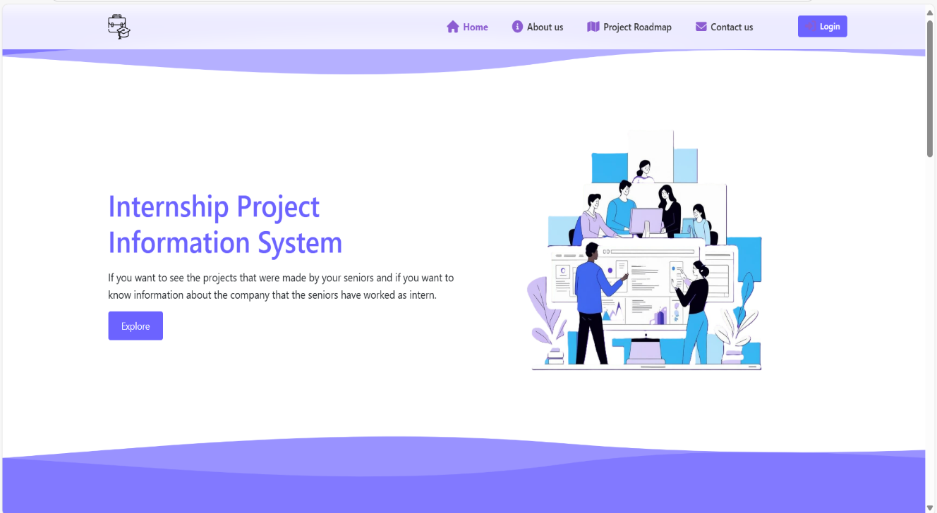
PUBLIC PORTAL (BEFORE LOGIN)
02
Figure : Welcome Page for public users

Slide 20
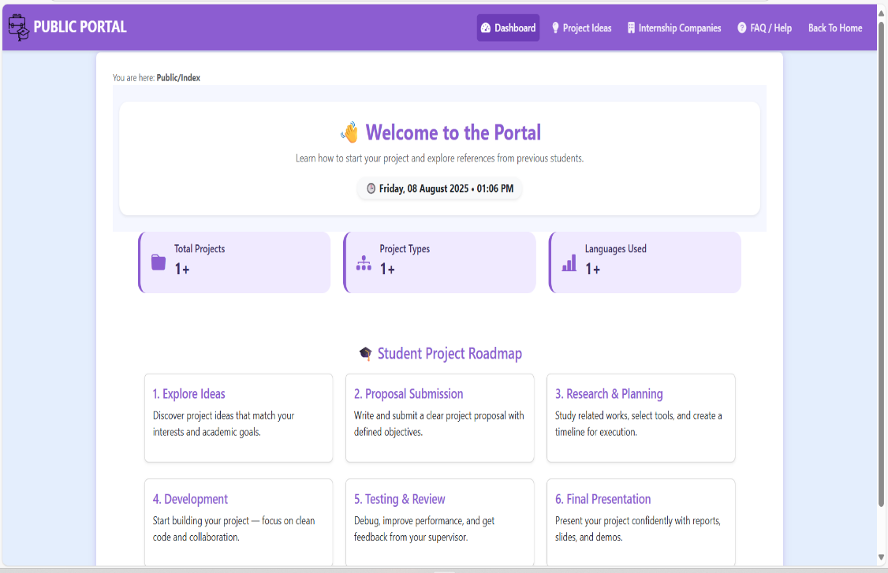
2.1 USER ACCESS AND NAVIGATION
Visitors access the system's Home Page without login, guided by a navigation bar to key areas like About, Projects, and Contact.
An “Explore” button leads to a public dashboard with general information and quick links.
Figure : Public Dashboard

Slide 21
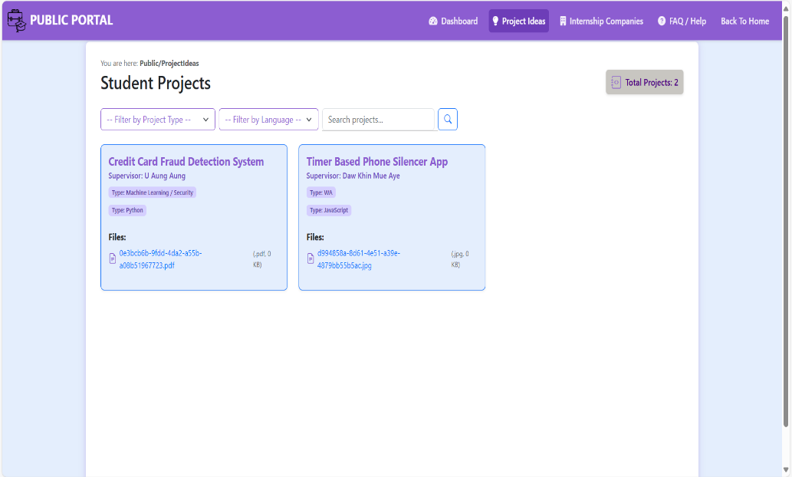
2.2 INFORMATION BROWSING
The public can view approved projects and internship companies, with options to filter and search relevant data.
Project ideas and company profiles are presented clearly to inspire and inform prospective students and visitors.
Figure :Student’s projects in project idea page

Slide 22
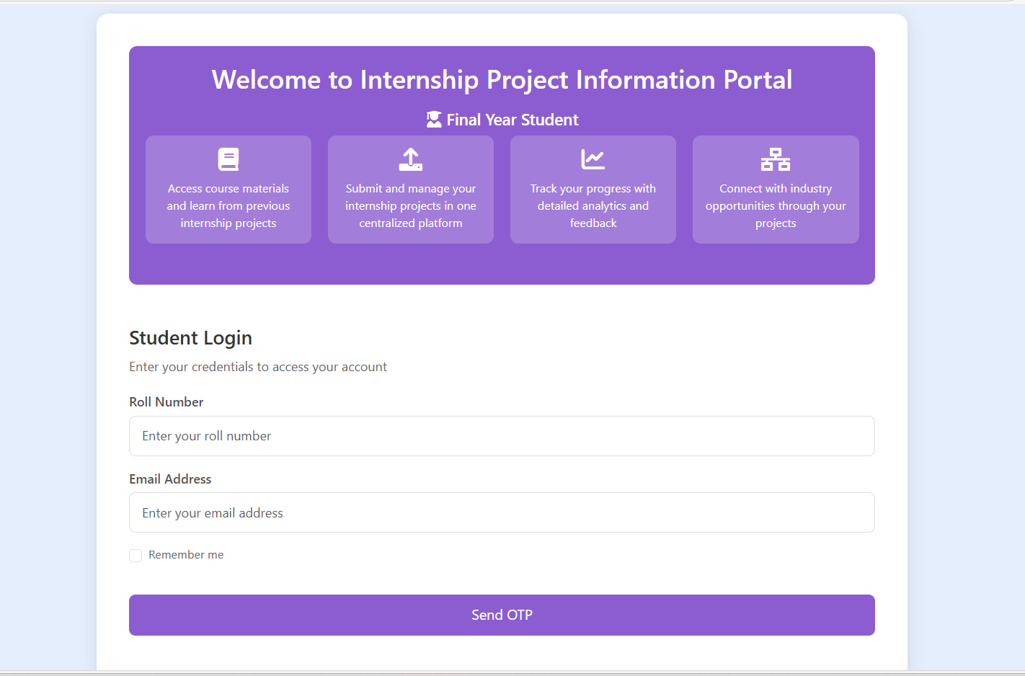
2.3 ACCESS RESTRICTION AND PROMPTS
Public users can browse general information freely, but to submit or manage projects, login is required.
The login uses an OTP system to verify student or teacher identity.
Access to member-only features is restricted until authentication, ensuring secure role-based permissions.
Figure : Student Login Form

Slide 23
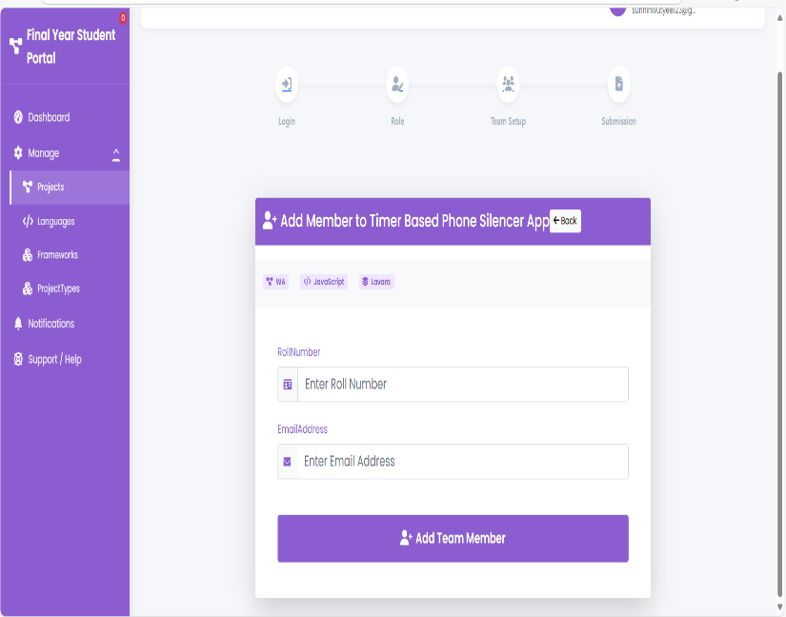
FINAL YEAR STUDENT PORTAL WORKFLOW
03
3.1 REGISTRATION AND SET UP
Students log in using their Roll Number and Email with OTP verification.
Leaders fill out personal and academic details and establish their profiles.
Members are added by Leaders and access the system with read-only privileges.
Figure: Student Login

Slide 24
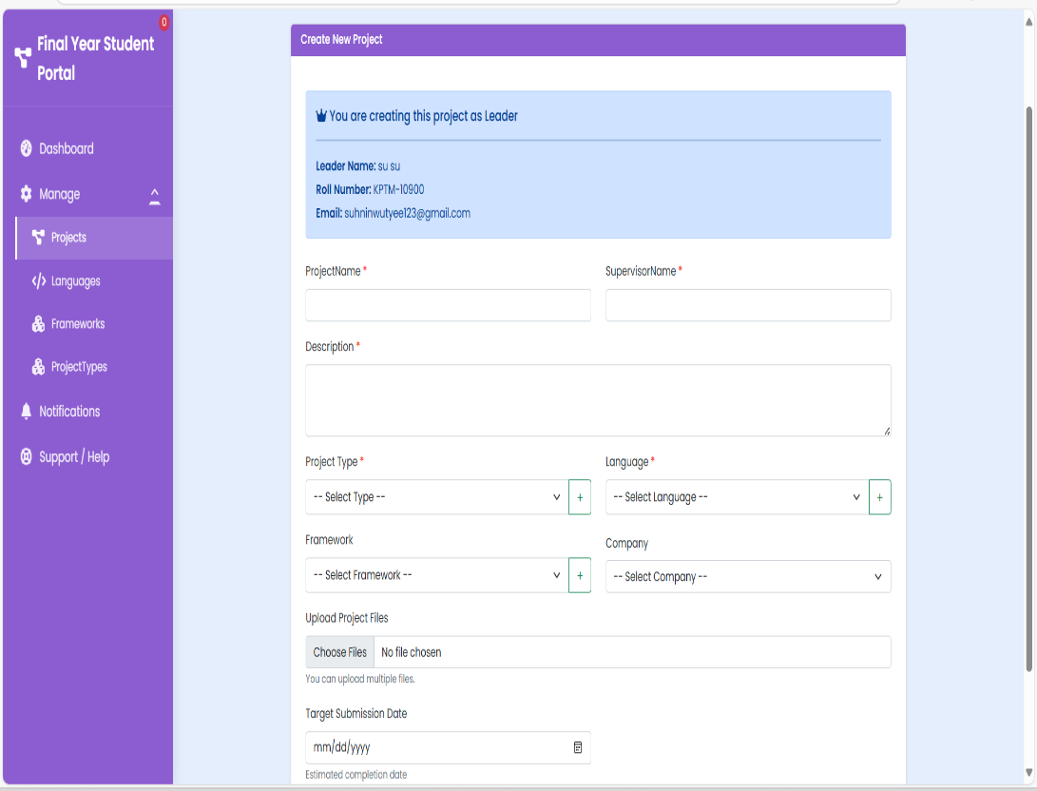
3.1 REGISTRATION AND SET UP
Leaders enter project details including title, description, supervisor, and technology stack.
Team members are added by entering Roll Numbers and Emails.
The project is submitted for approval, and its status updates to Pending.
Figure : Leader’s project submit form

Slide 25
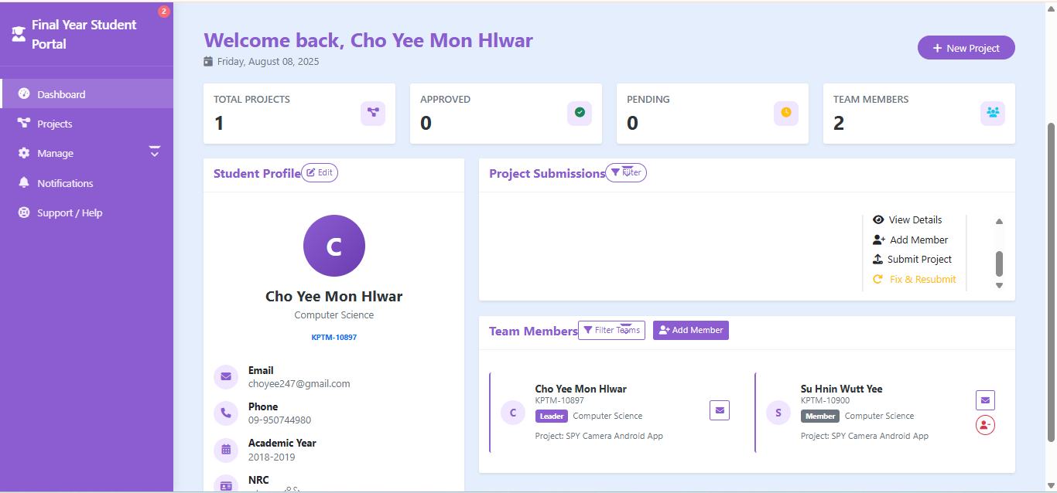
3.2 PROCESS TRACKING
Project status is visible to both Leaders and Members on their dashboards.
Students receive updates regarding approval or required changes.
This ensures everyone stays informed on project progression.
Figure : Student Dashboard

Slide 26
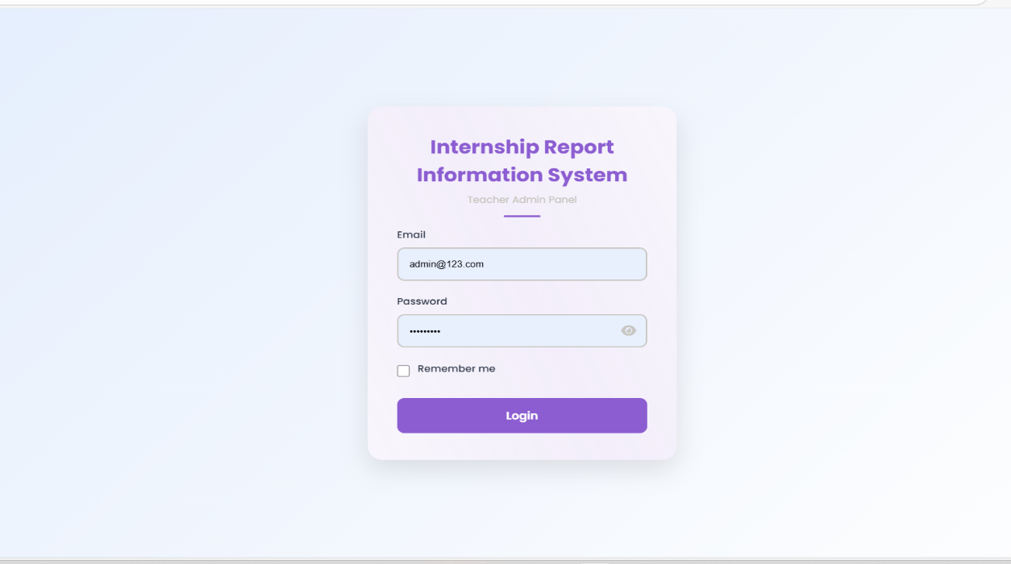
04
TEACHER PORTAL WORKFLOW(ADMIN)
Figure : Admin Login

Slide 27
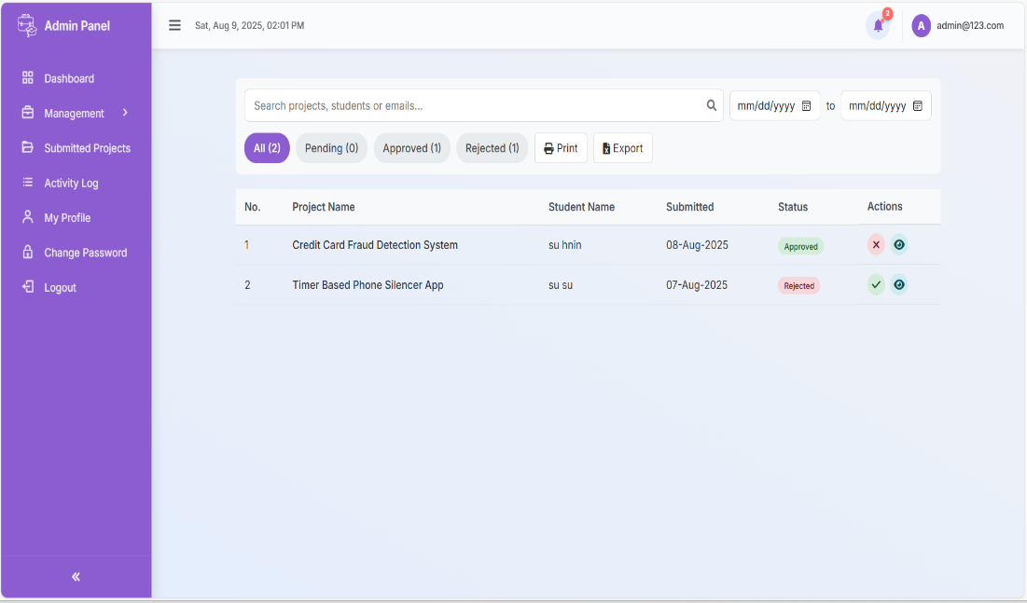
4.1 INTERNSHIP MANAGEMENT
Teachers log in via institutional credentials to access a dedicated dashboard.
They manage project approvals by reviewing submissions and changing project statuses.
Announcements about deadlines and critical information are posted for students.
Figure : Submitted project page

Slide 28
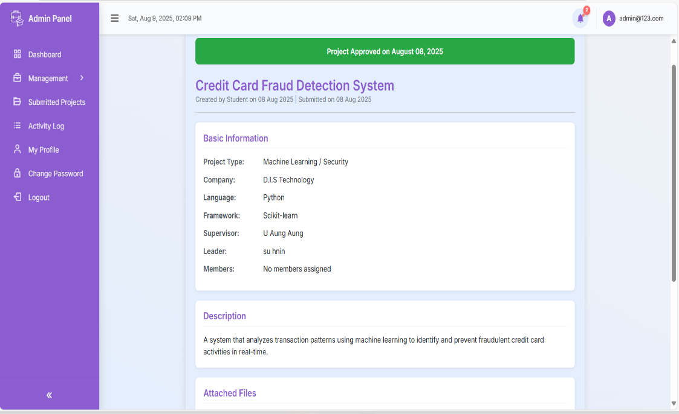
4.2 PROJECT MONNITORING AND ACCESSMENT
Teachers oversee student’s submitted project and role assignments.
They validate project details and monitor team compositions.
Notifications are sent to students regarding approval, rejection, or required revisions.
Figure : Project details

Slide 29
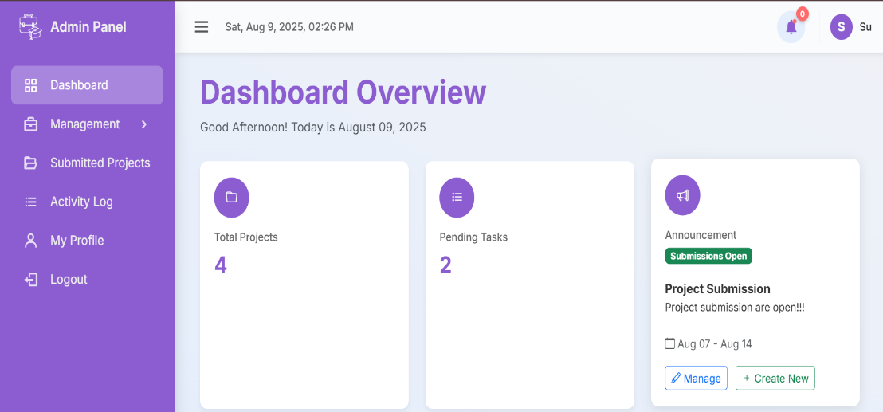
4.3 REPORTING AND COMMUNICATION
Teachers create official announcements to inform students about key dates.
Profile and password management options are available for administrative control.
Figure : Teacher Dashboard

Slide 30
CONCLUSION
The Internship Project Information System was created to make managing internships easier for students, teachers, and companies.
It helps keep all internship details in one place, makes tracking progress simple, and improves communication between everyone involved.
The system works well and can be improved in the future by adding more features like reports, mobile access, and job portal links.
Grateful for teacher Dr. Daw San San Tint and our team’s supervisor associated professor Daw Ohnmar Aung and all the teachers who attend and discuss in our presentation.

Slide 31
THANK YOU FOR YOUR ATTENTION!
If you have any question , feel free to ask.

