Slide 1
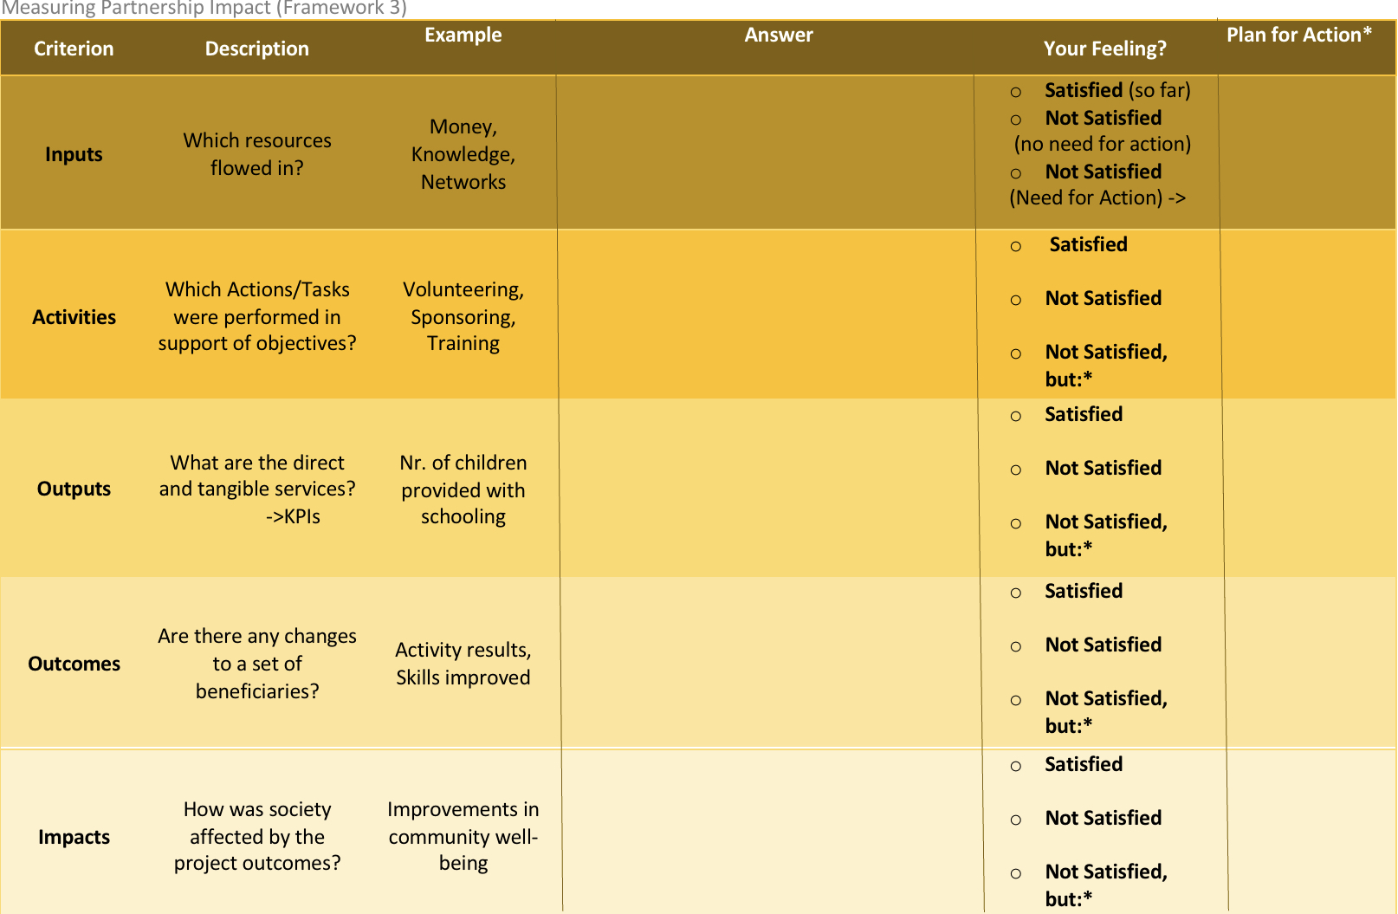

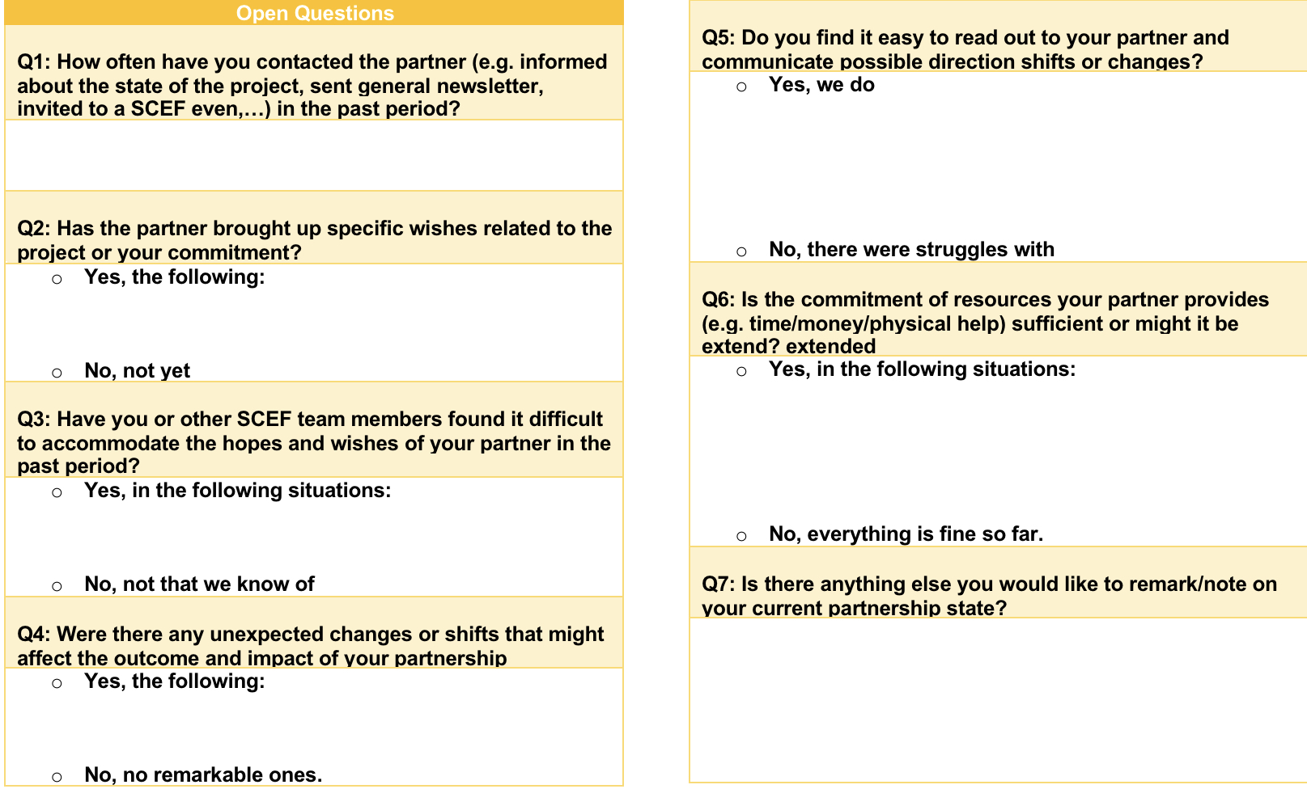
Evaluation & Continuation: Our Four-Step Framework
1
Inputs
Measurement
Activities
Track partnership
progress
Idea
Outputs
Use a short form with
progress prompts
Outcomes
Content
SCEF owner reviews it
at agreed intervals
Impact
Handling
Measuring Impact Form
Our Team
Recap: Problem Definition
Partnership Strategy
Implementation Frameworks
Implementation First Steps
Project Timeline

