Slide 1
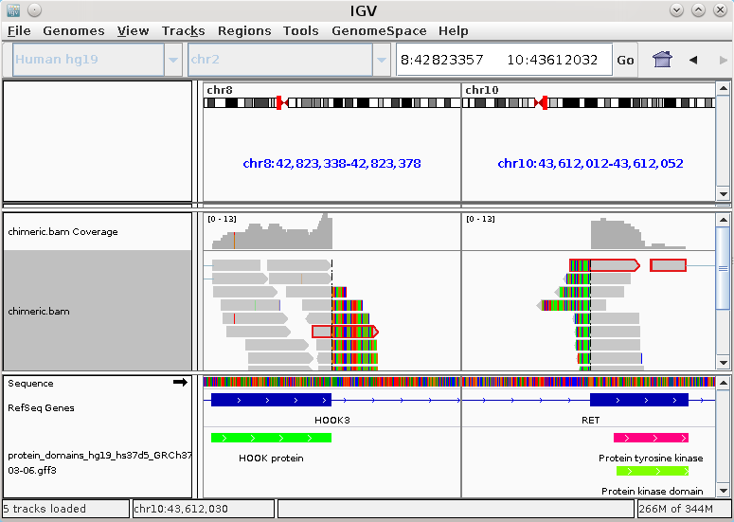
Paste both breakpoints
for side-by-side view.
Load Chimeric.out.sam
to inspect the supporting
reads of predicted fusions.
This read was highlighted
using IGV's “Select by name”
feature. It maps partially to
HOOK3 and to RET.
The protein domain annotation distributed with Arriba
reveals that the fusion retains the kinase domain.

