Slide 1
Dating Analysis using Python and Data Science techniques
Suhrit Venkatesh

Slide 2
Problem Statement
Spreadsheet ‘profiles.csv’ contains granular demographic information about a person’s age, height, income, hobbies etc.
Using this information, we are using data science techniques like regression to find correlation between the different variables
Some of the questions we are tying to answer include
Does a person’s age determine whether he is serious or skeptical of online dating?
Does Income play a role?

Slide 3
Mapping of descriptive columns to numbers
Drinks | Code
not at all | 0
rarely | 1
socially | 2
often | 3
very often | 4
desperately | 5
Smokes | Code
no | 1
sometimes | 2
when drinking | 3
yes | 4
trying to quit | 5
Did the same mapping for drugs

Slide 4
Data Wrangling
The spreadsheet gives us information of a person’s hobbies, likes, dislikes etc. Using Python, we combined all the data into a single field. This enabled us to calculate the length of the field, total number of words as well as average number of words.
The above information can be a useful guideline when compared with a person’s age and income level and helps answer the questions as to whether a person’s age or income level makes them less/more skeptical of online dating.
We also counted the number of times a person mentions “I” on their profile

Slide 5
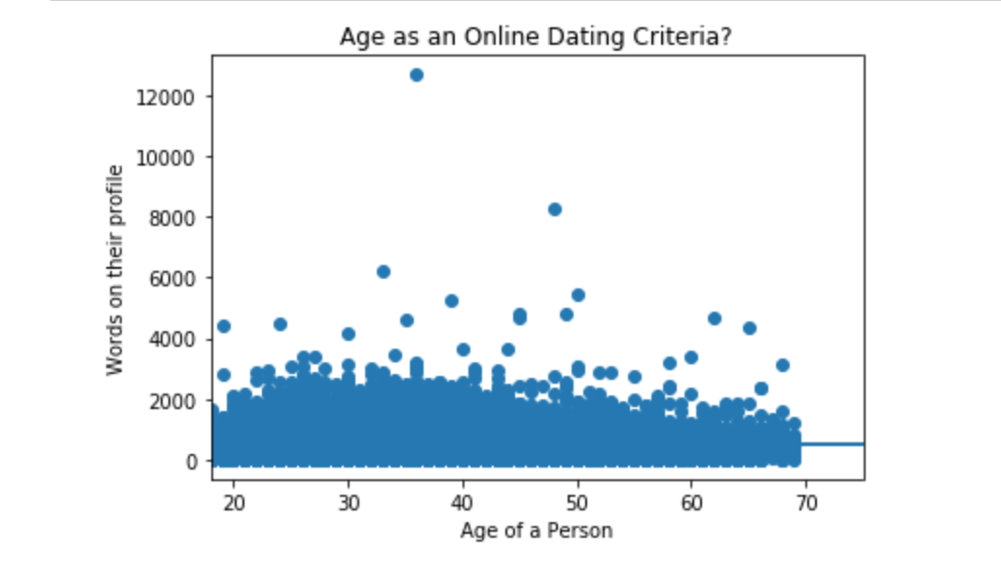
Does Age impact Online Dating interest?

Slide 6
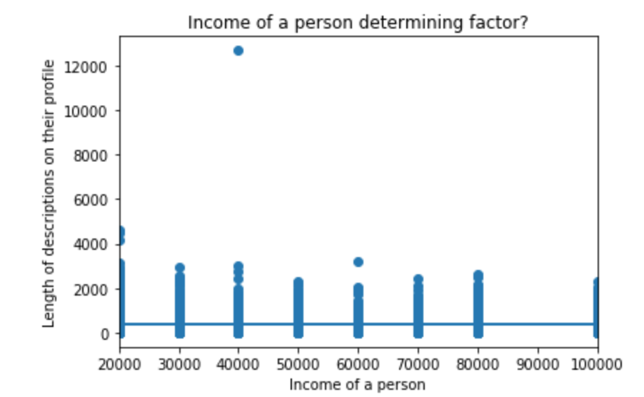
Income a factor?

Slide 7
Missing Information
One Crucial piece of information which would have been extremely useful to have is how frequently were women contacted and/or how quickly they respond. In addition, how many women are messaged by each man. Another piece of useful information would have been the reasons why men/women quite online dating. This would have been useful to determine the following questions?
Are women more/less active in Online Dating?
How many men message women on an average per day?
How long do profiles typically stay active on dating sites?
Why do men/women quit online dating?

