Slide 1

SMART INDIA HACKATHON 2026
GarudaTwin: Propulsion Intelligence for MALE UAV Engines
• Problem Statement ID – SIH26054
• Problem Statement Title – AI-Enabled Real-Time Digital Twin System for Health Monitoring, Fault Prediction and Mission Reliability Enhancement of Aero Piston Engines used in MALE UAVs
• Theme – Robotics and Drones
• PS Category – Software
• Team ID – 155188
• Team Name (Registered on portal) – GarudaAstra
⏱️ 1.5 s
🛡️ 0
🔁 947 / 947
AI names an injected
engine fault (demo run)
false alarms on 15,225
healthy test samples
AI decisions identical
on replay
Working prototype · every engine reading shown is simulated · measured on held-out simulated test data
Notes:
Title page per the SIH 2026 template. The three numbers are measured: AI naming time from the recorded demo run, false alarms from ai_health_rul/models/baseline_comparison.json, replay reproducibility from the recorded replay.

Slide 2
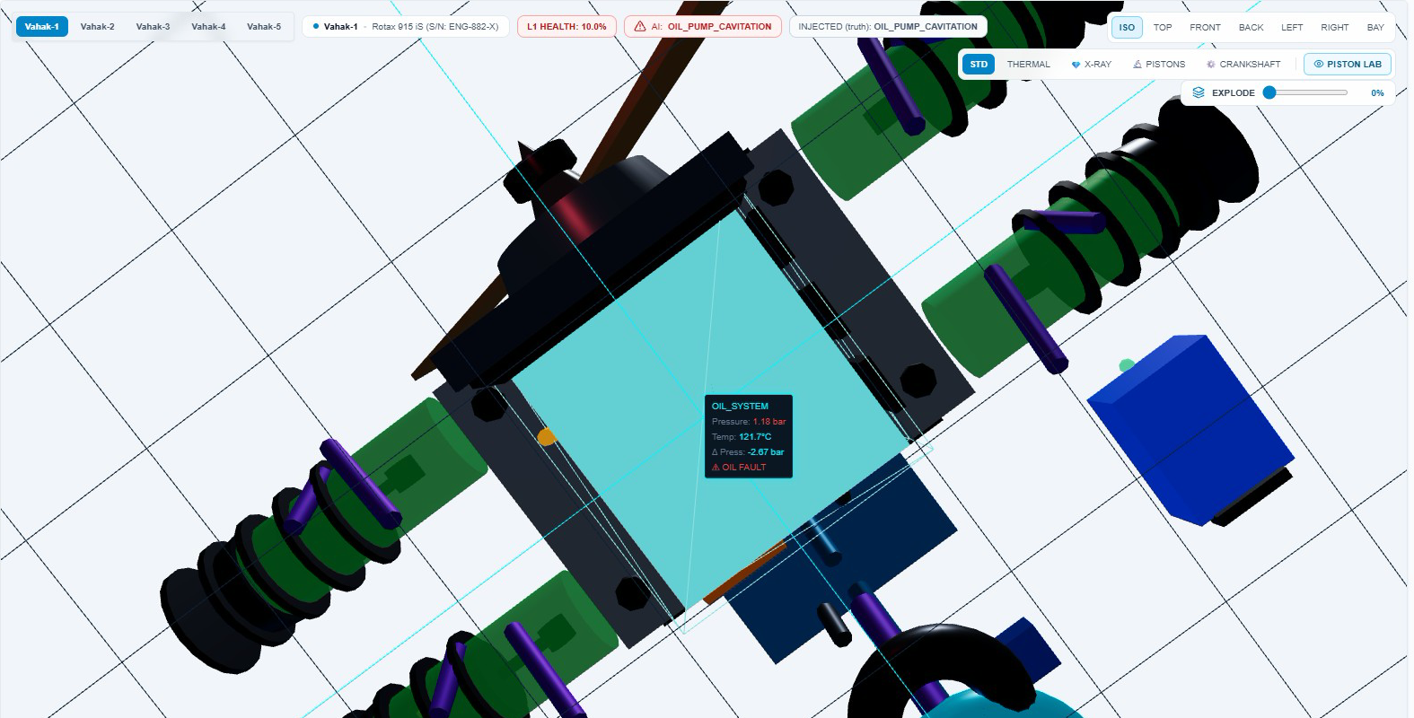
GarudaTwin: Propulsion Intelligence for UAV Engines
GarudaAstra
❖ Proposed Solution (Describe your Idea/Solution/Prototype)
One idea: a physics digital twin tells the AI what every engine reading should be.
Detailed explanation of the proposed solution
AI: oil-pump cavitation, named in 1.5 s
📡 25 readings
⚙️ Digital twin
📐 Residual
🧠 AI
🖥️ Operator
injected truth: hidden from AI
every second: temperatures, oil, fuel, vibration, electrical
physics gives the expected value of each reading
observed − expected = the deviation
detects it, names 1 of 11 faults, TreeSHAP shows why
sees the fault and its evidence; the operator decides
How it addresses the problem
The problem asks for
GarudaTwin's answer
Measured proof (simulated test data)
🩺 Health monitoring
Every reading checked against its expected value, every second
25 readings · lost data → NO DATA in 2 s
Working prototype: 3D engine twin during an injected oil-pump fault (simulated)
🔍 Fault prediction
Catches faults while still small, and names them
96 % of small faults (tuned limits: 37 %) · 11 faults, F1 0.98
🎯 Mission reliability
No false alarms; a lying sensor is not an engine alarm
0 false alarms / 15,225 healthy samples · drifting sensor → engine 99/100
Innovation and uniqueness of the solution
🧬 Physics + AI
every alert traces back to a measured deviation
🛡️ Sensor or engine?
CHT-2 +24 °C, EGT-2 within 1 °C → sensor drift
🔌 Real-data ready
CAN bus (DBC) and CSV through the same path
🔁 Checkable
truth hidden from the AI; replay 947/947 identical
Twin expects 3.85 bar, sensor reads 1.67 bar → residual −2.2 bar. Most consistent with oil-pump cavitation; a sensor fault or model error is also possible, so the evidence stays on screen.
● WORKING PROTOTYPE · ALL ENGINE DATA SHOWN IS SIMULATED
Notes:
Chart: recorded simulated run (demo/backup_sortie.csv), seconds from fault onset; observed mean 1.67 bar vs expected 3.85 bar (10-35 s). Small-fault recall: baseline_comparison.json recall_by_severity 0.05-0.15 (A2 tuned limits 37.1 %, C twin+AI 96.0 %). 11 fault classes + healthy: model_card.json. Sensor drift values: recorded demo frames (CHT-2 +23.3 to +24.6 C, EGT-2 within 1 C, AI health 99/100).

Slide 3
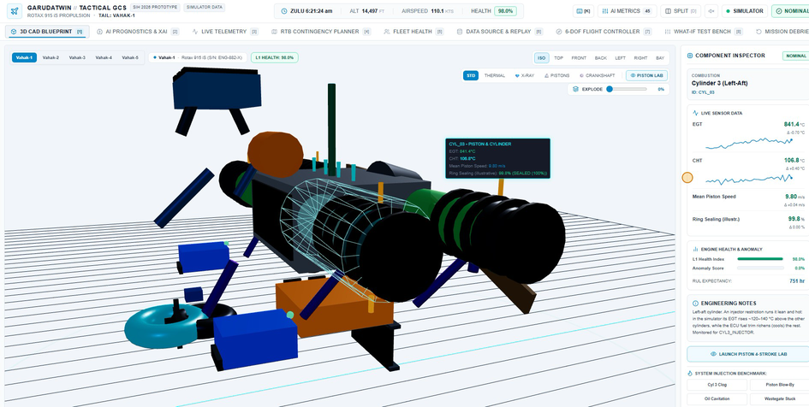
TECHNICAL APPROACH
GarudaAstra
Technologies to be used (e.g. programming languages, frameworks, hardware)
Methodology and process for implementation (Flow Charts/Images/ working prototype)
🖥️ Ground-station UI
📡 ① Engine data
🔌 ② Gateway
⚙️ ③ Golden twin
React
Vite
Three.js
Tailwind CSS
Leaflet
Simulator · CAN bus (DBC) · recorded CSV: one path, 25 channels.
CAN virtual rig: 67/67 frames accepted.
Range & time checks; 20 Hz to the screen.
No frame for 2 s → NO DATA, never NOMINAL.
Physics model with thermal lag.
Throttle, RPM, altitude, air temp → expected value of every reading.
🔌 Gateway & recorder
✓ DEMONSTRATED
✓ DEMONSTRATED
✓ DEMONSTRATED
Node.js
Express
Socket.IO
SQLite
🖥️ ⑥ Operator GCS
🧠 ⑤ Explainable AI
📐 ④ Residuals
🧠 AI service
3D twin, evidence table, fleet, what-if, RTB planner.
Advice only: the operator decides.
Mahalanobis anomaly detector (Ledoit-Wolf).
XGBoost names 1 of 11 faults; TreeSHAP shows why.
observed − expected, every reading.
→ 45 features incl. 8-sample means.
Python
FastAPI
XGBoost
scikit-learn
NumPy · pandas
✓ DEMONSTRATED
✓ DEMONSTRATED
✓ DEMONSTRATED
📡 Engine bus
CAN bus
DBC · cantools
python-can
🗄️ Flight recorder & replay
Every flight saved (SQLite) with the samples the AI scored; any flight or CSV can be replayed.
947 / 947 decisions identical on replay
🧪 AI training & testing
378,618 simulated samples · 5,400 episodes · 12 classes
Split by episode 70/15/15: scored only on episodes never seen in training
Macro F1 0.98 (fault naming)
💻 Hardware
Laptop (today)
USB-CAN adapter (next)
Working prototype: 3D twin + component inspector (expected vs observed)
● WORKING PROTOTYPE · ALL ENGINE DATA SHOWN IS SIMULATED
Notes:
Technologies from package.json and requirements.txt (PyTorch only powers a legacy endpoint not used by the GCS, so it is not listed). Anomaly detector: Mahalanobis distance with Ledoit-Wolf covariance, 2-sample persistence (model_card.json). Not in the demo: automatic return-to-base or flight control. In progress: remaining-life estimate (research).

Slide 4
FEASIBILITY AND VIABILITY
GarudaAstra
Analysis of the feasibility of the idea
🪜 Readiness ladder
✅ Runs today
🧪 7 test suites
📊 378,618
🔌 67 / 67
Simulation
✓ done
Live CAN path (virtual rig)
✓ done
Full loop on one laptop:
data → twin → AI → screen
automated tests pass on
a clean install
simulated training samples,
5,400 episodes
CAN frames accepted from
the virtual rig (DBC decode)
Engine test bench
→ next
Flight logs
→ next
💰 Economic: open-source stack, no licence cost; runs on a laptop; a USB-CAN adapter is the only new hardware.
Fleet trial
→ later
Potential challenges and risks
Strategies for overcoming these challenges
⚠️ No real engine fault data yet – all results are on simulated data
✅ Engine test-bench and flight logs; calibrate the twin per engine; repeat the same comparison on real data
⚠️ Uncalibrated sensors – stress test: fault-naming F1 falls 0.98 → 0.50
✅ Calibrate on each engine's healthy runs; sensor cross-checks; train with offset variety
⚠️ Twin constants are engineering assumptions – public specs, not yet validated
✅ Fit the constants from test-bench runs; keep data-quality and NO DATA checks
⚠️ Operator trust in an AI – a wrong call must never act on its own
✅ Evidence on screen, truth hidden from the AI, operator decides; nothing automatic
⚠️ Remaining life needs failure-progression data
✅ Kept as research until run-to-failure or maintenance records exist
● WORKING PROTOTYPE · ALL ENGINE DATA SHOWN IS SIMULATED
Notes:
7 test suites: test_data_source, test_fleet, test_gateway_security, test_geofence (Node) and test_ai, test_api, test_complete_ai_physics (Python), passed on the fresh-install test. Stress test: model_card.json stress_test_nuisance_offsets (fault_classifier macro F1 0.5036). 67/67 frames: CAN bridge log from the demo recording.

Slide 5
IMPACT AND BENEFITS
GarudaAstra
📈 Measured: same 810 held-out simulated test episodes for every method
48,920 test samples (15,225 healthy) · an alarm needs 2 consecutive samples · simulator results, not yet real-engine results
FALSE ALARMS ON HEALTHY ENGINES
Method
Faults caught
Small faults (5–15 %)
False alarms
Names it
2,110 → 0
Fixed limits (hand-set)
26.3 %
20 %
2,110
No
Limits tuned on healthy data
68.3 %
37 %
137
No
SMALL FAULTS CAUGHT
37 % → 96 %
+ physics twin
93.1 %
90 %
5
No
tuned fixed limits → physics twin + AI, and it names the fault
+ AI = GarudaTwin
96.5 %
96 %
0
Yes (F1 0.98)
Potential impact on the target audience
Benefits of the solution (social, economic, environmental, etc.)
🛩️
UAV operators: an earlier, explained warning; a lying sensor is not an engine alarm; lost data is never shown as healthy
🛡️ Social / safety
💰 Economic
fewer engine-related aircraft losses; explained alerts operators can trust
maintain on condition; avoid needless part removals and aborted sorties
🔧
Maintenance teams: the residual pattern shows where to look first; every flight can be replayed and checked
🌱 Environmental
🏗️ Strategic
🎯
Mission planners: fewer missions lost to false alarms; route options stay advice, the operator decides
fewer wasted parts, less fuel burnt on repeat test flights
open, explainable engine-health tool built in India for Indian UAV fleets
Expected benefits; to be confirmed on real engine data.
● WORKING PROTOTYPE · ALL ENGINE DATA SHOWN IS SIMULATED
Notes:
All figures from ai_health_rul/models/baseline_comparison.json (training/baseline_comparison.mjs). Small faults = severity 0.05-0.15 recall. Tuned limits: each reading limited at its highest value on healthy validation samples.

Slide 6


RESEARCH AND REFERENCES
GarudaAstra
Details / Links of the reference and research work
13 verified sources, mapped onto the six ISO 13374 condition-monitoring blocks
DA Engine data
DM Golden twin
SD Residual check
HA Fault diagnosis
PA Remaining life
AG Explain & advise
ENGINE-CLASS BASELINE (MALE UAV)
Nugroho, R. C. et al. (2023)
Performance simulation of Rotax 915iS PUNA MALE engine using AVL Boost
AIP Conf. Proc. 2981, 020013
doi:10.1063/5.0184501
THE DIGITAL-TWIN CONCEPT
Glaessgen, E. & Stargel, D. (2012)
The Digital Twin Paradigm for Future NASA and U.S. Air Force Vehicles
53rd AIAA SDM Conference
doi:10.2514/6.2012-1818
RESIDUAL = OBSERVED − MODEL
Isermann, R. (2005)
Model-based fault-detection and diagnosis – status and applications
Annual Reviews in Control 29(1), 71–85
doi:10.1016/j.arcontrol.2004.12.002
FAULT CLASSIFIER
Chen, T. & Guestrin, C. (2016)
XGBoost: A Scalable Tree Boosting System
ACM SIGKDD (KDD '16), 785–794
doi:10.1145/2939672.2939785
SIMULATED RUN-TO-FAILURE (NASA)
Saxena, A. et al. (2008)
Damage propagation modeling for aircraft engine run-to-failure simulation
Int. Conf. Prognostics & Health Mgmt. (PHM)
doi:10.1109/PHM.2008.4711414
TreeSHAP: WHY THE AI DECIDED
Lundberg, S. M. et al. (2020)
From local explanations to global understanding with explainable AI for trees
Nature Machine Intelligence 2(1), 56–67
doi:10.1038/s42256-019-0138-9
CAN BUS: OUR LIVE INPUT
ISO 11898-1:2024
Road vehicles — Controller area network (CAN) — Part 1: Data link layer
International standard (current edition)
iso.org/standard/86384
ONLINE TWIN ON A UAV ENGINE
Peng, C.-C. & Chen, Y.-H. (2024)
Fixed-Wing UAV Rotary Engine Anomaly Detection via Online Digital Twin Methods
IEEE Trans. Aerosp. Electron. Syst. 60(1)
doi:10.1109/TAES.2023.3329797
ANOMALY SCORE · INDIAN SCIENCE
Mahalanobis, P. C. (1936)
On the generalised distance in statistics
Reprinted in Sankhyā A 80(S1), 2018
doi:10.1007/s13171-019-00164-5
+ Ledoit & Wolf (2004) covariance
PISTON-ENGINE FAULT SIGNS
Miljković, D. (2019)
Detecting Aircraft Piston Engine Problems by Analysis of Engine Parameters
MIPRO 2019, 937–942
doi:10.23919/MIPRO.2019.8757079
⏳ OUR STATUS
Research in progress, not claimed.
Remaining life needs real failure-progression data; the twin and AI above do not depend on it.
THE 6-BLOCK CHAIN ABOVE
ISO 13374-1:2003
Condition monitoring and diagnostics of machines — Data processing, communication and presentation
International standard, Part 1
iso.org/standard/21832
⚙️ Engine facts: BRP-Rotax official data
Rotax 915 iS: 1,352 cm³ · 104 kW (141 hp) take-off · 2.54 reduction gearbox · max operating altitude 23,000 ft
→ Our dataset spans 0–23,000 ft: the engine's whole published altitude range.
flyrotax.com/products/915-is-a-isc-a
Twin constants beyond these specs are documented engineering assumptions; calibrating them on a real engine is our next step.
➕ What GarudaTwin adds to this research
📦 Code
🗄️ Datasets
🧠 Names the fault, shows its evidence (piston engine, 11 faults)
🛡️ Lying sensor ≠ sick engine (sensor-vs-engine check)
🔌 Silence is never healthy (NO DATA within 2 s)
📉 False alarms 2,110 → 0 vs simple limits (simulated test data)
GitHub: code, tests, model card
github.com/suhruthsai/
GarudaTwin-Propulsion-Intelligence
Google Drive: all data + dataset card
drive.google.com/drive/folders/
1NzgCeVztNYcLeIkrnXkrBK1E8dtIl7Up
● WORKING PROTOTYPE · ALL ENGINE DATA SHOWN IS SIMULATED
Notes:
13 sources: 10 peer-reviewed works (DOIs verified on Crossref), ISO 11898-1:2024 and ISO 13374-1:2003 (iso.org), and the BRP-Rotax 915 iS official data page. ISO 13374 defines six processing blocks: data acquisition, data manipulation, state detection, health assessment, prognostic assessment, advisory generation; GarudaTwin's stages map onto them. P. C. Mahalanobis founded the Indian Statistical Institute. Remaining-life (PA) is research in progress and not claimed.

