Slide 1
App进程
frameworks/base/media/java/android/media/
AudioTrack.java
frameworks/base/media/java/android/media/
AudioRecord.java
frameworks/base/media/java/android/media/
AudioManager.java
frameworks/base/core/java/com/android/server/audio/
AudioService.java
frameworks/base/media/java/android/media/
AudioSystem.java
frameworks/base/core/jni/
android_media_AudioTrack.cpp
frameworks/base/core/jni/
android_media_AudioRecord.cpp
frameworks/base/core/jni/
android_media_AudioSystem.cpp
frameworks/av/media/libaudioclient/
AudioTrack.cpp
frameworks/av/media/libaudioclient/
AudioRecord.cpp
frameworks/av/media/libaudioclient/
AudioSystem.cpp
SystemServer进程
AudioServer进程
frameworks/av/services/audioflinger/
AudioFlinger.cpp
frameworks/av/services/audiopolicy/service/
AudioPolicyService.cpp
frameworks/av/media/libaudiohal/impl/
DeviceHalHidl.cpp
frameworks/av/media/libaudiohal/impl/
StreamHalHidl.cpp
frameworks/av/media/libaudiohal/impl/
StreamHalHidl.cpp
AudioHal进程
vendor/qcom/opensource/audio-hal/primary-hal/hal/
AudioDevice.cpp
vendor/qcom/opensource/audio-hal/primary-hal/hal/
AudioStream.cpp
vendor/qcom/opensource/audio-hal/primary-hal/hal/
AudioStream.cpp
hardware/libhardware/include/hardware/
audio.h
hardware/libhardware/include/hardware/
audio.h
hardware/libhardware/include/hardware/
audio.h

Slide 2
AudioTrack.cpp
AudioRecord.cpp
mAudioTrack
mAudioRecord
IAudioTrack
IAudioRecord
AudioFlinger
mAudioHwDevs
mPlaybackThreads
mRecordThreads
BnAudioTrack
BnAudioRecord
AudioFlinger.TrackHandle
AudioFlinger.RecordHalInterface
mTrack
mRecordTrack
AudioFlinger.PlaybackThread.Track
AudioFlinger.PlaybackThread
AudioFlinger.RecordThread
AudioFlinger.RecordThread.RecordTrack
mTracks
mOutput
mTracks
mInput
AudioStreamOut
AudioHwDevice
AudioFlinger.AudioStreamIn
audioHwDev
stream
mHwDevice
audioHwDev
stream
StreamOutHalInterface
DeviceHalInterface
StreamInHalInterface
Notes:
DefaultKeyedVector<audio_module_handle_t, AudioHwDevice*> mAudioHwDevs;
DefaultKeyedVector< audio_io_handle_t, sp<PlaybackThread> > mPlaybackThreads;
DefaultKeyedVector< audio_io_handle_t, sp<RecordThread> > mRecordThreads;
这段代码定义了一个名为mPlaybackThreads的DefaultKeyedVector，它的键类型为audio_io_handle_t，值类型为sp<PlaybackThread>。DefaultKeyedVector是Android中的一个容器类，类似于C++中的map，它可以存储键值对，并且可以通过键来快速查找值。在这里，mPlaybackThreads用于存储音频输出设备的句柄(audio_io_handle_t)和对应的PlaybackThread对象的智能指针(sp<PlaybackThread>)。通过mPlaybackThreads，可以方便地管理和查找不同音频输出设备对应的PlaybackThread对象。
AudioStreamOut *mOutput;
AudioStreamIn *mInput;

Slide 3
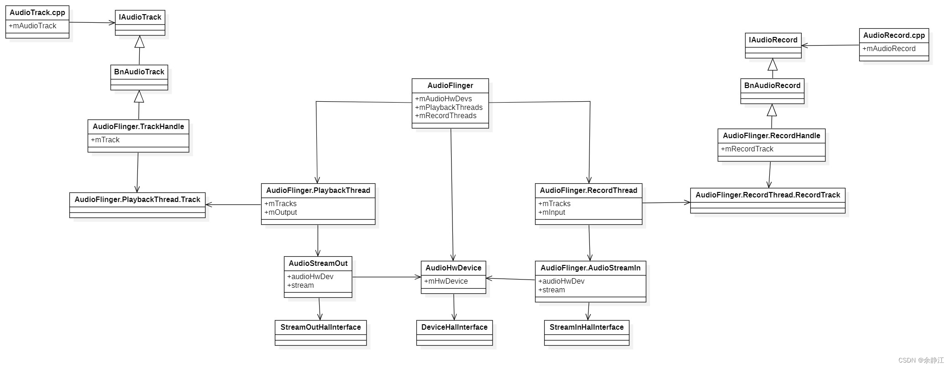

Slide 4
ProductStrategy
StreamType
VolumeGroup
AudioAttributes
deviceCategory
VolumeCurve
CurvePoint

Slide 5
SDP
RFCOMM
TCS
Audio
LMP
L2CAP
Voice
Baseband
ACL
SCO/eSCO
PCM

Slide 6
ATB111X
BROM
SPI bus
spinor
Flash
Loader-A
Addr:0x0
Loader-B
Addr:0x1000
APP-A
APP-B
NVRAM
Factory
NVRAM
User

