Slide 1
ANALYZE USER’S REQUIREMENT
Use Case Diagrams for:
Backend
Frontend

Slide 2
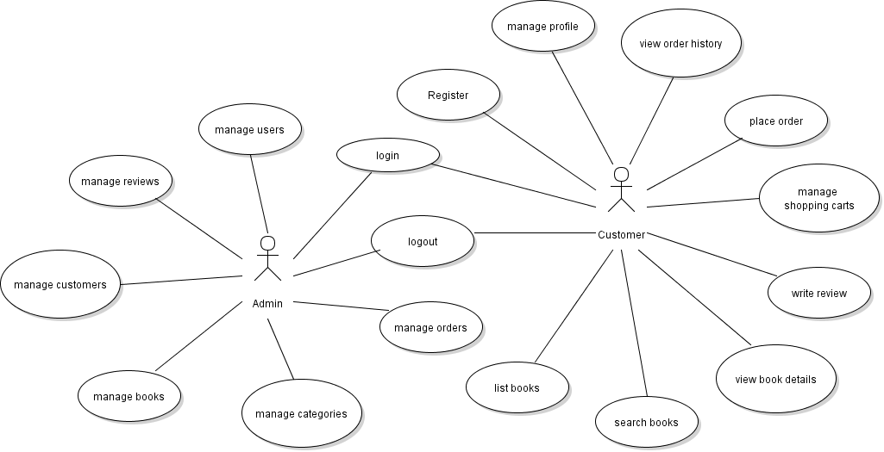
Overview Use Cases
BACKEND
FRONTEND

Slide 3
USE CASE DIAGRAMS FOR BACKEND

Slide 4
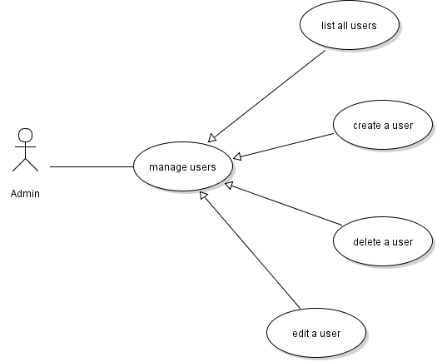
User Management Use Cases

Slide 5
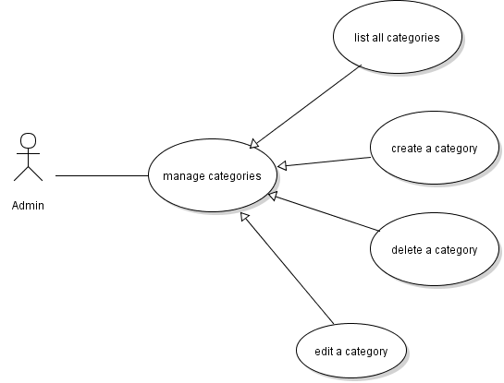
Category Management Use Cases

Slide 6
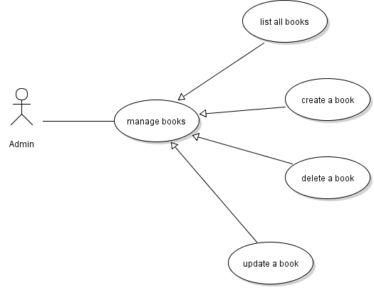
Book Management Use Cases

Slide 7
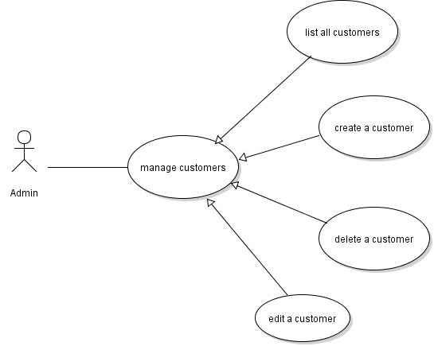
Customer Management Use Cases

Slide 8
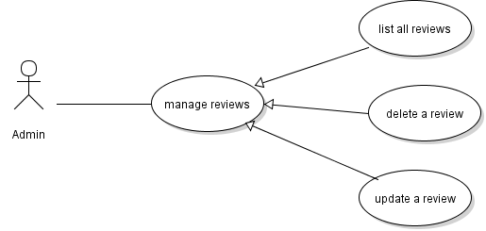
Review Management Use Cases

Slide 9
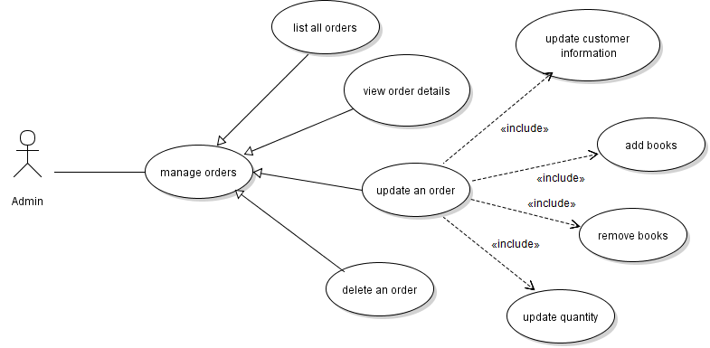
Order Management Use Cases

Slide 10
USE CASE DIAGRAMS FOR FRONTEND

Slide 11
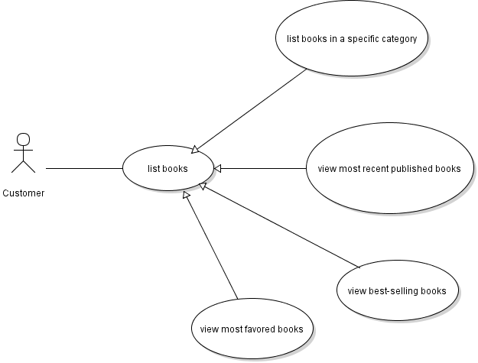
LIST BOOKS USE CASES

Slide 12
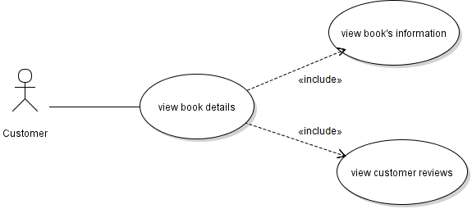
VIEW BOOK’S DETAILS USE CASE

Slide 13
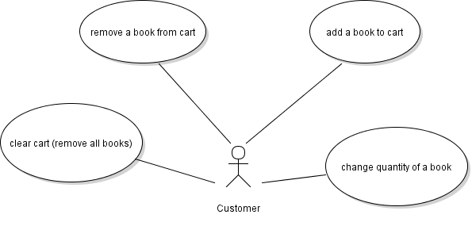
SHOPPING CART USE CASES

Slide 14
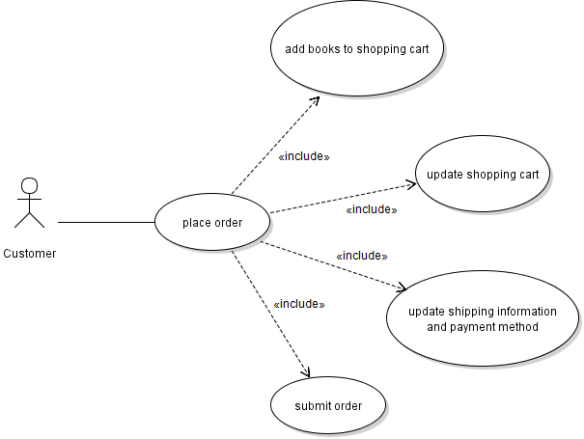
PLACE ORDER USE CASES

Slide 15
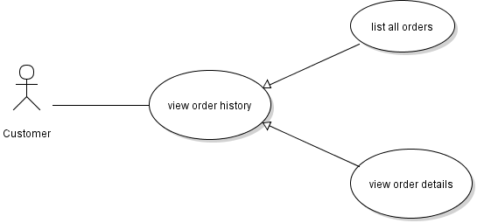
VIEW ORDER HISTORY USE CASE

Slide 16
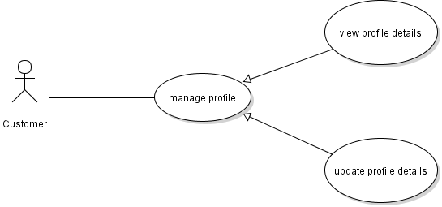
MANAGE PROFILE USE CASE

Slide 17
END

