Slide 1
CONVENTIONS
Java Code Convention
Java Class Name Convention
JSP Name Convention
URL Mapping Convention

Slide 2
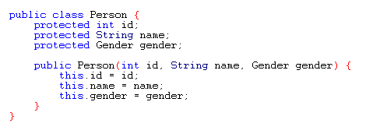
JAVA CODE CONVENTION
Use some parts of Java Code Convention from Oracle (originally published by Sun Microsystems in 1997)
Brackets style: opening at the end of line
Tabs: 4 white spaces

Slide 3
JAVA CODE CONVENTION (Contd.)
Class Names: Noun + CamelCase
Ex: Person, User, BookService, …
Method Names: verb + noun + camelCase
Ex: editUser(), deleteUser(), listBook(),…
Variable Names: noun + camelCase
Ex: user, newCategory, totalBooks, …
Comments: rarely used
Code should be self-explanatory

Slide 4
JAVA CLASS NAME CONVENTION
DAO Classes: <Entity>DAO
Ex: UserDAO, BookDAO, OrderDAO
Service Classes: <Entity>Services
Ex: UserServices, BookServices
Servlet Classes: <Action><Entity>Servlet
Ex: CreateBookServlet, ListBookServlet, PlaceOrderServlet

Slide 5
JSP NAME CONVENTION
Listing Page: <Entity>_list.jsp
Ex: book_list.jsp, customer_list.jsp
New/Edit Page: <Entity>_form.jsp
Ex: book_form.jsp, category_form.jsp

Slide 6
URL MAPPING CONVENTION
Homepage (frontend):
http://localhost:8080/BookStore/
Backend:
http://localhost:8080/BookStore/admin
Listing Page: /list_<entity>
Ex: /list_books, /list_categories, /list_customers
New Page: /new_<entity>; /<entity>_form.jsp
Ex: /new_book, /user_form.jsp

Slide 7
URL MAPPING CONVENTION (Contd.)
Save URL: /create_<entity>
Ex: /create_book, /create_category /create_customer
Edit URL: /edit_<entity>
Ex: /edit_book, /edit_category /edit_customer
Update URL: /update_<entity>
Ex: /update_book, /update_category /update_customer
Delete URL: /delete_<entity>
Ex: /delete_book, /delete_category /delete_customer

Slide 8
END.

