Slide 1
Secure Data Hiding in Image Using Steganography
CAPSTONE PROJECT
Presented By: Suhail Khan
Student Name : Suhail Khan
College Name & Department : IITM janakpuri , Computer applications

Slide 2
OUTLINE
Problem Statement
Technology used
Wow factor
End users
Result
Conclusion
Git-hub Link
Future scope

Slide 3
Problem Statement
Conventional encryption techniques are often noticeable and may attract attention.
A secure method is required to conceal sensitive messages within images.
Protecting data while preserving the original quality of the cover image.
Providing an easy-to-use encryption and decryption system for all users.

Slide 4
Technology used
Programming Language: Python
Image Processing Library: OpenCV
File Handling & Security: Basic encryption logic for password protection
Platform: Windows 11

Slide 5
Wow factors
Uses steganography to embed a message into an image without noticeable changes.
Lossless data hiding using pixel value manipulation instead of traditional cryptographic techniques.
Works on any standard image file format (PNG recommended for best results).

Slide 6
End users
Cybersecurity Enthusiasts – Studying secure communication techniques.
Government & Defense – Transmitting messages securely without detection.
Journalists & Activists – Hiding sensitive information in images to avoid surveillance.
Software Developers – Understanding and applying steganography concepts.

Slide 7
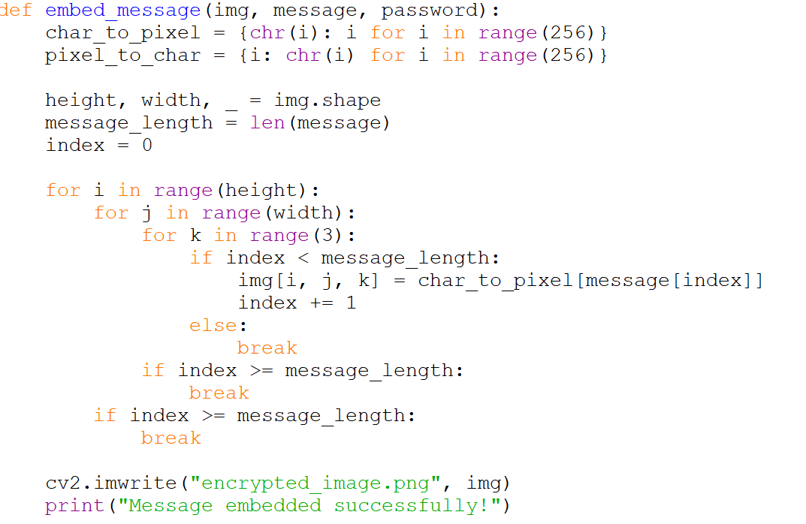
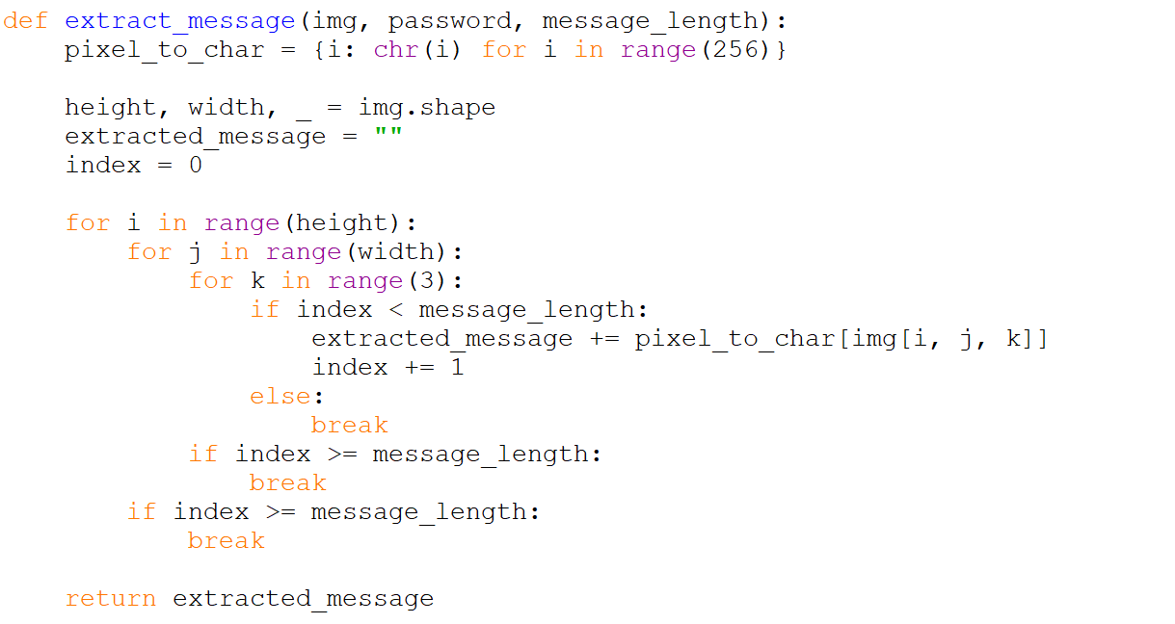

Results
Encryption code:
Decryption code:
Input Image File:
Output Image File:

Slide 8
Conclusion
Steganography provides a covert way of communicating sensitive information.
This project showcases a simple yet effective implementation of message hiding in images.
Future improvements can make it more robust, secure, and scalable.

Slide 9
GitHub Link
https://github.com/suhxill/aicte_ibm_intern.git

Slide 10
THANK YOU

