Slide 1

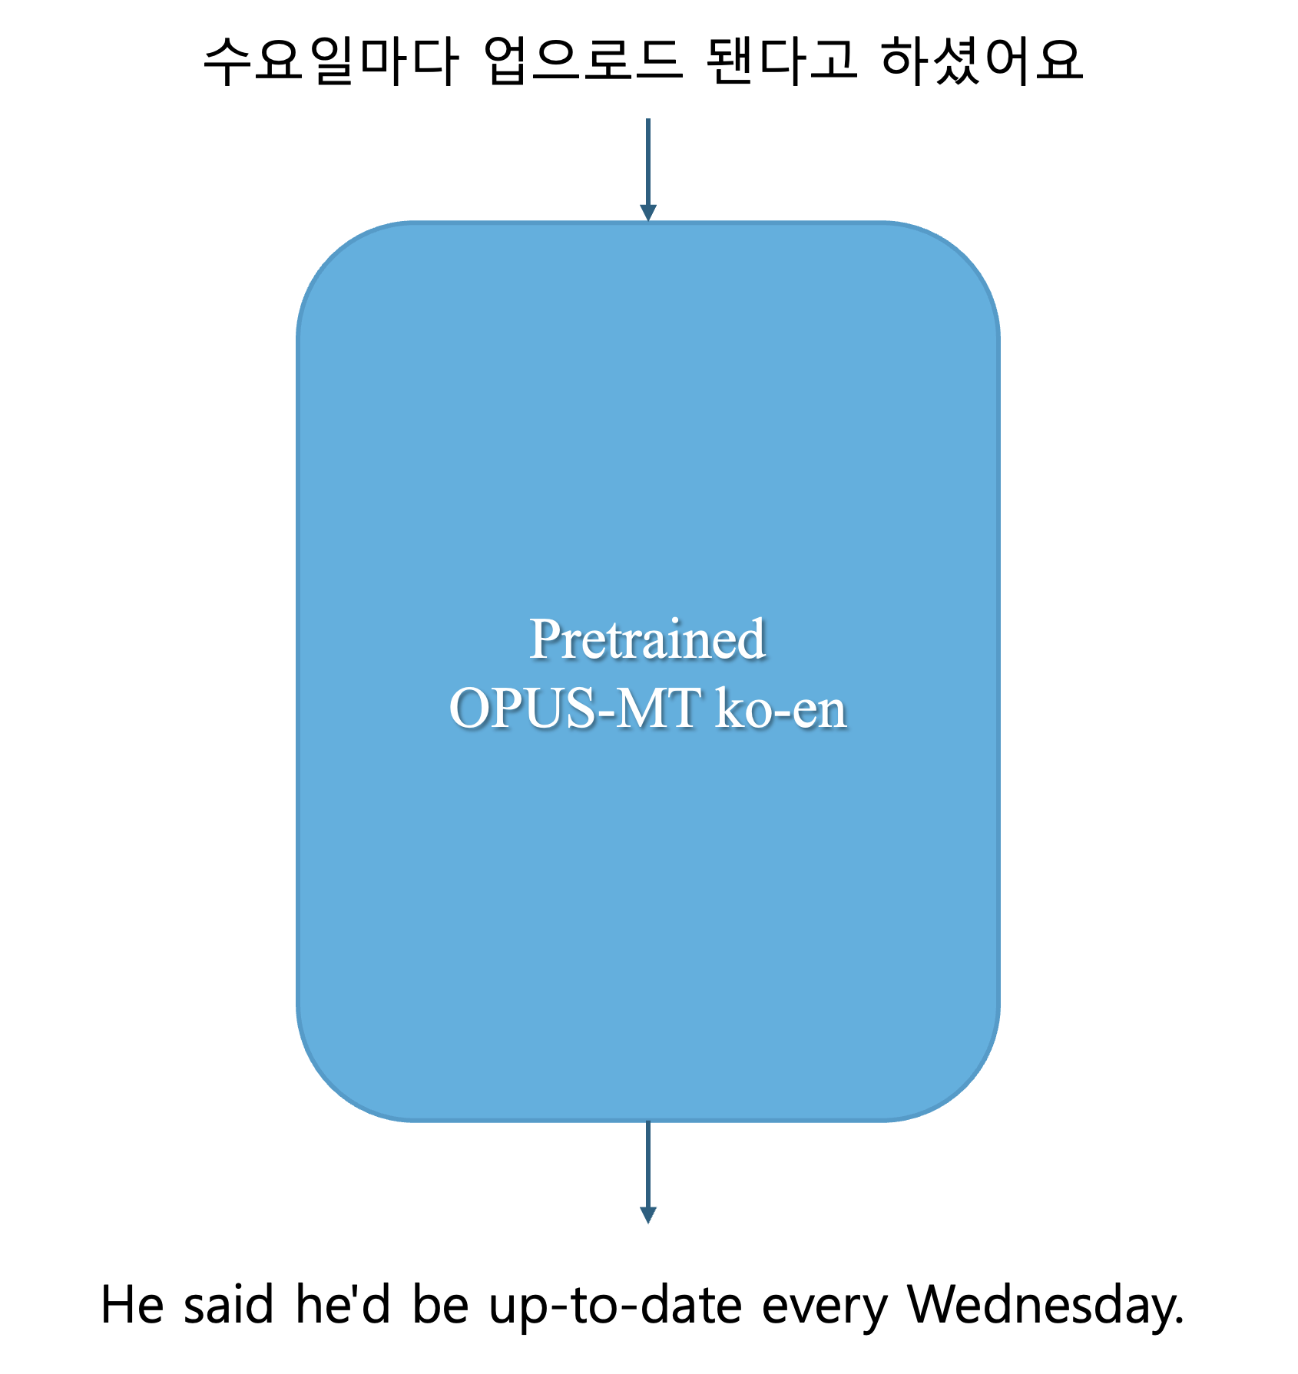
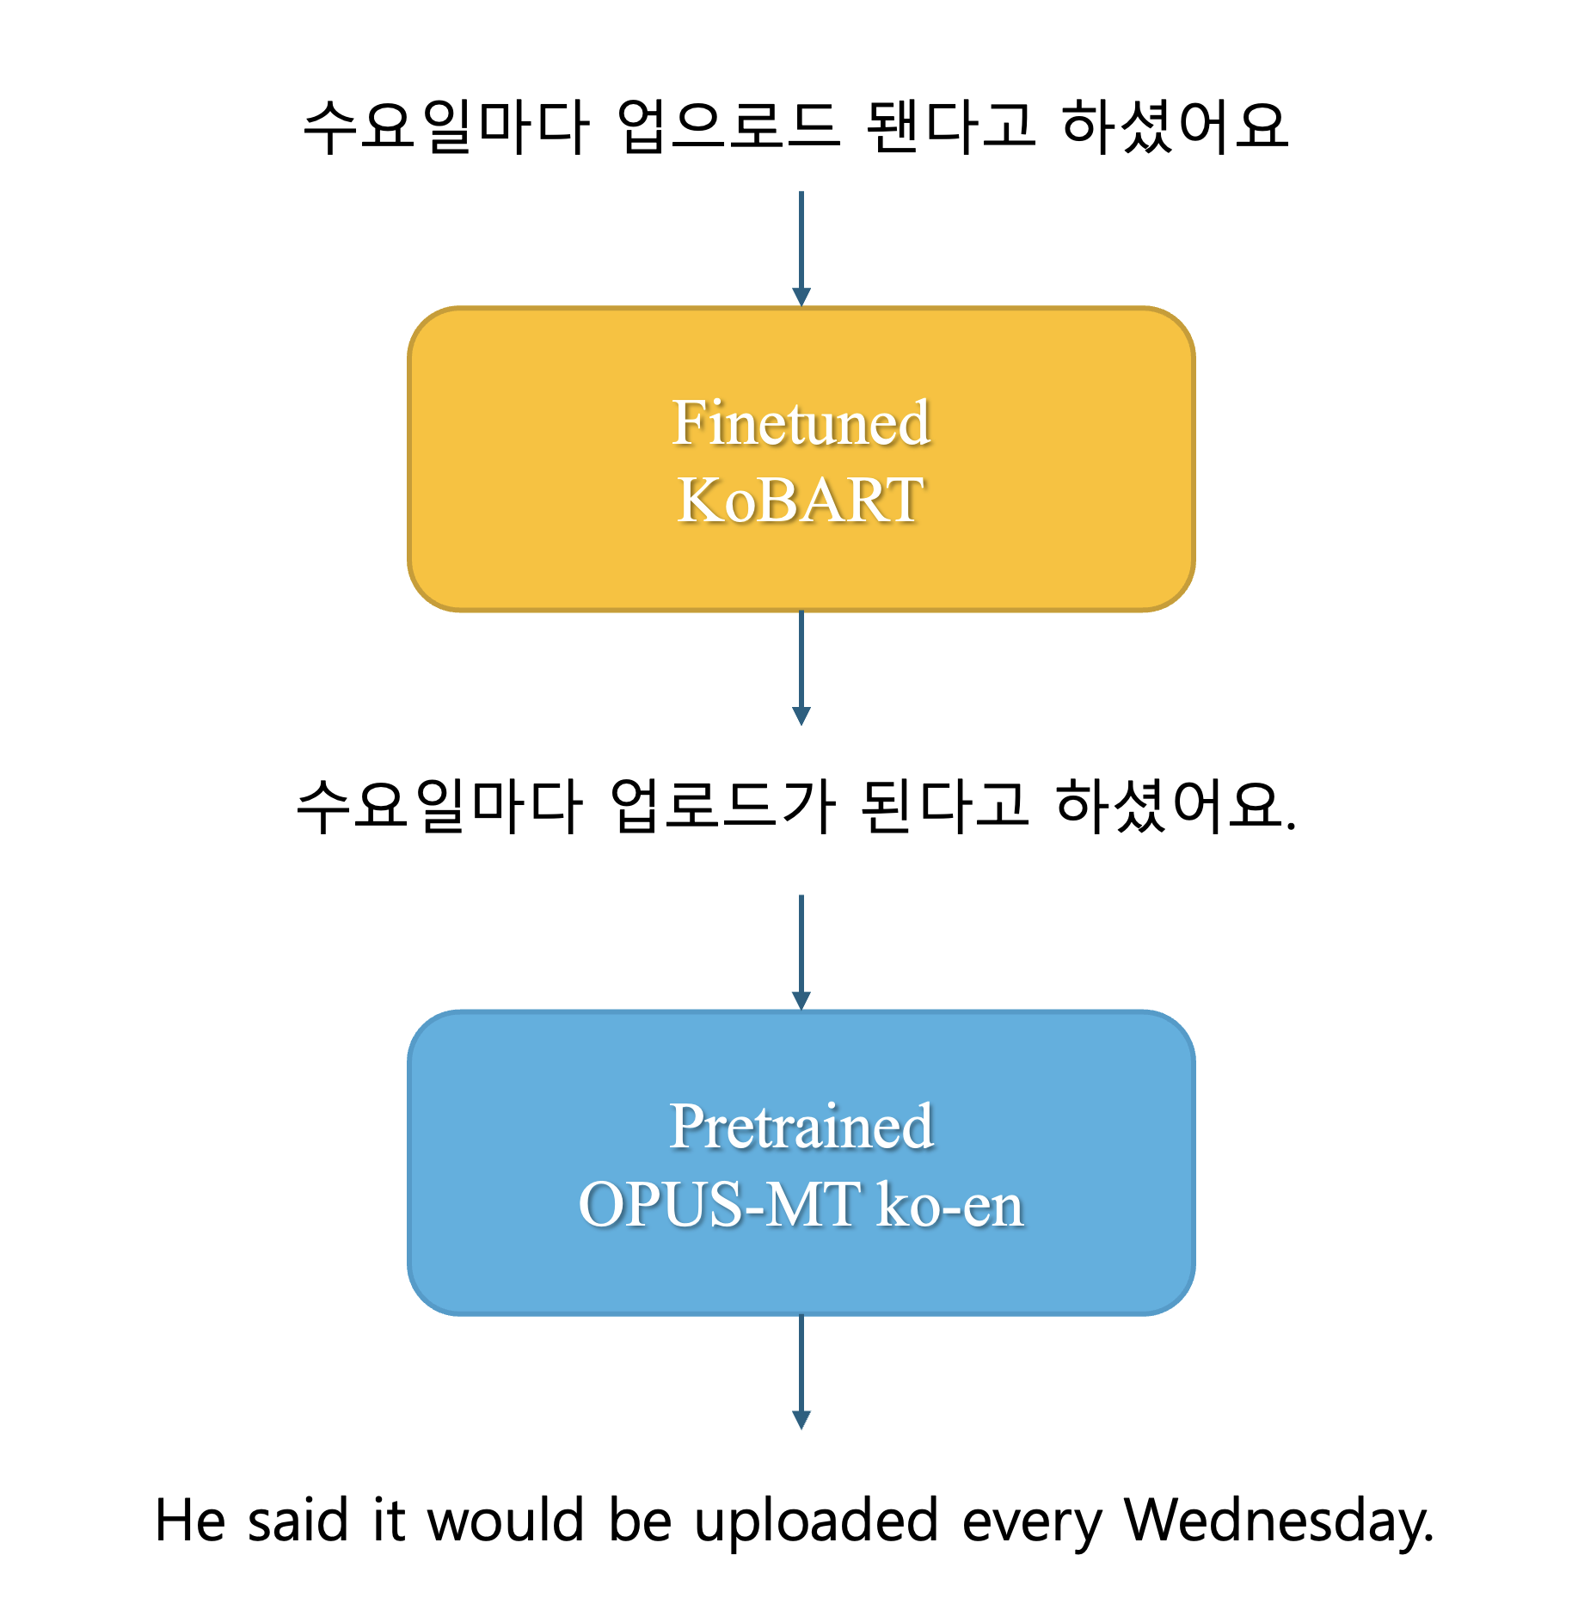


A KoBART-Based Approach to Korean Spelling Correction:
Impact on Downstream Korean-to-English Translation
Suhyeon Gwon
Korean Language and Literature, Seoul National University
yhus110@snu.ac.kr
Backgrounds
Noise in input data can significantly degrade the performance of language models. Even LLMs can be harmed by a small but widespread presence of noise.[1] This issue becomes even more critical for smaller models with limited capacity. [4]
Such noise would also be detrimental in downstream tasks like machine translation.
BART is a denoising autoencoder for pretraining sequence-to-sequence models, designed to handle various types of noise by reconstructing the original input from corrupted versions. [2]
KoBART is a Korean adaptation of BART, pretrained on large-scale Korean corpora. [3]
While large models offer improved performance, they also require significant computational resources and time. Therefore, using smaller models with enhanced noise handling capabilities can be a practical and scalable alternative, especially in real-world applications with limited resources.
[1] S. Cho, S. Jeong, J. Seo, T. Hwang, and J. C. Park, "Typos that Broke the RAG's Back: Genetic Attack on RAG Pipeline by Simulating Documents in the Wild via Low-level Perturbations," arXiv preprint arXiv:2404.13948, Oct. 2024.
[2] M. Lewis, Y. Liu, N. Goyal, M. Ghazvininejad, A. Mohamed, O. Levy, V. Stoyanov, and L. Zettlemoyer, "BART: Denoising Sequence-to-Sequence Pre-training for Natural Language Generation, Translation, and Comprehension," arXiv preprint arXiv:1910.13461, Oct. 2019.
[3] https://github.com/SKT-AI/KoBART
[4] M. Moradi and M. Samwald, "Evaluating the Robustness of Neural Language Models to Input Perturbations," arXiv preprint arXiv:2108.12237, Aug. 2021.
Research Goals
Experiments
Propose a KoBART-based spelling correction model tailored for Korean text preprocessing
Improve grammatical consistency and reduce noise in input sentences
Evaluate the impact of corrected input on downstream Korean-to-English translation using Opus-MT
Assess translation performance using BLEU score and Sentence-BERT-based semantic similarity
vs
Methodology
Experimental Setup
KoBART Train: trained for 10 epochs using AdamW optimizer with a cosine learning rate scheduler from 1e-5. Cross-entropy loss was used internally and the best model was selected based on the lowest validation loss(0.2249).
KoBART & Opus-MT Inference: Configured to generate outputs deterministically by setting generation temperature to 0.0, ensuring consistency in evaluation.
Results and Observations
The KoBART model demonstrated strong performance in correcting spelling errors.
In the downstream task, the corrected inputs consistently led to improved translation quality compared to the uncorrected versions. This suggests that removing noise through spelling correction contributes positively to the overall translation performance.
Data
Utilized ‘인터페이스(자판/음성)별 고빈도 오류 교정 데이터’ provided by AI Hub. Construct a dataset consisting of 15,300 training samples and 1,550 test samples, and each sample consists of an erroneous sentence paired with its corrected version.
Generate English translation labels from sentences without errors using the Opus-MT model, for downstream task.
KoBART
Train: The input is an erroneous sentence, and the target output is its corresponding corrected version.
Inference: Manipulated the test set such that half the sentences contain errors and the other half do not, to evaluate whether the model selectively corrects only the erroneous inputs.
Downstream Translation
Translated both the original and the corrected test sentences into English using the Opus-MT model.
The translations are then compared against the pseudo-labeled English references generated in the data preparation stage.
Evaluation
Evaluated both the correction and translation performance using BLEU score and Sentence-BERT-based semantic similarity.
Correction Performance of KoBART
Semantic similarity | 0.9629
BLEU score | 0.7797
Translation Performance of Opus-MT
Correction by KoBART | 0.7308
No Correction | 0.6661
Concluding Remarks
Correcting input noise, specifically spelling errors in Korean, has a positive effect on the performance of machine translation.
Smaller translation models like Opus-MT, which tend to be more sensitive to input noise, can particularly benefit from lightweight and efficient preprocessing models such as KoBART.
https://github.com/suhyeon-gwon/25_ai_final_project

