Slide 1

IP Mask
Intercepting server responses and dynamically altering the originating IP address before it leaves the local machine.
Team 4 Members: Dongxin Zhang, Chenjie Wu, Mingfu Huang, Junhao Hao

Slide 2
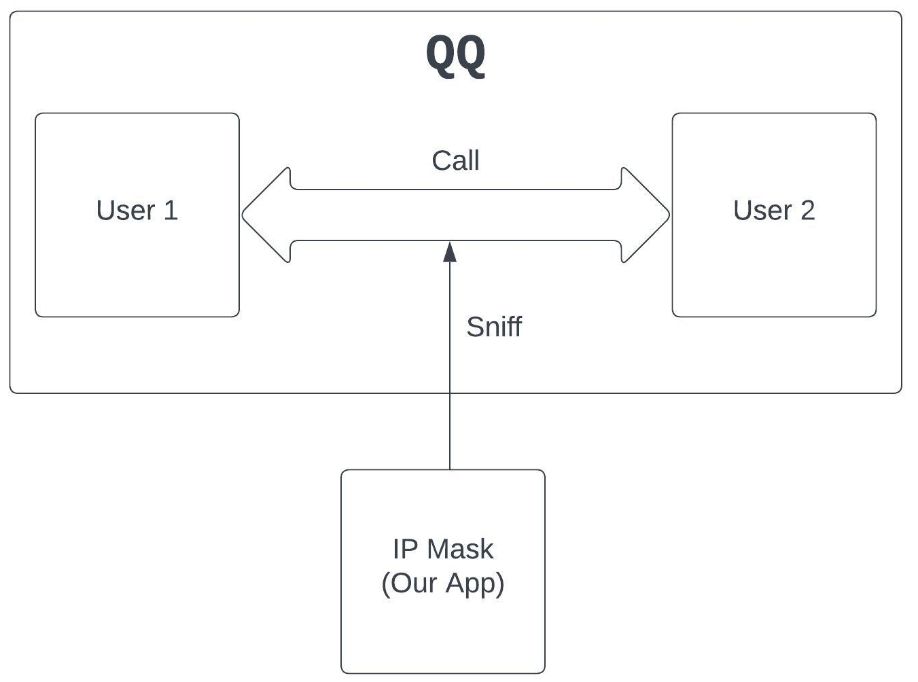
Feature: Detect VoIP Geolocation
For QQ
sniffers `02:00:48` in the packet raw string

Slide 3
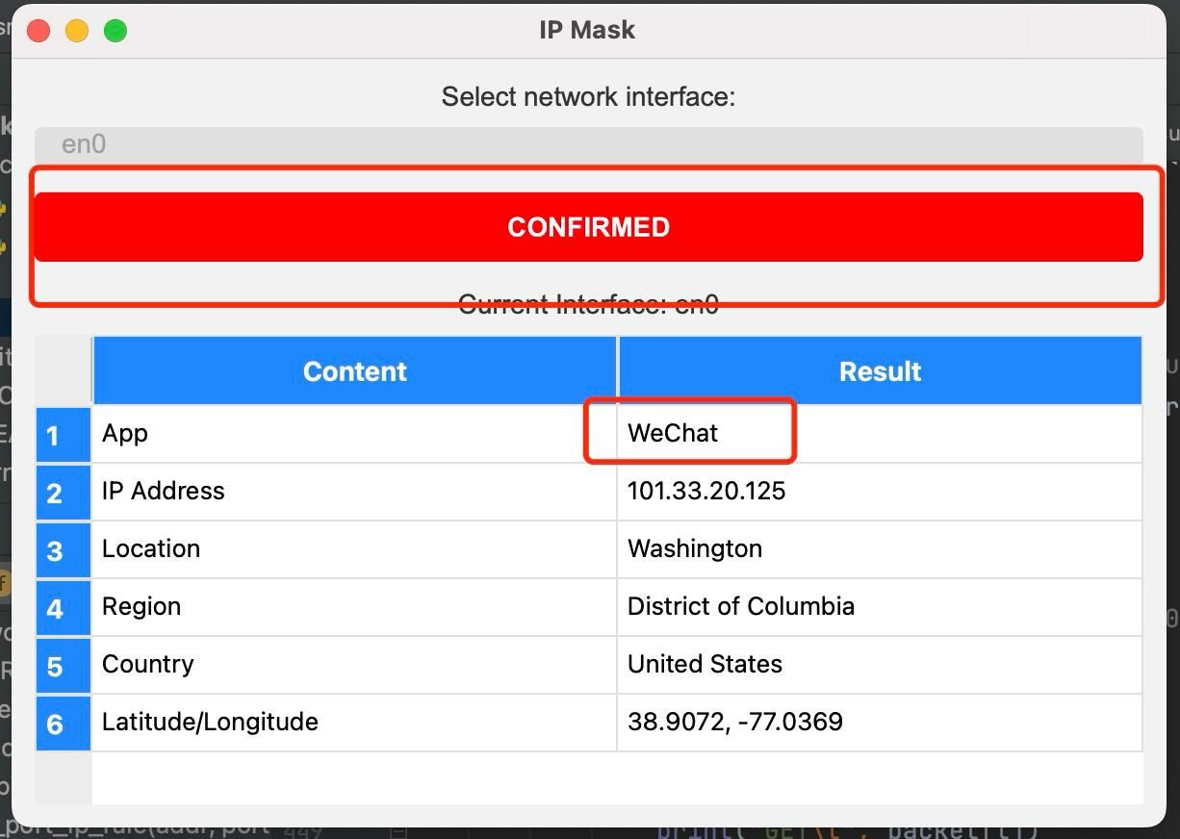
Feature: Detect VoIP Geolocation

Slide 4
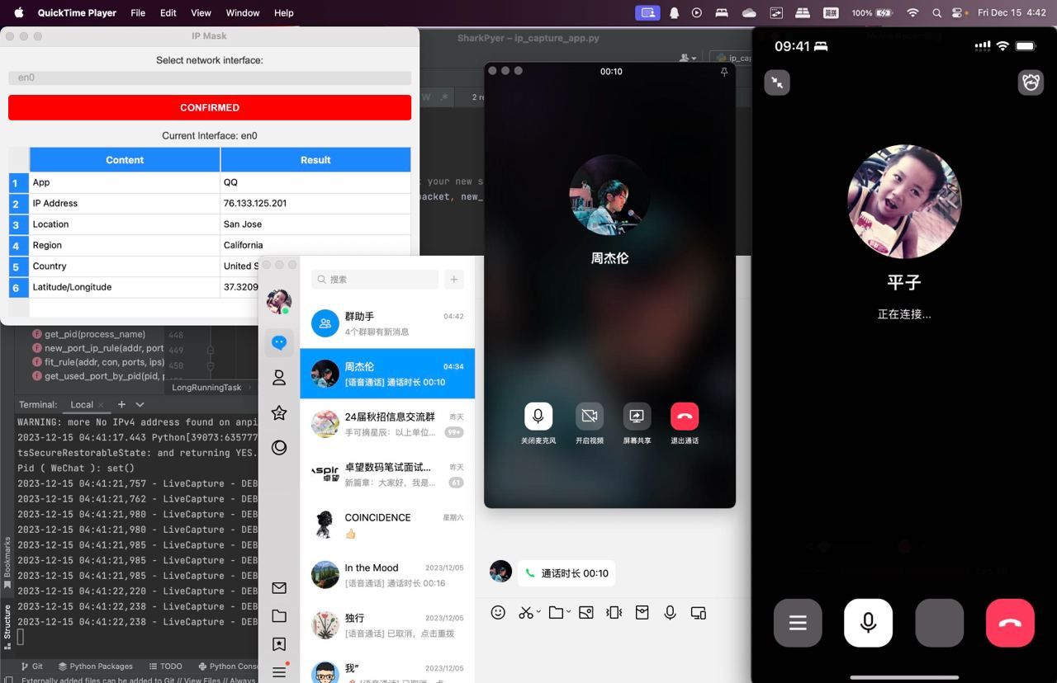
QQ is Calling through VoIP
Mirroring iPhone Screen
Detected IP
And Query Geolocation

Slide 5
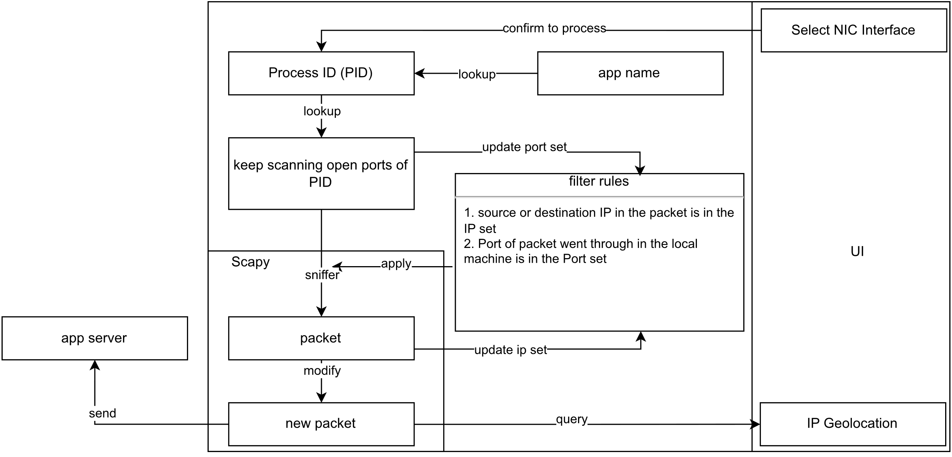
Feature: IP Mask

