Slide 1
IST_722 Final Presentation
Suihin Wong
Andrew Ku
Joseph R Maugeri

Slide 2
Introduction
To understand profitability of all items on FudgeCorp’s new website…
Products from Fudgemart (FM), and plans from Fudgeflix (FF) must be examined wholistically as Items
Customers from Fudgemart (FM), and Accounts from Fudgeflix (FF) must be considered wholistically as Customers
Define a new business process that relates the sales of all Items, and Customers, across both companies sold items

Slide 3
Assumptions
We must assume that a plan does not cost us anything to obtain in this new sales business process
Online sales are converted to a singular timestamp for accurate processing as customers shop from multiple time zones.

Slide 4
Goal
Provide a new sales business process for items and customers and collect that information in a merged data warehouse.
Map final DW dimensions and facts
Perform ETL to merge data and load to the DW dimensions and facts
Run BI on final DW to explore the merged sales business process

Slide 5
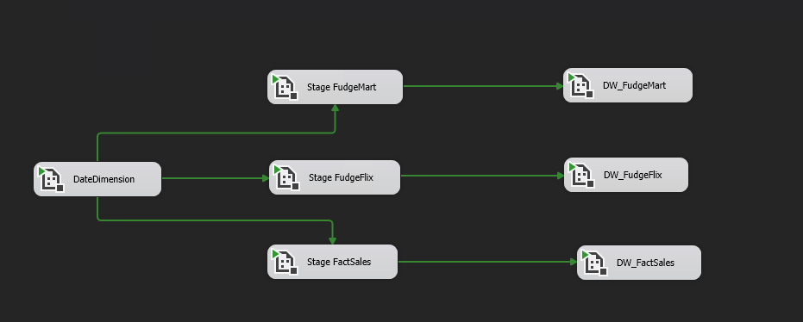
ETL
Notes:
Total of 12 ETLS, 2 from each of the various Dimension / Fact tables,

Slide 6
ETL: FudgeMart High Level Overview
Notes:
Within one section,

Slide 7
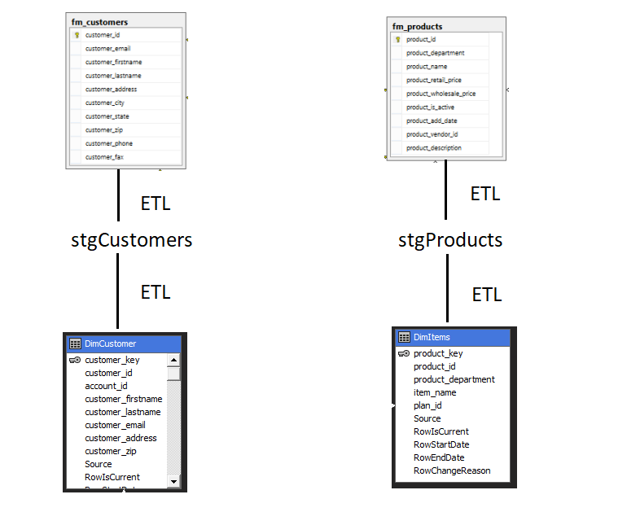
ETL: FudgeMart High Level Overview

Slide 8
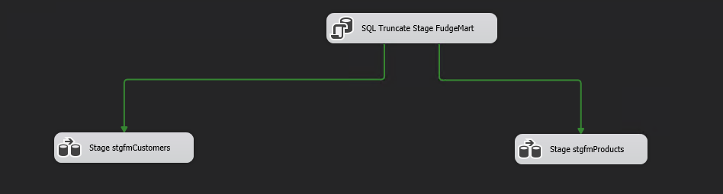
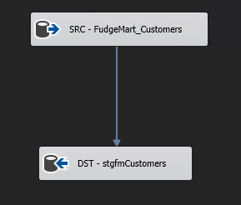
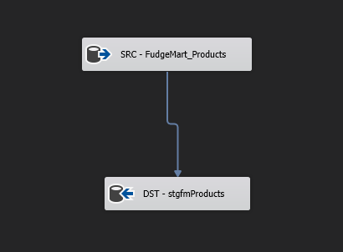
ETL 1&2) Stage fm_customers and fm_Products

Slide 9

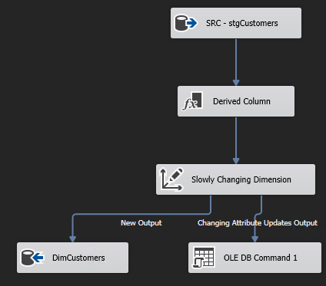
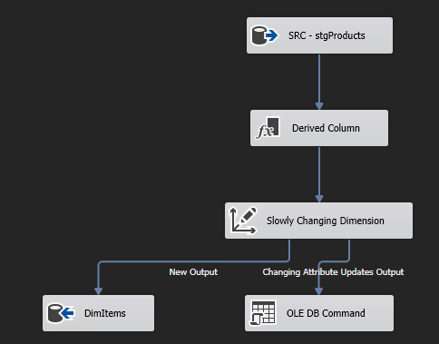
ETL 3&4) Stage to DimCustomers and DimItems

Slide 10
ETL: FudgeFlix High Level Overview

Slide 11
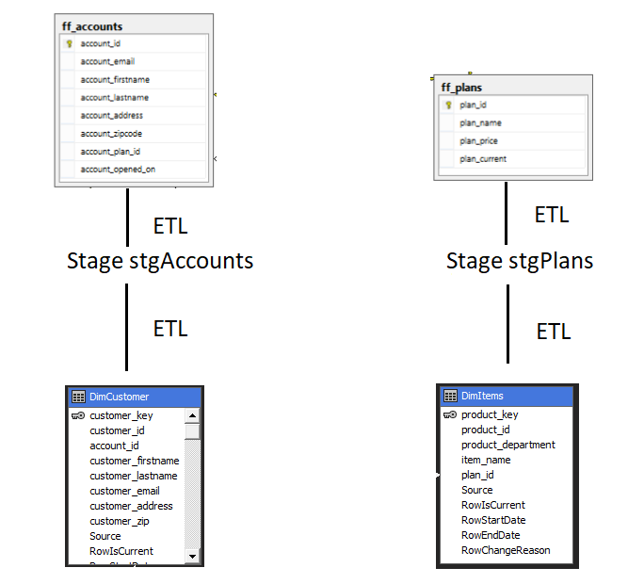
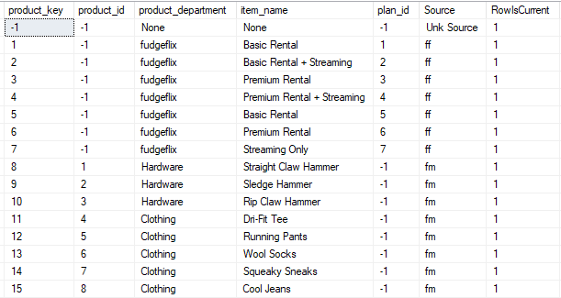
ETL: FudgeFlix High Level Overview

Slide 12
ETL: FactSales High Level Overview

Slide 13
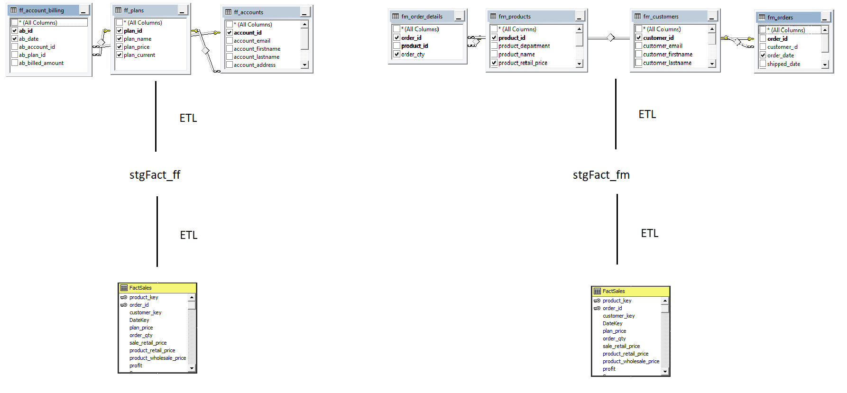
ETL: FactSales High Level Overview

Slide 14
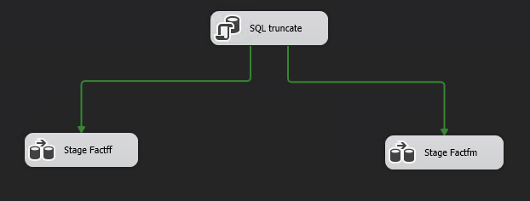
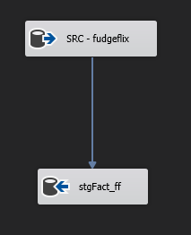
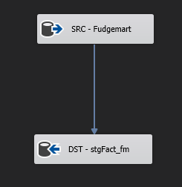
ETL 9&10) Stage Fact_ff and Fact_fm

Slide 15

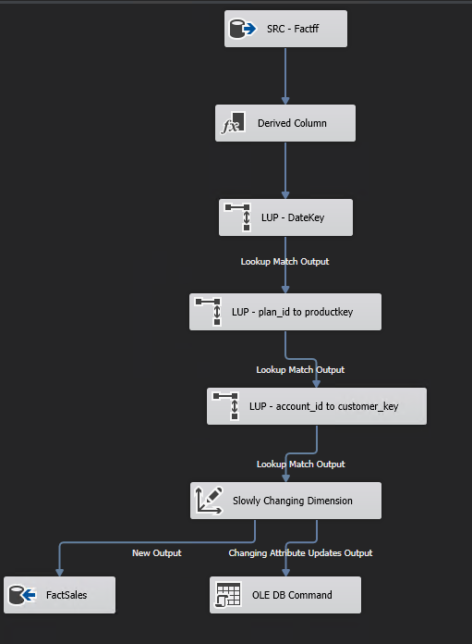
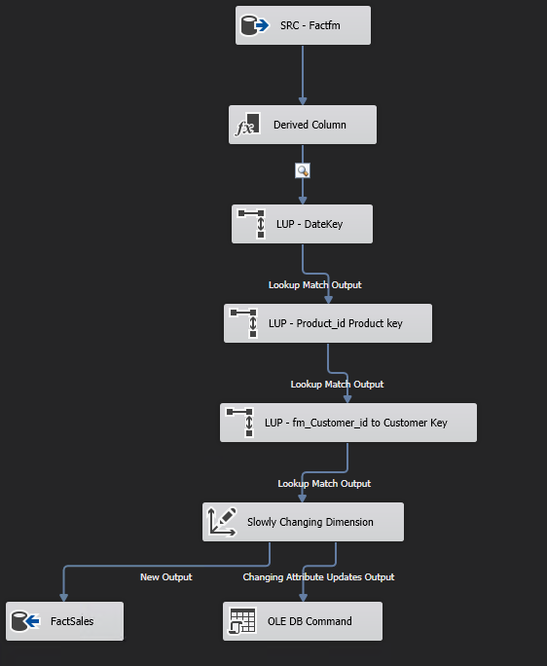
ETL 11&12) Stage to FactSales

Slide 16
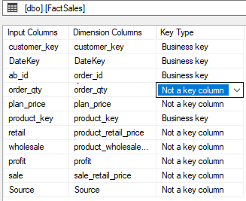
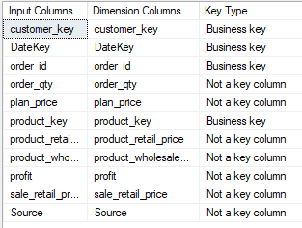
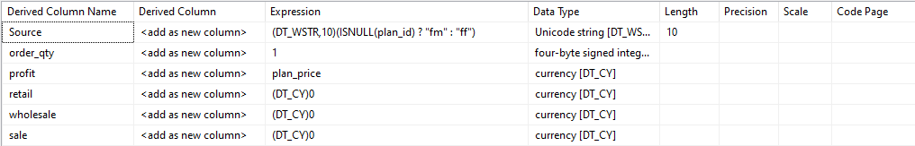
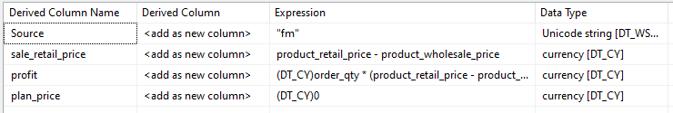
FactSales Summary
Fact_ff Fact_fm

Slide 17
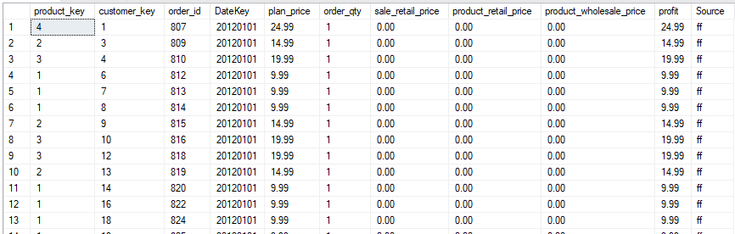
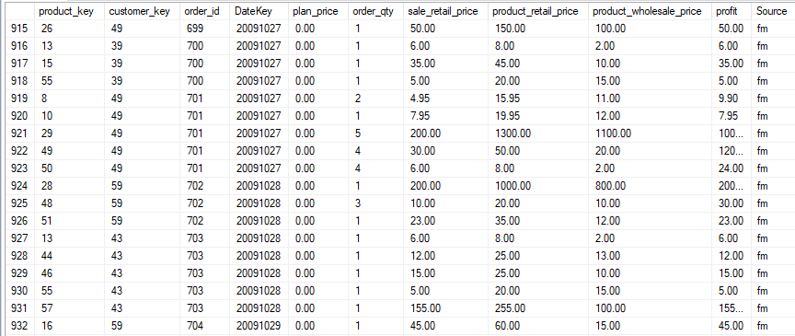
FactSales Result
FudgeFlix
FudgeMart

Slide 18
Sales Analysis
Which items are the most popular.
Total sales(profit) in quarterly, monthly.
Which location has the most sales.

Slide 19
Recommendations
Additional years of data will inform possible seasonality in sales
Online traffic data would be useful to understand customer behaviors

