Slide 1
1M1B AI FOR SUSTAINABILITY VIRTUAL INTERNSHIP
CleanAir AI
AQI
Real-Time Air Quality Intelligence
US EPA scale
In Collaboration with IBM SkillsBuild & AICTE
Student Name: Varun Mundepi
College: THDC-Institute Of Hydro Power Engineering And Technology
Notes:
Introduce CleanAir AI: a real-time air quality intelligence dashboard with a grounded AI assistant. Built for the 1M1B AI for Sustainability Virtual Internship with IBM SkillsBuild & AICTE. Replace the name and college placeholders before presenting. The skyline is a conceptual illustration.

Slide 2





01 · OBSERVE THE PROBLEM
The Problem: Making Air Quality Understandable
Real Environment
Air quality changes continuously
Air Pollution
Multiple pollutants influence air quality
Sensor Measurements
Measurements can be hard for ordinary users to interpret
Complex Environmental Data
Information may be spread across different monitoring sources
Information Gap
Users need understandable, real-time information with context
Need for Accessible AI-Assisted Interpretation
Notes:
Air quality data is generated continuously, but it is hard for ordinary users to interpret quickly. The flow on the left shows how a real-world condition turns into complex data and an information gap. No pollution statistics are cited on purpose.

Slide 3







02 · EMPATHIZE
Understanding the Users
WHO IS AFFECTED
WHAT THEY WANT TO KNOW
“What is the air quality right now?”
Citizens
Students
“Which pollutant is dominant?”
“How is the situation changing?”
Urban communities
Environment-conscious users
“How does my city compare with another city?”
“What does this information mean?”
Researchers / analysts
Users comparing air quality across cities
Notes:
Design Thinking – Empathize stage. These are the target users of CleanAir AI and the questions they need answered quickly.

Slide 4
03 · DEFINE · SDG ALIGNMENT
From Problem to Sustainability Goal
PRIMARY SDG
PROBLEM STATEMENT
11
“How might we use AI and real-time environmental data to make air-quality information easier to understand and use for sustainable urban awareness?”
Sustainable Cities and Communities
SECONDARY · SDG 3
SECONDARY · SDG 13
Good Health and Well-being
Climate Action
Makes environmental information easier to access, understand, compare and interpret, supporting sustainable urban awareness.
Clearer air-quality information can support health-conscious awareness.
Visible environmental monitoring supports climate-relevant awareness.
A technology-based contribution toward awareness, monitoring and informed decision-making. It does not claim to directly solve any SDG.
Notes:
Primary SDG is SDG 11. SDG 3 and SDG 13 are secondary alignments. CleanAir AI is framed as a technology-based contribution toward awareness, monitoring and informed decision-making – not as something that directly solves an SDG.

Slide 5
04 · RESEARCH · IDEATE · REFINE
Research → Ideation → Refinement
IBM Bob
IBM Bob
01
02
03
04
05
OBSERVE
RESEARCH
IDEATE
REFINE
BUILD
Identify air-quality information challenges
Problem context
Sustainability relevance
User needs
Possible AI applications
Monitoring
Analytics
Comparison
Conversational AI
Problem-statement refinement
AI workflow refinement
Responsible AI review
UX / concept refinement
Develop CleanAir AI
Live data, analytics, map and grounded assistant
IBM Bob was used as a research and project-refinement aid, while the implemented production AI assistant uses Groq + Llama 3.3 70B.
NOTE
Notes:
IBM Bob was used as a research and project-refinement aid in steps 02 and 04. The implemented production AI assistant is a separate system: Groq + Llama 3.3 70B.

Slide 6







05 · THE SOLUTION
Introducing CleanAir AI
Live Air Quality Dashboard
Criteria Pollutant Monitoring
Major Cities Catalog
AQI hero card, health category, dominant pollutant, live sync timestamp
PM2.5, PM10, NO₂, SO₂, CO and O₃ with units and threshold comparison
9 Indian and 9 international cities, e.g. Delhi, Dehradun, London, Tokyo
Historical Analytics
Multi-City Comparison
Monitoring Station Map
Interactive time-series trends for 24 hours, 7 days and 30 days
Side-by-side matrix and bar charts for up to 5 cities
Leaflet + OpenStreetMap plotting real sensor coordinates
AI Assistant
Responsible AI & Ethics
Resilient Data Architecture
Groq-powered, grounded explanations, pollutant risks and mitigation
Data provenance, grounding, limitations and credential protection
“AQI Unavailable” handling and fallback from live OpenAQ to demo data
Notes:
CleanAir AI is an integrated environmental intelligence platform. These nine capabilities come directly from the README.

Slide 7
06 · WHERE AI IS USED
AI at the Core of CleanAir AI
DEVELOPMENT-TIME · RESEARCH & REFINEMENT
PRODUCTION · FINAL PRODUCT
IBM Bob
Groq + Llama 3.3 70B
AI research, ideation & project refinement
The CleanAir AI Assistant
≠
Research
Brainstorming
Problem refinement
Solution ideation
Workflow refinement
Responsible AI consideration
Conversational interaction
Air-quality explanations
Pollutant interpretation
Environmental guidance
SEPARATE ROLES
Grounded in live sensor context · no medical diagnoses
IBM Bob does not power the CleanAir AI chatbot. It supported the process; Groq + Llama 3.3 70B is the AI inside the product.
Notes:
Two separate AI roles. IBM Bob supported research, brainstorming and refinement during project development. Groq + Llama 3.3 70B is the production AI assistant inside the product. They are not merged.

Slide 8
07 · AI WORKFLOW
How the CleanAir AI Assistant Works
1
2
3
4
Live OpenAQ Sensor Data
Current City Air-Quality Data
Context / Data Packet
Grounded AI Prompt
8
7
6
5
Grounded Environmental Explanation
CleanAir AI Assistant
Llama 3.3 70B
Groq API
“The LLM does not invent the sensor readings.”
The assistant receives the current city's live sensor data packet as explicit system context.
Notes:
The assistant receives the current city's live sensor data packet as explicit system context, so the LLM does not invent the sensor readings. This runs through the POST /api/chat endpoint on the FastAPI backend.

Slide 9

08 · SYSTEM ARCHITECTURE
Technical Architecture
React + Vite Frontend
Security Layer
Tailwind CSS
Recharts
Leaflet
OpenStreetMap
OPENAQ_API_KEY
FastAPI Backend
GROQ_API_KEY
Port 8000 · /api proxy · 8 REST endpoints
Server-side only
OpenAQ REST v3
Groq API
The React frontend never touches or exposes API keys.
Air-quality telemetry
Llama 3.3 70B
AI Assistant
Notes:
Architecture exactly as documented in the README: React + Vite frontend, FastAPI backend acting as an /api proxy on port 8000, OpenAQ REST v3 for telemetry, and Groq for the Llama 3.3 70B assistant. API keys never reach the browser.

Slide 10
09 · TECHNOLOGY STACK
Technology Stack
FRONTEND
BACKEND
ENVIRONMENTAL DATA
React 18
Vite
Tailwind CSS
Recharts
Lucide React
Leaflet
OpenStreetMap
Python 3.10+
FastAPI
Uvicorn
httpx
Pydantic v2
python-dotenv
OpenAQ API v3
PRODUCTION AI
Groq API
Llama 3.3 70B
AI RESEARCH & REFINEMENT
AI Research, Ideation & Project Refinement
IBM Bob
Used during development. It is not the production AI provider.
Notes:
Stack taken from the README. IBM Bob is listed for AI research, ideation and project refinement only, it is not the production AI provider.

Slide 11
10 · DATA & AQI INTELLIGENCE
From Environmental Data to Air Quality Intelligence
SIX CRITERIA POLLUTANTS
US EPA AQI CATEGORIES
MISSING-DATA HANDLING
0–50
Good
PM2.5
PM10
Insufficient pollutant data
Fine particles
Coarse particles
51–100
Moderate
AQI Unavailable
101–150
Unhealthy for Sensitive Groups
NO₂
SO₂
Nitrogen dioxide
Sulfur dioxide
151–200
Unhealthy
Available raw measurements remain visible
201–300
Very Unhealthy
CO
O₃
Missing data is never replaced with invented values.
301–500+
Hazardous
Carbon monoxide
Ozone
Notes:
CleanAir AI implements the US EPA AQI methodology. When there is not enough pollutant data to compute an AQI, the app shows AQI Unavailable and keeps showing whatever raw measurements exist. No values are invented.

Slide 12




11 · PRODUCT EXPERIENCE
CleanAir AI in Action
01
02
03
04
05
06
07
Choose City
View AQI
Inspect Pollutants
Explore Trends
Compare Cities
View Monitoring Stations
Ask AI Assistant
CONCEPTUAL ILLUSTRATION
AQI
PM2.5
PM10
NO₂
CleanAir AI Assistant
AQI
Health category
What does this AQI mean?
Dominant pollutant
Last synced
SO₂
CO
O₃
Notes:
User journey through the app. The window below is a conceptual illustration, not a real screenshot. Swap in real screenshots of your running app if you have them.

Slide 13
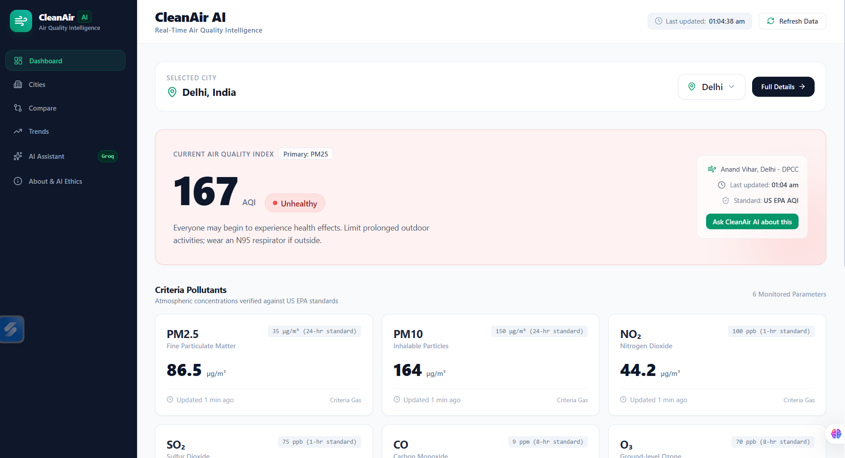
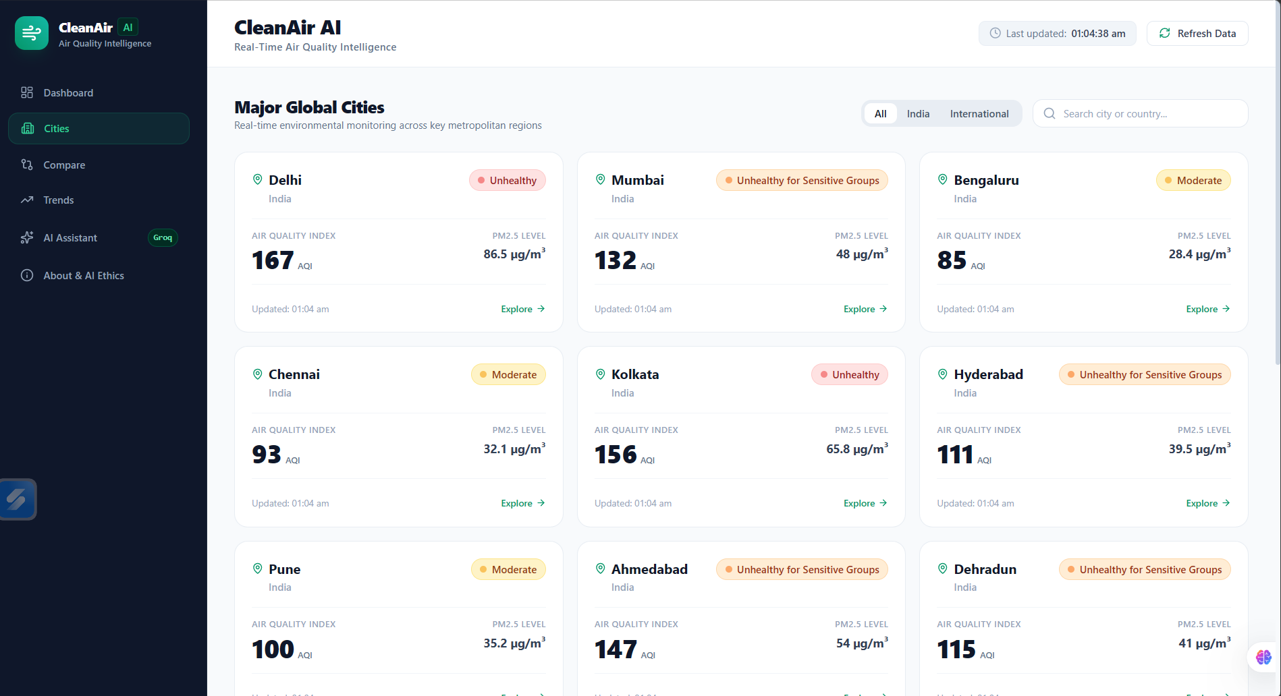
12 · PROJECT SCREENSHOTS · 1 / 3
Project Screenshots: Dashboard & Cities
Live AQI Dashboard
Major Cities Catalog
Insert screenshot here
Insert screenshot here
Placeholders only. Replace each frame with a real screenshot of the running application.
Notes:
Placeholders for real screenshots. In PowerPoint use Insert > Pictures, resize each image to fit its frame, then delete the 'Insert screenshot' label.

Slide 14
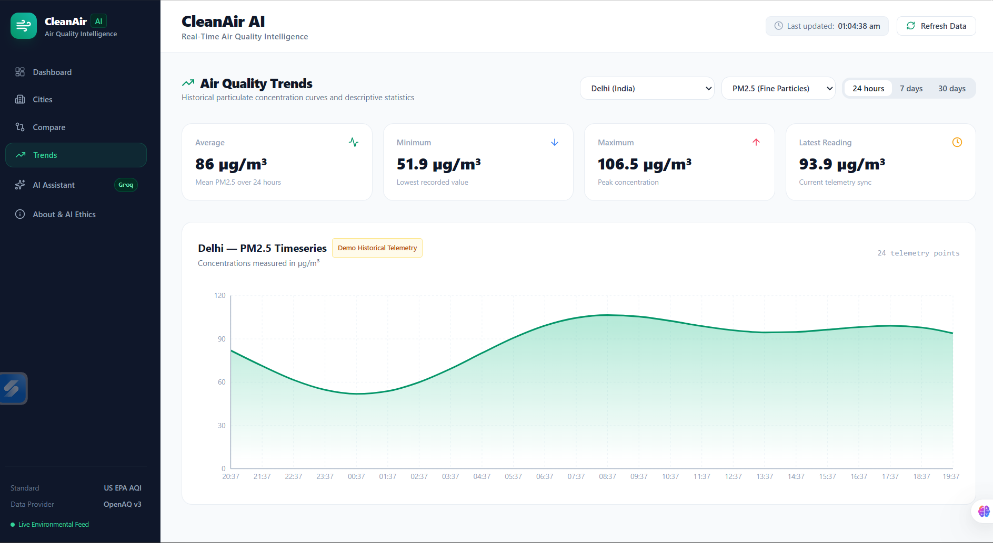
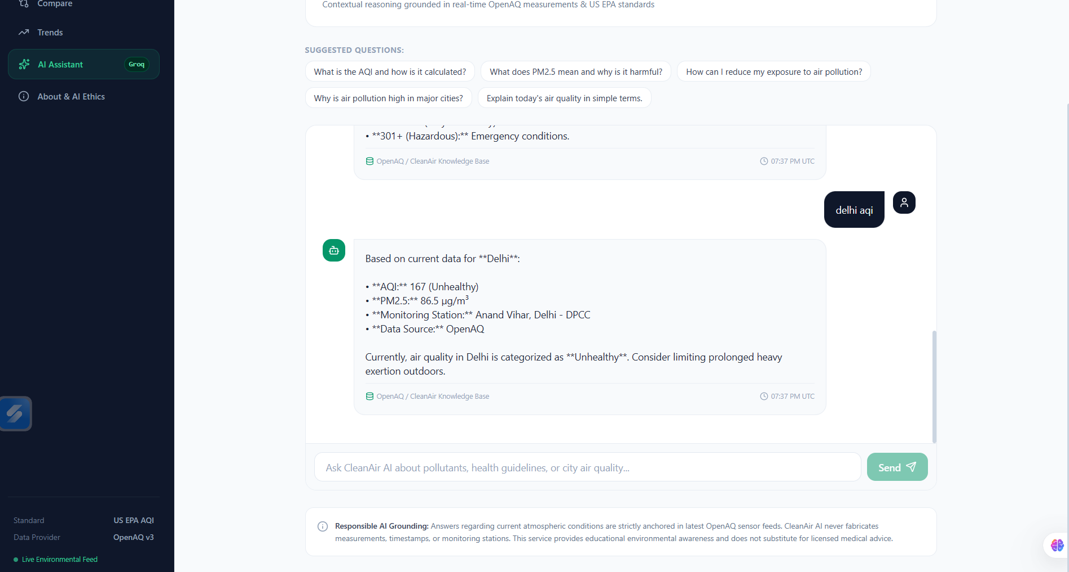

12 · PROJECT SCREENSHOTS · 2 / 3
Project Screenshots: Trends & AI Assistant
Historical Trends
AI Assistant
Insert screenshot here
Insert screenshot here
Placeholders only. Replace each frame with a real screenshot of the running application.
Notes:
Placeholders for real screenshots. In PowerPoint use Insert > Pictures, resize each image to fit its frame, then delete the 'Insert screenshot' label.

Slide 15
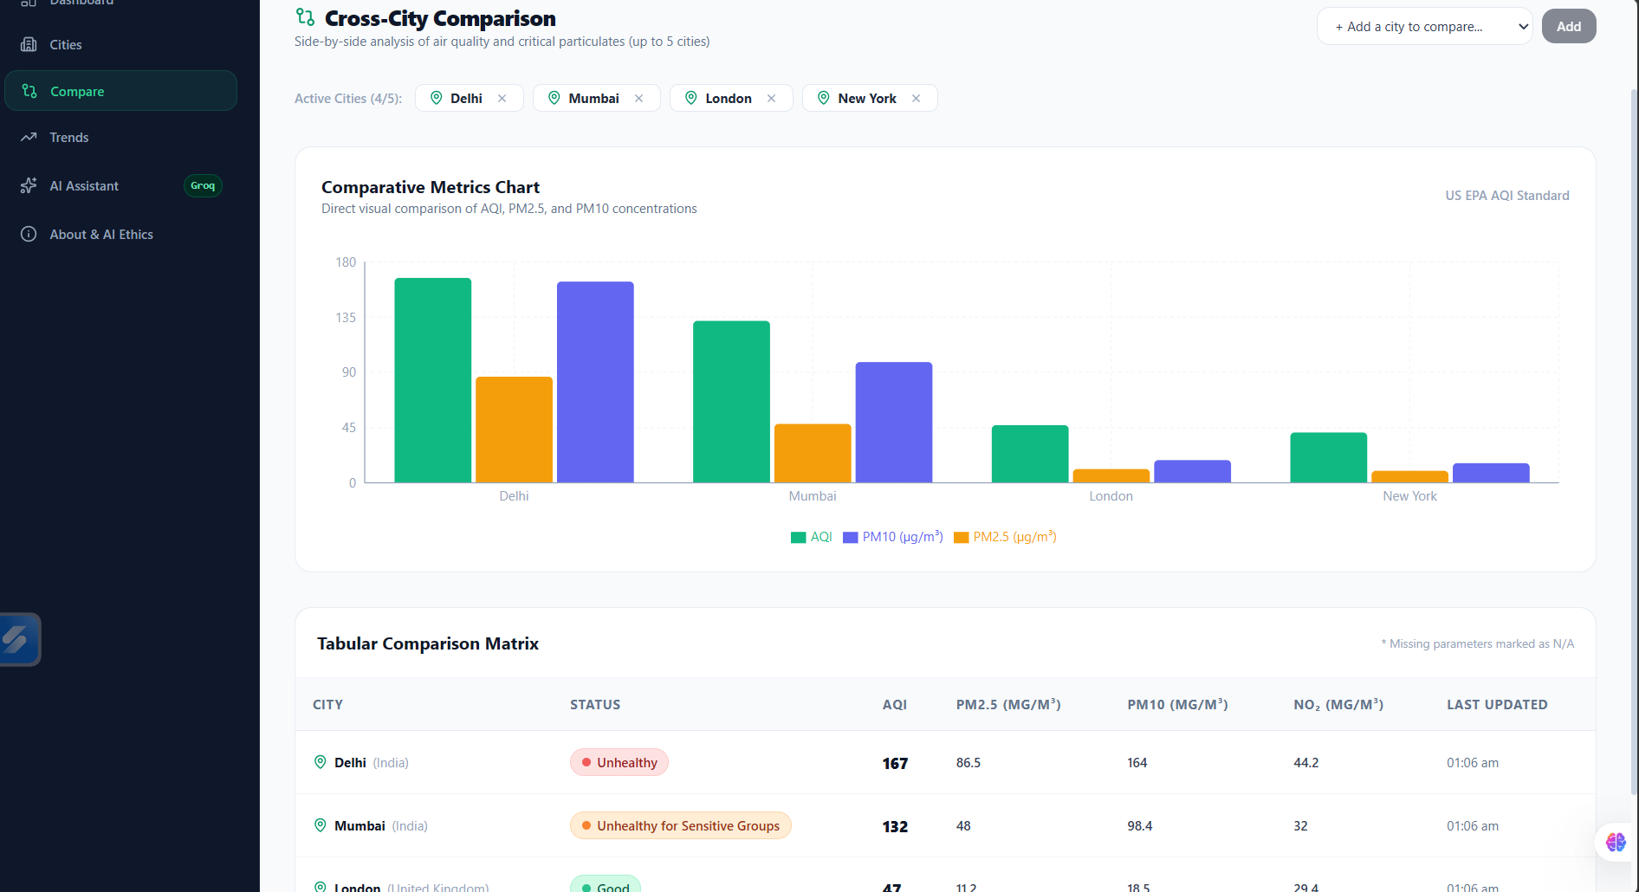
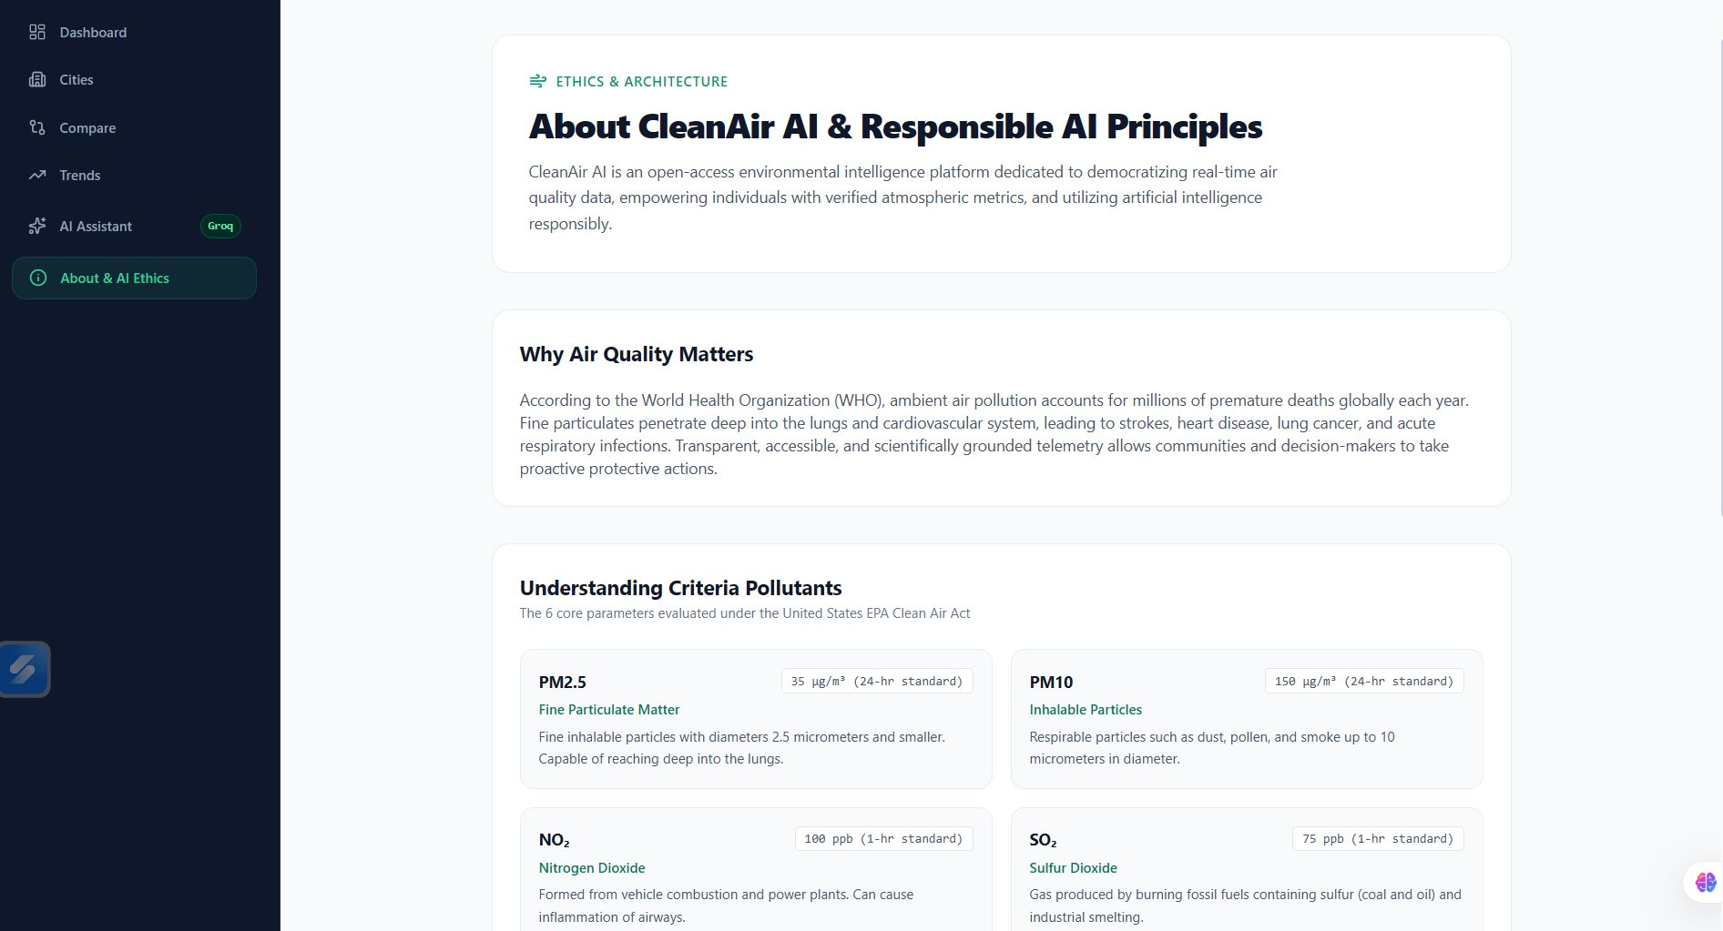
12 · PROJECT SCREENSHOTS · 3 / 3
Project Screenshots: Comparison & Ethics
Multi-City Comparison
Responsible AI & Ethics Page
Insert screenshot here
Insert screenshot here
Placeholders only. Replace each frame with a real screenshot of the running application.
Notes:
Placeholders for real screenshots. In PowerPoint use Insert > Pictures, resize each image to fit its frame, then delete the 'Insert screenshot' label.

Slide 16

Used IBM bob for project refinement

Slide 17






13 · RESPONSIBLE AI
Responsible AI by Design
No Data Fabrication
01
Grounding
02
Transparency
03
No artificial live readings or imaginary monitoring locations.
AI responses use the current city's sensor telemetry as explicit context.
Data provenance and system limitations are documented.
ETHICS
TRANSPARENCY
TRANSPARENCY
Safety
04
Privacy & Security
05
Missing Data Transparency
06
The assistant does not provide medical diagnoses. Information is for awareness only.
API credentials remain server-side and are never exposed to the frontend.
Shows “AQI Unavailable” when data is insufficient rather than fabricating a value.
ETHICS
PRIVACY
TRANSPARENCY
1M1B principles: Fairness • Transparency • Ethics • Privacy
Notes:
Six protections documented in the README. They are properties of CleanAir AI's design and implementation. IBM Bob does not itself enforce them.

Slide 18


14 · EXPECTED IMPACT
Expected Sustainability Impact
Environmental
Social
Educational
Community / Urban
Increased awareness of air-quality conditions
Easier access to environmental monitoring information
More understandable environmental information
Conversational access to complex data
Helps users learn about pollutants and AQI
Demonstrates practical AI for sustainability
Supports data-informed environmental awareness
Enables city-to-city comparison
Expected impact, not measured outcomes. No measured impact figures are claimed in this submission.
INTENDED CONTRIBUTION
Notes:
These are intended contributions, not measured results. No numerical impact metrics are claimed.

Slide 19








15 · FUTURE SCOPE & CONCLUSION
Building Toward Smarter Sustainable Communities
FUTURE SCOPE
More environmental data sources
More cities and monitoring networks
Air-quality forecasting
Mobile application
Alerts and notifications
Multilingual AI assistance
Smart-city integration
Expanded environmental intelligence
CleanAir AI demonstrates how real-time environmental data, AI-assisted interpretation, and responsible technology design can make sustainability information more accessible and understandable.
Notes:
Everything in the grid is future scope, not part of the current implementation. Close with the conclusion statement and thank the audience.

Slide 20
1M1B AI FOR SUSTAINABILITY VIRTUAL INTERNSHIP
Thank You
Varun Mundepi
THDC-Institute Of Hydro Power Engineering And Technology
CleanAir AI · Real-Time Air Quality Intelligence
Notes:
Closing slide. Thank the audience and invite questions.

