Slide 1
L5# Spring MVC examples, JPA, Hibernate
Harpreet Singh
Harpreet.singh@johnabbott.qc.ca

Slide 2
Spring MVC examples
Harpreet Singh
Harpreet.singh@johnabbott.qc.ca

Slide 3
Create Maven Project
Follow the guidelines if you have difficulties:
Open Eclipse
Create new project "Maven project"
Click next
Choose filter "maven-archetype-webapp"
Group ID=anyname, Artifact ID=ProjectName
Click Finish

Slide 4
Create Maven Project
7. Look for java folder under src/main/ so that structure looks like
src/main/java
8. If you see error sign in your project then
Go to project properties
Find "Target Runtime"
and check next to Tomcat Server

Slide 5
Create Maven Project
9. Providing dependencies to the Maven Project
Google the dependencies, for example: mysql jar
Go to mvnrepository and copy the dependency tag;
for example:
<dependency>
<groupId>mysql</groupId>
<artifactId>mysql-connector-java</artifactId>
<version>8.0.11</version>
</dependency>

Slide 6
Create Maven Project
Open pom.xml
Change the view to xml native or pom.xml
Paste dependency tag under the dependencies
To test, check folder structure on your left side of eclipse,
open maven dependencies and see if the JAR is downloaded
10. Finally, right click on your project,
Find Maven, select Update Project and press Okay.

Slide 7
Adding Spring JARs
Open pom.xml
Search for Spring Framework jars
spring-core
spring-web
spring-webmvc
Copy dependencies tag in your pom.xml and
Verify if you have downloaded the JAR files

Slide 8
Conf for Spring: replace web.xml
<?xml version="1.0" encoding="UTF-8"?>
<web-app xmlns:xsi="http://www.w3.org/2001/XMLSchema-instance"
xmlns="http://java.sun.com/xml/ns/javaee"
xsi:schemaLocation="http://java.sun.com/xml/ns/javaee
http://java.sun.com/xml/ns/javaee/web-app_3_0.xsd"
id="WebApp_ID" version="3.0">
<display-name>Archetype Created Web Application</display-name>
<servlet>
<servlet-name>dispatcher</servlet-name>
<servlet-class>org.springframework.web.servlet.DispatcherServlet</servlet-class>
<load-on-startup>1</load-on-startup>
</servlet>
<servlet-mapping>
<servlet-name>dispatcher</servlet-name>
<url-pattern>/</url-pattern>
</servlet-mapping>
<listener>
<listener-class>org.springframework.web.context.ContextLoaderListener</listener-class>
</listener>
</web-app>

Slide 9
Conf for Spring: add dispatcher-servlet.xml
<beans xmlns="http://www.springframework.org/schema/beans"
xmlns:context="http://www.springframework.org/schema/context"
xmlns:xsi="http://www.w3.org/2001/XMLSchema-instance"
xsi:schemaLocation="
http://www.springframework.org/schema/beans
http://www.springframework.org/schema/beans/spring-beans-3.0.xsd
http://www.springframework.org/schema/context
http://www.springframework.org/schema/context/spring-context-3.0.xsd">
<context:component-scan base-package="com.jac.controller" />
<bean class="org.springframework.web.servlet.view.InternalResourceViewResolver">
<property name="prefix" value="/WEB-INF/views/" />
<property name="suffix"><value>.jsp</value></property>
</bean>
<!-- Definition for studentManager bean -->
<bean id="studentManager" class="com.jac.model.service.StudentManager">
<property name="student" ref="student" />
</bean>
<bean id="student" class="com.jac.model.Student"></bean>
</beans>

Slide 10
Conf for Spring
Download folder from the Omnivox “SpringBasic.zip”
Copy and paste files if there is any problems
We will understand dispatcher-servlet.xml in detail

Slide 11
Conf for Spring: Controller & JSPs
Create a new class with name HelloWorldController
Copy and paste the content from HelloWorldController.java from the package that you have downloaded
Try to find the differences with Servlets

Slide 12
Conf for Spring: Controller & JSPs
Create a folder views under /webapp/WEB-INF/
Now copy and paste the file result.jsp in views folder

Slide 13
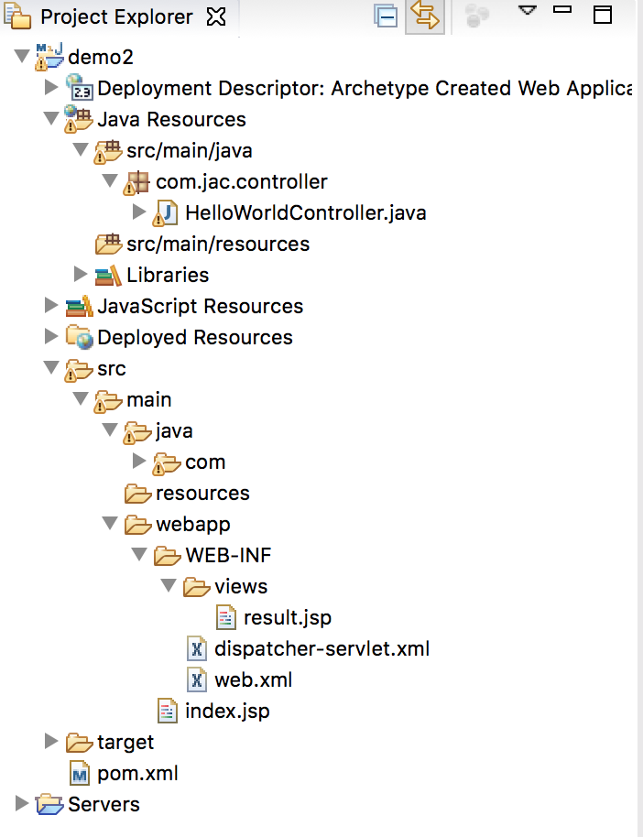
Match your folder structure
If it matches then right click on your project and Run on Server..

Slide 14
Spring MVC Framework
A typical Spring MVC application consists of:
A dispatcher servlet, which will intercept incoming requests.
A configuration file which directs a web container to send requests to a dispatcher servlet
Controllers that execute a business logic and route to relevant Views
URL mapping that instructs a dispatcher servlet how to map URLs to controllers
view resolver that watches out which controller has completed and how to get to the view

Slide 15
Front Controller
Front Controller is very important component one which route the all the requests into framework control
It initialize the framework to cater to the requests.
Load the map of all URLs and the components responsible to handle the request.
Prepare the map for the views.
In Spring MVC, Dispatcher Servlet is the front controller.

Slide 16
Flow in MVC
Whenever request lands the dispatcher servlet consults with HandlerMapping for mapping of URL and have Controller information
Then Dispatcher servlet has information about which is controller need to be invoked
Then that controller will be invoked
Controller can request the model for some information (about some DAO, Service layer or Data in POJO, or data in database using business logic)
once process has been done then dispatcher servlet get the response then dispatcher servlet will get view resolver to build the view
view resolver look out what view has being configured it has been JSP, Velocity, XML etc. based this configuration view has been prepared and the information from model i.e. POJO it will be put on the view and response will be send back to browser.

Slide 17
Lets see some conf files: web.xml
How many of you know about this tag?
<servlet>
<servlet-name>dispatcher</servlet-name>
<servlet-class> org.springframework.web.servlet.DispatcherServlet
</servlet-class>
</servlet>
<servlet-mapping>
<servlet-name>dispatcher</servlet-name>
<url-pattern>/</url-pattern>
</servlet-mapping>

Slide 18
Dispatcher-servlet.xml
In web.xml if servlet name is dispatcher then it will look for dispatcher-servlet.xml,
Web.xml previously
<servlet>
<servlet-name>dispatcher</servlet-name>
<servlet-class> org.springframework.web.servlet.DispatcherServlet
</servlet-class>
</servlet>

Slide 19
Dispatcher-servlet.xml
<context:component-scan base-package="com.jac.controller" />
Used to autodetect classes and register the corresponding beans
<bean class="org.springframework.web.servlet.view.InternalResourceViewResolver">
<property name="prefix" value="/WEB-INF/views/" />
<property name="suffix"> <value>.jsp</value> </property>
</bean>
prefix + view name + suffix
is used to resolve “internal resource view” (in simple, it’s final output, jsp or htmp page) based on a predefined URL pattern.

Slide 20
Spring working
Rest of the working of Spring is similar to what we have already studied
web.xml
Dispatcher-servlet.xml
Controller
Model – service –dao and then back to controller
Controller calls view
View is internally resolved

Slide 21
Setter injection example
<!-- Definition for studentManager bean -->
<bean id="studentManager" class="com.jac.model.service.StudentManager">
<property name="student" ref="student" />
</bean>
<!-- Definition for Student -->
<bean id="student" class="com.jac.model.Student"></bean>

Slide 22
Java Persistence API (JPA)/HIBERNATE
Harpreet Singh
Harpreet.singh@johnabbott.qc.ca

Slide 23
Object-Relational Mapping
It is a programming technique for converting object-type data of an object oriented programming language into database tables.
Hibernate is used convert object data in JAVA to relational database tables.

Slide 24
What is Hibernate?
It is open source object-relational mapping (ORM) for Java.
Hibernate is responsible for making data persistent by storing it in a database.

Slide 25
Why Hibernate and not JDBC?
JDBC maps Java classes to database tables (and from Java data types to SQL data types)
Hibernate automatically generates the SQL queries.
Hibernate provides data query and retrieval facilities and can significantly reduce development time as more time is required to manually handle data in SQL and JDBC.
It makes an application portable to all SQL databases.

Slide 26
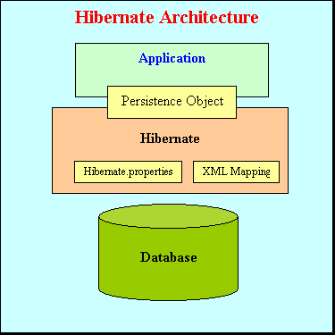
Architecture
Hibernate sits between your code and the database
Maps persistent objects to tables in the database

Slide 27
Hibernate
Configuration Object:
The Configuration object is the first Hibernate object you create in any Hibernate application and usually created only once during application initialization. The Configuration object provides two keys components:
Database Connection: This is handled through configuration files supported by Hibernate. These files are hibernate.properties and hibernate.cfg.xml.
Class Mapping Setup (classname.hbm.xml) This component creates the connection between the Java classes and database tables.

Slide 28
Hibernate
SessionFactory Object:
Configuration object is used to create a SessionFactory object which in turn configures Hibernate for the application using the supplied configuration file and allows for a Session object to be instantiated.
SessionFactory is a thread safe object and used by all the threads of an application.
The SessionFactory is heavyweight object so usually it is created during application start up and kept for later use.
You would need one SessionFactory object per database using a separate configuration file. So if you are using multiple databases then you would have to create multiple SessionFactory objects.

Slide 29
Hibernate
Session Object:
A Session is used to get a physical connection with a database.
It is lightweight and designed to be instantiated each time an interaction is needed with the database. Persistent objects are saved and retrieved through a Session object.
The session objects should not be kept open for a long time because they are not usually thread safe and they should be created and destroyed as needed.

Slide 30
Hibernate
Transaction Object:
A Transaction represents a unit of work with the database and most of the RDBMS supports transaction functionality. Transactions in Hibernate are handled by an underlying transaction manager and transaction (from JDBC or JTA).
This is an optional object and Hibernate applications may choose not to use this interface, instead managing transactions in their own application code.
Query Object:
Query objects use SQL or Hibernate Query Language (HQL) string to retrieve data from the database and create objects. A Query instance is used to bind query parameters and to execute the query.

Slide 31
References
https://maven.apache.org/guides/getting-started/maven-in-five-minutes.html
https://javamagic.wordpress.com/2010/08/27/overview-of-spring/
https://opus.bibliothek.uni-wuerzburg.de/opus4- wuerzburg/frontdoor/deliver/index/docId/4172/file/JavaWebFrameworks.pdf
https://pdfs.semanticscholar.org/presentation/9c42/53b6627aa1fa0b3196c4b7467c3212060168.pdf
https://www.dineshonjava.com/spring-web-mvc-framework-chapter-38/
http://cobweb.cs.uga.edu/~nural/6370/hibernate.ppt

