Slide 1
Cloud Computing with AWS
Suin Yun
Worldwide Financial Services
November 2020
Notes:
Talking points:
Introduce yourself, and give a 30-second overview of your background. Instill confidence in the customer that you are the cloud expert.
AWS Solutions Architect: help you develop advanced cloud based solutions and migrations from on prem workloads to the cloud. We plan, design, and scale AWS cloud implementations using the best practices recommended by AWS.
Learn who is in the room, and why they are there. Familiarity with the cloud. Ask people their names and titles and take note of any immediate areas of interest they would like to target. Make sure to follow-up on these areas as you progress the conversation.
Hopefully we can address some of your questions during this presentation.
Relevant customer examples:
If you have worked with a customer in a similar industry, share details that help build trust.
Conversations topics:
Share interesting bits that may be relevant to the customer to help build trust.
Who is this meeting geared toward?
Director level or lower. Folks that don’t have full ability to say ‘yes’ but are likely influencer or minor stakeholders. These folks are usually somewhere between being ‘down in the weeds’ and ‘ business value/100 level’. They think strategically but usually have a specific objective that they’ve been tasked with solving.
What is this meeting about?
The first customer meeting is about earning the customers trust, opening their mind, and earning the ability to have a follow up meeting. This is done via having a genuine conversation with the customer, learning what business motivators they have and helping them understand how AWS can be a business partner. All in all, being customer obsessed.
What are we trying to articulate on this slide:
This slide is meant to break the ice with the audience and learn about each other.
Other tips:
The deck should be reviewed for accuracy of content and images prior to the presentation.
Be balanced – Be humble, but not too timid
Treat this like a real customer meeting – Don’t break character, and demonstrate how you’d truly interact with a customer in a first meeting
Throughout the meeting, tailor the conversation to the customers industry
Pull in customer examples every chance you can. Be prepared to talk about them in detail.
https://aws.amazon.com/solutions/case-studies/
This deck is meant to be a backdrop to the conversation with the customer. You should be prepared to cover the material, but have a conversation and learn about the customer.
A good rule of thumb is to spend ~5 minutes per slide.
When a Q/A from the External Communication Training is suggested on a slide, you should work on having a clear and accurate response.
Write down customer questions that you can’t answer on the fly, and commit to following up after the meeting (and actually do this just as you would with a customer).
Strive to be contextual in your conversation. Allude back to customers’ roles, or previous questions they’ve asked.

Slide 2
Agenda
Introduction to Cloud + AWS
Key Drivers
Who is using AWS?
How does AWS work?
How can AWS help your business?
Q & A

Slide 3



What is Cloud?
What is Amazon Web Services (AWS)?
A broad and deep platform that helps customers
build sophisticated, scalable, secure applications
Notes:
Talking points:
Cloud Computing is the on-demand delivery of Information Technology resources via internet with Pay as you go pricing model.
Analogy: electricity is wired or the infrastructure of power | you no longer have to buy or maintain data centers and servers. everything you’d want in the traditional datacenters is available on the cloud, with a click of a button, You simply acquire computing, storage, and other services on an as-needed basis. [AWS manages and maintains the technology and infrastructure in a secure environment, and business access resources via internet or private connections]
Amazon Web Services is a cloud computing vendor that provides a highly reliable, scalable, and cost-effective infrastructure platform that powers over a million businesses in 190 countries around the world.
How AWS got started:
Over a decade of experience of e-commerce by building and operating Amazon.com.
Realized that we had developed a core competency in operating massive scale technologies
2006, share to developers and businesses to build sophisticated, modern and secure applications
Amazon is a unique company in how we operate.
Customer Obsessed. Everything we do starts with our customers, and works backwards from their needs. 90 – 95% of our roadmap is driven by customer feedback
We prioritize long-term relationships with trust with our customers.
Conversations topics:
What does your technology and IT infrastructure look like today?
What are we trying to articulate on this slide:
This slide is intended to get more specific about AWS, how it relates to Amazon.com, and how unique we are in this industry.
It is also intended to tell the customer what AWS’ vision of Cloud Computing is.
Other tips:
Review the “What is Cloud Computing” Q/A in the External Communication Training (https://kiku.aws.training/learningobject/wbc?id=24351).
Review the “How was AWS Started” and “What’s different about Amazon” details in the External Communication Training (https://kiku.aws.training/learningobject/wbc?id=24351)
Review AWS Core Messaging doc: https://wisdom.corp.amazon.com/Pages/Messaging.aspx

Slide 4
Why do customers choose AWS?
Agility
Allows teams to experiment and innovate quickly and frequently
Cost Savings
Only pay for what you use, lower upfront expenses
Elasticity
Stop guessing capacity, scale up and down with demand
Innovate Faster
Ability to focus on business differentiators, not infrastructure
Go Global in Minutes
Most extensive, reliable, and secure global cloud infrastructure
Service Breadth & Depth
180+ fully featured services to support any cloud workload
Notes:
What are we trying to articulate on this slide:
This slide is a overview of AWS and the specific value proposition that we bring to our customers.
Talking points:
There are 6 main advantages to AWS:
Agility: We take on the undifferentiated heavy lifting and managing the underlying infrastructure and platform. Enables rapid development, testing and transitioning to production based on the changes in their customer demand. | Capital One – microservices – increased the devOps team's efficiency to more than 99%.
Cost of Savings: Dow Jones 75% collapse (40 -> 6) $100 MM in 3 years
Elasticity: Intuit deployed their tax application – decreased 95% capacity and cost.
Innovate Faster: We offer a wide range of comprehensive offerings of Infrastructure, Platform, and Software as a service like compute offerings with dozens of instance types for all sizes. | FINRA 90% of data volumes to AWS – rapid data analysis and retrieval of 37 billion records daily.
Global in minutes: +190 countries. ASynchronous replication in minutes | S&P Global: singapore & S&P Global 50% in 8 months, $1 MM per month
Breadth of functionality: Coinbase – AI for Fraud Detection – Sophisticated
Conversations topics:
Which one(s) of these are most important to the customer?
Relevant customer examples:
Commonwealth Bank of Australia – Halved their storage costs and estimate they will save hundreds of millions of dollars
Other tips:
Review AWS FAQ Core Messaging doc on https://wisdom.corp.amazon.com/Pages/Messaging.aspx, specifically What are the advantages of moving to the cloud? and Why does AWS continue to be the leader in cloud?
Understand the customer, and tailor this part of the conversation to their business. Perhaps lead with that question on this slide, and spend 80% of time discussing that, with 20% on the other bits
Review the “What are the advantages of moving to the AWS cloud?” in the External Communication Training (https://kiku.aws.training/learningobject/wbc?id=24351)
Have a case study ready using https://aws.amazon.com/solutions/case-studies/

Slide 5



























































Industry leaders are building on AWS
Merck
Notes:
Talking points:
Different Sizes, different industries. They trust our platform to run their business
You can leverage the expertise we bring from working with the customers
We are confident from our experience that we will be able to work through your particular business needs with you.
Relevant customer examples:
Financial services : Goldman Sachs $50 BB, 1MM customers, Barclays UK, Intuit, FINRA, RBC, HSBC​
KMS - allows you to easily create and manage cryptographic keys and control their use across AWS services
Intuit deployed their tax application – decreased 95% capacity and cost. Dow Jones 75% collapse (40 -> 6) $100 MM in 3 years
FINRA 90% of data volumes to AWS – rapid data analysis and retrieval of 37 billion records daily.
SMP Global 50% in 8 months, $1 MM per month
Global in minutes: +190 countries. Synchronous replication in minutes
Breadth of functionality: Coinbase – AI for Fraud Detection – Sophisticated
What are we trying to articulate on this slide:
they trust our platform to run their customer information
Businesses of all sizes and in every industry are using AWS for their workloads.
Customers are using AWS to drive meaningful outcomes for their business and their customers.​
Startups, Enterprises, Small-to-Medium and even Fortune 500 customers are using AWS
AWS can handle every use case thrown at it by customers and those keep expanding
Over the last 14 years, the biggest tech businesses, including Airbnb, Pinterest, and Slack, have built their businesses natively on the AWS Cloud.
Health care: Johnson & Johnson and Merck and Pfizer and Bristol-Myers Squibb and Novartis​
Manufacturing: GE, Schneider Electric, Siemens and Philips​
Oil and gas: Shell, BP, Hess and Halliburton​
Media: Netflix and Disney and Fox and HBO and Turner and Discovery​
Travel and accommodations: Expedia moving everything to AWS, Singapore Air, Ryanair, Korean Airlines, Choice Hotels and Hilton Hotels​
Public sector: About 4,000 government agencies worldwide using AWS, 9,000 academic institutions and about 27,000 non-profits ​
Conversations topics:
What companies do you relate to most?
Other tips:
(Optional) Add a slide which highlights an industry use-case that is specific to your customer: https://aws.amazon.com/solutions/case-studies/

Slide 6
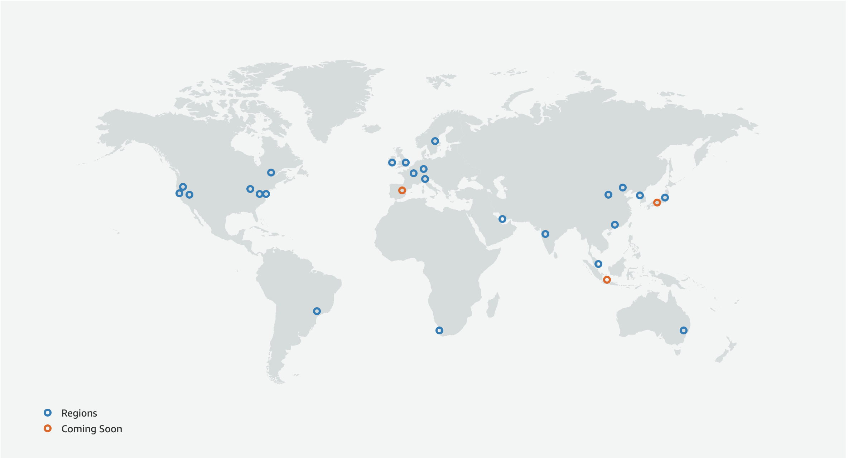
Scale globally with resilience in every region
The largest global foot print consistently built with a multi-AZ and multi-datacenter design
AWS Region
AWS Availability Zone (AZ)
Transit
AZ
Datacenter
Datacenter
AZ
AZ
AZ
Datacenter
Transit
#
Region & Number of Availability Zones
Announced Regions
A Region is a physical location in the world where we have multiple Availability Zones.
Availability Zones consist of one or more discrete data centers, each with redundant power, networking, and connectivity, housed in separate facilities.
Cape Town, Jakarta, Milan, Spain and Osaka
24 Regions
77 Availability Zones
216 Points of Presence
Notes:
Talking points:
AWS Infrastructure Details and overviews our global scale.
Region – AZ - Datacenters
To support global businesses we maintain 24 geographic regions around the world.
AWS Cloud Spans across 77 Availability Zones.
To have multiple AZ in one region means… deployment of web servers and even databases across 2 AZ’s with synchronous replication. 3 tier app: web servers across Az’s, load balancer, database across AZs with our RDS with Sync replication, automatic failover in case there is an issue with one AZ
Multiple AZ’s to deploy? Depends on the customer’s resilience and reliability requirements.
Each region also has two independent, fully redundant transit centers that allow traffic to cross the AWS backbone network, enabling regions to connect to the global network.
synchronous replication allows fail-over from primary to secondary data storage to occur nearly instantaneous, to ensure little to no application downtime.
Conversations topics:
Where are your customers located?
Region & Number of Availability Zones
US East N. Virginia (6), Ohio (3) US West N. California (3),Oregon (3) Asia Pacific Mumbai (2), Seoul (2), Singapore (3), Sydney (3), Tokyo (4), Osaka-Local (1)¹ Canada Central (2) China Beijing (2), Ningxia (3) Europe Frankfurt (3), Ireland (3), London (3), Paris (3) South America São Paulo (3) GovCloud (US) US-East (3), US-West (3), Bahrain (3), Hong Kong SAR (3), Milan (3), Stockholm (3).
Planned: Spain, Jakarta, Osaka
This reach is important because:
You can replicate your infrastructure in any region in the world in minutes
Data stays in the region you place it in—we do not move your data which is important in countries like Germany where locality is essential to doing business
You can architect your applications to span availability zones and regions to take advantage for both availability and low-latency performance for your users across the globe
Relevant customer examples:
This is an opportunity to pull in several customer names from across our customer base.
What is your current infrastructure footprint?
Other tips:
Not all customers have a global need. Focusing these customers on the ability to build applications across AZs, discussing edge locations and other customer types here will be key.
Review the website to make sure this slide is updated with the correct public information.

Slide 7
Broad and Deep Functionality
Notes:
Talking points:
There are 182 ff products and services and SAs are here to provide guidance that support each customer to meet the desired outcome.
Continually expanding our offerings to support any cloud workload
Customers can choose what is right for them, and use as much or as little AWS products as needed
Everything is built on core services such as Compute, Storage, Databases and Networking
Our database services offer several DB engines including MySQL, MSSQL, Oracle, PostgreSQL, etc. and include features such as multi-AZ replication, automatic backups, etc.
Higher level product categories range from Analytics such as data warehousing to Enterprise Applications such as corporate email and virtual desktops.
professional services and support.
Customers can leverage higher level services to remove undifferentiated heavy lifting, or continue to operate with core/primitive services to function as they have in the past
For commercial products, we have a larger partner ecosystem which offers technologies and tools from partners like F5, Cisco, etc.
Relevant customer examples:
Identify at least one other AWS customer that is relevant to this customer, and give details on a solution they’re running on AWS.
Conversations topics:
What kind of technologies and solutions are you leveraging today?
Where areas are working well for you, and which aren’t?
What functionality or capabilities are you interested in?
Do you have resources that spend time working on non-business related tasks (managing backups, storage admins, etc.)
Other tips:
This slide can be daunting at first glance, but is very powerful in telling our breadth and depth.
Take notice that there are no product name references here. We are abstracting our service/product names here, and driving toward the technology area that resonates with the customer
Go into the meeting knowing some technologies that the customer uses. This will require some prep work.
Take a look at how Andy covered this topic, https://youtu.be/1IxDLeFQKPk?t=532 . You can start from the bottom left and move across. Talk about not just the broad number of categories here, but that there is depth in each of these.
Be able to talk to these services at a high-level using Level 100 Services Wiki (https://w.amazon.com/bin/view/SA_Onboarding_Level_100_Technical_Product_Content_and_Resources/), or AWS Tech Professional Course (https://kiku.aws.training/Details/Curriculum?id=45423).
If you don’t have the answer to a question about a specific service remember to handle it gracefully. For example, indicate to the customer that you don’t know the answer (never lie) and say you will follow-up with a specialist and get back to them. And actually get back to them as if it were a real-world scenario.

Slide 8
Share your security responsibility with AWS
Customer data
Platform, applications, identity, & access management
Operating system, network, & firewall configuration
Client-side data encryption & data integrity authentication
Server-side encryption (file system &/or data)
Network traffic protection (encryption/integrity/identity)
Customer is responsible for security in the cloud
Compute
Storage
Database
Networking
AWS Global Infrastructure
Regions
Edge locations
Customer
Availability Zones
AWS
AWS is responsible for security of the cloud
Notes:
What are we trying to articulate on this slide:
Security is our number 1 priority, and the AWS Cloud has been architected to be one of the most flexible and secure cloud environments available.
The Shared Responsibility Model – We take care of security of the cloud. This is the physical infrastructure, the facilities, the actual compute and building blocks.
You, as a customer, take care of security in the cloud. This means you secure workloads and applications that you deploy onto the cloud. This means that you have the flexibility to put more emphasis on security of sensitive data, and adjust as needed in areas where you have less concern.
GDPR & PII
Relevant customer examples:
"When you’re in telehealth and you touch protected health information, security is paramount. AWS is absolutely critical to do what we do today. Security and compliance are table stakes. If you don’t have those, the rest doesn’t matter." - Cory Costley, Chief Product Officer, Avizia
https://aws.amazon.com/compliance/testimonials/
Conversations topics:
What kind of security controls/processes do you have at the moment?
Other tips:
Review the “Is the AWS Cloud secure” and “What are the key competitive differentiators between AWS and other cloud providers” details in the External Communication Training

Slide 9
Inherit global security and compliance controls
Certifications / Attestations |  |  | Laws / Regulations / Privacy |  |  | Alignments / Frameworks
C5 | 🇩🇪 | ✔ | Agentina Data Privacy |  | ✔ | CIS (Center for Internet Security) | 🌐 | ✔
Cyber Essentials Plus | 🇬🇧 | ✔ | CISPE | 🇪🇺 | ✔ | CJIS (US FBI) | 🇺🇸 | ✔
DoD SRG | 🇺🇸 | ✔ | EU Model Clauses | 🇪🇺 | ✔ | CSA (Cloud Security Alliance) | 🌐 | ✔
FedRAMP | 🇺🇸 | ✔ | FERPA | 🇺🇸 | ✔ | ENS High | 🇪🇸 | ✔
FIPS | 🇺🇸 | ✔ | GDPR | 🇪🇺 | ✔ | EU-US Privacy Shield | 🇪🇺 | ✔
HITRUST | 🇺🇸 | ✔ | GLBA | 🇺🇸 | ✔ | FFIEC | 🇺🇸 | ✔
IRAP | 🇦🇺 | ✔ | HIPAA | 🇺🇸 | ✔ | FISC | 🇯🇵 | ✔
ISO 9001 | 🌐 | ✔ | HITECH | 🌐 | ✔ | FISMA | 🇺🇸 | ✔
ISO 27001 | 🌐 | ✔ | IRS 1075 | 🇺🇸 | ✔ | G-Cloud | 🇬🇧 | ✔
ISO 27017 | 🌐 | ✔ | ITAR | 🇺🇸 | ✔ | GxP (US FDA CFR 21 Part 11) | 🇺🇸 | ✔
ISO 27018 | 🌐 | ✔ | My Number Act | 🇯🇵 | ✔ | ICREA | 🌐 | ✔
K-ISMS | 🇰🇷 | ✔ | UK DPA - 1988 | 🇬🇧 | ✔ | IT Grundschutz | 🇩🇪 | ✔
MTCS | 🇸🇬 | ✔ | VPAT/Section 508 | 🇺🇸 | ✔ | MITA 3.0 (US Medicaid) | 🇺🇸 | ✔
PCI DSS Level 1 | 🌐 | ✔ | Data Protection Directive | 🇪🇺 | ✔ | MPAA | 🇺🇸 | ✔
SEC Rule 17-a-4(f) | 🇺🇸 | ✔ | Privacy Act [Australia] | 🇦🇺 | ✔ | NIST | 🇺🇸 | ✔
SOC 1, SOC 2, SOC 3 | 🌐 | ✔ | Privacy Act [New Zealand] | 🇳🇿 | ✔ | PHR | 🇺🇸 | ✔
 |  |  | PDPA—2010 [Malaysia] | 🇲🇾 | ✔ | Uptime Institute Tiers | 🌐 | ✔
 |  |  | PDPA—2012 [Singapore] | 🇸🇬 | ✔ | Cloud Security Principles | 🇬🇧 | ✔
 |  |  | PIPEDA [Canada] | 🇨🇦 | ✔
🌐 = industry or global standard |  |  | Spanish DPA Authorization | 🇪🇸 | ✔
 |  |  | Spanish DPA Authorization | 🇪🇸 | ✔
Notes:
30 seconds - questions | Park the question? IDK and specialist
FIPS, SOC1-3, PCI-DSS
IRS, GLBA, GDPR
What are we trying to articulate on this slide:
That we provide services that meet compliance standards to help you achieve compliance of your workloads
You use our building blocks to build your applications and then have audits performed so that you retain compliance
Talking points:
We have achieved and secured for our customers several industry recognized certifications such as SOC1, SOC2, SOC3 and ISO27001
Can run HIPAA and PCI compliant workloads on AWS
Relevant customer examples:
"It is in our best interest to achieve HIPAA compliance for Globus Genomics. Recently, Amazon Web Services started signing BAAs that help us achieve compliance for the analysis services that were built on top of AWS." - Ravi Madduri, Research Fellow and Project Management, The University of Chicago
https://aws.amazon.com/compliance/testimonials/
Conversations topics:
What kind of compliance requirements do you have?
Other tips:
Trim the list to security and compliance controls that are relevant to your customer’s industry
Make sure you can talk to any of the certifications that are listed on the slide. If the control is on the slide, you should know what it is and how it could impact workloads for this customer.

Slide 10


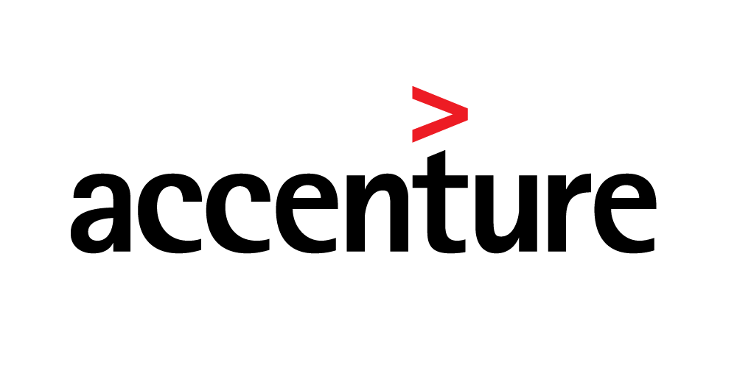
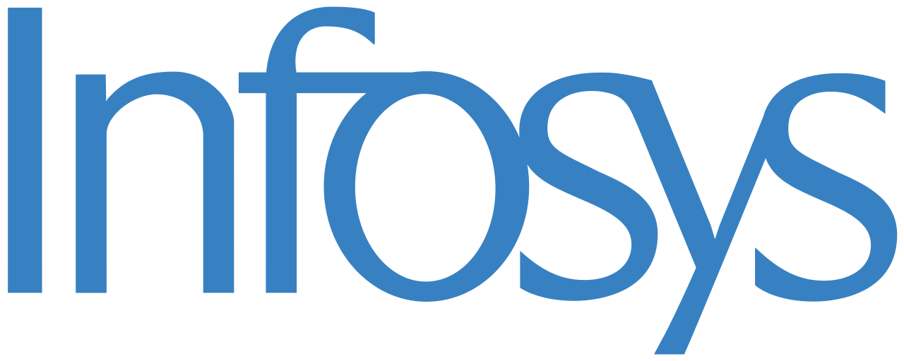
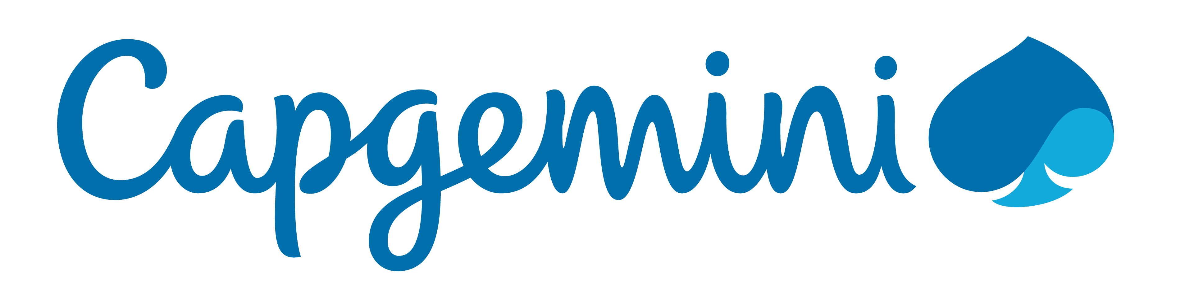







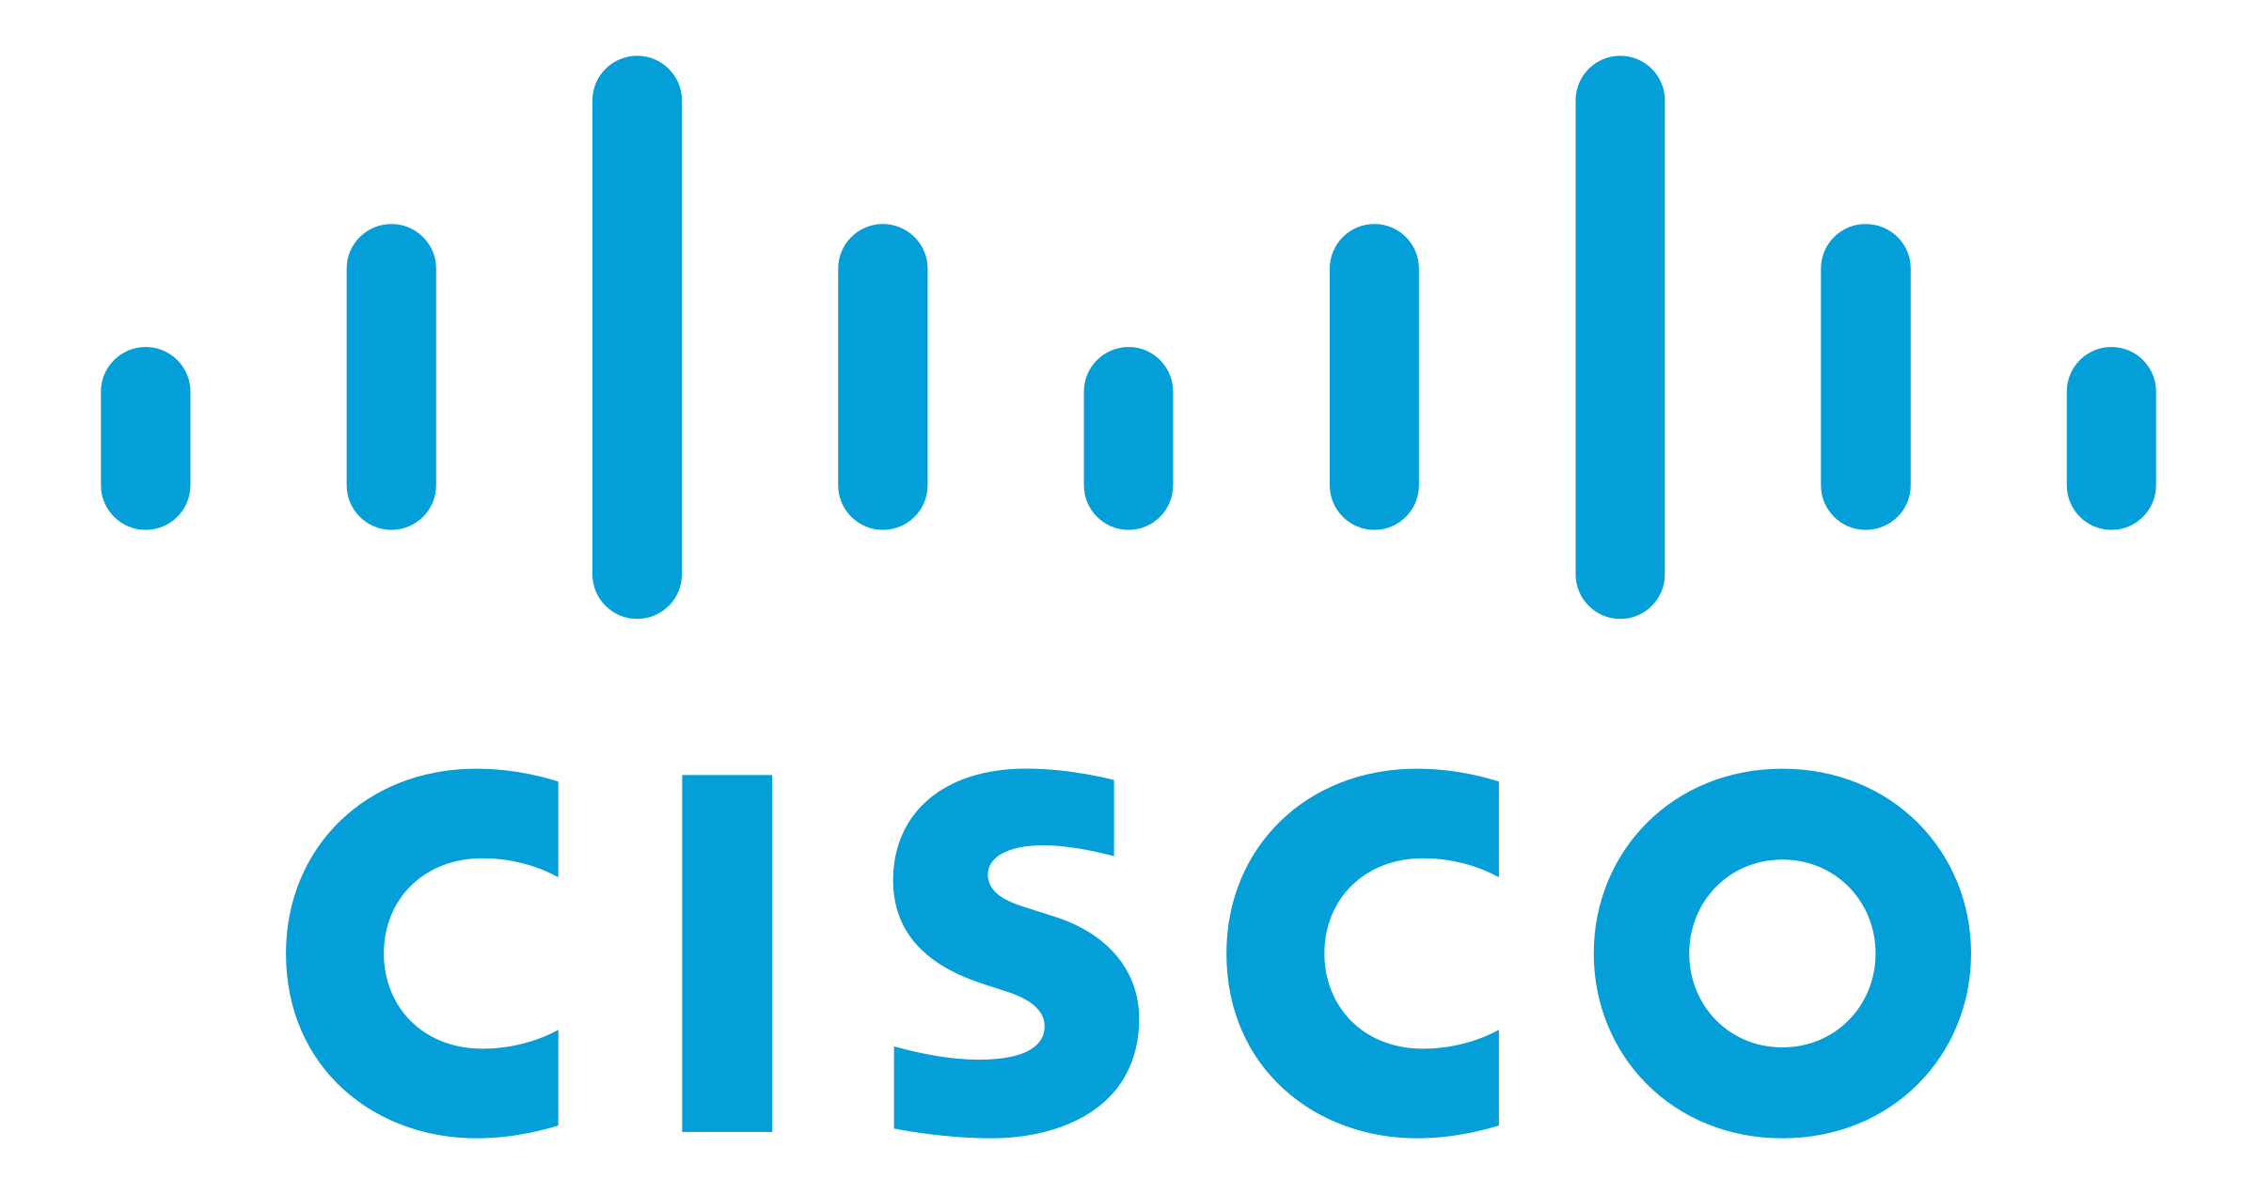
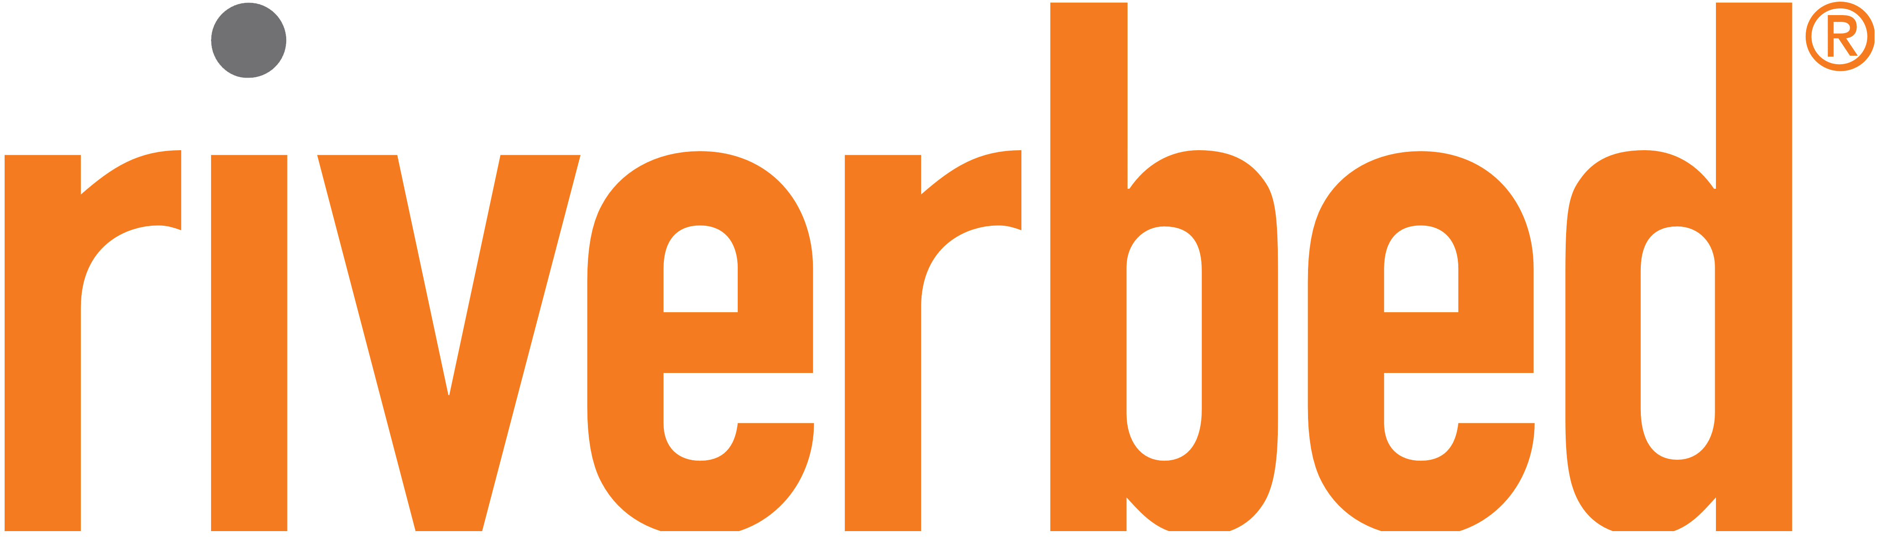
An Expansive Ecosystem
Thousands of the world’s largest technology and consulting companies
48+ Global Premier Consulting partners
12+ Enterprise-focused competencies
2,200+ products available for 1-click deployment across 35 distinct product categories
Customers run over 143M hours of software per month
Notes:
What are we trying to articulate on this slide:
This slide helps customers know that they are not in this on their own, and that they won’t have to start from scratch.
Talking points:
AWS ecosystem is the largest global community of customers and partners
Our ecosystem can be broken into 2 main categories, 8000 Systems Integrators (consulting partners) and 2000 Independent Software Vendors.
AWS Partner Network (APN) includes the largest SIs such as Deloitte and Accenture, as well regional and boutique partners like 2nd Watch that have built their practices around AWS.
APN also includes some of the largest ISVs such as Microsoft, Oracle and SAP that integrate into our platform, to those that have built their platform on top of AWS, such as Heroku, Engine Yard, etc.
The AWS Marketplace makes it easy to 1-click deploy software and solutions they need to build and run their businesses.
Marketplace simplifies licensing and billing for customers.
Gives access to thousands of commercial and open source solutions that customers are familiar with and already running in your existing environments.
Relevant customer examples:
N/A
Conversations topics:
Do you currently have AWS or cloud expertise in house?
Do you work with any consulting partners today?
What type of commercial and open source software do you leverage today?
Other tips:
Review the “Tell me more about your partner ecosystem” and “Tell me more about the AWS Marketplace” details in the External Communication Training

Slide 11
Getting started in your cloud journey
Continuous Reinvention
Value
Cloud native
Modernization
Project
Foundation
Legacy applications
and data
Migration
Time
Notes:
30 seconds | Not all the same; No Whole Migration at once;
For most enterprise/FSI customers, moving to cloud is a journey, not overnight. Usually journeys start with some experimentations (POC), next build foundation (account structure, guard rails, landing zone [network connectivity and IAM structure]), migration of the application, then focus on different categories of the applications. -> finally the reinvention phase. Not necessarily a linear journey, sometimes there are not migrations, you are just building and going straight through the reinvention.
What are we trying to articulate on this slide:
Describe the stages of cloud adoption from getting your feet wet to being all in on the cloud
Our customers are moving to the cloud to accelerate innovation, un-trap their data to drive new insights, achieve higher savings, and reduce their business risks.
While many enterprises are starting on their cloud journey by moving individual projects and perhaps claiming they are “cloud-first” for new applications, we have seen that the organizations who are most successful are those that aggressively address the challenges of mass migration early in their journey.
Talking points:
Today we see most organizations have these two distinct paths to their next generation of infrastructure: Cloud Native or Migration. One is where they start on the Cloud and the latter is where they have existing infrastructure that needs to be moved across.
Customer journeys to the Cloud typically involve these four phases (Don’t have to memorize this word for word but talk to the key point of each phase):
Project Phase - AWS is evaluated and vetted on a project-by-project basis. Early in the journey, businesses are in the Project Phase where they are looking to develop brand new business capabilities by taking advantage of cloud-native features.
Foundation Phase - After experiencing the benefits of cloud, customers then build the Foundation to scale their cloud adoption. This includes creating a landing zone (i.e. their cloud architecture including account structure, network connectivity and Identity Management), Center of Excellence, Operations Model, and Security and Compliance readiness. AWS becomes a proven choice and is often used for new projects.
Migration Phase – Businesses then move to a Migration Phase where they migrate existing applications, including mission-critical applications, or entire data centers to the cloud as they look to scale their adoption across a growing portion of their IT portfolio. Currently very few companies are in this Migration Phase, estimates are that less than 25% of enterprise level workloads have been moved to the cloud.
Modernization Phase - Modernization is when you're making the transformation to the cloud you have to make a lot of decisions on what you’re going to bring, and what you’re going to leave behind. E.g. Moving away from mainframes, moving away from older-guard commercial-grade relational databases (Oracle and SQL Server), moving from Windows to Linux, choice of technology and consulting partners
Reinvention Phase - The end stage of the journey is the Reinvention Phase. In the this stage, with operations in the cloud, customers focus on reinvention, taking full advantage of the flexibility and capabilities of AWS to transform their businesses, speeding time to market and innovation.
Relevant customer examples:
Capital One: https://aws.amazon.com/blogs/enterprise-strategy/capital-ones-cloud-journey-through-the-stages-of-adoption/
Conversations topics:
At this point you should know which phase the customer is in and which path they are on. Therefore you should be able to talk to it
Does the customer have any standard applications or use-cases that they’d like to cover in more detail, or learn about?
Other tips:
Review AWS Cloud Adoption Framework: https://d1.awsstatic.com/whitepapers/aws_cloud_adoption_framework.pdf?did=wp_card&trk=wp_card

Slide 12

Next steps
What problem can we help
solve?
Notes:
Tie back the project phase. Where should we get started? Make it prescriptive – recommend a few things you can do. I can work with you for diving deep for some AWS services, Follow up discussions with security/compliance. Discussing of building proof of concepts. Initial work loads you want to start experimenting with the clouds.
What are we trying to articulate on this slide:
Here we are trying to secure the next step with the customer and take the conversation from stakeholders to the technical implementers and doers.
Talking points:
Recap some of the points that resonated with the customer throughout the meeting.
Discuss what workloads customers typically start with.
What does a Proof of Concept look like on AWS, and how you can work with their team to get started.
Relevant customer examples: N/A
Conversations topics:
What is a workload that the customer is willing to experiment with in AWS?
What are the customers keys to success?
Other tips:
Ensure you thank everyone for their time and participation.
Recap all questions you’ve written down throughout, and recap follow-up action items by repeating them back to the customer: say the topics + the names.

