Slide 1
DATA STRUCTURES AND ALGORITHMS
Textbook:
Fundamentals of Data Structure in C++, Silicon Press
ElliS Horowitz, Sartaj Sahni, Dinesh Mehta
Teacher:
刘志昊
Email: lzh@seu.edu.cn
地 址：东南大学九龙湖校区计算机楼4楼/5楼

Slide 2
Teaching assistants:
郑思豪, Email:756673587@qq.com, Tel: 15852931110 (Class 3)
常欣辰, Email: 1054942583@qq.com, Tel: 15850559060 (Class 4)
Assignments submitted by email.

Slide 3
Total class hours: 64
week 1-16
Total lab. hours: 16

Slide 4
Assignments and projects:
Should be submitted to teaching assistants in time.

Slide 5
Evaluation:
Course Attendance: 10%,
Exercises and Projects: 20％，
Final Examination (Textbook and Course Notes allowed): 70％

Slide 6
References:
1 金远平, 数据结构( C++描述), 清华大学出版社, 2005
2 T. A. Standish, Data Structures, Algorithms & Software Principles in C, Addison-Wesley Publishing Company, 1994
3 殷人昆，数据结构(用面向对象方法与C++语言描述)第二版，清华大学出版社，2007

Slide 7
Tips
Make good use of your time in class
  Listening
  Thinking
  Taking notes
Expend your free time
  Preview and Review
  Programing
Take a pen and some paper with you
  Notes
  Exercises

Slide 8
Prerequisites:
Programming Language: C, C++
Pointer in C & C++

Slide 9
物有本末，事有终始。
知所先后，则近道矣。

Slide 10
In Computer science, a data structure is a particular way of storing and organizing data in a computer so that it can be used efficiently.

Slide 11
Sorting
Rearrange a[0], a[1], …, a[n-1] into ascending order. When done, a[0] <= a[1] <= … <= a[n-1]
8, 6, 9, 4, 3 => 3, 4, 6, 8, 9
Notes:
Strictly speaking, nondecreasing order: 2, 2, 3, 6, 8, 8, 10.

Slide 12
Sort Methods
Insertion Sort
Bubble Sort
Selection Sort
Counting Sort
Shell Sort
Heap Sort
Merge Sort
Quick Sort
……

Slide 13
Insert An Element
Given a sorted list/sequence, insert a new element
Given 3, 6, 9, 14
Insert 5
Result 3, 5, 6, 9, 14

Slide 14
Insert an Element
3, 6, 9, 14 insert 5
Compare new element (5) and last one (14)
Shift 14 right to get 3, 6, 9, , 14
Shift 9 right to get 3, 6, , 9, 14
Shift 6 right to get 3, , 6, 9, 14
Insert 5 to get 3, 5, 6, 9, 14

Slide 15
Insert An Element
// insert t into a[0:i-1]
int j;
for (j = i - 1; j >= 0 && t < a[j]; j--)
a[j + 1] = a[j];
a[j + 1] = t;

Slide 16
Insertion Sort
Start with a sequence of size 1
Repeatedly insert remaining elements

Slide 17
Insertion Sort
Sort 7, 3, 5, 6, 1
Start with 7 and insert 3 => 3, 7
Insert 5 => 3, 5, 7
Insert 6 => 3, 5, 6, 7
Insert 1 => 1, 3, 5, 6, 7

Slide 18
Insertion Sort
for (int i = 1; i < a.length; i++)
{// insert a[i] into a[0:i-1]
// code to insert comes here
}

Slide 19
Insertion Sort
for (int i = 1; i < a.length; i++)
{// insert a[i] into a[0:i-1]
int t = a[i];
int j;
for (j = i - 1; j >= 0 && t < a[j]; j--)
a[j + 1] = a[j];
a[j + 1] = t;
}

Slide 20

Insertion Sort
for (int i = 1; i < a.length; i++)
{// insert a[i] into a[0:i-1]
int t = a[i];
int j;
for (j = i - 1; j >= 0 && t < a[j]; j--)
a[j + 1] = a[j];
a[j + 1] = t;
}

Slide 21
Basic Concepts
Purpose:
Providing the tools and techniques necessary to design and implement large-scale software systems. Discussing necessary methodologies:
Data abstraction and encapsulation
Algorithm specification and design
Performance analysis and measurement
and
Recursive programming

Slide 22
1.1 Overview: System Life Cycle
Good programmers regard large-scare computer programs a system.
(1) Requirements
(2) Analysis
(3) Design
(4) Refinement and coding
(5) Verification and maintenance

Slide 23
Overview: System Life Cycle
(1) Requirements
All large programming projects begin with a set of specifications that define the purpose of the project.
input
output
(2) Analysis
begin to break the problem into manageable pieces
    bottom-up
    top-down

Slide 24
Overview: System Life Cycle
(3) Design
Approaches the system from the designer’s angle of the
data objects
operations on them
TO DO
abstract data type
algorithm specification and design strategies
Example: scheduling system of university
data objects: student, courses, teachers…
operations: inserting, removing, searching…
Notes:
Abstract data type will be introduced later

Slide 25
(4) Refinement and coding
representations for data object
algorithms for operations
(5) Verification and maintenance
correctness proofs
testing with a variety of input data
removing errors

Slide 26
1.3 Data Abstraction and Encapsulation
(p.7)Data Encapsulation or information Hiding is the concealing of the implementation details of a data object from the outside world.
(p.7)Data Abstraction is the separation between the specification of a data object and its implementation.
DVD player example.

Slide 27
(p.8)A Data Type is a collection of objects and a set of operations that act on those objects.
predefined and user-defined:
char, int, arrays, structs, classes.
(p.8)An Abstract Data Type (ADT) is a data type that is organized in such a way that the specification of the objects and the specification of the operations on the objects is separated from the representation of the objects and the implementation of the operations.

Slide 28
Benefits of data abstraction and data encapsulation:
(1) Simplification of software development
Applicaton : data types A, B, C & Code Glue
(a) a team of 4 programmers
(b) a single programmer

Slide 29
(2) Simplifying testing and debugging
Code with data abstraction
Code without data abstraction
A
B
C
Glue
Unshaded areas represent code to be searched for bugs.

Slide 30
(3) Reusability
Data abstraction and encapsulation typically give rise to data structures that are implemented as distinct entities of a software system. This makes it easier to extract the code for a data structure and its operations.
(4) Modifications to the representation of a data type
a change in the internal implementation of a data type will not affect the rest of the program as long as its interface does not change.

Slide 31
1.5 Algorithm Specification
An algorithm is finite set of instructions that, if followed, accomplishes a particular task.
Must satisfy the following criteria:
(1) Input Zero or more quantities externally supplied.
(2) Output At least one quantity is produced.
(3) Definiteness Clear and unambiguous.
(4) Finiteness Terminates after a finite number of steps.
(5) Effectiveness Basic enough, feasible

Slide 32
Compare: algorithms and programs
Finiteness

Slide 33
Recursive Algorithms
Direct recursion
Indirect recursion
Similar to mathematical induction

Slide 34
Exercises: P32-2，P33-14

Slide 35
1.7 Performance Analysis and Measurement
(p.38)Definition:
The Space complexity of a program is the amount of memory it needs to run to completion.
The Time complexity of a program is the amount of computer time it needs to run to completion.
Priori estimates --- Performance analysis
(2) Posteriori testing--- Performance measurement

Slide 36
Performance Analysis
Space complexity
The space requirement of program P:
S(P)=c+S_{P}(instance characteristics)
We concentrate solely on S_{P}.

Slide 37
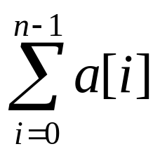
Performance Analysis
Example 1.10
float Rsum (float *a, const int n) //compute recursively
{
if (n <=0) return 0;
else return (Rsum(a,n-1)+a[n-1]);
}

Slide 38
The instances are characterized by
n
each call requires 4 words (n, a, return value,return address)
the depth of recursion is
n+1
S_{rsum}(n) =
4(n+1)

Slide 39
Time complexity
Run time of a program P:
T(P)=c + t_{P}(instance characteristics)
A program step is loosely defined as a syntactically or semantically meaningful segment of a program that has an execution time that is independent of instance characteristics.
In P41-43 of the textbook, there is an detailed assignment of step counts to statements in C++.

Slide 40
Step Count
A step is an amount of computing that does not depend on the instance characteristic n
10 adds, 100 subtracts, 1000 multiplies
can all be counted as a single step
n adds cannot be counted as 1 step

Slide 41
Our main concern:
how many steps are needed by a program to solve a particular problem instance?
2 ways:
introducing a global new variable count
(2) building a table

Slide 42
Example 1.12
count=0;
float Rsum (float *a, const int n)
{
count++; // for if
if (n <=0) {
count++; // for return
return 0;
}
else {
count++; // for return
return (Rsum(a,n-1)+a[n-1]);
}
}
t_{Rsum}(0) = 2,
t_{Rsum}(n) = 2+ t_{Rsum}(n-1)
= 2+2+ t_{Rsum}(n-2)
.
.
.
= 2n+ t_{Rsum}(0)
=2n+2

Slide 43
Example 1.14 Fibonnaci numbers
1 void Fibonnaci (int n)
2 { // compute the Fibonnaci number F_{n}
3 if (n <=1) cout << n<< endl; { // F₀=0 and F₁ =1
4 else { // compute F_{n}
5 int fn; int fnm2=0; int fnm1=1;
6 for (int i=2; i<=n; i++)
7 {
8 fn=fnm1+fnm2;
9 fnm2=fnm1;
10 fnm1=fn;
11 } //end of for
12 cout <<fn<<endl;
13 } //end of else
14 }

Slide 44
Let us use a table to count its total steps.
Line s/e frequency total steps
1 0 1 0
2 0 1 0
3 1 (n >1) 1 1
4 0 1 0
5 2 1 2
6 1 n n
7 0 n-1 0
8 1 n-1 n-1
9 1 n-1 n-1

Slide 45
10 1 n-1 n-1
11 0 n-1 0
12 1 1 1
13 0 1 0
14 0 1 0
So
for n>1, t_{Fibonnci}(n)=4n+1,
for n=0 or 1, t_{fibonnci}(n) =2

Slide 46
Sometime, the instance characteristics is related with the content of the input data set.
For many programs, the time complexity is not dependent solely on the number of inputs or outputs or some other easily specified characteristic
e.g., BinarySearch.
Hence:
best-case
worst-case,
average-case.

Slide 47
Asymptotic Notation (O)
Because of the inexactness of what a step stands for, we are mainly concerned with the magnitude of the number of steps.
Definition [O]: f(n)=O(g(n)) iff there exist positive constants c and n₀ such that f(n) ≤ c g(n) for all n, n>n₀.
Example 1.15: 3n+2=O(n), 6*2^{n}+n²=O(2^{n}),…

Slide 48
Note g(n) is an upper bound. It does not say anything about how good this bound is.
n=O(n² ), n= O(2^{n}), …,
for f(n)=O(g(n)) to be informative, g(n) should be
as small as possible.
In practice, the coefficient of g(n) should be 1. We never say O(3n).

Slide 49
Theory 1.2: if f(n)=a_{m}n^{m}+…+ a₁n+a₀, then f(n)=O(n^{m}).
When the complexity of an algorithm is actually, say, O(log n), but we can only show that it is O(n) due to the limitation of our knowledge. It is OK to say so. This is one benefit of O notation as upper bound.

Slide 50
Asymptotic Notation (Ω)
Definition [Ω]: f(n)=Ω (g(n)) iff there exist positive constants c and n₀ such that f(n) ≥c g(n) for all n, n>n₀.
Example 1.16: 3n+2=Ω (n), 6*2^{n}+n²=Ω (2^{n}),…

Slide 51
Note g(n) is an lower bound.
n²=O(n ), 2^{n}= O(n), …,
for f(n)= Ω(g(n)) to be informative, g(n) should be
as large as possible.
In practice, the coefficient of g(n) should be 1. We never say Ω(3n).
Theory 1.3: if f(n)=a_{m}n^{m}+…+ a₁n+a₀, and a_{m}>0 then f(n)= Ω(n^{m}).

Slide 52
Asymptotic Notation (Θ)
Definition [Θ]: f(n)=Θ (g(n)) iff there exist positive constants c₁, c₂ and n₀ such that c₁ g(n) ≤f(n) ≤c₂ g(n) for all n, n>n₀.
Example 1.17: 3n+2=Θ (n), 6*2^{n}+n²=Θ (2^{n}),…
The theta notation is more precise than both the “big oh” and omega notations.
f(n)=Θ (g(n)) iff g(n) is both an upper and lower bound on f(n).
Theory 1.4: if f(n)=a_{m}n^{m}+…+ a₁n+a₀, and a_{m}>0 then f(n)= Θ (n^{m}).

Slide 53
A Few Comparisons
Function #1
n³ + 2n²
n^{0.1}
n + 100n^{0.1}
5n⁵
n⁻¹⁵2^{n}/100
8^{2log n}
Function #2
100n² + 1000
log n
2n + 10 log n
n!
1000n¹⁵
3n⁷ + 7n

Slide 54
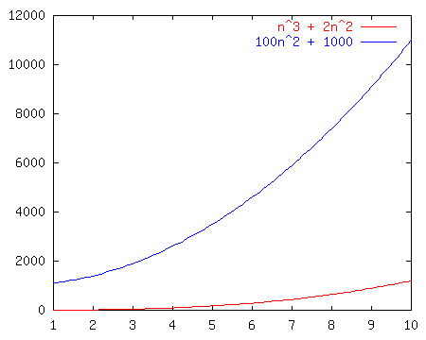
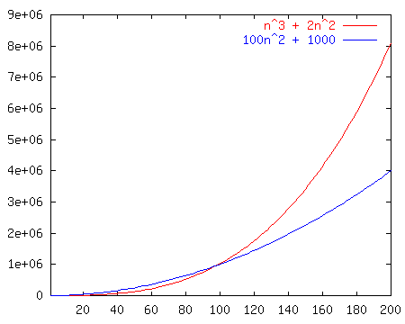
Race I
n³ + 2n²
vs.
100n² + 1000

Slide 55
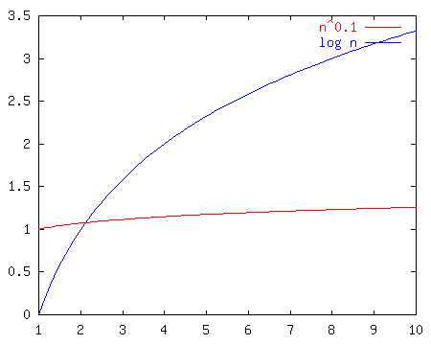
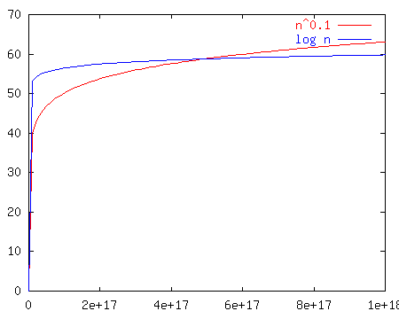
Race II
n^{0.1}
vs.
log n
Notes:
Well, log n looked good out of the starting gate and indeed kept on looking good until about n^17 at which point n^0.1 passed it up forever.
Moral of the story? N^epsilon beats log n for any eps > 0. BUT, which one of these is really better?

Slide 56
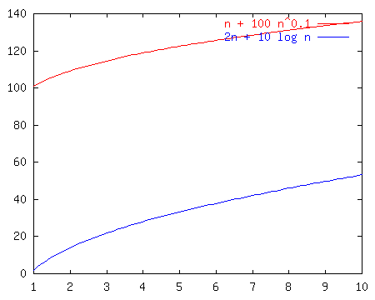
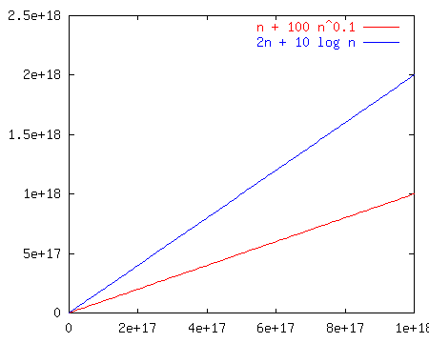
Race III
n + 100n^{0.1}
vs.
2n + 10 log n
Notes:
Notice that these just look like n and 2n once we get way out. That’s because the larger terms dominate. So, the left is less, but not asymptotically less.
It’s a TIE!

Slide 57
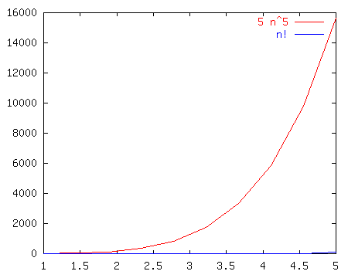
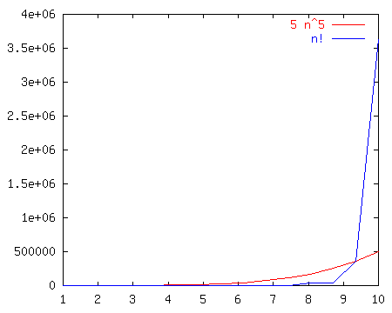
Race IV
5n⁵
vs.
n!
Notes:
N! is BIG!!!

Slide 58
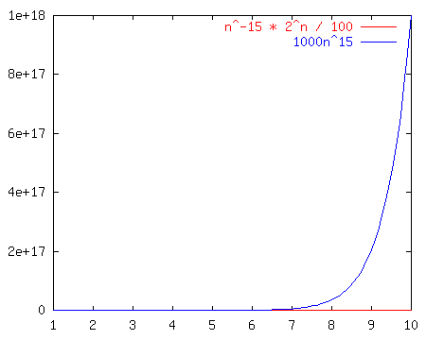
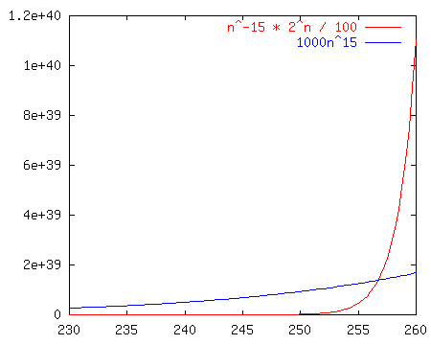
Race V
n⁻¹⁵2^{n}/100
vs.
1000n¹⁵
Notes:
No matter how you put it, any exponential beats any polynomial. It doesn’t even take that long here (~250 input size)

Slide 59
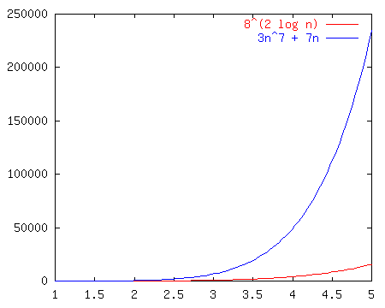
Race VI
8^{2log(n)}
vs.
3n⁷ + 7n
Notes:
We can reduce the left hand term to n^6, so they’re both polynomial and it’s an open and shut case.

Slide 60
The Losers Win
Better algorithm!
O(n²)
O(log n)
TIE O(n)
O(n⁵)
O(n¹⁵)
O(n⁶)
Function #1
n³ + 2n²
n^{0.1}
n + 100n^{0.1}
5n⁵
n⁻¹⁵2^{n}/100
8^{2log n}
Function #2
100n² + 1000
log n
2n + 10 log n
n!
1000n¹⁵
3n⁷ + 7n
Notes:
Welcome, everyone, to the Silicon Downs. I’m getting race results as we stand here.
Let’s start with the first race. I’ll have the first row bet on race #1. Raise your hand if you bet on function #1 (the jockey is n^0.1)
So on.
Show the race slides after each race.

Slide 61
Common Names
  constant: O(1)
  logarithmic: O(log n)
  linear: O(n)
  log-linear: O(n log n)
  quadratic: O(n²)
  polynomial: O(n^{k}) (k is a constant)
  exponential: O(c^{n}) (c is a constant > 1)
Notes:
Well, it turns out that the old Silicon Downs is fixed. They dope up the horses to make the first few laps interesting, but we can always find out who wins.
Here’s a chart comparing some of the functions. Notice that any exponential beats any polynomial.
Any superlinear beats any poly-log-linear.
Also keep in mind (though I won’t show it) that sometimes the input has more than one parameter. Like if you take in two strings. In that case you need to be very careful about what is constant and what can be ignored.
O(log m + 2^{n}) is not necessarily O(2^{n})

Slide 62
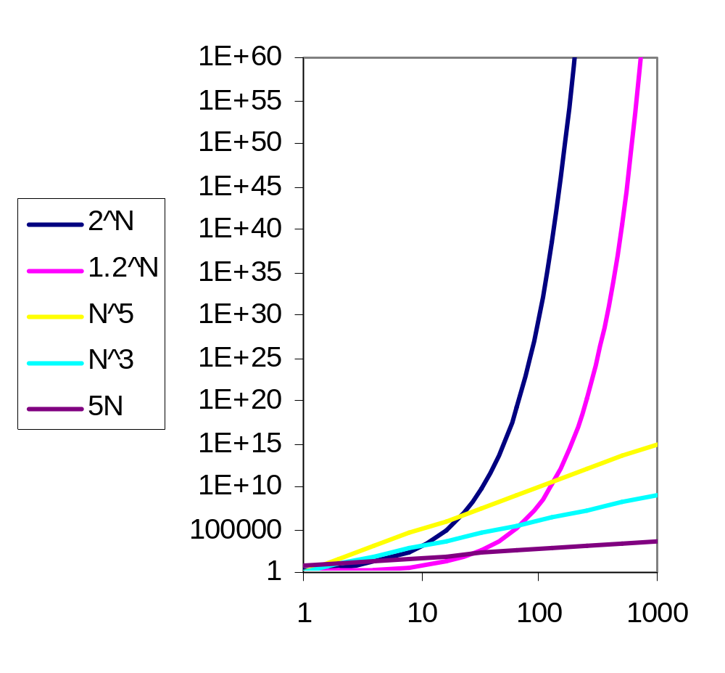
Practical Complexity
How the various functions grow with n?
1000 MIPS,
since Big Bang
1000 MIPS,
1 day

Slide 63
n | f(n)=n | f(n)=nlog₂n | f(n)=n² | f(n)=n⁴ | f(n)=n¹⁰ | f(n)=2^{n}
10 20 30 40 50 100 | .01μs .02 μs .03 μs .04 μs .05 μs .1 μs | .03 μs .09 μs .15 μs .21 μs .28 μs .66 μs | .1 μs .4 μs .9 μs 1.6 μs 2.5 μs 10 μs | 10 μs 160 μs 810 μs 2.56ms 6.25ms 100 ms | 10s 2.84h 6.83d 121d 3.1y 3171y | 1 μs 1 ms 1 s 18m 13 d 4*10¹³y
10³ | 1 μs | 9.66 μs | 1ms | 16.67m
10⁴ | 10 μs | 130 μs | 100ms | 115.7d
10⁵ | 100 μs | 1.66ms | 10s | 3171y
Table 1.8: Times on a 1-billion-steps-per-second computer

Slide 64
Performance Measurement
Performance measurement is concerned with obtaining the actual space and time requirements of a program.
To time a short event it is necessary to repeat it several times and divide the total time for the event by the number of repetitions.

Slide 65
Let us look at the following program:
int SequentialSearch (int *a, const int n, const int x )
{ // Search a[0:n-1].
int i;
for (i=0; i < n && a[i] != x; i++;)
if (i == n) return -1;
else return i;
}

Slide 66
void TimeSearch ( )
{
int a[1000], n[20];
const long r[20] = {300000, 300000, 200000, 200000,
100000, 100000, 100000, 80000, 80000, 50000, 50000,
25000, 15000, 15000, 10000, 7500, 7000, 6000, 5000,
5000 };
for ( int j=0; j<1000; j++ ) a[j] = j+1; //initialize a
for ( j=0; j<10; j++ ) { //values of n
n[j] = 10*j; n[j+10] = 100*( j+1 );
}
cout << “ n total runTime” << endl;

Slide 67
for ( j=0; j<20; j++ ) {
long start, stop;
time (&start); // start timer
for ( long b=1; b<=r[j]; b++ )
int k = seqsearch(a, n[j], 0 ); //unsuccessful search
time (&stop); // stop timer
long totalTime = stop - start;
float runTime = (float) (totalTime) / (float)(r[j]);
cout << " " << n[j] << " " << totalTime << " " << runTime
<< endl;
}
}
The results of running TimeSearch are as in the next slide.

Slide 68
n | total | runTime | n | total | runTime
0 10 20 30 40 50 60 70 80 90 | 241 533 582 736 467 565 659 604 681 472 | 0.0008 0.0018 0.0029 0.0037 0.0047 0.0056 0.0066 0.0075 0.0085 0.0094 | 100 200 300 400 500 600 700 800 900 1000 | 527 505 451 593 494 439 484 467 434 484 | 0.0105 0.0202 0.0301 0.0395 0.0494 0.0585 0.0691 0.0778 0.0868 0.0968
Times in hundredths of a second, the plot of the data can be found in Fig. 1.7.

Slide 69
Issues to be addressed:
Accuracy of the clock
Repetition factor
Suitable test data for worst-case or average performance
Purpose: comparing or predicting?
Fit a curve through points
Exercises:
P72-10

