Slide 1
Chapter 7
Sorting
7.1 Motivation
In data structures, the order among data elements is an important relation and sorting becomes the most frequent computing task.
In this chapter, we use:
list --- a collection of records, each record having one or more fields.
key --- the fields used to distinguish between among records.

Slide 2
Two important uses of sorting:
(1) As an aid in searching. Binary search a sorted list with n records in O(log n), much better than sequential search a unsorted list in O(n).
(2) As a means for matching entries in lists. Comparing two lists of n and m records containing data that are essentially the same but from different sources. If sorted we can do it in O(n+m), otherwise we need O(nm) time.

Slide 3
Actually there are much more applications of sorting, e.g., query optimization, job scheduling, etc..
Consequently, sorting problem has been extensively studied, and there are many methods proposed. Unfortunately, no one sorting method is the best for all applications.
We shall study several typical methods, indicating when one is superior to others.
Now let us formally state the sorting problem.

Slide 4
given a list of records (R₁, R₂, …, R_{n})
each R_{i} has key value K_{i}
assume an ordering relation (<) on the keys, so that for any 2 key values x and y, x=y or x<y or x>y. < is transitive.
The sorting problem is that of finding a permutation, σ, such that K_{σ(i)} ≤ K_{σ(i+1)} , 1≤i≤n-1. The desired ordering is (R _{σ(1)}, R _{σ(2)}, …, R _{σ(n)}).

Slide 5
Let σ_{s} be the permutation with the following properties:
(1) K_{σs(i)} ≤ K_{σs(i+1)} , 1≤i≤n-1.
(2) If i<j and K_{i} == K_{j} in the input list, then R_{i} precedes R_{j} in the sorted list.
A sorting method that generates the permutation σ_{s} is stable.

Slide 6
insert
quick
internal merge
heap
Sorting radix
external m-way merge
run generation
Throughout, we assume that relational operators have been overloaded so that record comparison is done by comparing their keys.

Slide 7
7.2 Insert Sort
Basic step: insert e into a sorted sequence of i records in such a way that the resulting sequence of size i+1 is also ordered.
Uses a[0] to simplify the while loop test, avoiding a test for end of list (i.e. i<1).
0 | 1 | 2 | …… | i | i+1
e

Slide 8
template<class T>
viod Insert(const T& e, T *a, int i)
{ //insert e into the ordered sequence a[1:i] such that the
// resulting sequence a[1:i+1} is also ordered. The array a
// must have space for at least i+2 elements.
a[0]=e;
while (e < a[i]) //stable
{
a[i+1]=a[i];
i--; // a[i+1] is always ready for storing element
}
a[i+1]=e;
}

Slide 9
Insertion sort:
Begin with the ordered sequence a[1], then successively insert a[2], a[3], …, a[n] into the sequence.
template<class T>
void InsertionSort (T *a, const int n)
{ //sort a[1:n] into nondecreasing order.
for (int j=2; j<=n; j++) {
T temp = a[j];
Insert (temp, a, j-1);
}
}

Slide 10
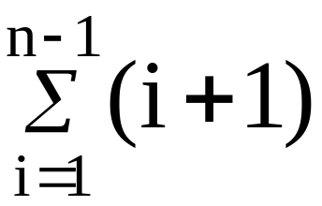
Analysis of insert sort:
(1) The worst case
Insert(e, a, i) makes i+1 comparisons before making insertion --- O(i).
InsertSort invokes Insert for i=j-1=1, 2,…,n-1, so the overall time is
O( )=O(n²).

Slide 11
(2) Estimate of the actual computing time
R_{i} is left out of order (LOO) iff R_{i} < max { R_{j} }.
1≤j<i
For every record, at least O(1) is needed. If k is the number of LOO records, the computing time is O(n+kn).
It can also be shown that the average time is O(n²).
When k<<n, this method is very desirable. And for n ≤ 30, it is the fastest.

Slide 12
Example 7.1: n=5, key sequence is 5, 4, 3, 2, 1
j | [1] | [2] | [3] | [4] | [5]
- | 5 | 4 | 3 | 2 | 1
2 | 4 | 5 | 3 | 2 | 1
3 | 3 | 4 | 5 | 2 | 1
4 | 2 | 3 | 4 | 5 | 1
5 | 1 | 2 | 3 | 4 | 5

Slide 13
Example 7.2: n=5, key sequence is 2, 3, 4, 5, 1
j | [1] | [2] | [3] | [4] | [5]
- | 2 | 3 | 4 | 5 | 1
2 | 2 | 3 | 4 | 5 | 1
3 | 2 | 3 | 4 | 5 | 1
4 | 2 | 3 | 4 | 5 | 1
5 | 1 | 2 | 3 | 4 | 5

Slide 14
InsertSort is stable.
Variations:
1 Binary Insert Sort.
2 Linked Insert Sort.
Exercises: P401-1, 3

Slide 15
7.3 Quick Sort
The quick-sort has the best average behavior among the sorting methods we shall be studying.
Idea: given a list (R_{left}, R_{left+1}, …, R_{right}), select a pivot record from among R_{i} (left ≤ i ≤ right) , put the pivot in the correct spot s(pivot) such that after the positioning,
R_{j} ≤ R_{s(pivot)} for j<s(i)
R_{j} ≥ R_{s(pivot)} for j>s(i)

Slide 16
The original list is partitioned into 2 sublists:
(R_{left}, …, R_{s(pivot)-1}) and
(R_{s(pivot)+1}, …, R_{right})
and they may be sorted independently.
For simplicity, we just choose R[left] as the pivot.

Slide 17
R_{left}
 | ≤R_{left}
 | = R_{left}
 | ≥R_{left}
Split
➔

Slide 18
template <class T>
void QuickSort (T *a, const int left, const int right)
{ // Sort a[left:right] into non-decreasing order. a[left] is
// arbitrarily chosen as the pivot. Assume a[left]≤a[right+1].
if (left < right) {
int i=left, j=right+1, pivot=a[left];
do {
do i++; while (a[i]<pivot);
do j --; while (a[j]>pivot);
if (i<j) swap(a[i], a[j]);
} while (i<j);
swap(a[left], a[j]);
QuickSort(a, left, j-1);
QuickSort(a, j+1, right);
}
}

Slide 19
To sort a[1:n], invoke QuickSort(a, 1, n).
Example 7.3:
R₁ | R₂ | R₃ | R₄ | R₅ | R₆ | R₇ | R₈ | R₉ | R₁₀ | left | right
[26 | 5 | 37 | 1 | 61 | 11 | 59 | 15 | 48 | 19] | 1 | 10
[11 | 5 | 19 | 1 | 15] | 26 | [59 | 61 | 48 | 37] | 1 | 5
[1 | 5] | 11 | [19 | 15] | 26 | [59 | 61 | 48 | 37] | 1 | 2
1 | 5 | 11 | [19 | 15] | 26 | [59 | 61 | 48 | 37] | 4 | 5
1 | 5 | 11 | 15 | 19 | 26 | [59 | 61 | 48 | 37] | 7 | 10
1 | 5 | 11 | 15 | 19 | 26 | [48 | 37] | 59 | [61] | 7 | 8
1 | 5 | 11 | 15 | 19 | 26 | 37 | 48 | 59 | [61] | 10 | 10
1 | 5 | 11 | 15 | 19 | 26 | 37 | 48 | 59 | 61

Slide 20
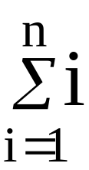
Analysis of QuichSort:
The worst case
2 sublists with size n-1 and 0.
T_{worst}(n) ≤cn + T_{worst}(n-1)
≤cn + c(n-1)+T_{worst}(n-2)
…
≤c + T_{worst}(0)=cn(n+1)/2+d= O(n²).

Slide 21
(2) The optimal case
2 sublists with equal size, roughly n/2.
T_{opt}(n) ≤cn + 2T_{opt}(n/2)
≤cn + 2(cn/2+2T_{opt}(n/4)
≤2cn + 4T_{opt}(n/4)
…
≤cnlog₂n+nT_{opt}(1) = O(nlogn).
(3) The average time
Lemma 7.1: T_{avg}(n) ≤ k*nlog_{e}n for n ≥2.

Slide 22
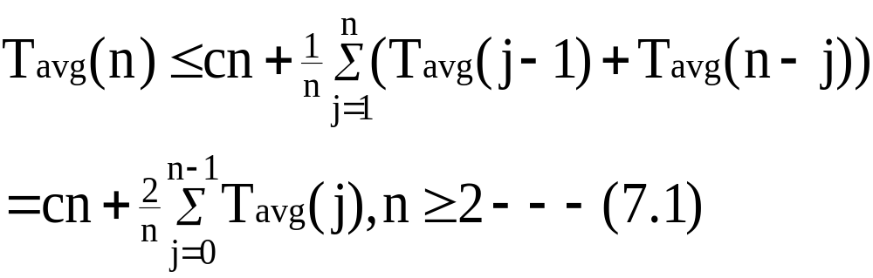
Proof:
In the call to QuickSort(a, 1, n), the pivot gets place at position j, we need to sort 2 sublists of size j-1 and n-j. j may take on any of the 1 to n with equal probability, so

Slide 23
Let T_{avg}(0) ≤b and T_{avg}(1) ≤b for some constant b,
k=2(b+c),
we show T_{avg}(n) ≤ knlog_{e}n for n ≥2.
Induction on n.
n=2, from (7.1) T_{avg}(2) ≤ 2c+2b ≤ k*2log_{e}2.
Assume T_{avg}(n) ≤ k*nlog_{e}n for 2≤n<m.
Then

Slide 24
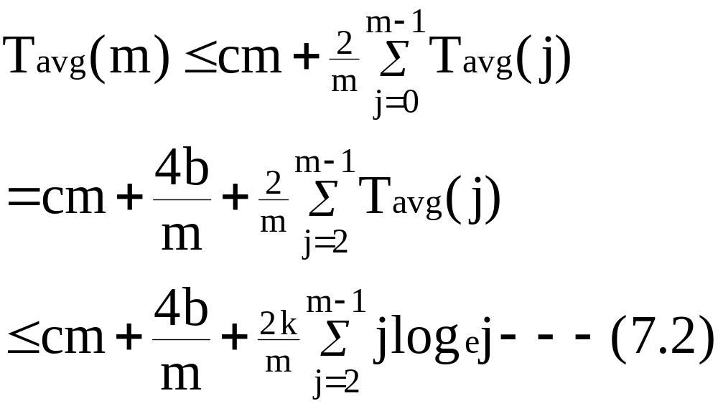

Slide 25
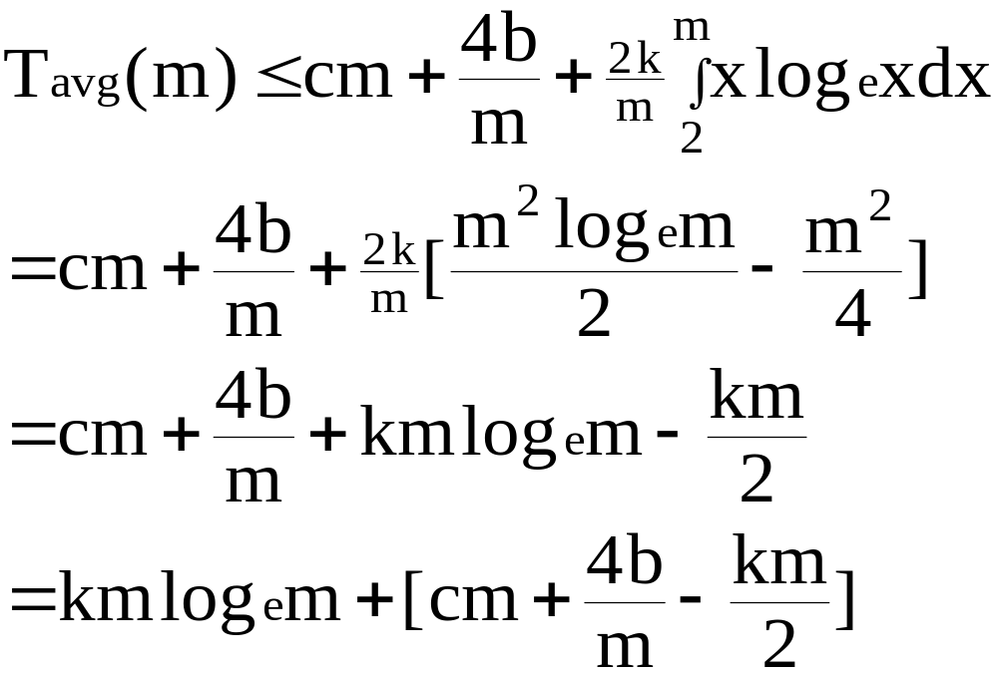
Since jlog_{e}j is an increasing function of j, Eq. (7.2) yields

Slide 26
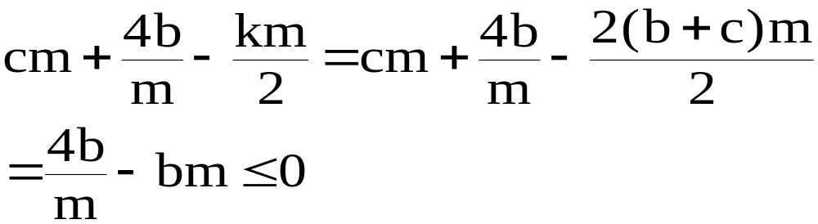
For m≥2
Therefore For m≥2, T_{avg}(m) ≤ kmlog_{e}m.

Slide 27
Stack space requirement:
best case: split evenly --- O(log n)
worst case: split into a left sublist of size n-1 and a right of 0 --- O(n)
if we use only one recursion and other parts are replaced by iteration, and sort the smaller sublist first, let S(n) be the space for list of size n, then
  S(1)=c (c is a constant)
  S(n)≤c+S(n/2)=c log n+S(1)=O(log n)

Slide 28
better choice of the pivot:
pivot=median {R_{left} , K_{(left+right)/2} , R_{right}}
Note also that quick sort is unstable.
Exercises: P405-1, 2, 5

Slide 29
7.5 Merge Sort
7.5.1 Merging
Merge 2 sorted lists to get a single sorted list.
i1
(X_{l}, …, X_{m}) iResult
➔ (Z_{l}, …, Z_{n})
(X_{m+1}, …, X_{n})
i2

Slide 30
template <class T>
void Merge (T *initList, T *mergedList,
const int l, const int m, const int n)
{ // two sorted lists initList[l:m] and initList[m+1:n] are
// merged to obtain the sorted list mergedList[l:n].
for (int i1=l, iResult=l, i2=m+1; i1<=m && i2<=n; iResult++)
if (initList[i1] <= initList[i2])
mergedList[iResult]=initList[i1++]; //stable
else
mergedList[iResult]=initList[i2++];
// copy remaining records , if any, of the first list
copy(initList+i1, initList+m+1, mergedList+iResult);
// copy remaining records , if any, of the second list
copy(initList+i2, initList+n+1, mergedList+iResult);
}

Slide 31
Analysis of Merge:
At each iteration of the for loop, either i1++ or i2++, the for loop is iterated at most n-l+1 times.
At most n-l+1 records are copied.
The total time: O(n-l+1).
If each record has a size s, then the total time is O(s(n-l+1)).
When s>1, use linked lists, only need n-l+1 links, the merge time becomes O(n-l+1) and is independent of s.

Slide 32
7.5.2 Iterative Merge Sort
Basic idea:
At the beginning, interpret the input as n sorted sublists, each of size 1. These lists are merged by pairs to obtain n/2 lists, each of length 2 ( if n is odd, then one list is of length 1). These n/2 lists are then merged by pairs, and so on until only one list is get.
As shown in the following:

Slide 33
26 |  | 5 |  | 77 |  | 1 |  | 61 |  | 11 |  | 59 |  | 15 |  | 48 |  | 19
5 |  | 26 |  | 1 |  | 77 |  | 11 |  | 61 |  | 15 |  | 59 |  | 19 |  | 48
1 |  | 5 |  | 26 |  | 77 |  | 11 |  | 15 |  | 59 |  | 61 |  | 19 |  | 48
1 |  | 5 |  | 11 |  | 15 |  | 26 |  | 59 |  | 61 |  | 77 |  | 19 |  | 48
1 |  | 5 |  | 11 |  | 15 |  | 19 |  | 26 |  | 48 |  | 59 |  | 61 |  | 77

Slide 34
A merge sort consists of several passes, it is convenient to write a function MergePass for this.
i
i+s-1
n-2*s+1
n
s
s
s
s
i+2*s-1

Slide 35
template <class T>
void MergePass (T *initList, T *resultList,
const int n, const int s)
{ // adjacent pairs of sublists of size s are merged from initList
// to resultList.
for (int i=1; i<=n-2*s+1; i+=2*s)//are there 2*s elements?
Merge(initList, resultList, i, i+s-1, i+2*s-1);
//merge remaining list of length<2*s
if ((i+s-1)<n) Merge (initList, resultList, i, i+s-1,n);
else copy(initList+i, initList+n+1, resultList+i);
}

Slide 36
Now the sort can be done by repeatedly invoking MergePass.
template <class T>
void MergeSort (T *a, const int n)
{ // Sort a[1:n] into nondreasing order.
T *tempList=new T[n+1];
//l is the length of the sublist currently being merged
for (int l=1; l<n; l*=2) {
MergePass(a, tempList, n, l);
l*=2;
MergePass ( tempList, a, n, l); //interchange role of a and templist
// last pass may just copy
}
delete [ ] tempList;
}

Slide 37
Analysis of MergeSort:
Makes several passes. After the 1st pass, the result sublists are of size 2=2¹. After the ith pass, the size is 2^{i}. Consequently, a total of ⎧log₂n⎫ passes are made, each takes o(n), the total time is O(n log n).
It is easy to verify that MergeSort is stable.
Exercises: P412-1

Slide 38
7.6 Heap Sort
Merge sort has a computing time of O(n log n), both in worst and average case, but it requires O(n) additional storage.
Heap sort requires o(1) additional space, and also has as its worst and average computing time O(n log n).
In heap sort, we utilize the max-heap structure in chapter 5 .

Slide 39
To create and recreate a heap efficiently, we need a function Adjust, which starts with a binary tree whose left and right subtrees are max heaps and adjusts the entire binary tree into a max heap.
root
j/2 is always ready for storing record
j
j+1
n

Slide 40
template <class T>
void adjust (T *a, const int root, const int n)
{ // No node index is > n
T e=a[root];
// find proper place for e
for (int j=2*root; j<=n; j*=2) {
if (j<n && a[j]<a[j+1]) j++; // j is the lager child of its parent
if (e>=a[j]) break;
a[j/2]=a[j]; //move jth record up the tree
}
a[j/2]=e;
}

Slide 41
Analysis of adjust:
If the depth of tree is d, the for loop is executed at most d times. Hence, the computing time is O(d).
To sort the list
Create a max heap by using Adjust.
Make n-1 passes, in each pass, swap the first and last records in the heap, and decrement the heap size and readjust it.

Slide 42
1
n/2
n
(1) Construct a heap

Slide 43
1
1
n-1
n
n-1
n
(2) Swap and readjust

Slide 44
template <class T>
void HeapSort (T *a, const int n)
{ // Sort a[1:n] into nondeceasing order.
for (int i=n/2; i>=1; i--) // convert list into a heap
// wrong, for (int i=1; i<=n/2; i++)
Adjust(a, i, n);
for (i=n-1; i>=1; i--) // sort
{
swap(a[1], a[i+1]; // swap first and last of current heap
Adjust(a, 1, i); // recreate heap
}
}

Slide 45
Example 7.7:
[1]
26
[2]
5
[3]
77
[4]
1
[5]
61
11
59
[6]
[7]
15
48
19
[8]
[9]
[10]
(a) Input list

Slide 46
[1]
77
[2]
61
[3]
59
[4]
48
[5]
19
11
26
[6]
[7]
15
1
5
[8]
[9]
[10]
(b) Initial heap

Slide 47
[1]
61
[2]
48
[3]
59
[4]
15
[5]
19
11
26
[6]
[7]
5
1
[8]
[9]
(c) Heap size=9
Sorted=[77]

Slide 48
[1]
59
[2]
48
[3]
26
[4]
15
[5]
19
11
1
[6]
[7]
5
[8]
(d) Heap size=8
Sorted=[61, 77]

Slide 49
[1]
48
[1]
26
[2]
19
[3]
26
[2]
19
[3]
11
[4]
15
[5]
5
11
1
[4]
15
[5]
5
1
[6]
[7]
[6]
(e) Heap size=7
Sorted=[59, 61, 77]
(f) Heap size=6
Sorted=[48, 59, 61, 77]

Slide 50
[1]
19
[1]
15
[2]
15
[3]
11
[2]
5
[3]
11
[4]
1
[5]
5
[4]
1
(g) Heap size=5
[26, 48, 59, 61, 77]
(h) Heap size=4
[19, 26, 48, 59, 61, 77]

Slide 51
[1]
11
[1]
5
[2]
5
[3]
1
[2]
1
(i) Heap size=3
[15, 19, 26, 48, 59, 61, 77]
(j) Heap size=2
[11, 15, 19, 26, 48, 59, 61, 77]
[1]
1
(j) Heap size=1
[5, 11, 15, 19, 26, 48, 59, 61, 77]

Slide 52
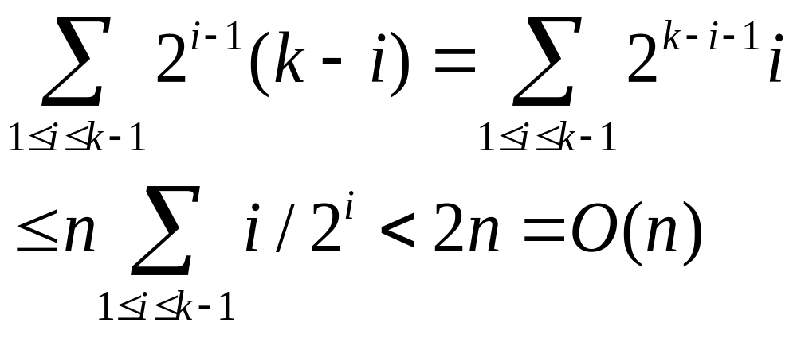
Analysis of HeapSort:
suppose 2^{k-1}≤ n < 2^{k} , the tree has k levels.
the number of nodes on level i ≤ 2^{i-1}.
in the first loop, Adjust is called once for each node that has a child, hence the time is no more than
level 1
level i
k-i
level k

Slide 53
in the next loop, n-1 applications of Adjust are made with maximum depth k= ⎧log₂(n+1)⎫.
The total time: O(n log n).
Additional space: O(1).
Exercises: P416-1, 2

Slide 54
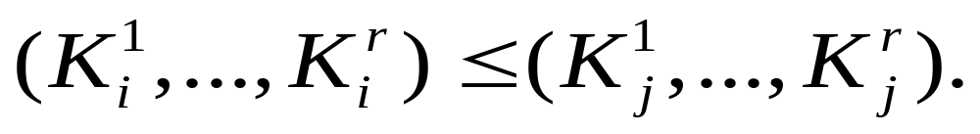
7.7 Sorting on Several Keys
Problem : to sort records on keys K¹, K², …, K^{r} (K¹ is the most significant key and K^{r} the least).
A list of records R₁, R₂, …, R_{n} is said to be sorted with respect to the keys K¹, K², …, K^{r} iff for every pair of i and j, i<j and

Slide 55
For example: sorting a deck of cards may be regarded as a sort on 2 keys, the suit and face values:
K¹ [Suits]:
♣ < ♦ < ♥ < ♠
K² [Face values]:
2<3<4<5<6<7<8<9<10<J<Q<K<A
A sorted deck of cards has the following ordering:
2♣,…, A♣,…, 2♠,…, A♠

Slide 56
MSD(most significant digit first) sort:
At first, sort on the most significant key K¹ to obtain several “piles” of records, each having the same value for K1.
Then each of these piles is independently sorted on the key K2 into “subpiles”.
…
The piles are combined.

Slide 57
LSD (least significant digit first) sort :
sort the cards first into 13 piles corresponding to their face values (K²). Place K’s on top of A’s, … , 2’s on top of 3’s.
then sort on the suit (K¹) using a stable method to obtain 4 piles, each ordered on K², combine the piles to obtain the sorted cards.
LSD is simpler than MSD as the piles and subpiles obtained do not have to be sored independently.

Slide 58
MSD sort:
Sorting on suit is done by a bin sort (i.e. four bins are set up, one for each suit value and the cards are placed into their corresponding bins)
Next, the cards in each bin are sorted using an algorithm similar to Insertion Sort.

Slide 59
LSD sort:
First use a bin sort on the face value (using 13 bins)
Collect all the cards together
Perform a bin sort on the suits using four bins.
Time complexity is O(n) if the spread in key values is O(n).

Slide 60
To sort on each key K^{i}, use bin sort, i. e., if 0≤ K^{i}<r, r bins are set up, one for each value of K^{i}, and records are placed into their corresponding bins. For n records, the time is O(n+r)
For one key, we can interpret it as being composed of several subkeys. For example, if the keys are numeric, then each decimal digit may be regarded as a subkey.
e.g., if 0≤K≤999, K can be considered as (K¹ K² K³), 0≤ K^{i} <10, i=1,2,3, this is also called Radix-10 sort.

Slide 61
In general, for a Radix-r sort, r bins are needed.
Assume:
(1) records to be sorted are R₁, R₂, …, R_{n} and their keys are decomposed using a radix of r, each key have d digits in the range of [0, r-1].
(2) the records in each bin will be linked together into a chain with f[i], 0<=i<r, a pointer to the first record in bin I and e[i], a pointer to the last record in bin i.
(3) These chains will operate as queues.
f[i]
e[i]

Slide 62
template <class T>
int RadixSort (T *a, int *link, const int d, const int r, const int n)
{ // Sort a[1:n] using a d-digit radix-r sort. digit(e, i, r) returns
// the ith radix-r digit (from the left, the first is the 0th digit)
// of e’s key. Each digit is in the range of [0, r).
int e[r], f[r]; // queue end and front pointers
// create initial chain of records starting at first
int first=1, j;
for (int i=1; i<n; i++) link[i]=i+1; // linked into a chain
link[n]=0;
for (i=d-1; i>=0; i--)
{ // sort on digit i
fill(f, f+r, 0); // initialize bins to empty queues
for (int current=first; current; current=link[current])
{ // put records into queues

Slide 63
int k=digit(a[current], i, r);
if (f[k]==0) f[k]=current; //need not change link
else link[e[k]]=current; //change link
e[k]=current;
}
for (j=0; !f[j]; j++); // find first nonempty queue
first=f[j];
int last=e[j];
for (int k=j+1; k<r; k++) // concatenate remaining queues
if (f[k] ) {
link[last]=f[k]; last=e[k];
}
link[last]=0;
}
return first;
}

Slide 64
Analysis of RadixSort:
d passes over the data, each taking O(n+r). Hence the total time is O(d(n+r)).
d will depend on r and the largest key.
Example 7.8: sort 10 numbers in the range [0,999], r=10, hence d=3.
[1] |  | [2] |  | [3] |  | [4] |  | [5] |  | [6] |  | [7] |  | [8] |  | [9] |  | [10]
179 |  | 208 |  | 306 |  | 93 |  | 859 |  | 984 |  | 55 |  | 9 |  | 271 |  | 33
(a) Initial input

Slide 65
e[0] |  | e[1] |  | e[2] |  | e[3] |  | e[4] |  | e[5] |  | e[6] |  | e[7] |  | e[8] |  | e[9]
 |  |  |  |  |  |  |  |  |  |  |  |  |  |  |  |  |  | 9
 |  |  |  |  |  | 33 |  |  |  |  |  |  |  |  |  |  |  | 859
 |  | 271 |  |  |  | 93 |  | 984 |  | 55 |  | 306 |  |  |  | 208 |  | 179
f[0] |  | f[1] |  | f[2] |  | f[3] |  | f[4] |  | f[5] |  | f[6] |  | f[7] |  | f[8] |  | f[9]
271 |  | 93 |  | 33 |  | 984 |  | 55 |  | 306 |  | 208 |  | 179 |  | 859 |  | 9
(b) First pass

Slide 66
e[0] |  | e[1] |  | e[2] |  | e[3] |  | e[4] |  | e[5] |  | e[6] |  | e[7] |  | e[8] |  | e[9]
9
208 |  |  |  |  |  |  |  |  |  | 859 |  |  |  | 179
306 |  |  |  |  |  | 33 |  |  |  | 55 |  |  |  | 271 |  | 984 |  | 93
f[0] |  | f[1] |  | f[2] |  | f[3] |  | f[4] |  | f[5] |  | f[6] |  | f[7] |  | f[8] |  | f[9]
306 |  | 208 |  | 9 |  | 33 |  | 55 |  | 859 |  | 271 |  | 179 |  | 984 |  | 93
(c) second pass

Slide 67
e[0] |  | e[1] |  | e[2] |  | e[3] |  | e[4] |  | e[5] |  | e[6] |  | e[7] |  | e[8] |  | e[9]
93
55
33 |  |  |  | 271
9 |  | 179 |  | 208 |  | 306 |  |  |  |  |  |  |  |  |  | 859 |  | 984
f[0] |  | f[1] |  | f[2] |  | f[3] |  | f[4] |  | f[5] |  | f[6] |  | f[7] |  | f[8] |  | f[9]
9 |  | 33 |  | 55 |  | 93 |  | 179 |  | 208 |  | 271 |  | 306 |  | 859 |  | 984
(d) third pass

Slide 68
Exercises: P422-1, 3, 5

Slide 69
7.9 Summary of Internal Sorting
The behavior of Radix Sort depends on the size of keys and the choice of r.
The following summarizes the other 4 methods we have studied:
Method | Worst | Average | Working Storage
Insertion Sort | n² | n² | O(1)
Heap Sort | n log n | n log n | O(1)
Merge Sort | n log n | n log n | O(n)
Quick Sort | n² | n log n | O(n) or O(log n)

Slide 70
The next slide gives the average runtimes for the 4 methods on a 1.7G Intel Pentium 4 PC with 512M RAM and Microsoft Visual.NET2003.
For each n at lest 100 randomly generated integer instances were run.

Slide 71
n | Insert | Heap | Merge | Quick
0 | 0.000 | 0.000 | 0.000 | 0.000
50 | 0.004 | 0.009 | 0.008 | 0.006
100 | 0.011 | 0.019 | 0.017 | 0.013
200 | 0.033 | 0.042 | 0.037 | 0.029
300 | 0.067 | 0.066 | 0.057 | 0.045
400 | 0.117 | 0.090 | 0.079 | 0.061
500 | 0.179 | 0.116 | 0.100 | 0.079
1000 | 0.662 | 0.245 | 0.213 | 0.169
2000 | 2.439 | 0.519 | 0.459 | 0.358
3000 | 5.390 | 0.809 | 0.721 | 0.560
4000 | 9.530 | 1.105 | 0.972 | 0.761
5000 | 15.935 | 1.410 | 1.271 | 0.970
Times are in milliseconds

Slide 72
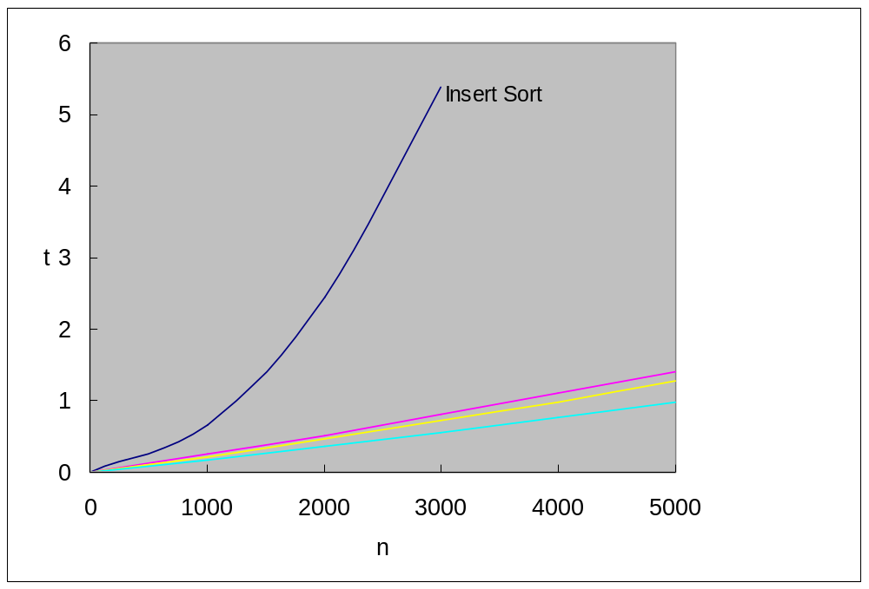
The following is a plot of average times (milliseconds) for sort methods:

Slide 73
For average behavior, we can see:
Quick Sort outperforms the other sort methods for suitably large n.
the break-even point between Insertion and Quick Sort is near 100, let it be nBreak.
when n < nBreak, Insert Sort is the best, and when n > nBreak, Quick Sort is the best.
improve Quick Sort by sorting sublists of less than nBreak records using Insertion Sort.

Slide 74
Experiments: P435-4

Slide 75
7.10 External Sorting
7.10.1 introduction
the lists are too large to be entirely contained in the internal memory, making an internal sort impossible.
the lists to be sorted resides on a disk.
block: the unit of data that is read from or written to a disk at one time.
disk --- provide direct access to block, its I/O time is determined by:

Slide 76
(1) seek time: time taken to position the read/write heads to the correct cylinder
(2) latency time: time until the right sector of the track is under the read/write head.
(3) transmission time: time to transmit the block of data to/from the disk.
Note I/O rate << CPU rate.

Slide 77
The most popular method for external sorting is merge sort, which consists of 2 phases:
(1) Segments of the input list are sorted using a good internal method in memory, these sorted segments, known as runs, are written onto disk as they are generated.
unsorted
Internal
memory
sorted runs
=>
=>
(2) The runs are merged together until only one run left.

Slide 78
Because Merge requires only the leading records of the two runs being merged to be present in memory at one time, it is possible to merge large runs together. It is more difficult to adapt the other internal sort methods considered to external sorting.
Example 7.12:
a list of 4500 records to be sorted
the internal memory is capable of sorting at most 750 records

Slide 79
block length --- 250 records.
Now we can sort the list as the following:
(1) Internally sort 3 blocks at a time to obtain 6 runs R₁ to R₆ .
run1 |  |  |  | run2 |  |  |  | run3 |  |  |  | run4 |  |  |  | run5 |  |  |  | run6
1- 750 |  |  |  | 751-1500 |  |  |  | 1501-2250 |  |  |  | 2251-3000 |  |  |  | 3001-3750 |  |  |  | 3751-4500

Slide 80
(2) Merge the 6 runs.
run1 |  |  |  | run2 |  |  |  | run3 |  |  |  | run4 |  |  |  | run5 |  |  |  | run6

Slide 81
Let
t_{s} = maximum seek time
t_{l} = maximum latency time
t_{rw} = time to read or write one block of 250 records
t_{IO} = t_{s} + t_{l} + t_{rw}
t_{IS} = time to internally sort 750 records
n t_{m} = time to merge n records from input buffers to output buffer
The computing times are as:

Slide 82
operation |  |  |  |  |  |  |  |  |  |  |  | time
(1) read 18 blocks, internally sort, write 18 blocks |  |  |  |  |  |  |  |  |  |  |  | 36 t_{IO} + 6t_{IS}
(2) merge runs 1 to 6 in pairs |  |  |  |  |  |  |  |  |  |  |  | 36 t_{IO} + 4500t_{m}
(3) merge 2 runs of 1500 records each |  |  |  |  |  |  |  |  |  |  |  | 24 t_{IO} + 3000t_{m}
(4) merge 1 run of 3000 records with 1run of 1500 |  |  |  |  |  |  |  |  |  |  |  | 36 t_{IO} + 4500t_{m}
total time |  |  |  |  |  |  |  |  |  |  |  | 132 t_{IO} + 12000t_{m} + 6t_{IS}

Slide 83
The computing time depends chiefly on the number of passes over the data.
We are mainly concerned with:
(1) Reduction of the number of passes by using a high-order merge.
(2) An appropriate buffer-handling scheme to provide for parallel input, output and merging.
(3) Generating fewer runs (or equivalently longer) under the memory limitation.

Slide 84
7.10.2 k-way Merging
For 2-way merge with m runs, a total of ⎧log₂m⎫ passes ( excluding the one for generating the runs) are needed.
In general, a k-way merge on m runs requires at most ⎧log_{k}m⎫ passes over the data. Thus, I/O time may be reduced. As shown in the following tree:

Slide 85
1 | 2 | 3 | 4 | 5 | 6 | 7 | 8 | 9 | 10 | 11 | 12 | 13 | 14 | 15 | 16

Slide 86
For large k (say, k ≥ 6), to select the smallest from the k possibilities, we can use a loser tree with k leaves.
The total time needed per level of the merge tree is O(n log₂k).
The merge tree has O(log_{k}m) levels, the total internal merge time is
O(n log₂k log_{k}m)= O(n log₂m)
which is independent of k!

Slide 87
Comments on high order merge:
save I/O
no big loss of internal processing speed.
(3) the decrease in I/O time is not as much as indicated by reduction to log_{k}m passes, because:

Slide 88
to do k-way merge we need at least k input buffers and 1 output buffer (or the best totally 2k+2).
given fixed internal memory,
k increases => smaller buffer size => more blocks => increased seek and latency time.
hence, beyond a certain k, I/O time increases despite the decrease in the number of passes.

Slide 89
7.10.4 Run Generation (for self-study)
Using a tree of loser, we can generate runs that are , on average, twice as long as obtainable by conventional internal sorting methods.
Background: given k record buffers
conventional method --- static
Input list | R₀ | R₁ | …… | R_{k-1}
after finishing sorting on (R₀,…, R_{k-1}), generate k record long runs.

Slide 90
tree of loser method --- dynamic
output
R₀ | R₁ | …… | R_{k-1}
input

Slide 91
After one winner is selected, output it, and get a new record from the input list into the winner’s buffer →longer runs, on average, 2k long.
Ideas:
k record buffers r[i], 0≤i<k, as leaf nodes, node number=k+i
k-1 non-leaf nodes numbered 1 to k-1, each non-leaf node i has only one field l[i], 1≤i<k, represents the loser of the tournament. l[i] contains the index of the loser’s buffer.

Slide 92
each r[i] has a run number field rn[i] associated with it to determine whether or not r[i] can be output as part of the run currently generated.
rmax --- the max of the run number of the real records currently in memory.
if input is empty, create a virtual record with rn=rmax+1, to push real records output before it.
Variable specification:
r[i], 0≤i<k --- the k records in the tree of loser

Slide 93
l[i], 1≤i<k --- loser of the tournament played at node i
l[0], q --- winner of the tournament
rn[i], 0≤i<k --- the run number to which r[i] belongs
rc --- current run number
rq --- run number of r[q]
rmax --- number of runs that will be generated
lastRec --- last record output

Slide 94
template <class T>
1 void Runs (T *r )
2 {
3 r = new T[k];
4 int *rn=new int[k], *l=new int[k];
5 for (int i = 0; i < k; i++ ) { //input records
6 ReadRecord(r[i]); rn[i] = 1;
7 }
8 InitializeLoserTree();
9 int q = l[0]; // tournament winner
10 int rq=1, rc=1, rmax=1; T LastRec;

Slide 95
11 while (1) { // output runs
12 if (rq != rc) { // end of run
13 output end of run marker;
14 if (rq > rmax) break; //meet virtual record, to line 35
15 else rc = rq;
16 }
17 WriteRecord(r[q]); LastRec=r[q];
18 //input new record into tree
19 if (end of input) rn[q]=rmax+1; //generate virtual record
20 else {
21 ReadRecord(r[q]);
22 if (r[q]<LastRec) //new record belongs to next run
23 rn[q] = rmax = rq+1;
24 else rn[q] = rc;
25 }

Slide 96
26 rq=rn[q];
27 // reconstruct the tree of losers
28 for (int t=(k+q)/2;t; t/=2) // t is initialized to be parent of q
29 if (rn[l[t]]<rq || rn[l[t]]==rq && r[l[t]]<r[q])
30 { // t is the winner
31 swap(q, l[t]);
32 rq = rn[q];
33 }
34 } // end of while
35 delete [ ] r; delete [ ] rn; delete [ ] l;
36}

Slide 97
Analysis of runs:
When the input list is sorted, only one run is generated. On average, the run size is 2k. The time required to generate all runs for an n record list is O(n log k).

Slide 98
7.10.5 Optimal Merging of Runs
When runs are of different size, the merging strategy of making complete passes over all runs does not yield minimum run times.
For example, suppose we have 4 runs of length 2, 4, 5, and 15, respectively.

Slide 99
2 merge trees for merging the 4 runs:
15
5
2
4
5
15
2
4
(a)
(b)

Slide 100
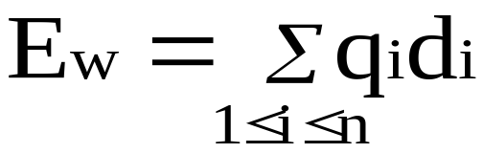
internal nodes --- the circular nodes.
external nodes --- the square nodes.
Given n runs, there are n external nodes in the merge tree. Let the external nodes numbered 1 to n, q_{i} be the size of the run node i represents, d_{i} be the distance from the root to the external node i, 1≤i≤n. Then the total merge time is
The E_{w} is called the weighted external path length.

Slide 101
The E_{w}
of (a) is 2*3 + 4*3 + 5*2 + 15*1 = 43
of (b) is 2*2 + 4*2 + 5*2 + 15*2 = 52
The cost of a k-way merge n runs of length q_{i}, 1≤i≤n, is minimized by using a merge tree of degree k that has minimum E_{w}.

Slide 102
We shall consider k=2 only. The result is easily generalized to the case k>2.
Another application for binary tree with minimum Ew is to obtain an optimal set of codes for messages M₁,…,M_{n+1}.
Each code is a binary string that will be used for transmission of the corresponding message.
These codes are called Huffman codes.

Slide 103
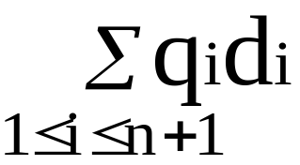
q_{i}--- relative frequency for M_{i}.
d_{i}--- distance from the root to the external node for M_{i}.
The cost of decoding is
0
1
M₄
0
1
M₃
0
1
M₁
M₂

Slide 104
Basic ideas of Huffman’s solution :
begin with a min heap of n single-node trees, which is an external node with the weight being one of the q_{i}’s.
repeatedly extract 2 minimum-weight a and b from the min heap, combine them into a single binary tree c, and insert c into the min heap.
after n-1 rounds, the min heap will be left with a single binary tree, which is the wanted.

Slide 105
Assume:
the function Huffman is a friend of TreeNode.
use the data field of a TreeNode to store the weight of the binary tree rooted at that node.

Slide 106
template <class T>
void Huffman(MinHeap<TreeNode<T> *> heap, int n)
{ // heap is initially a min heap of n single-node binary trees.
for (int i=0; i<n-1; i++) {//loop n-1 times to combine n nodes
TreeNode<T> *a=heap.Top();
heap.Pop();
TreeNode<T> *b=heap.Top();
heap.Pop();
TreeNode<T> *c=new TreeNode(a→data+b→data,
a, b); // refer section 5.2.3.2
heap.Push(c);
}
}

Slide 107
Example 7.15:
Suppose we have the weights q₁=2, q₂=3, q₃=5, q₄=7, q₅=9, and q₆=13, then the sequence of trees we get is as the following:
5
10
16
2
3
5
5
7
9
2
3
(a) q₁+q₂
(b) (a)+q₃
(c) q₄+q₅

Slide 108
23
39
10
13
16
23
5
5
7
9
10
13
2
3
5
5
2
3
(d) (b)+q₆
(e) (c)+(d)

Slide 109
Analysis of huffman:
the main loop --- n-1 times
each call to Top is O(1), to Pop and Push is O(log n)
The total time: O(n log n).
Exercises: P457-2

