Slide 1
Chapter 4
Agile Development
Software Engineering: A Practitioner’s Approach, 6th edition
by Roger S. Pressman

Slide 2
本章要点
敏捷开发
  极限编程（XP）
  自适应软件开发(ASD)
  动态系统开发方法 (DSDM)
  Scrum模型
  Crystal模型
  特征驱动开发（FDD）

Slide 3
Common Fears for Developers
The project will produce the wrong product[有错的产品].
The project will produce a product of inferior quality[低质量的产品].
The project will be late[延迟].
We’ll have to work 80 hour weeks[每周工作80小时].
We’ll have to break commitments[违约].
We won’t be having fun[没有休闲时间].

Slide 4
The Manifesto for Agile Software Development
2001年Kent Beck和其它16位知名软件开发者、软件工程专家以及软件咨询师（称为敏捷联盟）共同签署“敏捷软件开发宣言”，该宣言声明：
“We are uncovering better ways of developing software by doing it and helping others do it. Through this work we have come to value:
  Individuals and interactions over processes and tools
  Working software over comprehensive documentation
  Customer collaboration over contract negotiation
  Responding to change over following a plan
That is, while there is value in the items on the right, we value the items on the left more.”[虽说上述右边的各项很有价值,但我们认为左边的各项具有更大的价值]
-- Kent Beck et al(2001).

Slide 5
敏捷开发是一场运动
本质上讲，敏捷方法是为了克服传统软件工程中认识和实践的弱点设计而成的。敏捷开发带来多方面的好处，但它不适用于所有的项目、所有的方面、所有的人和所有的情况，它并不独立于传统的软件工程实践，也不能作为超越一切的哲学理念而用于所有软件工作。

Slide 6
What is “Agility”?
适应变更：Effective (rapid and adaptive) response to change
交流通畅：Effective communication among all stakeholders
客户参与：Drawing the customer onto the team[吸收]
有效控制：Organizing a team so that it is in control of the work performed
Yielding …
Rapid, incremental delivery of software

Slide 7
12 Principles of Agility—敏捷联盟[2003]
Our highest priority is to satisfy the customer through early and continuous delivery of valuable software.[我们最先要做的是通过尽早、持续交付有价值的软件来使客户满意]
Welcome changing requirements, even late in development. Agile processes harness change for the customer’s competitive advantage. [即使在开发的后期，也欢迎需求变更。敏捷过程利用变更为客户创造竞争优势]
Deliver working software frequently, from a couple of weeks to a couple of months, with a preference to the shorter time scale. [经常交付可工作软件,交付的时间间隔可以从几个星期到几个月,交付的时间间隔越短越好]
Business people and developers must work together daily throughout the project.[在整个项目开发期间,业务人员和开发人员必须天天都在一起工作]

Slide 8
Principles of Agility…
Build projects around motivated individuals. Give them the environment and support they need, and trust them to get the job done.[围绕受激励的个人构建项目.给他们提供所需的环境和支持,并且信任他们能够完成工作]
The most efficient and effective method of conveying information to and within a development team is face-to-face conversation.[在团队内部,最富有效果和效率的信息传递方法是面对面交谈]
Working software is the primary measure of progress. [可工作软件是进度的首要度量指标]
Agile processes promote sustainable development. The sponsors, developers, and users should be able to maintain a constant pace indefinitely.[敏捷过程提倡可持续的开发速度.赞助人、开发者和用户应该能够保持一种长期的、稳定的开发速度]

Slide 9
Principles of Agility…
Continuous attention to technical excellence and good design enhances agility. [不断地关注优秀的技能和好的设计会增强敏捷能力]
Simplicity - the art of maximizing the amount of work not done - is essential. [简单—使不需要的工作最大化的艺术—是必要的]
The best architectures, requirements, and designs emerge from self-organizing teams. [好的架构、需求和设计出自于自组织团队]
At regular intervals, the team reflects on[反省] how to become more effective, then tunes and adjusts its behavior accordingly. [每隔一定时间，团队会反省如何才能更有效地工作，并相应调整自己的行为]

Slide 10
An Agile Process
Is driven by customer descriptions of what is required (scenarios)
Recognizes that plans are short-lived[短期的]
Develops software iteratively with a heavy emphasis on construction activities
Delivers multiple ‘software increments[软件增量]’
Adapts as changes occur

Slide 11
Extreme Programming (XP)
The most widely used agile process, originally proposed by Kent Beck[1999]
XP Planning
  Begins with the creation of user stories
  Agile team assesses each story and assigns a cost
  Stories are grouped to for a deliverable increment
  A commitment[承担义务] is made on delivery date[交货日期]
  After the first increment, project velocity is used to help define subsequent delivery dates for other increments

Slide 12
Extreme Programming (XP)…
XP Design
  Follows the KIS (Keep It Simple) principle
  Encourage the use of CRC cards (see Chapter 8)
  For difficult design problems, suggests the creation of spike solutions — a design prototype
  Encourages refactoring — an iterative refinement of the internal program design
XP Coding
  Recommends the construction of a unit test for a story before coding commences
  Encourages pair programming
XP Testing
  All unit tests are executed daily
  Acceptance tests are defined by the customer and executed to assess customer visible functionality
立即建立这部分设计的可执行原型,实现并评估设计原型

Slide 13
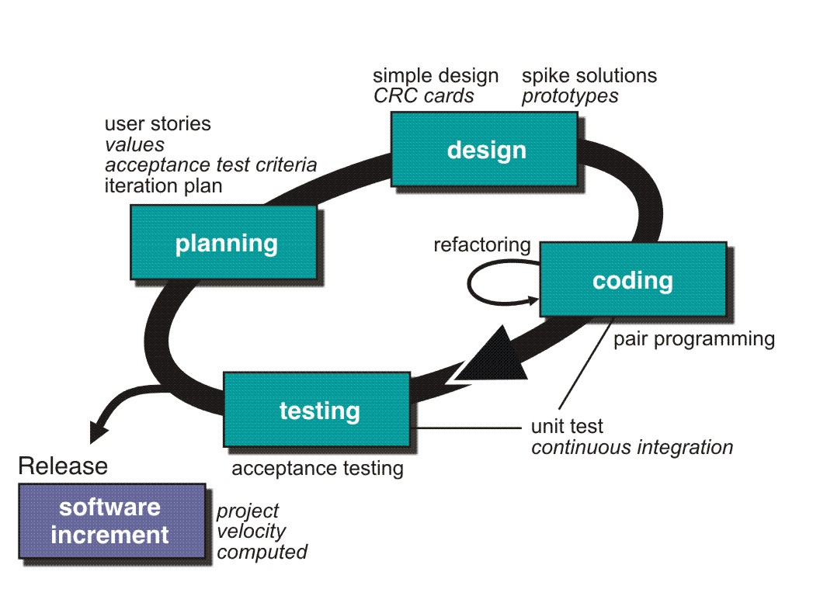
Extreme Programming (XP)…

Slide 14
Other Agile Processes
Adaptive Software Development (ASD)
Scrum
Feature Driven Development
……

Slide 15
Adaptive Software Development
Originally proposed by Jim Highsmith[2000]
ASD — distinguishing features
  Mission-driven planning
  Component-based focus
  Uses “time-boxing” (See Chapter 24)
  Explicit consideration of risks
  Emphasizes collaboration for requirements gathering
  Emphasizes “learning” throughout the process

Slide 16
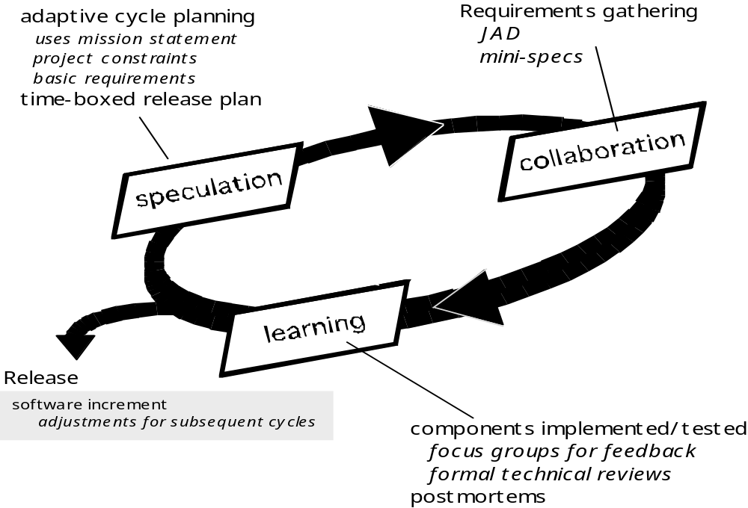
Adaptive Software Development…
Joint Application Development (JAD)

Slide 17
Scrum（ 争球）
Originally proposed by Schwaber and Beedle[2001]
Scrum—distinguishing features
  Development work is partitioned into “packets”
  Testing and documentation are on-going as the product is constructed
  Work occurs in “sprints[冲刺]” and is derived from a “backlog[待定项]” of existing requirements
  Meetings are very short and sometimes conducted without chairs
  “demos” are delivered to the customer with the time-box allocated

Slide 18
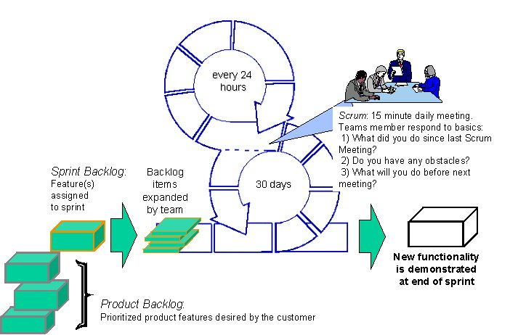
Scrum…
冲刺待定项

Slide 19
Feature Driven Development
Originally proposed by Peter Coad et al[1999]
FDD—distinguishing features
  Emphasis is on defining “features”
    a feature “is a client-valued function that can be implemented in two weeks or less.”
  Uses a feature template
    <action> the <result> <by | for | of | to> a (n) <object>
    For example, Add the technical-specifications of a product
  A features list is created and “plan by feature” is conducted
  Design and construction merge in FDD

Slide 20
Feature Driven Development…
Marketing
participates
MRD input
Carefully
Analyze
MRD
Prioritize and plan
Code development
Build code in small batches
1.Develop
an
Overall
Model
2.Build a
Feature
List
3.Plan
By
Feature
4.Design
By
Feature
5.Build
By
Feature
Wide rather than deep
Deep rather than wide
MRD: Market Requirement Document

Slide 21


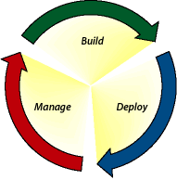
Engineering process
Engineering Lead Time
Marketing
Requirements
Develop
an
Overall
Model
Build
Feature
List
Plan
By
Feature
Design
By
Feature
Build
By
Feature
Test
By
Feature
Finished
Code
Weekly
Integration
Build
Bug Reports

