Slide 1
Chapter 8
Analysis Modeling
Software Engineering: A Practitioner’s Approach, 6th edition
by Roger S. Pressman

Slide 2
本章要点
领域分析
数据建模
OO概念
分析建模
  Scenario-Based Modeling
  Flow-Oriented Modeling
  Class-Based Modeling
  Behavioral Modeling

Slide 3
概述
使用很多不同格式的图表为信息、功能和行为需求建模。
基于场景的建模从用户的角度表现系统；
面向流的建模在说明数据对象如何通过处理函数进行转换方面提供了指示；
基于类的建模定义了对象、属性和关系；行为建模描述了系统状态、类和事件在这些类上的影响。
一旦创建了模型的雏型，就将不断改进，并分析评估清晰性、完整性和一致性。最终的分析模型将由所有的共同利益者确认。

Slide 4
8.1 Requirements Analysis
Requirements analysis
  specifies software’s operational characteristics
  indicates software's interface with other system elements
  establishes constraints that software must meet
Requirements analysis allows the software engineer (called an analyst or modeler in this role) to:
  elaborate on basic requirements established during earlier requirement engineering tasks
  build models that depict user scenarios, functional activities, problem classes and their relationships, system and class behavior, and the flow of data as it is transformed.

Slide 5
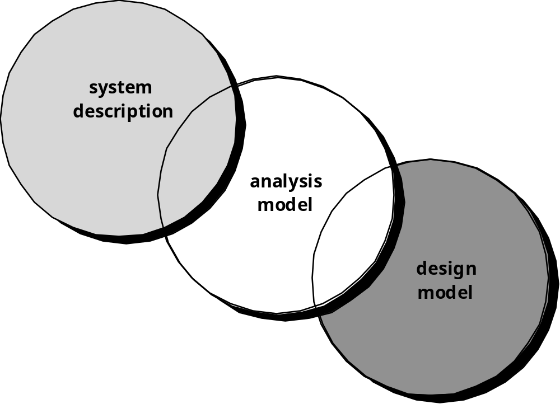
A Bridge

Slide 6
Rules of Thumb[经验原则]
The model should focus on requirements that are visible within the problem or business domain. The level of abstraction should be relatively high.
Each element of the analysis model should add to an overall understanding of software requirements and provide insight into the information domain, function and behavior of the system.
Delay consideration of infrastructure and other non-functional models until design.
Minimize coupling throughout the system.
Be certain that the analysis model provides value to all stakeholders.
Keep the model as simple as it can be.

Slide 7
Domain Analysis
Software domain analysis is the identification, analysis, and specification of common requirements from a specific application domain, typically for reuse on multiple projects within that application domain . . .
[Object-oriented domain analysis is] the identification, analysis, and specification of common, reusable capabilities within a specific application domain, in terms of common objects, classes, subassemblies, and frameworks . . .
Donald Firesmith

Slide 8
Domain Analysis
Define the domain to be investigated.
Collect a representative sample of applications in the domain.
Analyze each application in the sample.
Develop an analysis model for the objects.

Slide 9
8.2 Data Modeling
examines data objects independently of processing
focuses attention on the data domain
creates a model at the customer’s level of abstraction
indicates how data objects relate to one another

Slide 10
What is a Data Object?
Object
—something that is described by a set
of attributes (data items) and that will be
manipulated within the software (system)
each
instance
of an object (e.g., a book)
can be identified uniquely (e.g., ISBN #)
each plays a necessary role in the system
i.e., the system could not function without
access to instances of the object
each is described by attributes that are
themselves data items

Slide 11
Typical Objects
external entities (printer, user, sensor)
things
(e.g, reports, displays, signals)
occurrences or events (e.g., interrupt, alarm)
roles
(e.g., manager, engineer, salesperson)
organizational units
(e.g., division, team)
places
(e.g., manufacturing floor)
structures (e.g., employee record)

Slide 12
Data Objects and Attributes
A data object contains a set of attributes that act as an aspect, quality, characteristic, or descriptor of the object
object: automobile
attributes:
make
model
body type
price
options code

Slide 13
What is a Relationship?
relationship
—indicates “connectedness”;
a "fact" that must be "remembered"
by the system
several instances of a relationship can exist
objects can be related in many different ways

Slide 14
8.3 Object-Oriented Concepts
Must be understood to apply class-based elements of the analysis model
Key concepts:
  Classes and objects
  Attributes and operations
  Encapsulation and instantiation
  Inheritance

Slide 15
Classes
object-oriented thinking begins with the definition of a class, often defined as:
  template
  generalized description
  “blueprint” ... describing a collection of similar items
a metaclass (also called a superclass) establishes a hierarchy of classes
once a class of items is defined, a specific instance of the class can be identified

Slide 16
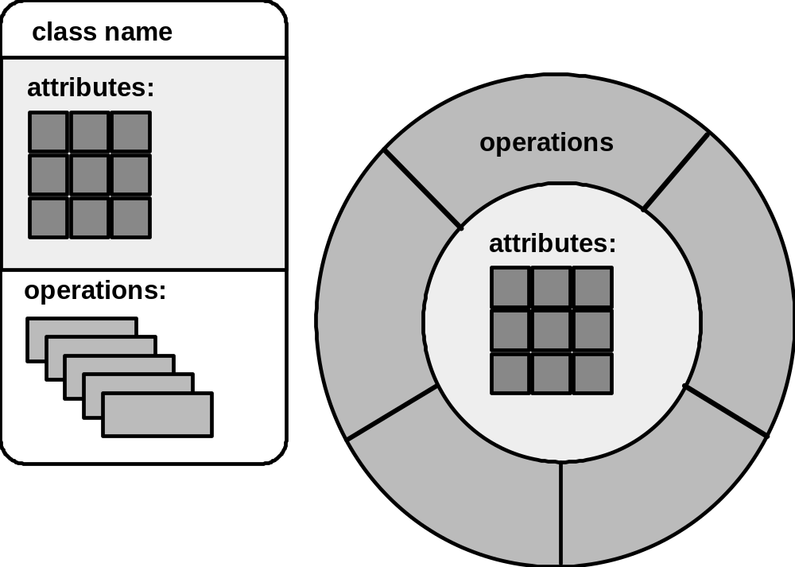
Building a Class

Slide 17
What is a Class?
occurrences
roles
things
organizational units
places
external entities
structures
class name
attributes:
operations:

Slide 18
Encapsulation/Hiding
The object encapsulates
both data and the logical
procedures required to
manipulate the data
method
# 1
method
# 2
data
method
# 3
method
# 6
method
# 5
method
# 4
Achieves “information hiding”

Slide 19
Class Hierarchy
PieceOfFurniture (superclass)
Table
Chair
Desk
”Chable"
subclasses of the
instances of Chair

Slide 20
Methods
(a.k.a. Operations, Services)
An executable procedure that is encapsulated in a class and is designed to operate on one or more data attributes that are defined as part of the class.
A method is invoked via message passing.

Slide 21
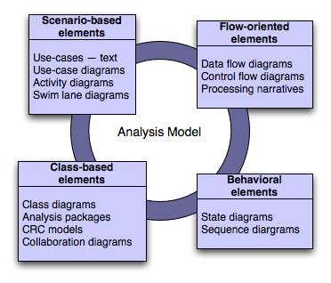
8.4 Analysis Model
Elements of the analysis model

Slide 22
8.5 Scenario-Based Modeling
“[Use-cases] are simply an aid to defining what exists outside the system (actors) and what should be performed by the system (use-cases).” Ivar Jacobson
  (1) What should we write about?
  (2) How much should we write about it?
  (3) How detailed should we make our description?
  (4) How should we organize the description?

Slide 23
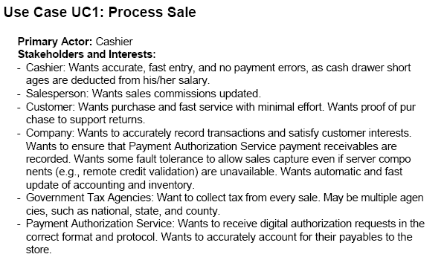
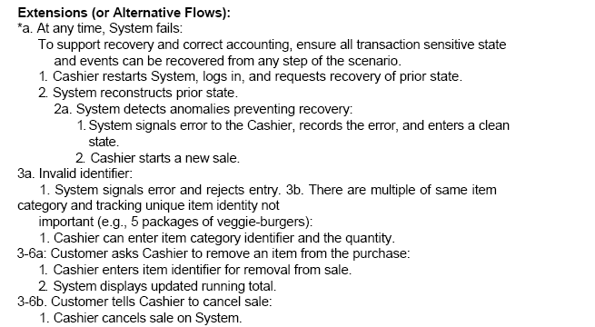
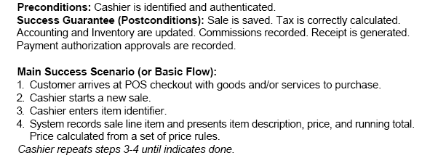
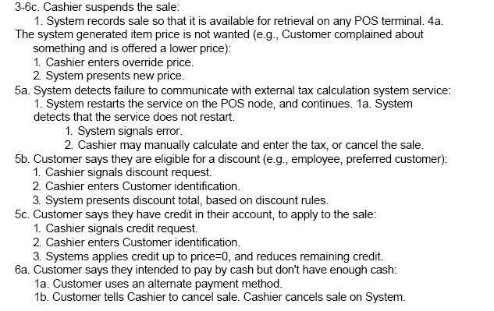
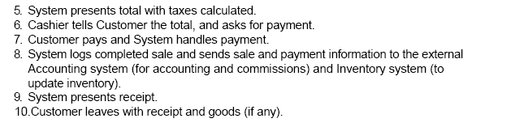

Slide 24
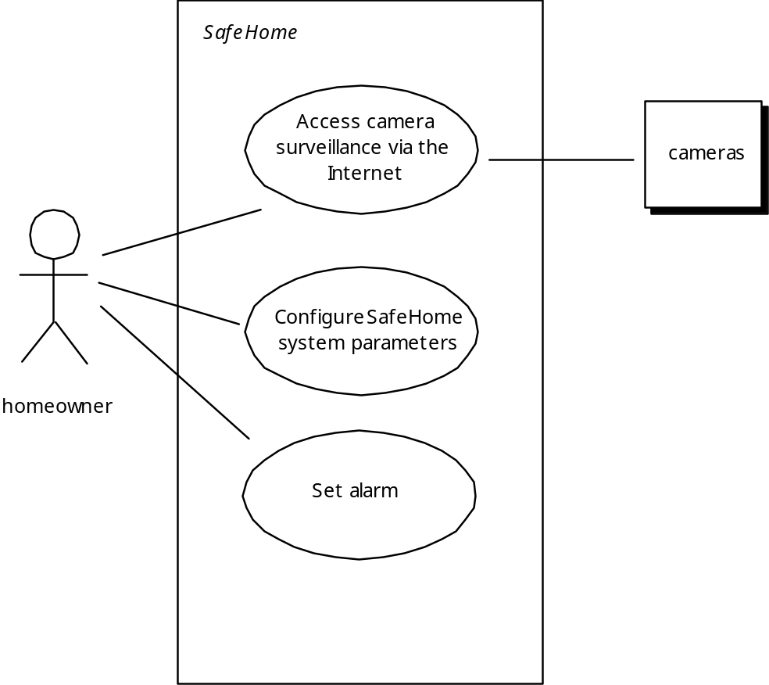
Use-Case Diagram

Slide 25
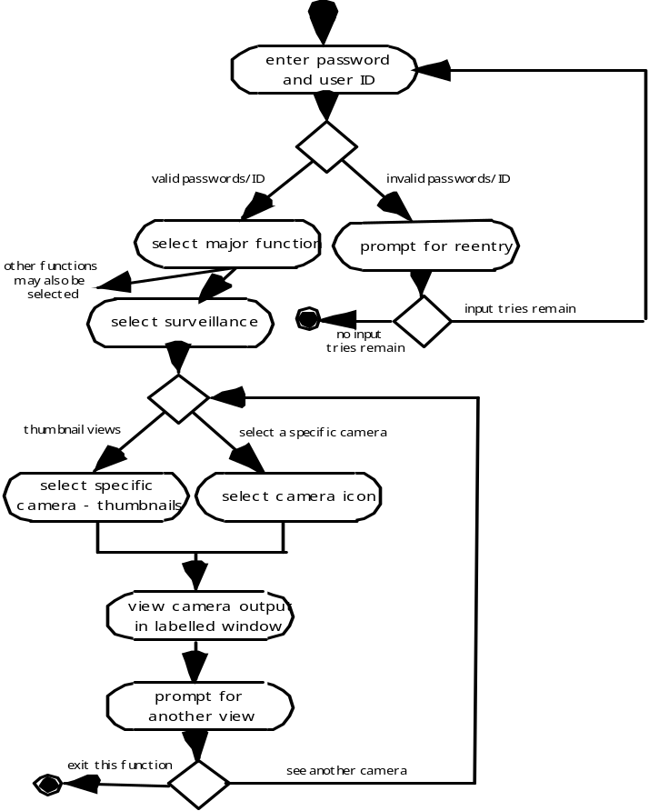
Activity Diagram
Supplements the use-case by providing a diagrammatic representation of procedural flow

Slide 26
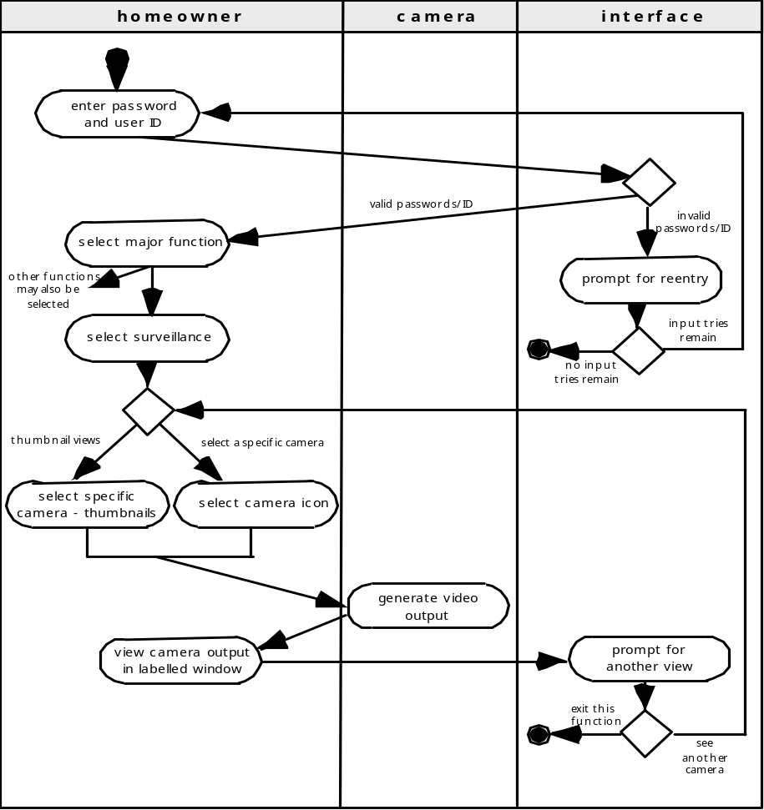
Swimlane Diagrams
Allows the modeler to represent the flow of activities described by the use-case and at the same time indicate which actor (if there are multiple actors involved in a specific use-case) or analysis class has responsibility for the action described by an activity rectangle

Slide 27
8.6 Flow-Oriented Modeling
Represents how data objects are transformed as they move through the system
A data flow diagram (DFD) is the diagrammatic form that is used
Considered by many to be an ‘old school’ approach, flow-oriented modeling continues to provide a view of the system that is unique—it should be used to supplement other analysis model elements

Slide 28
The Flow Model
Every computer-based system is an
information transform ....
computer
based
system
input
output

Slide 29
Flow Modeling Notation
external entity
process
data flow
data store

Slide 30
External Entity
A producer or consumer of data
Examples: a person, a device, a sensor
Another example: computer-based
system
Data must always originate somewhere
and must always be sent to something

Slide 31
Process
A data transformer (changes input
to output)
Examples: compute taxes, determine area,
format report, display graph
Data must always be processed in some
way to achieve system function

Slide 32
Data Flow
Data flows through a system, beginning
as input and be transformed into output.
base
compute
triangle
area
area
height

Slide 33
Data Stores
Data is often stored for later use.
sensor #
sensor #, type,
location, age
look-up
sensor
data
report required
type,
location, age
sensor number
sensor data

Slide 34
Data Flow Diagramming: Guidelines
all icons must be labeled with meaningful names
the DFD evolves through a number of levels of detail
always begin with a context level diagram (also called level 0)
always show external entities at level 0
always label data flow arrows
do not represent procedural logic

Slide 35
Constructing a DFD
review the data model to isolate data objects and use a grammatical parse to determine “operations”
determine external entities (producers and consumers of data)
create a level 0 DFD

Slide 36
Level 0 DFD Example
processing
request
user
requested
video
signal
digital
video
processor
monitor
video
source
NTSC
video signal

Slide 37
Constructing a DFD…
write a narrative describing the transform
parse to determine next level transforms
“balance” the flow to maintain data flow continuity
develop a level 1 DFD
use a 1:5 (approx.) expansion ratio

Slide 38
DFDs: A Look Ahead
analysis model
Maps into
design model

Slide 39
Control Flow Diagrams
Represents “events” and the processes that manage events
An “event” is a Boolean condition that can be ascertained by:
  listing all sensors that are "read" by the software.
  listing all interrupt conditions.
  listing all "switches" that are actuated by an operator.
  listing all data conditions.
  recalling the noun/verb parse that was applied to the processing narrative, review all "control items" as possible CSPEC inputs/outputs.

Slide 40
Control Flow Diagram
beeper on/off
copies done
full
manage
copying
read
operator
input
start
problem light
reload
process
empty
create
user
displays
perform
problem
diagnosis
jammed
display panel enabled

Slide 41
8.7 Class-Based Modeling
Identify analysis classes by examining the problem statement
Use a “grammatical parse” to isolate potential classes
Identify the attributes of each class
Identify operations that manipulate the attributes

Slide 42
Analysis Classes
External entities (e.g., other systems, devices, people) that produce or consume information to be used by a computer-based system.
Things (e.g, reports, displays, letters, signals) that are part of the information domain for the problem.
Occurrences or events (e.g., a property transfer or the completion of a series of robot movements) that occur within the context of system operation.
Roles (e.g., manager, engineer, salesperson) played by people who interact with the system.
Organizational units (e.g., division, group, team) that are relevant to an application.
Places (e.g., manufacturing floor or loading dock) that establish the context of the problem and the overall function of the system.
Structures (e.g., sensors, four-wheeled vehicles, or computers) that define a class of objects or related classes of objects.

Slide 43
Selecting Classes—Criteria
retained information
needed services
multiple attributes
common attributes
common operations
essential requirements

Slide 44
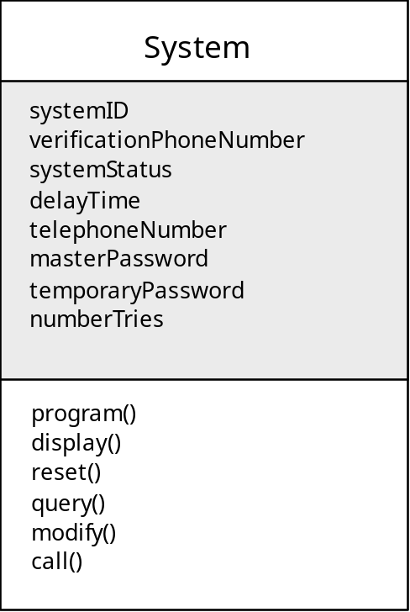
UML Class
Class name
attributes
operations

Slide 45
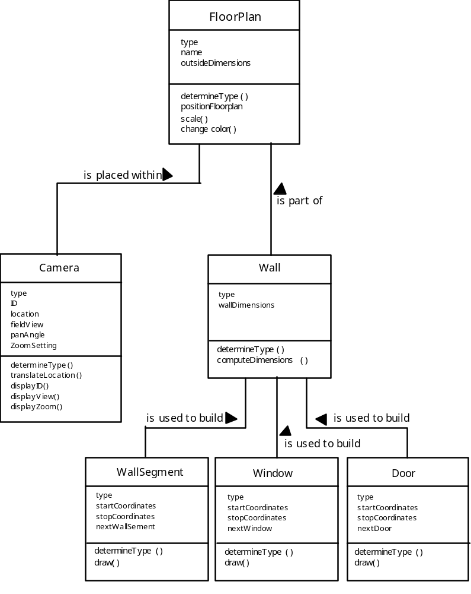
Class Diagram

Slide 46
CRC Modeling
CRC: Class-Responsibility-Collaborator用于识别和组织与系统或产品需求相关的类.
Analysis classes have “responsibilities”
  Responsibilities are the attributes and operations encapsulated by the class[类所知道或能做的任何事]
Analysis classes collaborate with one another
  Collaborators are those classes that are required to provide a class with the information needed to complete a responsibility. [协作者是那些提供完成某个职责所需要信息的类]
  In general, a collaboration implies either a request for information or a request for some action.

Slide 47
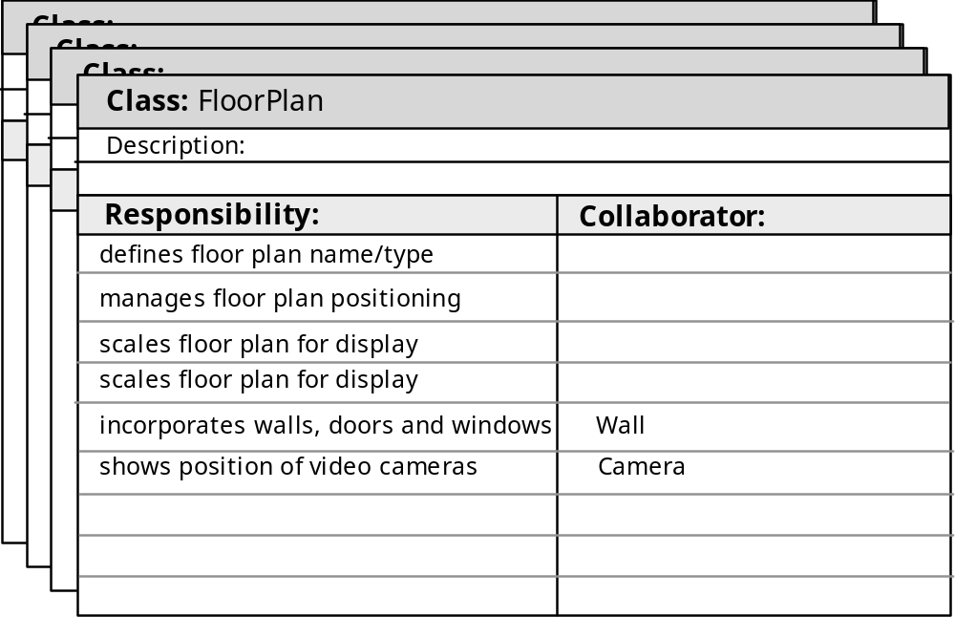
CRC Modeling

Slide 48
Associations and Dependencies
Two analysis classes are often related to one another in some fashion
  In UML these relationships are called associations
  Associations can be refined by indicating multiplicity
  In many instances, a client-server relationship exists between two analysis classes. In such cases, a client-class depends on the server-class in some way and a dependency relationship is established

Slide 49
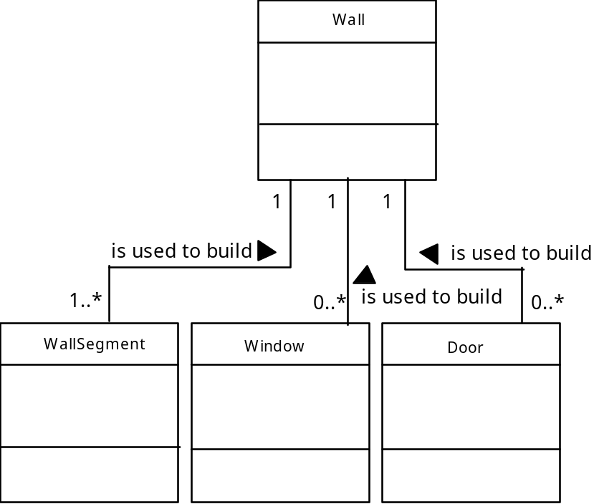
Multiplicity

Slide 50
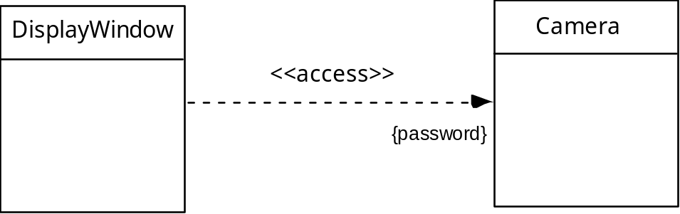
Dependencies

Slide 51
Analysis Packages
Various elements of the analysis model (e.g., use-cases, analysis classes) are categorized in a manner that packages them as a grouping
The plus sign (+)preceding the analysis class name in each package indicates that the classes have public visibility and are therefore accessible from other packages.
Other symbols can precede an element within a package. A minus sign indicates that an element is hidden from all other packages and a # symbol indicates that an element is accessible only to packages contained within a given package.

Slide 52
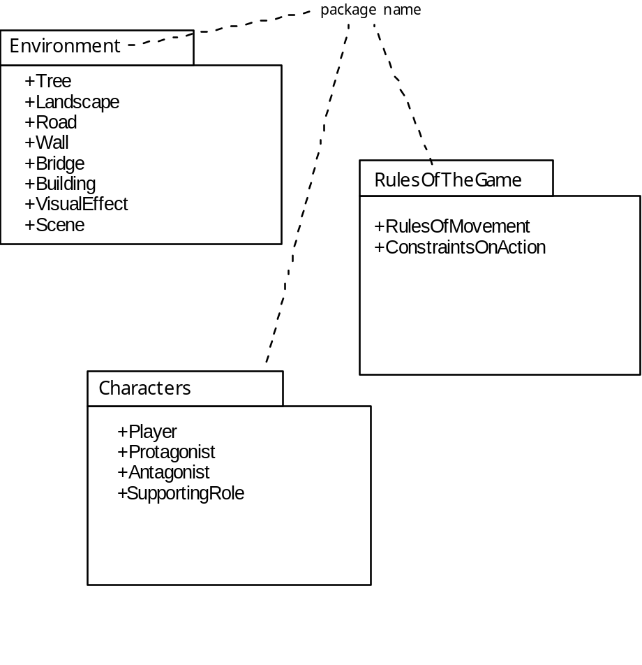
Analysis Packages

Slide 53
8.8 Behavioral Modeling
The behavioral model indicates how software will respond to external events or stimuli. To create the model, the analyst must perform the following steps:
  Evaluate all use-cases to fully understand the sequence of interaction within the system.
  Identify events that drive the interaction sequence and understand how these events relate to specific objects.
  Create a sequence diagram for each use-case.
  Build a state diagram for the system.
  Review the behavioral model to verify accuracy and consistency.

Slide 54
State Representations
In the context of behavioral modeling, two different characterizations of states must be considered:
  the state of each class when the system performs its function and
  the state of the system when observed from the outside as the system performs its function
The state of a class takes on both passive and active characteristics [CHA93].
  A passive state[钝态] is simply the current status of all of an object’s attributes.
  The active state[活跃态] of an object indicates the current status of the object as it undergoes a continuing transformation or processing.

Slide 55
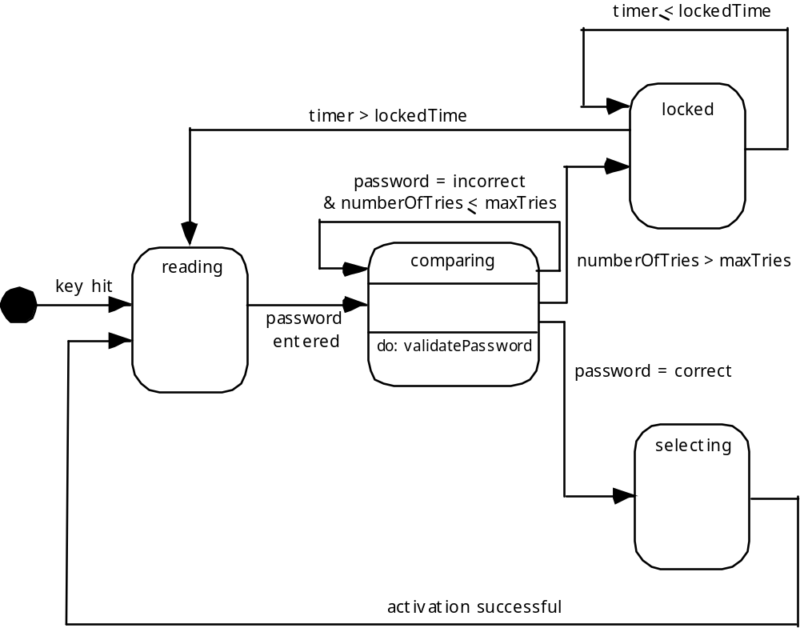
State Diagram for the ControlPanel Class

Slide 56
The States of a System
state—a set of observable circumstances that characterizes the behavior of a system at a given time
state transition—the movement from one state to another
event—an occurrence that causes the system to exhibit some predictable form of behavior
action—process that occurs as a consequence of making a transition

Slide 57
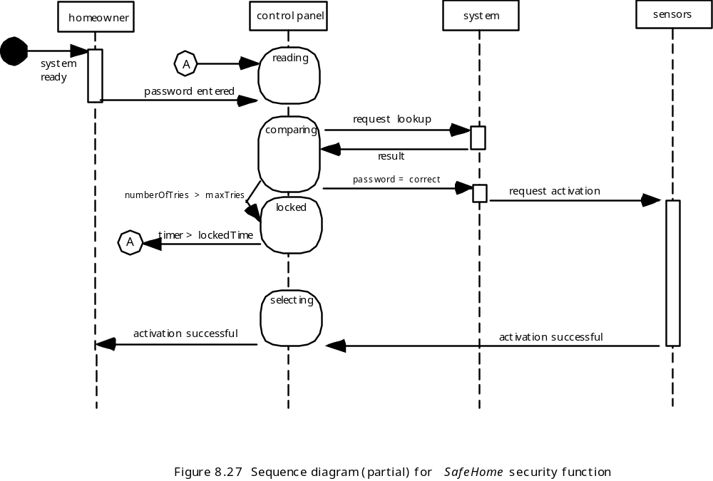
Sequence Diagram

Slide 58
Writing the Software Specification
Everyone knew exactly what had to be done until someone wrote it down!

