Slide 1
Chapter 15
Product Metrics for Software
Software Engineering: A Practitioner’s Approach, 6th edition
by Roger S. Pressman

Slide 2
本章要点
软件质量
产品度量
  分析度量
  设计度量
  代码度量
  测试度量

Slide 3
概述
产品度量有助于软件工程师对其设计和构造的软件获得深层次的了解。
产品度量为分析、设计、编码和测试能更客观地执行和更定量的评估提供基础。
与项目度量和过程度量不同【第22章】。

Slide 4
15.1 软件质量
一般来讲，软件质量是对明确陈述的功能和性能需求、明确记录的开发标准以及对所有专业化软件开发应具备的隐含特征的符合度。
  软件需求是质量测量的基础，不符合需求就是没有质量。
  若未能遵守开发准则，则肯定质量有问题。
  若软件符合显示需求，但未能满足其隐式需求，则软件质量仍然值得怀疑。

Slide 5
McCall’s Triangle of Quality
Maintainability[可维护性]
Flexibility[灵活性]
Testability[可测试性]
Portability[可移植性]
Reusability[可复用性]
Interoperability[互操作性]
P
R
O
D
U
C
T
R
E
V
I
S
I
O
N
P
R
O
D
U
C
T
T
R
A
N
S
I
T
I
O
N
R
O
D
U
C
T
R
E
V
I
S
I
O
N
P
R
O
D
U
C
T
T
R
A
N
S
I
T
I
O
N
P
R
O
D
U
C
T
O
P
E
R
A
T
I
O
N
P
R
O
D
U
C
T
O
P
E
R
A
T
I
O
N
Correctness Usability Efficiency
Reliability Integrity

Slide 6
A Comment
McCall’s quality factors were proposed in the early 1970s. They are as valid today as they were in that time. It’s likely that software built to conform to these factors will exhibit high quality well into the 21st century, even if there are dramatic changes in technology.

Slide 7
ISO 9126质量因素
功能性: Functionality
可靠性: Reliability
易用性: Usability
效率: Efficiency
可维护性: Maintainability
可移植性: Portability

Slide 8
15.2 产品度量框架
软件产品：文档、代码、软件等
度量手段:
  测度（measures）
  度量（metrics）
  指标（Indicators）
度量原则
度量过程

Slide 9
度量原则
设定度量目标：The objectives of measurement should be established before data collection begins;
定义要明确：Each technical metric should be defined in an unambiguous manner;
有效理论支持：Metrics should be derived based on a theory that is valid for the domain of application (e.g., metrics for design should draw upon [利用] basic design concepts and principles and attempt to provide an indication of the presence of an attribute that is deemed desirable);
度量指标的选择要是最合适的：Metrics should be tailored to best accommodate specific products and processes.

Slide 10
典型度量过程
Formulation【公式化】. The derivation of software measures and metrics appropriate for the representation of the software that is being considered.
Collection【收集数据】. The mechanism used to accumulate data required to derive the formulated metrics.
Analysis【分析结果】. The computation of metrics and the application of mathematical tools.
Interpretation【解释评估】. The evaluation of metrics results in an effort to gain insight into the quality of the representation.
Feedback【反馈】 Recommendations derived from the interpretation of product metrics transmitted to the software team.

Slide 11
面向目标的软件度量
The Goal/Question/Metric （GQM） Paradigm
  establish an explicit measurement goal that is specific to the process activity or product characteristic that is to be assessed
  define a set of questions that must be answered in order to achieve the goal, and
  identify well-formulated metrics that help to answer these questions.
Goal definition template
  Analyze {the name of activity or attribute to be measured}
  for the purpose of {the overall objective of the analysis}
  with respect to {the aspect of the activity or attribute that is considered}
  from the viewpoint of {the people who have an interest in the measurement}
  in the context of {the environment in which the measurement takes place}.

Slide 12
度量属性的有效性
简单 的和可计算的. It should be relatively easy to learn how to derive the metric, and its computation should not demand inordinate effort or time
在经验上和直观上有说服力. The metric should satisfy the engineer’s intuitive notions about the product attribute under consideration
一致的和客观的. The metric should always yield results that are unambiguous.
单位和量纲的使用是一致的. The mathematical computation of the metric should use measures that do not lead to bizarre combinations of unit.
编程语言的独立性. Metrics should be based on the analysis model, the design model, or the structure of the program itself.
高质量反馈的有效机制. That is, the metric should provide a software engineer with information that can lead to a higher quality end product

Slide 13
Collection and Analysis Principles
Whenever possible, data collection and analysis should be automated;
Valid statistical techniques should be applied to establish relationship between internal product attributes and external quality characteristics
Interpretative guidelines and recommendations should be established for each metric

Slide 14
软件产品度量全景
分析度量
设计度量
代码度量
测试度量

Slide 15
15.3 Analysis Metrics
Function-based metrics: use the function point as a normalizing factor or as a measure of the “size” of the specification
Specification metrics: used as an indication of quality of analysis model and requirements specification by measuring number of characteristics, such as un-ambiguity, integrity, correctness, understandability, etc.

Slide 16
Function-Based Metrics
The function point metric (FP), first proposed by Albrecht [ALB79], can be used effectively as a means for measuring the functionality delivered by a system.
Function points are derived using an empirical relationship based on countable (direct) measures of software's information domain and assessments of software complexity
Information domain values are defined in the following manner:
  number of external inputs (EIs)
  number of external outputs (EOs)
  number of external inquiries (EQs)
  number of internal logical files (ILFs)
  Number of external interface files (EIFs)

Slide 17
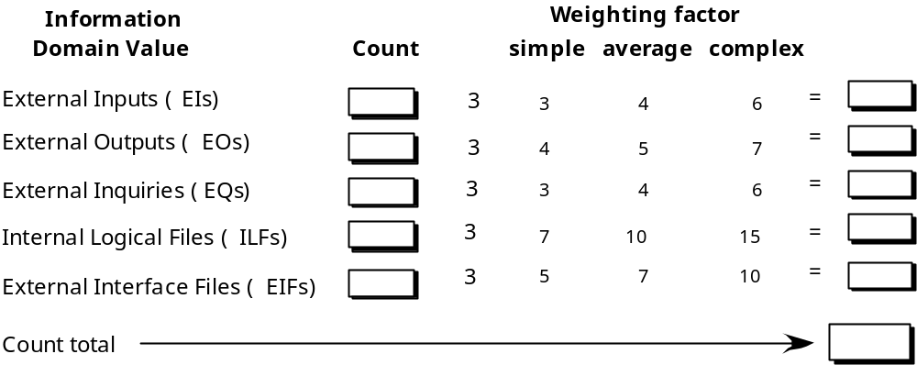
Function Points
3
x
9
3
8
2
x
2
6
2
x
2
7
1
x
1
4
x
20
4
50
FP=总计（count total） × 【0.65+0.01× Σ（F_{i}）】

Slide 18
15.4 设计度量
体系结构设计度量
OO设计度量
面向类的度量
构件级设计度量
面向操作度量
用户界面设计度量

Slide 19
Architectural Design Metrics
Architectural design metrics
  Structural complexity = g(fan-out)
  Data complexity = f(input & output variables, fan-out)
  System complexity = h(structural & data complexity)
HK metric: architectural complexity as a function of fan-in and fan-out
Morphology metrics[形态度量学]: a function of the number of modules and the number of interfaces between modules

Slide 20
Metrics for OO Design-I
Whitmire [WHI97] describes nine distinct and measurable characteristics of an OO design:
  Size
    Size is defined in terms of four views: population, volume, length, and functionality
  Complexity
    How classes of an OO design are interrelated to one another
  Coupling
    The physical connections between elements of the OO design
  Sufficiency
    “the degree to which an abstraction possesses the features required of it, or the degree to which a design component possesses features in its abstraction, from the point of view of the current application.”
  Completeness
    An indirect implication about the degree to which the abstraction or design component can be reused

Slide 21
Metrics for OO Design-II
Cohesion
  The degree to which all operations working together to achieve a single, well-defined purpose
Primitiveness
  Applied to both operations and classes, the degree to which an operation is atomic
Similarity
  The degree to which two or more classes are similar in terms of their structure, function, behavior, or purpose
Volatility
  Measures the likelihood that a change will occur

Slide 22
Class-Oriented Metrics （1）
weighted methods per class (WMC)
depth of the inheritance tree (DIT)
number of children (NOC)
coupling between object classes (CBO)
response for a class (RFC)
lack of cohesion in methods (LCOM)
Proposed by Chidamber and Kemerer:

Slide 23
Class-Oriented Metrics （2）
class size (CS)
number of operations overridden by a subclass (NOO)
number of operations added by a subclass (NOA)
specialization index (SI)
Proposed by Lorenz and Kidd [LOR94]:

Slide 24
Class-Oriented Metrics （3）
Method inheritance factor (MIF)
Coupling factor (CF)
Polymorphism factor (PF)
The MOOD Metrics Suite

Slide 25
Operation-Oriented Metrics
average operation size (OS_{avg})
operation complexity (OC)
average number of parameters per operation (NP_{avg})
Proposed by Lorenz and Kidd [LOR94]:

Slide 26
Component-Level Design Metrics
Cohesion metrics: a function of data objects and the locus of their definition
Coupling metrics: a function of input and output parameters, global variables, and modules called
Complexity metrics: hundreds have been proposed (e.g., cyclomatic complexity)

Slide 27
Interface Design Metrics
Layout appropriateness[布局恰当性]: a function of layout entities, the geographic position and the “cost” of making transitions among entities

Slide 28
15.5 Code Metrics
Halstead’s Software Science: a comprehensive collection of metrics all predicated on[以…为基础] the number (count and occurrence) of operators and operands within a component or program
  An “operator” is a fixed symbol or reserved word in a language, and “operand” is everything else: variable names, function names, numeric constants, etc. Comments don’t count.
Long=n₁logn₁+n₂logn₂
Volume=Long × log₂(n₁+n₂)

Slide 29
15.6 Metrics for Testing
Testing effort[测试工作量] can also be estimated using metrics derived from Halstead measures[参见15-7a, 15-7b]
Binder [BIN94] suggests a broad array of design metrics that have a direct influence on the “testability” of an OO system.
  Lack of cohesion in methods (LCOM).
  Percent public and protected (PAP).
  Public access to data members (PAD).
  Number of root classes (NOR).
  Fan-in (FIN).
  Number of children (NOC) and depth of the inheritance tree (DIT).

