Slide 1
Chapter 26
Quality Management
Software Engineering: A Practitioner’s Approach, 6th edition
by Roger S. Pressman

Slide 2
本章要点
质量成本
质量保证

Slide 3
Quality
The American Heritage Dictionary[美国传统大辞典] defines quality as
  “a characteristic or attribute of something.”
For software, two kinds of quality may be encountered:
  Quality of design encompasses requirements, specifications, and the design of the system.
  Quality of conformance is an issue focused primarily on implementation.
user satisfaction = compliant product[合格产品] + good quality + delivery within budget and schedule

Slide 4
Software Quality
Conformance to explicitly stated functional and performance requirements, explicitly documented development standards, and implicit characteristics that are expected of all professionally developed software.

Slide 5
质量控制
Prevention costs include
  quality planning
  formal technical reviews
  test equipment
  Training
Internal failure costs include
  rework
  repair
  failure mode analysis
External failure costs are
  complaint resolution[抱怨]
  product return and replacement
  help line support [热线电话]
  warranty work [保障工作]
质量成本
质量保证
Cost of Quality

Slide 6
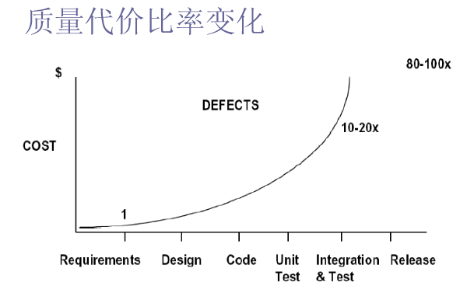
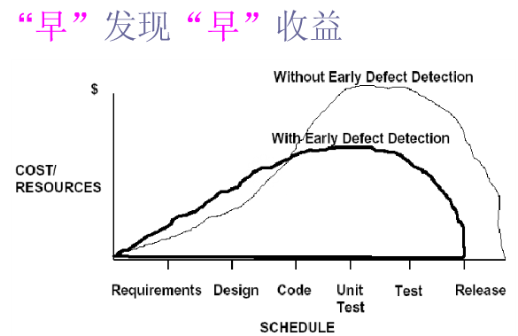

Slide 7
软件质量保证（SQA）
Process
Definition &
Standards
Formal
Technical
Reviews
Analysis
&
Reporting
Test
Planning
& Review
Measurement

Slide 8
Role of the SQA Group
Prepares an SQA plan for a project.
  The plan identifies
    evaluations to be performed
    audits and reviews to be performed
    standards that are applicable to the project
    procedures for error reporting and tracking
    documents to be produced by the SQA group
    amount of feedback provided to the software project team
Participates in the development of the project’s software process description.
  The SQA group reviews the process description for compliance with[符合] organizational policy, internal software standards, externally imposed standards (e.g., ISO-9001), and other parts of the software project plan.

Slide 9
Role of the SQA Group…
Reviews software engineering activities to verify compliance with the defined software process.
  identifies, documents, and tracks deviation[偏差] from the process and verifies that corrections have been made.
Audits designated software work products to verify compliance with those defined as part of the software process.
  reviews selected work products; identifies, documents, and tracks deviations; verifies that corrections have been made
  periodically reports the results of its work to the project manager.
Ensures that deviations in software work and work products are documented and handled according to a documented procedure.
Records any noncompliance[违规] and reports to senior management.
  Noncompliance items are tracked until they are resolved.

Slide 10
SQA各种方法
评审/正式技术评审[FTR]
SQA的形式化方法
基于统计的软件质量保证
软件可靠性度和安全性评估
ISO 9000质量标准
……

Slide 11
Reviews & Inspections
... there is no particular reason
why your friend and colleague
cannot also be your sternest critic
[不苟言笑评论家].
Jerry Weinberg

Slide 12
What Are Reviews?
a meeting conducted by technical people for technical people
a technical assessment of a work product created during the software engineering process
a software quality assurance mechanism
a training ground

Slide 13
What Reviews Are Not
A project summary or progress assessment
A meeting intended solely to impart[透露] information
A mechanism for political or personal reprisal[报复]!

Slide 14
The Players
review
leader
standards bearer (SQA)
producer
maintenance
oracle
recorder
reviewer
user rep

Slide 15
Conducting the Review
1.
be prepared—evaluate
product before the review
2.
review the product, not
the producer
3.
keep your tone mild[适度的], ask
questions instead of
making accusations[谴责]
4.
stick to the review agenda
5.
raise issues, don't resolve them
6.
avoid discussions of style—stick to technical
correctness
7.
schedule reviews as project tasks
8.
record and report all review results

Slide 16
Review Options Matrix
*
IPR
WT
IN
RRR
trained leader
agenda established
reviewers prepare in advance
producer presents product
“reader” presents product
recorder takes notes
checklists used to find errors
errors categorized as found
issues list created
team must sign-off on result
IPR—informal peer review WT—Walkthrough
IN—Inspection RRR—round robin review
yes
yes
yes
no
yes
yes
yes
yes
yes
yes
yes
yes
yes
no
no
yes
no
no
yes
maybe
no
maybe
maybe
maybe
no
maybe
no
no
no
no
yes
yes
yes
yes
no
yes
no
no
yes
yes
*

Slide 17
Metrics Derived from Reviews
inspection time per page of documentation
inspection time per KLOC or FP
inspection effort per KLOC or FP
errors uncovered per reviewer hour
errors uncovered per preparation hour
errors uncovered per SE task (e.g., design)
number of minor errors (e.g., typos)
number of major errors
(e.g., nonconformance to req.)
number of errors found during preparation

Slide 18
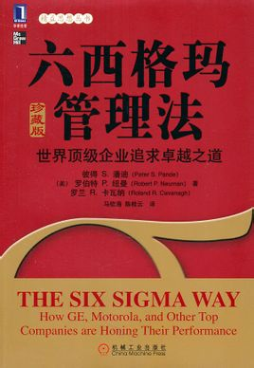
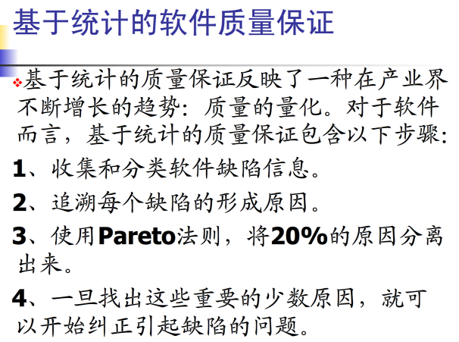
Statistical SQA
Product
& Process
Collect information on all defects
Find the causes of the defects
Move to provide fixes for the process
measurement
... an understanding of how
to improve quality ...

Slide 19
Software Reliability
A simple measure of reliability is mean-time-between-failure (MTBF), where
MTBF = MTTF + MTTR
The acronyms MTTF and MTTR are mean-time-to-failure （平均失效时间）and mean-time-to-repair（平均修复时间）, respectively.
Software availability is the probability that a program is operating according to requirements at a given point in time and is defined as
Availability = [MTTF/MTBF] x 100%

Slide 20
Software Safety
Software safety is a software quality assurance activity that focuses on the identification and assessment of potential hazards[潜在危险] that may affect software negatively and cause an entire system to fail.
If hazards can be identified early in the software process, software design features can be specified that will either eliminate or control potential hazards.

Slide 21
ISO 9001:2000 Standard
ISO 9001:2000 is the quality assurance standard that applies to software engineering.
The standard contains 20 requirements that must be present for an effective quality assurance system.
The requirements delineated by ISO 9001:2000 address topics such as
  management responsibility, quality system, contract review, design control, document and data control, product identification and traceability, process control, inspection and testing, corrective and preventive action, control of quality records, internal quality audits, training, servicing, and statistical techniques.

Slide 22
Chapter 27
Change Management
Software Engineering: A Practitioner’s Approach, 6th edition
by Roger S. Pressman

Slide 23
本章要点
软件配置管理
版本控制
变更控制

Slide 24
The “First Law”
软件第一定律
No matter where you are in the system life cycle, the system will change, and the desire to change it will persist throughout the life cycle.
Bersoff, et al, 1980

Slide 25
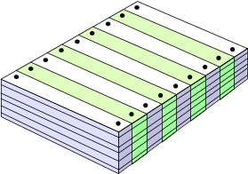
What Are These Changes?
changes in
business requirements
changes in
technical requirements
changes in
user requirements
other
documents
software models
Project
Plan
data
Test
code

Slide 26
The Software Configuration
programs
documents
The pieces
data

Slide 27

Baselines
The IEEE (IEEE Std. No. 610.12-1990) defines a baseline as:
    A specification or product that has been formally reviewed and agreed upon, that thereafter serves as the basis for further development, and that can be changed only through formal change control procedures.
a baseline is a milestone in the development of software that is marked by the delivery of one or more software configuration items (SCIs) and the approval of these SCIs that is obtained through a formal technical review

Slide 28
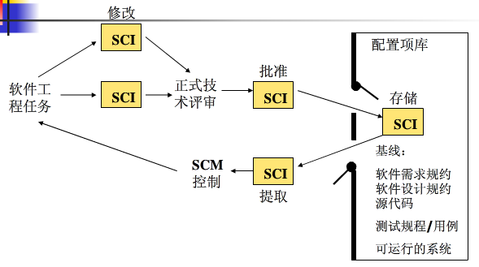
Baselines…
基线化的SCI和项目数据库

Slide 29
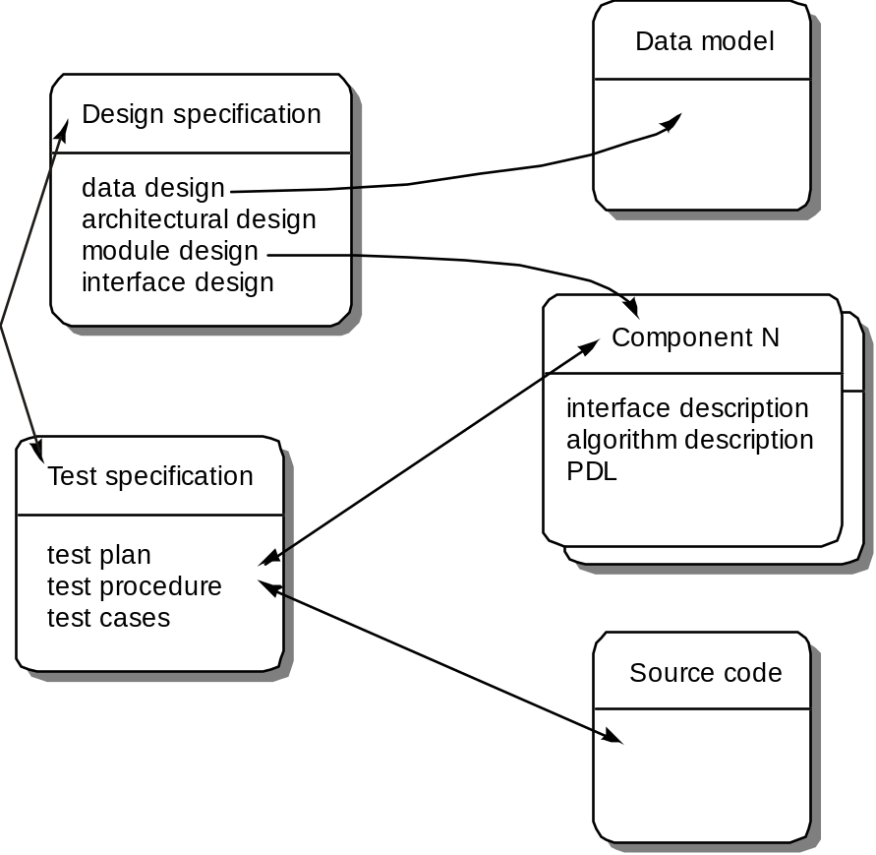
Software Configuration Objects

Slide 30
SCM Repository
The SCM repository [知识库] is the set of mechanisms and data structures that allow a software team to manage change in an effective manner
The repository performs or precipitates[沉淀] the following functions [FOR89]:
  Data integrity
  Information sharing
  Tool integration
  Data integration
  Methodology enforcement
  Document standardization

Slide 31
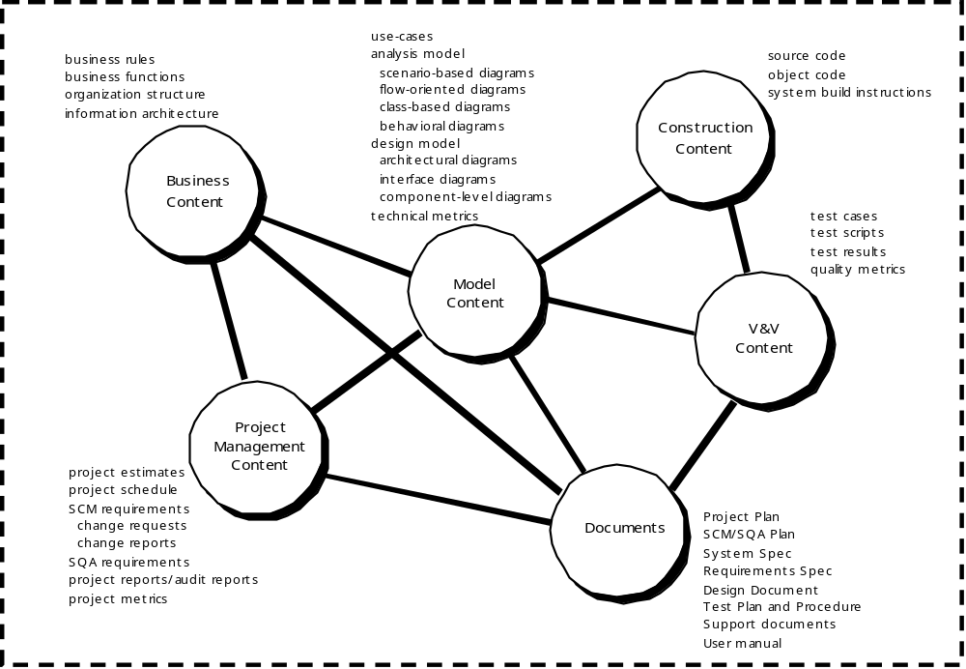
Repository Content

Slide 32
Repository Features
Versioning: saves all of these versions to enable effective management of product releases and to permit developers to go back to previous versions
Dependency tracking and change management: The repository manages a wide variety of relationships among the data elements stored in it.
Requirements tracing: Provides the ability to track all the design and construction components and deliverables that result from a specific requirement specification
Configuration management: Keeps track of a series of configurations representing specific project milestones or production releases. Version management provides the needed versions, and link management keeps track of interdependencies.
Audit trails[查账索引]: establishes additional information about when, why, and by whom changes are made.

Slide 33
SCM Elements
Component elements—a set of tools coupled within a file management system (e.g., a database) that enables access to and management of each software configuration item.
Process elements—a collection of procedures and tasks that define an effective approach to change management (and related activities) for all constituencies involved in the management, engineering and use of computer software.
Construction elements—a set of tools that automate the construction of software by ensuring that the proper set of validated components (i.e., the correct version) have been assembled.
Human elements—to implement effective SCM, the software team uses a set of tools and process features (encompassing other CM elements)

Slide 34
The SCM Process
Addresses the following questions …
How does a software team identify the discrete elements of a software configuration?
How does an organization manage the many existing versions of a program (and its documentation) in a manner that will enable change to be accommodated efficiently[有效容纳]?
How does an organization control changes before and after software is released to a customer?
Who has responsibility for approving and ranking changes?
How can we ensure that changes have been made properly?
What mechanism is used to appraise[评价] others of changes that are made?

Slide 35

The SCM Process

Slide 36
Version Control
Version control combines procedures and tools to manage different versions of configuration objects that are created during the software process
A version control system implements or is directly integrated with four major capabilities:
  a project database (repository) that stores all relevant configuration objects
  a version management capability that stores all versions of a configuration object (or enables any version to be constructed using differences from past versions);
  a make facility that enables the software engineer to collect all relevant configuration objects and construct a specific version of the software.
  an issues tracking (also called bug tracking) capability that enables the team to record and track the status of all outstanding issues associated with each configuration object.

Slide 37
Change Control
STOP

Slide 38
Change Control Process—I
need for change is recognized
change request from user
developer evaluates
change report is generated
change control authority decides
request is queued for action
change request is denied
user is informed
change control process—II

Slide 39
Change Control Process-II
assign people to SCIs
check-out SCIs
make the change
review/audit the change
establish a “baseline” for testing
change control process—III

Slide 40
Change Control Process-III
perform SQA and testing activities
check-in the changed SCIs
promote SCI for inclusion in next release
rebuild appropriate version
review/audit the change
include all changes in release

