Slide 1
Object-Oriented Technology and UML
Notes:
© Dr. Jim Arlow 2000 v1.0

Slide 2
Goals of the course
To provide an essential understanding of
OO --- Methodology
UML --- Modelling Language
UP --- Software Process
OO Analysis and Design with UML and UP
Notes:
© Dr. Jim Arlow 2000 v1.0

Slide 3
Course materials
Grady Booch,James Rumbaugh, Ivar Jacobson. The Unified Modeling Language User Guide, 2nd Ed. 2005
Jim Arlow,Ila Neustadt. UML 2 and the Unified Process, 2nd Ed. 2006
Carig Larman. Applying UML and Patterns: An Introduction to Object-Oriented Analysis and Design and the Unified Process, 3nd Ed. 2006
Scott W. Ambler. The Elements of UML 2.0 Style 2nd Ed. 2007
The latest UML specification
……
Notes:
© Dr. Jim Arlow 2000 v1.0

Slide 4
Grading
40%
  Attendance
  Projects and Reports
60%
  Final Exam

Slide 5
Introduction
Notes:
© Dr. Jim Arlow 2000 v1.0

Slide 6
Software Crisis
Software crisis was a term used in the early days of computing science for the difficulty of writing useful and efficient computer programs in the required time.
The software crisis was due to the rapid increases in computer power and the complexity of the problems that could be tackled.
With the increase in the complexity of the software, many software problem arose because existing methods were neither sufficient nor up to the mark.

Slide 7
Software Crisis
Projects running over-budget.
Projects running over-time.
Software was very inefficient.
Software was of low quality.
Software often did not meet requirements.
Projects were unmanageable and code difficult to maintain.

Slide 8
Causes of Software Crisis
The causes of the software crisis were linked to the overall complexity of the system and the software development process.

Slide 9
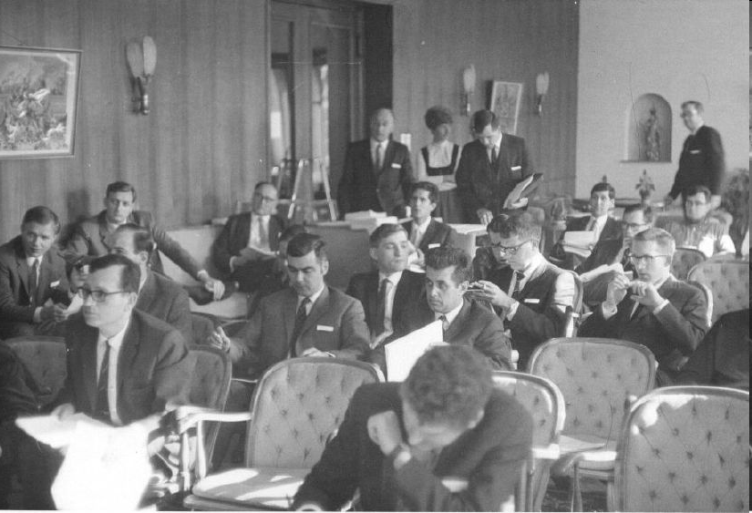
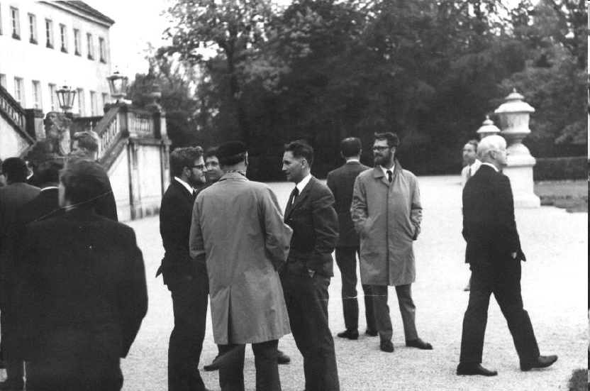
Software Engineering
1968, Garmisch, Germany, NATO

Slide 10
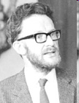
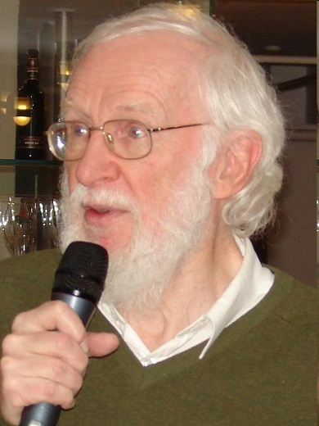
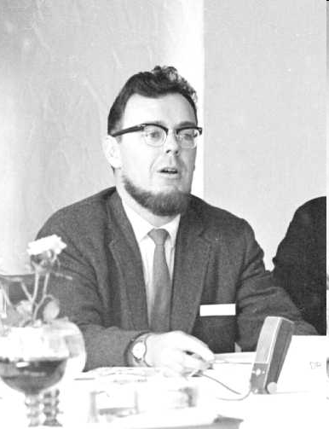
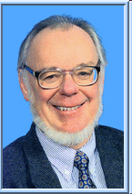
Software Engineering
Peter Naur and Brian Randell

Slide 11
Status Of Software Development
Software crisis persists
Important goal of software engineering: Solving the software crisis

Slide 12
Complexity Of The Software System
“Software entities are more complex for their size than perhaps any other human construct……”
  By Frederick P. Brooks (1999 Turing Award Winner)
  Originally appeared in: Brooks, Frederick P., "No Silver Bullet: Essence and Accidents of Software Engineering," IEEE Computer, Vol. 20, No. 4 (April 1987) pp. 10-19.

Slide 13
Solution to Software Crisis?
Software complexity is inherent
Reduce and control the complexity of software

Slide 14
Solution to Software Crisis?
The basic method of controlling software complexity:
Decomposition
Abstract
Modularization
Information hiding

Slide 15
Solution to Software Crisis?
To solve these problems, we produce:
Theory
Methodology
Language
Technology
Process
Tool
…

Slide 16
Software Engineering Methods And Techniques
Structured method
Object-oriented method
Component-based method
Agent-based method
……

Slide 17
Structured method
Process oriented
  Data flow is emphasized
Functional decomposition
  Stepwise refinement
Advantages
  Simple, easy to master, the method is more mature, there are more tools to support
Disadvantages
  Low development efficiency, reusability is poor

Slide 18
Object-oriented Method
Describe the things in the real world as objects
An object is an encapsulation of data and methods
Objects interact through messages
Objects are divided into classes, various hierarchical relationships may be constituted between various classes

Slide 19
Structured Method And Object-oriented Method
Structured analysis (SA) in Structured method
  Focusing on functional decomposition of a system
Object-oriented analysis (OOA)
  Focusing on understanding the problem from the perspective of real objects
Take a library management system as an example
  SA: book registration, overdue fines registration …
  OOA: library administrators, catalogs and books …

Slide 20
Structured Method And Object-oriented Method
SA
  Requirements of customers is very clear
  Definition of business process is complete, and will not often change
OOA
  The software will use object-oriented programming language
  Customer requirements are not clear
  Judging by past experience, customers will frequently require the addition of new features
  The system to be developed is complex
  ……

Slide 21
Structured Method And Object-oriented Method
Structured Method
  Focusing on data structures, algorithms and implementation steps
  Code is difficult to reuse
  Lack of visual modeling techniques with strong expression
Object-oriented Method
  System is constructed by objects
  Sending messages between objects
  An object combines data and behavior together
  Visual models can be easily evolved as a model of solution

Slide 22
OO
The object model encompasses the principles of
  abstraction
  encapsulation
  modularity
  hierarchy
  typing
  concurrency
  persistence
  What is important about the object model is that these elements are brought together in a synergistic way.

Slide 23
OO
Abstraction is one of the fundamental ways that we as humans cope with complexity.
Abstraction arises from a recognition of similarities between certain
  objects
  situations
  processes

Slide 24
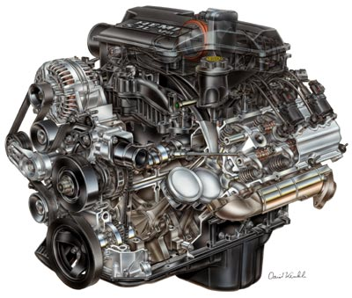
OO
An abstraction focuses on the outside view of an object and so serves to separate an object’s essential behavior from its implementation.
Focus on outside view

Slide 25
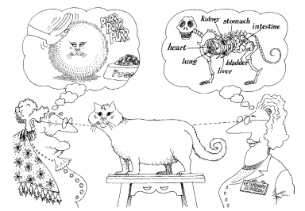
Abstraction focuses on the essential characteristics of some object,
relative to the perspective of the viewer.

Slide 26
OO
Abstraction and encapsulation are complementary concepts:
  Abstraction focuses on the observable behavior of an object, whereas
  encapsulation focuses on the implementation that gives rise to this behavior.

Slide 27
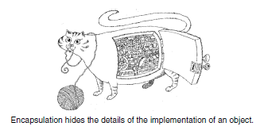

OO

Slide 28
OO
Encapsulation is most often achieved through information hiding, which is the process of hiding all the secrets of an object that do not contribute to its essential characteristics; typically,
  the structure of an object is hidden, as well as
  the implementation of its methods.

Slide 29
OO
Classes and objects form the logical structure of a system; we place these abstractions in modules to produce the system’s physical architecture.
Especially for larger applications, in which we may have many hundreds of classes, the use of modules is essential to help manage complexity.

Slide 30
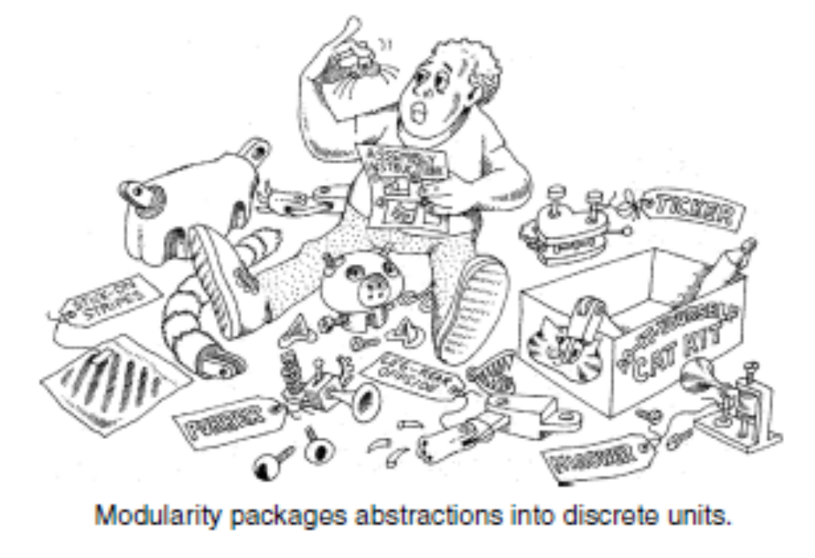
OO

Slide 31
OO
The overall goal of the decomposition into modules is the reduction of software cost by allowing modules to be designed and revised independently.

Slide 32
OO
Thus, the principles of abstraction, encapsulation, and modularity are synergistic
An object provides a crisp boundary around a single abstraction, and both encapsulation and modularity provide barriers around this abstraction.

Slide 33
OO
A set of abstractions often forms a hierarchy, and by identifying these hierarchies in our design, we greatly simplify our understanding of the problem.

Slide 34
OO
Inheritance is the most important “is a” hierarchy.
Inheritance thus represents a hierarchy of abstractions, in which a subclass inherits from one or more super classes.
  Typically, a subclass augments or redefines the existing structure and behavior of its super classes.

Slide 35
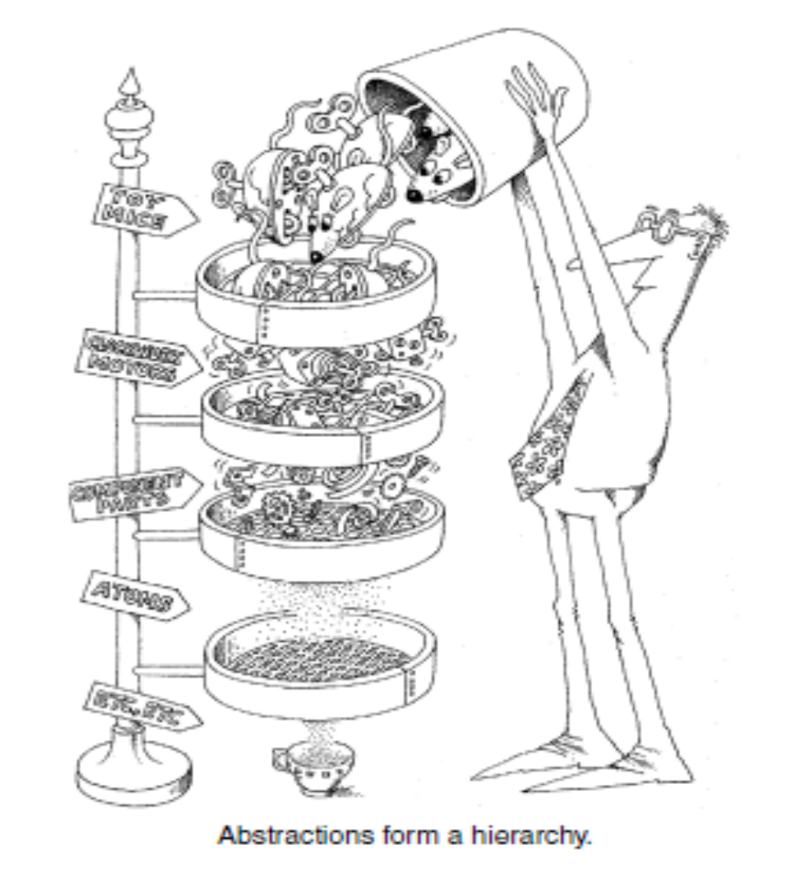

Slide 36
Model
A Model is an abstract representation of a thing.
It’s very difficult to map requirements into software directly. We need to build models from different perspectives and hierarchies.

Slide 37
Model
Everyone filters information to create their own particular model of the world. Noam Chomsky described this as three processes:
  Deletion – information is filtered out
  Distortion – information is modified by the related mechanisms of creation and hallucination
  Generalisation –the creation of rules, beliefs and principles about truth and falsehood
these filters are applied automatically and unconsciously
these filters are applied automatically and unconsciously
these filters are applied automatically and unconsciously
these filters are applied automatically and unconsciously
Notes:
© Dr. Jim Arlow 2000 v1.0

Slide 38
What is UML?
Unified Modelling Language (UML) is a general purpose visual modelling language
  Can support all existing lifecycles
  Intended to be supported by CASE tools
Unifies past modelling techniques and experience
Incorporates current best practice in software engineering
UML is not a methodology!
Notes:
© Dr. Jim Arlow 2000 v1.0

Slide 39
UML history
Fusion
1st unification
attempt
OMT, Booch, CRC
UML
work begins
Object
Management
Group RFP
UML proposal
accepted by
OMG
UML 1.x
UML 2.0
Schlaer/
Mellor
Prehistory
Booch
Rumbaugh
(OMT)
1994
1995
1996
1997
2003
2004
Jacobson
(Objectory)
Booch &
Rumbaugh
(OMT) join
Rational
Jacobson
(Objectory)
joins
Rational
UML
becomes
an industry
standard
Ongoing UML development
Coad/
Yourdon
A major upgrade to UML at the end of 2003:
  Greater consistency
  More precisely defined semantics
  New diagram types
  Backwards compatible
Notes:
© Dr. Jim Arlow 2000 v1.0

Slide 40

UML future?
The future of development of UML will be increasingly affected by Model Driven Architecture (MDA)
MDA
Platform
Independent
Model
map
Platform
Specific
Model
generate
Code
deploy
Notes:
© Dr. Jim Arlow 2000 v1.0

Slide 41
Why "unified"?
UML is unified across several domains:
  Across historical methods and notations
  Across the development lifecycle
  Across application domains
  Across implementation languages and platforms
  Across development processes
  Across internal concepts
Notes:
© Dr. Jim Arlow 2000 v1.0

Slide 42
The Main Phases Of The Software Life Cycle
Requirement Analysis
Software Design
Coding/Programming
Testing/Debug
Running/Maintenance

Slide 43
Software Process Model
Waterfall Model
Evolutionary model
Spiral model
Iterative and Incremental Process Model
UP Model

Slide 44
Waterfall Model
Requirements
Requirements
Analysis
Analysis
Design
Design
Coding
Coding
Testing
Testing
maintenance
maintenance

Slide 45
Waterfall Model
About waterfall model:
  The different stages are to be carried out consecutively
  At each stage, the work done will be documented, which will form the basis for the work that is done at the next stage
  After deployment, the system will be maintained as long as it remains in service

Slide 46
Waterfall Model
Advantages：
It is an intuitive, sensible and general-purpose engineering approach to software engineering.
It emphasizes planning for an activity before carrying it out, better than just start coding without considering overall architecture of the program.
It recommends a top-down approach, from high level of abstraction to more details.
It provides a strong management tool for controlling software projects.

Slide 47
Waterfall Model
Disadvantages：
If errors are found when working on one stage, it is reasonable to correct the problems before proceeding.However, Some earlier versions of the waterfall model restricted feedback to the previous stage in the process only.

Slide 48
Evolutionary Model
Evolutionary model suggests that software should be developed in a more ‘evolutionary’ manner.

Slide 49
Evolutionary Model
Prototype
Specification
Initial
Version
Intermediate Version1
Outline
Description
Development
Intermediate Version2
Intermediate Version3
Intermediate Version4
Intermediate Version5
Final
Version
Validation

Slide 50
Evolutionary Model
How evolutionary model works?
  Development starts with the production of a prototype system implementing only the core functionality of the complete system.
  The prototype will be used to discuss with the users
  Feedback from the users would then guide subsequent development, …
  The prototype would evolve into a more complete system, with small increments of functionality being added at any given stage and repeated consultations with the users taking place.

Slide 51
Evolutionary Model
Advantages:
By involving users in the development process, the problem of discovering errors late has been overcome.
A series of working prototypes mean that the evolving system was being tested from an early stage in a project

Slide 52
Evolutionary Model
Disadvantages:
It is very difficult to see how project managers could sensibly plan a project.
The model gives no guarantee that the evolutionary process will in fact ever converge on a stable system.

Slide 53
Spiral Model
The spiral model was developed in an attempt
  to develop an explicit software process that addressed the weakness of the waterfall model
  to reserve more of its traditional management oriented advantages than the evolutionary model

Slide 54
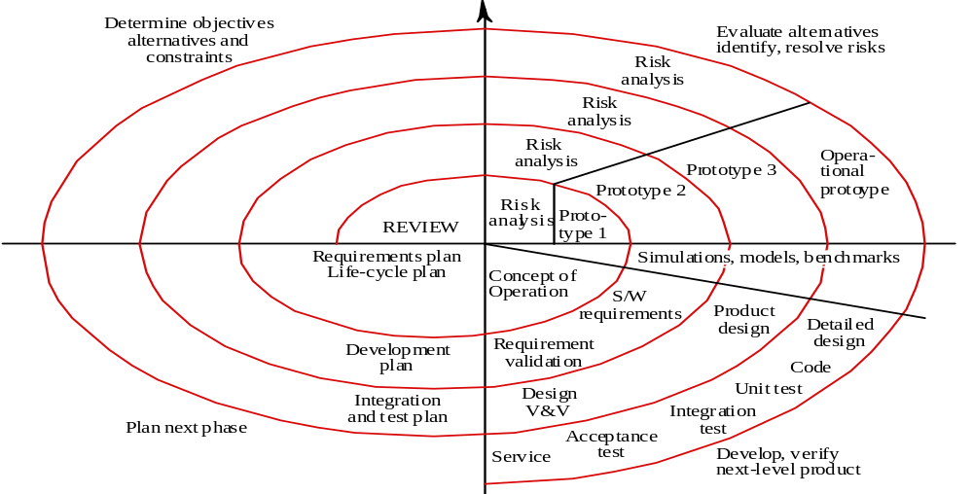
Spiral Model
Q2
Q1
Q4
Q3
the spiral model (after Boehm 1988)

Slide 55
Spiral Model
Q1: consider the objectives for the iteration, the various alternative solutions that should be considered and the constraints under which a solution must be developed.
Q2: a risk analysis is carried out. The aim of this is to ensure that each iteration focuses on the highest risks threatening the project.
Q3: construct prototypes to help evaluate possible approaches to resolving the risks, before committing to a detailed development.
Q4:a review of the work done in the iteration and plans are made for the subsequent iteration.

Slide 56
Spiral Model
Main characteristics:
  It is a hybrid model that support process iteration
  The process is represented as a spiral, each loop in the spiral representing a process phase
  Four sectors per loop
  1) objective setting,
  2) risk assessment and reduction,
  3) development and validation,
  4) planning

Slide 57
Iterative and incremental development
Incremental development :
develop core functionality first, to the level of getting a working system, and then
add the remaining functionality incrementally, in a series of increments

Slide 58
Iterative and incremental development
Iterative development:
Software projects be managed as a series of iterations;
Not just as a single pass through the various activities identified in the waterfall model

Slide 59
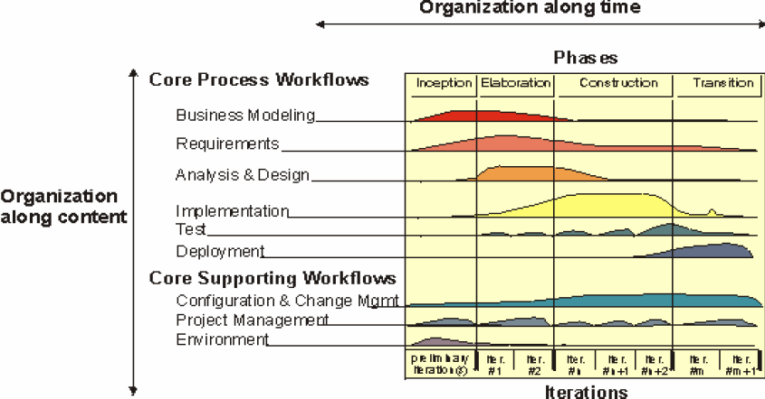
UP

Slide 60
Major Milestones: Business Decision Points
UP
Customer
Acceptance
or End of Life
Architecture
Base Lined
Product Sufficiently Mature for Customers
Scope and Business Case Agreement
Inception
Elaboration
Construction
Transition
time
Lifecycle
Objective
Milestone
2008-05-01
Lifecycle
Architecture
Milestone
2009-05-01
Initial Operational
Capability
Milestone
2009-12-30
Product
Release
2010-04-01
2007-09-01
Notes:
The phases of RUP were chosen such that phase boundaries correspond to significant decision points in the life of a project. For example, at the end of Inception, enough work has been done to capture the problem to be solved, and a vision of the system has been developed. An initial set of risks has also been identified and evaluated. Based on this information, a decision is made whether to fund the project. Similar decision points correspond to the end of Elaboration, Construction, and Transition.
Milestones help you to assess the progress of a project at key points. Management can use these to establish clear criteria from which to decide the course of a project. They provide opportunities to change course. However, unlike the waterfall approach, phases contain iterations which yield executable results.
Phases represent the management perspective of the project, the “35,000 foot level.” The details are left to the engineering perspective, which is at the iteration level.
The names of the milestones are identical to the ones proposed by Barry Boehm in the article “Anchoring the Software Process,” IEEE Software, July 1996, pp. 73-82.

Slide 61
UP
The inception phase is primarily concerned with project planning and risk evaluation.
The elaboration phase is concerned with defining the overall architecture of the system.
In the construction phase, the system is built, ending with a release that can be delivered to the customers for beta testing.
The transition phase covers the period of beta testing and terminates with the release of the completed system.

Slide 62
UP
Each activity can occur in any iteration, but the balance of activities in an iteration will change as the project progresses from inception to completion.
Each phase terminates with a milestone to capture the points within the project lifecycle
Each phase can contain a number of iterations; Each iteration will typically be structured as a mini-waterfall process.
An iteration should result in an incremental improvement to the product being constructed.

Slide 63
UP
UP is:
  Use case (requirements) driven
  Architecture centric
  Iterative and incremental

