Slide 1
Unified Modelling Language
Notes:
© Dr. Jim Arlow 2000 v1.0

Slide 2
Content
What is UML
Why UML
UML History and Future
UML Features
UML Structure
UML Application
UML Tools
Notes:
© Dr. Jim Arlow 2000 v1.0

Slide 3
What is UML?
Unified Modelling Language (UML) is a general purpose, open, extensible, industry standard visual modelling language
Unifies past modelling techniques and experience
Incorporates current best practice in software engineering
UML is not a methodology!
Notes:
© Dr. Jim Arlow 2000 v1.0

Slide 4
Why UML
Unified:
  - Across historical methods and notations
  - Across the development lifecycle
  - Across application domains
  - Across implementation languages and platforms
  - Across development processes
  - Across internal concepts
Notes:
© Dr. Jim Arlow 2000 v1.0

Slide 5
Why UML
Modelling
- to think and master complex systems
- to understand and communicate
- to capture decisions
- to find problems
- …

Slide 6
Why UML
Language
- visual
- wide use
- standardization
- …

Slide 7
UML history
Fusion
1st unification
attempt
OMT, Booch, CRC
UML
work begins
Object
Management
Group RFP
UML proposal
accepted by
OMG
UML 1.x
UML 2.0
Schlaer/
Mellor
Prehistory
Booch
Rumbaugh
(OMT)
1994
1995
1996
1997
2003
2004
Jacobson
(Objectory)
Booch &
Rumbaugh
(OMT) join
Rational
Jacobson
(Objectory)
joins
Rational
UML
becomes
an industry
standard
Ongoing UML development
Coad/
Yourdon
A major upgrade to UML at the end of 2003:
  Greater consistency
  More precisely defined semantics
  New diagram types
  Backwards compatible
Notes:
© Dr. Jim Arlow 2000 v1.0

Slide 8
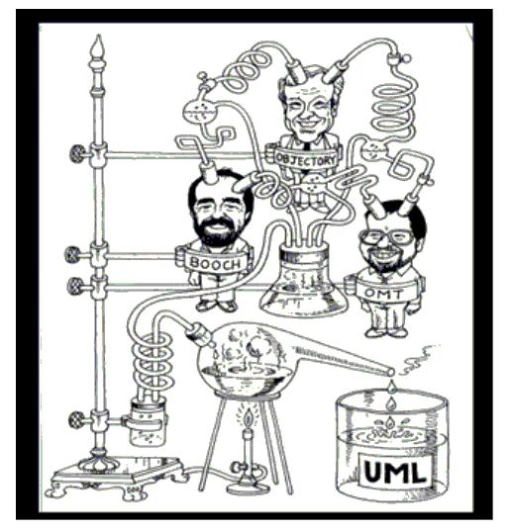
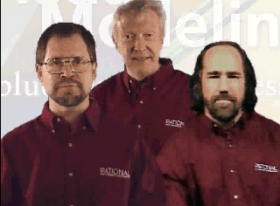
UML history
Three amigos

Slide 9

UML future?
The future of development of UML will be increasingly affected by Model Driven Architecture (MDA)
MDA
Platform
Independent
Model
map
Platform
Specific
Model
generate
Code
deploy
Notes:
© Dr. Jim Arlow 2000 v1.0

Slide 10
UML Features
Has been accepted as the standard modeling language by OMG
Support for object-oriented development
The ability of visualization and expression are strong
Independent of the development process, and can be applied to different software development process
Independent of the programming language
…

Slide 11

UML Structure
In this section we present an overview of the structure of the UML
All the modelling elements mentioned here are discussed later, and in much more detail!
Building blocks
Rules
Common mechanisms
Architecture
Notes:
© Dr. Jim Arlow 2000 v1.0

Slide 12
UML building blocks
Things
  Modelling elements
Relationships
  Tie things together
Diagrams
  Views showing interesting collections of things
  Are views of the model
Notes:
© Dr. Jim Arlow 2000 v1.0

Slide 13
Things
Structural things – nouns of a UML model
  Class, interface, collaboration, use case, active class, component, node
Behavioural things – verbs of a UML model
  Interactions, state machine
Grouping things
  Package
    Models, frameworks, subsystems
Annotational things
  Notes
  Tagged values
package
Some Information about a thing
Notes:
© Dr. Jim Arlow 2000 v1.0

Slide 14
Relationships
relationship
UML syntax
brief semantics
dependency
The source element depends on the target element and may be affected by changes to it.
association
The description of a set of links between objects.
aggregation
The target element is a part of the source element.
composition
A strong (more constrained) form of aggregation.
containment
The source element contains the target element.
generalization
The source element is a specialization of the more general target element and may be substituted for it.
realization
The source element guarantees to carry out the contract specified by the target element
Notes:
© Dr. Jim Arlow 2000 v1.0

Slide 15
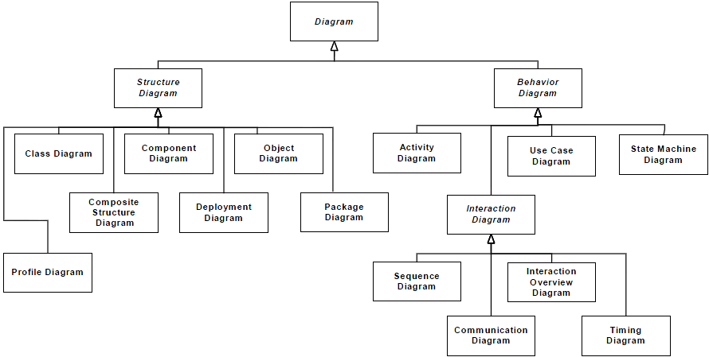
UML has 14 types of diagram
Notes:
© Dr. Jim Arlow 2000 v1.0

Slide 16
UML has 14 types of diagram
Structure diagrams model the structure of the system (the static model)
Behavior diagrams model the dynamic behavior of the system (the dynamic model)
Each type of diagram gives a different type of view of the model

Slide 17
Structural Diagrams
Class Diagram
Component Diagram
Object Diagram
Deployment Diagram
Composite Structure Diagram
Package Diagram
Profile Diagram

Slide 18
Class Diagram
In software engineering, a class diagram in UML is a type of static structure diagram that describes the structure of a system by showing the system's classes, their attributes, operations (or methods), and the relationships among objects
May be the most commonly used diagram in practices

Slide 19
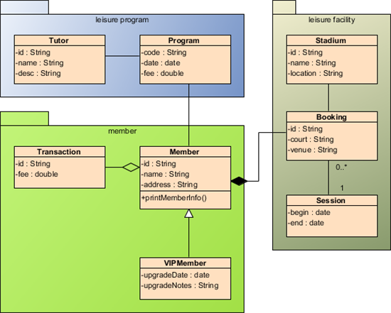
Class Diagram

Slide 20
Component Diagram
An component diagram shows the internal parts, connectors, and ports that implement a component
A component diagram also shows the organizations and dependencies among software components, including source code components, binary code components, and executable components

Slide 21
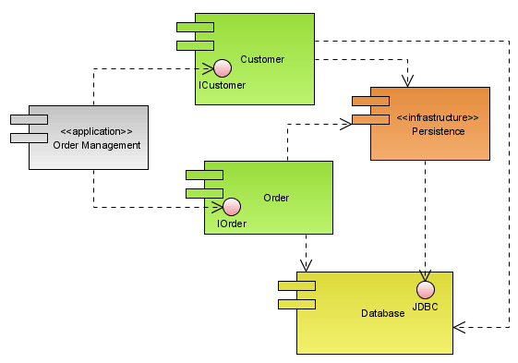
Component Diagram

Slide 22
Object Diagram
An object diagram shows a set of objects and their relationships
You use object diagrams to illustrate data structures, the static snapshots of instances of the things found in class diagrams
Object diagrams address the static design view or static process view of a system just as class diagrams do, but from the perspective of real or prototypical cases

Slide 23
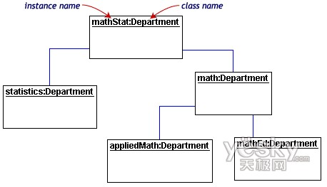
Object Diagram

Slide 24
Deployment Diagram
A deployment diagram shows a set of nodes and their relationships
You use deployment diagrams to illustrate the static deployment view of an architecture
Deployment diagrams are related to component diagrams in that a node typically encloses one or more components

Slide 25
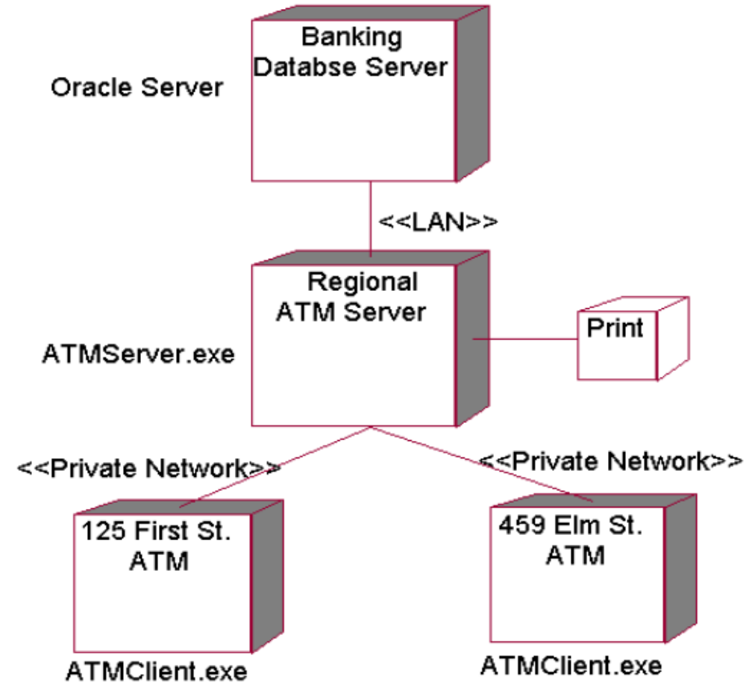
Deployment Diagram

Slide 26
Structure Diagrams added in UML2.X
Composite Structure Diagram
Package Diagram
Profile Diagram

Slide 27
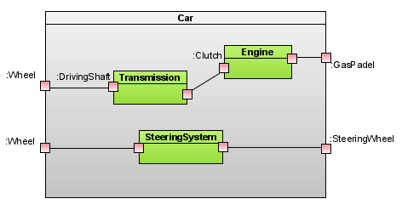
Composite Structure Diagram

Slide 28
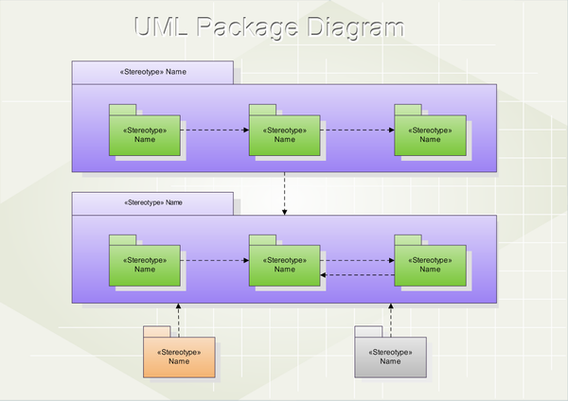
Package Diagram

Slide 29
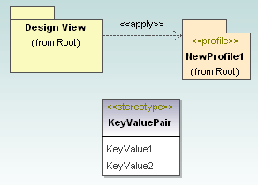
Profile Diagram

Slide 30
Behavioral Diagrams
Activity Diagram
Use Case Diagram
State Machine Diagram
Interaction Diagram
  Communication Diagram
  Sequence Diagram
  Timing Diagram
  Interaction Overview Diagram

Slide 31
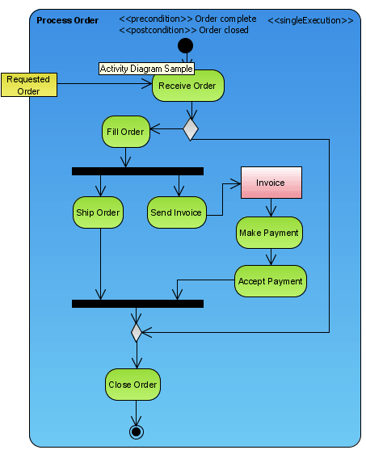
Activity Diagram

Slide 32
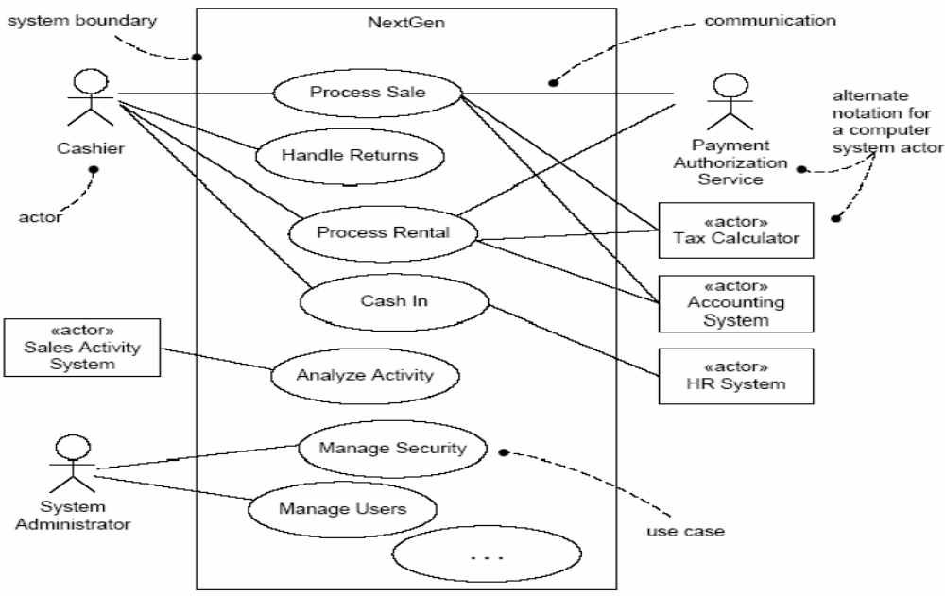
Use Case Diagram

Slide 33
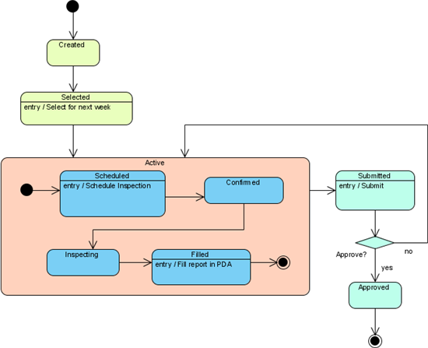
State Machine Diagram

Slide 34
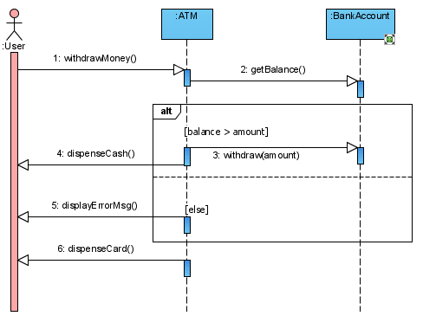
Sequence Diagram

Slide 35
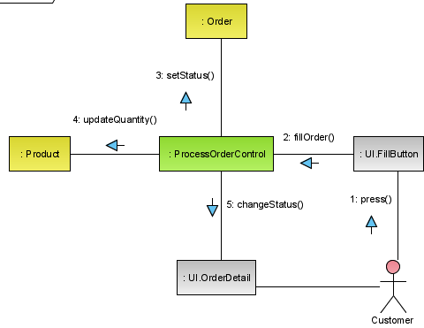
Communication Diagram

Slide 36
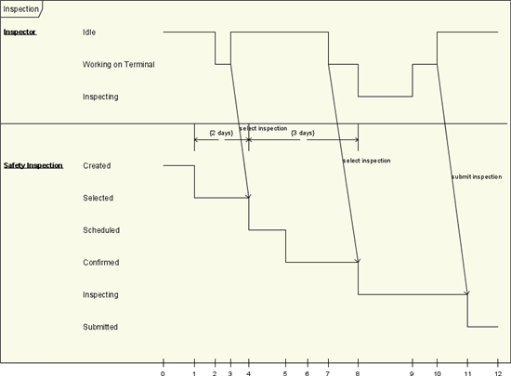
Timing Diagram

Slide 37
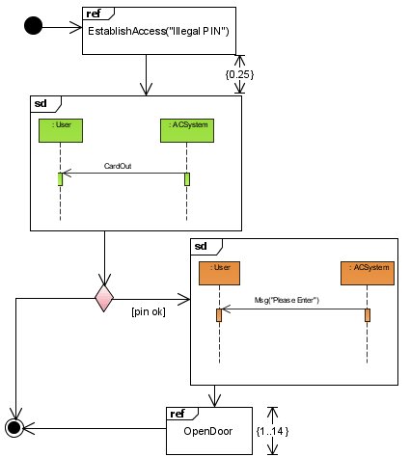
Interaction Overview Diagram

Slide 38
UML Diagrams May be used at different stages
Attention
  In the actual modeling process, almost no one uses all the diagrams defined in UML. Some of which may never be used
Requirements Modeling
  Use case diagram
View the static parts of a system
  Class diagram
  Component diagram
  Composite structure diagram
  Object diagram
  Deployment diagram
View the dynamic parts of a system
  Use case diagram
  Sequence diagram
  Communication diagram
  State diagram
  Activity diagram

Slide 39
UML Rules
The UML has syntactic and semantic rules for
  Names
    What you can call things, relationships, and diagrams
  Scope
    The context that gives specific meaning to a name
  Visibility
    How those names can be seen and used by others
  Integrity
    How things properly and consistently relate to one another
  Execution
    What it means to run or simulate a dynamic model

Slide 40
UML common mechanisms
UML has four common mechanisms that apply consistently throughout the language:
  Specifications
  Adornments
  Common divisions
  Extensibility mechanisms
Notes:
© Dr. Jim Arlow 2000 v1.0

Slide 41
Specifications
semantic backplane
BankAccount
name
accountNumber
icon or modeling element
Class specification
deposit()
withdraw()
calculateInterest()
Deposit
Use case specification
Dependency specification
Behind every UML modelling element is a specification which provides a textual statement of the syntax and semantics of that element
These specifications form the semantic backplane of the model
Notes:
© Dr. Jim Arlow 2000 v1.0

Slide 42
Adornments
Window
Every UML modelling element starts with a basic symbol to which can be added a number of adornments specific to that symbol
We only show adornments to increase the clarity of the diagram or to highlight a specific feature of the model
Window
{author = Jim, status = tested}
+size : Area=(100,100)
#visibility : Boolean = false
+defaultSize: Rectangle
#maximumSize : Rectangle
-xptr : XWindow*
+create()
+hide()
+display( location : Point )
-attachXWindow( xwin : XWindow*)
Notes:
© Dr. Jim Arlow 2000 v1.0

Slide 43
Common divisions
Classifier and instance
  A classifier is an abstraction, an instance is a concrete manifestation of that abstraction
  The most common form is class/object e.g. a classifier might be a BankAccount class, and an instance might be an object representing my bank account
  Generally instances have the same notation as classes, but the instance name is underlined
Interface and implementation
  An interface declares a contract and an implementation represents a concrete realization of that contract
BankAccount
balance
getBalance()
«instantiate»
myAccount:BankAccount
balance = 100.0
Borrowable
LibraryItem
Notes:
© Dr. Jim Arlow 2000 v1.0

Slide 44
Extensibility mechanisms
note
«entity»
Ticket
{version = 1.1}
stereotype
constraint
{ each Ticket has a unique id }
tagged value
id
Stereotypes
  A stereotype allows us to define a new UML modelling element based on an existing one
  We define the semantics of the stereotype ourselves
  Stereotypes add new elements to the UML metamodel
  Written as «stereotypeName»
Constraints
  Extends the semantics of an element by allowing us to add new rules about the element
  Written as { some constraint }
Tagged values
  Allows us to add new, ad-hoc information to an element’s specification
  Written as { tag1 = value1, tag2 = value2 … }
are attached
to a stereotype
Notes:
© Dr. Jim Arlow 2000 v1.0

Slide 45
Stereotype syntax options
stereotype name
in guillemets
«entity»
Ticket
stereotype
preferred
stereotype icon
preferred
icon
Ticket
stereotype name
and icon
«entity»
Ticket
stereotyped
relationship
«control»
JobManager
«call»
Scheduler
A stereotype introduces a new modelling element and so we must always define semantics for our stereotypes
Each model element can have many stereotypes
Notes:
© Dr. Jim Arlow 2000 v1.0

Slide 46
UML profiles
A profile customizes UML for a specific purposes
A UML profile is a collection of stereotypes, tagged values and constraints
  The tagged values and constraints are associated with stereotypes
Stereotypes extend one of the UML meta-model elements (e.g. Class, Association)
  Any element that gets the stereotype also gets the associated tagged values and constraints
Notes:
© Dr. Jim Arlow 2000 v1.0

Slide 47
Architecture
"The organisational structure of a software system"
  UML specification & IEEE Std. 610.12-1990
  RUP has a 4+1 view of architecture
vocabulary
functionality
system assembly
configuration management
Logical view
Implementation view
The 4+1 View of Architecture, Philippe Kruchten, IEEE Software, 12(6) Nov. 1995, p. 45-50
Use case view
behaviour
Process view
Deployment view
performance
scalability
throughput
system topology
distribution delivery
installation
Notes:
© Dr. Jim Arlow 2000 v1.0

Slide 48
UML
structural thing
behavioral thing
thing
grouping thing
annotational thing
dependency
basic building block
relationship
association
generalization
realization
diagram
name
scope
rule
visibility
integrity
stereotype
execution
specification
tagged value
adornment
common mechanism
common division
constraint
extensibility mechanism
architecture

Slide 49
UML Applications
Software system modeling
Description of non-software systems

Slide 50
UML Tools
Rational Rose
Visual Paradigm
StarUML
Enterprise Architect
ArgoUML
Visio
Trufun(Chinese)
……
More
  http://www.umlchina.com/Tools/Newindex1.htm

Slide 51
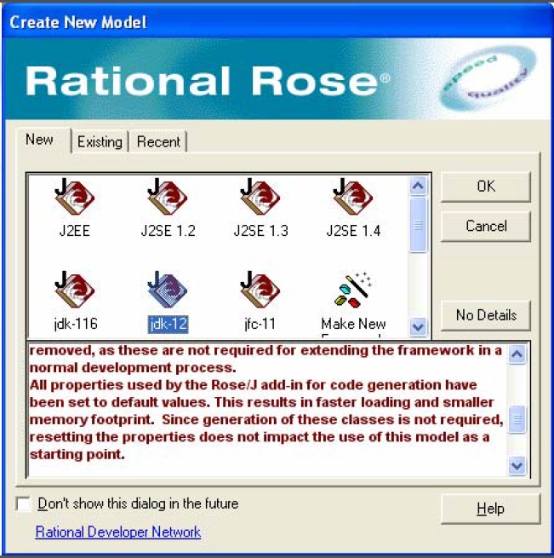
UML Tools

