Slide 1
Class Diagrams
Notes:
© Dr. Jim Arlow 2000 v1.0

Slide 2
Content
Overview
Concepts
Methods
Notes:
© Dr. Jim Arlow 2000 v1.0

Slide 3
Content
Overview
Concepts
Methods
Notes:
© Dr. Jim Arlow 2000 v1.0

Slide 4
Overview
A class diagram describes the types of objects in the system and the various kinds of static relationships that exist among them.
Class diagrams also show the properties and operations of a class and the constraints that apply to the way objects are connected.

Slide 5
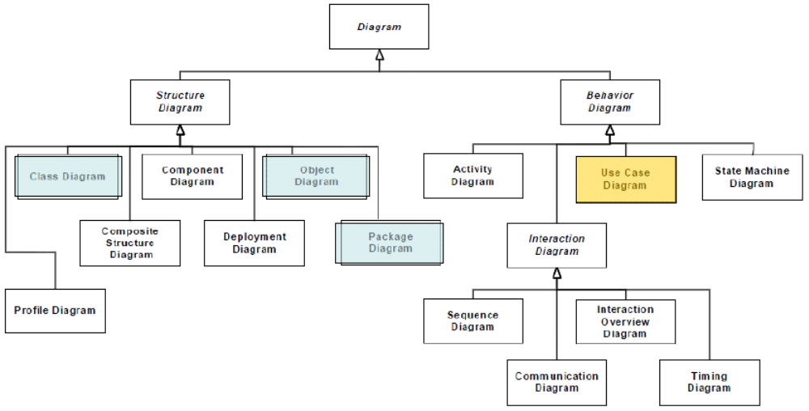
Overview

Slide 6
Content
Overview
Concepts
Methods
Notes:
© Dr. Jim Arlow 2000 v1.0

Slide 7
UML class notation
name
compartment
BankAccount
-number : String
-owner : String[1]
-balance : double = 0.0
attribute
compartment
+create(theNumber : String, theOwner : String)
+deposit( amount : double)
+withdraw(amount : double)
+getNumber() : String
+getowner() : String
+getBalance() : double
operation
compartment
Classes are named in UpperCamelCase
Use descriptive names that are nouns or noun phrases
Avoid abbreviations!
Notes:
© Dr. Jim Arlow 2000 v1.0

Slide 8
Attribute compartment
[visibility] name[:type] [ ‘[’ multiplicity[ordered] ‘]’ ] [= initialValue] [{property-string}]
[visibility] name[:type] [ ‘[’ multiplicity[ordered] ‘]’ ] [= initialValue] [{property-string}]
[visibility] name[:type] [ ‘[’ multiplicity[ordered] ‘]’ ] [= initialValue] [{property-string}]
mandatory
mandatory
- name: String [1] = "Untitled" {readOnly}
Everything is optional except name
initialValue is the value the attribute gets when objects of the class are instantiated
Attributes are named in lowerCamelCase
  Use descriptive names that are nouns or noun phrases
  Avoid abbreviations
Notes:
© Dr. Jim Arlow 2000 v1.0

Slide 9
Visibility
Symbol | Name | Semantics
+ | public | Any element that can access the class can access any of its features with public visibility
- | private | Only operations within the class can access features with private visibility
# | protected | Only operations within the class, or within children of the class, can access features with protected visibility
~ | package | Any element that is in the same package as the class, or in a nested subpackage, can access any of its features with package visibility
You may ignore visibility in analysis
In design, attributes usually have private visibility (encapsulation)
PersonDetails
name : String
address : String [3]
emailAddress : String [0..1]
Notes:
© Dr. Jim Arlow 2000 v1.0

Slide 10
Multiplicity
Multiplicity specifies how many instances of the attribute’s type are present.
Generally, multiplicities are defined with a lower bound and an upper bound. The lower bound may be any positive number or zero; the upper is any positive number or * (for unlimited).
Car
wheels : Wheel [4]
engine : Engine
passengers : Person [1..5]
our car class will have four wheels
our car class will have 1-5 passengers
multiplicity expression
Notes:
© Dr. Jim Arlow 2000 v1.0

Slide 11
Property-String
The {property-string} allows you to indicate additional properties for the attribute.
For example, you can use {readOnly} to indicate that clients may not modify the property.
Name : String=“COSE SEU” {readOnly}

Slide 12
Operation compartment
operation signature
[visibility] name[(direction parameterName:parameterType=default,…)] [:returnType] [{property-string }]
parameter list
+ balanceOn (date: Date) : Money
Operations are named lowerCamelCase
  Special symbols and abbreviations are avoided
  Operation names are usually a verb or verb phrase
Notes:
© Dr. Jim Arlow 2000 v1.0

Slide 13
Parameter direction
use in detailed design only!
parameter direction | semantics
in | the parameter is an input to the operation. It is not changed by the operation. This is the default
out | the parameter serves as a repository for output from the operation
inout | the parameter is an input to the operation and it may be changed by the operation
return | the parameter is one of the return values of the operation. An alternative way of specifying return values
Notes:
© Dr. Jim Arlow 2000 v1.0

Slide 14
Scope
There are two kinds of scope for attributes and operations:
BankAccount
-accountNumber : int
-count : int = 0
+create( aNumber : int)
+getNumber() : int
-incrementCount()
+getCount() : int
class scope
(underlined)
instance scope
(the default)
Notes:
© Dr. Jim Arlow 2000 v1.0

Slide 15
Scope
Instance scope attributes and operations belong to or operate on specific objects.
Class scope attributes and operations belong to or operate on the whole class of objects.

Slide 16
Instance scope vs. class scope
 | instance scope | class scope
attributes | By default, attributes have instance scope | Attributes may be defined as class scope
 | Every object of the class gets its own copy of the instance scope attributes | Every object of the class shares the same, single copy of the class scope attributes
 | Each object may therefore have different instance scope attribute values | Each object will therefore have the same class scope attribute values
operations | By default, operations have instance scope | Operations may be defined as class scope
 | Every invocation of an instance scope operation applies to a specific instance of the class | Invocation of a class scope operation does not apply to any specific instance of the class – instead, you can think of class scope operations as applying to the class itself
 | You can’t invoke an instance scope operation unless you have an instance of the class available. You can’t use an instance scope operation of a class to create objects of that class, as you could never create the first object | You can invoke a class scope operation even if there is no instance of the class available – this is ideal for object creation operations
scope determines access
Notes:
© Dr. Jim Arlow 2000 v1.0

Slide 17
Object construction
How do we create instances of classes?
Each class defines one or more class scope operations which are constructors. These operations create new instances of the class
BankAccount
BankAccount
+create( aNumber : int )
+BankAccount( aNumber : int )
generic constructor name
Java/C++ standard
Notes:
© Dr. Jim Arlow 2000 v1.0

Slide 18
ClubMember class example
Each ClubMember object has its own copy of the attribute membershipNumber
The numberOfMembers attribute exists only once and is shared by all instances of the ClubMember class
Suppose that in the create operation we increment numberOfMembers:
  What is the value of count when we have created 3 account objects?
ClubMember
-membershipNumber : String
-memberName : String
-numberOfMembers : int = 0
+create( number : String, name : String )
+getMembershipNumber() : String
+getMemberName() : String
-incrementNumberOfMembers()
+decrementNumberOfMembers()
+getNumberOfMembers() : int
Notes:
© Dr. Jim Arlow 2000 v1.0

Slide 19

Constraints
The UML allows you to use anything to describe constraints. The only rule is that you put them inside braces ({}).
You can use natural language, a programming language, or the UML's formal Object Constraint Language (OCL), which is based on predicate calculus.

Slide 20
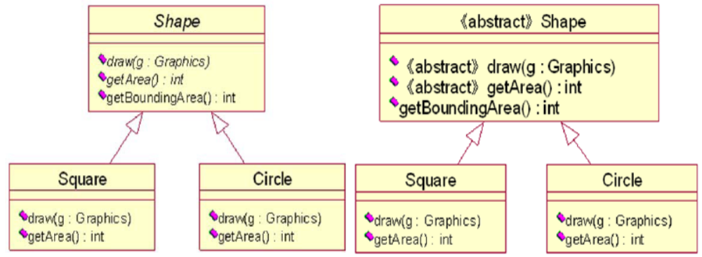
Abstract classes

Slide 21
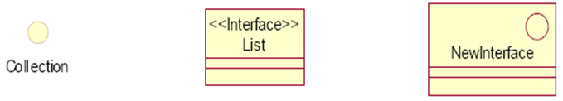
Interfaces

Slide 22
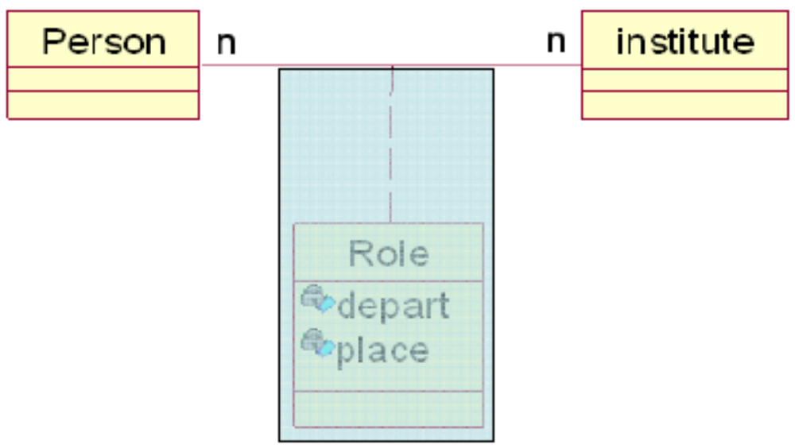
Association classes

Slide 23
Templates
Up to now, we have had to specify the types of all attributes, method returns and parameters. However, this can be a barrier to reuse
Consider:
spot the difference!
BoundedIntArray
BoundedFloatArray
BoundedStringArray
size:int
elements[]:int
size:int
elements[]:float
size:int
elements[]:String
etc.
addElement( e:int ):void
getElement( i:int):int
addElement( e:float ):void
getElement( i:int):float
addElement( e:String ):void
getElement( i:int):String
Notes:
© Dr. Jim Arlow 2000 v1.0
x

Slide 24
Template syntax
template parameters
IntArray
template
T, size:int=10
default value
BoundedArray
elements[100]:int
elements[size]:T
«bind»<T->int, size->100>
addElement( e:int ):void
getElement( i:int):int
addElement( e:T ):void
getElement( i:int):T
«bind»<T->String>
StringArray
explicit binding
(the instantiation is named)
elements[10]:String
Template instantiation - the template parameters are bound to actual values to create new classes based on the template:
  If the type of a parameter is not specified then the parameter defaults to being a classifier
  Parameter names are local to the template – two templates do not have relationship to each other just because they use the same parameter names!
  Explicit binding is preferred as it allows named instantiations
addElement( e:String ):void
getElement( i:int):String
BoundedArray<T->float, size->10>
elements[10]:float
addElement( e:float ):void
getElement( i:int):float
implicit binding
(the instantiation is anonymous)
Notes:
© Dr. Jim Arlow 2000 v1.0

Slide 25
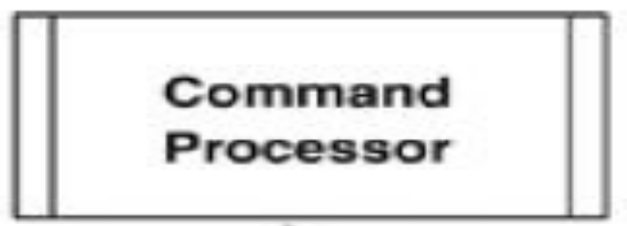
Active classes
An active class has instances, each of which executes and controls its own thread of control.

Slide 26
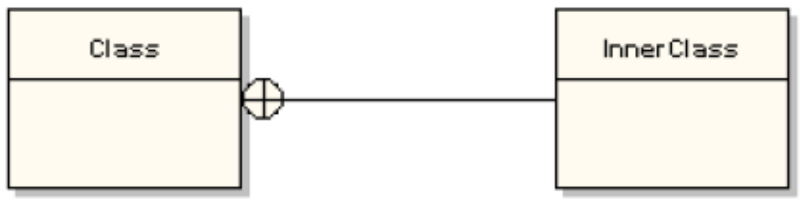
Nested classes
A nested class is a class defined inside another class
  It is encapsulated inside the namespace of its containing class
  Nested classes tend to be design artifacts
Nested classes are only accessible by:
  their containing class
  objects of their containing class
Notes:
© Dr. Jim Arlow 2000 v1.0

Slide 27
What is an association?
association
Club
Person
links instantiate associations
«instantiate»
«instantiate»
«instantiate»
link
bookClub:Club
chairman
jim:Person
Associations are relationships between classes
Associations between classes indicate that there are links between objects of those classes
A link is an instantiation of an association just as an object is an instantiation of a class
Notes:
© Dr. Jim Arlow 2000 v1.0

Slide 28
Association syntax
association
name
employs
Company
Person
1
*
multiplicity
navigability
role names
employer
employee
Company
Person
1
*
An association can have role names or an association name
The black triangle indicates the direction in which the association name is read:
  “A Company employs many Persons”
Notes:
© Dr. Jim Arlow 2000 v1.0

Slide 29
Multiplicity
A Company employs many persons
Company
employer
employee
Person
1
*
Each Person works for one Company
Multiplicity is a constraint that specifies the number of objects that can participate in a relationship at any point in time
If multiplicity is not explicitly stated in the model then it is undecided – there is no default multiplicity
multiplicity syntax: minimum..maximum
0..1 | zero or 1
1 | exactly 1
0..* | zero or more
* | zero or more
1..* | 1 or more
1..6 | 1 to 6
Notes:
© Dr. Jim Arlow 2000 v1.0

Slide 30
Multiplicity exercise
Company
How many
  Employees can a Company have?
  Employers can a Person have?
  Owners can a BankAccount have?
  Operators can a BankAccount have?
  BankAccounts can a Person have?
  BankAccounts can a Person operate?
1
employer
7
employee
Person
owner
1
1..*
operator
0..*
0..*
BankAccount
Notes:
© Dr. Jim Arlow 2000 v1.0

Slide 31

Exercise
Model a computer file system. Here are the minimal facts you need:
  The basic unit of storage is the file
  Files live in directories
  Directories can contain other directories
Use your own knowledge of a specific file system to build a model
Hint: a class can have an association to itself!
Notes:
© Dr. Jim Arlow 2000 v1.0

Slide 32
Reflexive associations
subdirectory
0..*
Directory
1
0..*
File
0..1
parent
reflexive association
autoexec
C
config
Windows
My Documents
Corel
To John
Command
directories
files
Notes:
© Dr. Jim Arlow 2000 v1.0

Slide 33
Hierarchies and networks
hierarchy
network
A
0..*
B
0..*
0..1
0..*
a1:A
c1:B
b1:B
f1:B
b1:A
c1:A
d1:A
e1:B
d1:B
e1:A
f1:A
g1:A
a1:B
g1:B
in an association hierarchy, each object has zero or one object directly above it
in an association network, each object has zero or many objects directly above it
Notes:
© Dr. Jim Arlow 2000 v1.0

Slide 34
Navigability
An Order object stores a list of Products
Navigable
Navigability indicates that it is possible to traverse from an object of the source class to objects of the target class
  Objects of the source class may reference objects of the target class using the role name
Even if there is no navigability it might still be possible to traverse the relationship via some indirect means. However the computational cost of the traversal might be very high
source
target
Order
*
*
Product
navigability
Not navigable
A Product object does not store a list of Orders
A
B
A to B is navigable
B to A is navigable
A
B
A to B is navigable
B to A is not navigable
A
B
A to B is navigable
B to A is undefined
A
B
A to B is undefined
B to A is undefined
Notes:
© Dr. Jim Arlow 2000 v1.0

Slide 35
Associations and attributes
=
House
address
Address
House
1
1
address:Address
House
pseudo-attribute
attribute
address:Address
If a navigable relationship has a role name, it is as though the source class has a pseudo-attribute whose attribute name is the role name and whose attribute type is the target class
Objects of the source class can refer to objects of the target class using this pseudo-attribute
Use associations when:
  The target class is an important part of the model
  The target class is a class that you have designed yourself and which must be shown on the model
Use attributes when:
  The target class is not an important part of the model e.g. a primitive type such as number, string etc.
  The target class is just an implementation detail such as a bought-in component or a library component e.g. Java.util.Vector (from the Java standard libraries)
Notes:
© Dr. Jim Arlow 2000 v1.0

Slide 36
Association classes
Company
*
employment
*
Person
Each Person object can work for many Company objects.
Each Company object can employ many Person objects.
When a Person object is employed by a Company object, the Person has a salary.
But where do we record the Person’s salary?
Not on the Person class - there is a different salary for each employment
Not on the Company class - different Person objects have different salaries
The salary is a property of the employment relationship itself
  every time a Person object is employed by a Company object, there is a salary
Notes:
© Dr. Jim Arlow 2000 v1.0

Slide 37
Association class syntax
Company
*
*
Person
Job
the association class consists of the class, the association and the dashed line
association class
salary:double
We model the association itself as an association class. One instance of this class exists for each link between a Person object and a Company object
  Instances of the association class are links that have attributes and operations
  Can only use association classes when there is one unique link between two specific objects. This is because the identity of links is determined exclusively by the identities of the objects on the ends of the link
We can place the salary and any other attributes or operations which are really features of the association into this class
Notes:
© Dr. Jim Arlow 2000 v1.0

Slide 38
Using association classes
If we use an association class, then a particular Person can have only one Job with a particular Company
Company
*
*
Person
Job
salary:double
If, however a particular Person can have multiple jobs with the same Company, then we must use a reified association
Company
1
*
Job
*
1
Person
salary:double
Notes:
© Dr. Jim Arlow 2000 v1.0

Slide 39
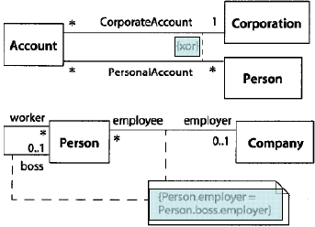
Constraints

Slide 40
Qualified associations
They are useful to show how we can look up or navigate to specific objects
Qualifiers usually refer to an attribute on the target class
the combination (Club, memberId) specifies a unique target object
Club
Club
1
qualifier
memberId
1
*
0..1
Member
Member
memberId:String
memberId:String
Notes:
© Dr. Jim Arlow 2000 v1.0

Slide 41
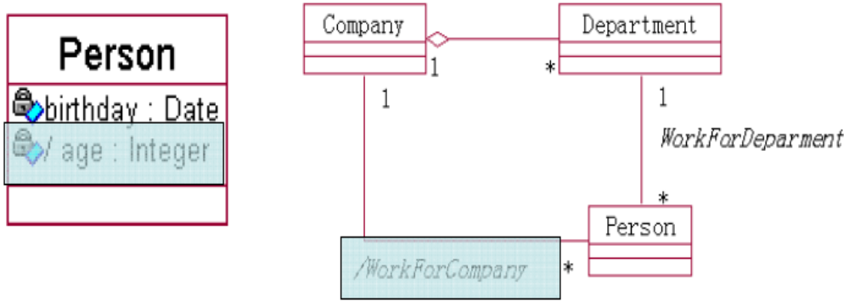
Derived Attributes and Associations
Derivation indicates a constraint between attributes or associations.

Slide 42
Aggregation and composition
Analysis
A
B
{xor}
aggregation
composition
«trace»
«trace»
Design
A
B
A
B
In analysis, we often use unrefined associations. In design, these can become aggregation or composition relationships
We must also add navigability, multiplicity and role names
Notes:
© Dr. Jim Arlow 2000 v1.0

Slide 43
Aggregation and composition
UML defines two types of association:
Aggregation
Composition
Some objects are weakly
related like a computer and
its peripherals
Some objects are strongly
related like a tree and
its leaves
Notes:
© Dr. Jim Arlow 2000 v1.0

Slide 44
Aggregation semantics
A Computer may be attached to 0 or more Printers
At any one point in time a Printer is connected to 0 or 1 Computer
Over time, many Computers may use a given Printer
The Printer exists even if there are no Computers
The Printer is independent of the Computer
aggregation is a whole–part relationship
Computer
0..1
0..*
Printer
whole or
aggregate
aggregation
part
The parts can exist independently of the aggregate
It is possible to have shared ownership of the parts by several aggregates
Notes:
© Dr. Jim Arlow 2000 v1.0

Slide 45
Composition semantics
The buttons have no independent existence. If we destroy the mouse, we destroy the buttons. They are an integral part of the mouse
Each button can belong to exactly 1 mouse
composition is a strong form of aggregation
Mouse
1
1..4
Button
composite
composition
part
Composition is a form of aggregation, with strong ownership and coincident lifetime as part of the whole
Notes:
© Dr. Jim Arlow 2000 v1.0

Slide 46
1 to many associations
source
target
To refine 1-to-many associations we introduce a collection class
Collection classes instances store a collection of object references to objects of the target class
A collection class always has methods for:
  Adding an object to the collection
  Removing an object from the collection
  Retrieving a reference to an object in the collection
  Traversing the collection
Collection classes are typically supplied in libraries that come as part of the implementation language
A
1
*
B
«trace»
1
Vector
1
1
*
A
B
Notes:
© Dr. Jim Arlow 2000 v1.0

Slide 47
Collection semantics
You can specify collection semantics by using association end properties:
property
semantics
{ordered}
Elements in the collection are maintained in a strict order
{unordered}
There is no ordering of the elements in the collection
{unique}
Elements in the collection are all unique an object appears in the collection once
{nonunique}
Duplicate elements are allowed in the collection
property pair
OCL collection
{unordered, nonunique}
Bag
A
{ordered, unique}
B
{unordered, unique}
Set (default)
1
*
{ordered, unique}
OrderedSet
{ordered, nonunique}
Sequence

Slide 48
Generalisation
A relationship between a more general element and a more specific element
The more specific element is entirely consistent with the more general element but contains more information
An instance of the more specific element may be used where an instance of the more general element is expected
Substitutability Principle
Notes:
© Dr. Jim Arlow 2000 v1.0

Slide 49
Example: class generalisation
more general element
parent
superclass
base class
ancestor
generalisation
specialisation
Shape
“is kind of”
child
subclass
descendent
Square
Circle
Triangle
more specific elements
A generalisation hierarchy
Notes:
© Dr. Jim Arlow 2000 v1.0

Slide 50
Class inheritance
Subclasses inherit all features of their superclasses:
  attributes
  operations
  relationships
  stereotypes, tags, constraints
Subclasses can add new features
Subclasses can override superclass operations
We can use a subclass instance anywhere a superclass instance is expected
Shape
origin : Point = (0,0)
width : int {>0}
height : int {>0}
draw( g : Graphics )
getArea() : int
getBoundingArea() : int
Square
Circle
radius : int = width/2
{width = height}
Substitutability Principle
Notes:
© Dr. Jim Arlow 2000 v1.0
The operations draw() and getArea() need to work differently for Square and Circle.

Slide 51
Overriding
Shape
draw( g : Graphics )
getArea() : int
getBoundingArea() : int
Square
Circle
draw( g : Graphics )
getArea() : int
draw( g : Graphics )
getArea() : int
width x height
π x radius²
Subclasses often need to override superclass behaviour
To override a superclass operation, a subclass must provide an operation with the same signature
  The operation signature is the operation name, return type and types of all the parameters
Notes:
© Dr. Jim Arlow 2000 v1.0

Slide 52
Abstract operations & classes
abstract class
Shape
abstract class and operation names must be in italics
draw( g : Graphics )
getArea() : int
getBoundingArea() : int
abstract
operations
concrete
operations
Square
Circle
concrete classes
draw( g : Graphics )
getArea() : int
draw( g : Graphics )
getArea() : int
We can’t provide an implementation for
Shape :: draw( g : Graphics ) or for
Shape :: getArea() : int
because we don’t know how to draw or calculate the area for a "shape"!
Operations that lack an implementation are abstract operations
A class with any abstract operations can’t be instantiated and is therefore an abstract class
Notes:
© Dr. Jim Arlow 2000 v1.0

Slide 53
Multiple inheritance
Sometimes a class may have more than one superclass
The "is kind of" and substitutability principles must apply for all of the classifications
Multiple inheritance is sometimes the most elegant way of modelling something. However:
  Not all languages support it
  (e.g. Java)
  It can always be replaced by single inheritance and delegation
Alarm
Dialler
IActivate
AutoDialler
in this example the AutoDialler sounds an alarm and rings the police when triggered - it is logically both a kind of Alarm and a kind of Dialler
Notes:
© Dr. Jim Arlow 2000 v1.0

Slide 54
Generalization Constraints
UML defines four constraints that may be applied to generalization relationships:
complete - all children specified
incomplete - not all children specified
disjoint - objects of the parent may have no more than one of the children as a type
overlapping - objects of the parent may have more than one of the children as a type

Slide 55
Aggregation vs. inheritance
Inheritance gives you fixed relationships between classes and objects
You can’t change the class of an object at runtime
There is a fundamental semantic error here. Is an Employee just their job or does an Employee have a job?
Employee
Manager
Programmer
«instantiate»
john:Programmer
How can we promote john?
Can john have more than one job?
Notes:
© Dr. Jim Arlow 2000 v1.0

Slide 56
A better solution…
Using aggregation we get the correct semantics:
  An Employee has a Job
With this more flexible model, Employees can have more than one Job
Employee
0..*
0..*
Job
Manager
Programmer
«instantiate»
«instantiate»
«instantiate»
:Manager
:Programmer
john:Employee
just change this link at runtime to promote john!
Notes:
© Dr. Jim Arlow 2000 v1.0

Slide 57
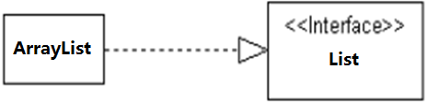
Realization
An interface is a class that has no implementation.
A class provides an interface if it implements the interface.

Slide 58
What is a dependency?
"A dependency is a relationship between two elements where a change to one element (the supplier) may affect or supply information needed by the other element (the client)". In other words, the client depends in some way on the supplier
  Dependency is really a catch-all that is used to model several different types of relationship. We’ve already seen one type of dependency, the «instantiate» relationship
Notes:
© Dr. Jim Arlow 2000 v1.0

Slide 59
Dependencies
«use» - the client makes use of the supplier to implement its behaviour
«call» - the client operation invokes the supplier operation
«create» - the client creates instances of the supplier.
«parameter» - the supplier is a parameter of the client operation
«send» - the client (an operation) sends the supplier (a signal) to some unspecified target
«instantiate» - the client is an instance of the supplier
Notes:
© Dr. Jim Arlow 2000 v1.0

Slide 60
«use» - example
the stereotype is often omitted
«use»
A
B
foo( b : B )
bar() : B
doSomething()
A «use» dependency is generated between class A and B when:
An operation of class A needs a parameter of class B
An operation of class A returns a value of class B
An operation of class A uses an object of class B somewhere in its implementation
A :: doSomething()
{
B myB = new B();
…
}
Notes:
© Dr. Jim Arlow 2000 v1.0

Slide 61
Dependencies
«trace» - the client and the supplier represent the same concept but at different points in development
«substitute» - the client may be substituted for the supplier at runtime. The client and supplier must realize a common contract. Use in environments that don't support specialization/generalization
«refine» - the client represents a fuller specification of the supplier
«realize» - the client is an implementation of a specification or interface defined by the supplier
«derive» - the client may be derived from the supplier. The client is logically redundant, but may appear for implementation reasons
Notes:
© Dr. Jim Arlow 2000 v1.0

Slide 62
«derive» - example
BankAccount
1
0..*
Transaction
BankAccount
1
0..*
Transaction
1
1
«derive»
1
1
Quantity
Quantity
balance
1
/balance
1
This example shows three possible ways to express a «derive» dependency
BankAccount
1
0..*
Transaction
/balance:Quantity
1
1
Quantity
Notes:
© Dr. Jim Arlow 2000 v1.0

Slide 63
Dependencies
«access»
  The public contents of the supplier package are added as private elements to the namespace of the client package
«import»
  The public contents of the supplier package are added as public elements to the namespace of the client package
«permit»
  The client element has access to the supplier element despite the declared visibility of the supplier
Notes:
© Dr. Jim Arlow 2000 v1.0

Slide 64
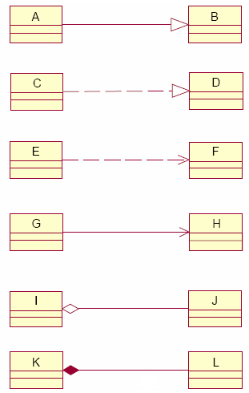
Relationships

Slide 65
Abstract Levels
Unified Modeling Language (UML) Models represent systems at different levels of detail
Some models describe a system from a higher, more abstract level, while other models provide greater detail
➢Conceptual
➢Specification
➢Implementation

Slide 66

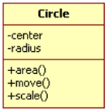
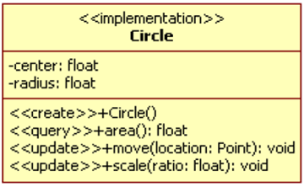
Abstract Levels
conceptual level
specification level
implementation level

Slide 67
Content
Overview
Concepts
Methods
Notes:
© Dr. Jim Arlow 2000 v1.0

Slide 68
What are Analysis classes?
Analysis classes represent a crisp abstraction in the problem domain
  They may ultimately be refined into one or more design classes
All classes in the Analysis model should be Analysis classes
Analysis classes have:
  A very “high level” set of attributes. They indicate the attributes that the design classes might have.
  Operations that specify at a high level the key services that the class must offer. In Design, they will become actual, implementable, operations.
Analysis classes must map onto real-world business concepts
BankAccount
class name
name : String
address
balance : double
attributes
deposit()
withdraw()
calculateInterest()
operations
We always specify attribute types if we know what they are!
Notes:
© Dr. Jim Arlow 2000 v1.0

Slide 69
What makes a good analysis class?
Its name reflects its intent
It is a crisp abstraction that models one specific element of the problem domain
  It maps onto a clearly identifiable feature of the problem domain
It has high cohesion
  Cohesion is the degree to which a class models a single abstraction
  Cohesion is the degree to which the responsibilities of the class are semantically related
It has low coupling
  Coupling is the degree to which one class depends on others
Rules of thumb:
  3 to 5 responsibilities per class
  Each class collaborates with others
  Beware many very small classes
  Beware few but very large classes
  Beware of “functoids”
  Beware of “omnipotent” classes
  Avoid deep inheritance trees
A responsibility is a contract or obligation of a class - it resolves into operations and attributes
Notes:
© Dr. Jim Arlow 2000 v1.0

Slide 70
What are design classes?
Design classes are classes whose specifications have been completed to such a degree that they can be implemented
Design classes arise from analysis classes:
  Remember - analysis classes arise from a consideration of the problem domain only
  A refinement of analysis classes to include implementation details
  One analysis class may become many design classes
  All attributes are completely specified including type, visibility and default values
  Analysis operations become fully specified operations (methods) with a return type and parameter list
Design classes arise from the solution domain
  Utility classes – String, Date, Time etc.
  Middleware classes – database access, comms etc.
  GUI classes – Applet, Button etc.
Design patterns…
Notes:
© Dr. Jim Arlow 2000 v1.0

Slide 71




Sources of design classes
Problem
domain
Analysis
classes
Design
classes
Solution
domain
java.util

Slide 72
Anatomy of a design class
analysis
design
BankAccount
BankAccount
name
number
balance
«trace»
-name:String
-number:String
-balance:double = 0
deposit()
withdraw()
calculateInterest()
+BankAccount(name:String, number:String)
+deposit(m:double):void
+withdraw(m:double):boolean
+calculateInterest():double
+getName():String
+setName(n:String):void
+getAddress():String
+setAddress(a:String):void
+getBalance():double
constructor
Notes:
© Dr. Jim Arlow 2000 v1.0

Slide 73

Well-formed design classes
Design classes must have the following characteristics to be “well-formed”:
  Complete and sufficient
  Primitive
  High cohesion
  Low coupling
How do the users of your classes
see them?
Always look at your classes from
their point of view!
MyClass
Notes:
© Dr. Jim Arlow 2000 v1.0

Slide 74
Completeness, sufficiency and primitiveness
Completeness:
  Users of the class will make assumptions from the class name about the set of operations that it should make available
  For example, a BankAccount class that provides a withdraw() operation will be expected to also provide a deposit() operation!
Sufficiency:
  A class should never surprise a user – it should contain exactly the expected set of features, no more and no less
Primitiveness:
  Operations should be designed to offer a single primitive, atomic service
  A class should never offer multiple ways of doing the same thing:
    This is confusing to users of the class, leads to maintenance burdens and can create consistency problems
  For example, a BankAccount class has a primitive operation to make a single deposit. It should not have an operation that makes two or more deposits as we can achieve the same effect by repeated application of the primitive operation
The public members of a class define a "contract" between the class and its clients
Notes:
© Dr. Jim Arlow 2000 v1.0

Slide 75
High cohesion, low coupling
High cohesion:
  Each class should have a set of operations that support the intent of the class, no more and no less
  Each class should model a single abstract concept
  If a class needs to have many responsibilities, then some of these should be implemented by “helper” classes. The class then delegates to its helpers
Low coupling:
  A particular class should be associated with just enough other classes to allow it to realise its responsibilities
  Only associate classes if there is a true semantic link between them
  Never form an association just to reuse a fragment of code in another class!
  Use aggregation rather than inheritance
HotelBean
CarBean
HotelCarBean
this example comes from a real system!
What’s wrong with it?
Notes:
© Dr. Jim Arlow 2000 v1.0

Slide 76
Finding classes
Perform noun/verb analysis on documents
Perform CRC card analysis
Use the division of Boundary, Control, and Entity Classes
Use Category list, Archetype patterns
Domain analysis
Determine classes according to design patterns
Find classes under the guidance of the software development process
…
Notes:
© Dr. Jim Arlow 2000 v1.0

Slide 77
Noun/verb analysis procedure
Collect all of the relevant documentation
  Requirements document
  Use cases
  Project Glossary
  Anything else!
Make a list of nouns and noun phrases
  These are candidate classes or attributes
Make a list of verbs and verb phrases
  These are candidate responsibilities
Tentatively assign attributes and responsibilities to classes
Notes:
© Dr. Jim Arlow 2000 v1.0

Slide 78
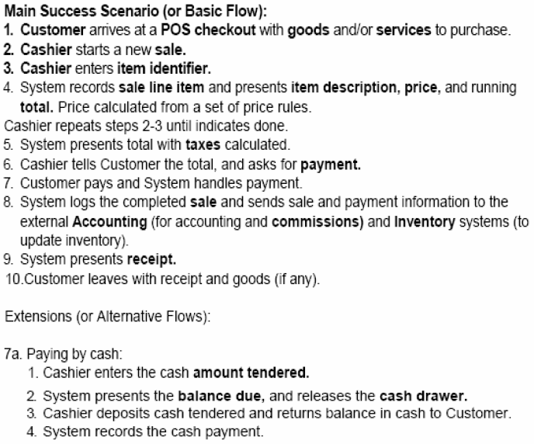
Noun/verb analysis procedure

Slide 79

CRC card procedure
Class Name: BankAccount
Responsibilities:
Collaborators:
Maintain balance
Bank
things the class does
things the class works with
Class, Responsibilities and Collaborators
Separate information collection from information analysis
  Part 1: Brainstorm
    All ideas are good ideas in CRC analysis
    Never argue about something – write it down and analyse it later!
  Part 2: Analyse information - consolidate with noun/verb
Notes:
© Dr. Jim Arlow 2000 v1.0

Slide 80
RUP Stereotypes
boundary class
entity class
control class

Slide 81
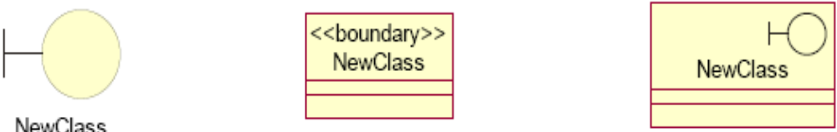
Boundary class
A boundary class is a class that mediates interaction between the system and its environment
User interface classes
System interface classes
Device interface classes

Slide 82
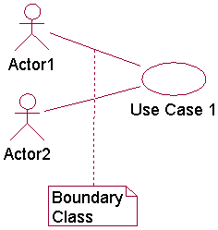
Boundary class
Find User-Interface Classes
Boundary classes representing the user interface may exist from user-interface modeling activities
There is at least one boundary object for each use case actor pair
Find System-Interface Classes
A boundary class which communicates with an external system is responsible for managing the dialogue with the external system
Find Device Interface Classes
The system may contain elements that act as if they were external (change value spontaneously without any object in the system affecting them), such as sensor equipment

Slide 83
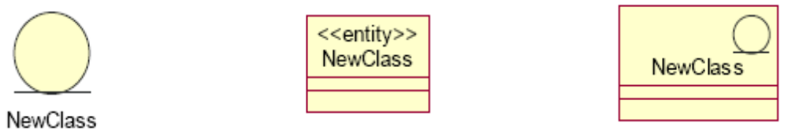
Entity class
An entity class is a class that is used to model persistent information and associated behavior about something
Typical examples of entity classes in a banking system are Account and Customer

Slide 84
Entity class
Entity classes represent stores of information in the system; they are typically used to represent the key concepts the system manages
A frequent source of inspiration for entity classes are the Glossary (developed during requirements) and a business-domain model (developed during business modeling, if business modeling has been performed)

Slide 85
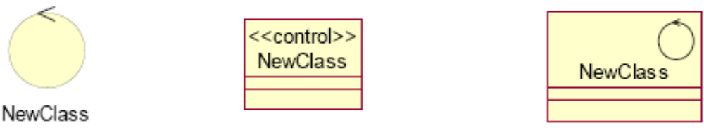
Control class
A control class is a class used to model control behavior specific to one or a few use cases

Slide 86
Other sources of analysis classes
Physical objects
Paperwork, forms etc.
  Be careful with this one – if the existing business process is very poor, then the paperwork that supports it might be irrelevant
Known interfaces to the outside world
Conceptual entities that form a cohesive abstraction e.g. LoyaltyProgramme
Archetype patterns: Customer Relationship Management, Order…
…
Notes:
© Dr. Jim Arlow 2000 v1.0

Slide 87
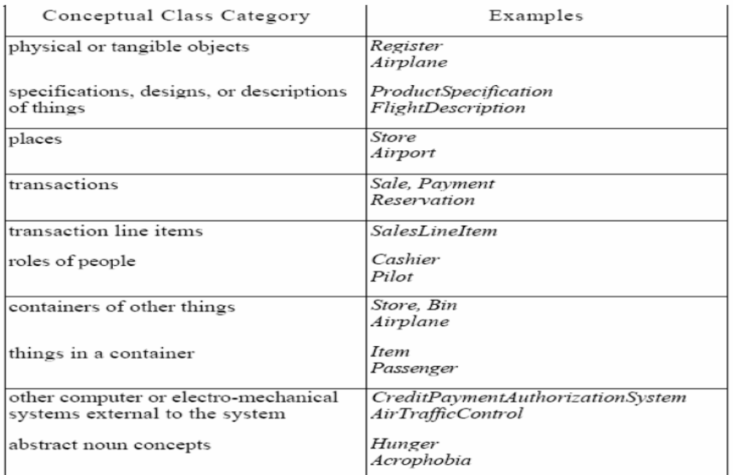
Category

Slide 88
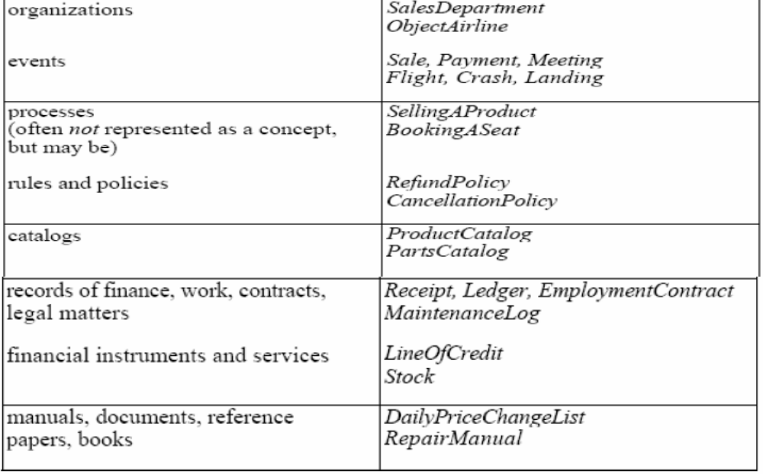
Category

Slide 89
POS potential analysis classes
Register (cat list)
Item (noun)
Store (cat list)
Sale (noun)
Payment (noun)
ProductCatalog(cat list)
ProdSpecification(cat list)
SalesLineItem(noun)
Cashier
Customer
Manager

Slide 90
Sources of association
Perform noun/verb analysis on documents
Perform CRC card analysis
…

Slide 91
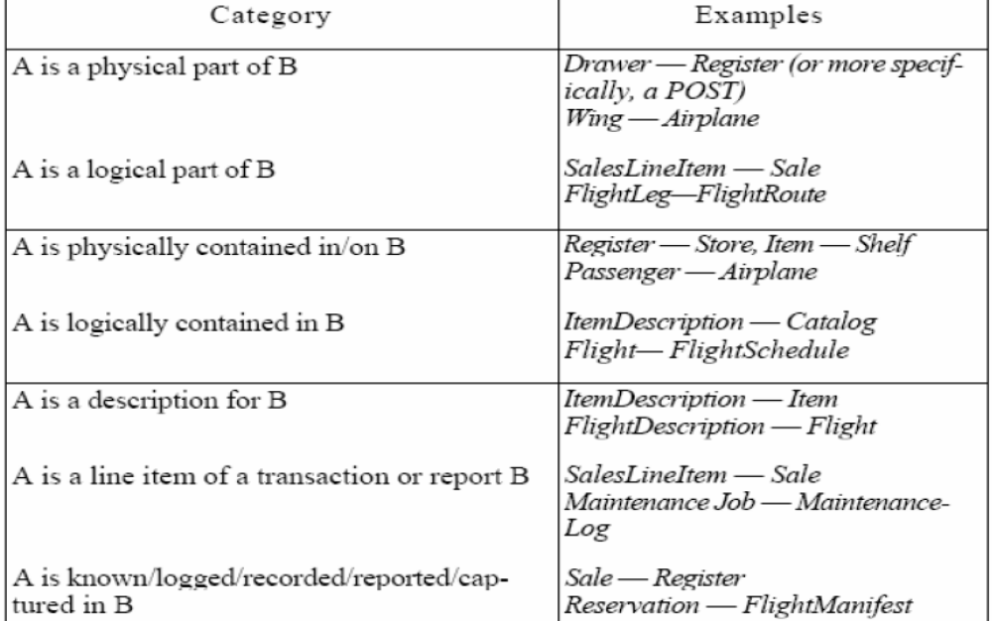
category

Slide 92
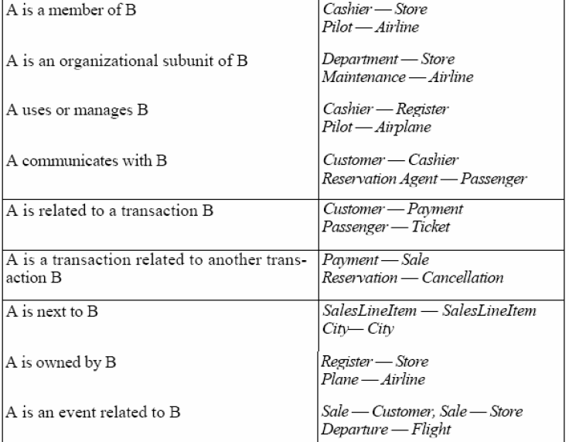
category

Slide 93
POS-potential association
A is subpart/member of B. (SaleLineItem-Sale)
A uses or manages B. (Cashier –Register)
A is transaction related to B. (Payment -Sale)
A is next to B. (SaleLineItem-SaleLineItem)
A is an event related to B. (Sale-Store)
……

Slide 94
Sources of Attribute
Perform noun/verb analysis on documents
Perform CRC card analysis
…

Slide 95
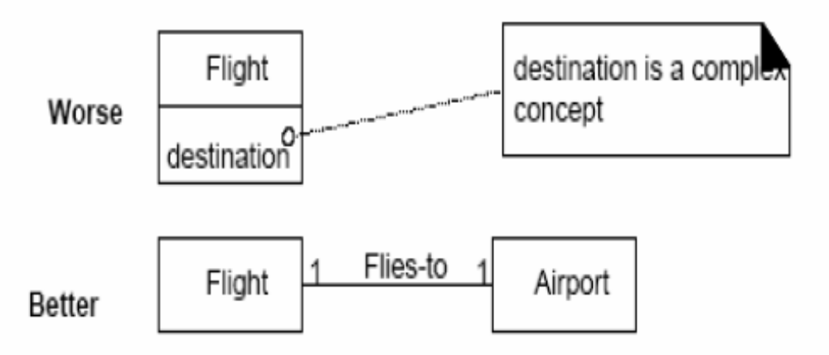
Attribute or Class?

Slide 96
Sources of Operation
Operation Definition implies responsibility assignment.

Slide 97
Sources of Operation
Perform noun/verb analysis on documents
Perform CRC card analysis
GRASP
…

Slide 98
Sources of Operation
GRASP (General Responsibility Assignment Software Patterns)
--Information Expert
--Creator
--Low Coupling
--High Cohesion
--Controller
--Polymorphism
--Indirection
--Pure Fabrication
--Protected Variations

Slide 99
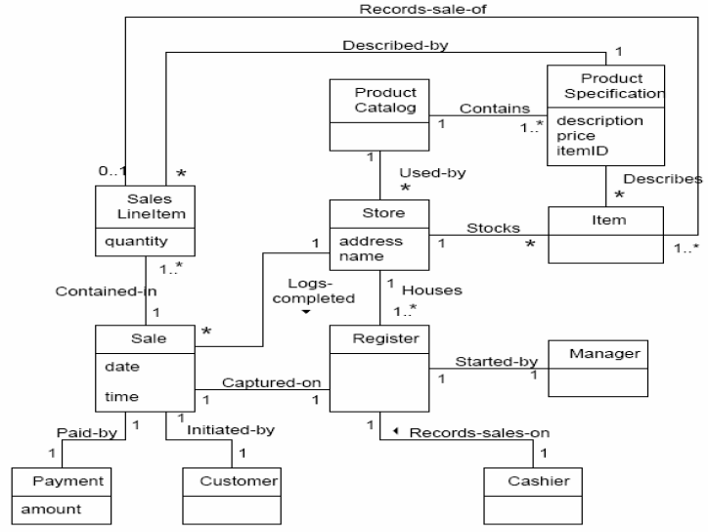
POS analysis class diagram

Slide 100
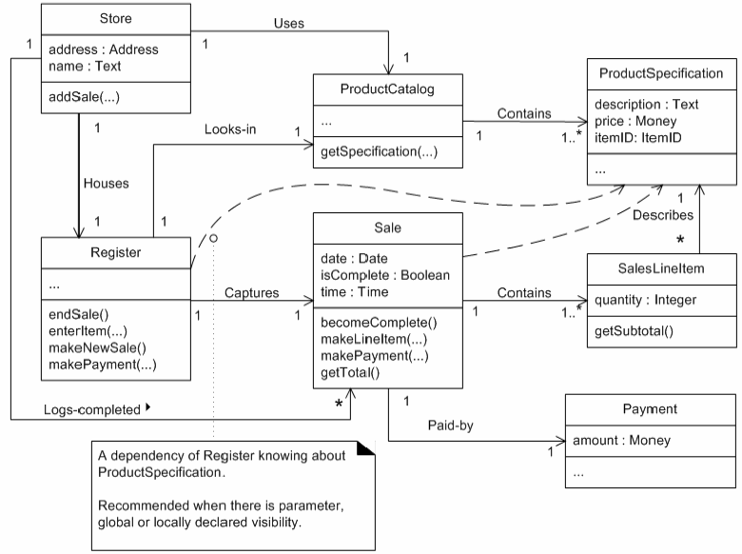
POS design class diagram

Slide 101
Steps Of Class Diagram Modeling
Domain analysis, determine system requirements
Determine classes and their responsibility, determine the attributes and operations
Initially determine the relationships between classes
Refine the relationships between classes
Draw the class diagram, and give the necessary textual description

Slide 102
OOD principles
Open Closed Principle (OCP)
Liskov Substitution Principle (LSP)
Dependency Inversion Principle (DIP)
Interface Segregation Principle (ISP)

Slide 103
Open Closed Principle
Software entities (classes, modules, functions, etc.) should be open for extension, but closed for modification(Bertrand Meyer)
We should write our modules so that they can be extended, without requiring them to be modified
In other words, we want to be able to change what the modules do, without changing the source code of the modules

Slide 104
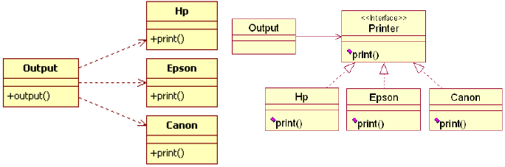
Open Closed Principle

Slide 105
Example of Open Closed Principle
A graduate is a teaching assistant of COSE, and he is also working as a cashier in the campus restaurant
In other words, the graduate has three roles: student, teaching assistant and cashier, but at the same time there is only one role
According to the above description, which design is the most reasonable?

Slide 106
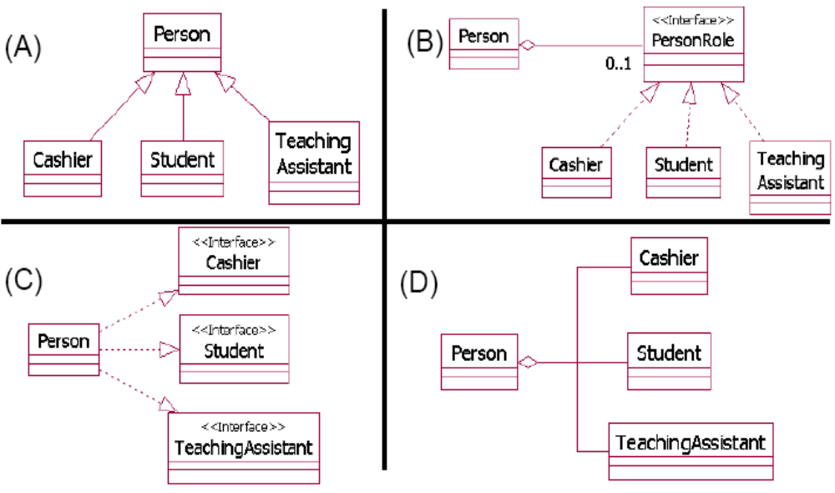
Example of Open Closed Principle

Slide 107
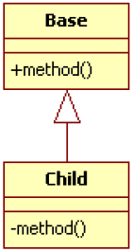
Liskov Substitution Principle
Subclasses should be substitutable for their base classes (BarbarLiskov)
Derived classes should be substitutable for their base classes
That is, a user of a base class should continue to function properly if a derivative of that base class is passed to it

Slide 108
Dependency Inversion Principle
Dependency Inversion is the strategy of depending upon interfaces or abstract functions and classes, rather than upon concrete functions and classes

Slide 109
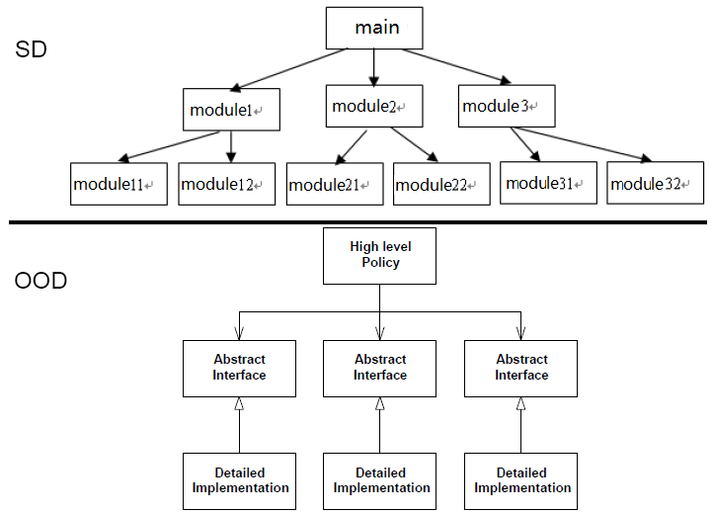
Dependency Inversion Principle

Slide 110
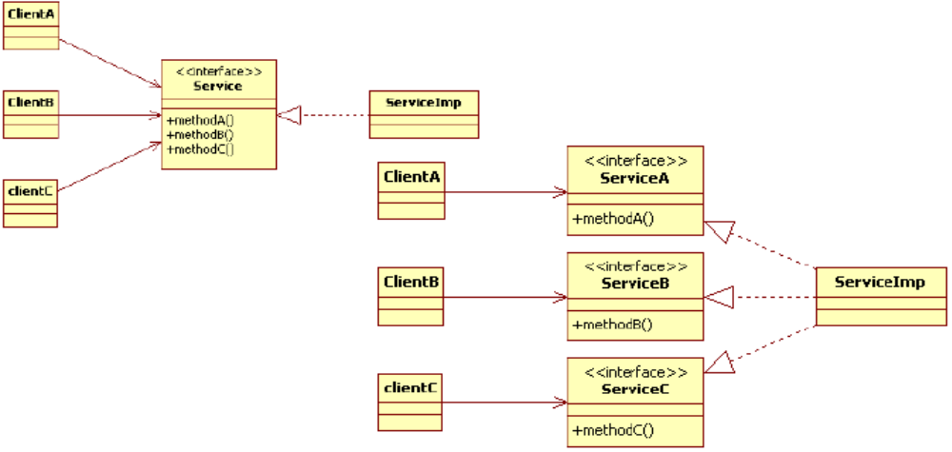
Interface Segregation Principle
Many client specific interfaces are better than one general purpose interface

Slide 111
OOD - GoF Patterns
Creational patterns
  1. Abstract Factory
  2. Builder
  3. Factory Method
  4. Prototype
  5. Singleton

Slide 112
OOD - GoF Patterns
Structural patterns
􀂄1. Adapter
􀂄2. Bridge
􀂄3. Composite
􀂄4. Decorator
􀂄5. Facade
􀂄6. Flyweight
􀂄7. Proxy

Slide 113
OOD - GoF Patterns
Behavioral patterns
􀂄1. Chain of Responsibility
􀂄2. Command
􀂄3. Interpreter
􀂄4. Iterator
􀂄5. Mediator
􀂄6. Memento
􀂄7. Observer
􀂄8. State
9. Strategy
10. Template Method
11. Visitor

Slide 114
Observer
Intent
Define a one-to-many dependency between objects so that when one object changes state,
all its dependents are notified and updated automatically.
Also Known As
Publish-Subscribe

Slide 115
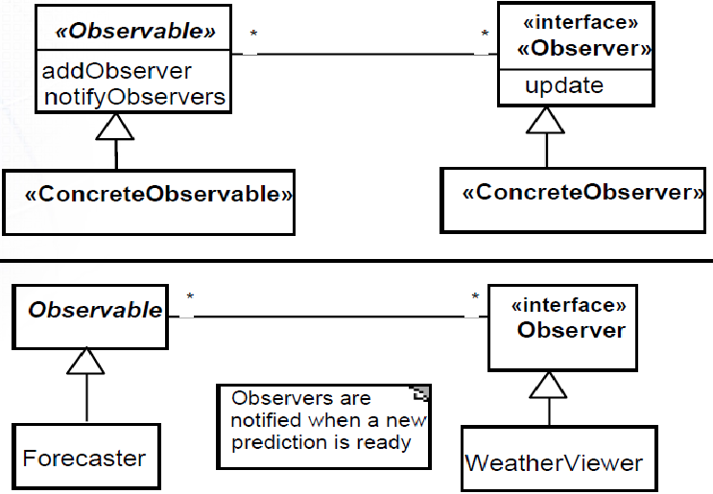
Observer

Slide 116
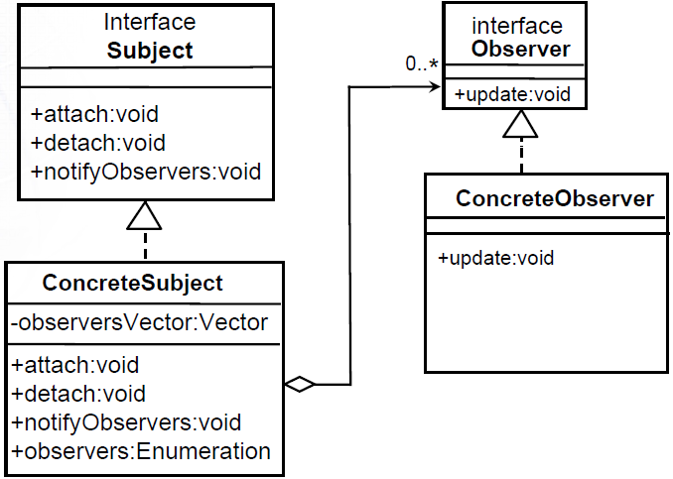
Observer

Slide 117
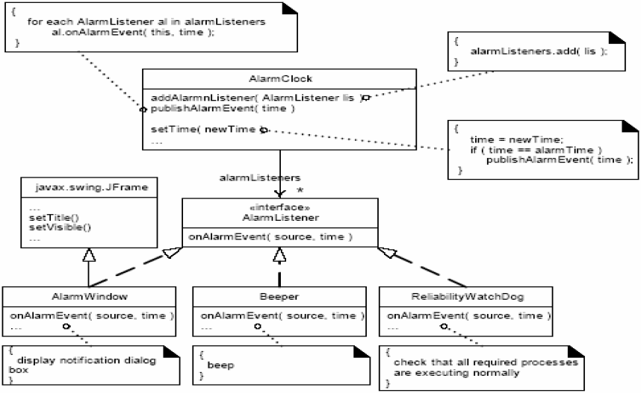
Observer

Slide 118
Project
Build the class model of the library system.

