Slide 1
Package Diagrams
Notes:
© Dr. Jim Arlow 2000 v1.0

Slide 2
Content
Overview
Concepts
Methods
Notes:
© Dr. Jim Arlow 2000 v1.0

Slide 3
Content
Overview
Concepts
Methods
Notes:
© Dr. Jim Arlow 2000 v1.0

Slide 4
Overview
A package is a grouping construct that allows you to take any construct in the UML and group its elements together into higher-level units.
A package diagram shows packages and their relationships.

Slide 5
Overview
Packages help you organize the elements in your models so that you can more easily understand them.
Packages let you control access to their contents so that you can control the dependencies in your application's architecture.
Packages provide units for parallel working and configuration management

Slide 6
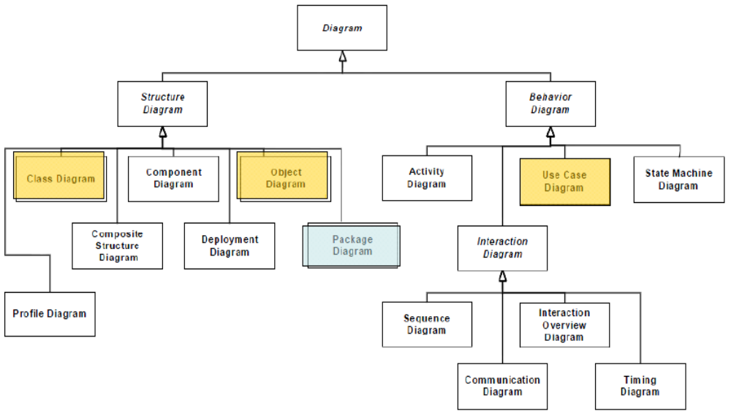
Overview

Slide 7
Content
Overview
Concepts
Methods
Notes:
© Dr. Jim Arlow 2000 v1.0

Slide 8
Package
A package is a general-purpose mechanism for organizing elements into groups.
packages contain:
  classes
  interfaces
  components
  nodes
  use cases
  packages
  …

Slide 9
Package syntax
Membership
Membership
«access»
see later!
Membership
MemberDetails
public (exported) elements
+ClubMembership
+Benefits
+MembershipRules
+MemberDetails:Member
-JoiningRules
Member
private element
JoiningRules
ClubMembership
Benefits
qualified package
name
Membership::MemberDetails
MembershipRules
Notes:
© Dr. Jim Arlow 2000 v1.0

Slide 10
Visibility
You can control the visibility of the elements owned by a package just as you can control the visibility of the attributes and operations owned by a class.

Slide 11
Visibility
Public elements are visible to the contents of any package that can see the element’s enclosing package.
Protected elements can only be seen by children.
Private elements cannot be seen outside the package.

Slide 12
Nested packages
If an element is visible within a package then it is visible within all nested packages
  e.g. Benefits is visible within MemberDetails
Show containment using nesting or the containment relationship
Membership
«import»
MemberDetails
Member
JoiningRules
ClubMembership
Benefits
MembershipRules
Membership
MembershipRules
JoiningRules
ClubMembership
Benefits
«import»
MemberDetails
containment relationship
Member
anchor icon
Notes:
© Dr. Jim Arlow 2000 v1.0

Slide 13
Package dependencies
dependency
semantics
An element in the client uses an element in the supplier in some way. The client depends on the supplier.
Supplier
«use»
Client
Public elements of the supplier namespace are added as public elements to the client namespace.
Supplier
«import»
Client
Public elements of the supplier namespace are added as private elements to the client namespace.
Supplier
«access»
Client
«trace» usually represents an historical development of one element into another more refined version. It is an extra-model relationship.
Analysis
Model
«trace»
Design
Model
The client package merges the public contents of its supplier packages. This is a complex relationship only used for metamodeling - you can ignore it.
Supplier
«merge»
Client
Notes:
© Dr. Jim Arlow 2000 v1.0

Slide 14
Package generalisation
The more specialised child packages inherit the public and protected elements in their parent package
Child packages may override elements in the parent package. Both Hotels and CarHire packages override Product::Item
Child packages may add new elements. Hotels adds Hotel and RoomType, CarHire adds Car
Product
+Price
+Market
+Item
-MicroMarket
parent
Hotels
CarHire
+Product::Price
+Product::Market
+Item
+Hotel
+RoomType
+Product::Price
+Product::Market
+Item
+Car
children
Notes:
© Dr. Jim Arlow 2000 v1.0

Slide 15
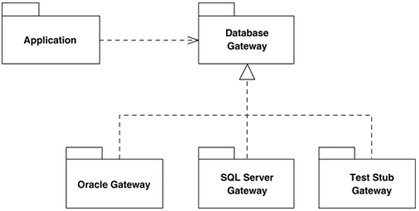
Package implementation
One package can define interfaces implemented by other packages.

Slide 16
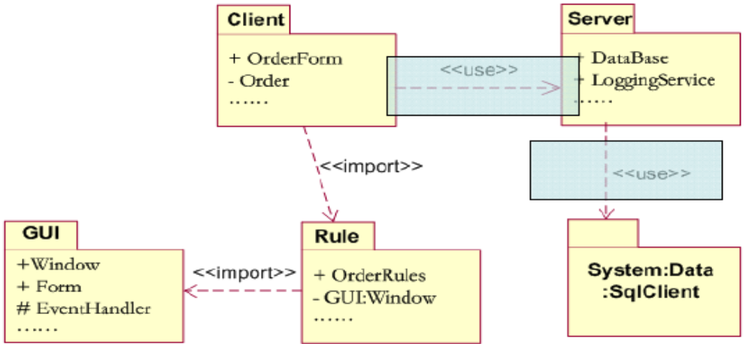
Package diagrams

Slide 17
Architectural views
application
specific layer
Sales
Products
application
general layer
Account
Management
Inventory
Management
partitions
This involves organising the modelling elements into a set of cohesive packages
The architecture should be layered and partitioned to separate concerns
  It’s useful to layer analysis models into application specific and application general layers
Coupling between packages should be minimised
Each package should have the minimum number of public or protected elements
Notes:
© Dr. Jim Arlow 2000 v1.0

Slide 18
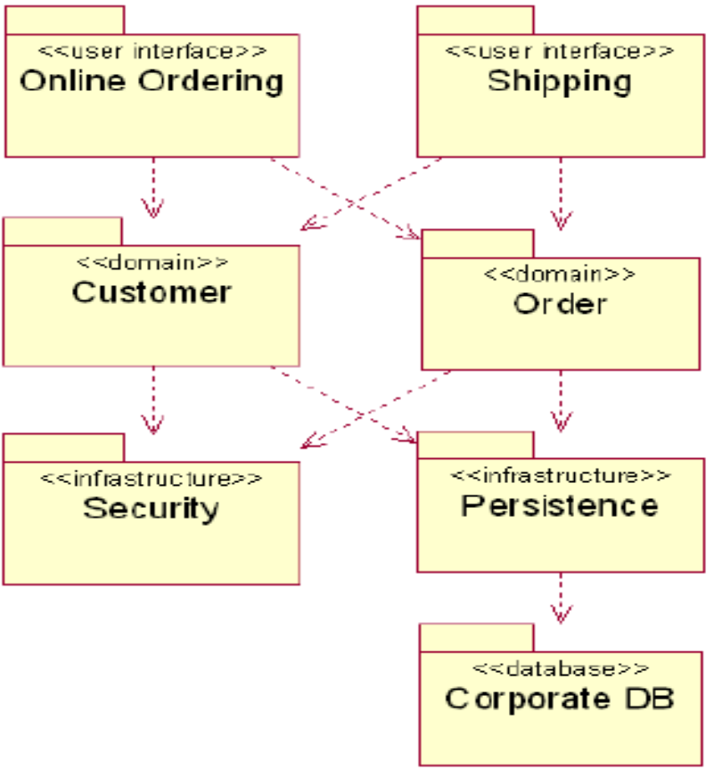
Architectural views

Slide 19
Package stereotypes
«system»
«subsystem»
«facade»
«stub»
«framework»
…

Slide 20
Content
Overview
Concepts
Methods
Notes:
© Dr. Jim Arlow 2000 v1.0

Slide 21
Methods
Scan the modeling elements in a particular architectural view and look for clumps defined by elements that are conceptually or semantically closed to one another.
Surround each of these clumps in a package.
For each package, distinguish which elements should be accessible outside the package.
Explicitly connect packages that build on others via dependencies.
Connect specialized packages to their more general part via generalization.

Slide 22
Methods
A cohesive group of closely related classes or a class hierarchy and supporting classes
Minimise dependencies between packages
Localise business processes in packages where possible
Minimise nesting of packages
Don’t worry about dependency stereotypes
Don’t worry about package generalisation
Avoid cyclic dependencies!
C
A
merge
A
B
split
A
B
Notes:
© Dr. Jim Arlow 2000 v1.0

Slide 23
Methods
Reuse Equivalency Principle，REP
Common Reuse Principle，CRP
Common Closure Principle，CCP
Acyclic Dependencies Principle，ADP

