Slide 1
State Machine Diagrams
Notes:
© Dr. Jim Arlow 2000 v1.0

Slide 2
Content
Overview
Concepts
Methods
Notes:
© Dr. Jim Arlow 2000 v1.0

Slide 3
Content
Overview
Concepts
Methods
Notes:
© Dr. Jim Arlow 2000 v1.0

Slide 4
Overview
Some model elements such as classes, use cases and subsystems, can have interesting dynamic behaviour.
In the UML, state machines can be used to model this behaviour.
Notes:
© Dr. Jim Arlow 2000 v1.0

Slide 5
State Machine
A state machine models the lifetime of a single object, whether it is an instance of a class, a use case, or even an entire system.

Slide 6
State Machine Diagram
State machines may be visualized using state machine diagrams
The UML provides a graphical representation of states, transitions, events, and effects
This notation permits you to visualize the behavior of an object in a way that lets you emphasize the important elements in the life of that object

Slide 7
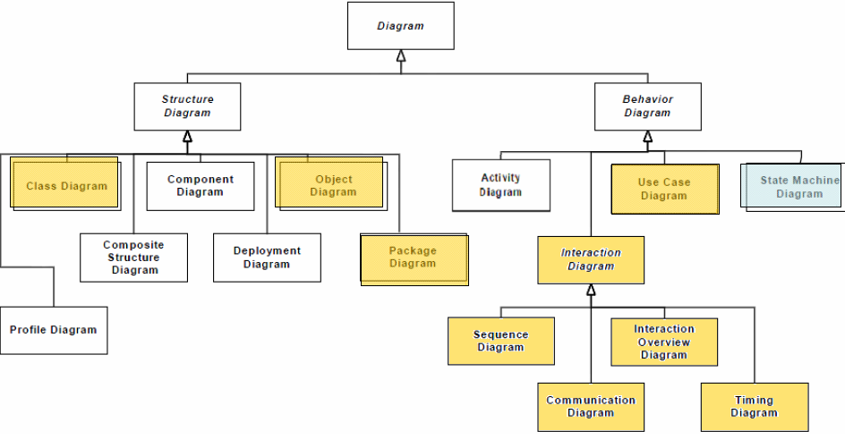
Overview

Slide 8
Content
Overview
Concepts
Methods
Notes:
© Dr. Jim Arlow 2000 v1.0

Slide 9
State machine diagrams
light bulb {protocol}
state = off
turnOn
Off
On
turnOff
burnOut
Off
On
We begin with the light bulb in the state off
Notes:
© Dr. Jim Arlow 2000 v1.0

Slide 10
Light bulb turnOn
light bulb {protocol}
State = off
turnOn
Off
On
turnOff
burnOut
Event =
turnOn
Off
On
We throw the switch to On and the event turnOn is sent to the lightbulb
Notes:
© Dr. Jim Arlow 2000 v1.0

Slide 11
Light bulb On
light bulb {protocol}
State = on
turnOn
Off
On
turnOff
burnOut
Off
On
The light bulb turns on
Notes:
© Dr. Jim Arlow 2000 v1.0

Slide 12
Light bulb turnOff
light bulb {protocol}
State = on
turnOn
Off
On
turnOff
burnOut
Event =
turnOff
Off
On
We turn the switch to Off. The event turnOff is sent to the light bulb
Notes:
© Dr. Jim Arlow 2000 v1.0

Slide 13
Light bulb Off
light bulb {protocol}
state = off
turnOn
Off
On
turnOff
burnOut
Off
On
The light bulb turns off
Notes:
© Dr. Jim Arlow 2000 v1.0

Slide 14
Basic state machine syntax
event
A
anEvent
B
initial state
transition
state
final state
Every state machine should have a initial state which indicates the first state of the sequence
Unless the states cycle endlessly, state machines should have a final state which terminates the sequence of transitions
We’ll look at each element of the state machine in detail in the next few slides!
Notes:
© Dr. Jim Arlow 2000 v1.0

Slide 15


Initial state and final state
Initial state
➢Indicates the default starting place for the state machine or substate
➢An initial state is represented as a filled black circle
Final state
➢Indicates that the execution of the state machine or the enclosing state has been completed
➢A final state is represented as a filled black circle surrounded by an unfilled circle (a bull's eye)

Slide 16
States
"A condition or situation during the life of an object during which it satisfies some condition, performs some activity or waits for some event"
How many states?
Color
red : int
green : int
blue : int
Notes:
© Dr. Jim Arlow 2000 v1.0

Slide 17
State syntax
Actions are instantaneous and uninterruptible
  Entry actions occur immediately on entry to the state
  Exit actions occur immediately on leaving the state
Internal transitions occur within the state. They do not transition to a new state
Activities take a finite amount of time and are interruptible
EnteringPassword
state name
entry and exit actions
entry/display password dialog
exit/validate password
keypress/ echo "*"
help/display help
do/get password
internal transitions
internal activity
Action syntax: eventTrigger / action
Activity syntax: do / activity
Notes:
© Dr. Jim Arlow 2000 v1.0

Slide 18
Transitions
A transition is a relationship between two states indicating that an object in the first state will perform certain actions and enter the second state when a specified event occurs and specified conditions are satisfied

Slide 19
Transitions
state machine
A
event1, event2 [guard condition] / act1, act2
B
events
Boolean
guard condition
actions
Notes:
© Dr. Jim Arlow 2000 v1.0

Slide 20
Events
Events trigger transitions in state machines
Events can be shown externally, on transitions, or internally within states (internal transitions)
There are four types of event:
  Call event
  Signal event
  Change event
  Time event
Off
turnOff
turnOn
event
On
Notes:
© Dr. Jim Arlow 2000 v1.0

Slide 21
Call events
A call for an operation execution
The event should have the same signature as an operation of the context class
A sequence of actions may be specified for a call event - they may use attributes and operations of the context class
The return value must match the return type of the operation
SimpleBankAccount
internal call event
action
close()
InCredit
external call event
deposit(m)/ balance = balance + m
condition
withdraw(m)
[balance < m]
withdraw(m)
[balance >= m]
RejectingWithdrawal
AcceptingWithdrawal
entry/ logRejectedWithdrawal()
entry/ balance = balance - m
entry action
Notes:
© Dr. Jim Arlow 2000 v1.0

Slide 22
Time events
Time events occur when a time expression becomes true
Overdrawn
balance < overdraftLimit / notifyManager
after( 3 months )
Frozen
Context: CreditAccount class
Notes:
© Dr. Jim Arlow 2000 v1.0

Slide 23
Branching – the choice pseudo state
The choice pseudo state directs its single incoming transition to one of its outgoing transitions
Each outgoing transition must have a mutually exclusive guard condition
BankLoan
Unpaid
acceptPayment
choice pseudo-state
[payment > balance]
[payment < balance]
[payment = balance]
OverPaid
makeRefund
FullyPaid
PartiallyPaid
acceptPayment
Notes:
© Dr. Jim Arlow 2000 v1.0

Slide 24
Composite states
A substate is a state that's nested inside another one
A state that has substates (nested states) is called a composite state
A composite state may contain either concurrent (orthogonal) or sequential (nonorthogonal) substates
In the UML, you render a composite state just as you do a simple state, but with an optional graphic compartment that shows a nested state machine

Slide 25
Composite states
Have one or more regions that each contain a nested submachine
  Simple composite state
    exactly one region
  Orthogonal composite state
    two or more regions
Use the composition icon when the submachines are hidden
A composite state
region 1
A
B
submachines
region 2
C
A composite state
composition icon
Notes:
© Dr. Jim Arlow 2000 v1.0

Slide 26
Simple composite states
Contains a single region
The nested states inherit the cancel transition from DialingISP
ISPDialer
DialingISP
entry/ offHook
dial
WaitingForDialtone
[dialtone]
Dialing
WaitingForCarrier
do/ dialISP
after(20 seconds)/ noDialtone
after(20 seconds)/ noCarrier
[carrier]
notConnected
connected
cancel
NotConnected
Connected
entry/ onHook
exit/ onHook
do/ useConnection
Notes:
© Dr. Jim Arlow 2000 v1.0

Slide 27
Orthogonal composite states
Has two or more regions
When we enter the superstate, both submachines start executing concurrently
Initializing composite state details
Initializing
InitializingFireSensors
do/ initializeFireSensor
InitializingSecuritySensors
do/ initializeSecuritySensor
Notes:
© Dr. Jim Arlow 2000 v1.0

Slide 28
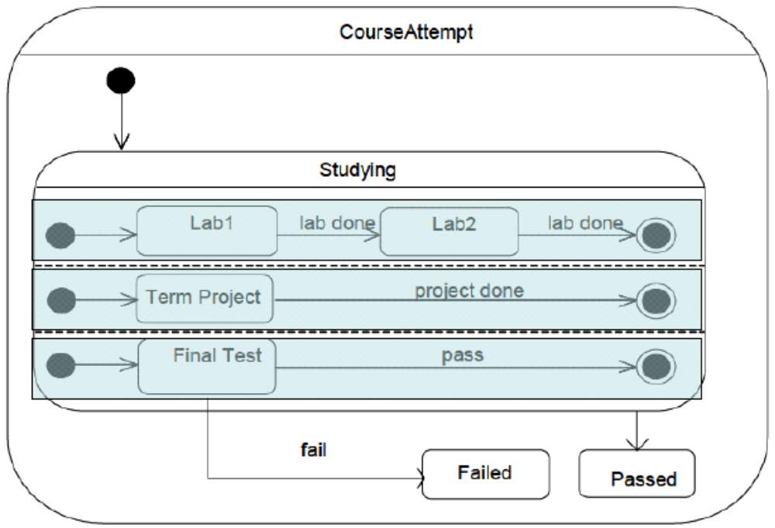
Orthogonal composite states

Slide 29
Submachine communication
We often need two submachines to communicate
Synchronous communication can be achieved by a join
Asynchronous communication is achieved by one submachine setting a flag for another one to process in its own time.
  Use attributes of the context object as flags
Submachine communication using the attribute PaidFor as a flag: The upper submachine sets the flag and the lower submachine uses it in a guard condition
OrderProcessing
AcceptingPayment
do/acceptPayment
PaidFor
entry/paidFor = true
AssemblingOrder
do/assemble order
DeliveringOrder
[paidFor]
Notes:
© Dr. Jim Arlow 2000 v1.0

Slide 30
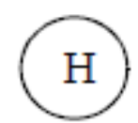
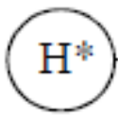
History States
History allows a superstate to remember the last substate before an outgoing transition.
Representation
➢Shallow history
➢Deep history

Slide 31
Shallow history
Shallow history remembers the last substate at the same level as the shallow history pseudo state
Next time the super state is entered there is an automatic transition to the remembered substate
Notes:
© Dr. Jim Arlow 2000 v1.0

Slide 32
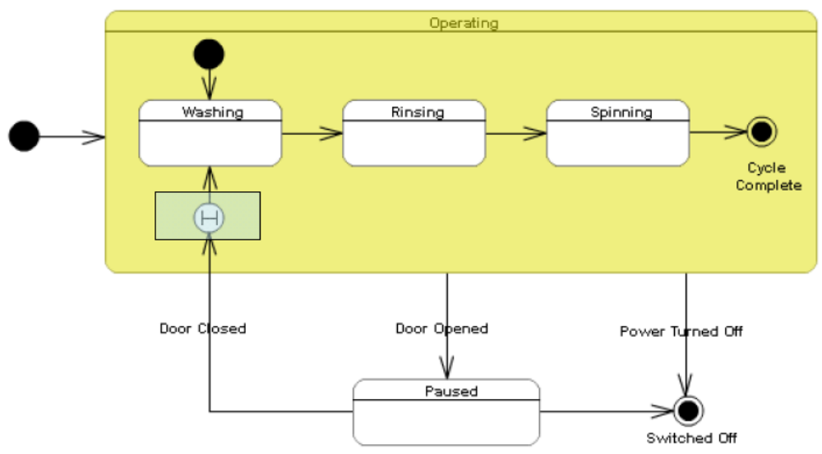
Shallow history

Slide 33
Deep history
Deep history remembers the last substate at the same level or lower than the deep history pseudo state
Notes:
© Dr. Jim Arlow 2000 v1.0

Slide 34
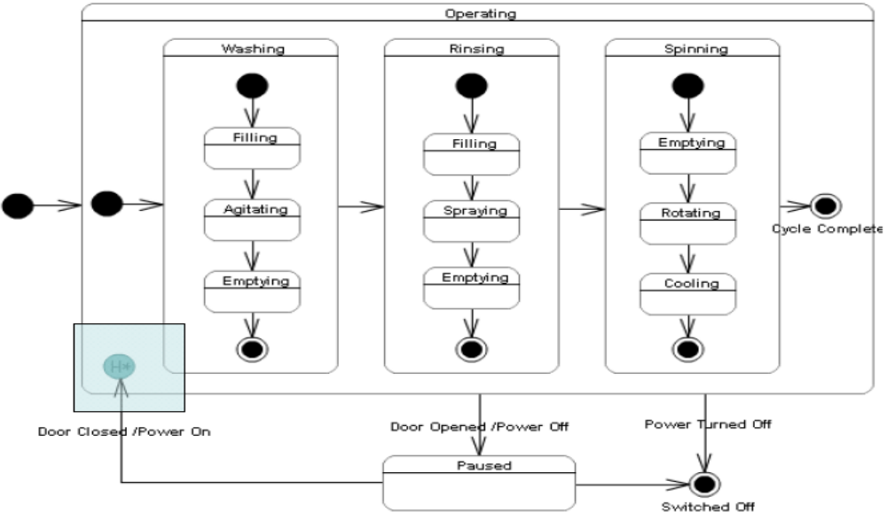
Deep history

Slide 35
Content
Overview
Concepts
Methods
Notes:
© Dr. Jim Arlow 2000 v1.0

Slide 36
Methods
Set the context for the state machine.
Establish the initial and final states for the object.
Decide on the events to which the object may respond.
Starting from the initial state to the final state, lay out the top-level states the object may be in. Connect these states with transitions triggered by the appropriate events. Add actions to these transitions.
Identify any entry or exit actions.
Expand these states as necessary by using substates.
Check all events and actions.
Check the state machine against expected sequences of events and their responses.

Slide 37
Style of UML State Machine Diagram
Do Not Overlap Guards
Indicate Entry Actions Only When Applicable to All Entry Transitions
Indicate Exit Actions Only When Applicable to All Exit Transitions➢

Slide 38
Style of UML State Machine Diagram
Question “Black-Hole” States
➢A black-hole state is one that has transitions into it but none out of it, something that should be true only of final states
➢This is an indication that you have missed one or more transitions
Question “Miracle” States
➢A miracle state is one that has transitions out of it but none into it, something that should be true only of start points
➢This is also an indication that you have missed one or more transitions

Slide 39
Project
Build a state machine diagram to describe the life history of the class “Book”.

