Slide 1
Laptop Market Dynamics: A SQL-Driven Exploration
SUJAI ADITHYA MURALIDHARAN

Slide 2
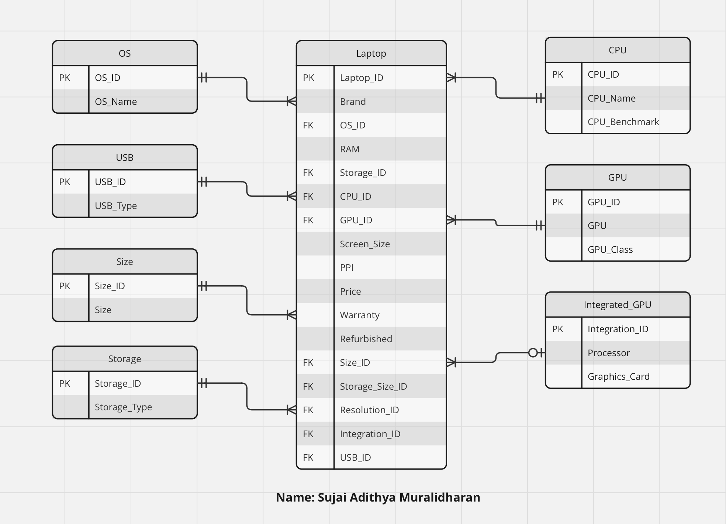
Data Source & ERD
Sourced from Kaggle
9 Normalized Tables
Laptop Specifications

Slide 3
LET’S DELVE INTO OUR BUSINESS QUESTIONS →

Slide 4
Rank the top 5 laptops with the highest CPU benchmark scores, including information about the processor, GPU, and screen resolution.
Q1

Slide 5
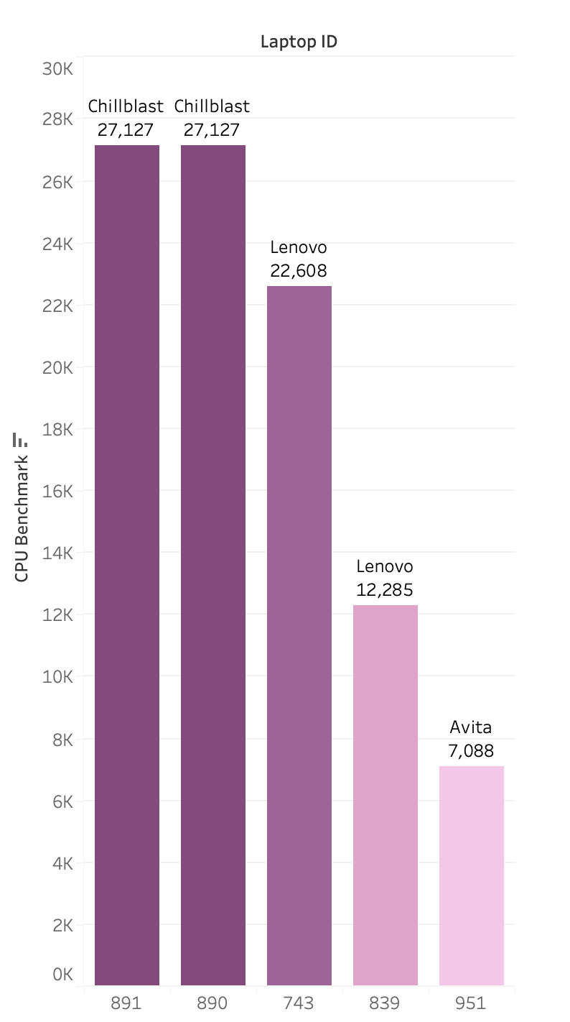
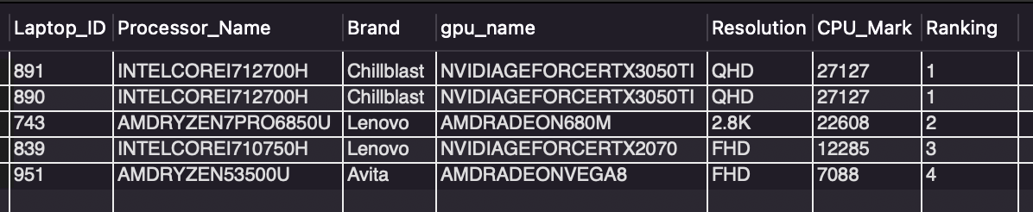
What do we get?
→ Identify High-Performance Laptops → Target Power Users (Gamers, Professionals) → Stock Prioritization → Marketing Strategies
SQL Output
Notes:
So, this question will provide us insights about the range of laptops available in the store. It gives us the list of the top 5 performing laptops available in the store, and therefore we can curate the marketing strategy

Slide 6
Determine the percentage distribution of laptops across different USB types for each brand.
Q2

Slide 7
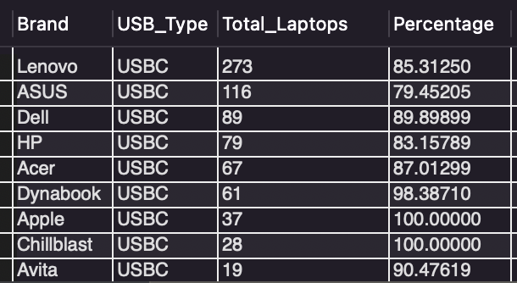
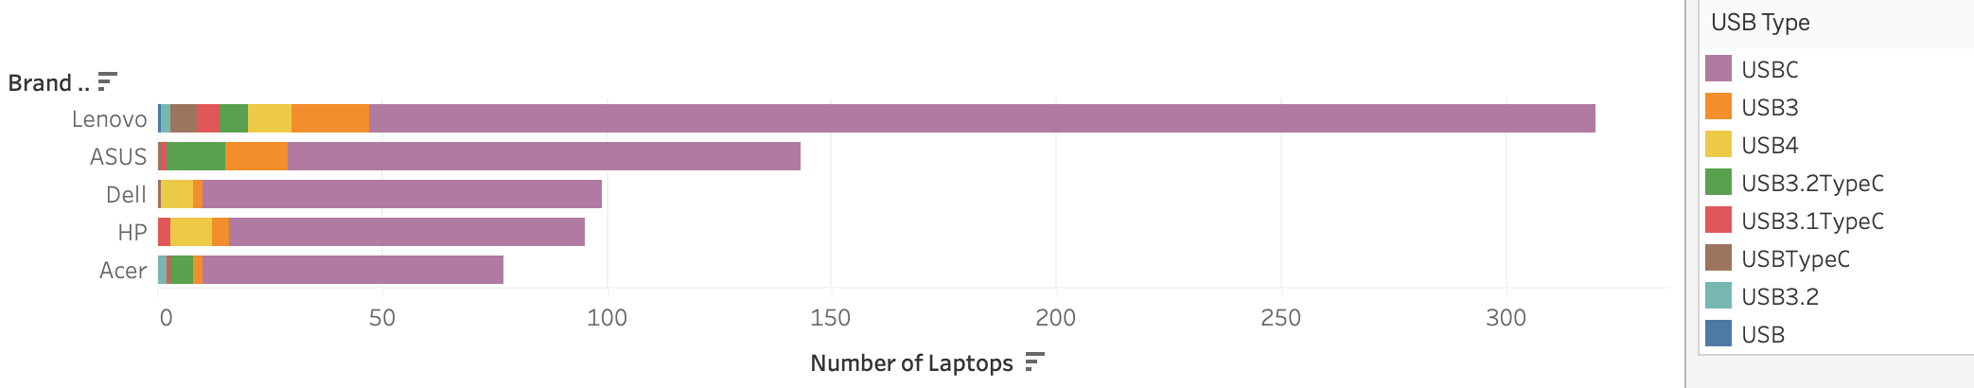
What do we get?
SQL Output
→ Understanding the Distribution of USB types → Assessing Technology Adoption → Consumer Preferences → Forecasting Future Trends

Slide 8
What is the average screen size of laptops for each GPU class, and how does it compare to the overall average screen size?
Q3

Slide 9
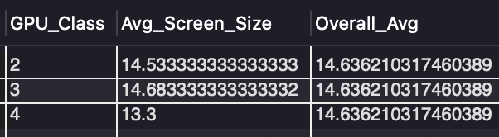
What do we get?
→ Helps understand which GPU classes are associated with larger or smaller screens. → Indicates different user segments (gamers, general users, etc.)
SQL Output

Slide 10
Find the top 3 USB types with the highest number of laptops and the percentage they contribute to the total, considering only laptops with UHD, FHD, UHDPLUS and FHDPLUS resolution.
Q4

Slide 11
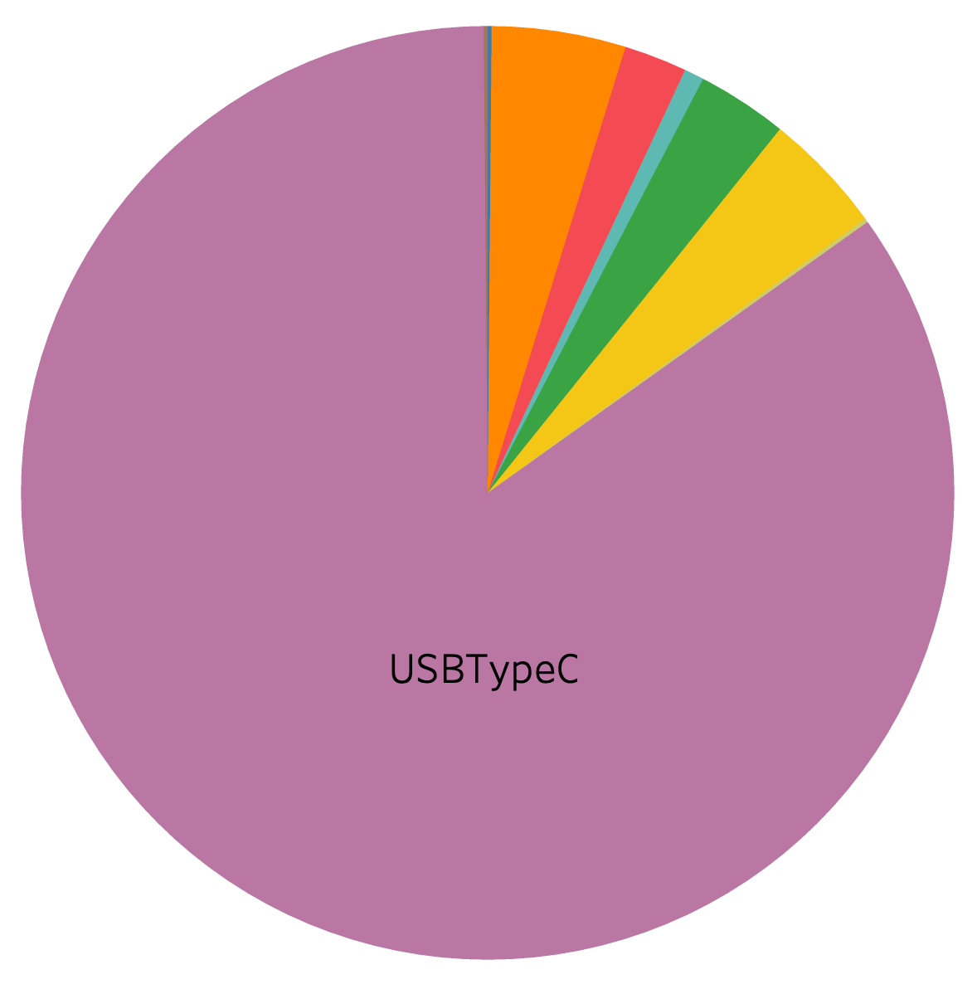
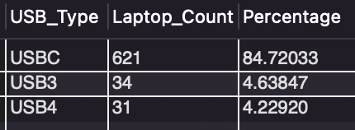
What do we get?
→ Identify the Common USB Types in High-End Laptops → Accessory Compatibility → Inventory Decisions
SQL Output

Slide 12
Identify the top 3 resolutions with the lowest average RAM capacity for laptops and provide the percentage of total laptops each resolution represents.
Q5

Slide 13
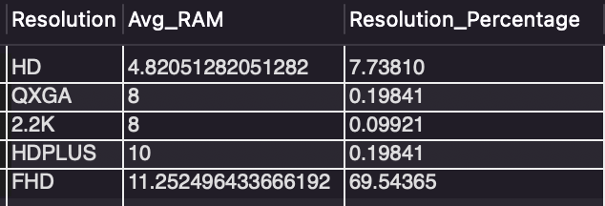
What do we get?
Correlation between Resolution and RAM
Guide in bundling and upselling strategies
Target high-resolution laptop users with additional RAM upgrades
SQL Output

Slide 14
Identify the brand with the highest average storage size for laptops with a screen size larger than the overall average. Also, provide the cumulative percentage of total storage for all laptops.
Q6

Slide 15
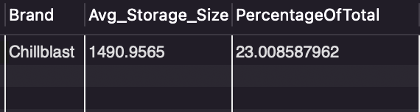
What do we get?
→ Helps identify which brands are catering to power users needing large storage and screen sizes. → Can inform brand partnerships and competitive positioning.
SQL Output

Slide 16
Among refurbished laptops, what is the average price difference between those with storage capacity greater than 256GB and those with storage capacity 256GB or less? Provide the percentage distribution of these two storage
Q7

Slide 17
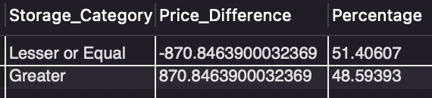
What do we get?
Price sensitivity in the refurbished market can guide pricing strategies.
A significant price difference indicates a market willing to pay more for additional storage
Inventory decisions and promotional offers.
Buying behaviour in the refurbished market to fine-tune marketing and sales approaches.
SQL Output

Slide 18
Determine the top 3 screen sizes with the highest average laptop prices, considering only laptops with a screen resolution of 2K and FHD.
Q8

Slide 19
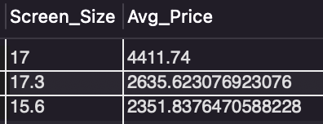
What do we get?
Understanding where the premium market lies
Crucial for targeting high-end consumers
How to leverage this in marketing and product development
SQL Output

Slide 20
Thank You!

