Slide 1


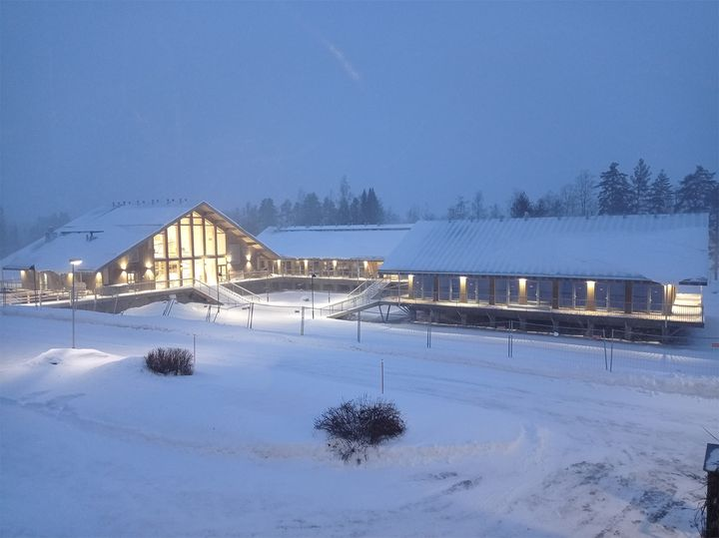
ACTRIS Science Conference 2024
Rennes, France
Aerosol optical properties of the supermicron aerosol particles in a European boreal environment
Sujai Banerji¹, Luoma, K.², Ylivinkka, I.¹, Ahonen, L.¹, Kerminen, V-M.¹ and Petäjä, T.¹
¹Institute for Atmospheric and Earth System Research (INAR)/Physics, Faculty of Science, University of Helsinki, Finland
²Finnish Meteorological Institute, Helsinki, Finland
16th May, 2024
1

Slide 2
Introduction
Quantify the aerosol optical properties at the SMEAR II site in southern Finland.
The time series and seasonal variation of the extensive and intensive properties for PM₁₀ and PM₁ aerosol particles.
Special emphasis has been placed on supermicron aerosol particles (i.e. PM₁ < supermicron aerosol particles ≤ PM₁₀)
Absence of optical closure between in situ-derived and AERONET-derived AOD values suggests the contribution of missing coarse mode particles.
SMEAR II provides a unique setting for observing natural aerosol contributions like pollen and spores, which are significant especially during seasonal peaks.
2

Slide 3
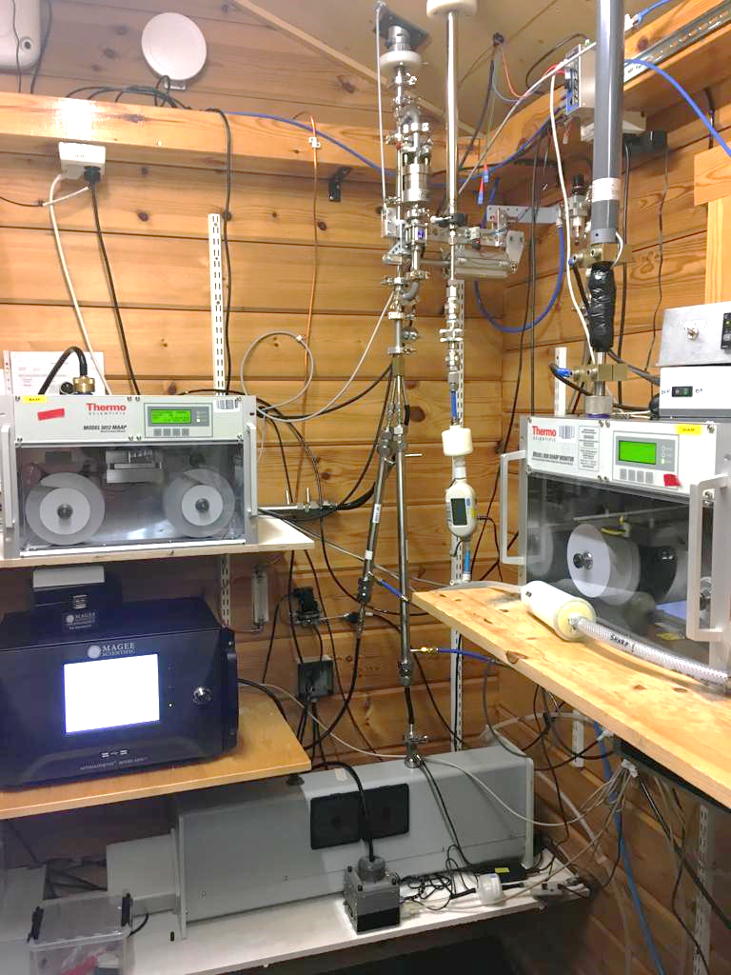
PM₁₀/PM₁ switching inlet
Multi-angle absorption photometer (Thermo Scientific MAAP
Model 5012)
PM₁₀ range = [(10, 19), (30, 39), (50, 59)]
PM₁ range = [(0, 9), (20, 29), (40, 49)]
Aethalometer (Magee Scientific model AE33)
Integrating nephelometer
TSI model 3563
3

Slide 4
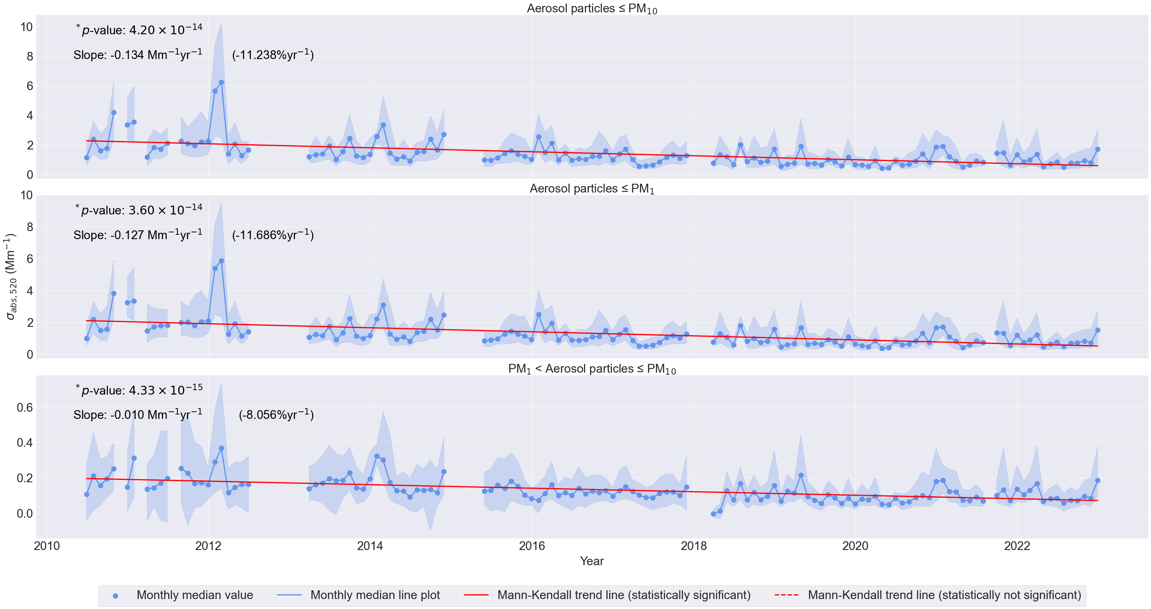
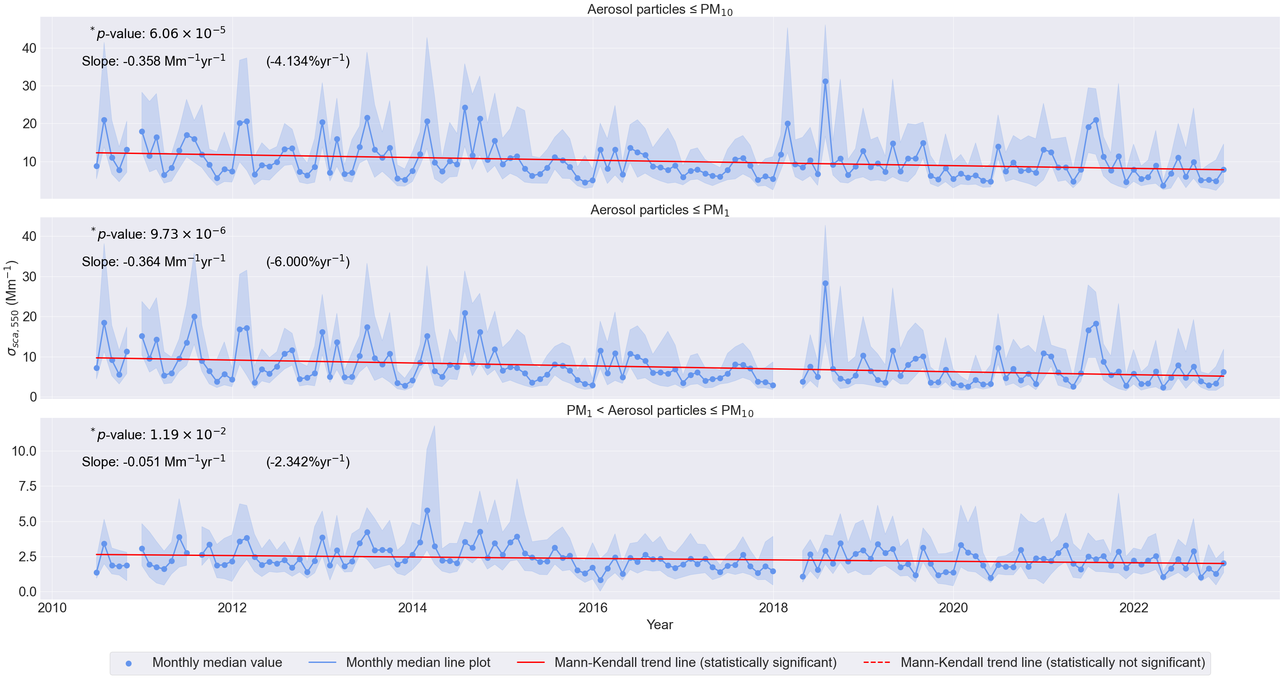
Extensive properties: σ_{abs, 520} and σ_{sca, 550}
Figure 1. Time series of σ_{abs, 520} for PM₁₀, submicron and supermicron aerosol particles from 2010-22.
Figure 2. Time series of σ_{sca, 550} for PM₁₀, submicron and supermicron aerosol particles from 2010-22.
4

Slide 5
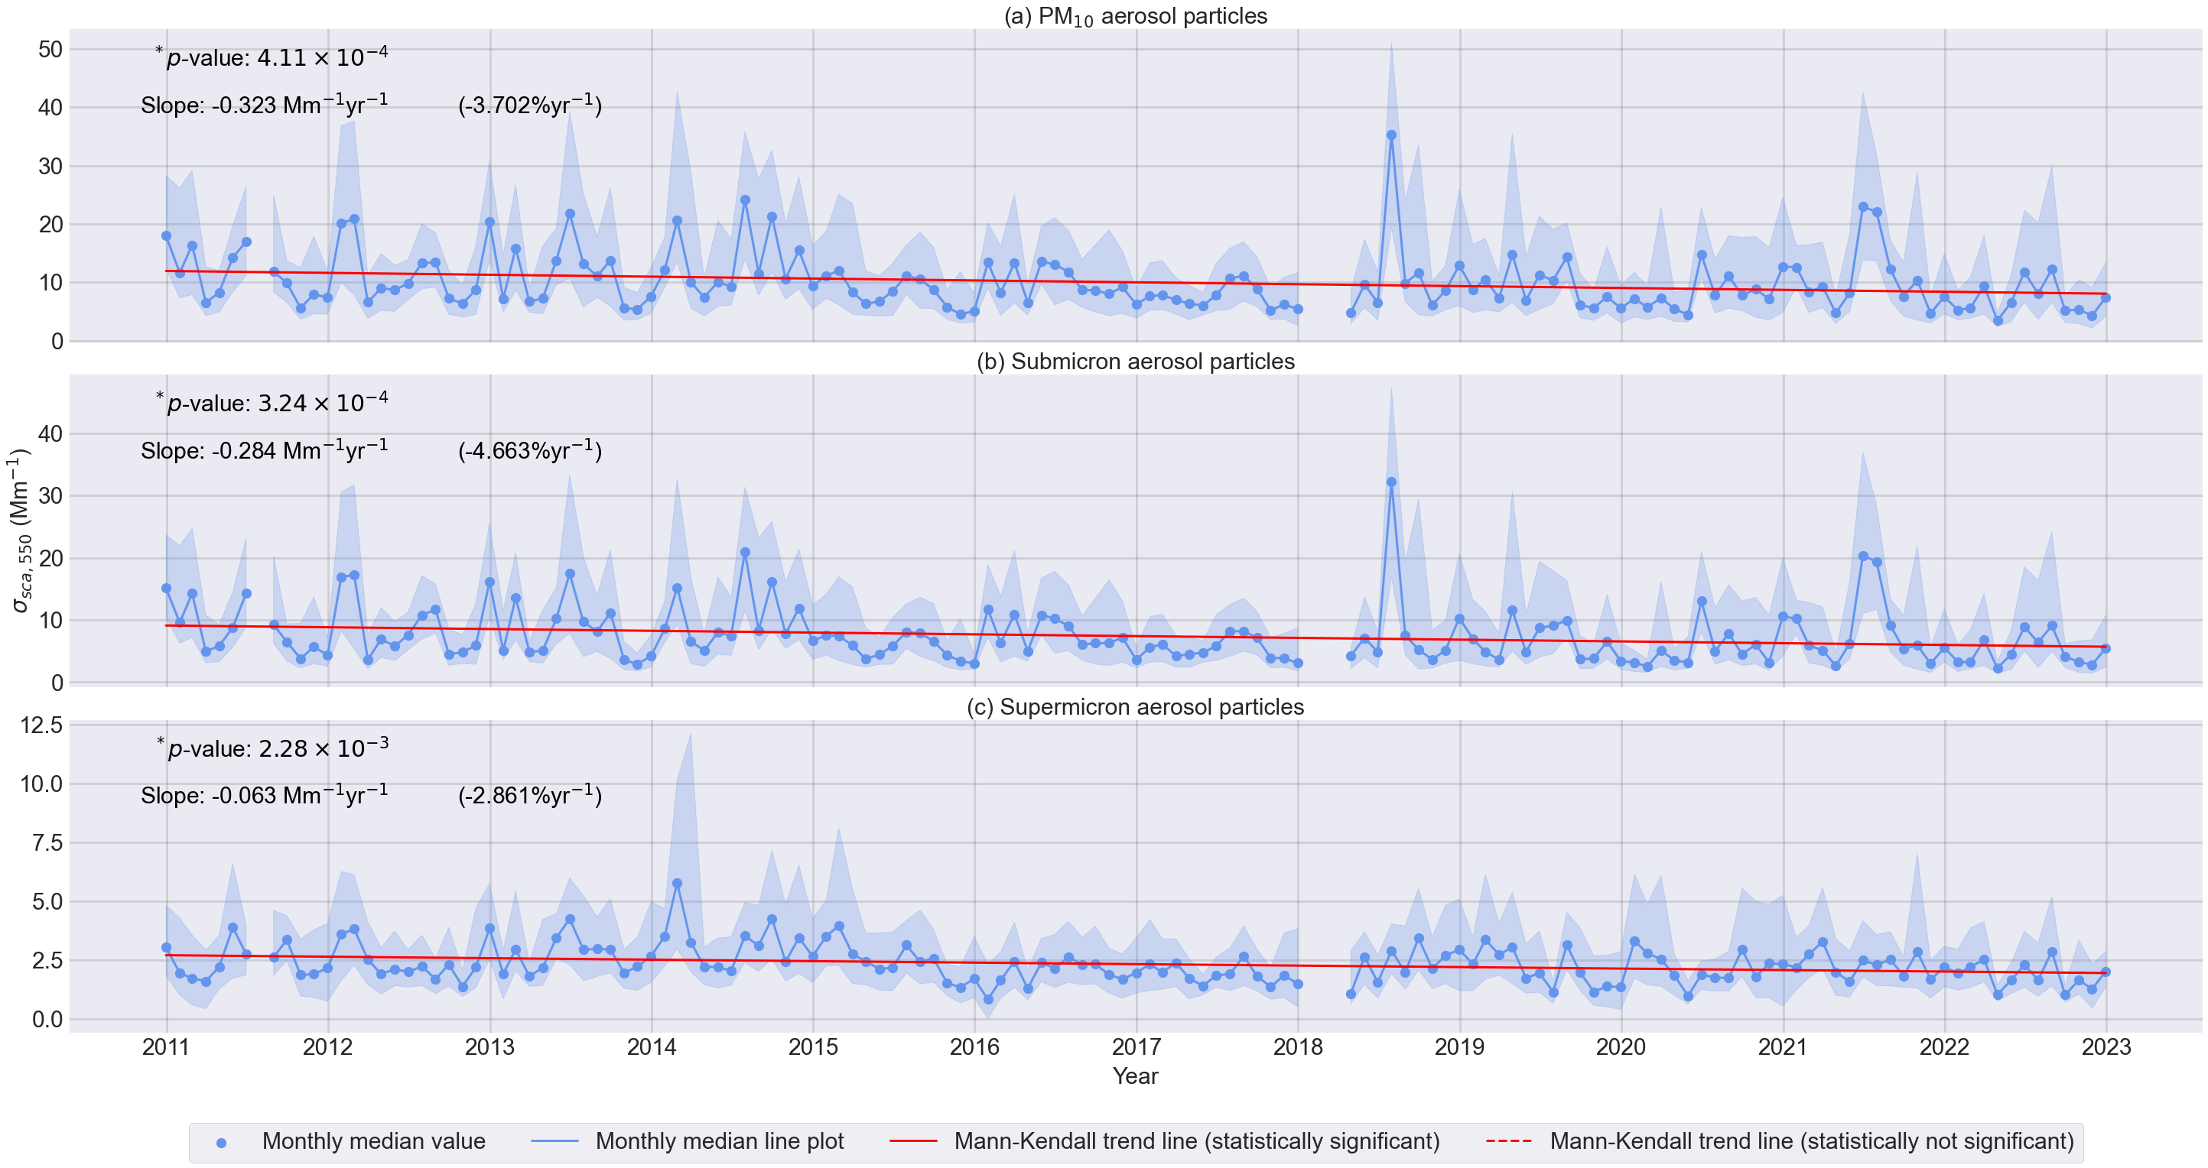

Slide 6
Key take away points
The decreasing trend of the σ_{sca, 550} in the present study, may be partially attributed to a decrease in the concentration of SO₂ since the 1970s (Smith et al., 2011, Klimont et al., 2013).
Both the reduction of SO₂ between 1998-2018, as reported by Li et al., 2023, and CS between 2006-2022, as reported by Sulo et al., 2022, suggest a decrease in the σ_{sca, 550} of the aerosol particles across the different size ranges.
The observed decrease in the absorption coefficient was about twice as significant as the decrease in the scattering coefficient.
5
Notes:
A decreasing CS indicates fewer opportunities for aerosol particles to grow through gas-to-particle conversion processes. So, for SMEAR II point 2
Point 3 suggests that absorbing materials like Black Carbon (BC) and Brown Carbon (BrC) diminished more rapidly than scattering materials such as sulfate, which can form a coating around an absorbing particle to enhance absorption due to the lensing effect (Luoma et al., 2019).

Slide 7
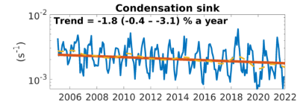
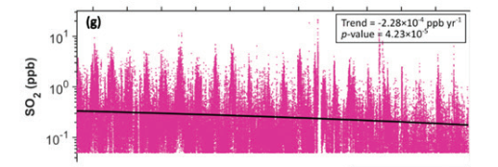
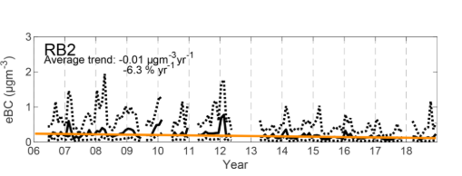
Supporting indicators from recent literature
Figure 6. Time series of CS from 2006-2022 at SMEAR II (Sulo et al., 2022; ACP).
Figure 5. Time series of SO₂ mixing ratio from 1997-2019 at SMEAR II (Li et al., 2023; BER).
Figure 7. Time series of eBC from 2006-18 at SMEAR II (Luoma et al., 2021; ACP).
6

Slide 8
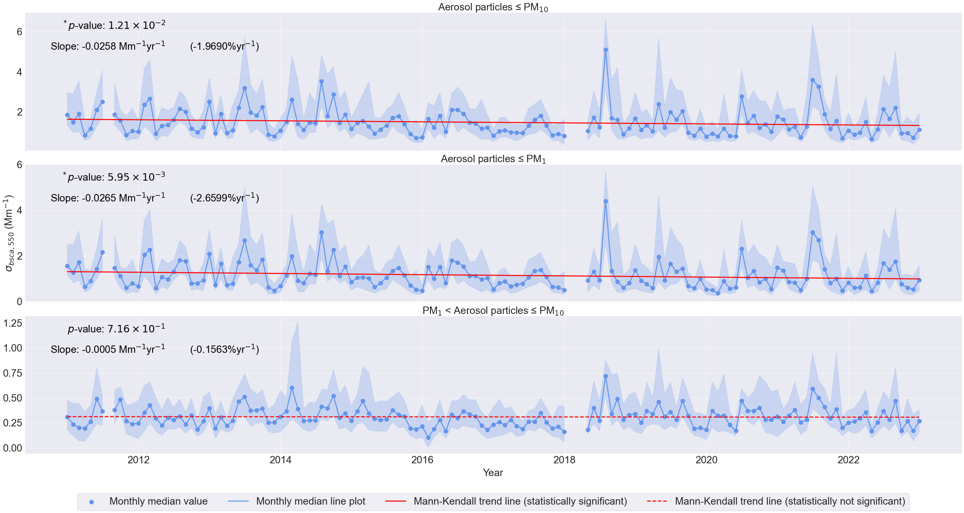
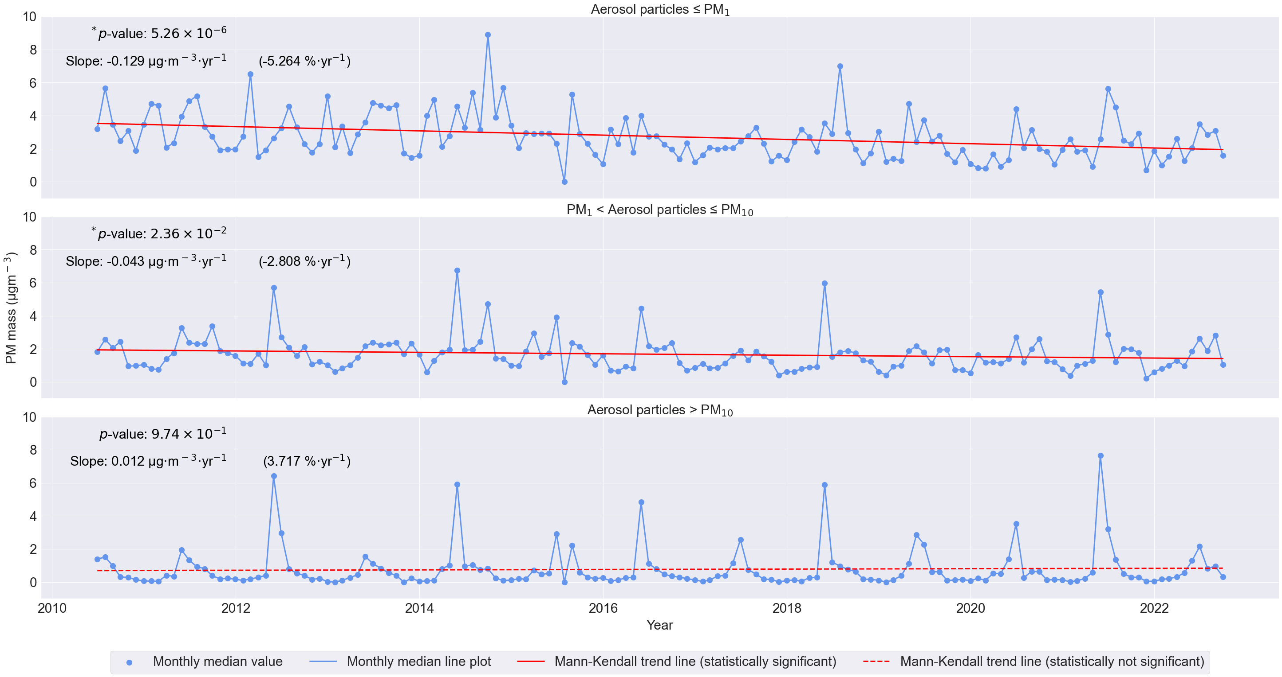
Extensive properties: σ_{bsca, 550} and PM mass
Figure 3. Time series of σ_{bsca, 550} for the PM₁₀, submicron and supermicron aerosol particles from 2010-22.
Figure 4. Time series of PM mass for the submicron, supermicron and super-PM₁₀ aerosol particles from 2010-22.
7

Slide 9
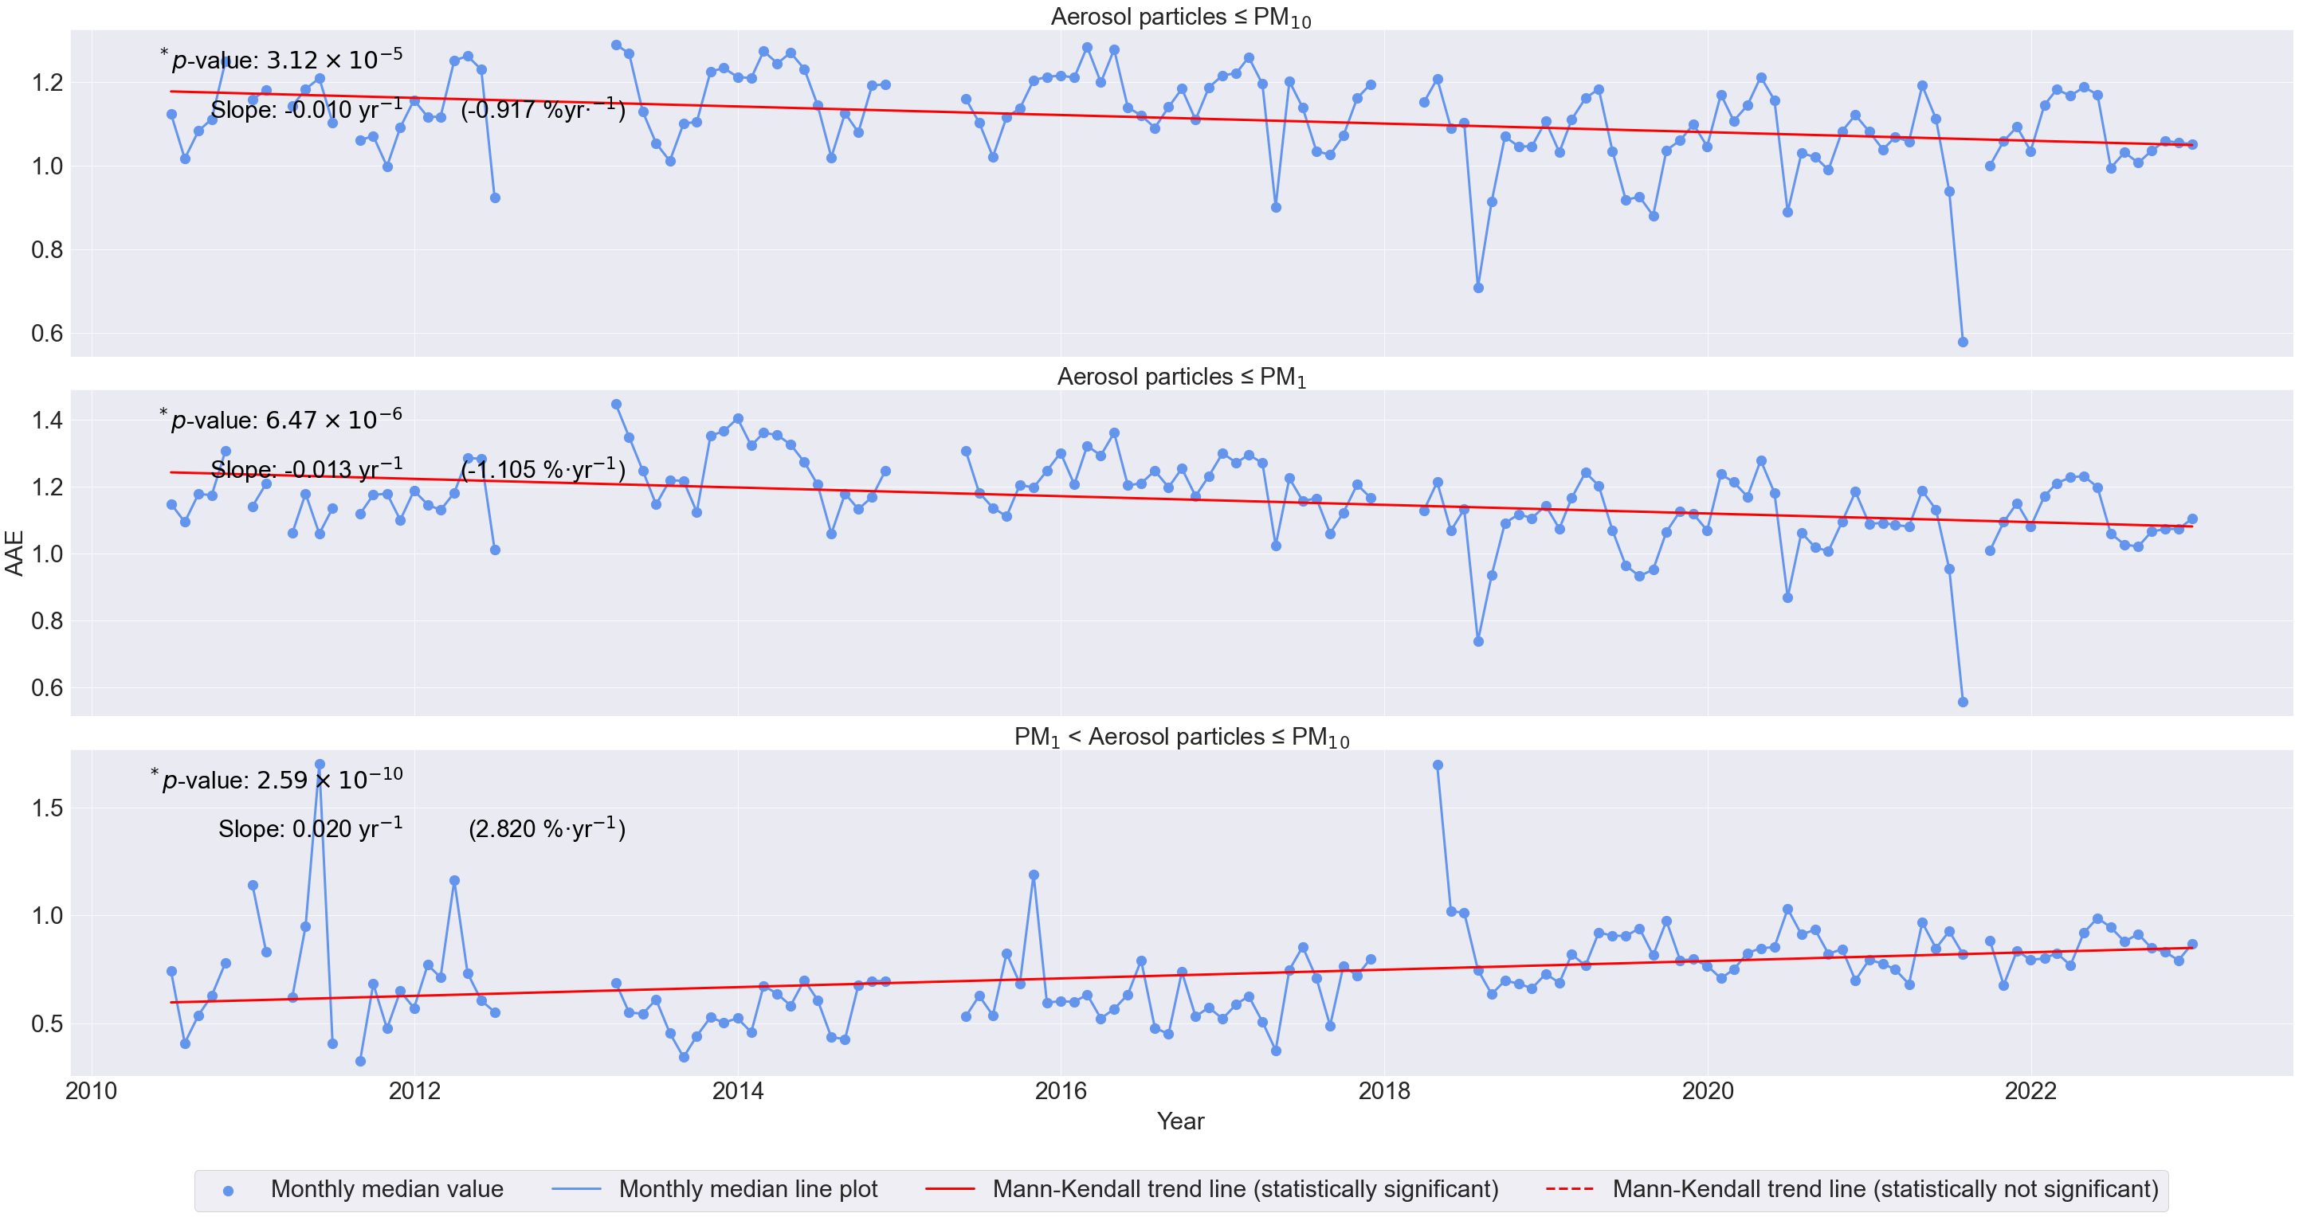
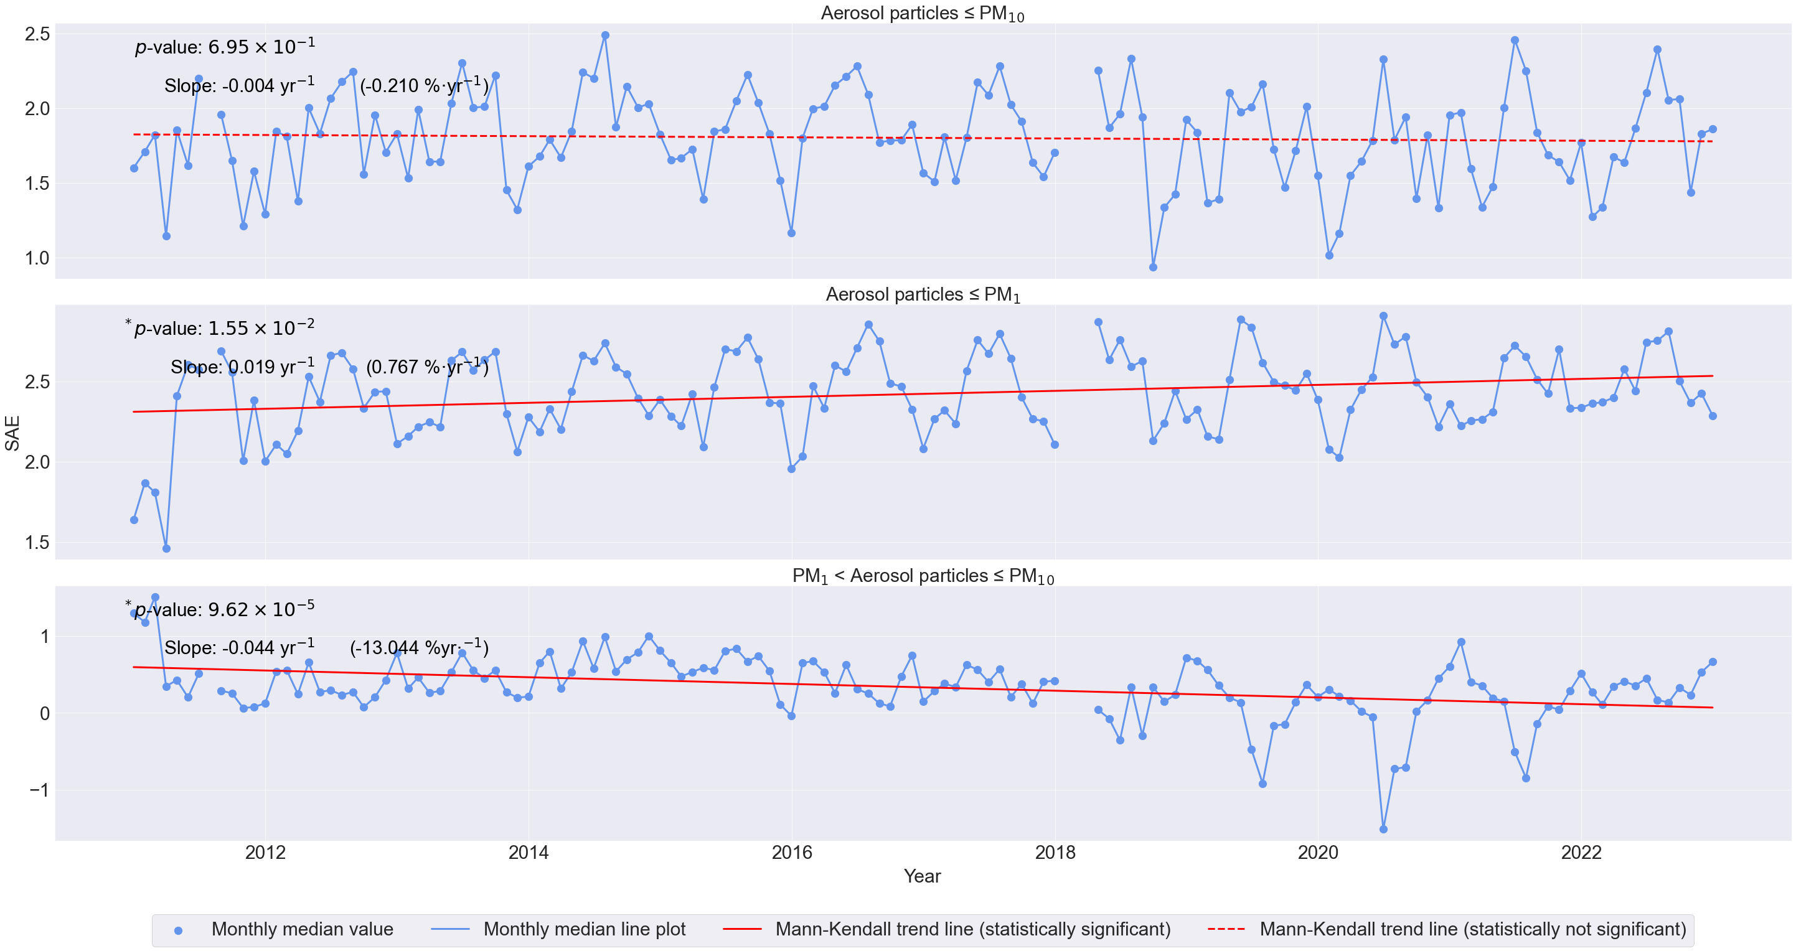
Intensive properties: AAE and SAE
Figure 7. Time series of AAE from 2010-22 at SMEAR II.
Figure 8. Time series of SAE from 2010-22 at SMEAR II.
8

Slide 10
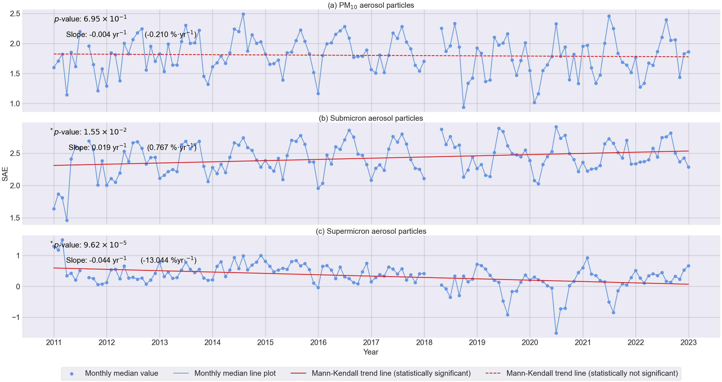

Slide 11
Implications for aerosol size distribution
An increasing SAE of the submicron aerosol particles suggests a shift in the accumulation-mode particles toward smaller sizes.
This is further emphasized by the increasing trends that is observed in the SSA and the b in the submicron aerosol particles.
9
Notes:
The SSA and the b in the PM₁₀ and the supermicron fractions also suggest that the aerosol size distribution consists predominantly of submicron aerosol particles. A similar trend was also reported by Luoma et al., 2019 for SMEAR II.

Slide 12
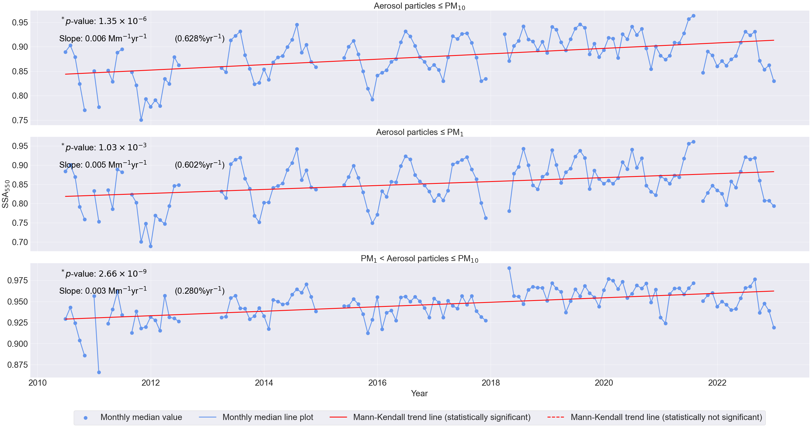
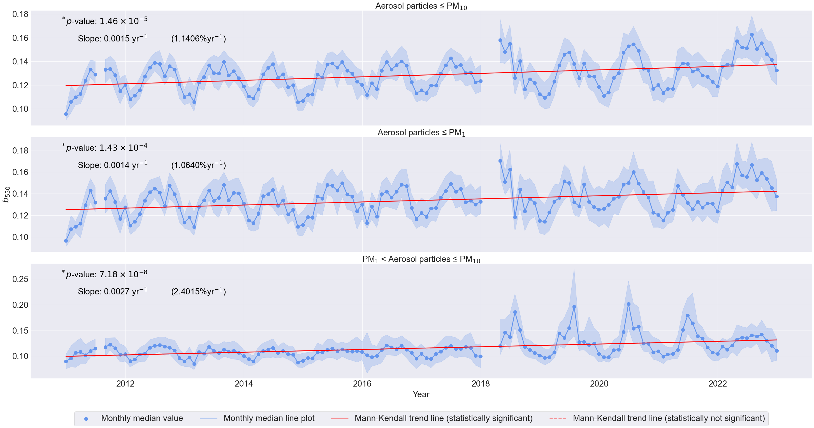
Intensive properties: SSA and b
Figure 8. Time series of SSA from 2010-22 at SMEAR II.
Figure 9. Time series of b from 2010-22 at SMEAR II.
10

Slide 13
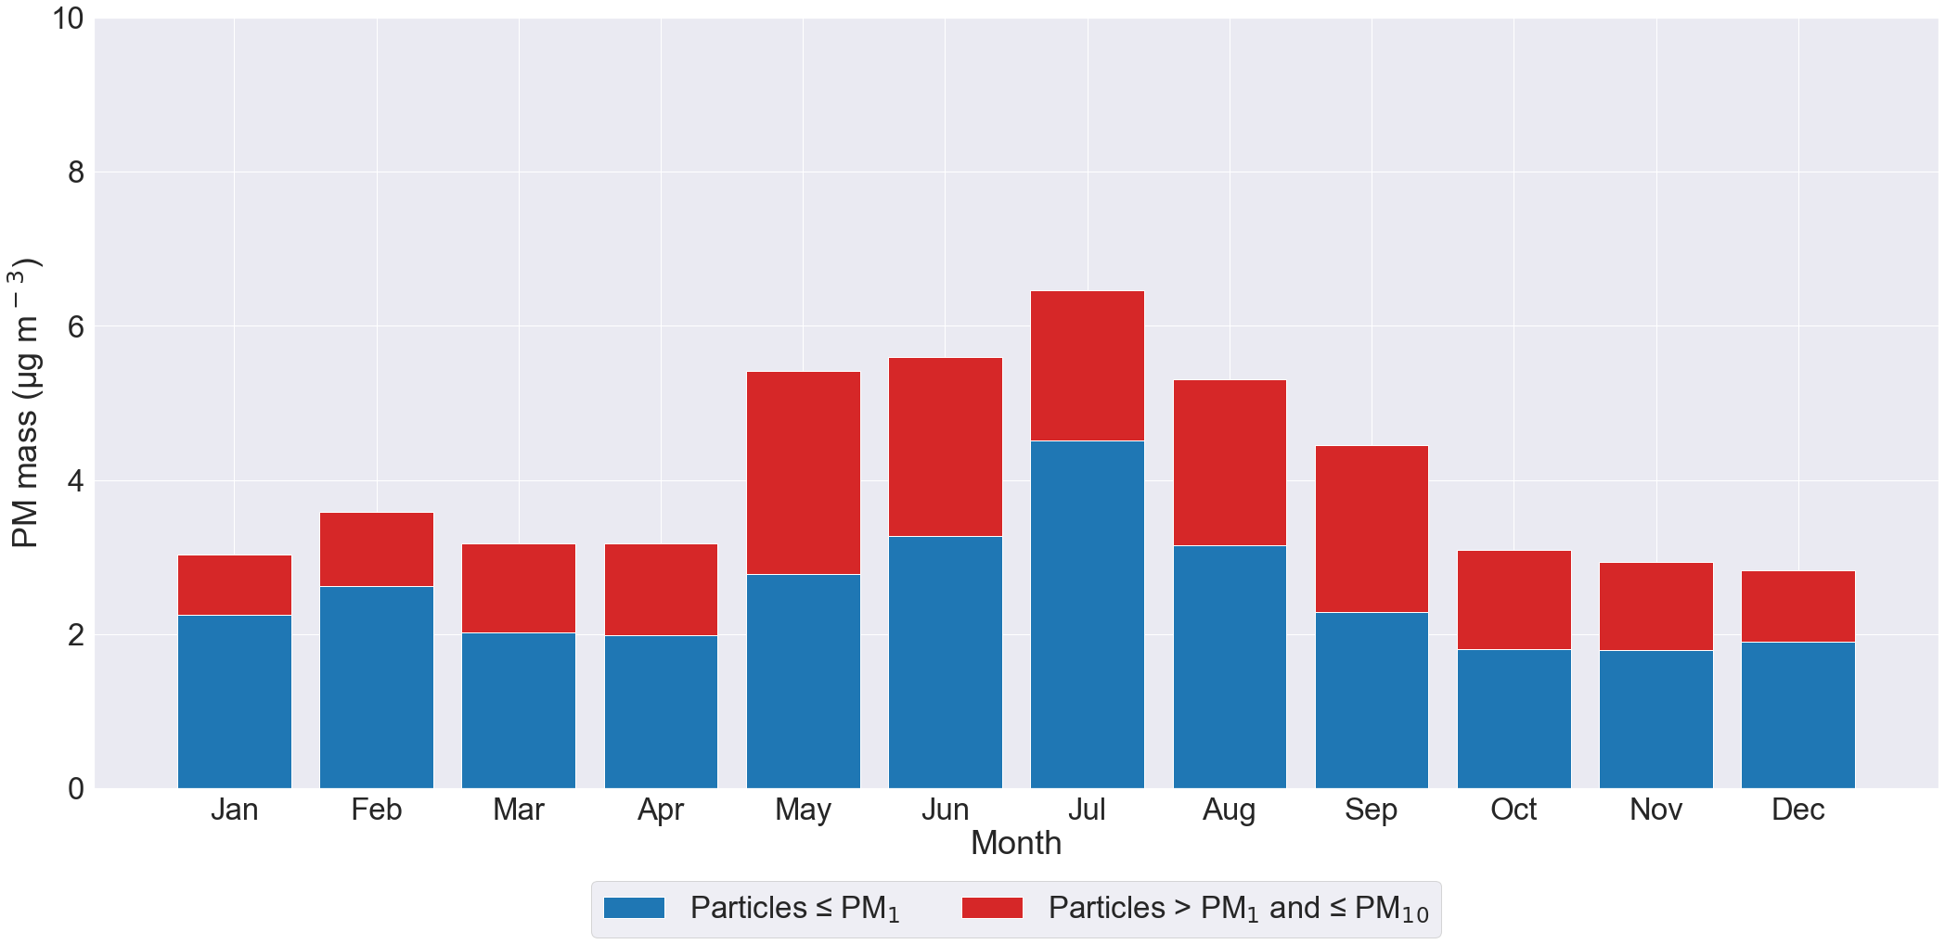
Contribution of the supermicron aerosol particles
Figure 10. Time series of PM mass for the submicron, supermicron and super-PM₁₀ aerosol particles from 2010-22.
Figure 11. Seasonal variability of PM mass for the submicron and supermicron aerosol particles from 2010-22.
12

Slide 14
Summary and conclusions
The overall trend seems to show that the aerosol size distribution consists of more submicron aerosol particles.
The trend of b for the supermicron aerosol particles is approx. > 2 times the trend of b for the submicron aerosol particles.
But a very sharp decline in the SAE of the supermicron aerosol particles suggests that perhaps supermicron aerosol particles may have a role to play.
The seasonal variablity of PM mass does show that supermicron aersol particles can make a substantial fraction of the PM mass during the spring and summer seasons.
However, optically the supermicron aerosol particles show very little effect.
13
Notes:
During May, the PM mass of submicron and supermicron aerosol particles is almost equal. Also, in recent years, dust events have become more prevalent (i.e. almost 60% of the dust events between 1982-2022 with an almost doubling dust storms since 2010) (Verga et al., 2023).
But this little effect is important for optical closure studies.
We have impactor measurements for the super-PM₁₀ aerosol particles also, but then we lack optical measurements for the super-PM₁₀ aerosol particles. Thus, we cannot use both the PM mass and aerosol optical data in conjunction with each other for a closure study.
Then, proceed to show the last two slides with the seasonal variability of the light absorption and scattering coefficients.

Slide 15
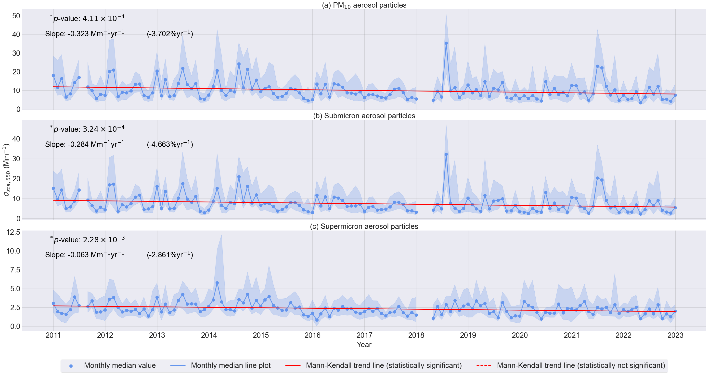
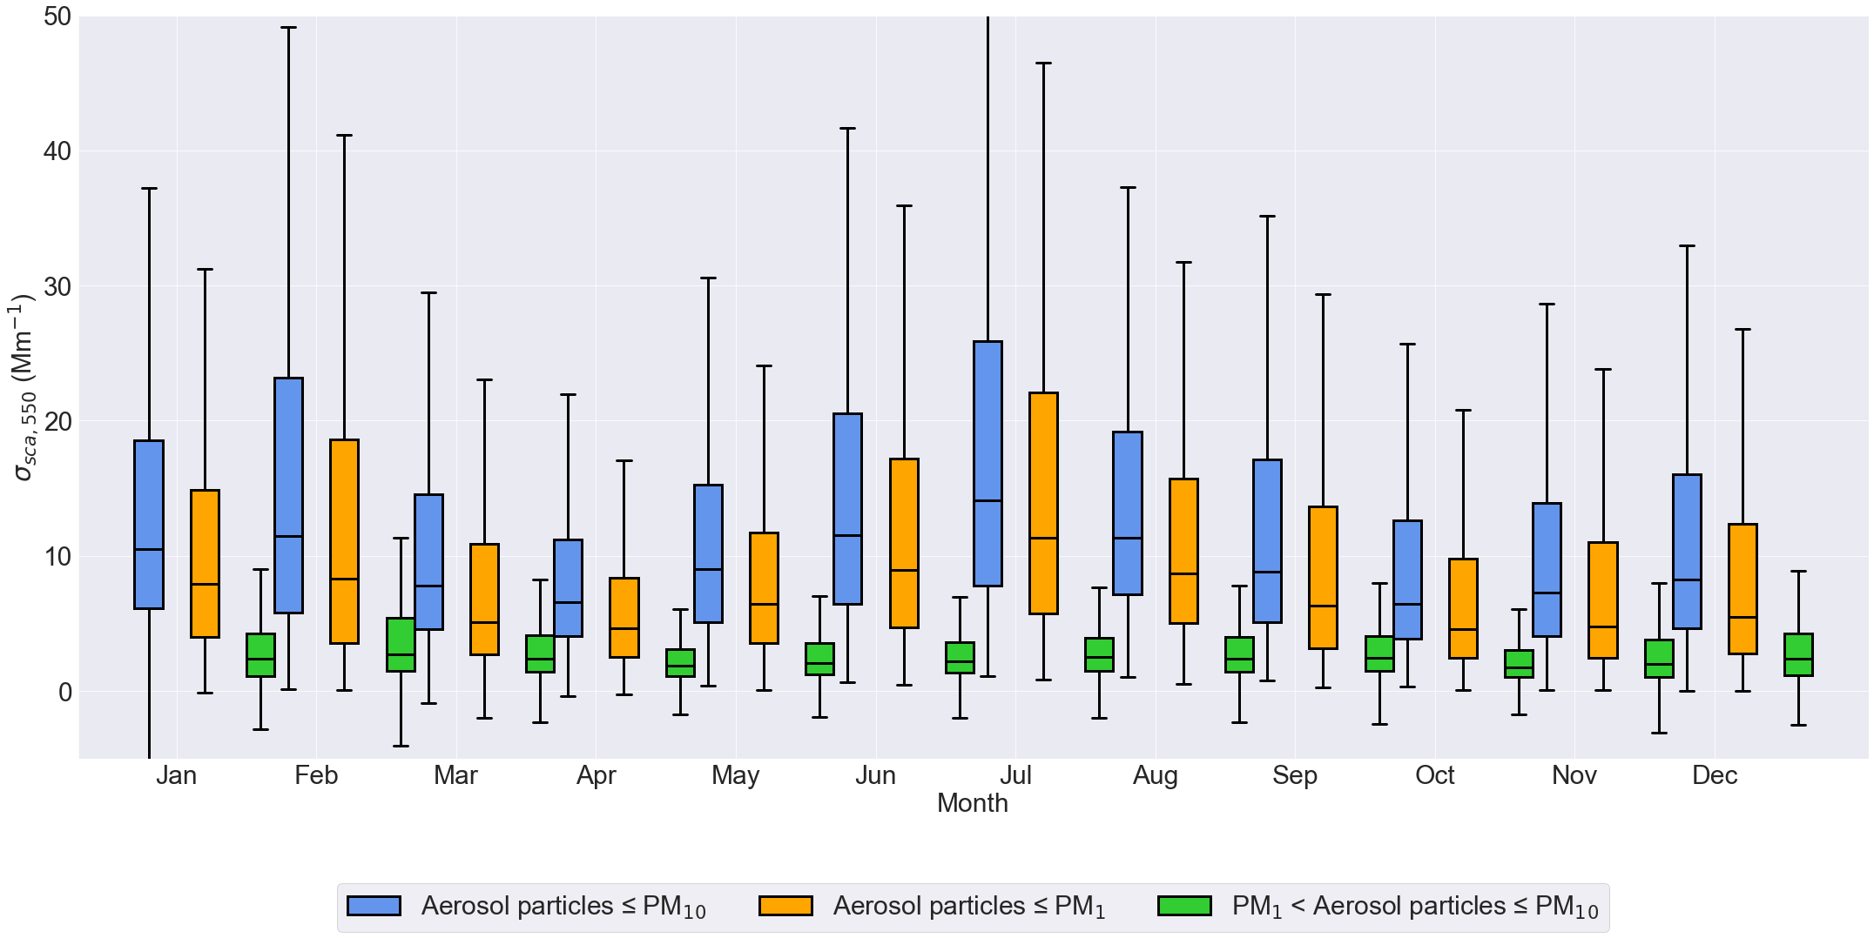

Slide 16
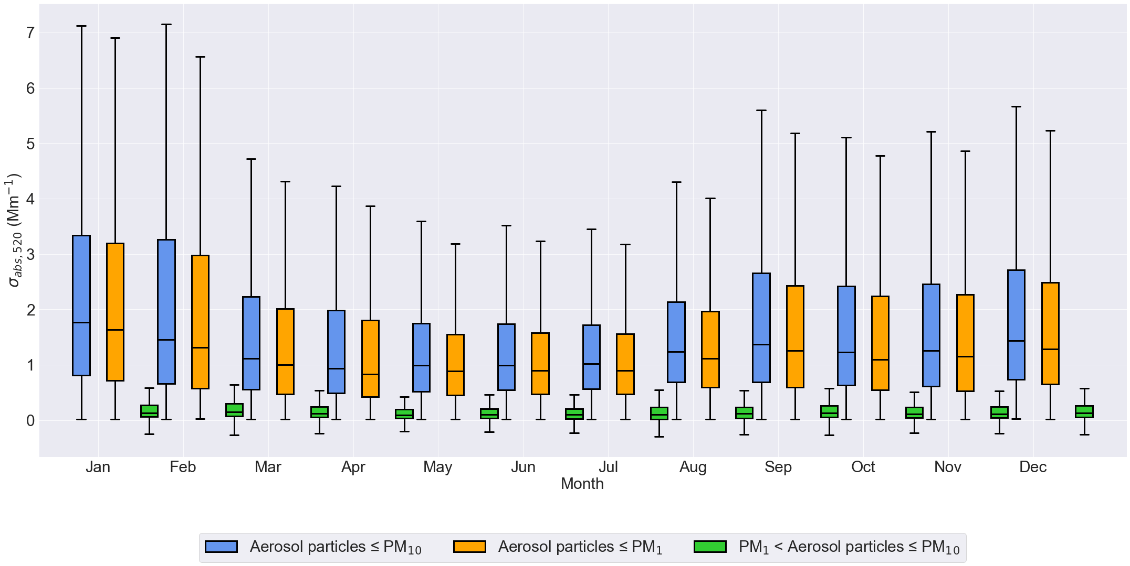
14

