Slide 1

Car Price Prediction Using Machine Learning
Using machine learning to predict used car prices.
Submitted by Ketan Mattoo 21105035
Sujal Aggarwal 21105036 Himanshu Bansal 21105050

Slide 2

Project Overview
Predicting car prices with Linear Regression and Lasso.
1
Dataset Source
2
Main Objective
Kaggle dataset of used cars.
Accurate price prediction using ML.
3
Evaluation Metrics
R-squared error to measure accuracy.

Slide 3
Dataset Overview
Dataset with 9 relevant columns about used cars.
Columns
Data Size
Year, Name, Price, Purchase Price, Mileage, Fuel Type, Seller Type, Transmission, Previous Owners
Over 300 data points for analysis.

Slide 4
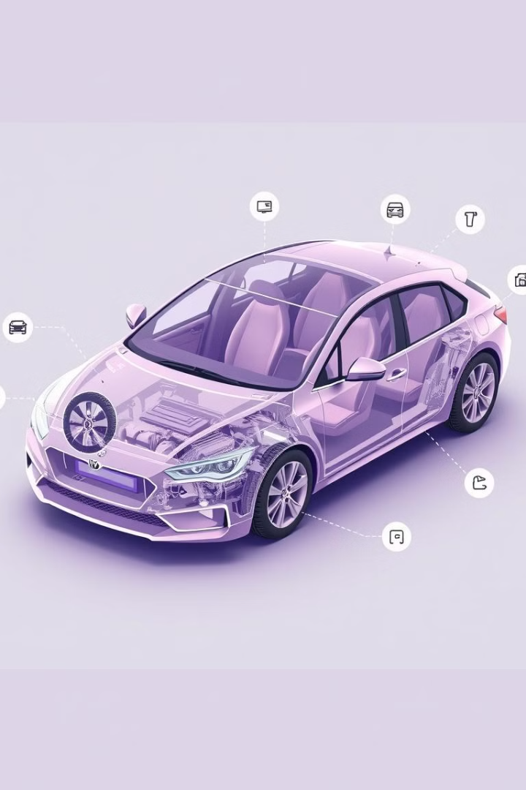
Data Columns Description
Each column provides crucial information for prediction.
Car Year
Year of manufacture, age of the car.
Car's Name
Specific car model and variant.
Present Price
Current market price of the car.
Purchasing Price
Original purchase price of the car.
Kilometers Driven
Total mileage driven by the car.
Fuel Type
Type of fuel used, e.g., petrol or diesel.
Seller Type
Individual or dealer selling the car.
Transmission Type
Manual or automatic transmission.
Previous Owners
Number of previous owners of the car.

Slide 5
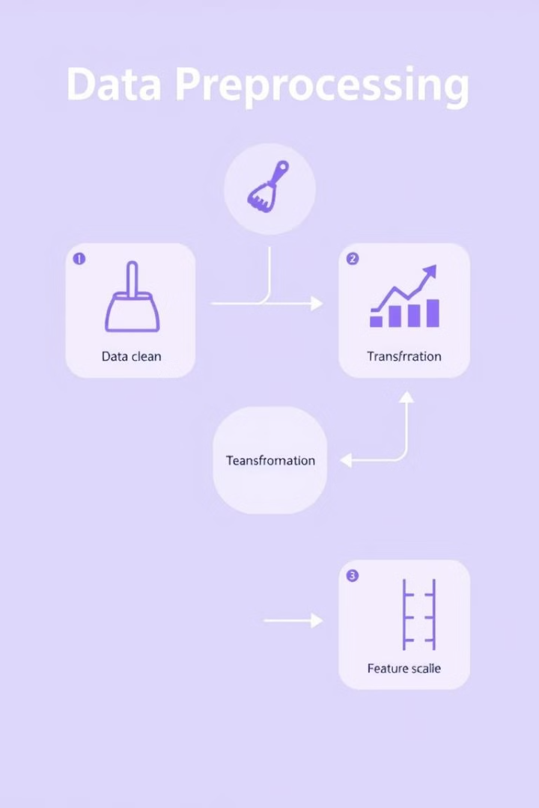
Data Preprocessing
Cleaning and preparing the dataset for modeling.
1
Missing Values
2
Categorical Variables
Imputed missing values using appropriate methods.
Converted to numerical data using encoding techniques.
3
Feature Scaling
Standardized features for better model performance.

Slide 6
Model Selection
Choosing the right models for car price prediction.
Linear Regression
Lasso Regression
Simple model, no feature selection.
Regularized model, performs feature selection.

Slide 7

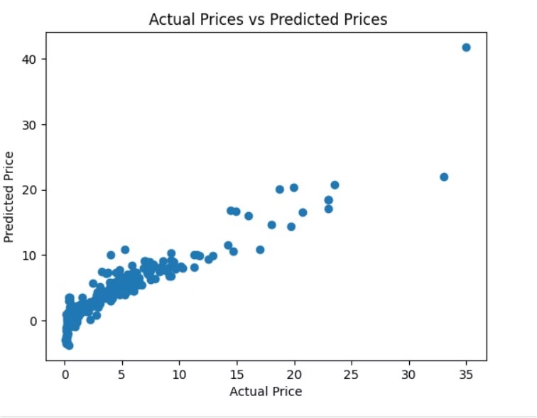
Linear Regression Model
Performance of Linear Regression on the dataset.
1
R-squared Error
Achieved 0.836 on the test data.

Slide 8

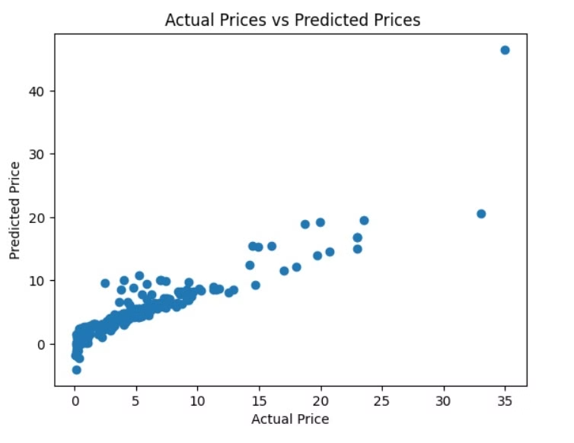
Lasso Regression Model
Performance of Lasso Regression on the dataset.
1
R-squared Error
Achieved 0.870 on the test data.

Slide 9

Thank You!
This concludes our presentation on car price prediction using machine learning.
We appreciate your time and interest in this project.

