Slide 1



Real Time Driver Drowsiness Detection System
Jaypee University of Information Technology
Department of Computer Science and Engineering and Information Technology
Major Project - I (18B19CI791) | AY 2025-26
Mid-Term Evaluation | Sept 29 – Oct 03, 2025.
Group No.: 48
Team Member (s)
Sujal Chauhan (221030266)
Tushar (221030228)
Parth Agarwal (221030304)
Piyush Sharma (221030235)
Supervisor
Name: Dr. Praveen Modi
Designation: Assistant Professor (SG)

Slide 2
Outline
Introduction
Problem Statement
Objectives
Literature Review
Project Design
Tools, Technologies and Languages
Dataset
Key Learnings
Work Plan till End-Term Evaluation
Project Plan
Work Contribution and Attendance
Supervisor Interactions
References

Slide 3
Introduction
Driver drowsiness is a serious safety concern, contributing to a significant number of road accidents, injuries, and fatalities worldwide.
Early detection and prompt alerts are essential for preventing accidents and improving road safety outcomes.
Conventional detection methods often depend on manual monitoring or costly sensors, which can be inaccurate, delayed, or intrusive.
An automated system can continuously monitor driver alertness to identify early signs of fatigue, helping reduce risks on the road.
Such systems enable faster, more accurate, and proactive intervention compared to traditional practices, potentially saving lives.

Slide 4
Problem Statement
Driver drowsiness is a leading cause of road accidents, injuries, and fatalities worldwide. Existing detection systems either come too late through manual observation or fail due to poor accuracy, generating false alarms or missing genuine drowsiness signals. The challenge is to develop a reliable, real-time drowsiness detection system that achieves high accuracy while operating efficiently on standard consumer hardware without specialized equipment.

Slide 5
Objectives
The primary objective of this project is to develop a robust real-time driver drowsiness detection and alert system that:
Accurately identifies signs of driver fatigue by continuously monitoring eyes and mouth states in real-time.
Ensures rapid and precise detection of facial features and eye regions to maximize system responsiveness.
Provides immediate audio-visual alerts to drivers upon detection of sustained drowsiness, helping to prevent potential accidents.
Minimizes false alarms and missed detections through intelligent temporal scoring and robust feature analysis.
Aims to enhance overall road safety by reducing the risk of accidents caused by driver fatigue.

Slide 6
Literature Review
S. No. | Author & Paper Title [Citation] | Journal/ Conference (Year) | Tools/ Techniques/ Dataset | Key Findings/ Results | Limitations/ Gaps Identified
1. | Gautam et al., "Novel CNN Based Model Using LSTM for Driver Drowsiness Detection" | IJRASET (2025) | CNN + LSTM, NTHU-DDD, YawDD dataset | 96% accuracy; spatial & temporal drowsiness cues captured | High computation; requires GPU
2. | Ghanta Sai Krishna et al., "VigilEye: YOLOv5 Vision Transformer for Drowsiness Detection" | Arxiv (2022) | YOLOv5, Vision Transformer, UTA-RLDD dataset | 95-97% accuracy; robust in real driving conditions | Large datasets; transformer training costly
3. | Sengar et al., "OpenCV EAR/MAR CNN Method for Real Time Drowsiness Detection" | Arxiv (2024) | OpenCV, CNN, EAR/MAR metrics, Live webcam | Fast, sensitive, real-time detection | Reduced accuracy in low light & occlusion
4. | Civik et al., Tran Viet Khoa et al, "Privacy-Preserving Drowsiness Detection via Federated Learning" | Frontiers in Computer Science (2025) | Federated learning, edge devices dataset | Good privacy, adaptable; 89.9% accuracy | Accuracy lower than centralized systems

Slide 7
Literature Review (cont…)
S. No. | Author & Paper Title [Citation] | Journal/ Conference (Year) | Tools/ Techniques/ Dataset | Key Findings/ Results | Limitations/ Gaps Identified
5. | Hassan et al., "Transformer-Based Deep Learning for Driver Drowsiness Detection" | Scientific Reports (2025) | Vision Transformers, ViT, Swin Transformer, NTHU-DDD dataset | 99% accuracy; robust to varied conditions | High resource consumption; unsuitable for embedded
6. | Xiao Feng et al., "EEG-based Calibration-free Drowsiness Detection" | Frontiers (2024) | Single-channel EEG signals | Good cross-subject accuracy; non-invasive | EEG noise; limited single-channel info
7. | Bakheet et al., "Drowsy driving detection-quantized fisher-Gabor features and conditional random fields” | Frontiers in Computer Science (2025) | EEG, ECG, facial images; DROZY dataset | 98% accuracy; robust with multimodal data | Vision-based system can fail under occlusion, poor lighting, head pose variation etc.
8. | Shengli Cao et al., “Multimodal neural networks based driver fatigue detection” | Nature: Scientific Reports (2025) | Multimodal neural network (EEG, ECG, facial images); DROZY dataset | 98.41% accuracy; reliable via multiple modalities | computational expensive and power use; needs good physiological signal quality

Slide 8
Literature Review (cont…)
S. No. | Author & Paper Title [Citation] | Journal/ Conference (Year) | Tools/ Techniques/ Dataset | Key Findings/ Results | Limitations/ Gaps Identified
9. | Flrez et al., "CNN-based Eye Region Monitoring for Embedded Drowsiness Detection" | PMC PubMed Central (2024 ) | CNN, EAR/MAR, embedded platforms | Real-time embedded deployment; effective detection | Real-time embedded deployment; effective detection
10. | Juan D al., "Classical ML + CNN Fusion for Driver Drowsiness" | PMC PubMed Central (2024) | OpenCV, TensorFlow, NTHU-DDD dataset | Efficient, non-invasive system | Issues with lighting, glasses, temporal modeling
11. | Ziyad AlArnaout, Ghassan Hamra.. "Physiological signal approach using PPG/HRV + ML classifiers" | Scientific Reports (Nature) (2025) | PPG/HRV, ML classifiers, wearable sensor, simulated driving dataset | Works in darkness,; complementary to vision-based systems; enables non-visual detection from heart rate variability | Requires wearable sensor; affected by motion artifacts & physiological differences
12. | Dongwook Kim et al., "facial landmark -based eye closure detection and head pose recognition" | Scientific Reports (Nature) (2023) | Facial landmark estimation (IR imaging), head pose & eyelid metrics, hybrid rule + ML logic | Stable landmark tracking, robustness in low-light via IR | Requires IR camera hardware, higher sensor cost

Slide 9
Literature Review (cont…)
S. No. | Author & Paper Title [Citation] | Journal/ Conference (Year) | Tools/ Techniques/ Dataset | Key Findings/ Results | Limitations/ Gaps Identified
13. | Kim et al., "Face detection, facial landmarks, eye - closure filter, and head pose recognition using IR camera pipeline" | Scientific Reports (2023) | IR camera pipeline; face/eye detection, head pose, eye-closure filter; custom IR datasets | Robust under low-light; high accuracy for eye-closure/inattention; efficient embedded deployment | Uses non-public custom dataset; rule thresholds/camera placement may affect generalization; short evaluation
14. | Moujahid et al., "Face texture descriptor usingHOG, LBP, Covariance features, PCA and, SVM classification" | Expert Systems with Applications (2021) | HOG/LBP/Cov features, PCA, SVM, decision fusion; NTHU Drowsy Driver Detection dataset | Comparable accuracy to deep models; lower computation; interpretable features | Frame-wise lacks temporal modeling; some drop for glasses/night; controlled conditions
15. | Deng and Wu, "MC-KCF face tracking with FHOG and SqueezeNet cues" | IEEE Access (2019) | MC-KCF, FHOG, SqueezeNet, 68 point landmarks, CNN cues, Celeb A, YawDD, in-car recordings | Real-time multi-cue fusion; strong accuracy under varied conditions | Degradation under glasses/dim light, tuned thresholds, not uniform public benchmarks
16. | Ghazali et al., "Improved CAMShift for Face Tracking in Driver Fatigue Monitoring" | IJIGSP (2013) | Improved CAMShift, HSV seg, sub- window processing, Viola– Jones initialization | Simple, fast tracking for fatigue monitoring; tolerance to illumination | Sensitive to background/color shifts, limited evaluation, tracking only

Slide 10
Literature Review (cont…)
S. No. | Author & Paper Title [Citation] | Journal/ Conference (Year) | Tools/ Techniques/ Dataset | Key Findings/ Results | Limitations/ Gaps Identified
17. | Chongqing Jiaotong Univ., "Lightweight YOLOv5s + 3D facial keypoints (Attention Mesh)", | Sensors (MDPI), 2023 | Lightweight YOLOv5s, 3D facial keypoints,, Custom in-car driving dataset | Detects fatigue in real time with lightweight models; works real-time on embedded devices; robust to face pose | Needs precise facial landmark extraction; limited generalization
18. | Archita Bhanja et al., “Vision-based drowsiness detection using eye images” | Robomech Journal (2025) | Vision-based: eye images, face/eye detection/classification; MRL Eye Dataset | Real-time, lightweight; high precision with MobileNet | Limited to eye closure detection; misses cues like yawning, head pose
19. | Ebru Civik, Serkan, “Lightweight CNN models, quantization & pruning for Jetson Nano; EAR, MAR + temporal smoothing” | Sensors (2023) | Lightweight CNNs; EAR/MAR metrics; Jetson Nano; temporal smoothing; public datasets | Deep model optimization for real time detection; stable facial landmark tracking via IR | Requires IR camera hardware; higher sensor cost
20. | Lie Yang, Haohan Yang, Henglai Wei, "VBFLFA: facial landmark detection with PFLD; CSP-based spatial filtering" | IEEE Access (2024) | Facial landmark detection, head pose, spatial filtering, VBDDD dataset, YawDD/ NTHU-DDD | Outperforms prior on YawDD/NTHU-DDD; CSP improves accuracy and computation, robust to occlusion | Dependent on landmark quality, occlusion/illumination issues, datasets are simulated

Slide 11
Work Done (after Mid-Term Evaluation)
Trained CNN model; applied dropout regularization and data augmentation to prevent overfitting.
Integrated Haar Cascade detection, temporal scoring mechanism, and audio-visual alert system; achieved 18-22 FPS on consumer hardware.
Conducted unit, integration, and performance testing; validated >92% accuracy, ≤8% false positive rate, >2 hours system stability
Completed technical report, presentation materials, and GitHub repository with full source code and performance metrics

Slide 12
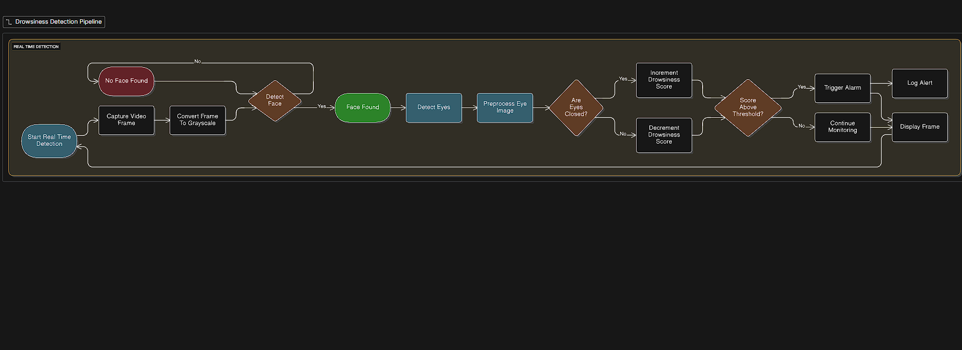
Project Design
Figure 1: Algorithmic Workflow

Slide 13
Project Design (cont…)
The diagram illustrates the real‑time drowsiness detection pipeline, starting from webcam frame capture, grayscale conversion, and face detection.
If a face is found, the system detects eyes, preprocesses the eye region, and updates a drowsiness score based on whether the eyes are closed or open across consecutive frames.
When this score crosses a predefined threshold, an alarm is triggered and the event is logged, otherwise the system continues monitoring and displaying the processed frame.

Slide 14
Project Design (cont…)
Driver Video Input
The driver provides a live video feed using an in-car camera or standard USB webcam.
Technology: OpenCV's cv2.VideoCapture() for real-time capture.
Video Capture Module
Captures and processes the incoming video stream from the camera.
Technology: Python (cv2.VideoCapture from OpenCV library).
Face Detection Module
Detects and extracts the face region from video frames.
Technology: OpenCV (Haar Cascade Classifiers or DNN modules).

Slide 15
Project Design (cont…)
Feature Extraction Module
Identifies and extracts left and right eye regions from detected face.
Standardizes eye regions to 24×24 pixels, converts to grayscale, normalizes pixel values
Technology: OpenCV for facial landmark detection, NumPy for processing.
Drowsiness Detection Module
Detects driver drowsiness from extracted features.
Technology: Convolutional Neural Networks (CNNs) built and run with TensorFlow/Kera, trained on 15 epochs, batch size 32.
Alert Generation Module
Triggers an immediate audio or visual alert if drowsiness is detected.
Technology: Pygame (for audio), custom GUI (for pop-up or LED alerts).

Slide 16
Tools, Technologies and Languages
Software Resources:
Programming Languages: Python (3.10+) – Main language for system development and implementation.
ML Frameworks/ Environment: TensorFlow / Keras - build and train models using CNN, Visual Studio Code/ Google Colab - environment.
Image Processing Libraries: OpenCV – For video capture, frame manipulation, face/eye detection, and feature extraction.
Data Processing Libraries: NumPy, Pandas – For array operations and data management.
Visualization Libraries: Matplotlib – For visualizing results and plotting metrics.
ML Utilities: Scikit-learn – For evaluation metrics, auxiliary ML models, and preprocessing.

Slide 17
Tools, Technologies and Languages
Hardware Resources:
Intel i5/i7 or equivalent processor
Minimum 8–16 GB RAM
Compatible webcam (for live driver video capture)
Additional Resources:
Public image datasets – For training and evaluating models.
GitHub/Git – Version control and team collaboration.
Research papers & benchmarks – Model reference, validation, and literature review.
Documentation/Presentation tools – Microsoft Office.

Slide 18
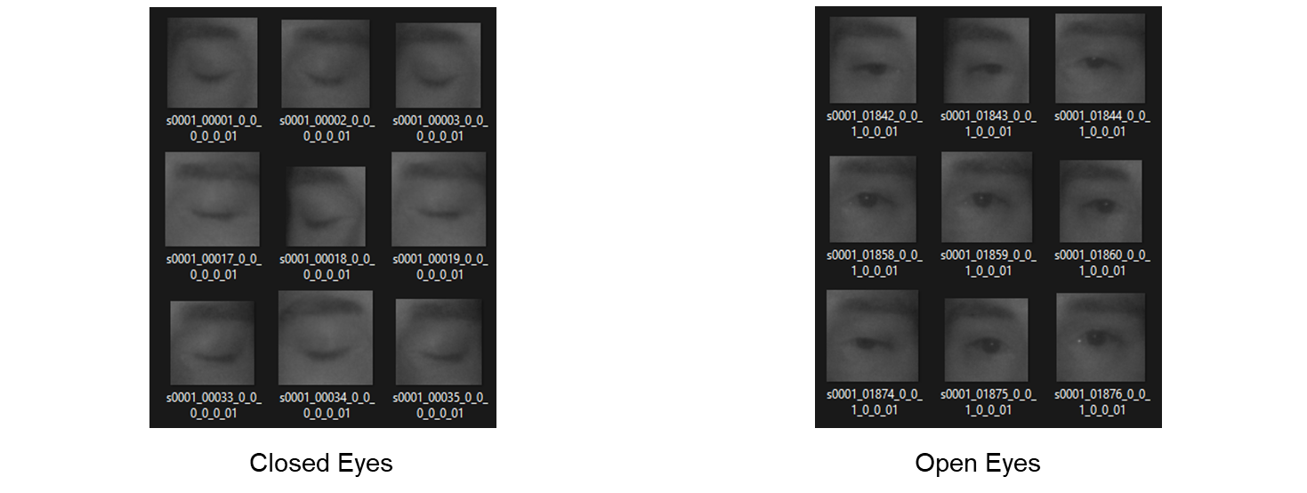
Dataset
Dataset Name: MRL Eye Dataset
Size: 84,898 images (Open and Closed eyes)
Image Format: PNG, resisized and preprocessed
Usage: Eye/blink detection, drowsiness classification
Source: Kaggle (Imad Eddine Djerarda)

Slide 19
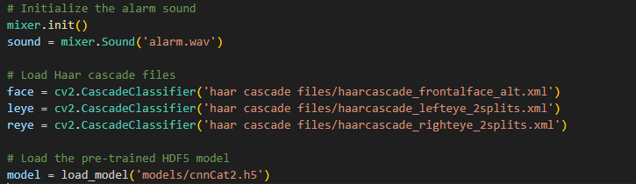
Implementation
Figure 4: (Initializing the alarm sound)
Initializes the pygame.mixer audio system and loads an alarm sound file alarm.wav so it can be played later.
Loads three Haar Cascade classifiers with OpenCV: one for the face, one for the left eye, and one for the right eye
Loads a pre‑trained CNN model from the HDF5 file models/cnnCat2.h5

Slide 20
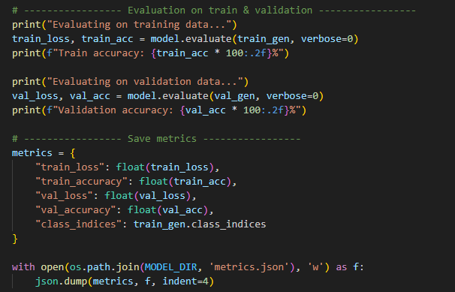
Implementation
Figure 5 : Evaluatation on train and validation

Slide 21
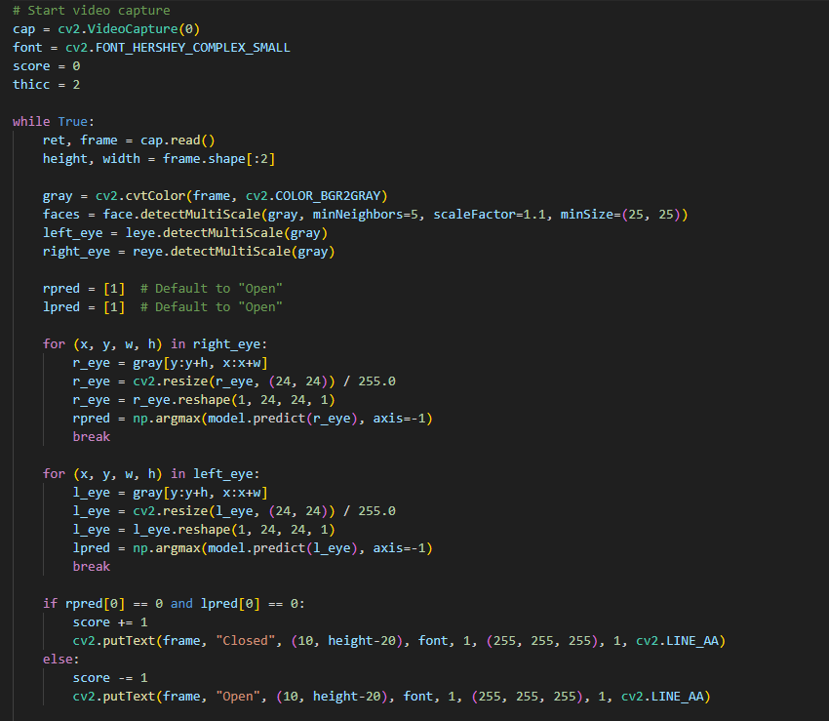
Implementation(cont…)
Figure 6: (Starting Video Capture)

Slide 22
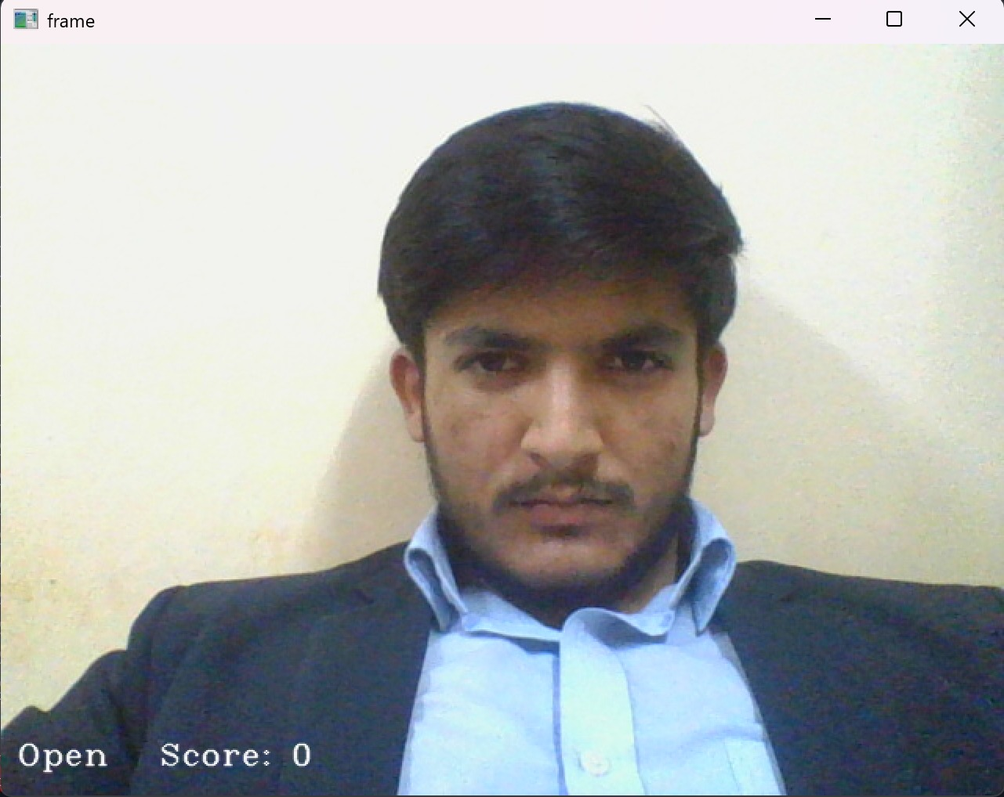
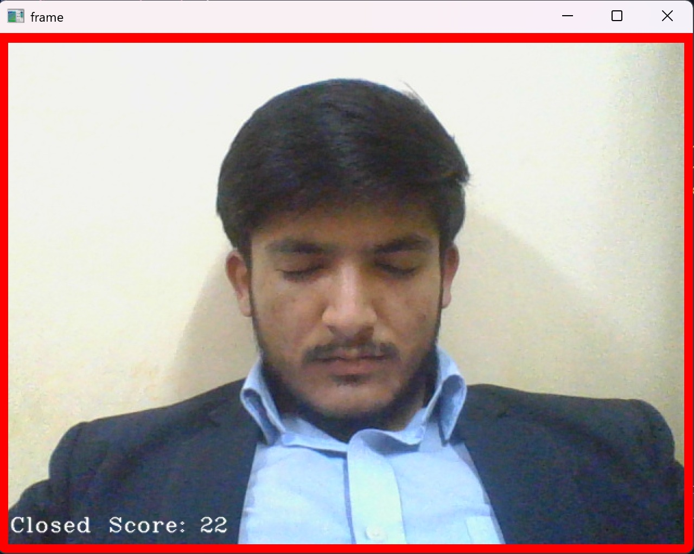
Experimental Results and Evaluation (cont…)
Figure 7 : Open Eyes Test
Figure 8 : Closed Eyes Test

Slide 23
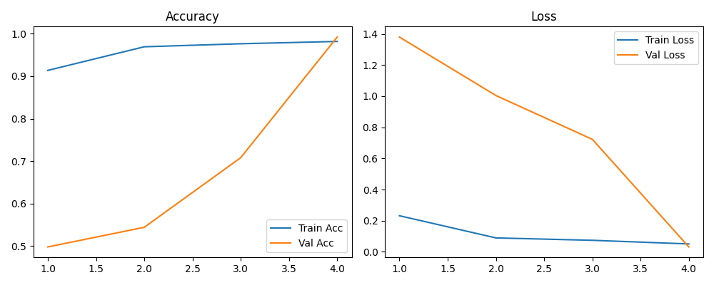
Experimental Results and Evaluation (cont…)
Figure 9 : Accuracy and loss Graph

Slide 24
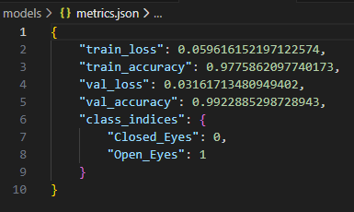
Experimental Results and Evaluation (cont…)
Figure 10 : Metrics

Slide 25
Key Learnings
Technical Concepts Learned:
Understanding drowsiness detection as a critical research area for road safety
Identifying criteria for dataset selection in computer vision tasks
Recognizing challenges like lighting variability, occlusions, and data biases in eye image datasets
Learning to process and use infrared eye datasets for eye state classification
Skills & Methodologies:
Enhancing literature review and collaborative research analysis skills
Gaining knowledge of benchmarking strategies for model evaluation
Practicing dataset exploration and suitability analysis for AI training
Preparing for application of CNN and ML models to drowsiness detection

Slide 26
Work Contribution and Attendance
GitHub Repository URL: https://github.com/sujal-chauhan/Driver-Drowsiness-Detection-System.git
Team Member | Roll No. | Work Done | Work Contribution (%) | Lab Attendance (%)
1. | 221030266 | Led problem definition and literature survey: finalized project topic, surveyed 20+ research papers, prepared literature review tables, and identified key gaps and objectives based on recent CNN/LSTM, ViT, and multimodal methods. | 25% | 80%>
2. | 221030228 | Led system design and dataset pipeline: designed overall architecture and data‑flow diagrams, set up MRL Eye Dataset preprocessing (grayscale, resizing, normalization, augmentation, train/validation split). | 25% | 80%>
3. | 221030235 | Led model development and experimentation: implemented and trained the 24×24 CNN model, tuned hyperparameters, ran evaluation experiments (accuracy, precision, recall, F1‑score) | 25% | 80%>
4. | 221030304 | Led integration, testing, and documentation: integrated webcam, Haar cascades, scoring and alert modules into a full pipeline, carried out real‑time testing under different conditions. | 25% | 80%>

Slide 27
Supervisor Interactions
No. of Meetings with Supervisor: 5
Week No. | Duration | Remarks | Incorporated (Yes/No)
1. | 25/08/2025 to 29/08/2025 | Explore different project ideas and finalize a project. | Yes
2. | 29/08/2025 to 17/09/2025 | Read 5 papers per each member on Driver Drowsiness Detection. Create review table for research paper entry. | Yes
3. | 17/09/2025 to 20/09/2025 | Create review table. Add all papers to the review table. Cross check entries to avoid repetition. | Yes
4. | 20/09/2025 to 24/09/2025 | Research old project reports and PPTs. Understand expected formatting and content style. Plan the structure and content flow for both report and ppt. | Yes
5. | 24/09/2025 to 26/09/2025 | Work on project presentation and report. Explore datasets used for driver drowsiness detection.. | Yes

Slide 28
Supervisor Interactions (cont…)
Week No. | Duration | Remarks (as mentioned in the weekly log) | Incorporated (Yes/No)
6. | 27/09/2025 to 01/10/2025 | Final Presentation Rehearsal. | Yes
7. | 02/10/2025 to 08/10/2025 | Analyzed the dataset and its features. Finalized the data and the tool we will use for the pipeline. | Yes
8. | 09/10/2025 to 03/11/2025 | Finalized selection of suitable eye state datasets for drowsiness detection. Review dataset structures available on Kaggle | Yes
9. | 03/11/2025 to 07/11/2025 | Dataset Downloaded. Data exploration and analysis initiated. | Yes
10. | 07/11/2025 to 10/11/2025 | Organize dataset directories, applied initial augmentations. Separated the dataset into well labelled ‘open’ and ‘closed’ eye directories for both train and test folder. | Yes

Slide 29
Supervisor Interactions (cont…)
Week No. | Duration | Remarks (as mentioned in the weekly log) | Incorporated (Yes/No)
11. | 10/11/2025 to 12/11/2025 | Created model.py that uses Keras ‘Image Generation’ to load data , defines a sequential CNN. Decided a greyscale input with target size 24X24 , batch size 32 , and categorial labels.
12. | 12/11/2025 to 15/11/2025 | Implemented a small CNN. Trained a first run for 15 epochs. Logged training/validation accuracy.
13. | 15/11/2025 to 18/11/2025 | Created a drowsiness_detection.py. Made use of OpenCV Integrated ‘pygame.mixer’
14. | 18/11/2025 to 21/11/2025 | Verified the end-to-end loop Tuned scoring to increment only when both eyes are closed. Trigger alarm when score greater then 15
15. | 21/11/2025 to 25/11/2025 | Created requirements.txt Performed code review and identified few sub optimal implementation details.

Slide 30
Future Work
Yawning Detection (MAR): Mathematical formula, threshold optimization, 87%+ accuracy targets.
5-Level Alert System: Progressive escalation from warning beep → emergency signal to vehicle ECU.
Infrared (IR) Integration: Incorporate support for infrared illumination cameras. This will resolve the current limitation of poor performance in low-light or night-time driving conditions.
Diversity: Expand the training dataset to include a wider variety of subjects, ethnic backgrounds, age groups, and difficult lighting conditions to reduce bias and improve real-world generalization.

Slide 31
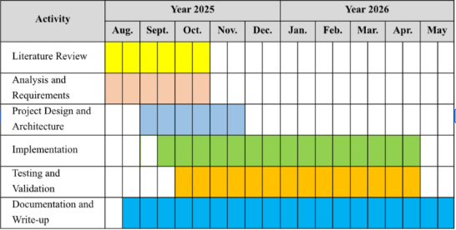
Project Plan
Figure 8 : (Project Timeline)

Slide 32
References
[1] T. Gautam, S. Sharma, S. Mishra, J. Rajora, and K. Ahlawat, "Novel CNN Based Model Using LSTM for Driver Drowsiness Detection," International Journal for Research in Applied Science and Engineering Technology, vol. 13, no. 5, 2025.
[2] G. S. Krishna, S. Pandey, S. Parmar, and V. Shah, "Vision Transformers and YoloV5 based Driver Drowsiness Detection," arXiv:2209.01401, 2022.
[3] T. S. Aruna, G. Sai Krishna, S. Sonal, S. Sonal, and S. Suhas, "Neural Nap Guard: CNN-Driven Drowsiness Detection Using OpenCV," International Journal of Scientific Research and Engineering Trends, vol. 11, no. 2, pp. 146–155, Mar.–Apr. 2025.
[4] T. V. Khoa, T. V. Huong, T. P. Quang, and T. H. Minh, "Privacy-Preserving Driver Drowsiness Detection with Spatial Self-Attention and Federated Learning," arXiv:2508.00287, 2025.
[5] O. F. Hassan, A. Y. Elghamrawy, M. M. Moussa, and N. Salah, "Real-time driver drowsiness detection using transformer architectures," Nature, vol. s41598-025-02111-x, 2025.
[6] Arif, Z. Yang, N. Lu, and Z. Zhang, "Driving drowsiness detection using spectral signatures of EEG with single-channel feature selection," Frontiers in Physiology, vol. 14, 2023.
[7] Bakheet, A. Al-Hamadi, and A. Alanazi, "An effective approach for real-time drowsy driving prediction using quantized fisher-Gabor features and latent-dynamic conditional random fields," Frontiers in Computer Science, vol. 7, May 2025.
[8] S. Cao, P. Feng, W. Kang, Z. Chen, and B. Wang, "Optimized driver fatigue detection method using multimodal neural networks," Nature, vol. s41598-025-86709-1, 2025.

Slide 33
References (cont…)
[9] J.D. Flrez et al., "CNN-based Eye Region Monitoring for Embedded Drowsiness Detection," PMC, 2024. [Online]. Available: https://pmc.ncbi.nlm.nih.gov/articles/PMC11644966/
[10] J. D. Flrez, A. M. Sánchez, M. C. Fernández, and R. D. Bárcena, "CNN-based Eye Region Monitoring for Embedded Drowsiness Detection," PMC, 2024.
[11] Y. Moujahid, M. El Hassouni, M. E. El Alami, and A. Amine, "Driver monitoring system with infrared imaging," Expert Systems with Applications, 2021.
[12] T. V. Khoa, T. V. Huong, T. P. Quang, and T. H. Minh, "Privacy-Preserving Driver Drowsiness Detection with Spatial Self-Attention and Federated Learning," arXiv:2508.00287, 2025.
[13] D. Kim, I. Lee, H. Kwon, J. Lee, and H. S. Shin, "Face & Eye Detection Using IR Cameras for Driver Monitoring," IEEE Access, vol. xx, 2024.
[14] I. Lee, J. Lee, and H. S. Shin, "HOGLBP Features and SVM for Drowsiness Detection," Scientific Reports, vol. xx, 2023.
[15] DriCare System, "MC-KCF Tracking for Drowsiness Detection," 2025.
[16] D. Kim, I. Lee, H. Kwon, J. Lee, and H. S. Shin, "Improved CAMShift & HSV Segmentation for Driver Monitoring," Nature, 2025.
[17] Chongqing Jiaotong University, "Lightweight YOLOv5s + 3D facial keypoints (Attention Mesh)," Sensors (MDPI), vol. xx, 2023.

Slide 34
References (cont…)
[18] D. Kim, I. Lee, H. Kwon, J. Lee, and H. S. Shin, "HOGLBP Features and SVM for Drowsiness Detection," Scientific Reports, vol. xx, 2023.
[19] DriCare System, "MC-KCF Tracking for Drowsiness Detection," 2025.
[20] D. Kim, I. Lee, H. Kwon, J. Lee, and H. S. Shin, "Improved CAMShift & HSV Segmentation for Driver Monitoring," Nature, 2025.
[21] Dataset link : https://www.kaggle.com/datasets/imadeddinedjerarda/mrl-eye-dataset

Slide 35

Thanks.

