Slide 1
HUFFMAN
SUJAL LUHAR

Slide 2
Struct of NODE:
data
freq
*left
*Right

Slide 3
Struct of HEAP
size
cap
**
nodes
*
After inserting all the filled nodes, we will heapify.

Slide 4
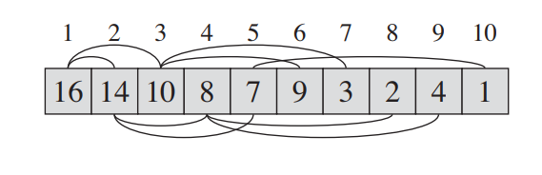
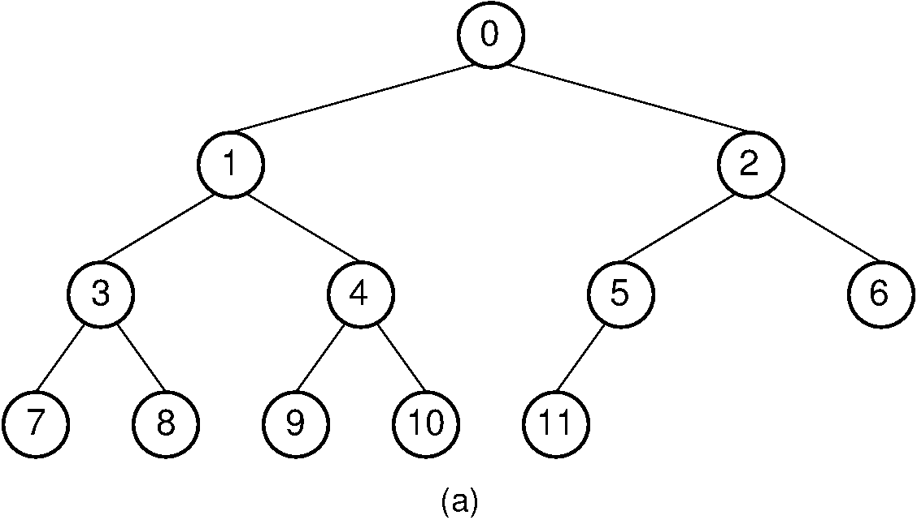
Heapify:
In our code(this is max heap, we have min heap)

Slide 5
Extract Root:
Here we will exract 2 minimum frequencies and add up them in new node.
freq->l + freq->r
Sp.char
*left = *l
*Right=*r
HeapAtOwnPlace():
Then we will put this in array of heap repeatatively.

Slide 6


