Slide 1
Front End Engineering-I Project
GROUP NO / TEAM NO: G16/T18 SUHANA KAURA 2210992414 SUJAL 2210992415 SUKHPREET SINGH 2210992416 SUKRITI 2210992417 FACULTY COORDINATOR :- DR. MANDEEP KAUR
:
Chitkara University Institute of Engineering and Technology,
Chitkara University, Punjab

Slide 2
Table of Contents
Sr.no | Section | Page no
1) | Introduction | 3
2) | Problem Statement | 4
3) | Technical Details | 5
4) | Key Features | 6
5) | Project Highlights | 7-8
6) | Conclusion | 9
7) | Reference | 10

Slide 3
Introduction
PURPOSE OF WORD COUNTER:-
Word counter counts the no. of words in the word document while you type .It also count pages, paragraphs, lines, characters .
It can be used in:
1)Writing
2)Editing
GOAL OF WORD COUNTER:-
It basically helps to improve the word choice and writing style and also helps to detect grammar mistakes.

Slide 4
Problem Statement
The problem that the word counter aims to solve is the need for an accurate and efficient way to count the number of words in a given piece of text. This need arises in various contexts, such as writing, editing, publishing, and academic research .
There has been some research on the impact of word count on the readability and effectiveness of written content.
Overall, the word counter website aims to provide a simple and reliable tool for accurately counting the number of words in a given piece of text, helping users to meet their specific word count requirements and achieve their writing, editing, and publishing goals.

Slide 5
Technical Details
HTML AND CSS:
HTML is used to create the structure of a webpage.
CSS is used to style and format the web page.
BOOTSTRAP: It helps to build a fully responsive website.
FONT AWESOME:- This is used because flexibility of styling is available.
GOOGLE FONTS:- They increase the readability , design and accessibility of the web page.
ANIMATIONS: Animations have been made to use in the website in order to beautify its content.
MEDIA QUERY: Media query has been used for making our website responsive.
IDE : vs code editor has been used for writing our code.

Slide 6
Key Features
Accurate word counting
User-friendly interface
Compatibility with different file formats
Speed
Short and precise captions for social media.
By providing these key features, a word counter website can effectively solve the word counter problem and provide a useful tool for writers, editors, publishers.

Slide 7
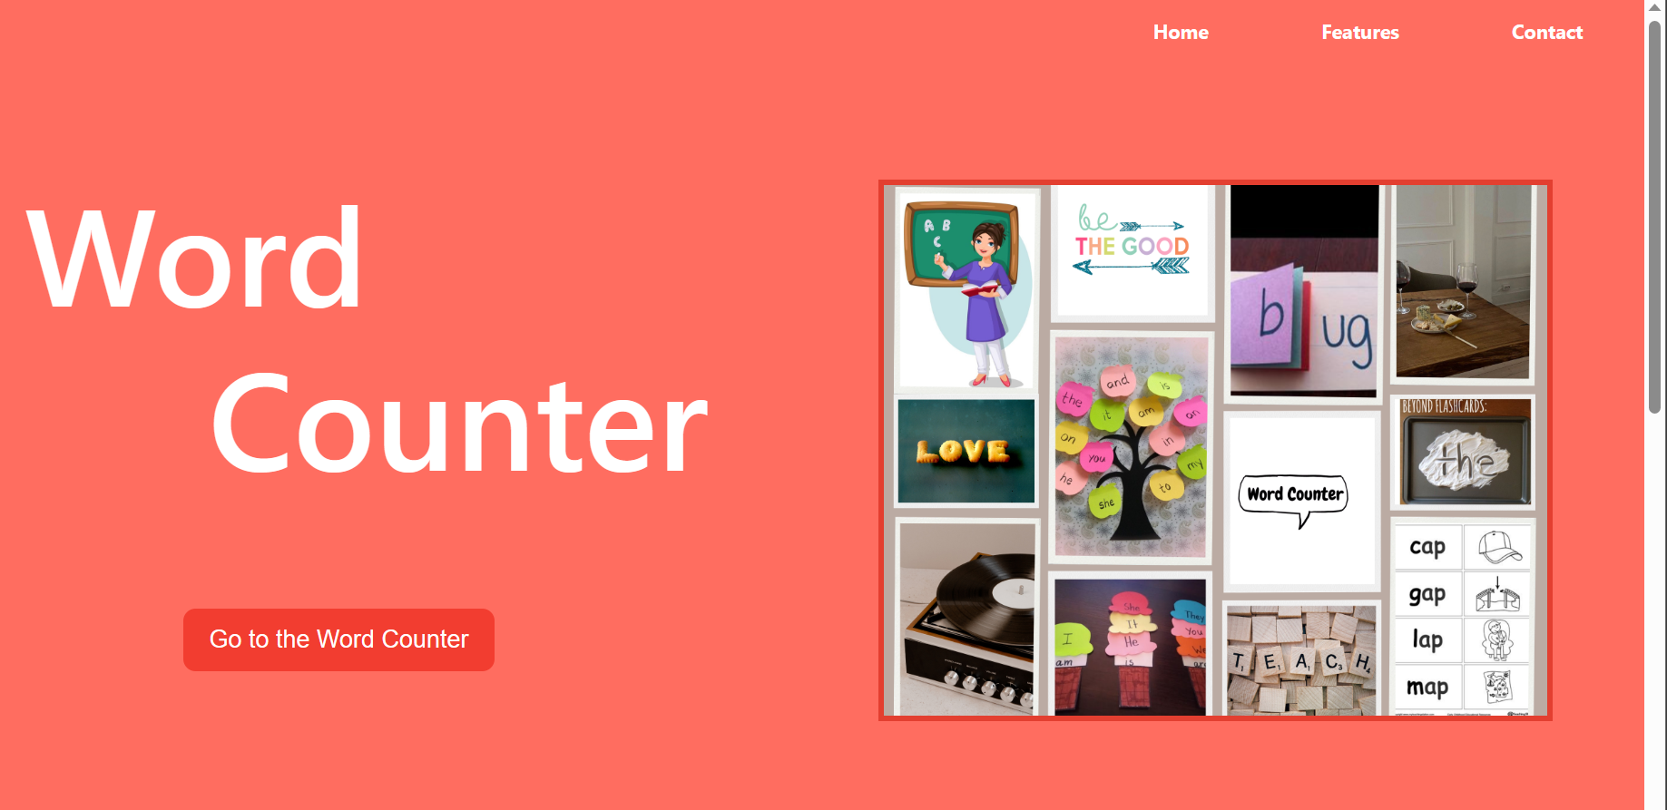
Project Highlights
HOME PAGE:

Slide 8
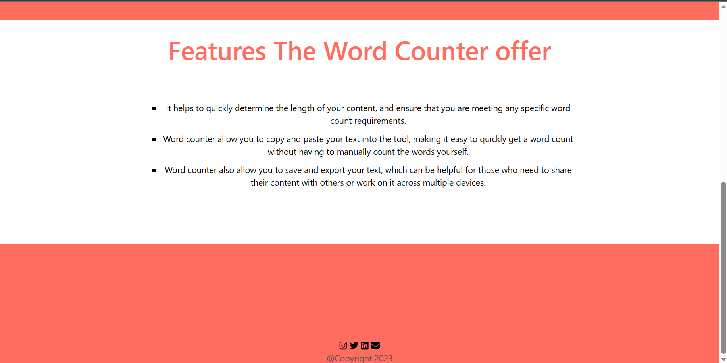
Project Highlights

Slide 9
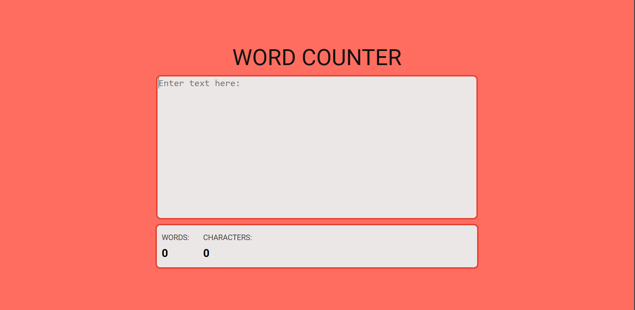
Project Highlights
WORD COUNTER :

Slide 10
Conclusion
Word counter is very useful website as it helps the user to determine the length of the content and ensures the word limit.
It counts the word limit and saves the time of user.
It also allows to save and export the text which can be very useful for those who want to share their contents with others .

Slide 11
FUTURE SCOPE
1. Spell Check:
It’s a wonderful tool for correcting spelling mistakes or grammatical errors.
2. Accessible by various social media networking sites.
There is a word limit set up for some sites like twitter, Instagram, facebook,etc.
This website will decrement the word count automatically for such websites as soon we start writing the article . This feature will be added with the use of javascript.

Slide 12
References/Links used
https://www.w3schools.com/
https://getbootstrap.com/
https://fontawesome.com/
https://fonts.google.com/

Slide 13


