Slide 1
EXPLORING NEIGHBORHOODS OF TORONTO
To open an Indian Restaurant

Slide 2
Problem Statement
Prospects of opening an Indian Restaurant in Toronto.
Toronto, the capital of the province of Ontario, is the most populous Canadian city.
One of the most immigrant-friendly cities in North America with more than half of the entire Indian Canadian population residing in Toronto.
It is one of the best places to start an Indian restaurant.

Slide 3
Target Audience
Business people who wants to open an Indian restaurant in Toronto.
Indian crowd who wants to find neighborhoods with lots of options for Indian Restaurant.
Freelancer who wants to have their own restaurant as a side business.

Slide 4
Data Sources
“List of Postal code of Canada: M” (https://en.wikipedia.org/wiki/List_of_postal_codes_of_Canada:_M) wiki page to get all the information about the neighborhoods present in Toronto.
“https://cocl.us/Geospatial_data” csv file to get all the geographical coordinates of the neighborhoods.
“Demographics of Toronto” (https://en.m.wikipedia.org/wiki/Demographics_of_Toronto#Ethnic_diversity) to get information about distribution of population by their ethnicity.
Foursquare’s explore API to fetch details about venues present in Toronto.

Slide 5
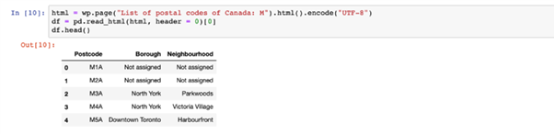
Scraping Toronto Neighborhoods

Slide 6
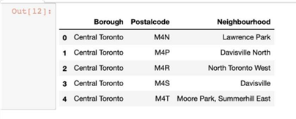
After some cleaning like removing not assigned values from the dataframe, we’ll get the proper dataframe.

Slide 7
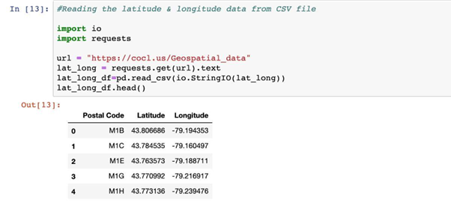
Geographical coordinates of Toronto

Slide 8
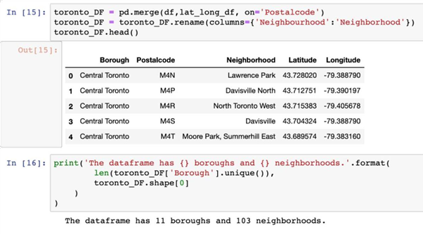
Merging both the data-frame into one by merging on the postal code.

Slide 9
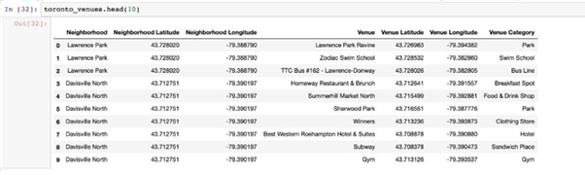
Get location Data using Foursquare api
The API returns a JSON file and we need to turn that into a data-frame.

Slide 10
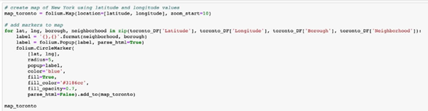
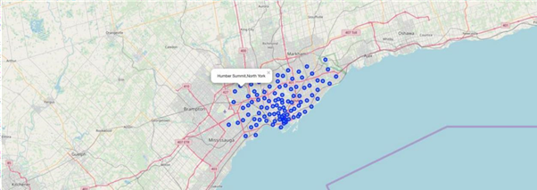
Toronto map with its neighborhoods

Slide 11
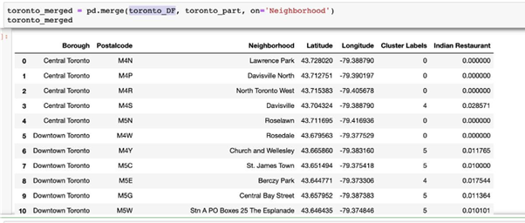
Relationship between neighborhood and Indian Restaurant
After some data analysis

Slide 12
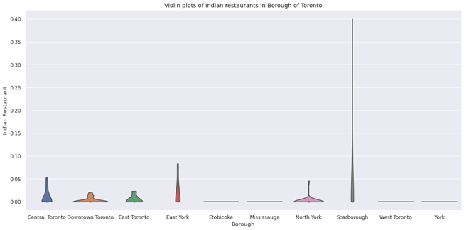

Slide 13
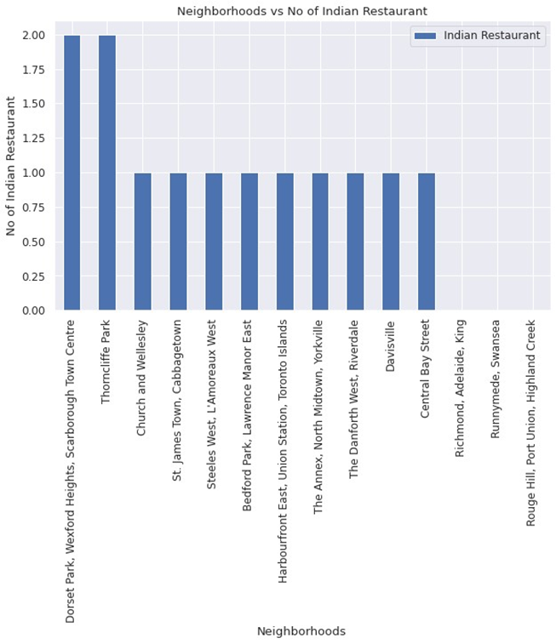
visualize the neighbourhood with Indian Restaurants:

Slide 14

Scrap the distribution of population from Wikipedia
Scraped the Wikipedia page, “Demographics of Toronto” in order to obtain the data about the Toronto & the Neighborhoods in it. Compared to all the neighborhoods in Toronto below given neighborhoods only had considerable amount of Indian crowd

Slide 15
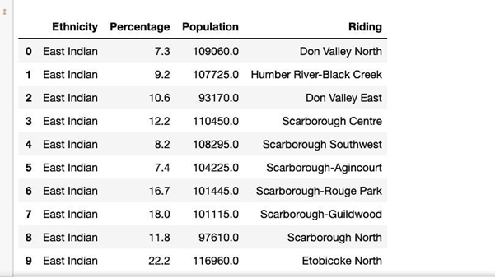
Relationship between neighbourhood and Indian population

Slide 16
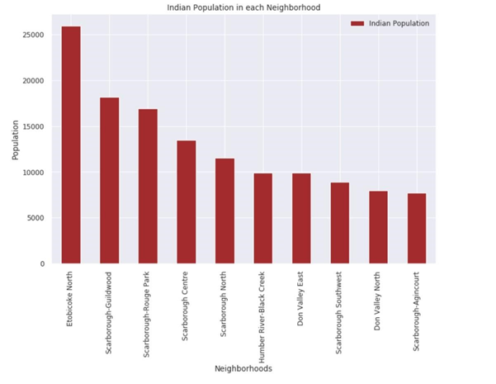
visualize the population spread in neighborhoods:

Slide 17
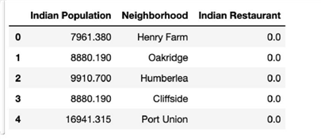
After performing the data cleaning & data analysis we couldn’t identify a big relationship established between densely populated Indian neighborhoods & number of Indian restaurants

Slide 18
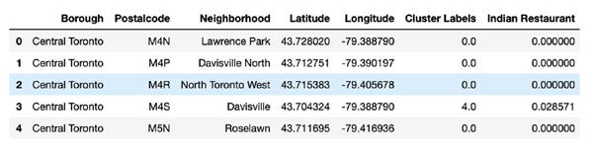
Predictive Modelling
Clustering the Toronto Neighborhood Using K-Means with K = 6

Slide 19
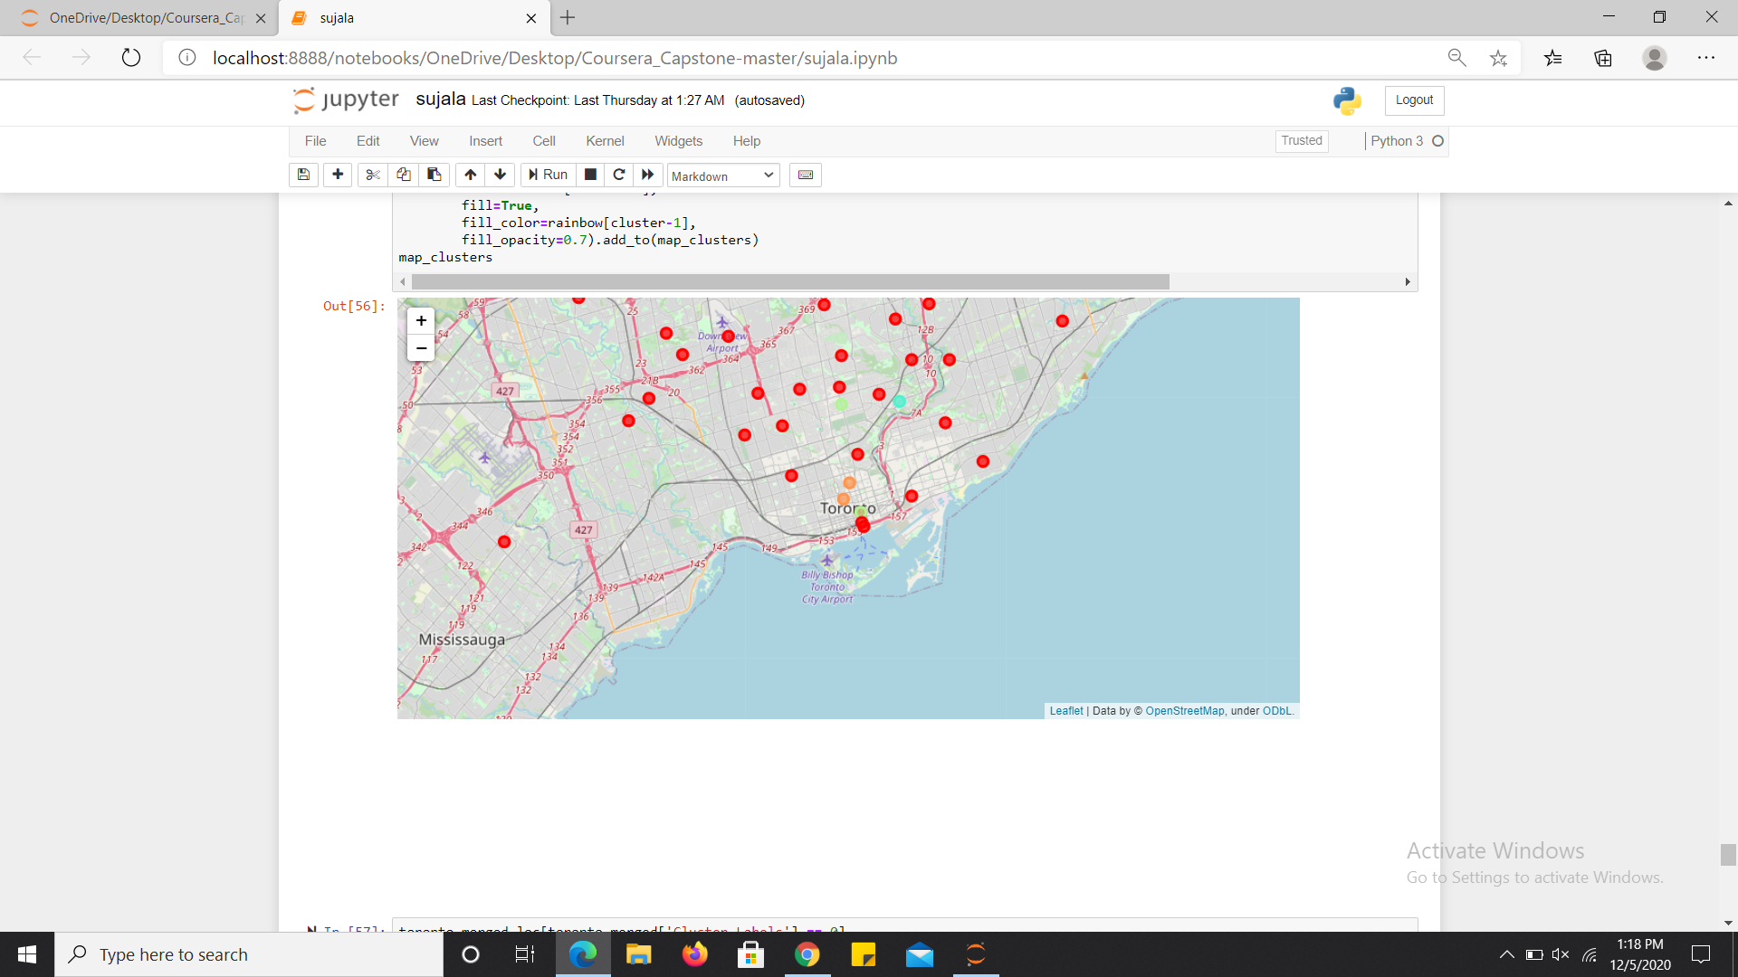

Slide 20
Cluster 0 contains all the neighbourhoods which has least number of Indian restaurants. It is shown in red colour in the map
Cluster 5 contains the neighborhoods which is sparsely populated with Indian restaurants. It is shown in orange color in the map.
Cluster 3 contains all the neighborhoods which is medium populated with Indian restaurants. It is shown in blue color in the map.
Cluster 4 contains all the neighborhoods which is densely populated with Indian restaurants. It is shown in green color in the map

Slide 21
Results
We identified that only Central Toronto, Downtown Toronto, East Toronto, East York, North York & Scarborough boroughs have high amount of Indian restaurants with the help of Violin plots between Number of Indian restaurants in Borough of Toronto.
In all the ridings, Scarborough-Guildwood, Scarborough-Rouge Park, Scarborough Centre, Scarborough North, Humber River-Black Creek, Don Valley East, Scarborough Southwest, Don Valley North & Scarborough-Agincourt are the densely populated with Indian crowd ridings

Slide 22
Results
With the help of clusters examining & violin plots looks like Downtown Toronto,Central Toronto, East York are already densely populated with Indian restaurants. So it is better idea to leave those boroughs out and consider only Scarborough, East Toronto & North York for the new restaurant’s location.
After careful consideration it is a good idea to open a new Indian restaurant in Scarborough borough since it has high number of Indian population which gives a higher number of customers possibility and lower competition since very less Indian restaurants in the neighbourhoods.

