Slide 1
Sneakers Point
LUZZA DANGOL
BIPIN SHRESTHA
ANISH MAHARJAN
Rojal manandhar

Slide 2
Introduction
Online shopping has become one of the most interesting parts of all internet activities. Shoes are items that people purchase online these days. The motivations behind this behavior may be the online sales offers or variety of items and having a vast variety of choices.
This program is all about the shoe store. The store is unisex where the shoes are available for all the male and female customers. It provides various types of shoes with all the sizes on behalf of the customer. There are many options for customer to select of their choices. The demand for shoe items is growing day by day rapidly. Customer satisfaction is our main moto.

Slide 3
Objectives
To manages all the information about shopping, products, customers.
To create a simple billing system.
To make shopping more efficient.
To make it simple to choose.
To provide a variety of choices.
A wide range of options is available.

Slide 4
Purposes
Customers can purchase items from the comfort of their own homes or workplace.
Shopping is made easier and convenient for the customer.(delivery)
It is also easy to cancel the transactions.(defect)
It saves time and efforts.
Good discounts / lower prices. (offer heavy discount)
It helps to get detailed information about the product.(size of the product and price of the product)
Online payment is also available. (bank qr ,esewa ,khalti ,ime pay)

Slide 5
Video demonstration of Sneakers point

Slide 6
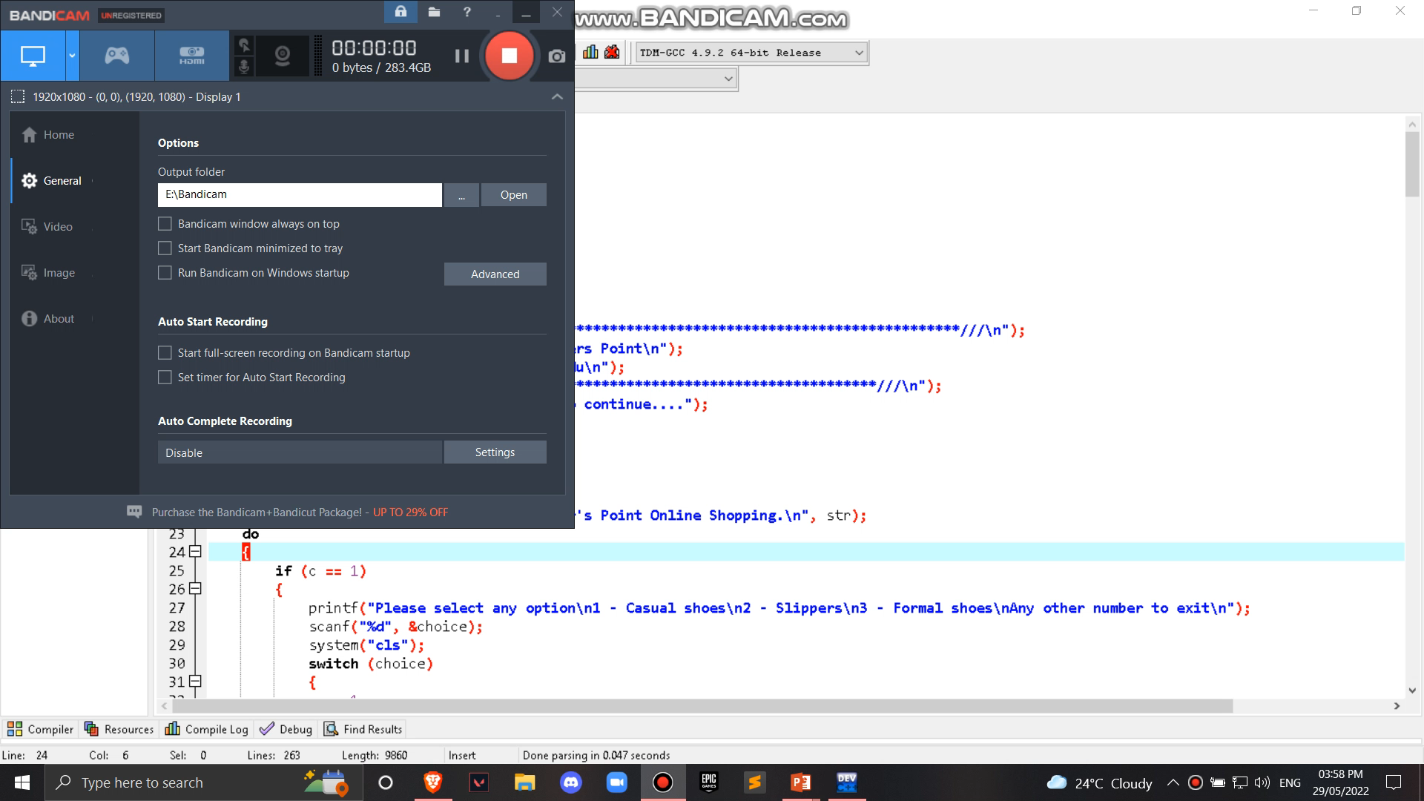

Slide 7
Conclusion
In conclusion, the project was a great opportunity for us to learn about the process of coding in commercial and business field.

Slide 8
Thank you

