Slide 1


S3 Clothing Collection
By: Sikha Subba
Sujal Amatya
Suhani Malla

Slide 2

INTRODUCTION
This program is about fashion wear for all gender types which helps for easy billing system. It provides various options for different preferences and also for different leading brands . It provides various sizes to the customers and also provides various options for clothes like cotton, silk, satin fabric, spandex fabric etc. with various color options. The demand for custom closets is growing day by day to keep clothes and other everyday items organized.

Slide 3
OBJECTIVES
To provide easy billing system .
To provide time efficient shopping.
To provide easy selection.
To Provide various options.
Flexible selection.

Slide 4
FUNCTION
For effective budget management .
For easy selection method.
Flexible gender preferences.
Provides systematic and calculated bill.

Slide 5
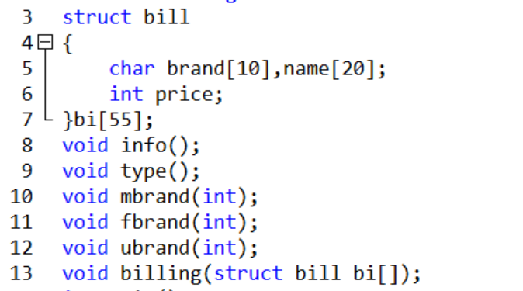
Functions we used:

Slide 6
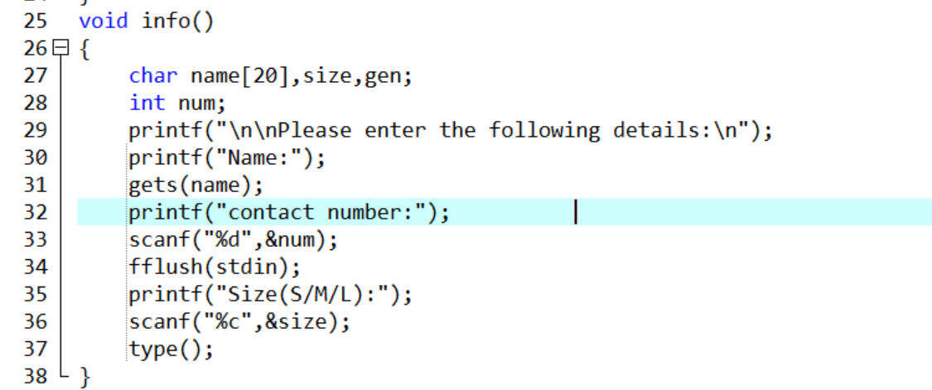
Gathering data:

Slide 7
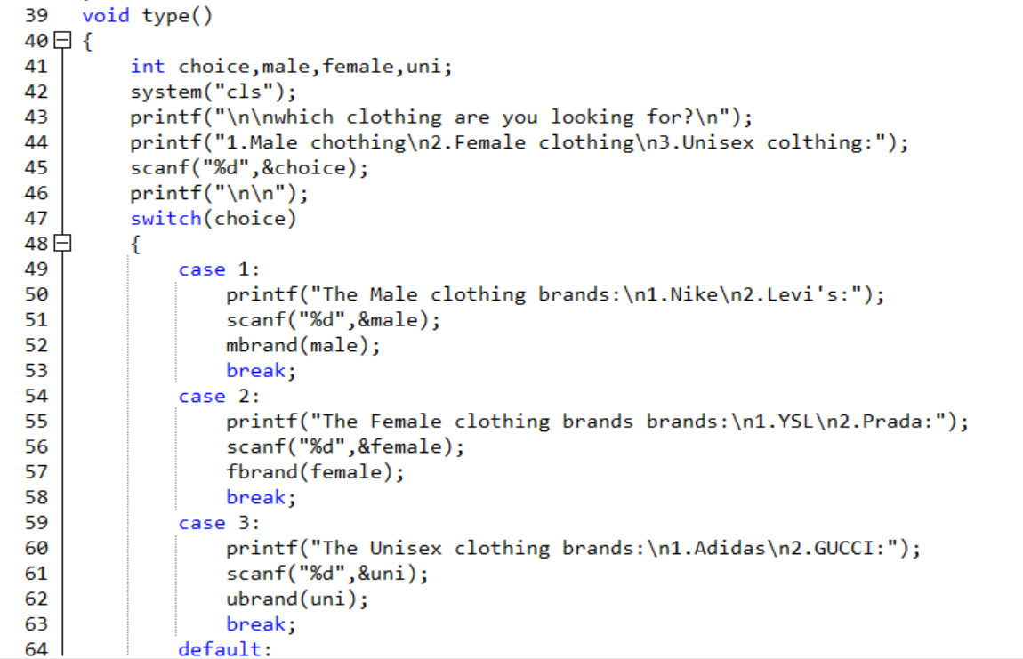
Different branding options

Slide 8
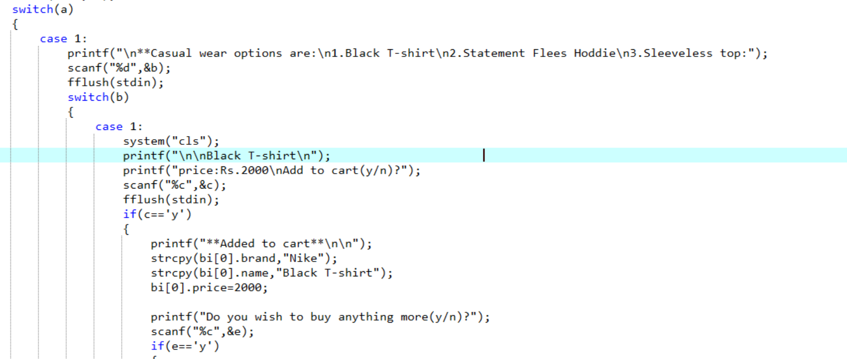
Selecting fashion wears:

Slide 9
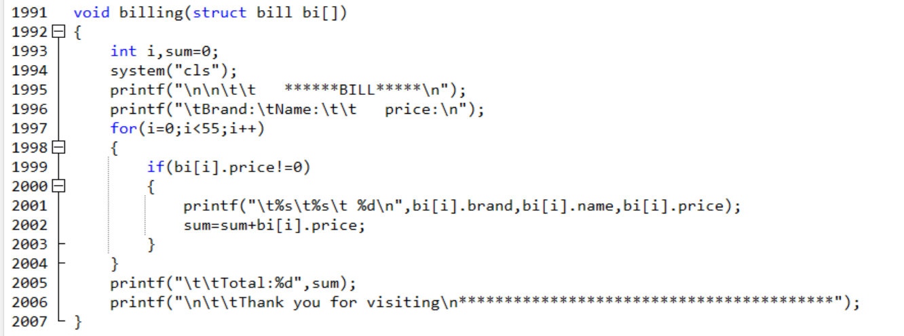
Billing system

Slide 10
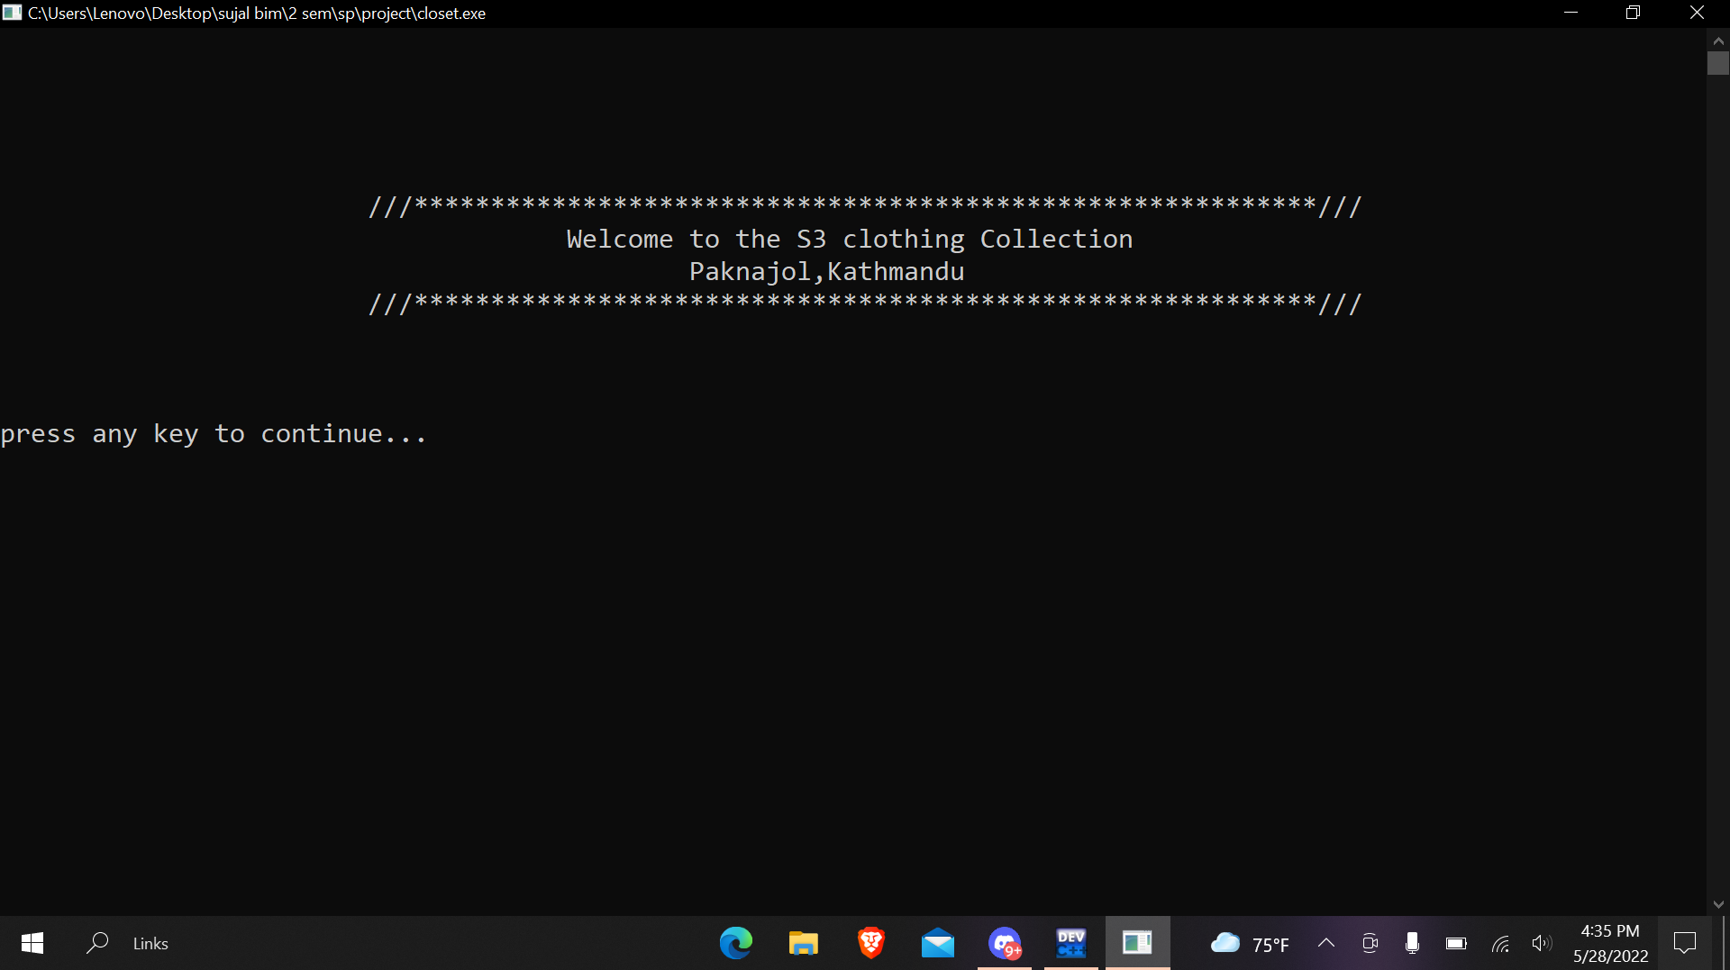

Slide 11
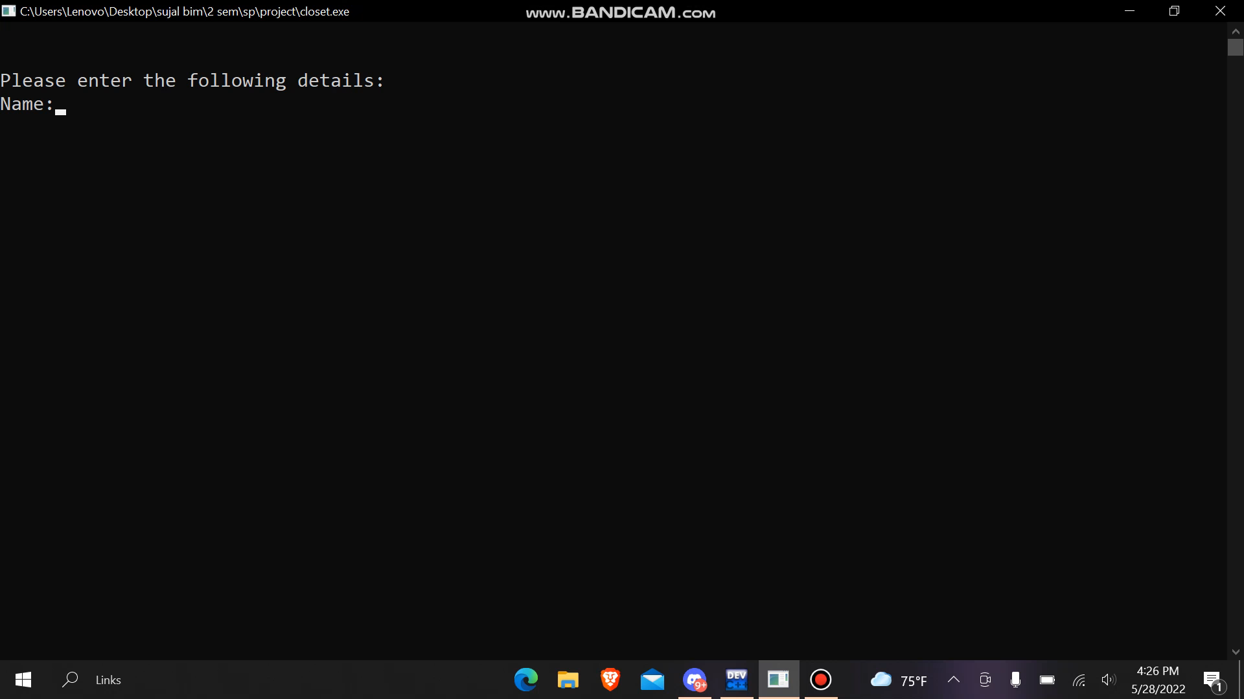

Slide 12

THANK YOU !!!

