Slide 1
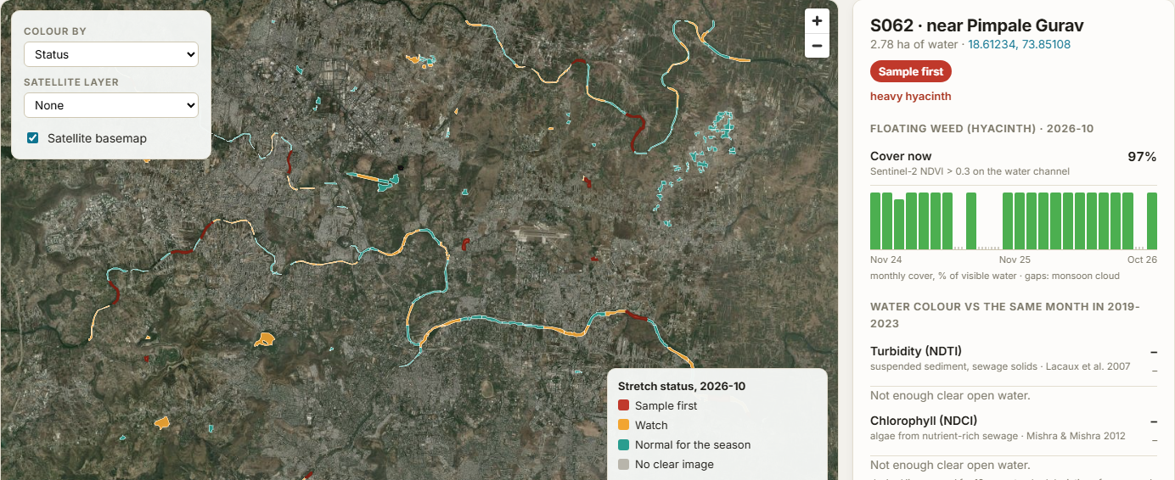
SEVA INNOVATION CHALLENGE 2026 • URBAN DEVELOPMENT
Jal-drishti AI
Working prototype
Every stretch of a city's rivers and lakes, checked from space each month: where to take water samples, and whether a cleanup worked. For MPCB and city corporations.
• 158 river and lake stretches in Pune, 24 months, in ~1.5 min
• Sentinel-2, method after NASA ARSET
Live demo: [deployment link]
Sub-theme: Sewage, urban water pollution and wastewater reuse
Sujal Chondekar · Kshitij Mehrotra
Mentor: Dr. Swati Hira, Assistant Professor, CSE
Indian Institute of Information Technology, Nagpur
Notes:
Title slide. Fill every field exactly as entered in the online application form so reviewers can match the deck to the application.

Slide 2
2
The Problem
What real challenge in society, government service or industry are you solving?
What is the problem?
Who is affected, and where?
About half of the sewage from Maharashtra's cities reaches rivers untreated. Pollution is checked by hand: one sample a month at fixed stations, so no one sees where a river turns bad between them, or whether cleanups worked.
People living along Maharashtra's 54 polluted river stretches: Mumbai region (Mithi, Ulhas), Pune (Mula-Mutha), Nagpur (Nag) and more. Also the city corporations, MPCB and NGT, who need evidence to act and to check contractors.
4,250 MLD
of sewage reaches Maharashtra's rivers untreated, every day
Evidence
Current gaps
Why it matters
~4,250 MLD of sewage untreated every day (9,271 made, 5,024 treated; MPCB, Dec 2025)
54 polluted stretches, the most of any state (CPCB 2025)
Pune: ₹8 cr spent on hyacinth removal, yet it persists; payments disputed (2026)
Monthly samples at ~173 river stations: one point every many km
Lab results come weeks later; no picture between stations
No independent check that hyacinth removal or new STPs improved the river
Dirty water flows on to homes, farms and fish downstream, and crores go into cleanups that no one can independently check.
Sources: MPCB monthly progress report, Dec 2025; CPCB polluted river stretches 2025 (via Drishti IAS); MPCB water bulletin, Jan 2026; Punekar News, Jun 2026; Free Press Journal, 2026.
Seva Innovation Challenge 2026 | Slide 2 of 6
Notes:
Reviewers look for a clearly defined, real and significant problem backed by evidence. One strong statistic is better than many weak ones. Cite the source for every number.

Slide 3
3
Our Solution & Innovation
What have you built or designed, how does it work, and what is new about it?
Our solution in brief
What makes it new?
Jal-drishti AI checks every ~1 km of a city's rivers and lakes each month: weed, turbidity and algae vs normal, so boards know where to sample and if cleanups worked.
 | Existing approach | Our approach
Cost | Field trips and lab tests per station | Free open satellite data; one small server
Speed / time | One sample a month; results weeks later | A whole city in ~1.5 min; new image every 5 days
Reach / access | ~173 river points for the whole state | Every ~1 km stretch: 158 in Pune alone
Ease of use | Lab reports, no map | Web map, ranked list, before/after check
Working prototype: Pune rivers, Oct 2026
How it works
1
2
3
Input
›
Process
›
Output
A city, or any river or lake outline
Finds the channel; measures weed, turbidity and chlorophyll monthly vs 2019-2023
Stretch map, sample-first list, cleanup check, PDF and KML
Key USP
Independent, repeatable evidence for cleanups. It shows Pune's floating weed rising from ~6% to ~29% of river water every dry season in both 2025 and 2026: the before/after check that removal contracts lack.
Seva Innovation Challenge 2026 | Slide 3 of 6
Notes:
Show clearly how the solution addresses the problem on Slide 2. Compare against what exists today — reviewers score originality and relevance here.

Slide 4
4
Feasibility & Implementation
How ready is the solution, and what will it take to implement it on the ground?
Current stage (mark ✔ where you are today)
Live prototype: [deployment link]
✔
Idea
Proof of Concept
Working Prototype
Field Pilot
Ready to Deploy
Technology
Estimated cost
Timeline
Partners
Google Earth Engine + web map app
Data: Sentinel-2 (10-20 m), ESA WorldCover
Method: NASA ARSET inland water quality
Next: drone checks of hotspots; hyperspectral (EnMAP)
Data: ₹0 (free Copernicus data)
Server: ~₹5,000 / month for all cities
City pilot: under ₹1 lakh, mostly water samples to check the flags
3 months: Pune pilot with MPCB; compare flags with lab samples and calibrate
6 months: Mumbai, Thane, Nagpur; monthly report card for each river
12 months: all 54 polluted stretches statewide
Maharashtra Pollution Control Board (MPCB)
Pune and Pimpri-Chinchwad municipal corporations
State River Rejuvenation Authority
MRSAC, Nagpur (state remote sensing centre)
Seva Innovation Challenge 2026 | Slide 4 of 6
Notes:
Be realistic. A clear, costed plan with an identified adopting department scores better than an ambitious but vague one. Mention any validation already done (tests, user feedback, certifications).

Slide 5
5
Impact & Scalability
What change will your solution create, and how can it grow beyond the first location?
54
Weeks → mins
158 vs 2
Polluted river stretches
Saving in time
Points watched in Pune
the whole state list, checked every month
city screening vs monthly sampling and lab results
river stretches vs monthly sampling points on the Mula
Social impact
Sustainability
Scale-up plan
Earlier action on weed, algae and sewage outfalls
Cleaner water for people living downstream
Public, checkable evidence of cleanup spending
Runs on free satellite data
Low server cost fits MPCB or city budgets
Can be hosted by MRSAC; open-source code
Any Indian city: national NWMP, global data
Add a city in minutes; lakes and reservoirs too
Next: drone checks of hotspots; hyperspectral types
Sources: CPCB polluted river stretches 2025; CPCB reply in NGT OA 214/2024 (Mula sampled at two locations, monthly); Jal-drishti run for Pune, Oct 2026. Server cost is an estimate.
Seva Innovation Challenge 2026 | Slide 5 of 6
Notes:
Quantify impact wherever possible and state your assumptions. Where relevant, link the solution to an existing Government scheme, mission or the Sustainable Development Goals.

Slide 6
6
Team/Individual & Support Required
Who is behind the idea, and what help do you need from the Challenge?
SC
Sujal Chondekar
KM
Kshitij Mehrotra
Support we are seeking
Lead developer
Developer
B.Tech CSE, IIIT Nagpur · satellite analysis, web app
B.Tech CSE, IIIT Nagpur · data and validation
✔
Mentorship & technical guidance
✔
Pilot with a government department
✔
Funding / grant support
SH
Dr. Swati Hira
Faculty mentor
Incubation & workspace
Assistant Professor, CSE, IIIT Nagpur
Testing, certification or IP support
A Pune pilot with MPCB and the municipal corporations would let us test the satellite flags against water samples and turn them into a monthly report card for every river.
Indian Institute of Information Technology, Nagpur
Thank you | sujalchondhekar@gmail.com
Live demo: [deployment link]
Seva Innovation Challenge 2026 | Slide 6 of 6
Notes:
List only active team members. Be specific about the support requested — it helps the organisers match you with the right mentor, department or incubator.

