Slide 1
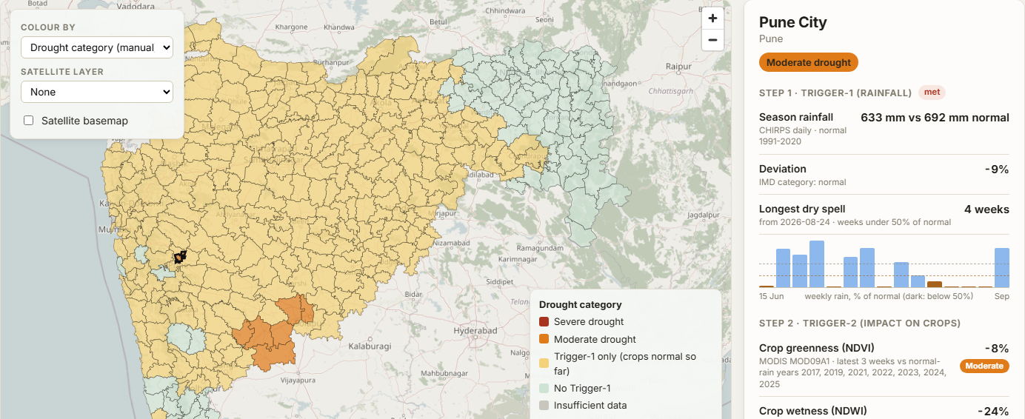
SEVA INNOVATION CHALLENGE 2026 • AGRICULTURE
Pik-drishti AI
Working prototype
Village-level satellite evidence for drought declaration and crop-loss panchanama, following the Government of India drought manual. For revenue and agriculture departments.
• All 365 talukas in ~1 min; every village of a taluka in ~2 min
• Trigger-1 matches the official 2026 list in Jalgaon (15/15)
Live demo: pik-drishti.onrender.com
Sub-theme: Farmer income protection, market access and digital crop-loss assessment
Notes:
Title slide. Fill every field exactly as entered in the online application form so reviewers can match the deck to the application.

Slide 2
2
The Problem
What real challenge in society, government service or industry are you solving?
What is the problem?
Who is affected, and where?
After floods or unseasonal rain, every damaged farm is inspected by hand (panchanama) before relief or insurance is paid. With lakhs of farms hit at once this takes weeks, and farmers must leave the ruined crop standing as proof.
Small and marginal farmers across Maharashtra. In 2025, 29 of 36 districts and 253 talukas were hit, Marathwada the worst. Also the talathis and agriculture assistants who must survey every field, and the officials who approve relief.
60 lakh+ ha
of crops damaged by rain and floods in Maharashtra, June–Sept 2025
Evidence
Current gaps
Why it matters
60–68 lakh ha crops damaged, Jun–Sep 2025; ₹31,628 cr relief (State Govt)
Banana storms, 2026: survey ordered ~3 weeks late, 1.5–2 months to reach Solapur
The State itself proposed using satellites to assess damage (PTI)
Panchanama is manual, field by field, and depends on the surveyor
Drone surveys help but go district by district and cost more
YES-TECH / CROPIC estimate season-end yield for insurance, not each farm's damage right after an event
Until the survey is done, relief, crop loans and re-sowing all wait, and ₹31,628 crore of aid rests on manual field checks.
Sources: Govt of Maharashtra relief package, 7 Oct 2025 (Scroll, The Week); Rural Voice, 27 Jun 2026; PTI via Outlook India, Jan 2024; MoA&FW YES-TECH (2023).
Seva Innovation Challenge 2026 | Slide 2 of 6
Notes:
Reviewers look for a clearly defined, real and significant problem backed by evidence. One strong statistic is better than many weak ones. Cite the source for every number.

Slide 3
3
Our Solution & Innovation
What have you built or designed, how does it work, and what is new about it?
Our solution in brief
What makes it new?
Pik-drishti AI turns free satellite data into village evidence for the drought manual's triggers and for crop-loss panchanama.
 | Existing approach | Our approach
Cost | Staff visit every village | Free satellite data; small server
Speed / time | Weeks to 2 months a district | Talukas ~1 min; villages ~2 min
Reach / access | Field staff miss farms | All 48,926 villages, each season
Ease of use | Paper forms, manual totals | Web map, PDF, KML; no GIS
Working prototype: drought map, Oct 2026
How it works
1
2
3
Input
›
Process
›
Output
A taluka, or village boundaries, plus a season or the date of a flood
Reads rainfall, radar and crop greenness; applies the drought manual's rules
Village map, ranked verification list, PDF, CSV and KML
Key USP
Follows the Government of India drought manual step by step and shows the evidence for every village. Its Trigger-1 already matches the official 2026 list in Jalgaon (15/15) and Buldhana (13/13).
Seva Innovation Challenge 2026 | Slide 3 of 6
Notes:
Show clearly how the solution addresses the problem on Slide 2. Compare against what exists today — reviewers score originality and relevance here.

Slide 4
4
Feasibility & Implementation
How ready is the solution, and what will it take to implement it on the ground?
Current stage (mark ✔ where you are today)
Live prototype: pik-drishti.onrender.com
✔
Idea
Proof of Concept
Working Prototype
Field Pilot
Ready to Deploy
Technology
Estimated cost
Timeline
Partners to approach
Google Earth Engine + web map app
Data: CHIRPS, MODIS, Sentinel-1/2, WorldCover
Next: drone survey of flagged villages
Data: ₹0 (free NASA, ESA and CHC data)
Server: ~₹5,000 / month for a whole state
About ₹1-2 per village per year
District pilot: under ₹1 lakh, mostly field checks
3 months: district pilot on the 2026 drought vs panchanamas
6 months: drone surveys of flagged villages; Marathi app
12 months: statewide, with land-record farm boundaries
Relief & Rehabilitation Department, GoM
Agriculture Department (taluka agriculture officers)
MRSAC, Nagpur (state remote sensing centre)
District collectors
IIIT Nagpur
Seva Innovation Challenge 2026 | Slide 4 of 6
Notes:
Be realistic. A clear, costed plan with an identified adopting department scores better than an ambitious but vague one. Mention any validation already done (tests, user feedback, certifications).

Slide 5
5
Impact & Scalability
What change will your solution create, and how can it grow beyond the first location?
48,926
Weeks → mins
33 lakh+
Villages covered
Saving in time
Farmer livelihoods supported
every village of Maharashtra, every season
first screening vs a 1.5-2 month field survey
farmers in one 2025 relief round alone
Social impact
Sustainability
Scale-up plan
Relief and re-sowing come sooner for small farmers
Fewer farms missed; officials verify the worst first
Source-cited evidence reduces disputes
Runs on free satellite data
Low server cost fits a department budget
Can be hosted by MRSAC; open-source code
Any state: the drought manual is national and the data global
Only needs that state's village boundaries
Next: drone surveys for plot-level detail; rabi drought, hail
Sources: Govt of Maharashtra relief aid of ₹3,258 cr for 33.65 lakh farmers, Oct 2025 (The Hitavada); village count from Census 2001 boundaries (DataMeet). Server cost is an estimate.
Seva Innovation Challenge 2026 | Slide 5 of 6
Notes:
Quantify impact wherever possible and state your assumptions. Where relevant, link the solution to an existing Government scheme, mission or the Sustainable Development Goals.

Slide 6
6
Team/Individual & Support Required
Who is behind the idea, and what help do you need from the Challenge?
SC
Sujal Chondekar
SH
Dr. Swati Hira
Support we are seeking
Developer
Faculty mentor
B.Tech CSE, IIIT Nagpur · satellite analysis, web app
Assistant Professor, CSE, IIIT Nagpur
✔
Mentorship & technical guidance
✔
Pilot with a government department
Indian Institute of Information Technology, Nagpur
✔
Funding / grant support
Thank you | sujalchondhekar@gmail.com
Live demo: pik-drishti.onrender.com
Incubation & workspace
Testing, certification or IP support
A district pilot with the Relief & Rehabilitation and Agriculture Departments would let us test the village list against panchanamas and make it the first step of every drought and crop-loss assessment.
Seva Innovation Challenge 2026 | Slide 6 of 6
Notes:
List only active team members. Be specific about the support requested — it helps the organisers match you with the right mentor, department or incubator.

