Slide 1
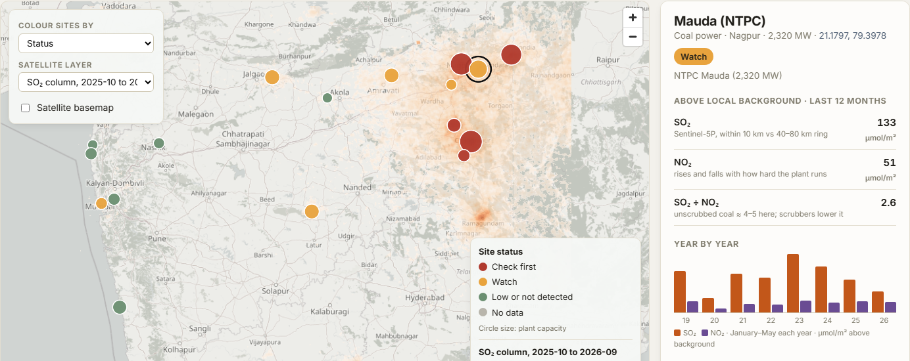
SEVA INNOVATION CHALLENGE 2026 • SUSTAINABILITY - ENERGY, CLIMATE AND OTHERS
Udyog-drishti AI
Working prototype
A monthly satellite check of SO₂ and NO₂ at Maharashtra's large coal power plants and industrial areas: where to inspect first, and whether a scrubber worked. Independent of the plants' own monitors.
• 17 plants and industrial areas, monthly since 2019, in ~1 min
• Sentinel-5P SO₂ and NO₂; agrees with plants' official filings
Live demo: udyog-drishti.onrender.com
Sub-theme: Industrial decarbonisation, pollution control and wastewater reuse
Sujal Chondekar · Kshitij Mehrotra · Sandeep Mataghare · Sanchay Hira
Mentor: Dr. Swati Hira, Assistant Professor, CSE
Indian Institute of Information Technology, Nagpur
Notes:
Title slide. Fill every field exactly as entered in the online application form so reviewers can match the deck to the application.

Slide 2
2
The Problem
What real challenge in society, government service or industry are you solving?
What is the problem?
Who is affected, and where?
Big industries are checked mainly by stack monitors they run themselves and by occasional inspections. Since July 2025 most coal plants no longer need SO₂ scrubbers, and no one independently tracks what each plant and industrial cluster releases, month by month.
People living near Maharashtra's coal plants and critically polluted clusters: Chandrapur, Koradi–Khaparkheda (Nagpur), Tarapur, Taloja, Dombivli. Also MPCB, CPCB and NGT committees, who need independent evidence to act.
78%
of India's coal power units no longer need SO₂ scrubbers (July 2025)
Evidence
Current gaps
Why it matters
Koradi, Khaparkheda, Tiroda, Mauda: 9,360 MW exempted from SO₂ scrubbers (Jul 2025)
Chandrapur: own stack reports show SO₂ ~6× the limit (2024–26)
Nagpur over the PM10 limit on 46 of 92 spring days in 2026
Self-reported monitors (OCEMS): run by the plant, with gaps and poor data quality
Inspections are occasional; no picture between visits
No independent check that scrubbers or effluent plants actually cut pollution
Sulphur and ash keep reaching lungs, farms and rivers around Nagpur and Chandrapur, and the only proof of compliance is the polluter's own data.
Sources: MoEFCC notification, 11 Jul 2025; Mahagenco CSTPS EC compliance reports to MoEF&CC, 2024–26; TechTimes analysis of CPCB data, Aug 2026; CEEW 2024 and CSE on OCEMS; CREA, Jul 2026.
Seva Innovation Challenge 2026 | Slide 2 of 6
Notes:
Reviewers look for a clearly defined, real and significant problem backed by evidence. One strong statistic is better than many weak ones. Cite the source for every number.

Slide 3
3
Our Solution & Innovation
What have you built or designed, how does it work, and what is new about it?
Our solution in brief
What makes it new?
Udyog-drishti AI tracks SO₂ and NO₂ over every big plant each month from Sentinel-5P, independent of plant monitors: where to inspect, and if scrubbers work.
 | Existing approach | Our approach
Cost | Inspections and stack audits, plant by plant | Free satellite data; one small server
Speed / time | Occasional visits; monitor data from the plant | All of Maharashtra in ~1 min, every month
Reach / access | Self-reported monitors, often with gaps | 17 sites, every month since 2019
Ease of use | Portals per plant, rarely public | One map, ranked list, before/after check
Working prototype: Maharashtra, Sep 2026
How it works
1
2
3
Input
›
Process
›
Output
Plant list, or any industrial area
SO₂ and NO₂ above local background, monthly since 2019
Inspect-first list, scrubber check, maps, PDF and KML
Key USP
Independent of the polluter's data, yet it agrees with official filings: Chandrapur (flagged here) reports SO₂ ~6× the limit; Mauda's SO₂ ÷ NO₂ fell 38% vs 14% at unscrubbed plants, and NTPC confirms its scrubbers.
Seva Innovation Challenge 2026 | Slide 3 of 6
Notes:
Show clearly how the solution addresses the problem on Slide 2. Compare against what exists today — reviewers score originality and relevance here.

Slide 4
4
Feasibility & Implementation
How ready is the solution, and what will it take to implement it on the ground?
Current stage (mark ✔ where you are today)
Live prototype: udyog-drishti.onrender.com
✔
Idea
Proof of Concept
Working Prototype
Field Pilot
Ready to Deploy
Technology
Estimated cost
Timeline
Partners to approach
Google Earth Engine + web map app
Data: Sentinel-5P SO₂ and NO₂ (daily)
Method: ring background; ratio vs exempt plants
Next: drone gas sensors at flagged stacks; methane (EMIT)
Data: ₹0 (free Copernicus data)
Server: ~₹5,000 / month for the state
Pilot: under ₹2 lakh, mostly stack tests to check the flags
3 months: Nagpur–Chandrapur pilot with MPCB; compare with stack tests
6 months: every coal plant statewide; monthly report card
12 months: cement, steel, refineries; effluent watch at MIDCs
Maharashtra Pollution Control Board (MPCB)
Mahagenco and NTPC environment teams
CPCB; State Environment Department
MRSAC, Nagpur (state remote sensing centre)
Seva Innovation Challenge 2026 | Slide 4 of 6
Notes:
Be realistic. A clear, costed plan with an identified adopting department scores better than an ambitious but vague one. Mention any validation already done (tests, user feedback, certifications).

Slide 5
5
Impact & Scalability
What change will your solution create, and how can it grow beyond the first location?
22,020 MW
Months → 1 min
3 of 3
Coal capacity watched
Saving in time
Checks vs official filings
14 plant sites and 3 industrial areas, monthly
statewide screen vs plant-by-plant inspection
Chandrapur, Koradi, Mauda agree with stack and scrubber records
Social impact
Sustainability
Scale-up plan
Inspections go first where SO₂ is highest
Cleaner air around Nagpur and Chandrapur
Public check on scrubber spending and exemptions
Runs on free satellite data
Low server cost fits an MPCB budget
Can be hosted by MRSAC; open-source code
Any Indian state: the satellite is global
Carbon-market sectors: cement, steel, refineries
Next: drone gas checks; landfill methane
Sources: Global Power Plant Database (capacity); Udyog-drishti run, Jan 2019–Sep 2026; Mahagenco and NTPC EC compliance reports to MoEF&CC (2024–26). Server cost is an estimate.
Seva Innovation Challenge 2026 | Slide 5 of 6
Notes:
Quantify impact wherever possible and state your assumptions. Where relevant, link the solution to an existing Government scheme, mission or the Sustainable Development Goals.

Slide 6
6
Team/Individual & Support Required
Who is behind the idea, and what help do you need from the Challenge?
SC
Sujal Chondekar
KM
Kshitij Mehrotra
Support we are seeking
Lead developer
Developer
B.Tech CSE, IIIT Nagpur · satellite analysis, web app
B.Tech CSE, IIIT Nagpur · data and validation
✔
Mentorship & technical guidance
✔
Pilot with a government department
✔
Funding / grant support
SM
Sandeep Mataghare
SH
Sanchay Hira
Team member
Team member
Incubation & workspace
Testing, certification or IP support
A Nagpur–Chandrapur pilot with MPCB would test the satellite flags against stack tests and plant monitors, and give every big plant a monthly report card.
Mentor: Dr. Swati Hira, Assistant Professor, CSE, IIIT Nagpur
Thank you | sujalchondhekar@gmail.com
Live demo: udyog-drishti.onrender.com
Seva Innovation Challenge 2026 | Slide 6 of 6
Notes:
List only active team members. Be specific about the support requested — it helps the organisers match you with the right mentor, department or incubator.

