Slide 1


PROJECT UDYAM DIGITAL · DIGITAL TRACK
Accel Saathi: a small business gets online in one conversation
A GenAI advisor in 10 Indian languages, in the app and on WhatsApp, that sells like your best salesperson: the right bundle with reasons, one monthly price, KYC in minutes and a tracker that ends status calls.
► DEMO VIDEO
2½ minutes · YouTube
youtu.be/8l98qG0CE1c
Click or scan to watch
7.4% → 15%
lead to activation
17.6 → 7 days
lead to live
₹15k → ₹7.7k
running cost per activation
Try it live
udyam.openforge.online
Deployed · 10 languages
Team TouristGuide_NIT_Jamshedpur · Sujal Bhatu, Prince Mehta · Airtel Sync 2026
► DEMO VIDEO (2½ min): https://youtu.be/8l98qG0CE1c
► CODE + TESTS: https://github.com/sujalbhatu/accel-saathi
Notes:
Accel Saathi answers Project Udyam Digital. One line: a pharmacy owner sends one message in her own language and leaves with a priced, verified, booked order, then never has to call to chase it. The three numbers are the modelled results on slide 8, each built from Accel's own leads data: half of the journey losses removed at each step, with every other loss kept; cost per activation includes our running costs (cloud, model, e-KYC, WhatsApp); with a 5-person product team (about 30 lakh a quarter, our estimate) it is about 11,700 at this lead volume, falling as leads grow. The QR opens the live build; the partner console is at /#/console.

Slide 2
Accel loses small businesses to the journey, not to demand
THE PROBLEM Apr–Jun 2026: 5,000 leads, 368 activated (7.4%). ₹35.6 lakh of ₹55.4 lakh spent went on leads never won.
LEAD FUNNEL, APR–JUN 2026
1,583 LEADS LOST TO THE JOURNEY ITSELF
WHERE THE 17.6 DAYS GO
12.8 days are spent waiting for people and paper. We do all of it in one sitting; only the install (4.8 days) stays.
SIGNALS IN THE DATA, AND WHAT WE BUILT FOR EACH
9.6% vs 2.0%
5.9% → 27.9%
6.2% vs 8.0%
₹4.1k vs ₹24.3k
activation with vs without a GSTIN (4.7×)
6-month churn after 1 vs 5 status chases (small samples: 34 and 43)
conversion of regional-language vs Hindi or English leads
cost per activation: referral vs field sales
Built: GSTIN first: one number fills and verifies the profile
Built: WhatsApp update at every stage; STATUS by message
Built: The advisor in all 10 languages the leads speak
Built: WhatsApp entry, partner QR and assisted mode
Notes:
All numbers from smb_leads.csv (5,000 leads, Apr to Jun 2026). Acquisition spend 55.4 lakh in total, 35.6 lakh of it on leads that dropped. 1,583 of the 4,632 lost leads (34%) left for reasons the journey causes: no time for a visit 531, visit not scheduled 296, documents and paperwork 273 (missing GST/Udyam 94, paperwork too long 79, signatory unavailable 53, details mismatch 47), quote too complex 206, quote too slow 179, install over 21 days 98. Days are the average gaps between stage dates for the 368 activated customers. Churn by status chases: 2 of 34 customers with one chase churned, 12 of 43 with five; a link, not proof of cause, so the pilot A/B tests it.

Slide 3
Win offices first, shops on self-serve, chains with the field force
Q1 · SEGMENTS AND BUNDLES Ranked on the leads data; each bundle is our advisor's real output (12-month price, before GST).
Segment, in order | Share of leads | Activation | Cost per activation | Payback on revenue | 6-month churn | Contract | How they buy | Example bundle from our advisor
Professional offices 1st · the pilot starts here | 25% | 11.1% | ₹10,695 | 1.6 mo | 13.8% | 12 months | Self-serve; a call back when asked | Dental clinic, Pune, 8 staff: fibre 300, 2 mobile lines, email and security for 5, cloud backup · ₹4,936/mo
Micro retail & services 2nd · self-serve alongside | 54% | 4.1% | ₹20,007 | 8.1 mo | 22.7% | 12 months | Self-serve on WhatsApp or the app; no visit | Pharmacy, Jaipur, 4 staff, UPI fails, a theft: fibre 100, 2 mobile lines, billing tablet, 2 CCTV, backup internet · ₹3,593/mo
Small multi-site 3rd · at scale, assisted | 15% | 11.0% | ₹15,614 | 0.6 mo | 10.8% | 12 months | Advisor quotes; field confirms each site | Restaurant chain, 5 outlets: fibre 300 × 5, SD-WAN, failover, POS, CCTV, guest Wi-Fi · ₹33,819/mo
Small manufacturers 4th · field-led | 6% | 12.8% | ₹15,324 | 1.0 mo | 8.1% | 24 months | Field-led; advisor prices it on the visit | Auto-parts plant, 80 staff: 20 Mbps leased line, firewall, 8 machine IoT, CCTV, email · ₹19,811/mo
Shops only pay back digitally
Field force moves up-market
Contract by segment
₹20,007 to win a ₹2,470 bundle is 8 months of revenue. At our ₹5,000 target, self-serve pays back in 2. Basic starts at ₹1,448 (fibre and a SIM).
Chains and plants pay back in a month and bring 73% of revenue. Field visits go there; shops and offices close on their own.
12 months for shops, offices and chains; 24 for plants (same churn, and 62% already choose it). No 6-month deals: 2 of 3 churned. 24 months is offered only as a lower monthly price.
Notes:
Segment metrics from smb_leads.csv. Cost per activation = all acquisition spend in the segment / activations in it. Payback = cost per activation / median monthly bundle of activated customers, in months of revenue (not margin). Revenue share of activated bundles: multi-site 57%, professional 21%, manufacturers 16%, micro 6%. Example bundles are the advisor's own output on product_catalogue.csv at 12-month prices, before GST, as the app shows them first (3 Nov build, Recommended level); on 24 months they are 4,316 / 3,093 / 30,869 / 16,822. Micro owners spend a median 925 a month on telecom today, so we never claim a saving; the advisor offers a lighter bundle in one tap and sells on what the bundle fixes (UPI drops, theft). The demo persona is a shop because it is the hardest case: the smallest budget and the most price sensitive. The pharmacy owner told the advisor that UPI fails at rush hour and she had a theft, so billing, backup internet and CCTV are in; without those problems the advisor pre-ticks billing only (what 9 pharmacies on Accel mostly kept): fibre 100, 2 lines and billing for 2,546 a month. Order of segments: offices first (11.1% activation, 1.6-month payback, already self-serve), shops self-serve alongside in the same cities, chains at scale with field site checks, plants stay field-led. Contracts: in the data only chains and plants ever signed 24 months; within chains, 24-month customers churned more (15.8% of 38 vs 6.7% of 45) and plants churn the same either way (8.7% vs 7.1%), so the overall 13.1% vs 15.1% is a mix effect, not proof that 24 months keeps customers. So 12 months is the default for shops, offices and chains, 24 for plants, and 24 months is shown only as a lower monthly price. No 6-month deals: 2 of 3 churned.

Slide 4
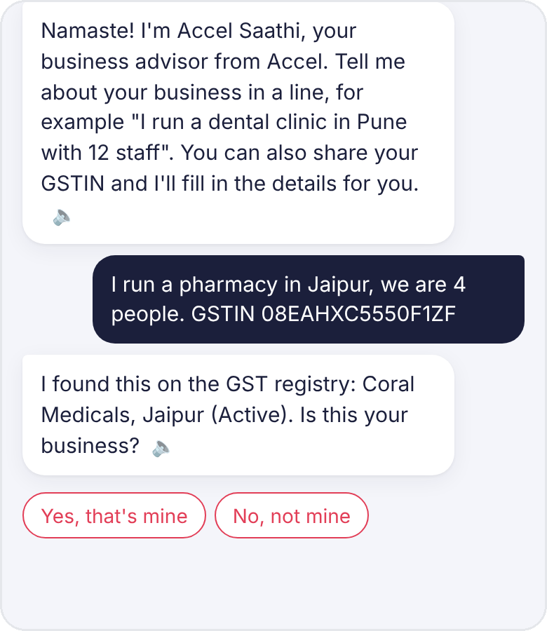
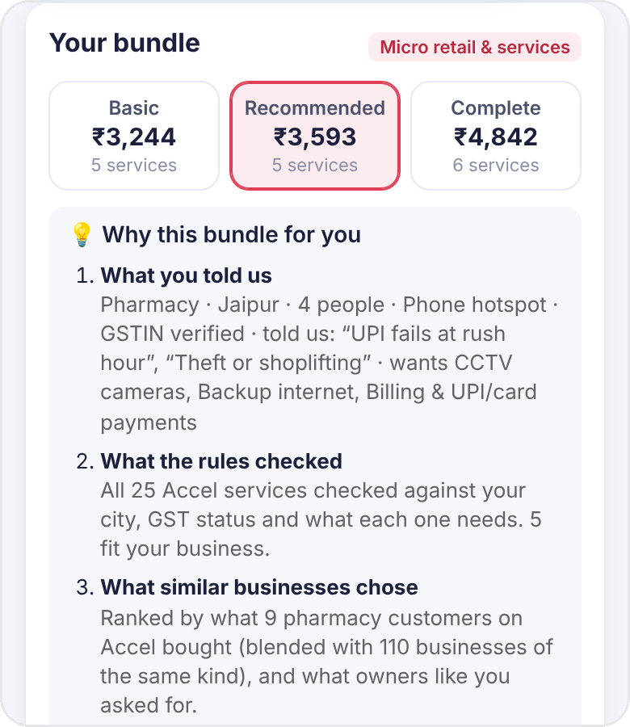
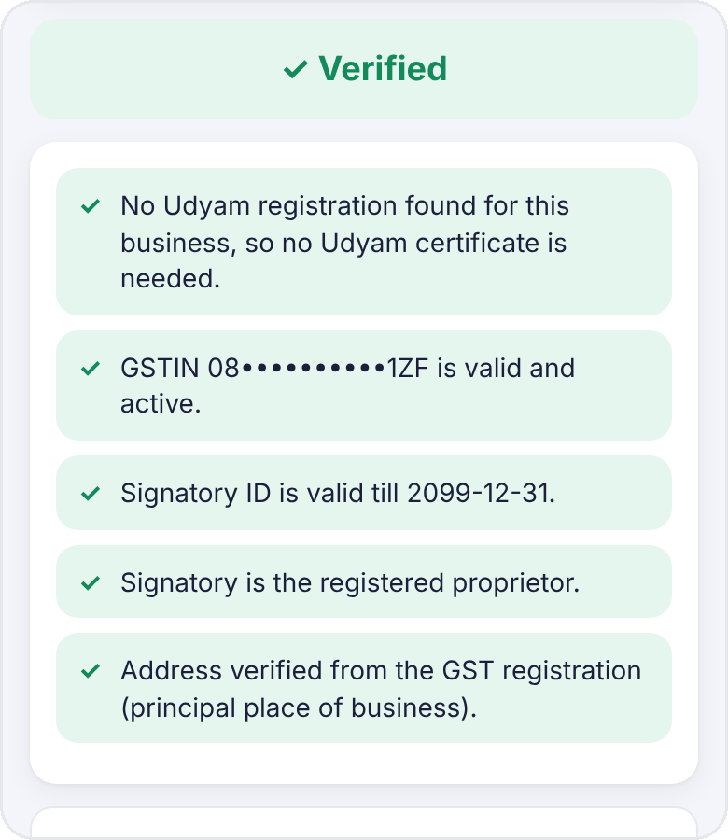
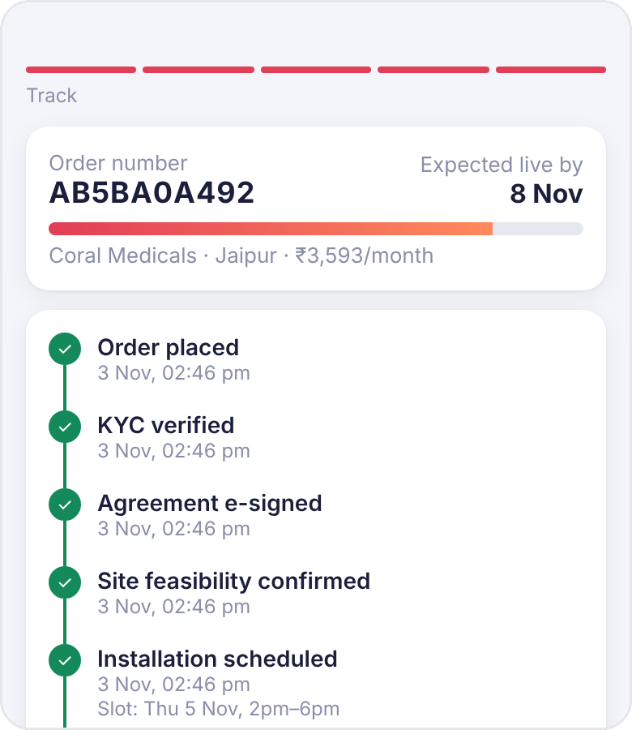
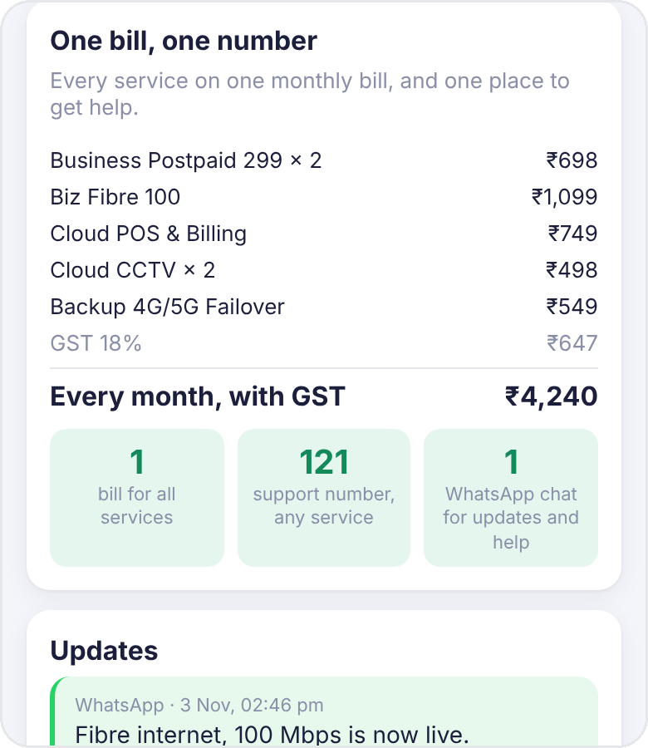
Priya goes from one message to a booked installation in 15 minutes
Q2 + Q3 · THE JOURNEY, BUILT Coral Medicals, Jaipur: our hardest, lowest-paying segment. Live-app screens; 15 min is our timed run.
1
One line, profile filled
2
Built on her problems
3
KYC in 2 minutes
4
A tracker, not calls
5
One bill, one number
Her GSTIN fills the profile; it asks "is this you?" first.
"UPI fails" and "theft" add backup and 2 cameras: ₹2,546 → ₹3,593.
DigiLocker and Aadhaar OTP, checked line by line. No paper.
Her install slot, a date per service, WhatsApp at each step.
5 services, ₹4,240 a month with GST, one support number.
TODAY
17.6 days · 3 calls to chase · a 4-day quote · a bill per product
ACCEL SAATHI
15 min to a booked install · live in ~5 days · 0 calls · 1 bill
Same journey in 10 languages
Try it live
Notes:
Screens are from our app as deployed at https://udyam.openforge.online (a 390 x 844 phone, English). Priya Chauhan, Coral Medicals, GSTIN 08EAHXC5550F1ZF is in mock_gstin_registry.csv and has no Udyam registration, so the app does not ask for one. The same journey runs in 10 languages (English, Hindi, Marathi, Kannada, Gujarati, Telugu, Tamil, Bengali, Punjabi, Malayalam) with voice input and read-aloud, and on the real WhatsApp Cloud API number. 1: GSTIN lookup with a confirm step. 2: at the needs step she taps two of the problems the advisor asks about (UPI fails at rush hour, theft); it ticks billing and backup internet for the first and CCTV for the second, and the why-this-bundle panel quotes her words. 5 services for 3,593 a month on 12 months (3,093 on 24); without the two problems the same pharmacy gets fibre 100, 2 lines and billing for 2,546, close to the 2,470 median micro bundle, so she pays 1,047 more only for what she asked to fix; Basic 3,244 and Complete 4,842 are one tap away; every line opens to why, what it does and what happens without it. 3: DigiLocker + Aadhaar OTP, verified with the checks listed. 4: tracker with stage times and slot booking, shown up to the booked slot; every stage also goes to WhatsApp. In the demo the partner console advances the stages, so their times are the same minute; in production they come from Accel's order system. Why a shop: it is our lowest-paying segment (slide 3), so if the journey works for her, offices, where the pilot starts, are easier. 5: the one-bill card after go-live. 15 minutes: about 3 for the chat, 2 for KYC, 1 to e-sign and pick a slot, with room to spare.

Slide 5
The advisor sells like a good salesperson and never invents a price
Q2 · THE ADVISOR The AI understands her; rules, real customers and the catalogue decide. Try these lines live.
HOW IT DECIDES
IT SELLS, NOT JUST ANSWERS
PERSONAL, NOT ONE-SIZE
1
Understand
Her words, in any of 10 languages, become facts and problems.
This is too expensive for me
Same pharmacy, no problems
Fibre 100, 2 lines, billing
₹2,546/mo
I understand, every rupee counts. ₹3,593/month is about ₹120 a day for 5 services on one bill. Your choice: trim the extras ₹3,244 · the same bundle on 24 months ₹3,093 · or tell me a budget.
[ Trim extras: ₹3,244/mo ] [ 24 months: ₹3,093/mo ] [ Keep it, go ahead ]
She says "UPI fails" and "theft"
+ backup internet, + 2 cameras
₹3,593/mo
2
Check
Rules on all 25 services. Every ₹ is the catalogue's.
Her own problems add what no best-seller list can: backup and 2 cameras. The learned ranking ties segment best-sellers (A5).
Rank
Learned from 368 customers; her problems go first.
My nephew set up Jio for 399, why should I pay you?
PROOF IT WORKS
3
92/92
advisor checks, AI on and off, 28 sales moments
100/100
the journey in all 10 languages, AI off
Fair question. I can't see that plan, but your ₹3,593 gets 100 Mbps fibre steady enough for UPI and billing, 5 services on one bill, live in about 5 days. Want only the essentials? Basic is ₹3,244.
[ Basic: ₹3,244/mo ] [ Make it cheaper ] [ ✓ Go ahead ]
4
Level
Basic, Recommended, Complete, with a "why" in her words.
12/12
KYC specimens judged right
106/106
WhatsApp, privacy, partner, KYC, ranking
Never changes her bundle without asking; every reply ends with a next step.
SMART KYC AND PRIVACY BY DESIGN · DPDP ACT 2023
GSTIN and Udyam registry, DigiLocker, Aadhaar OTP
OCR re-read with checksums; 20+ checks
Encrypted before storage (AES-256-GCM)
Tokens, not data, sent to any AI
One consent switch per purpose
Erase my data, any time
Notes:
The LLM only turns free text into structured facts, an action and a language; it never picks a product or a price. Prototype routing: Groq (gpt-oss-120b) first for English and Hindi, Gemini Flash-Lite first for the other 8 languages, each falling back to the other on 429/5xx, then to rules; production runs the same open-weights model in Accel's private cloud. Selling: a price complaint gets ways down with prices (Basic, a lighter bundle, 24 months, a budget) and nothing changes until she picks; a competitor price gets what her bundle includes and the cheapest honest alternative; "let me think" saves the bundle (link or WhatsApp) and asks what holds her back; "ask my partner" gives a summary to share; "which do you recommend" gives reasons from her problems and from what similar customers kept. These replies are rules-based, so they are instant and identical with the AI off. The two replies are Priya's, from the build (4-person Jaipur pharmacy, phone hotspot), shortened to fit the slide; the buttons are exactly as shown; try the same lines on the live site. No invented prices: any ₹ amount in an AI reply that is not in her quote is removed before she sees it. Ranking (ranker.py, backtest.py): each service's share among similar activated customers, business type pulled toward its segment with a prior of 30 customers, churned customers weighted 0.5. Leave-one-out back-test on all 368 activated customers, same bundle size for every method: precision 63.2% learned vs 60.0% hand-written rules vs 37.2% one popular bundle; recall 67.1 / 65.2 / 43.1; F1 0.651 / 0.625 / 0.399. Best-sellers per segment score 63.1% (F1 0.650), a tie: Accel's purchases differ mainly by segment, so learning cannot beat that on this data; what it adds is business type where there is data, retention (churned customers count half) and the owner's own problems, which no average can know. Appendix A5 has the method. Tests in backend/tests, run by GitHub Actions on every push: tests/eval/run_rag_eval.py (83 labelled owner questions in 10 languages: right section first 76.6%, in the top 4 sent to the AI 93.5%, MRR 0.85, vs 54.5% / 64.9% / 0.60 for plain BM25; Tamil is weakest at 67% top 4; with the live AI: 0% answers with a number not in the sources, 96.2% in the owner's language, 93.8% cite a correct source, 5 of 6 off-topic questions declined, about 1.8 s typical and 4 s slow; a typical AI call is about 3,000 tokens in and 130 out, and the rules handle most turns, so at public paid prices an advisor conversation costs about ₹0.11, ₹0 on free plans), run_retrieval_eval (66 questions after the keyword fixes, plus 16 written later and never tuned on: 12 of 16 found; privacy questions in Malayalam, Telugu and Tamil still miss), run_advisor_scenarios 92 (also run with the live AI; turns the free AI could not serve fell back to rules as designed), run_language_checks 100 (10 languages x 10 checks, AI off), run_kyc_pack 12, run_whatsapp_orders 59, run_privacy_checks 17, run_partner_flows 17, run_kyc_flows 10, run_ranking_eval 3; 59 + 17 + 17 + 10 + 3 = 106. Security: store.py seals every record with AES-256-GCM before it is written, phone-number keys become HMAC tokens; llm.py swaps phone, GSTIN, PAN, Aadhaar, e-mail and names for tokens before any AI call.

Slide 6
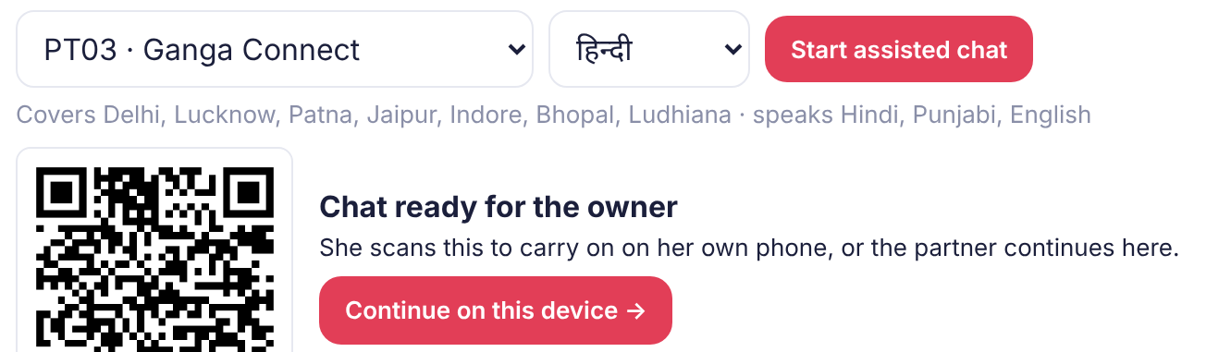
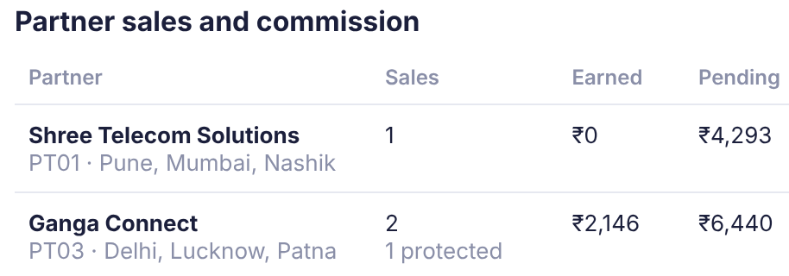
The field force and partners sell more, not less
Q4 · FIELD FORCE AND PARTNERS The advisor does the paperwork; partners keep the sale and are paid for customers who stay.
COST PER ACTIVATION BY CHANNEL, APR–JUN
PARTNER CONSOLE IN THE BUILD
WHY PARTNERS WILL PUSH IT
Commission protection
The owner confirms her number by a code on her own phone. That number stays the partner's for 30 days, even if she orders alone later. A typed-in number earns nothing.
Pay tied to retention
One month's rental per sale, half when live, half after 6 months: ₹2,470 for a typical shop, ₹6,900 at the median. The advisor does the paperwork, so a partner serves more owners a day.
WHO SELLS WHAT
Owner | Channel
Shops, offices | Self-serve: app or WhatsApp
Wants a person | Partner assists, in person
Chat didn't close | Scored call list, next step
Chains, plants | Advisor prices, field checks sites
Ganga Connect starts a chat for an owner; the QR hands it to her phone. Its sales, protected sales and commission update live.
Counter QR
Each partner's QR opens the app tagged to them, so walk-ins they send are credited too.
Field time goes where it pays
Field sales costs ₹24,335 per activation; a shop takes 8 months to pay that back. Freed visits go to chains and plants (73% of revenue). In the pilot, every self-serve sale in a rep's area counts toward their target.
Notes:
Channel costs: acquisition spend per activation by lead_source in smb_leads.csv (field sales 24,335; channel partner 20,851; website 6,352; inbound 5,113; referral 4,099; WhatsApp campaign 4,026). Assisted mode, owner-code consent, 30-day protection and the commission ledger are built and tested (backend/tests/run_partner_flows.py, 17 checks: wrong code refused, 5 wrong tries lock the code, unverified numbers earn nothing, referral QR credited, protection across a new session). The commission rate is a proposal for the pilot. Today ₹16.9 lakh a quarter goes to partner-sourced leads for 81 activations; at one month's rental (₹6,900 median) the 167 partner sales in our model (22% of 760, today's share) cost ₹11.5 lakh, inside that budget, which is why the impact model keeps spend flat. What partners earn per sale today is not in the data, so we do not claim a rise per sale; the gain for a partner is volume, because an assisted chat takes about 15 minutes instead of a visit and the sale stays theirs.

Slide 7
Rivals sell plans or single products; we sell the whole setup, self-serve
COMPETITIVE ANALYSIS What a small-business owner can buy today, and how; from official pages and press, checked 3–4 Nov 2026.
WHERE EACH RIVAL SITS FOR AN OWNER
OUR SIDE, HONESTLY
WHAT THEY DO BETTER, AND OUR ANSWER
▲ Self-serve, in minutes
Built and live
Advisor in 10 languages, catalogue prices, KYC checks, tracker, real WhatsApp (test number), partner console
Jio Business: price and brand
We win on fit, not price: a right-sized bundle, the 24-month saving shown, cheaper in one tap.
Accel Saathi
the whole setup, self-serve: the gap we fill
PhonePe, Paytm
UPI or a sound-box, on the phone
Jio Business
broadband + 3 apps, cheapest entry
Local ISPs: cheapest, next door
325 lost leads were "locked in", 207 went "cheaper". Local partners sell through us and keep the sale.
Vi Business
plans and an assessment
Needs Accel to switch on
Live GST and Udyam registries (we use the case's mock ones), an e-KYC licence (KUA) for Aadhaar, one-bill billing, a verified WhatsApp sender
Local ISP or cable
a line from someone next door
Vi and TTBS: advice, cloud tools
Vi assesses, TTBS sells telephony. We go from advice to KYC and order in one flow.
Accel today
the whole setup, by visits: 17.6 days
Tata Tele Business
cloud telephony and SaaS, sales-led
▼ A visit, a store or a call
Payment apps: live in minutes
Owners sign up for UPI in minutes, for one product. We match that speed for the whole setup.
← One product
The whole setup →
Cheapest way in, public price a month: Jio Max 801, 100 Mbps + 3 apps · Vi ₹349 business SIM · PhonePe ₹125 sound-box · Saathi Basic ₹1,448, fibre + a SIM
Our moat
38% of leads already use Accel and convert at 9.2% vs 6.2% on other providers. Their ID KYC is reused: no new ID documents.
Placement is our reading of official pages and press, checked 3–4 Nov 2026: jio.com/business, Business Broadband Max with JioMeet, JioGate, JioAttendance (Max 801 at 100 Mbps: TelecomTalk, 13 Mar 2026); myvi.in/business, ReadyForNext assessment, business postpaid from ₹349 (TelecomTalk, 13 Apr 2025); TTBS sells Smartflo cloud telephony, no mobile network since 2019; phonepe.com merchant help, SmartSpeaker ₹125 a month. Accel is the case's fictional operator.
Notes:
The map places each rival by what an owner can see or do on public pages, not by internal capability: across, how much of the setup one purchase covers (a UPI sound-box or a single line, up to mobile, fibre and business apps together); up, how far an owner gets without a visit, a store or a call. Accel today sells the whole setup through field visits (17.6 days on average in the data); Saathi moves it to self-serve. Our side is a prototype: the box says what is built and live and what needs Accel to switch on. Jio Business sells broadband plans with its own apps (JioAttendance, JioMeet, JioGate). Vi Business offers the Ready For Next assessment with Dun & Bradstreet. Tata Tele Business Services sells Smartflo cloud telephony and SMB SaaS but has had no mobile network of its own since 2019. In our data, 325 lost leads were locked in with their provider and 207 left for a cheaper competitor. Accel mobile users: "Accel" and "Accel (mobile only)" current_provider, 1,890 of the 5,000 leads (38%: 1,505 mobile-only, 385 broadband), 9.1 to 9.2% activation vs 6.2% for leads on other providers (Competitor A 6.5%, Competitor B 7.4%, local ISP 5.4%). Their ID KYC is reused (the app asks "I already use an Accel mobile number"); business details such as the GSTIN are still checked. Payment apps (PhonePe for Business, Paytm for Business) sign a merchant up on the phone with e-KYC, for one product (UPI, a soundbox or a card machine) and with their own field agents: they set the speed owners now expect, which the case calls digital-first players offering instant sign-up for single products. The price row is each rival's cheapest public way in, not a like-for-like bundle: Jio's plan name Max 801 and its 100 Mbps and apps are from TelecomTalk (13 Mar 2026); Vi business postpaid starts at ₹349 (TelecomTalk, 13 Apr 2025); PhonePe SmartSpeaker monthly plan ₹125 plus ₹318 setup (phonepe.com merchant help). Our ₹1,448 is the advisor's Basic for a 3-person kirana (fibre 100 + one business SIM, 12 months, before GST). Claims re-checked on 4 Nov 2026.

Slide 8
Twice the customers from the same leads, at half the running cost each
Q5 · IMPACT AND METRICS Modelled on one quarter of Accel's leads; each target is a go/no-go gate for the pilot.
MODELLED: EVERY QUARTER, SAME LEADS
HOW WE MEASURE SUCCESS: TARGET = PILOT GATE
368 → 760
Metric | Today | Target | Why it is reachable
Lead to activation | 7.4% | 15% | Half the visit, quote and paperwork losses removed at each step
Lead to live | 17.6 days | ≤ 7 days | 12.8 days of contact, needs, quote and KYC become one sitting
Status chases per customer | 3.0 | < 0.5 | WhatsApp update at every stage; STATUS by message
Cost per activation | ₹15,053 | < ₹8,000 | 2× activations, running cost incl.; the team cost per customer falls as leads grow
6-month churn | 15.2% | ≤ today, by segment | Won-back leads are 57% shops (22.7% today); the pilot tracks chases per customer as the early sign
activations a quarter, same spend: +392 ≈ ₹3.2 crore a year
₹15,053 → ₹7,746
per activation: (₹55.4 lakh same spend + ₹3.5 lakh to run) / 760
≈ ₹11,700 all-in
with a 5-person team (₹30 lakh a quarter); falls as leads grow
Assumption: half the journey losses at each step go; those kept still face every later loss. Half, as the visit (827 of 1,583) is gone, not shortened.
Range: a quarter → 538 (₹10,947); three quarters → 1,045 (₹5,638).
ROLLOUT, WITH A GATE AT EACH STEP
TOP RISKS AND OUR CONTROL
Pilot · 8 weeks
Scale · 2 quarters
Grow · year 1
AI says something wrong: rules set every price; a person on every screen
Partners resist: commission protection, the scored call list
e-KYC licence: Aadhaar OTP needs Accel as a KUA; else DigiLocker
2× installs: slots capped at crew capacity; install days are a gate
Business SIMs: each SIM user's own Aadhaar OTP, as DoT requires
Jaipur and Pune: offices first, shops self-serve alongside; 3 languages; A/B vs the field journey. About ₹30 lakh.
Go if 1.5× the field arm's conversion, ≤ 7 days, < 1 chase
All 10 languages, tier 1–2 cities, every partner on assisted mode; chains with field site checks.
Go if cost per activation < ₹8,000
Bundles for Accel's mobile-only business base, GST and Udyam registration help, IoT for plants.
Churn ≤ today in every segment
Our cost estimates: running Saathi ₹3.5 lakh a quarter = cloud and model ₹3.0 + e-KYC ₹0.2 + WhatsApp and AI ₹0.3; a 5-person team ₹30 lakh a quarter. Pilot ₹30 lakh for 8 weeks.
Notes:
Impact model, re-run on smb_leads.csv: at each funnel step we split today's losses into journey losses (no time for a visit, visit not scheduled, quote too complex or too slow, missing documents, paperwork, signatory, details mismatch, install over 21 days: 1,583 leads) and every other loss (unreachable, not interested, price, locked in, competitor, site not feasible and so on). Saathi removes half of the journey losses at each step; the leads it keeps still face every other loss at today's rates further down. Result: 760 activations a quarter instead of 368, 15.2% conversion. Why half: the biggest journey loss, the visit (531 + 296 = 827 of the 1,583), is removed outright, not shortened, and the quote and KYC become one sitting. Sensitivity: a quarter of the journey losses removed gives 538 (10.8%) at 10,947 each; three quarters gives 1,045 (20.9%) at 5,638; all of them gives 1,401. Acquisition spend stays at 55.4 lakh a quarter and we add 3.5 lakh a quarter to run the service (our estimate: private cloud and open model 3.0 lakh at 1 lakh a month; Aadhaar e-KYC at 20 rupees each under UIDAI's 2019 pricing regulation, about 900 a quarter, 0.2 lakh; WhatsApp utility messages at 0.115 rupees each in India and the AI calls, about 0.15 lakh, rounded up to 0.3). Cost per activation = 58.9 lakh / 760 = 7,746 in running cost. People are not in that figure: a 5-person product team at the pilot's rate (about 30 lakh a quarter, our estimate) makes it 88.9 lakh / 760 = about 11,700 at this data's 5,000 leads, still 22% below today's 15,053 (which includes the field force). The team cost is fixed, so it falls per customer as leads grow, and the model keeps all of today's 55.4 lakh spend even though shops no longer need visits. Installs: 760 activations need about twice today's installs, so the pilot offers only the slots crews can cover and gates on install days. Business SIMs: DoT's business-connection rules need KYC of each SIM user, so each staff member verifies with an Aadhaar OTP on their own phone (production phase). Pilot gate: conversion at least 1.5 times the field arm in the same segment and city, because offices already convert at 11.1%. Revenue: 392 extra customers x 6,900 median bundle x 12 = about 3.2 crore a year; the median, not the mean (12,350), to stay conservative; revenue ignores churn (15.2% in 6 months), while the won-back mix implies about 7,700 a month: the two roughly cancel. Partner commission (one month's rental, 6,900 median, on 22% of sales = 11.5 lakh) fits inside the 16.9 lakh already spent on partner-sourced leads. Shifting the mix to WhatsApp, inbound and referral (4,000 to 5,100 per activation today) is the path to 5,000 in year 1. Pilot budget about 30 lakh for 8 weeks (a 5-person team, cloud, partner onboarding in two cities; our estimate). Churn: the won-back leads are 57% micro shops, whose churn is 22.7% today, so blended churn would rise to about 16.8% at today's segment rates; the target is therefore churn at or below today in each segment, not a blended number. The link between status chases and churn (1 chase 5.9% of 34, 5 chases 27.9% of 43, but 2 chases 14.3% and 3 chases 11.7%) is a hypothesis; an 8-week pilot cannot see 6-month churn, so it tracks chases per customer and first-month complaints. For Priya: 3,593 a month on 12 months (3,093 on 24), live in about 5 days, with no calls.

Slide 9
PROJECT UDYAM DIGITAL · ACCEL SAATHI
APPENDIX
Supporting detail for the jury. Not part of the 7 scored slides.
A1 Architecture
A2 Privacy note (DPDP Act 2023)
A3 Every signal in the data, and the decision it drove
A4 Test results and the KYC answer key
A5 How the advisor ranks a bundle, and the back-test
Team TouristGuide_NIT_Jamshedpur · Sujal Bhatu, Prince Mehta · Airtel Sync 2026
Notes:
Appendix: supporting detail, not scored. A1 architecture, A2 privacy note, A3 data signals and decisions, A4 test results and the KYC answer key, A5 the ranking method and back-test.

Slide 10
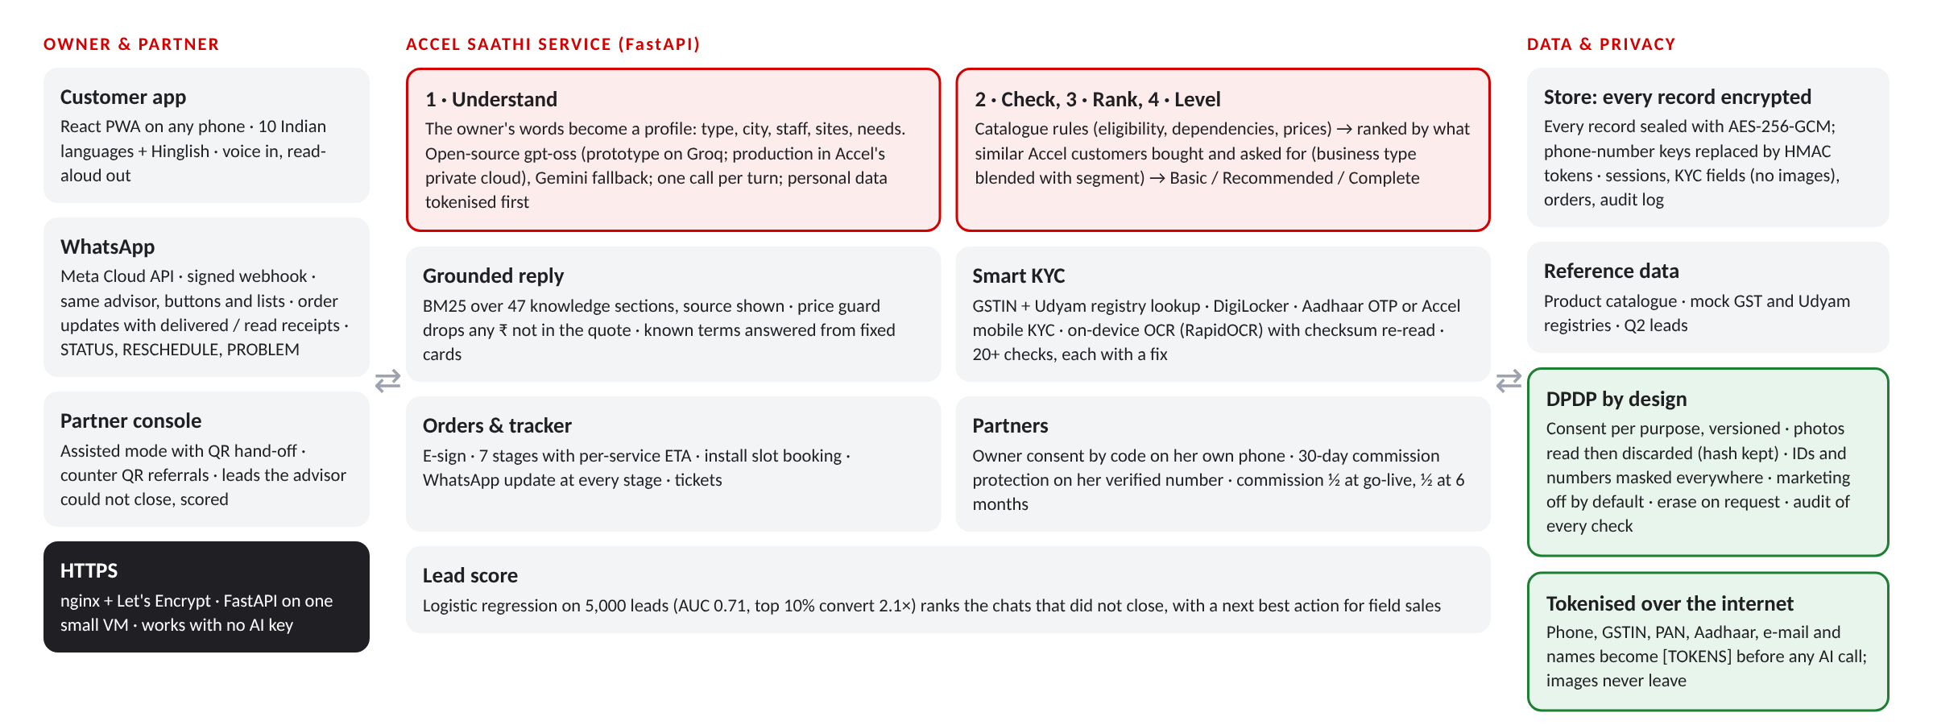
A1 · Architecture: the AI understands, rules decide, privacy is built in
One FastAPI service behind HTTPS serves the app, the WhatsApp webhook and the partner console. Live at udyam.openforge.online. Code and tests: github.com/sujalbhatu/accel-saathi.
Prototype: React + Vite PWA · FastAPI · SQLite, every record encrypted · RapidOCR (ONNX, CPU) · scikit-learn · WhatsApp Cloud API · Groq and Gemini. Runs on a 1 GB VM; the AI is optional.
Production path: the same service in Accel's private cloud, a managed encrypted database, an open model hosted there, and Accel's own e-KYC licence (KUA) for Aadhaar.

Slide 11
A2 · Privacy note: collect what each step needs, for as long as it needs it
Designed to the DPDP Act 2023. The full notice is in the app at /privacy.html and shown before any document is read.
Purpose | Data | Kept for | Basis
Advice | Chat messages, business type, city, team size, sites | The session; erased on request before an order | Consent (owner starts the chat)
KYC | GST, Udyam, signatory and address fields; a hash of each photo, never the image | While the connection is active, then as licence rules require | Consent switch (required for KYC)
Order and installation | Contact name, masked mobile, install address, chosen bundle | Contract term | Contract
Order updates | WhatsApp number, stored apart from the order, masked everywhere | Until go-live and support end | Consent switch (on by default, can be off)
Marketing | Nothing unless switched on | Until withdrawn | Consent switch (off by default)
Owner's rights
Consent in her language with one switch per purpose; withdraw as easily as given; erase my data in one tap before an order, or "DELETE MY DATA" on WhatsApp; a named grievance officer.
Assisted sales
When a partner holds the device, consent comes only from a code sent to the owner's own phone, so a partner can never consent for her.
Security
Encrypted before storage: every record sealed with AES-256-GCM, phone-number keys replaced by tokens. HTTPS everywhere; webhooks verified by Meta's signature; IDs masked in screens and logs.
AI and breaches
Personal data becomes tokens before any AI call; images never leave. Production model runs in Accel's private cloud. Breaches reported as the DPDP Rules require.

Slide 12
A3 · Every signal we found in the data, and the decision it drove
smb_leads.csv, 5,000 leads, Apr–Jun 2026. Nothing in the app is hard-coded to this copy of the data.
Signal in the data | Decision in the product and plan
GSTIN holders activate at 9.6% vs 2.0% without (4.7×) | Ask for the GSTIN first; registry fills and verifies the profile
Churn 5.9% after 1 status chase vs 27.9% after 5 (2 of 34 vs 12 of 43), not steady between; NPS 7.5 to 6.0 | WhatsApp update at every stage, STATUS / RESCHEDULE / PROBLEM by message
Regional-language leads convert at 6.2% vs 8.0% for Hindi or English | Advisor, buttons and WhatsApp in 10 languages, voice in, read-aloud out
Referral ₹4,099 and WhatsApp ₹4,026 per activation vs field ₹24,335 | WhatsApp entry, partner counter QR, assisted mode
Accel users (38% of leads) convert at 9.2% vs 6.2% on other providers | Reuse Accel KYC; lead with the bundle for this base
Only chains and plants took 24 months; in chains they churned more (15.8% vs 6.7%); 2 of 3 six-month deals churned | 12 months for shops, offices and chains, 24 for plants; 24 shown only as a lower price; no 6-month deals
Micro shops: ₹20,007 to acquire, ₹2,470 bundle, 22.7% churn | Shops are self-serve only; field time goes to chains and plants
1,583 drop-offs from visits, slow or complex quotes, paperwork, installs over 21 days | One sitting: instant quote in plain words, KYC in minutes, ETA per service
325 "locked in", 207 "went cheaper" | Win on fit and one bill, not price; local partners sell through us
Impact model (slide 8): at each funnel step, half of the journey losses are removed and every other loss stays at today's rate, so 368 → 760 (a quarter removed: 538; three quarters: 1,045). Cost per activation = (₹55.4 lakh, same spend, + ₹3.5 lakh a quarter to run Saathi) / 760 = ₹7,746; with a 5-person team (₹30 lakh a quarter), ≈ ₹11,700. Revenue = 392 × ₹6,900 median bundle × 12 ≈ ₹3.2 crore a year (the median, not the ₹12,350 mean).

Slide 13
A4 · Test results: what we checked, and the KYC answer key
All suites are in backend/tests and run on GitHub on every push; the advisor suite also runs with the live AI (--llm).
Suite | Pass | What it covers
Advisor scenarios | 92/92 | 35 owners, 5 languages, 7 chat changes, 22 questions, 28 sales moments; 498+ catalogue checks; AI on and off
Search test | 93.5% | 83 questions, 10 languages: right section in the 4 the AI gets (keywords alone 65%)
AI answers | 0% | invented numbers (live AI, 83 questions); 96% owner's language, 94% right source; ≈ ₹0.11 a chat
Ranking back-test | 3/3 | Leave-one-out, 368 customers: beats hand rules and one bundle for all; ties segment best-sellers (A5)
10 languages | 100/100 | The whole journey in each language, AI off: every string, prices, script, the selling taps
Specimen KYC pack | 12/12 | Every applicant judged as the planted problem requires (right table)
WhatsApp orders | 59/59 | Signed webhooks, every stage update, STATUS, RESCHEDULE, PROBLEM; one reminder only
Privacy and ranking | 17/17 | No readable data in the DB file, tampering refused, AI sees only tokens, ranking learned per business type
Partner flows | 17/17 | Owner code, lockout after 5 tries, protection across sessions, referral QR, console totals
KYC flows | 10/10 | No-GSTIN owners, remove and replace, Udyam only when registered
Applicant | Decision | Reason found
K01 | Rejected | GSTIN cancelled in the registry
K02 | Approved | Clean
K03 | Approved | Clean
K04 | Rejected | GST certificate too blurred to read
K05 | Rejected | Udyam certificate missing
K06 | Rejected | Altered GSTIN: checksum fails; registry shows the real one
K07 | Rejected | Legal name differs from the registry
K08 | Approved | Clean
K09 | Approved | Clean
K10 | Review | LLP: authorisation letter needed (template given)
K11 | Rejected | Bill 257 days old (limit 90)
K12 | Approved | Clean

Slide 14
A5 · How the advisor ranks a bundle, and how we tested it
Beyond fixed weights: metadata on both sides of the catalogue, learned from customers, re-ranked by what she tells us.
1
Catalogue metadata
Each of the 25 services is tagged with the need it meets, who may buy it (city tier, size, GSTIN), what it depends on and how many to add per person, site or counter.
BACK-TEST: 368 ACTIVATED CUSTOMERS, LEAVE-ONE-OUT
Method | Precision | Recall | F1
One bundle for everyone | 37.2% | 43.1% | 0.399
Hand-written rules (our first version) | 60.0% | 65.2% | 0.625
Best-sellers in her segment | 63.1% | 66.9% | 0.650
Accel Saathi, learned | 63.2% | 67.1% | 0.651
2
Owner problems
8 everyday problems (UPI fails at rush hour, theft, missed calls, records on one PC, internet drops, guests want Wi-Fi, repeat customers, branches out of sight) mapped to services. Asked as taps; read from free text in 10 languages by rules and the AI.
3
Learned from customers
Share of similar activated customers who kept each service: her business type, pulled toward its segment with a 30-customer prior; churned customers count half. What owners asked for nudges the order (a quarter weight).
How: each customer is taken out of the counts, then predicted from what we would know at the first chat (type, size, sites, city, GST, internet today). Every method builds a valid bundle of the same size.
What it shows: learning beats hand-written rules and a one-size bundle. Accel's purchases differ mostly by segment, so it matches segment best-sellers; business type, retention and her own problems add what no average can know.
What we did not use: products of interest at lead time matched purchases only 29% of the time, so they never decide a pre-tick.
4
Levels and reasons
Basic: essentials plus her problems. Recommended: the learned pre-ticks. Complete: plus what businesses like hers usually add. "Why this bundle" shows the four steps in her words.

