Slide 1
ZENKART CUSTOMER ANALYTICS
– Business Case Summary
Zenkart is facing issues with repeat purchases, sales volatility, inconsistent customer behavior, and delivery delays.
Objective: Use data to understand what is going wrong and identify opportunities to improve customer experience and business performance.

Slide 2
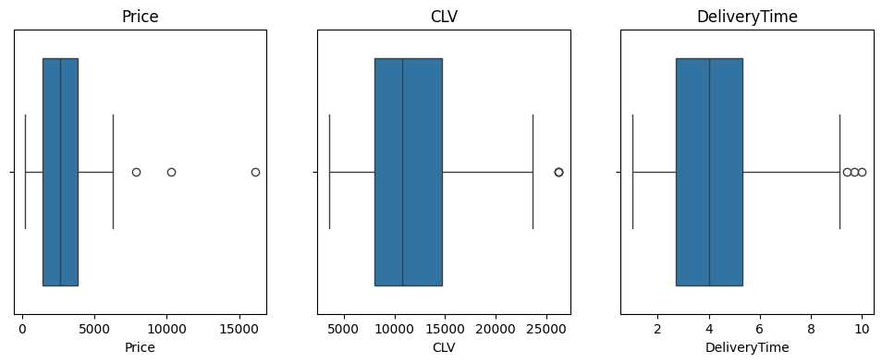
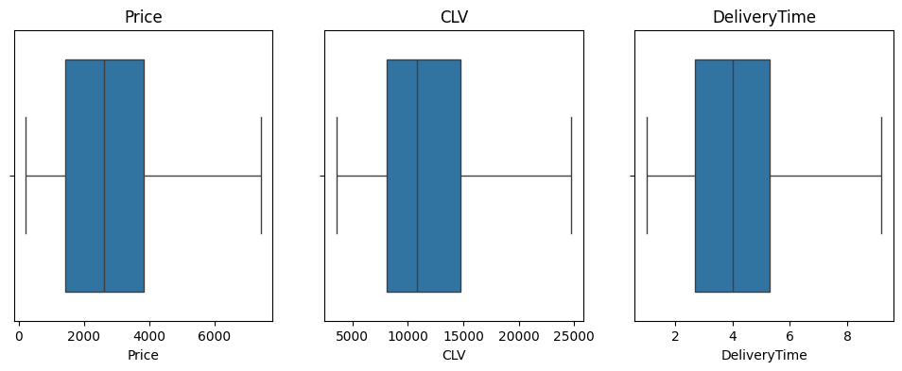
DATA CLEANING & PREPARATION
Handled missing values using median imputation for Income & DeliveryTime.
Did not fill Rating; created HasRated to capture real customer behavior.
Detected and capped outliers in Price, CLV, DeliveryTime using IQR.
Outliers capped using IQR method to stabilize segmentation and forecasting.
Several extreme values identified using IQR.

Slide 3
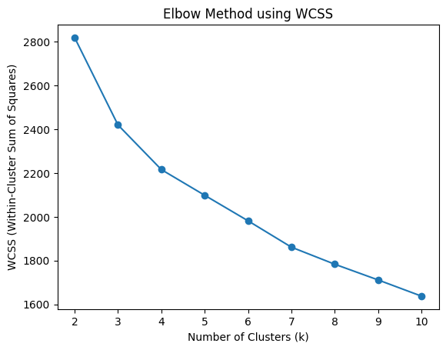
CUSTOMER SEGMENTATION (K-MEANS)
Features Used
  Recency
  Frequency
  Monetary Value
  AvgDeliveryTime
  CLV
  Age
  Income
  CityTier
Features selected to capture both purchasing behavior and customer demographics.
Elbow clearly indicates k = 4 as best cluster count.

Slide 4
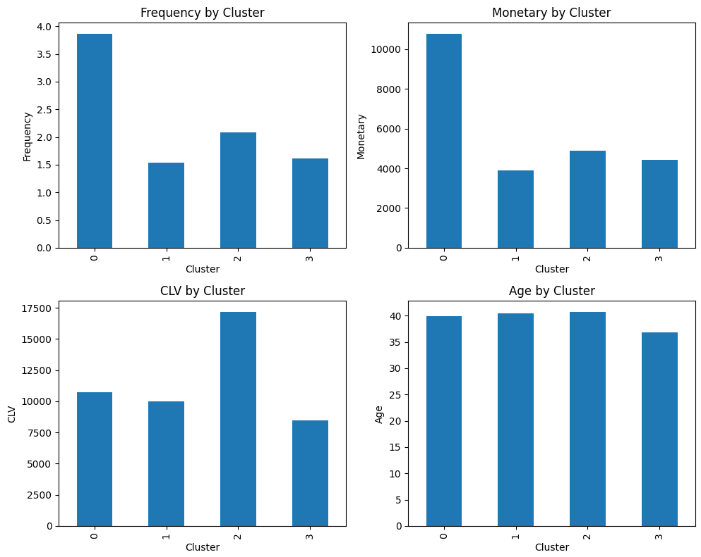
CLUSTER INTERPRETATION & KEY CUSTOMER PROFILES
Cluster | Segment Name | Key Traits
0 | Mid-Tier Loyal Customers | Buy regularly, stable spending, moderate income
1 | Dormant / At-Risk Customers | Very high Recency, low Frequency & Monetary, highest churn risk
2 | Premium High-Value Customers | High Income, highest CLV, strong long-term revenue contributors
3 | Price-Sensitive / Slow-Delivery | Lower income, fewer orders, longer delivery times impacting satisfaction

Slide 5
CHURN PREDICTION (CLASSIFICATION MODEL)
Model Used - Logistic Regression
Trained on customer-level behavioral + demographic features
Handling Class Imbalance
Baseline Model (Imbalanced Data):
Accuracy: 81%
Churn Recall: 12%
Model fails to identify churners
Balanced Model (class_weight = ‘balanced’):
Accuracy: 60%
Churn Recall: 76%
Model now identifies majority of churners
High recall is more important than accuracy because identifying churners helps prevent customer loss.
What Drives Churn
High Recency → long inactivity
Low Frequency → few repeat orders
Longer DeliveryTime → delivery experience issues

Slide 6
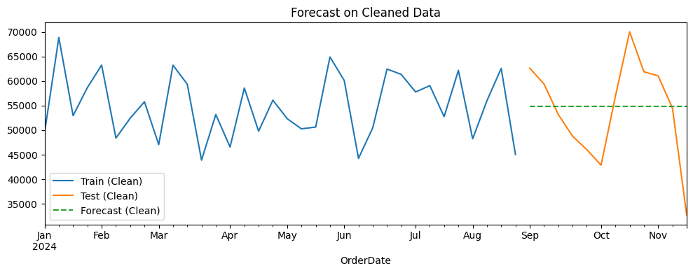
TIME SERIES FORECASTING (WEEKLY SALES)
12-Week Forecast
Model Used: Simple Exponential Smoothing (SES)
Weekly Sales Preparation
Converted daily transactions → weekly total sales
Handled missing weeks (forward fill)
Capped extreme weekly spikes (IQR method)
Clean weekly series improves forecasting stability.
Impact of Cleaning (MAPE Comparison)
Before Cleaning: 34.7% MAPE
After Cleaning: 16.5% MAPE
Cleaning missing values and outliers halved the error.
Stable 12-week forecast for planning & inventory decisions

Slide 7
Improve Delivery Performance (Operations)
  Focus especially on Cluster 3 (price-sensitive + longer delivery times)
Targeted Retention Campaigns (Marketing)
  Prioritize Cluster 1: Dormant / At-Risk Customers
  Address inactivity & bring back customers with high recency
3. Strengthen Loyalty for High-Value Customers
  Cluster 2: Premium High-Value
  Introduce loyalty rewards, early access, and premium support
4. Inventory & Demand Planning
  Use the 12-week sales forecast to plan:
    Stock levels
    Procurement cycles
    Seasonal builds
  Cleaned forecast reduces error by 50%+, improving planning accuracy
5. Boost Rating Participation
  Encourage more customers to rate products
  Helps improve product feedback and personalization
RECOMMENDATIONS

Slide 8
Cleaned and transformed Zenkart’s data into actionable customer insights
Identified 4 clear customer segments with different needs and behaviors
Built a churn model that improved recall from 12% → 76%
Created a 12-week sales forecast with 50% better accuracy after cleaning
Delivered practical recommendations across marketing, retention, operations, and planning
FINAL TAKEAWAY

