Slide 1
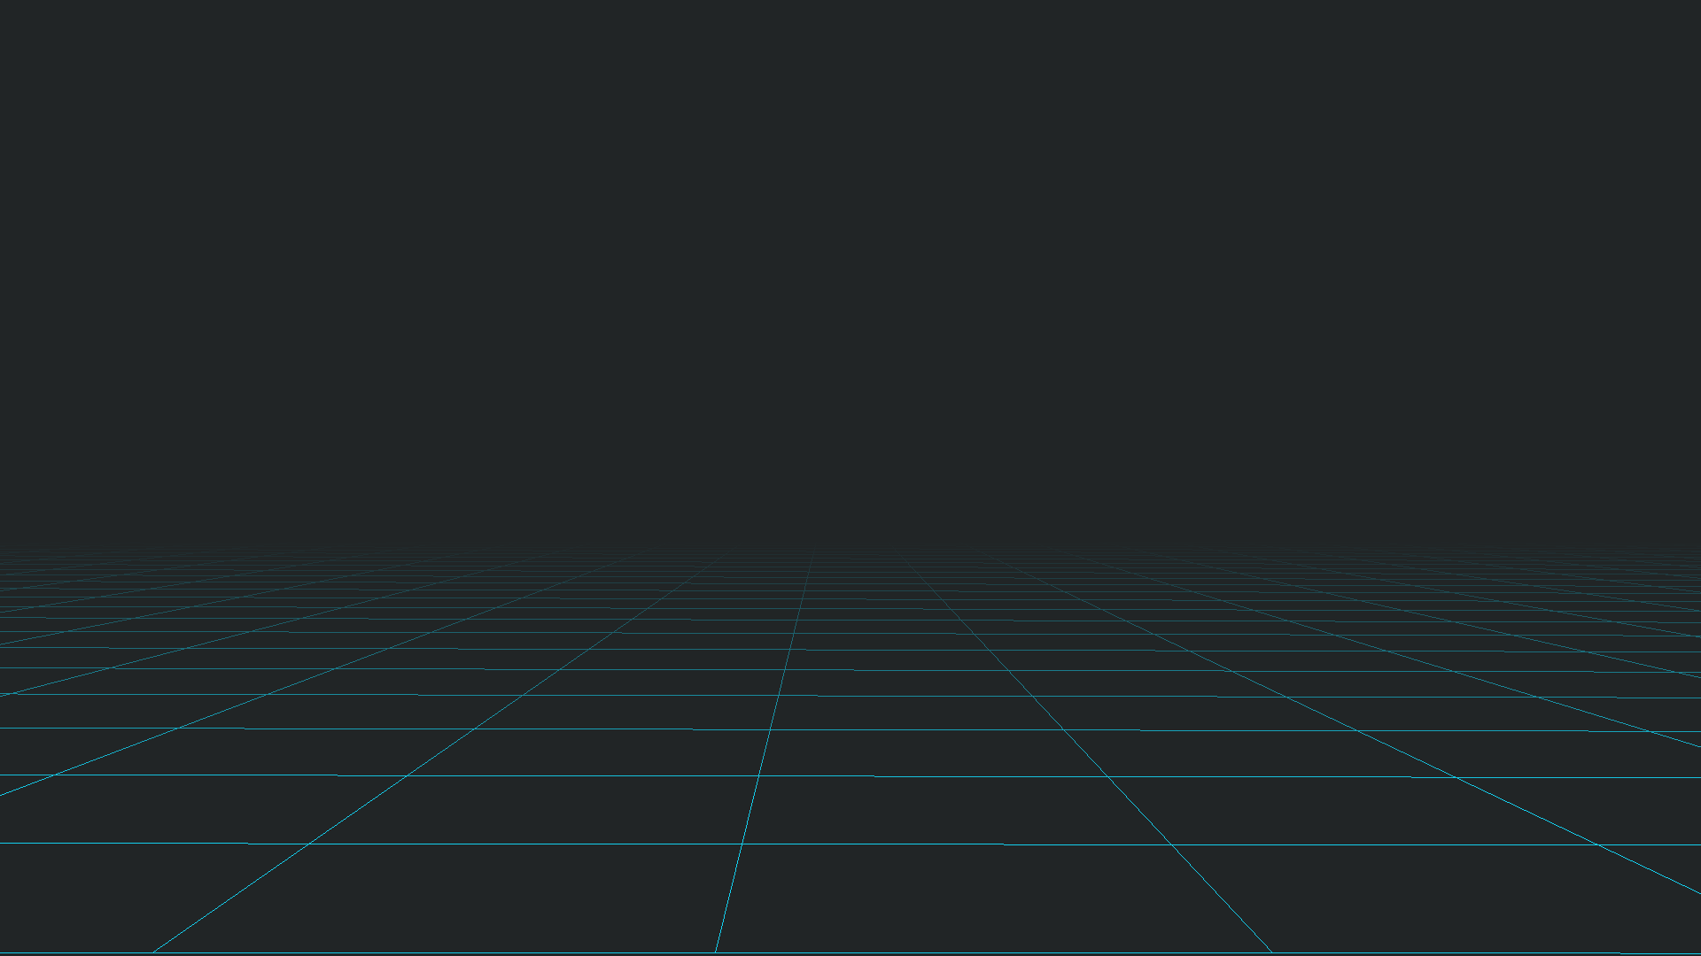
Lyn
A simple programming language to create
mathematical animations.

Slide 2
Our Goals with Lyn :
Hands-on interactive experience with abstract concepts
Usable for all
Feasible for a broad spectrum of topics

Slide 3
What we’ve achieved so far :
Built a rendering engine and implemented some primitive shapes
Built some compound components based on the primitives implemented
Implemented animations
Exposed an API to control the rendering engine from Python itself
Built the Lyn programming language from the ground up

Slide 4
What’s Ahead:
Port the renderer for the web using Rust
LYNIUM- Our very own community-based preset index
Introduce support for three dimensional renderings

