Slide 1
IILM UNIVERSITY, GREATER NOIDA
INTERNSHIP REPORT PRESENTATION
Python Full Stack
Development With Project
AICTE – EduSkills Virtual Internship Program
Sujal Gautam
Roll No. 2410031651 | B.Tech CSE
June – August 2026

Slide 2
ABOUT THE STUDENT
Candidate Profile
🎓
Roll Number
2410031651
Sujal
Gautam
Institute
IILM University, Greater Noida, U.P.
Programme
B.Tech – Computer Science & Engineering
B.Tech CSE, Batch 2024–2028
Internship Domain
Python Full Stack Development With Project
Duration
8 Weeks | June – August 2026
Python Full Stack Development Virtual Internship • Sujal Gautam
02

Slide 3
ABOUT THE PROGRAM
EduSkills, AICTE & Industry Learning
EduSkills Academy is an ISO 9001:2015 and ISO/IEC 20000-1:2018 certified organization working under the theme “Nation Building Through Skills.” It partners with the All India Council for Technical Education (AICTE) to run the AICTE–EduSkills Virtual Internship Program under the patronage of the National Internship Portal, Ministry of Education.
🏅
🏳
💻
ISO Certified
AICTE Patronage
Full Stack Curriculum
ISO 9001:2015 & ISO/IEC 20000-1:2018 certified organization.
Run under the National Internship Portal, Ministry of Education.
Structured 8-week Python, FastAPI & React learning path.
Python Full Stack Development Virtual Internship • Sujal Gautam
03

Slide 4
PROBLEM STATEMENT
Building a Redis-Style In-Memory Cache
Students often understand caching concepts theoretically but rarely get hands-on practice building a working key-value store. This project, “In-Memory Cache with TTL Lite,” tackles that gap — implementing a simplified version of systems like Redis, supporting core operations, hit/miss tracking, time-based expiration, deletion, and statistics reporting, entirely in Python.
This project built the full workflow of an in-memory caching system:
SET & GET
→
Hit / Miss
Tracking
→
TTL
Expiration
→
DELETE
Operation
→
Stats
Report
Python Full Stack Development Virtual Internship • Sujal Gautam
04

Slide 5
PROJECT OBJECTIVES
What the Internship Set Out to Achieve
⚙
🔌
⚛
Python & Full Stack Basics
FastAPI & Validation
React Fundamentals
Build a strong foundation in Python, OOP, and full-stack development concepts.
Build backend APIs using FastAPI with request handling and Pydantic validation.
Learn components, JSX, hooks (useState, useEffect) and dynamic UI building.
🗄
🔑
🚀
Database Integration
In-Memory Cache with TTL
Capstone Deployment
Integrate relational databases with SQLAlchemy ORM and perform CRUD operations.
Design a key-value store with hit/miss tracking, TTL expiry, delete & reporting.
Build and deploy a complete full-stack capstone application end to end.
Python Full Stack Development Virtual Internship • Sujal Gautam
05

Slide 6
TECHNOLOGIES & TOOLS
The Toolkit Behind the Internship
</>
⚡
✅
⚛
Python
FastAPI
Pydantic
React
Core programming language
Backend API framework
Request & data validation
Frontend UI & hooks
🗄
🔁
📦
⏱
SQLAlchemy
Redux / Zustand
Docker
TTL Caching
Database ORM & CRUD
Frontend state management
Testing & deployment
Key-value store, in-memory
Python Full Stack Development Virtual Internship • Sujal Gautam
06

Slide 7
SYSTEM ARCHITECTURE
From Command Input to Cache Report
📝
Input Layer
Commands read from stdin (SET, GET, DELETE, STATS)
↓
Storage Layer
Key-value pairs held in a Python dictionary
🗄
↓
TTL Layer
Expiry timestamps attached; stale entries auto-invalidated
⏱
↓
Metrics Layer
Hit / miss counters track cache performance
📊
↓
Delete Layer
Explicit DELETE removes entries on demand
🗑
↓
Reporting Layer
Aggregated stats output as structured JSON
📈
Python Full Stack Development Virtual Internship • Sujal Gautam
07

Slide 8
METHODOLOGY
The 8-Week Learning Journey
1
WEEK
2
WEEK
3
WEEK
4
WEEK
Full Stack & Python Basics
FastAPI & Data Validation
React Fundamentals & Hooks
Frontend-Backend Integration
Environment setup, data types, functions, OOP
Backend APIs, routing, Pydantic validation
Components, JSX, useState, useEffect
Reusable components, API calls, data rendering
5
WEEK
6
WEEK
7
WEEK
8
WEEK
Database with SQLAlchemy
Advanced React & State Mgmt
Testing & Deployment
Capstone Project
ORM, CRUD operations, relational models
React Router, Redux / Zustand for scale
Backend/frontend testing, Docker, cloud deploy
Full-stack e-commerce app: FastAPI + SQLAlchemy + React
Python Full Stack Development Virtual Internship • Sujal Gautam
08

Slide 9
EXPECTED OUTCOMES
Skills & Capabilities Gained
✓
Practical understanding of implementing in-memory data structures for key-value storage
✓
Experience managing data lifecycle through Time-To-Live (TTL) expiration mechanisms
✓
Skill in tracking and analyzing cache performance metrics like hits and misses
✓
Proficiency in Python for building stateful applications and structured JSON reports
✓
Hands-on exposure to FastAPI, React, and SQLAlchemy across the full stack
✓
Completed all learning modules and cleared the Final Assessment with an “Outstanding” grade
Python Full Stack Development Virtual Internship • Sujal Gautam
09

Slide 10
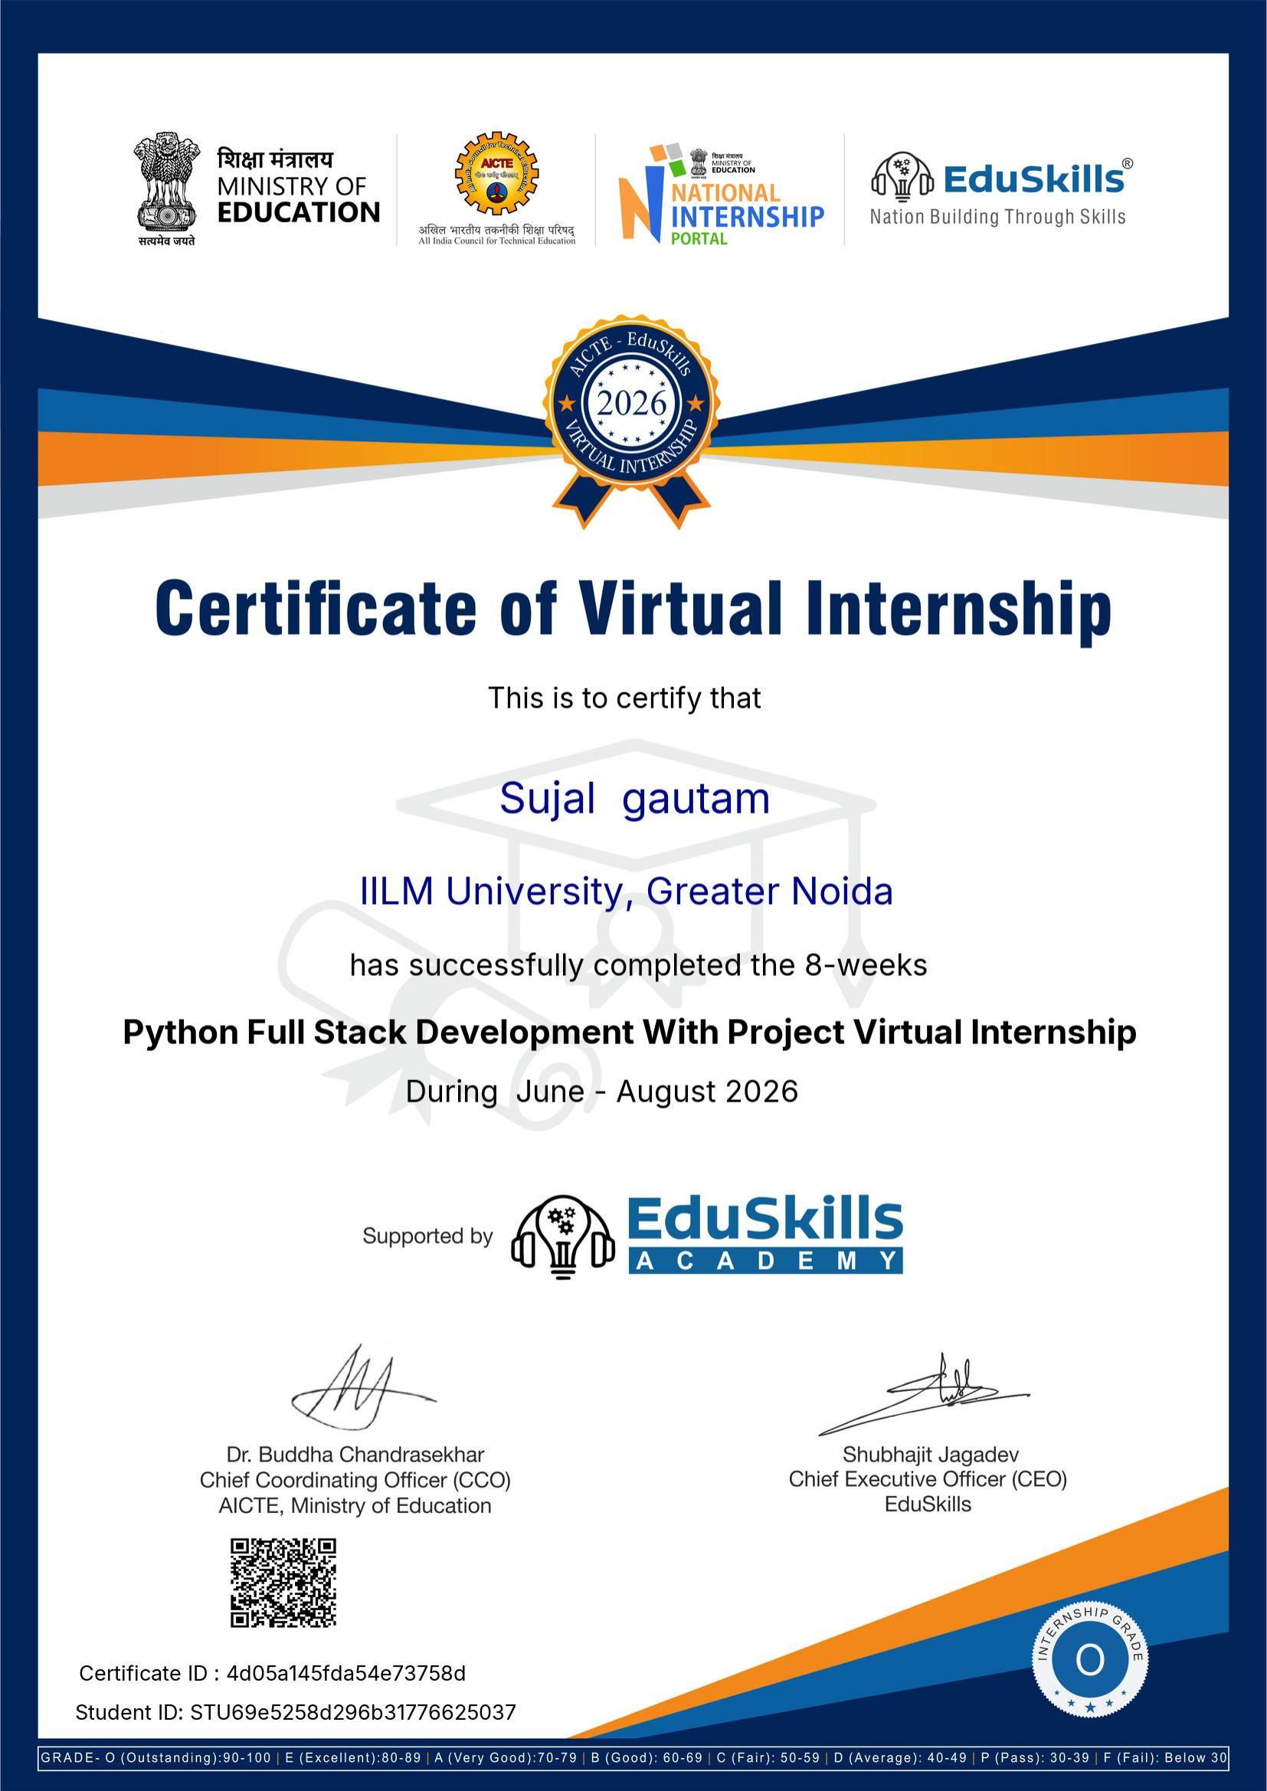
CERTIFICATION
Successfully Completed
Grade
O – Outstanding
Certificate ID
4d05a145fda54e73758d
Student ID
STU69e5258d296b31776625037
Duration
8 Weeks | June – August 2026
Python Full Stack Development Virtual Internship • Sujal Gautam
10

Slide 11
🎓
Thank You
Python Full Stack Development With Project | AICTE – EduSkills Program
Sujal Gautam
Roll No. 2410031651 | IILM University, Greater Noida

