Slide 1

Consumer Shopping Behavior Analysis
Python · SQL · Power BI — uncovering retail insights from 3,900 transactions

Slide 2
Why This Analysis Matters
Businesses collect vast transaction data — but meaningful insights require the right analytical approach.
1
Data Collection
2
Cleaning
3
EDA
4
SQL Analysis
5
Dashboard
6
Insights

Slide 3






Project Objectives
Purchasing Behavior
Revenue Categories
Analyze customer buying patterns
Identify top-performing products
Demographics
Seasonal Trends
Study spending by age & gender
Evaluate sales by season
Payment Methods
Power BI Dashboard
Analyze payment & shipping preferences
Build interactive visualizations

Slide 4

Dataset Overview
Key Attributes
Customer ID, Age, Gender, Location
Category, Purchase Amount, Season
Payment Method, Subscription Status
Review Rating, Discount, Promo Code
3,900
19
Total records
Features

Slide 5


Data Preprocessing with Python
Duplicates Removed
Clean records ensured
Missing Values
Review ratings handled
Age Groups Created
Segmented for analysis
Libraries
Pandas, NumPy, Matplotlib, Seaborn

Slide 6





SQL Business Analysis
SQL queries drove business-oriented insights across the cleaned dataset.
Revenue Analysis
Gender & Age
Seasonal Trends
Total & category-wise
Segment contribution
Sales by season
Payment & Shipping
Subscription & Discount
Customer preferences
Subscriber vs non-subscriber

Slide 7
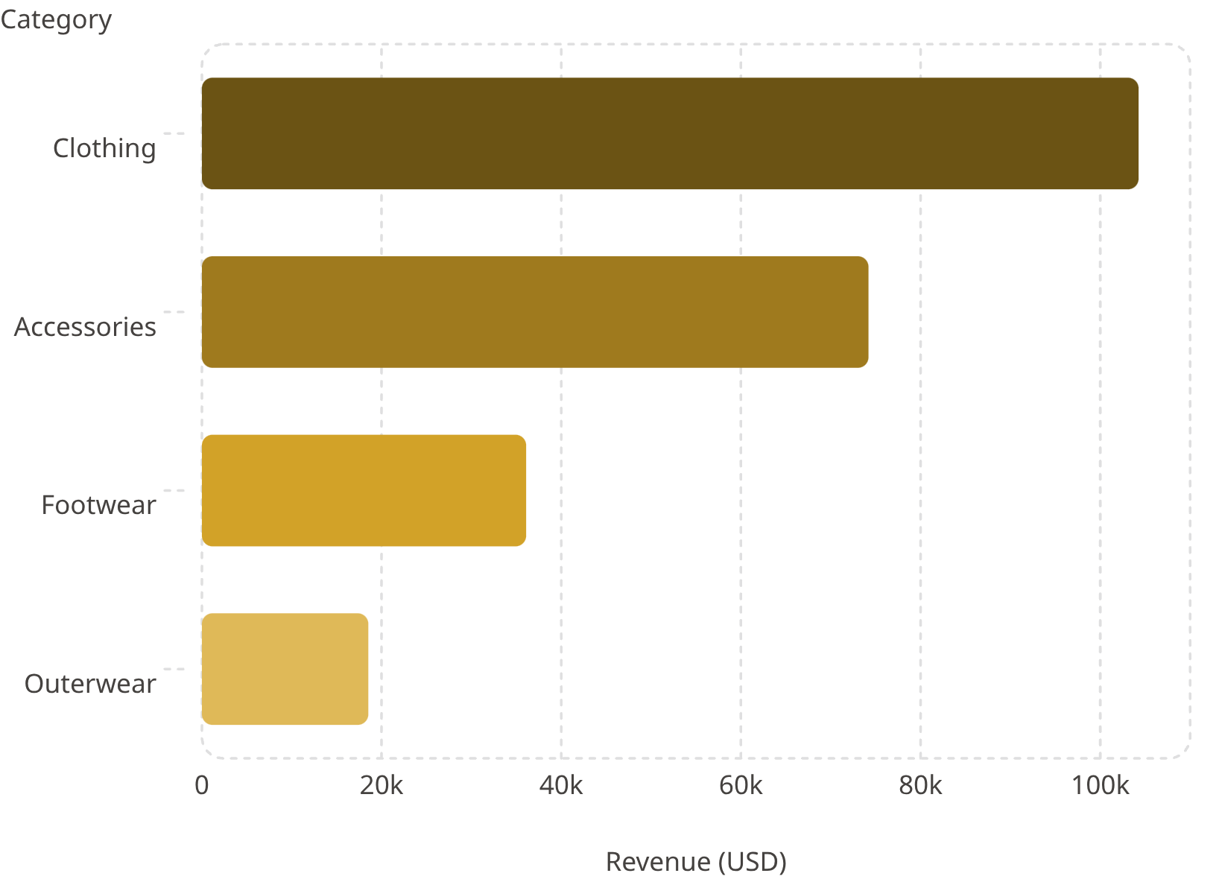

Key Findings: Revenue by Category
Total Revenue
$233,081 across all categories
Clothing Dominates
Nearly half of total sales
Gender Split
Male: $157,890 · Female: $75,191

Slide 8
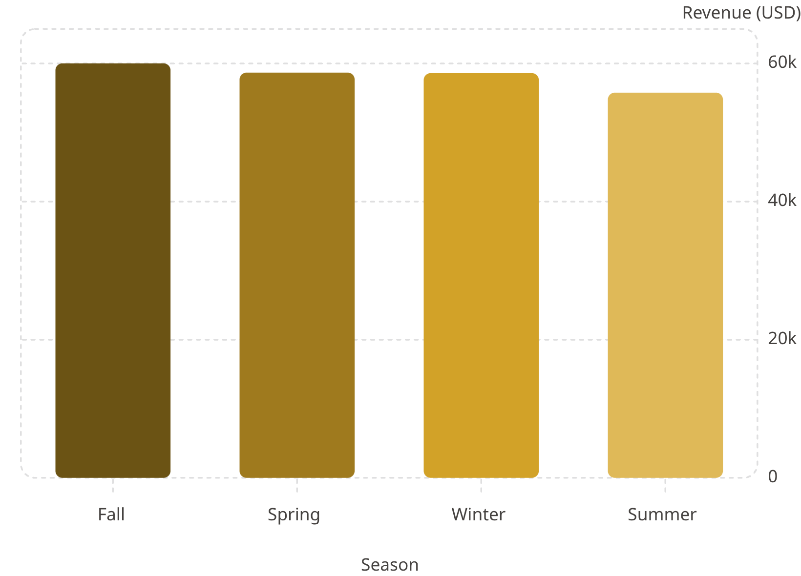
Seasonal, Payment & Subscription Insights
Seasonal Insight
Fall generated the highest sales revenue at $60,018.
Payment Method
Credit Card led at $40,310 — all methods closely clustered.
Subscription
Non-subscribers: $170,436 (2,847 customers)
Subscribers: $62,645 (1,053 customers)

Slide 9





Power BI Dashboard & Tools
KPI Cards
Interactive Filters
Total customers, avg rating, avg purchase
Subscription, Gender, Category, Shipping
Visualizations
Revenue by category, age group, sales trends
Tools & Technologies
Python
Cleaning & analysis
SQL
Business queries
Power BI
Dashboard
GitHub
Version control

Slide 10

Conclusion & Future Scope
Key Takeaways
Future Scope
Clothing = highest revenue category
Male customers drove largest sales share
Ages 46–55 = most valuable segment ($45,619)
Fall = top-performing season
Machine Learning
Segmentation Models
Predict purchasing behavior
Customer clustering
Sales Forecasting
Recommendation Systems
Real-time cloud dashboards
Personalized product suggestions

