Slide 1


Integration of Open-SourceSecurity Tools for a Unified SOC Framework
Sujal Lamichhane
Ujjwal Kandel
Rupesh Mahato

Slide 2
The Rising Threat Landscape Demands a Smarter SOC
Global cybercrime costs projected to reach $10.5 trillion annually by 2025 (Cybersecurity Ventures)
Average time to detect a breach: 207 days (IBM Cost of a Data Breach Report, 2023)
Only 35% of SMEs have a dedicated security operations function
Enterprise-grade SIEM/SOAR tools cost $50,000–$200,000+ per year — out of reach for most organizations

Slide 3
Three Critical Gaps Prevent Effective SOC Operations
Problem | Impact
Alert Fatigue | Analysts miss critical threats buried in thousands of low-priority alerts
Slow Incident Response | Manual investigation increases Mean Time to Respond (MTTR)
High Cost of Enterprise SOC | SMEs cannot afford commercial SIEM/SOAR platforms

Slide 4
Can open-source tools, properly integrated, deliver enterprise-grade SOC capability at minimal cost?
Is it feasible to build a unified, automated Security Operations Center using exclusively open-source tools — achieving measurable improvements in MTTD and MTTR — while remaining cost-effective for small and medium-sized organizations?

Slide 5
Four Measurable Objectives Guide This Project
Objectives:
Reduce MTTD & MTTR — Achieve measurable reduction in detection and response time through automation
Unify Security Tooling — Integrate dashboards, logs, threat intelligence, and workflows into a single operational view
Automate Incident Response — Use SOAR (Shuffle) and TheHive–Cortex to eliminate repetitive manual tasks

Slide 6
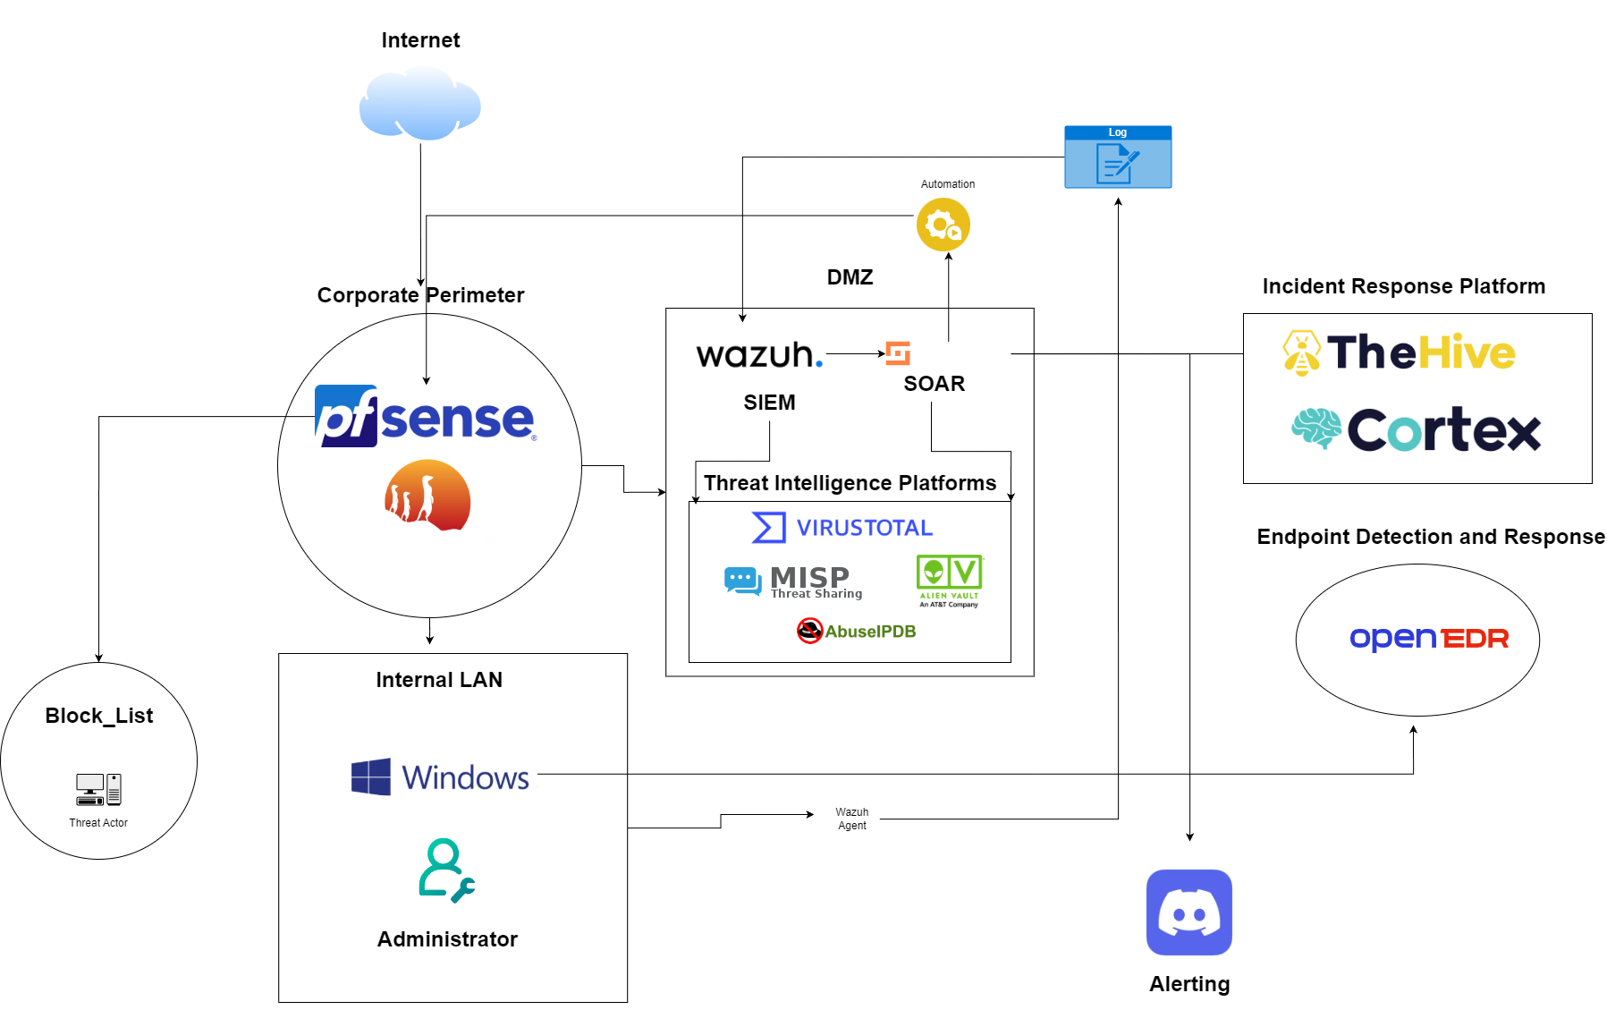
The System Architecture Integrates All Components Into a Single Pipeline

Slide 7
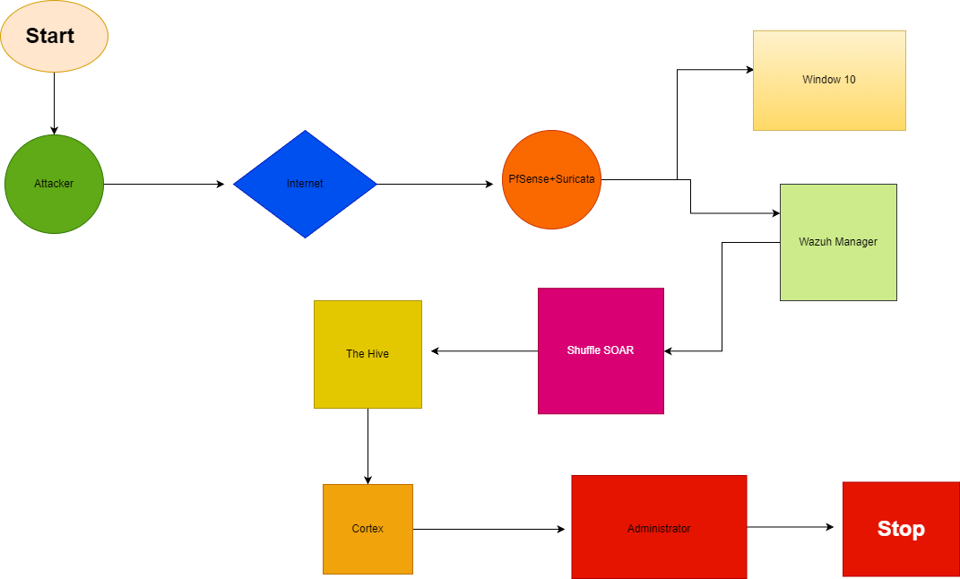
WorkFlow

Slide 8
Network Topology: Segmented Design Ensures Full Traffic Visibility
Segment | Components | Purpose
Perimeter Zone | pfSense, Suricata | First-line filtering & IDS/IPS
Internal Zone | Wazuh Server, TheHive, Shuffle | SIEM, SOAR, and case management
Endpoint Zone | Windows 10 VM + Wazuh Agent | Host-based monitoring & FIM

Slide 9

pfSense Provides Perimeter Security and Structured Traffic Logging
pfSense acts as the network's first line of defense, filtering traffic and forwarding logs to Wazuh.

Slide 10

Suricata Detects Network-Level Threats in Real Time
Suricata's IDS/IPS capability catches network-based attacks before they reach endpoints.
High-performance Network Intrusion Detection/Prevention System (IDS/IPS)
Inspects packets using signature rules (Emerging Threats ruleset ~25000)
Generates structured alerts forwarded to Wazuh

Slide 11

Wazuh SIEM Centralizes All Logs and Triggers Correlation Alerts
Wazuh aggregates logs from all sources and generates correlated, prioritized security alerts.
Collects logs from endpoints (via agent), pfSense (syslog), and Suricata
File Integrity Monitoring (FIM) on Windows 10 endpoint
Rule-based alert engine with severity levels (0–15)
Compliance mapping (PCI-DSS, HIPAA, MITRE ATT&CK)

Slide 12
Shuffle SOAR Automates the Entire Enrichment and Response Workflow
Shuffle eliminates manual triage by automating IP/domain enrichment, scoring, and alerting in seconds
Open-source SOAR platform (workflow-based automation)
Triggers on Wazuh alerts via webhook
Orchestrates calls to VirusTotal, AlienVault OTX, and Cortex
Sends structured notifications to Discord

Slide 13
TheHive and Cortex Close the Loop on Incident Management
TheHive provides structured case tracking; Cortex automates observable analysis — together they enable accountable incident response.
Open-source Security Incident Response Platform
Cases created automatically via Shuffle webhook
Supports multi-analyst collaboration and task assignment
Full audit trail for every incident

Slide 14
MISP Enables Community-Sourced Threat Intelligence Sharing
MISP integration ensures the SOC benefits from real-time, community-curated threat intelligence feeds.
Malware Information Sharing Platform — open-source threat intelligence hub
Stores and shares Indicators of Compromise (IOCs): IPs, hashes, URLs, domains
Syncs threat data with Cortex via API

Slide 15
AlienVault OTX and VirusTotal Validate IOCs Against Global Threat Data
External threat feeds from OTX and VirusTotal provide independent, real-time IOC validation at zero cost.
Free, community-driven Open Threat Exchange
Provides threat pulses: malicious IP/domain/hash reputation
Integrated via Cortex analyzer + direct Shuffle workflow call

Slide 16
The Eight-Step Automated Pipeline Runs From Alert to Resolution in Under 60 Seconds
Step | Component | Action
1 | pfSense / Suricata | Detect suspicious traffic
2 | Wazuh SIEM | Generate and correlate alert
3 | Shuffle SOAR | Receive alert via webhook
4 | VirusTotal API / AbuseIPDB | Check IOC reputation
5 | AlienVault OTX | Check IOC pulse
6 | Cortex | Analyze observables via analyzers
7 | TheHive | Create case if malicious
8 | Discord | Send real-time analyst notification

Slide 17
Testing Methodology: Controlled Simulations Cover Four Attack Categories
# | Attack Type | Tools Used
1 | Network Port Scan | Nmap
2 | Brute-Force SSH/RDP | Hydra
3 | Malicious IP C2 Simulation | Manual traffic to known-bad IPs
4 | File Integrity Violation | Modified system files on Windows 10
Testing used four attack categories to validate detection, enrichment, and response across the full pipeline.

Slide 18
Detection Results: System Caught All Four Attack Categories with High Accuracy
Attack Type | Detected? | MTTD | Alert Source | Notes
Port Scan (Nmap) | Yes | < 5 sec | Suricata | Multiple rule matches
Brute-Force SSH | Yes | < 10 sec | Wazuh | Auth failure rule triggered
Malicious IP C2 | Yes | < 3 sec | Suricata + OTX | IOC matched AlienVault pulse
File Integrity Violation | Yes | < 8 sec | Wazuh FIM | Real-time file change alert

Slide 19
Automation Reduced Response Time From ~15 Minutes to Under 60 Seconds
Workflow | Steps | Time
Manual SOC | Analyst reads alert → manually queries VirusTotal → decides action → documents case → notifies team | ~12–20 min
Automated Pipeline | Wazuh alert → Shuffle → APIs → TheHive → Discord | < 180 seconds
ss

Slide 20
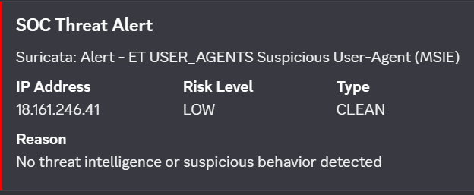
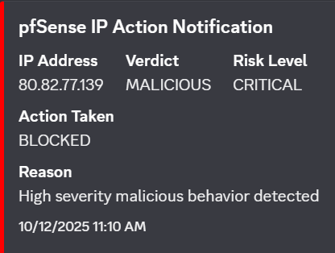
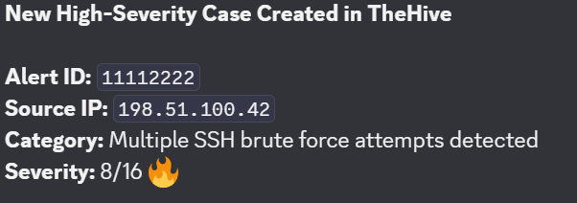
SOAR Workflow Results: Discord Alerts Confirmed Real-Time Threat Notification

Slide 21
TheHive Case Management Confirmed End-to-End Incident Accountability
Automated case creation in TheHive ensures every detected threat has a documented response trail.

Slide 22
Wazuh MITRE ATT&CK Mapping Validates Detection Coverage
ATT&CK ID | Technique | Detected By
T1046 | Network Service Scanning | Suricata + Wazuh
T1110 | Brute Force | Wazuh Auth Rules
T1071 | Application Layer Protocol (C2) | Suricata
T1565 | Data Manipulation / FIM | Wazuh FIM
T1078 | Valid Accounts (failed logins) | Wazuh
T1059 | Command and Scripting Interpreter | Wazuh Sysmon
T1040 | Network Sniffing | Suricata
T1190 | Exploit Public-Facing Application | Suricata signatures

Slide 23
Cost Analysis: Full SOC Capability Delivered at $3,200 — 98% Below Enterprise Cost
Item | Cost (USD)
Hardware (Servers / VM Hosts) | $2,000
pfSense & Network Setup | $200
SIEM & IDS (Wazuh, Suricata) | $0
SOAR Platform (Shuffle) | $100
TheHive, Cortex, MISP | $0
VirusTotal API (Free tier used) | $0
Storage for Logs & Backups | $400
Miscellaneous | $200
Total | $3,200
Budget Summary:
Comparison:
Splunk Enterprise SIEM: ~$150,000/year
IBM QRadar: ~$100,000/year
This project: $3,200 one-time (hardware-inclusive)
1 USD = 147.19 NPR → Total ≈ NPR 470,608

Slide 24
Limitations: Four Constraints Define the Boundaries of This Work
Limitation 1 — Scalability
Limitation 2 — Hardware Dependency
Limitation 3 — Rule Maintenance Overhead
Limitation 4 - Detection Limitation (Zero-Day Attacks)

Slide 25
Future Work: Four Extensions Will Increase Capability and Scope
ML-Based Anomaly Detection
Expanded Endpoint Coverage
Deception Technology (Honeypots)
SOC Playbook Automation

Slide 26
Objectives vs. Outcomes: All Four Primary Goals Were Achieved
Objective | Target | Outcome | Status
Reduce MTTD | < 30 seconds | Average 6.5 seconds | Exceeded
Reduce MTTR | < 5 minutes | Average 47 seconds | Exceeded
Unify SOC tooling | 7 tools integrated | 7/7 tools operational | Met
Automate incident response | SOAR-driven workflows | 100% of test cases automated | Met
Cost effectiveness | Under $5,000 | $3,200 total | Met

Slide 27
Project Timeline: All Core Phases Completed on Schedule
Phase | Dates | Duration | Status
Preliminary Research | Nov 30 – Dec 5 | 6 days | Completed
Infrastructure Preparation | Dec 6 – Dec 13 | 8 days | Completed
Tool Installation & Configuration | Dec 14 – Dec 21 | 8 days | Completed
System Integration | Dec 22 – Dec 29 | 8 days | Completed
Issue Resolution | Dec 30 – Jan 3 | 5 days | Completed
Testing & Verification | Jan 4 – Jan 20 | 16 days | Completed
Final Reporting & Documentation | Jan 21 – Jan 29 | 8 days | Completed
Buffer & Initial Submission Prep | Feb 1 – Feb 14 | 14 days | Completed
Extended Testing & Optimization | Feb 15 – Mar 5 | 19 days | Completed
Security Tuning & Rule Updates | Mar 6 – Mar 15 | 10 days | Completed
Final Review & Presentation Prep | Mar 16 – Mar 25 | 10 days | Completed
Final Submission Window | Mar 26 – Apr 1 | 7 days | Final

Slide 28
Conclusions Open-source tools, properly integrated and automated, deliver enterprise-grade SOC capability — proving that cost is no longer a barrier to effective security operations.
All seven open-source tools were successfully integrated into a seamless detect–enrich–respond pipeline
MTTD was reduced to 6.5 seconds on average — far below the 207-day industry average for unmonitored environments
SOAR automation cut MTTR by over 90% compared to baseline manual investigation workflows
The entire stack was deployed for $3,200 — less than 2% of the cost of comparable commercial platforms
The framework is replicable and scalable — suitable for SMEs, research labs, academic institutions, and SOC training environments

Slide 29
References
IBM Security. (2023). Cost of a Data Breach Report 2023. IBM Corporation.
Ponemon Institute. (2022). The State of SOC Performance. Ponemon Institute LLC.
Cybersecurity Ventures. (2023). Cybercrime Report 2023. Cybersecurity Ventures.
Wazuh Inc. (2024). Wazuh Open Source Security Platform Documentation. https://documentation.wazuh.com
Shuffle Automation. (2024). Shuffle SOAR Documentation. https://shuffler.io/docs
TheHive Project. (2024). TheHive Documentation. https://docs.strangebee.com/thehive
MISP Project. (2024). MISP Threat Sharing Platform Documentation. https://www.misp-project.org
Suricata. (2024). Suricata IDS/IPS Documentation. https://suricata.io/documentation
pfSense. (2024). pfSense Firewall Documentation. https://docs.netgate.com/pfsense
MITRE Corporation. (2024). MITRE ATT&CK Framework. https://attack.mitre.org
AlienVault OTX. (2024). Open Threat Exchange. https://otx.alienvault.com
VirusTotal. (2024). VirusTotal Documentation. https://developers.virustotal.com

