Slide 1

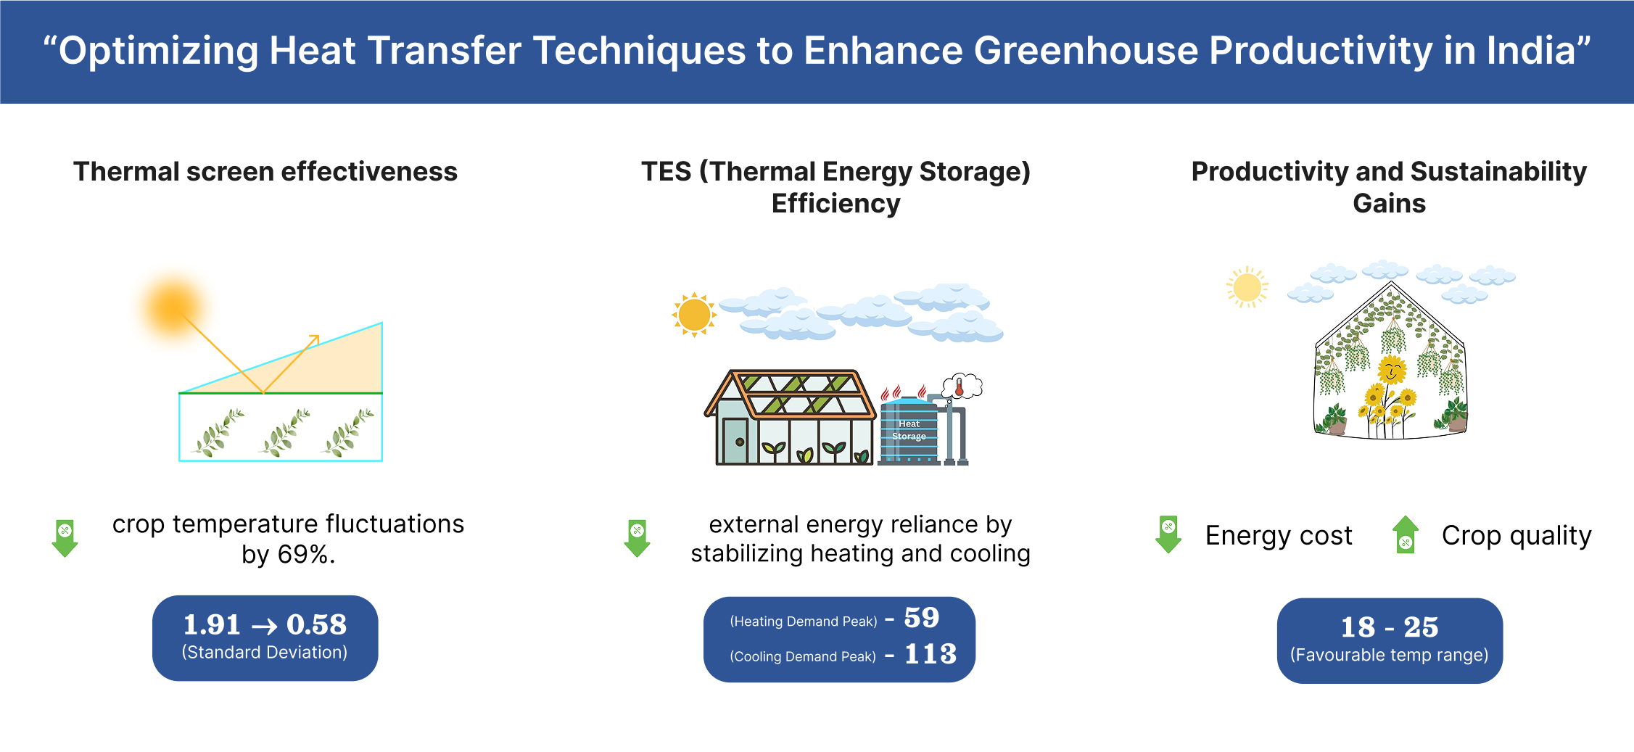
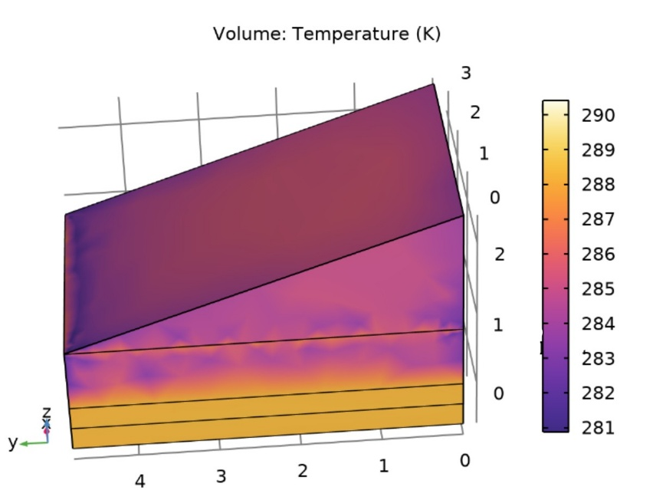
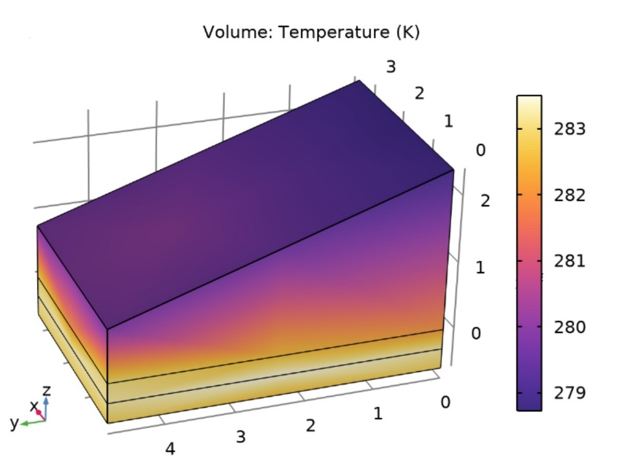
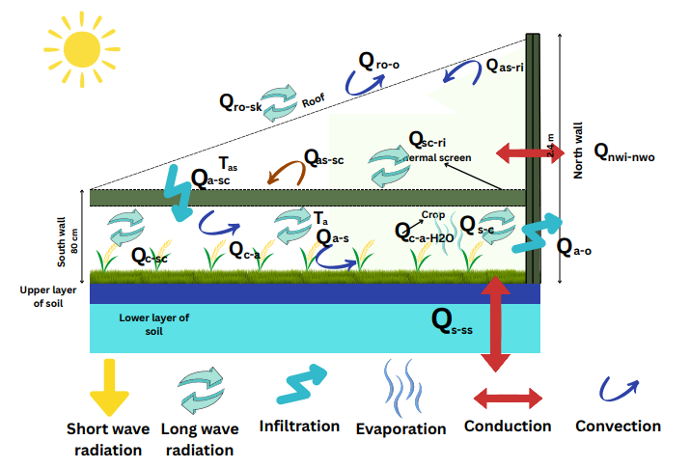
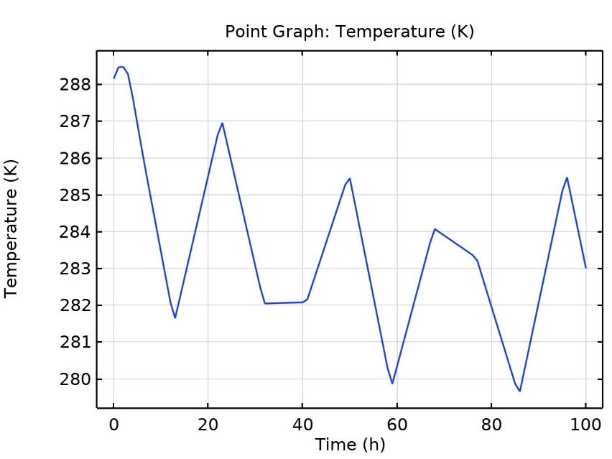
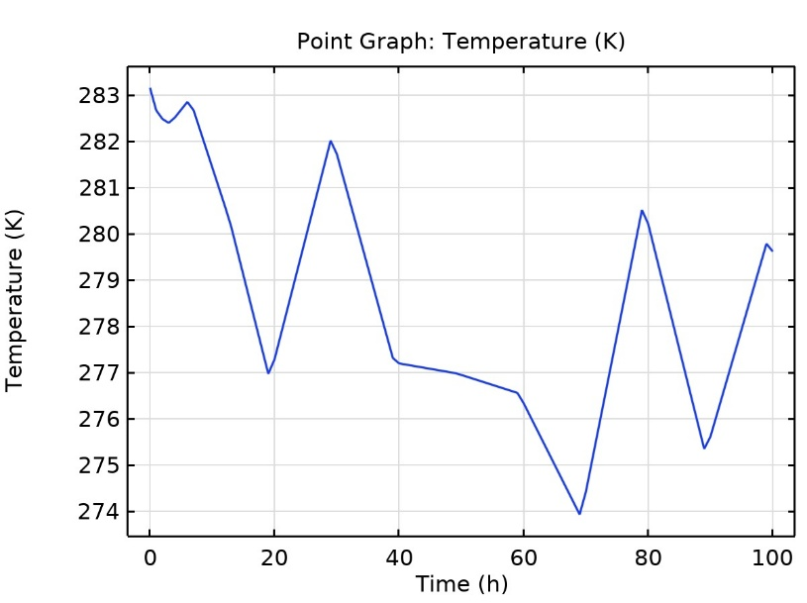
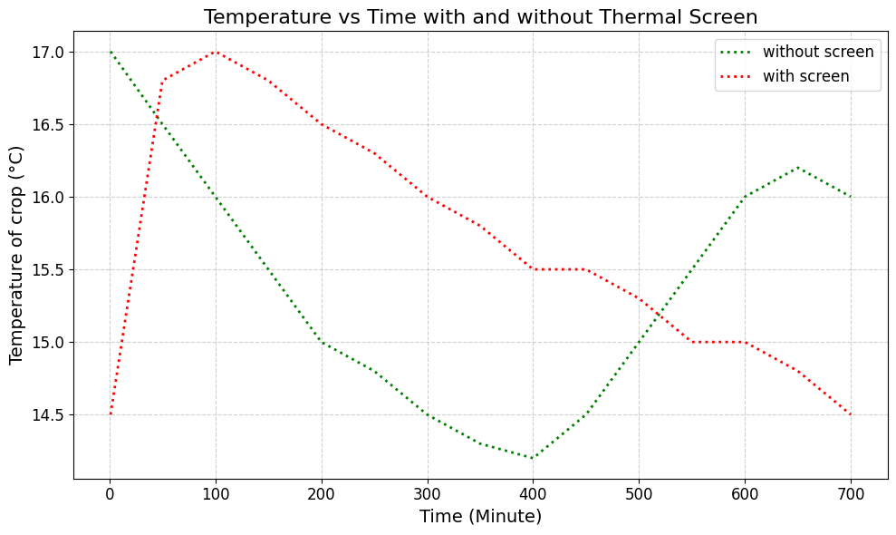
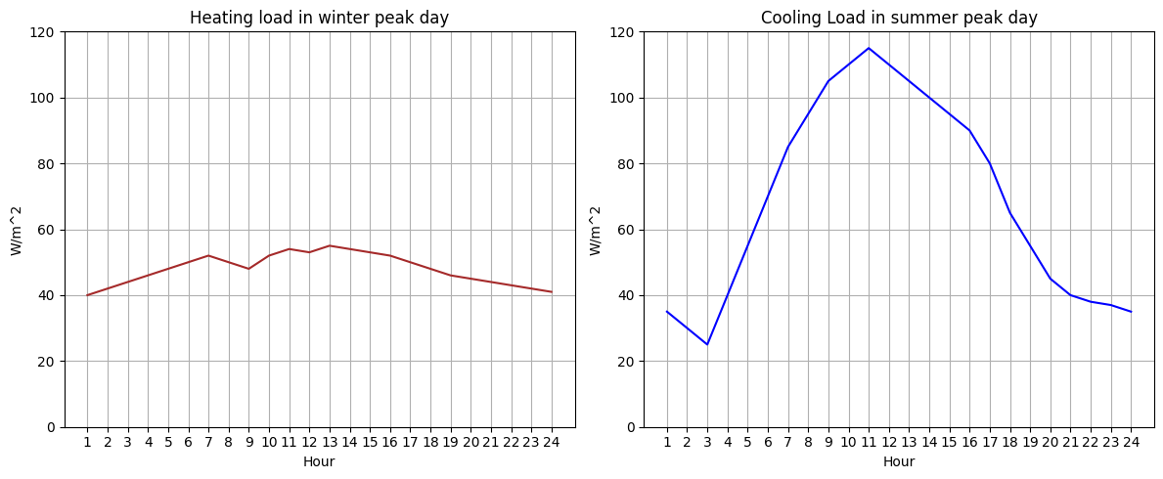
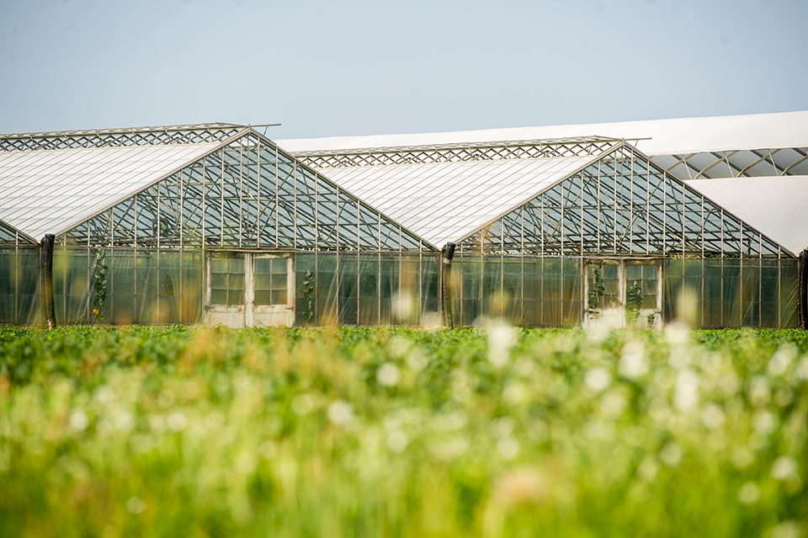


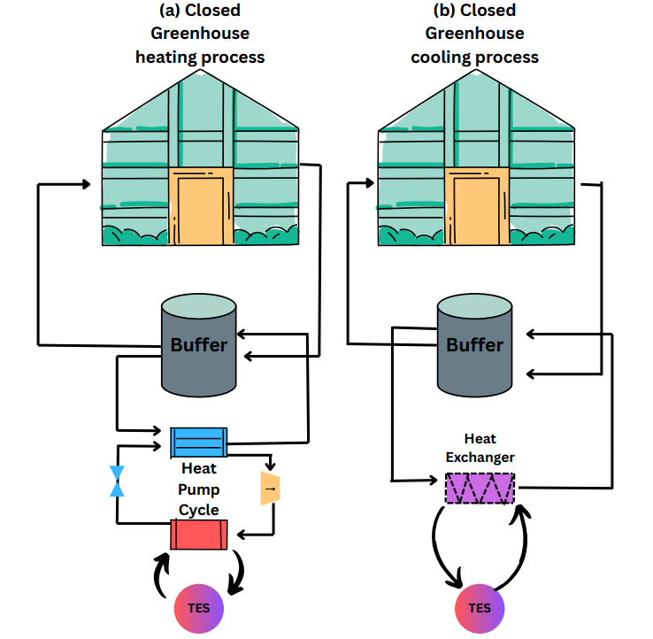
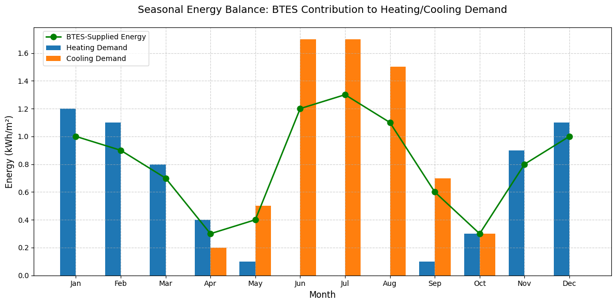

Enhancing Greenhouse Productivity in India using Optimized Heat Transfer techniques
Sujal , Shobhit Kumar , Deepanshu, Rishabh Dewangan , Piyush Kanwat
Department of Chemical Engineering, Indian Institute of Technology, New Delhi(110016)
Discussion
Crop temperature fluctuations decreased by over 70%, improving plant health and minimizing stress.
Thermal screens effectively reduced nighttime heat loss and stabilized internal greenhouse temperatures.
Thermal Energy Storage (TES) systems balanced heating and cooling demands by storing surplus energy for night use.
Combined use of thermal screens and TES led to higher crop yields, lower energy costs, and greater sustainability.
The strategies demonstrated are scalable and adaptable for diverse Indian climatic conditions.
Initial installation costs for thermal screens and TES systems can be high for small-scale farmers. The model assumes ideal material properties and may not account for long-term material degradation or extreme weather events.
Integration with renewable energy systems (e.g., solar panels, wind turbines) for complete energy self-sufficiency. Development of dynamic climate control algorithms to adjust thermal screens and TES usage in real-time based on external weather forecasts.
Methods and Materials
Results
Conclusions
Semi-solar greenhouse with glass cover and concrete north wall
Movable thermal screen inside for insulation and heat control
Underground thermal energy storage (TES) with buffer tank and heat pump
Excess energy stored in TES and utilised in winter or in night
Used MATLAB to solve system and analyze temperature changes at different points
COMSOL simulation of Semi-Solar Greenhouse in ambient conditions to obtain the heat map
Leads to greener, more resilient, cost effective methods with enhanced productivity and sustainability
Integrated thermal screens and TES to improve temperature stability, energy efficiency, and crop yield.
Reduced environmental impact and operational costs.
Provided a sustainable and scalable solution for greenhouse farming in India.
Future work should combine these methods with renewable energy and automated climate control.
With thermal screen
Without thermal screen
During daytime shortwave radiation heats plants, soil, air and structural components.
Heat transfer modes include conduction, convection, and longwave radiation exchange.
Nighttime heat loss mainly occurs through longwave radiation, especially under clear skies.
Evapotranspiration from plants adds moisture to indoor air.
The thermal screen, made of cloth-type material, is installed inside the greenhouse.
It is used primarily during nighttime to reduce heat loss.
It limits longwave radiation and convective heat transfer, helping retain warmth.
It maintains stable temperatures around crops, reducing energy consumption and dew risk.
By visualizing both heat maps, we can observe that the thermal screen helps to maintain a higher temperature inside the greenhouse compared to the case without the thermal screen.
Winter: Extra heating needed to protect crops ~1.2 kWh/m² peak.
Summer: Cooling required to prevent overheating ~1.7 kWh/m² peak.
With thermal screen
Without thermal screen
Comparison Plot of crop of temperature with and without thermal screen obtained by solving system on MATLAB
Fluctuations in temperature at night get reduced by the use of thermal screen.
Thermal screens proven effective in reducing long wave radiation at night.
Heating Process:
Heat from solar/renewables → stored in buffer tank via heat pump.
Buffer tank + TES store energy for later use.
Stored heat released to warm greenhouse.
Saves energy and reduces fossil fuel use.
Heating demand (winter months): ~1.2 kWh/m² peak (Jan–Mar, Nov–Dec)
Cooling demand (summer months): ~1.7 kWh/m² peak (Jun–Aug)
58% of annual fossil fuel offset by BTES (Vadiee & Martin, 2013)
BTES covers 80–95% of heating demand in winter and 60–75% of cooling demand in summer
Cooling Process:
Excess heat → removed by heat exchanger to buffer/TES.
Heat stored or dissipated later.
Prevents overheating and protects crops.
Maintains stable greenhouse climate.
Figure Greenhouse
Contact
References
Sujal, Shobhit Kumar, Rishabh Dewangan, Deepanshu, Piyush Kanwat
Indian Institute of Technology, New Delhi (110016)
ch1230170@iitd.ac.in, ch7230769@iitd.ac.in
91+9518464645, 91+9319894169
Taki, M., Ajabshirchi, Y., Ranjbar, S. F., Rohani, A., & Matloobi, M. (2016). Modeling and experimental validation of heat transfer and energy consumption in an innovative greenhouse structure. Information Processing in Agriculture, 3(3), 157-174.
Vadiee, A., & Martin, V. (2013). Thermal energy storage strategies for effective closed greenhouse design. Applied energy, 109, 337-343.
Vadiee, A., & Martin, V. (2012). Energy management in horticultural applications through the closed greenhouse concept, state of the art. Renewable and Sustainable Energy Reviews, 16(7), 5087-5100.
Taki, M., Ajabshirchi, Y., Ranjbar, S. F., Rohani, A., & Matloobi, M. (2016). Modeling and experimental validation of heat transfer and energy consumption in an innovative greenhouse structure. Information Processing in Agriculture, 3(3), 157-174.
Chen, W., & Liu, W. (2004). Numerical and experimental analysis of convection heat transfer in passive solar heating room with greenhouse and heat storage. Solar Energy, 76(5), 623-633.

